Slide 1

Advocacy Institute
Healthcare Finance 101
12.11.2024
Jim Ulrich, Chief Executive Officer
York General Health Care Services
Tim Johnson, Chief Financial Officer
Nebraska Hospital Association

Slide 2
Healthcare Finance 101 - Objectives
The main objectives of this session are listed below:
Hospital Financial Components
  What’s Core to a Hospital’s Financial Infrastructure?
Healthcare Insurance Landscape
  Payors Present in our Organizations
  Payment Models Present in our Organizations
Sample Hospital Statement of Operations
4. The Current State of Healthcare
The Future of Healthcare
The Importance of Advocacy
7. Questions

Slide 3
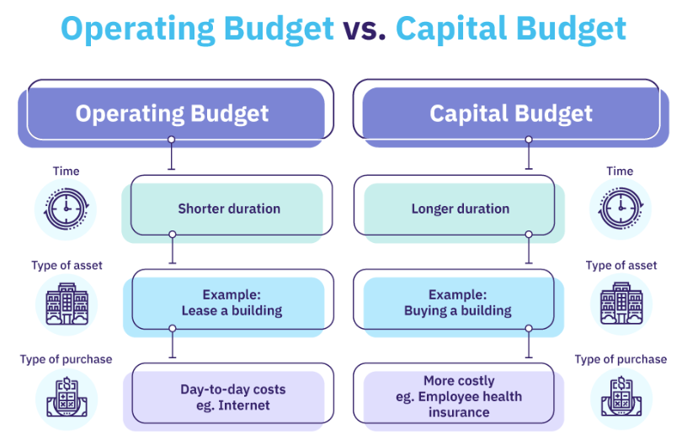
Hospital Financial Components
What’s Core To A Hospital’s Financial Infrastructure?
Payor Contracts
Contract Management System
Charge Description Master
General Ledger
Medicare Cost Report
Hospital Accounting System
Revenue Cycle Systems
Hospital EHR
Payroll System
Fixed Asset System
Supply Chain System
Operating and Capital Budgeting
…. and many, many more!

Slide 4

Hospital Financial Components
Payor Contracts
Hospital and physician reimbursement rates
Hospital and physician reimbursement methodologies
Provider Enrollment Requirements
Claim Submission Requirements
Clean Claims Parameters
Billing, Claims & Medical Necessity Guidelines
Responding to Payor Medical Records Requests
Provider Appeals

Slide 5

Hospital Financial Components
Charge Description Master
Digital “master list” or database of all items charged to patients in the hospital – includes facility fees, diagnostic services, therapeutic services, medical supplies, pharmaceuticals, equipment, procedures, etc.
Hospital charges are the same for all patients for the same service regardless of insurance type.
Each charge includes a wide range of specific attributes including Revenue Department Number, Charge Code, Charge Code Description, Charge Amount, National Revenue Code, CPT/HCPCS Code, Modifier, Unit of Measure
The “charge amount” for the same service
can vary widely hospital-to-hospital and is
set using a wide range of different and
unique charge-setting methodologies

Slide 6

Hospital Financial Components
Hospital General Ledger
Digital “ledger” that includes a tracking of virtually all financial transactions occurring in the hospital including patient revenue, contractual allowances, reimbursements, non-operating revenue, bad debt, expenses, assets, liabilities, etc.
Revenue is typically broken out and tracked by department, payor and patient type (inpatient, outpatient, etc.)
Expenses are typically grouped into common account types and tracked by department (salaries & wages, professional fees, purchased services, medical supplies, pharmaceuticals, etc.)
For real, genuine GEEKS… the hospital
General Ledger or “GL” is one of the
coolest repositories of data ever!

Slide 7

Hospital Financial Components
Medicare Cost Report
Best equated to submission of an annual tax return, the Medicare Cost Report is used to “settle” or reconcile interim Medicare payments versus final amounts owed by CMS
Due to the current reimbursement method used by CMS to pay Critical Access Hospitals, the Cost Report is considered a critical financial component for most Nebraska rural hospitals
The Cost Report includes a wide range of schedules that incorporate data such as: patient utilization, revenue, expenses, overhead & indirect cost allocation statistics, interim reimbursements, provider FTE information, RHC visits, etc.
By far, the most important step in filing the
annual Cost Report is to ensure the accuracy
of the underlying financial data upon which
it is built

Slide 8

Hospital Financial Components
Revenue Cycle Systems (front-end)
Payor contracting and provider enrollment/credentialing are critical first steps in the process
Vital infrastructure updates are necessary before seeing the first covered patient: Insurance Master, Charge Master, EHR documentation, payor claims/coding/billing logic, claim submission attributes – and LOTS of training
Next, we can tackle patient scheduling, insurance verification and pre-authorizations
Patient Access is typically the “entry point” and traditionally includes registration, cash collections and financial counseling
During the patient stay, efficient/effective
charge capture processes and case
management both play important roles

Slide 9
Hospital Financial Components
Revenue Cycle Systems (middle / back-end)
Upon patient is discharge, the hospital’s “DNFB” clock starts to run – charges, coding & supporting documentation
Now, final charges are posted, the claims drop, the “scrubber” takes over and claims are electronically submitted to the hospital’s contracted “clearinghouse”
If a claim is not “clean”, it may require follow-up by either human intervention or a wide range of other operational steps
Once a claim is clean, most insurer payments are now completed electronically. “835 remittance advices” are received from the payor and auto-posted to the hospital’s bank account
The back-end may also include denials management, payor appeals, patient balance collectionS or other similar processes

Slide 10
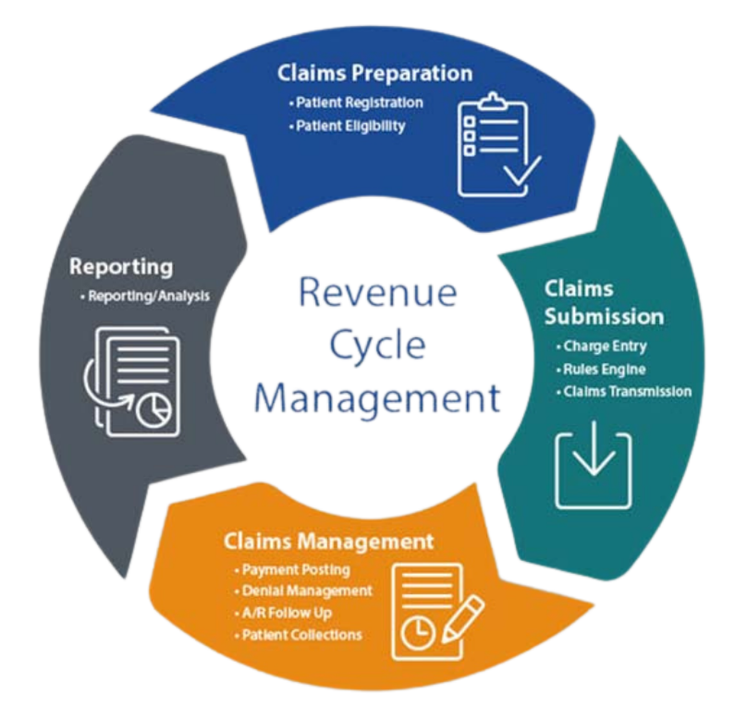
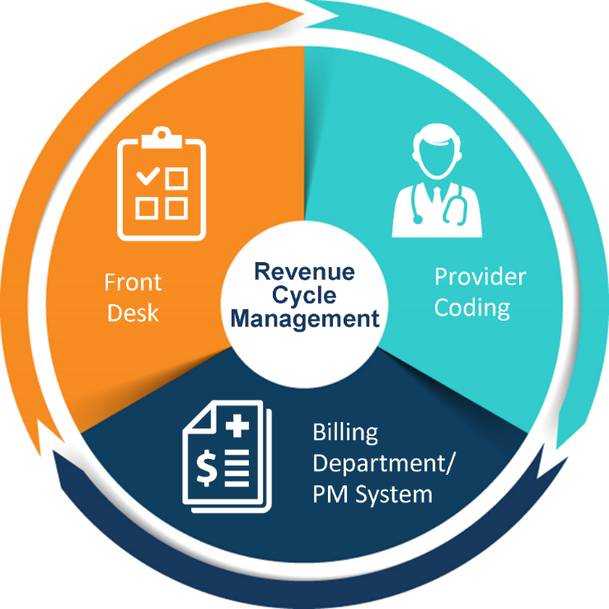
Hospital Financial Components
What’s The Revenue Cycle Really Look Like?

Slide 11
Healthcare Insurance Landscape
Payors Present in Our Organizations
State and Federal Government Payors – Medicare, Medicaid and Medicare/Medicaid Advantage
Recent year growth in Advantage Plans and the negative impacts to rural health care.
  Differing coverages and rules from the traditional Medicare and Medicaid plans. Examples include preauthorization rules and payment that Is not full cost-based reimbursement for Critical Access Hospitals.
Some of the major Health Care Insurance Payors in Nebraska include:
  Blue Cross Blue Shield
  United Health Care
  Aetna
  Molina – Medicare Advantage

Slide 12
Healthcare Insurance Landscape
Payment Models Present in Our Organizations
Payment Models in our Organizations Today
  Cost Based Reimbursement – Critical Access Hospitals
  Fee Schedule
  Percent of Charges
  Capitated Payments, Population Health
  Prospective Payment System
  Home Health –PDPG- Patient Driven Grouping Model (Case Mix adjusted for patient’s condition).
  ESRD – End Stage Renal Dialysis
  Long Term Care – PDPM (Patient Driven Payment Model)
  Clinics – Fee Schedule/ Relative Value Units (RVU)
Rural Emergency Hospital designation
  OP PPS rate plus 5%, and an additional monthly facility payment of per month
  Less services than a CAH 24 hour ER, Lab, Radiology, Pharmacy, Observation (cannot average more than 24 hours per patient).
Yes, Health Care reimbursement is COMPLICATED!

Slide 13
Hospital Financial Statement

Slide 14
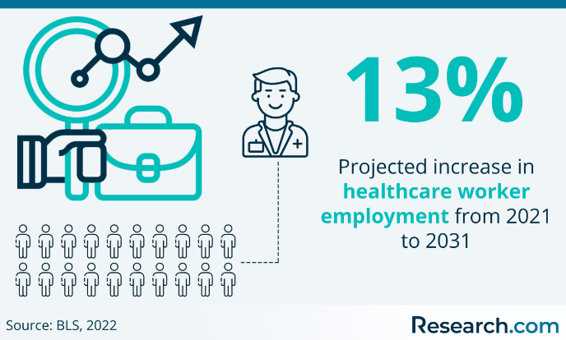
The Current State Of Healthcare
Post COVID, Health Care experienced the emergence of some big challenges. These challenges were many, but primarily Workforce and Cost increases. Though these challenges had been present in the past, they emerged in a heightened state in recent years. These challenge are still present today.

Slide 15

The Current State of Healthcare
These challenges have resulted in decreased Operating Margins for both Critical Access and Larger hospital systems as well.
  According to recent pulse surveys conducted by the Nebraska Hospital Association, more than 50% of Nebraska Hospitals are operating at a negative margin. Rural hospitals are hurting at an even higher percentage.
The Long Term Care sector of the Health Care Industry has the same major challenges. Unfortunately, many communities experienced the closure of their nursing home in recent years.

Slide 16
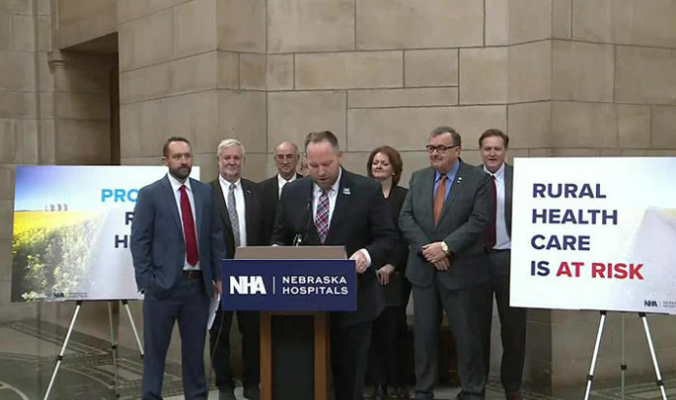
The Future
What can we expect?
In the short-term, Once CMS approval is obtained, Nebraska Hospitals will have greatly enhanced Medicaid reimbursement with the recent passage of LB 1087 this past legislative session. LB 1087 Hospital Quality Assurance and Access Assessment Act.
This provider assessment will provide more dollars to go with the State’s appropriations for Medicaid to enable an increase in our Federal draw-down of more than a billion dollars per year. This will be split up, after administrative fees, to all Nebraska Hospitals based on their Medicaid patient utilization.

Slide 17

The Future
What can we expect?
In the long-term, The American Hospital Association through their Pathways Workgroup, in the summer of 2023, provided their Regional Policy Boards their look into the future of health care.
10 potential pathways include:
  Person-centered
  Coordinated
  Safe and high quality
  Equitable
  Sustainably Staffed
  Innovative
  Accessible
  Affordable
  Economically sustainable
  Appropriately resourced

Slide 18

The Importance of Advocacy
The need for strong advocacy efforts through a financial lens.
Tight operating margins, and the need for enhance revenue through strong local healthcare delivery, and controlling costs.
Helping to ensure local access to care through minimizing regulations, increase the coverage of services through insurance, and increasing our reimbursement levels from Medicare and Medicaid.
Promoting the importance of healthcare in communities and rural areas. “Strong healthcare foster strong communities, and strong communities enable strong healthcare”. Healthcare is a strong economic driver in communities.
To achieve these goals – Support the NHA PAC, build relationships with our local, state, and national delegations and educate on our issues and needs. Get to know your representatives by name. Be present and at the table.

Slide 19
QUESTIONS?

