Slide 1

Standardizing Sepsis Management to Elevate Quality Care and Patient Outcomes
Jennie M. Melham Memorial Medical Center
Broken Bow, Nebraska
Notes:
Hello everyone! We are so thrilled to share our quality improvement efforts surrounding sepsis and positively affecting patient outcomes.

Slide 2
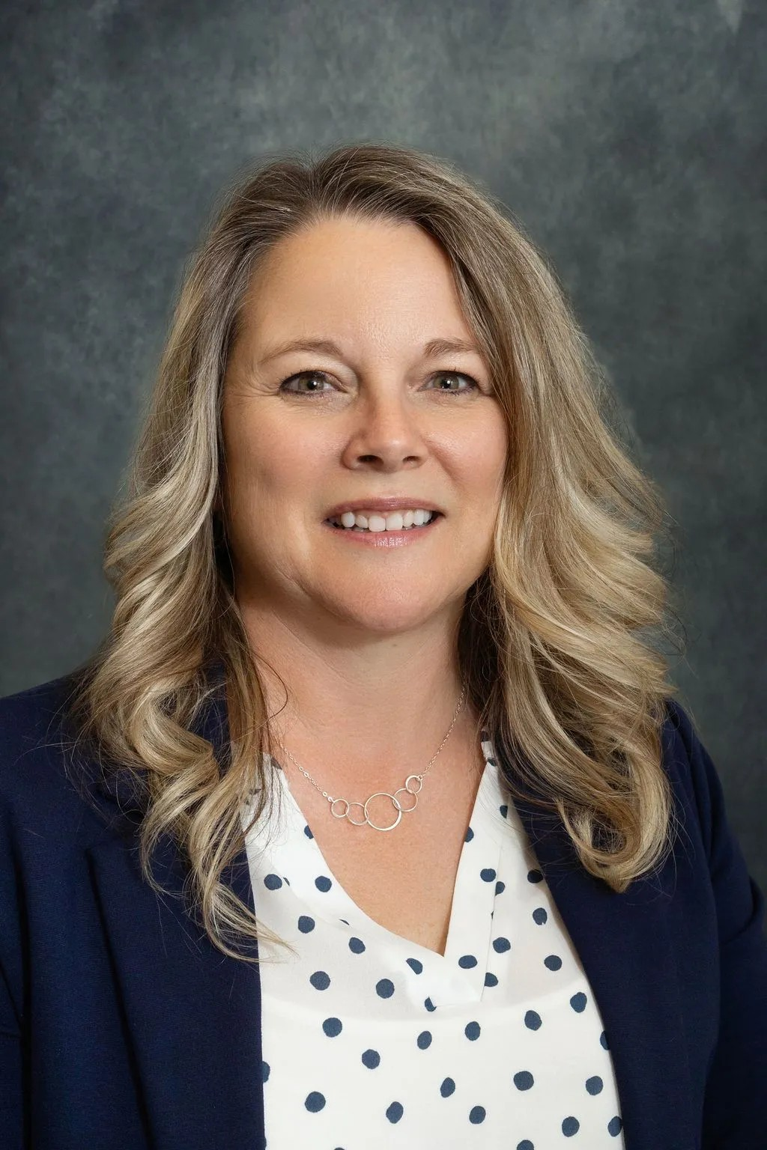


PRESENTERS
Jennifer Schaaf
Chief Performance Officer, PharmD, RP, CPHQ, CHC
Beth Lehmkuhler, Quality Assurance Coordinator, RN, CPHQ
Stephanie Wetovick, Pharmacy Manager, PharmD, RP
Notes:
I am Jenn Schaaf, I am the Chief Performance Officer and Compliance Officer at Jennie Melham. I am a pharmacist by trade, and I joke that I do all the things other people don’t want to do, Compliance, Risk Management, Quality & Patient Safety. Beth Lehmkuhler is our Quality Assurance Coordinator. She is a nurse by trade and loves all things data. She is experienced in Hospice, Case Management, Quality and Patient Safety. Stephanie is our Pharmacy Manager. She has retail and hospital pharmacy experience and does a wonderful job keeping our patients safe!

Slide 3
DISCLOSURE:
None of the presenters for this educational activity have relevant financial relationship(s) to disclose with ineligible companies whose primary business is producing, marketing selling, re-selling, or distributing health care products used by or on patients.
Notes:
Here is our disclosure statement. We do not have any disclosures. We are healthcare providers just like you!

Slide 4
OBJECTIVES:
Recognize the critical role of thorough project planning in achieving successful project outcomes.
Explain the importance of leveraging data to inform decision-making and identify key benefits of data-driven strategies in improving outcomes.
Explain the importance of early recognition and standardized care in reducing sepsis mortality.
Notes:
Our objectives today address the importance of project planning, the role that data plays into making data driven decisions, and why early recognition is key to reducing sepsis mortality.

Slide 5
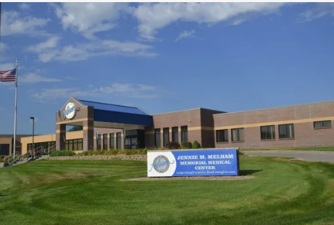
JENNIE M. MELHAM
MEMORIAL MEDICAL CENTER
23 Bed Critical Access Hospital in Central Nebraska
Inpatient, Observation, Swingbed
Emergency Department, Surgery, Specialty Clinic, IV Infusion, Pharmacy, Lab, Radiology, CardioPulmonary, Cardiac Rehab, Nuclear Med
Level IV Trauma Designation
Average Daily Inpatient Census: 2.5
Emergency Department Average Volume: 180/month
Notes:
Here’s our hospital. Jennie M. Melham Memorial Medical Center. That’s a mouthful, so we call ourselves Melham Medical Center. Our hospital was founded by a gentleman who wanted to create a memorial in Broken Bow to his mother, Jennie M. Melham, whose strength and spirit guided her in raising three young sons after the death of her husband, Charles. Due to her deteriorating health, she spent considerable time at the Broken Bow Community Hospital. Unfortunately, at that time, the old Broken Bow Community Hospital, was in jeopardy of losing accreditation due to structural & safety issues. Creating a modern medical center in a rural community was the dream that became a reality in 1972. The staff continues to carry that dream into the future, guided by our motto, "Large enough to serve, small enough to care.“ We are a 23-bed critical access hospital located in Central Nebraska. We care for many patients, inpatient and outpatient. Our ED sees 180-200 patients per month and is a designated level 4 trauma center.

Slide 6
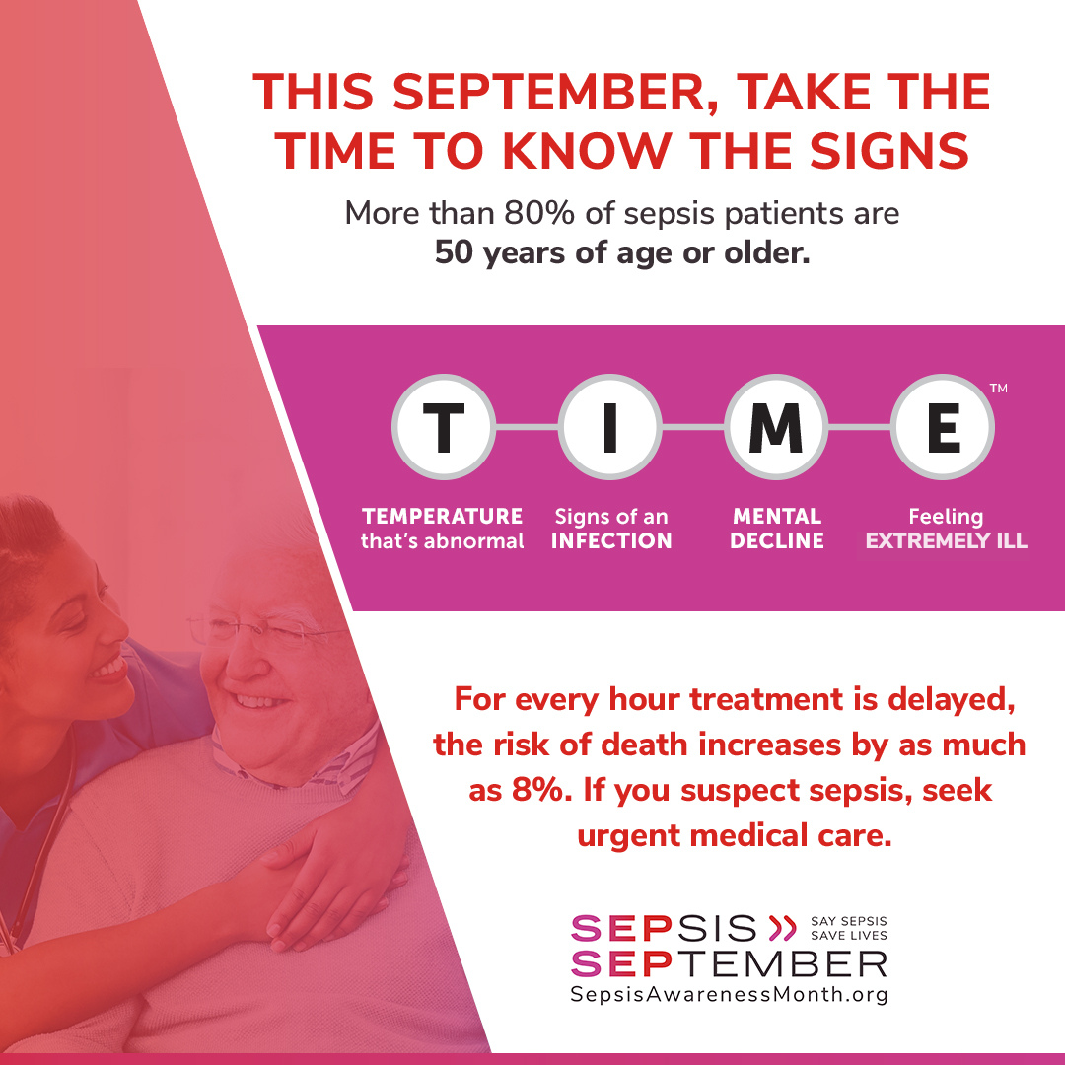
WHY SEPSIS?
Notes:
So, now let’s dive into the actual project. First, Why did we choose sepsis as a project?

Slide 7
SEPSIS…
The body’s overwhelming and life-threatening response to infection which can lead to tissue damage, organ failure, & death
The leading cause of death in U.S. hospitals
The leading cause of readmissions
19% are rehospitalized in 30 days
40% are rehospitalized in 90 days
The risk of mortality increases 4-9% for every hour treatment is delayed.
Up to 80% of septic shock patients can be saved with rapid treatment
Notes:
One of our first triggers points was our sepsis mortality rate. It was was above the state benchmark as reported through NHA data. We had a 24% mortality rate while the state benchmark at the time was18%. We had no standardized sepsis protocols, and our nursing staff inconsitently utilized qSOFA screening tools. Then there’s the statistics - you see here. We all track readmissions right? The readmission rate at 90 days is staggering. And delaying treatment is significant to patient outcomes with mortality increasing for every hour treatment is delayed! We needed to do something and do it as quickly and efficiently as possible.

Slide 8
WHY SEPSIS?
Infection Prevention Risk Assessment
Risk Priority One: Sepsis
Objective(s) | Develop a comprehensive Sepsis protocol by 09/30/2024
Measure(s) | Development of project charter # Sepsis education events and attendance
Strategies | Create a multidisciplinary sepsis project team including but not limited to: Pharmacy, Lab, IP, frontline staff, Clinical informatics, RT, Nursing Educator, and Medical Staff Provider. Initiate development of sepsis protocol utilizing all interdisciplinary factors. Implement a consistently used scoring tool. Provide educational opportunities and training related sepsis to frontline staff and Medical Staff Providers.
Responsibility | ASP Team, Sepsis Project Team
Evaluation/Progress | CDC’s Hospital Sepsis Program Core Elements Self-Assessment tool completed by ASP team on 02/28/2024. Resulted in 2 out of 52 elements met (4%). NHA clinical Sepsis gap analysis completed by ASP team on 03/19/2024. Resulted in 2/42 components met (5%). Quality improvement project idea worksheet completed on 04/04/2024 by ASP Team.
Notes:
The unsatisfactory benchmark made a significant impact during the infection preventionist’s IP Risk Assessment. The risk assessment identified Sepsis as the number one Risk Priority. The risk is assigned by evaluating the probability or likelihood of sepsis occurring, the impact or severity if it does occur, and the frequency or how often it occurs. In our case, Sepsis scored the highest of all of the items evaluated with high marks across the board in probability, severity and frequency. Let me also mention that we were in the middle of an enormous electronic health record upgrade, implementing CPOE & barcoded medication administration in the ED, so this seemed like the perfect time to implement a sepsis protocol in the ED.

Slide 9
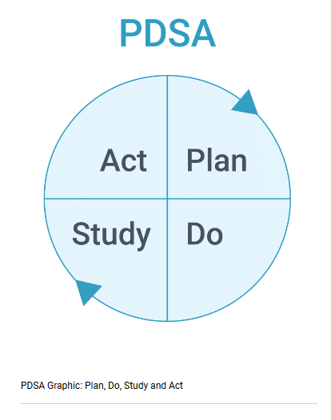
PDSA
Plan - Do - Study - Act
PLAN
for
The Sepsis Collaborative
Notes:
Once we identified the immediate need to address sepsis, we then utilized our quality improvement framework, PDSA. I’m sure most of you are familiar with PDSA, and we know the first step is planning.

Slide 10

IMPORTANCE OF PROJECT PLANNING
70% of projects fail to deliver promised outcomes, due to poor planning and lack of clear objectives
Projects are 2.5 times more successful when robust project management practices - including planning - are implemented
20-33% of total project effort is typically spent on planning & this investment significantly improves outcomes
Notes:
In PDSA cycles, the “Plan” phase sets the foundation for REPEATABLE improvement. Skipping or rushing this phase undermines the entire cycle. The statistics do not lie on this one guys. 70% of projects fail due to poor planning. Projects are more likely to succeed when 20-33% of the effort is spent in the planning phase.

Slide 11
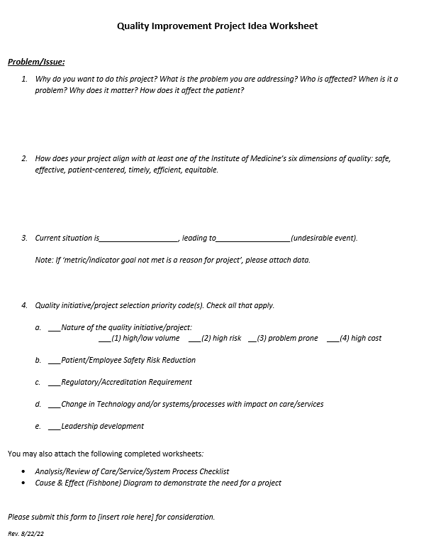
PDSA - Plan
Tool: Project Idea Worksheet
Purpose:
Define the problem
Provide background context
Assess current state
Identify issues before implementation
Justify the need
Ensure resource allocation
Notes:
I’m not afraid to brag a bit here. I’m proud of our facility. We have an extremely solid PDSA foundation and we utilize many different tools during our PDSA cycles. Here is an example of one of our tools that we used.– We call it the PROJECT IDEA WORKSHEET. It addresses why we want to do the project, what is the problem? Does it align with one of the Institute of Medicine’s 6 quality aims –, safe, effective, patient centered, timely , efficient, equitable? What is the current situation? Where does it fall in the priorities? Is it safety, regulatory, technological?

Slide 12
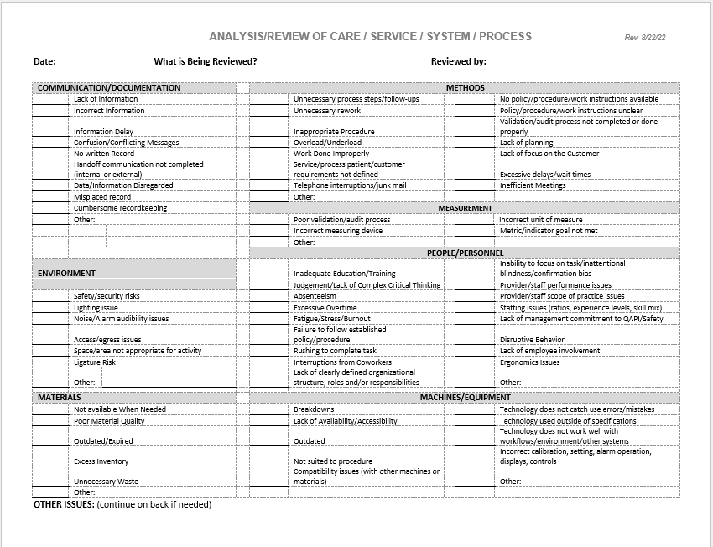
PDSA - Plan
Tool: Analysis/Review of Systems
Notes:
Here is another tool that we used. The ANALYSIS OR REVIEW OF SYSTEMS. We evaluated documentation, methods, measurement, matrials, machines, etc. It helped us evaluate & identify the problem areas related to sepsis. These are great tools to help us document and refer back to as the project moves along. They’re also what we included in our approval presentation to our Senior Leaders and to the governing Board to show we completed a thorough analysis & evaluation. Our CEO and Board actually signed a letter of commitment to creating an effective and efficient SEPSIS COLLABORATIVE. And thus it was born – The sepsis collaborative.

Slide 13
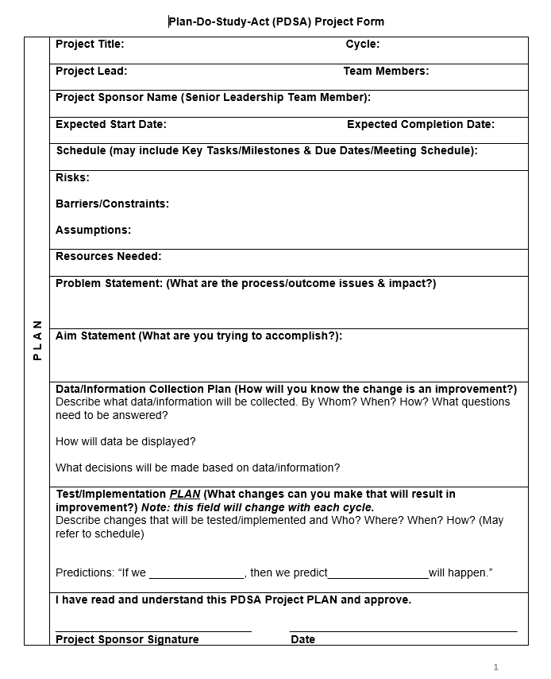
PDSA - Plan
Tool: PDSA Project Form
Purpose:
Identify stakeholders, roles & responsibilities
Set timeline, meeting cadence & deadlines
State objectives & success metrics
Define the problem statement & AIM statement
Identify risks, barriers, assumptions
Allocate resources
Notes:
After we completed our project idea worksheet and gained approval to initiate the Sepsis Collaborative, we began to use another tool, the PDSA PROJECT FORM to help us compile members of the team, define the scope and what was not in the scope, what barriers we might encounter, what resources we would need, what metrics we would use, and most importantly, develop an AIM statement, Our AIM statement or definition of the problem was “A lack of a systematic standardized approach for recognition and treatment of sepsis is leading to incomplete and inconsistent screening and treatment of sepsis resulting in an above state benchmark mortality rate. “

Slide 14

PDSA - Plan
Stakeholders
Team members:
Chief Performance Officer
Pharmacy Manager
Quality Assurance Coordinator
Infection Preventionist
Chief Nursing Officer
Clinical Informaticist
Case Manager
ED & Acute Care RN’s
Advanced Practice Provider
Notes:
Initially the project began with myself, the infection preventionist, Stephanie (our pharmacist) and Beth (our Quality Assurance Coordinator). As we sat at the table, we identified many more stakeholders that could lend their expertise to make this project successful. What started out as 4 people, ended up with the 10 roles you see listed here. It was truly a collaborative as we made this as multidisciplinary as we possibly could.

Slide 15

PDSA - Plan
Tool: Data Collection
Notes:
That completes my portion of the Planning phase of PDSA. My message to you is “don’t skimp on the planning!” I’m happy to share our tools with you if you’d like to reach out to me. Now, I will turn it over to Beth, our Quality Assurance Coordinator. She will talk about the data, which is still in the planning phase as the data helped us develop baseline metrics to help define the project’s success. She has the data! ☺

Slide 16

COLLECTING THE DATA
What is the Actual Outcome?
Current State/Baseline
What is the Intended Outcome?
SEP-1 Bundle/Best Practice
What are the Identified Gaps?
Gap Analysis
What happened, what was supposed to happen, and where are the gaps?
Notes:
Questions I often ask myself in my Quality Role: What happened? What was supposed to happen? Where were the gaps? By asking ourselves what happened we had to establish a baseline, what was our current state before Sepsis work started? The intended outcome (or the “what was supposed to happen”) in this project we used the NHA tool kit and/or best practices for Sep. 1 bundle. To identify the gaps we used 2 different gap analysis.

Slide 17
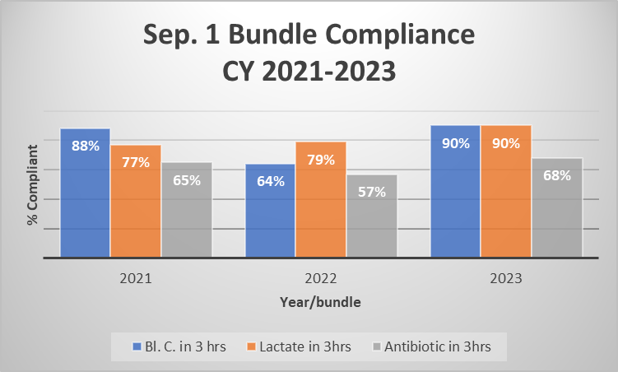

COLLECTING THE DATA (what happened)
Retrospective Chart Review = Establishing Baseline
Approximately 54% of the time, the Sepsis Bundle Treatment guidelines were not met in our facility, excluding locum providers.
Notes:
So what happened? To establish some baseline data of our current state prior to implementing the project I went back and audited 3 years of charts. We did this by having our HIM department pull a report of ICD Diagnosis codes for Sepsis, I then used this report to audit charts- and yes unfortunately this was a manual audit, but the data we obtained told the story and set the baseline for the project, something my nerdy self enjoys “telling the story with data”. We stratified the data in several different ways but mainly focused on the Sep. 1 bundle compliance. As you can see our compliance rate of 54% “was not even close”.

Slide 18
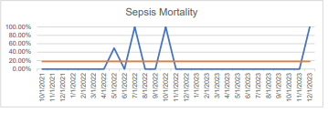

COLLECTING THE DATA (what happened)
Comparison Data
Sepsis Mortality (Claims) 4th Quarter 2023: 24.00% per NHA Scorecard.
NHA Benchmark= 18.00%
Notes:
We were also at the beginning of this project receiving scorecards from NHA with Sepsis Mortality Rates. We were also missing the mark here with a 24% mortality rate.

Slide 19

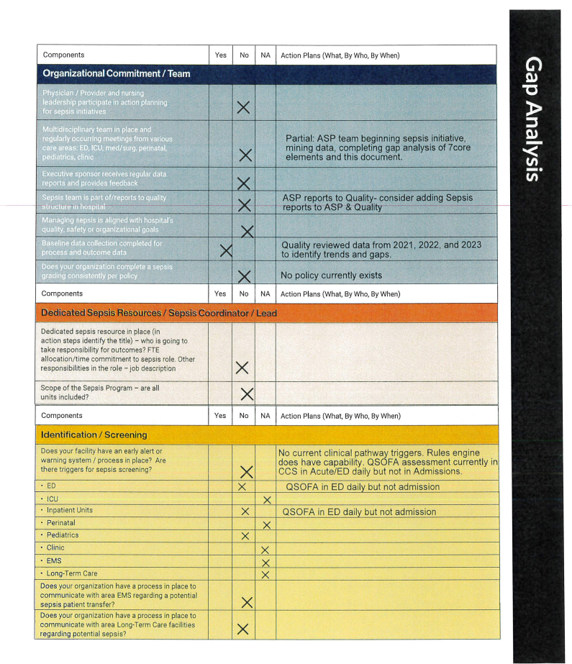
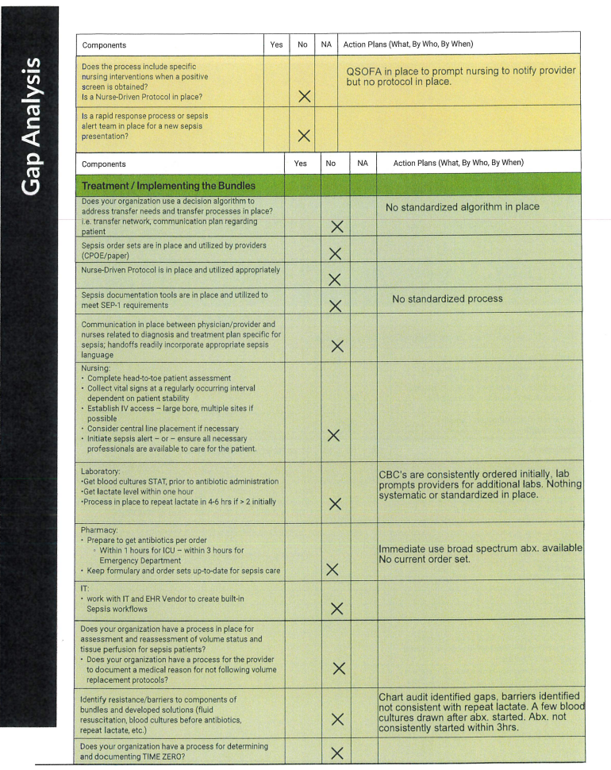
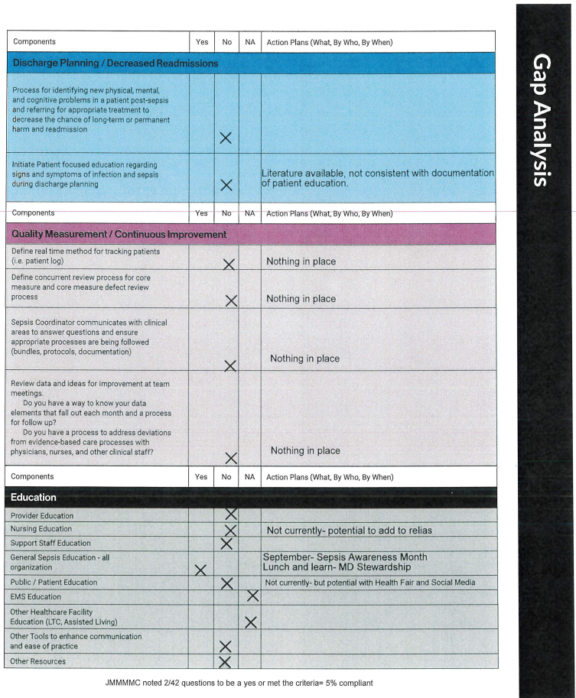
COLLECTING THE DATA
(What’s supposed to happen and the gaps)
NHA Gap analysis
2/42 components met (5%)
CDC Gap Analysis - 2/52 components met (4%)
Notes:
Once audits and baseline data were complete, we sat down with the team and went through both the gap analysis from NHA and CDC. We found several gaps when comparing our current state, with expected state, and were only 4-5% compliant with the gap analysis.

Slide 20

COLLECTING THE DATA
Setting of Goals and Deadlines
Use of NHA Sepsis Toolkit = Road Map
Aligning steps in the toolkit and setting deadlines.
Creating a Timeline
Notes:
We looked at the NHA toolkit measures and aligned them with committee meeting dates to establish some deadlines for the project. We created a timeline based on goals and deadlines to help provide a us with a road map.

Slide 21
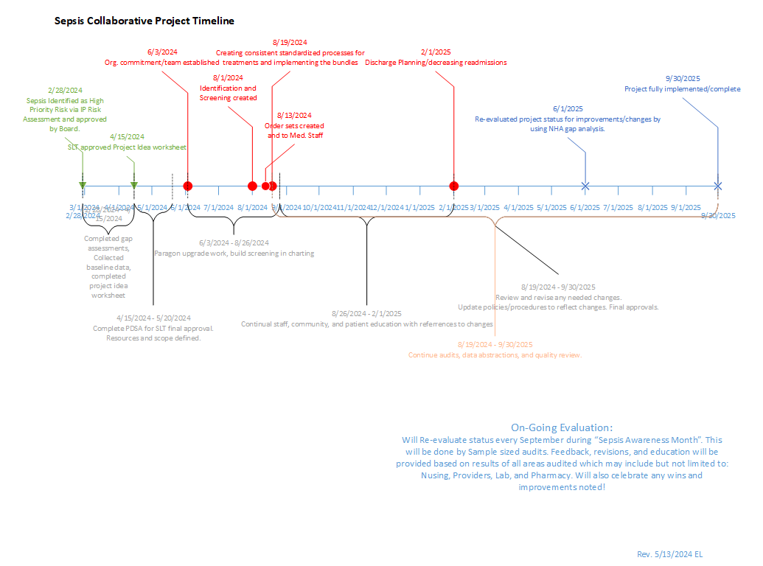

COLLECTING THE DATA
Notes:
The timeline as seen here helped keep us on task with the ultimate goal of having implemented the project by 9/30/2025 (end of our fiscal year).

Slide 22

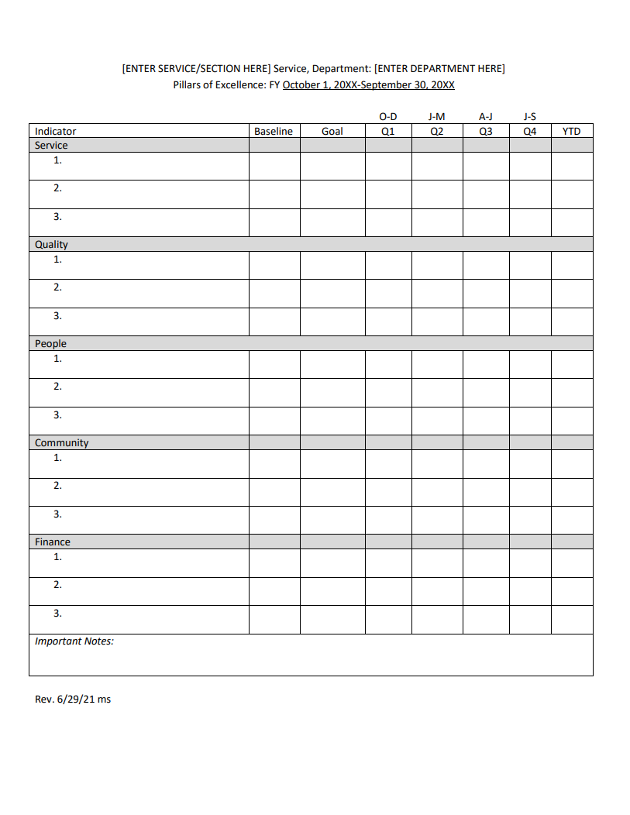
COLLECTING THE DATA
Tracking and Reporting the Data
Timely Audits
Share File between Lab and Pharmacy
Inclusion of Sep. 1 Bundle Compliance on Pharmacy Quality Pillars and Hospital Wide Pillars.
Quarterly numbers (via Pillars) shared up through Quality meetings, Medical Staff, and Board.
Notes:
After establishing baseline data, gaps, and goals, we needed a way to track and monitor progress. A share file was created between the Lab and Pharmacy, this allowed a timilier audit based on the diagnosis codes provided by our HIM department. The Sep. 1 bundle compliance data was then shared via the pharmacy pillars. These pillars periodically get reported through Quality, Medical Staff, and the Board. This allowed not only tracking and monitoring of the data improvement efforts but as a communication tool between committees and staff.

Slide 23

PDSA - Do
Build & Implementation
Notes:
Now that we established the what happened, what was supposed to happen, the gaps, and then how we were going to continue tracking, trending, and reporting the data for the project. Now it was time to get down to the nitty gritty. The action stage or “Do” portion of our PDSA and to go over that I will now hand off to our Pharmacy Manager and our “heavy lifter” of the group Stephanie Wetovick.

Slide 24

BUILD & IMPLEMENTATION
EHR Improvement - Sepsis Flowsheets
Clinical Informaticist engaged EHR team to create sepsis-based flowsheets and screening tools
Development and approval of two sepsis treatment protocols - Acute/ED
Prioritized adult treatment protocols
Multidisciplinary approach for development utilized input from nursing, laboratory, radiology, pharmacy and a clinical provider.
Treatment based on suspected source of infection
Patient Ages (CY2021 - CY2023)
0 - 20 | 1
21 - 40 | 1
41 - 60 | 3
61 - 80 | 22
81 - ≥100 | 23
Notes:
Clinical informaticist engaged EHR team to help make improvements in our abilities to detect sepsis earlier. First, we opted to shift from our original screening tool - qSOFA - to the MEWS and utilized this within the EHR build, which allowed to better alert for sepsis potential based on vital sign input by nursing staff.
Simultaneously, the Sepsis Collaborative Committee worked together to develop protocols for the facility. Based on previous audit information, we were able to stratify data according to age and focus our efforts on adult protocols, as 90% of our septic patients were 60 years of age and older.
By utilizing the collaborative team to develop the protocols, we were able to use a multidisciplinary approach for development. This also streamlined the approval process for the facility as input and consensus was gained during the development process.

Slide 25

PDSA - Study
Monitoring & Results

Slide 26
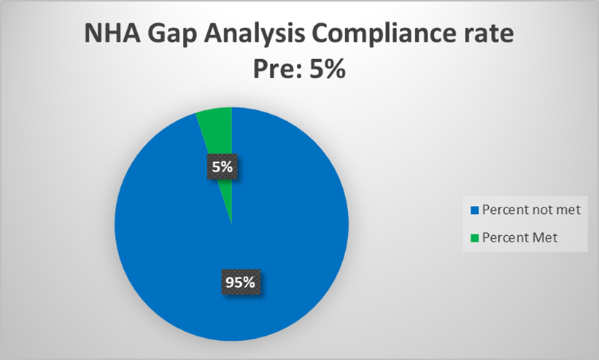
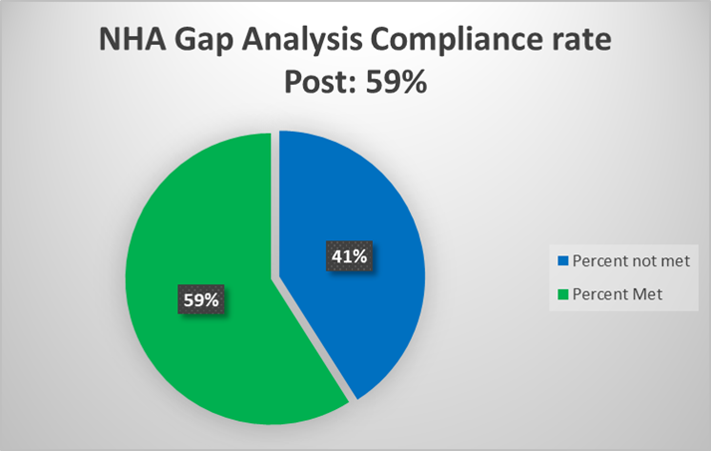
MONITORING & RESULTS
Gap Analyses Revisited - NHA Clinical Gap Analysis
Pre-Implementation: Post-Implementation:
Notes:
We measured success or need for continued improvement of the Sepsis Collaborative efforts through a variety of ways.
Initially, the Sepsis Collaborative Committee met post-implementation to revisit the gap analyses to verify if improvement was gained throughout the efforts.
The NHA Clinical Gap Analysis (for sepsis) improved from a compliance rate of 5% to 59%.

Slide 27
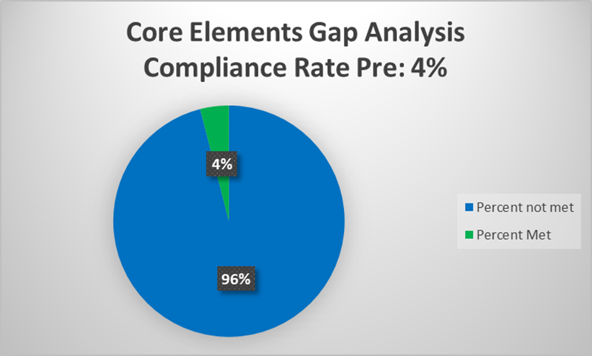
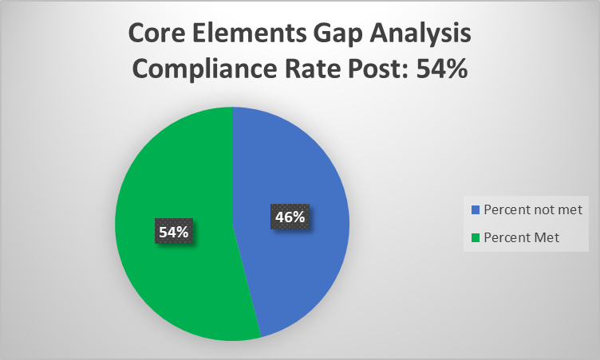
MONITORING & RESULTS
Gap Analyses Revisited - CDC Sepsis Core Elements Gap Analysis
Pre-Implementation: Post-Implementation:
Notes:
The CDC Sepsis Core Elements Gap Analysis improved from a compliance rate of 4% to 54%.
Examples of measured components in the gap analyses include: availability of order sets and monitoring of appropriate use, evaluation of sepsis outcomes, availability of education to facility staff, and department-specific goals (nursing, laboratory, pharmacy, IT, etc)

Slide 28
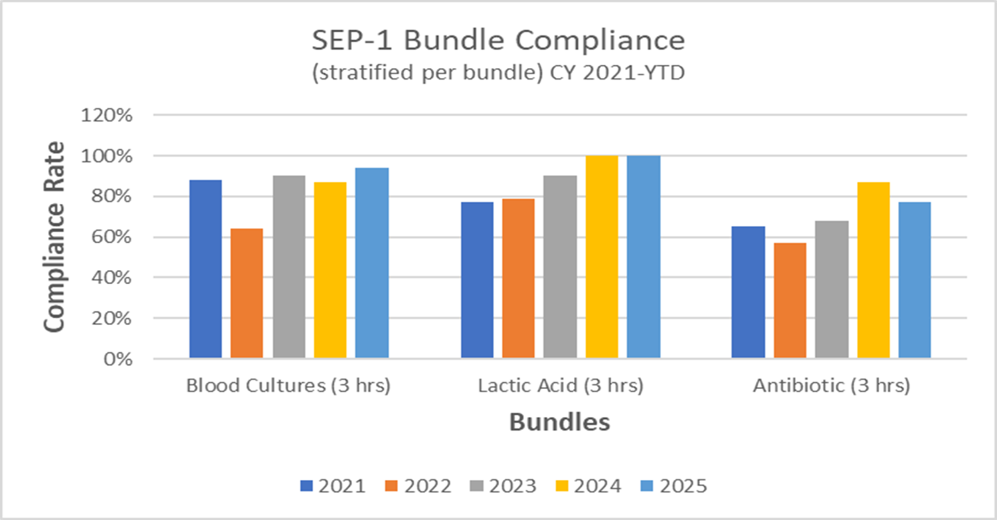
MONITORING & RESULTS
Improvement in SEP-1 Bundle Compliance (within 3 hours of suspicion of sepsis)
Lactate drawn
Blood cultures drawn (prior to antibiotic start)
Antibiotic initiated
Notes:
We also saw an improvement of compliance with the SEP-1 Bundle. For our facility, we define compliance with the SEP-1 bundle as having a lactate drawn, blood cultures drawn (prior to the antibiotic), and initiation of an antibiotic within 3 hours of suspicion of sepsis.
Based on the above table, we were able to stratify data per bundle component. It allowed us to see that, historically, initiating the antibiotic in a timely manner presented a greater clinical challenge than ordering the laboratory markers. However, we were also able to see that the implementation of the collaborative improved each bundle individually.

Slide 29
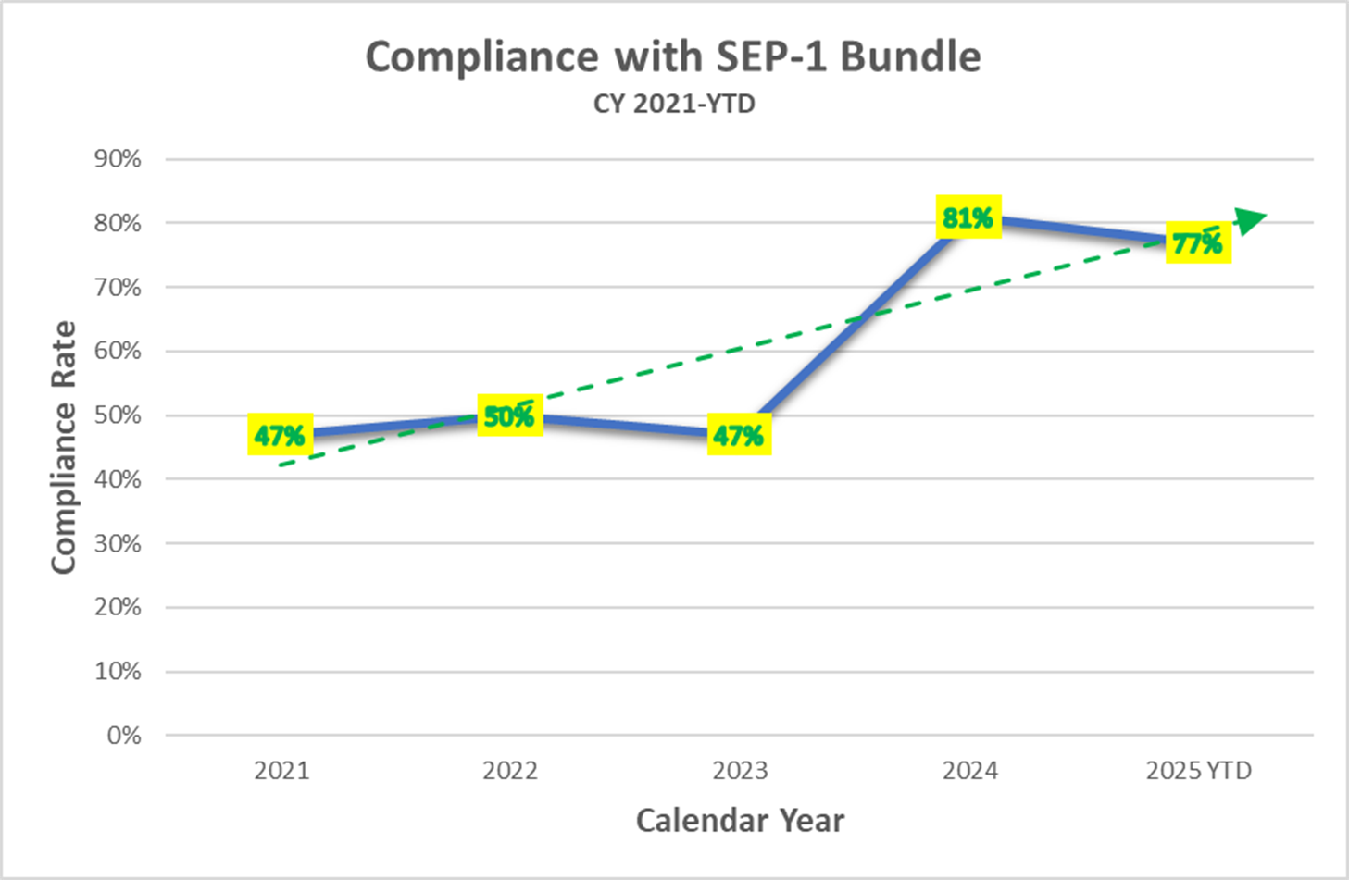

MONITORING & RESULTS
February 2024: Sepsis identified as a high priority risk and project is initiated.
Notes:
We also measured compliance with the SEP-1 bundle as a whole. We can see that when the collaborative began their work and subsequent education efforts, SEP-1 bundle compliance improved with the trendline moving upward and in the right direction.
Initially, this graph was developed for data through roughly Q2 of this fiscal year. Since these figures were developed, there was a dip in SEP-1 bundle compliance to 67% at the end of June 2025. This decrease was solely due to the timely of antibiotics within 3 hours, with some antibiotics falling out of compliance by almost an hour. After education was provided to ordering providers, SEP-1 bundle compliance rebounded to 82% by the end of September 2025.

Slide 30

MONITORING & RESULTS
Improvement in sepsis mortality rate
CY2023 Q4 - 24% mortality rate
CY2025 Q1 - 0% mortality rate
Notes:
Our initial monitoring goal, an improvement of sepsis mortality rate, was achieved by reducing our rate from 24% at the end of CY2023 to 0% at the beginning of CY2025.
One limitation from tracking the mortality rate at our facility is our small patient population and, as a critical access hospital, many of our sickest patients are transferred to a higher level of care. Moving forward, we will be looking to measure other sepsis markers, such as sepsis-related readmissions and the effects on length of stay.

Slide 31

MONITORING & RESULTS
Improvement in sepsis recognition
Increased awareness of sepsis
Earlier detection of sepsis and sepsis-like illness
Calendar Year | Total Patients Identified
2021 | 17
2022 | 14
2023 | 19
2024 | 21
2025 (through Sept) | 34
Notes:
An unanticipated yet positive outcome emerged during implementation of the Sepsis Charter: increased awareness and recognition of sepsis and sepsis-like illness. Prior to implementation, retrospective audits identified that our facility identified not more than 20 patients per year with sepsis. After implementation and extensive educational initiatives, the number of patients identified with sepsis has increased, as reflected in the table: 21 patients in 2024 and 34 patients in 2025 (through September).

Slide 32

MONITORING & RESULTS
Improvement in patient education process for post-sepsis care
Discharge packets developed specifically for sepsis patients
Important follow-up care (transitions of care)
Recognizing signs/symptoms and when to return for treatment
Hospital Discharge Checklist
Discharge plan, follow-up appointments, medications, etc.
Notes:
Through focused discharge education efforts, the nursing and case management team engaged patients in their post-sepsis care. During the project, dedicated discharge packets were developed specifically for sepsis patients, incorporating tailored educational materials focused on recognizing and managing potential post-sepsis complications, as well as highlighting important follow-up care. Melham patients are equipped with essential information about their care prior to discharge, enabling them to actively participate in their recovery and successfully navigate their transition of care.

Slide 33

PDSA - Act
Continued Actions

Slide 34
CONTINUED ACTIONS
Improvement in SEP-1 bundle compliance
Education provided to providers regarding initial dose of antibiotic
Time zero documentation
Barrier - Integration and functionality of EHR system
Order set: fluid resuscitation
Development of rules engine for vital signs alert
Education and Collaboration
Internal - staff, providers
External - LTC, assisted living, EMS, community
Notes:
Continued monitoring is necessary to ensure that the efforts of the Sepsis Collaborative are maintained. As stated earlier, the SEP-1 bundle will continue to be monitored to ensure that the key components of timely and effective sepsis treatment are being met. Primarily, we will continue to ensure that our providers recognize the importance of initiating the antibiotic while the patient is in the ED, so that it is initiated as soon as possible. Additionally, we determined that it was difficult to determine “time zero” for sepsis suspicion as it was not universally documented by all providers. Ultimately, we opted to cite “time zero” in relation to the timing of when sepsis-related labs were initially ordered.
An additional barrier that we continue to troubleshoot is the functionality and minimal integration of our EHR. It is important to note that during the project charter, our facility was simultaneously undergoing a large, facility-wide EHR upgrade. While this ultimately greatly improved a variety of systems and processes, including the expansion of CPOE and barcode medication administration (patient safety win!), it complicated other workflows. Specifically, we continue to troubleshoot the fluid resuscitation portion of our sepsis order set, which lacks an easily navigable method for ensuring that the appropriate, weight-based amount of fluid is administered while also displaying it clearly, should the patient be transferred (to the floor or from the facility) prior to bolus completion. Additionally, we continue to work with our EHR vendor on a rules engine function to display sepsis alerts based on vital signs.
Another goal for continued improvement of our Sepsis Charter is to further our educational efforts, not only internally but outside the facility as well. Our goal is to collaborate with outside healthcare providers to enhance early recognition and response to sepsis by equipping them with the knowledge and tools necessary to identify symptoms promptly and initiate timely treatment.

Slide 35

CONCLUSIONS & LESSONS LEARNED
Comprehensive project planning
Early identification of stakeholders
Multidisciplinary teamwork
Continued monitoring and follow-up
Notes:
Many important lessons learned through the work of the sepsis initiative, which have been highlighted through this presentation.
The critical importance of initial project planning, the necessity of identifying stakeholders early in the project, engaging a multidisciplinary team and continuing the work to further improve outcomes.

Slide 36

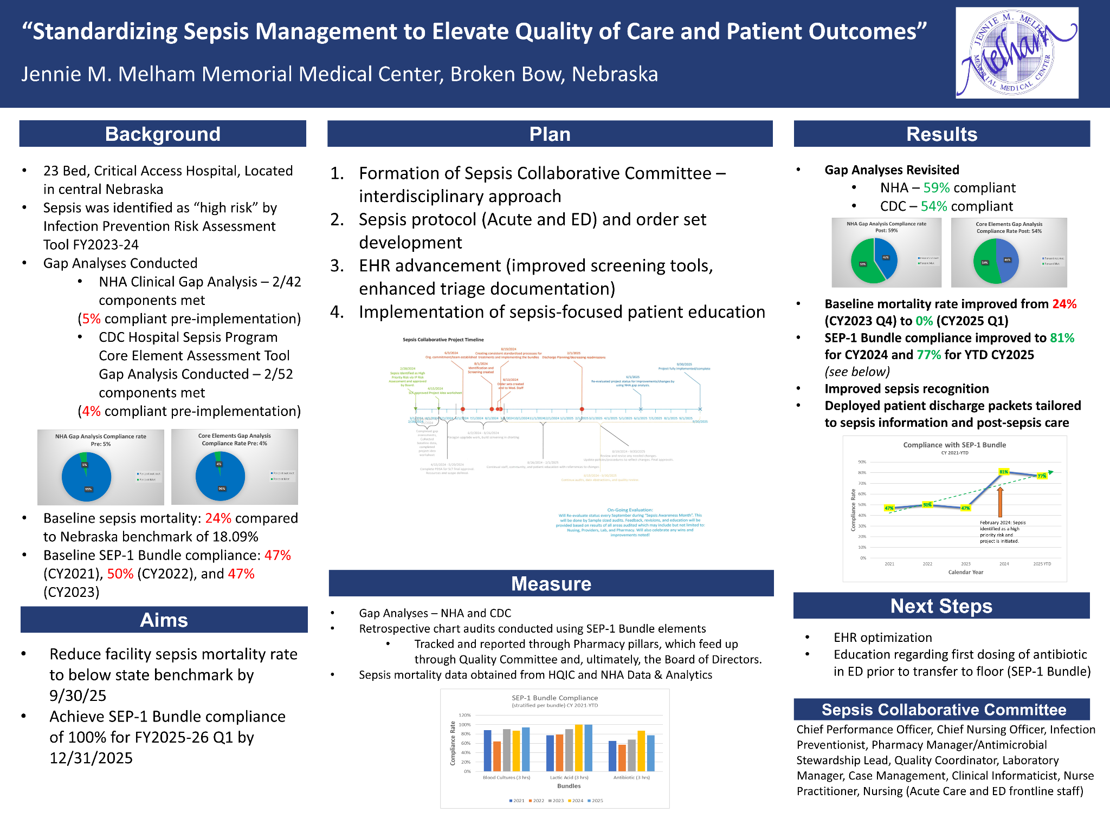
QUEST FOR EXCELLENCE
Notes:
We wanted to note that we submitted the work of our Sepsis Collaborative for this year’s Quest for Excellence through the NHA.

Slide 37
REFERENCES
Sepsis Alliance, www.sepsis.org
Project management statistics; trends and common mistakes in 2024, TeamStage, https://teamstage.io/project-management-statistics/
The importance of the planning phase to project success, Project Management Institute, www.pmi.org/learning/library/importance-planning-phase-project-success-6021
NHA Sepsis Toolkit, NHA 2020
Notes:
In case you’d like to fact check us, here are our references

Slide 38

QUESTIONS?

Slide 39

THANK YOU!
Jennifer.Schaaf@melham.org
Beth.Lehmkuhler@melham.org
Stephanie.Wetovick@melham.org

