Slide 1
RHC Care Coordination as a Strategic Initiative
June 10, 2025

Slide 2
US Healthcare Spending
https://www.ama-assn.org/about/ama-research/trends-health-care-spending

Slide 3
Decreasing the Cost of Care
Emergency Department $$$$$$ | $ Physician Fee $ Facility Fee $ Treatment Cost $$$ Higher Copay
Urgent Care $$$$ | $ Treatment Costs $ Facility Fee $$ Regular Copay *Varies by Clinic*
Primary Care Clinic $$ | $ Treatment Cost $ Lower Copay

Slide 4
Importance of Primary Care
Primary care represents the greatest opportunity for improving healthcare quality and lowering costs
For every $100 spent on healthcare in the US, only about $5 are spent on primary care
Every $1 invested in primary care the healthcare system can save up to $13
Doubling the nation’s current spending on primary care would more than pay for itself in savings.
This Photo by Unknown Author is licensed under CC BY-NC

Slide 5
Patient Case
Notes:
Harold
Steve
Nancy

Slide 6
Strategic Value of Care Coordination-Patients
Improved Health Outcomes
Better chronic disease management through continuous follow-up and education
Increased adherence to treatment plans and preventative care
Enhanced Patient Engagement
Patients feel supported, heard, and involved in their care
Promotes self-management and shared decision-making
Reduced Emergency and Hospital Utilization
Fewer ER visits and preventable hospitalizations
Better symptom control and early intervention
Improved Access to Services
Navigation support for specialty care, transportation, and community resources
Streamlined scheduling and follow-ups
Continuity and Consistency of Care
One central point of contact for coordination across multiple providers and services
Clear communication and personalized care planning
Addressing Social Drivers of Health (SDOH)
Identifies barriers like food insecurity, housing, or transportation
Connects patients with appropriate local resources

Slide 7
Strategic Value of Care Coordination-Clinic
Increased Revenue Opportunities
Reimbursement for care management services (CCM, TCM, RPM, etc.)
Better risk adjustment through improved documentation and coding
Improved Quality Metrics & Compliance
Supports performance in value-based programs like MIPS, ACOs, and MBQIP
Enhances tracking of care gaps and preventative services
Reduced Provider Burnout
Offloads non-clinical care tasks to trained support staff
Enables providers to focus on complex decision-making and patient care
Better Patient Retention and Satisfaction
Builds trust and loyalty by providing holistic, continuous care
Strengthens patient-clinic relationships in tight-knit rural communities
Operational Efficiency
Standardized workflows for follow-up, documentation, and outreach
Improved data collection for strategic planning and population health
Strengthened Community Partnerships
Builds collaborative relationships with local agencies, public health, and social services
Positions the clinic as a hub for community wellness and coordinated care

Slide 8
Kay strategies for Effective Care Coordination
Patient-Centered Approach
Engaging patients and families in care plans
Addressing social determinants of health (e.g., transportation, access to services)
Interdisciplinary Collaboration
Role of care teams (physicians, nurses, social workers, etc.)
Establishing clear communication protocols
Technology Integration
Leveraging EHRs and telehealth for seamless information sharing
Tools for tracking and managing patient care plans
Community Partnerships
Collaborating with local organizations (e.g., pharmacies, social services)
Building referral networks for specialty care

Slide 9
Expansion of RHC Care Management Services
Historically, RHCs have only been allowed to bill and be reimbursed for Care Management Services, including Remote Patient Monitoring, Remote Therapeutic Monitoring, or using CPT code G0511 or G0512 once per month per beneficiary
Starting January 1, 2024, an RHC may bill code G0511 multiple times in a calendar month as long as all requirements are met and services are not double counted. In addition, G0511 will include coverage for the following service areas:
Behavioral Health Integration (BHI)
Chronic Care Management (CCM)
Principal Care Management (PCM)
Principal Illness Navigation (PIN)
Remote Patient Monitoring (RPM)
Remote Therapeutic Monitoring (RTM)
Community Health Integration (CHI)
Notes:
The new rule states that RHCs can bill the G0511 code multiple times in a calendar month if they meet requirements for those underlying services. For instance, those providing TCM (transitional care management) services and complying with all the rules while also meeting the rural patient monitoritng (RPM) criteria can bill G0511 for two times that month for TCM and RPM.
RHCs can provide all the services G0511 captures as long as they meet underlying requirements for each service and bill for all of them separately. The G codes allow certain non qualified healthcare professionals to furnish services allowed under general supervision of the provider.
G0512 allows for RHC and FQHC to provide the psychiatric collaborative care model, with 60mins or more of clinical staff time for psychiatric cocm services directed by an RHC provider and includes services furnished by a behavioral health care manager and consultation with a psychiatric consultant, per calendar month

Slide 10
Recent updates and changes
General Care Management Services | HCPCS/CPT Code(s)
Chronic Care Management | 99437, 99439, 99487, 99489, 99490, 99491
Principle Care Management | 99424, 99426
Behavioral Health Integration | 99484
Remote Patient Monitoring (RPM) | 99453, 99454, 99457, 99091
Remote Therapeutic Monitoring (RTM) | 98975, 98976, 98977, 98980
Community Health Integration | G0019
Principle Illness Navigation | G0023
Notes:
Starting July 1, 2025 RHCs will no long be able to bill for Care Coordination Services using the GO511. As of July 1 you will need to use the appropriate HCPCS and CPTs codes for billing.

Slide 11
Transitional Care Management (TCM)
4. Transitional Care Management (TCM)
Codes: G0506 (MDM add-on), G0463 for RHC visits + TCM documentation
Eligibility: Patient discharged from inpatient, SNF, or observation stay
Requirements: Contact within 2 business days, face-to-face visit within 7–14 days, care coordination documentation
Strategic Value:
Reduces readmissions
Builds trust and follow-up compliance
Critical to swing bed or CAH discharge planning integration

Slide 12
Care Management Services
Chronic Care Management (CCM)
CCM is for members with two or more chronic conditions and includes the management of medications, appointments, and services managed by one healthcare provider
Providers can receive payment when at least 20 minutes of qualifying CCM services are provided during a calendar month
General CCM services furnished outside of face to face include:
Continuous patient relationship with chosen care team member
Supporting patients with chronic diseases in achieving goals
24/7 patient access to care and health information
Patient receiving preventative care
Patient and caregiver engagement
Prompt sharing and using patient health information
CCM
Structured recording of patient health information
Keeping comprehensive electronic care plans
Managing care transitions and other care management services
Coordinating and sharing patient health information promptly within and outside the practice
Notes:
Provider can receive payment when providing at least 20mins of qualifying activities per month. Some example of qualifying services are communication with patient and caregivers, providing education regarding care, reviewing medication compliance, ensuring follow-up visits are scheduled, loop closure for exam results and coordination with specialist.
CCM play a crucial role in improving outcomes, enhancing patient experience and reducing healthcare costs by providing comprehensive coordinated and patient-centered care for individual with chronic conditions.
Access to care and care continuity should include:
● Providing 24-hour-a-day, 7-day-a-week (24/7) access to physicians or other qualified practitioners or clinical staff, including providing patients or caregivers with a way to contact their health care practitioners to discuss urgent needs no matter the day or time
● Providing continuity of care with a designated care team member with whom the patient can schedule routine appointments and who’s regularly in touch with the patient to help them manage their chronic conditions
● Providing patients and caregivers a way to communicate with their practitioners about their care by phone and through secure messaging, secure web, or other asynchronous non-face-to-face consultation methods (like email or a secure electronic patient portal) Comprehensive Care Management Comprehensive care management should:
● Assess the patient’s medical, functional, and psychosocial needs
● Make sure the patient gets timely recommended preventive services
● Review medications and any potential interaction
s ● Oversee the patient’s medication self-management
● Coordinate care with home- and community-based clinical service providers ● Communicate with home- and community-based providers about the patient’s psychosocial needs and functional decline, and document it in the patient’s medical record
You can manage care transitions between and among health care providers and settings by:
● Including referrals to other clinicians, or following up after an ED visit or after discharges from hospitals, skilled nursing facilities, or other health care facilities
● Creating and exchanging or sharing continuity of care documents promptly with other practitioners Concurrent Billing Consider these guidelines when billing for concurrent services:
● You can’t report complex CCM and non-complex CCM for the same patient in a calendar month (don’t report 99491 in the same calendar month as 99487, 99489, or 99490)
● You can’t bill CCM during the same service period by the same practitioner as HCPCS codes G0181 or G0182 (home health care supervision, hospice care supervision) or CPT codes 90951–90970 (certain ESRD services)
● You can report CCM codes 99487, 99489, 99490, and 99491 by the same practitioner for services provided during the 30-day transitional care management (TCM) service period (CPT codes 99495, 99496)
●You can’t report complex CCM and prolonged E/M services in the same calendar month
● You can’t count time toward the CCM service code for any other billed code
● RHCs and FQHCs can bill CCM and TCM services for the same patient during the same period
● Remote physiologic monitoring (RPM) and remote therapy monitoring (RTM) can be billed concurrently with CCM and TCM
● Practitioners may bill either RPM and RTM, but not both, concurrently with any CCM or TCM service
● Consult CPT instructions for other codes you can’t bill concurrently with CCM
● Other provider billing restrictions may apply if you’re taking part in a CMS-sponsored model or demonstration program

Slide 13
Chronic Care Management-CCM
1. Chronic Care Management (CCM)
Code: G0511 Starting July 1 99437, 99439, 99487, 99489, 99490, 99491
Eligibility: Two or more chronic conditions expected to last 12+ months
Requirements: At least 20 minutes of non-face-to-face care management by clinical staff per month, patient consent, care plan development
Strategic Value:
Improves chronic disease control
Reduces ED visits and hospitalizations
Drives recurring monthly revenue

Slide 14
Care Management Services
Principal Illness Navigation
Covers principal illness navigation services for patients with a serious condition that is expected to last at least 3 months and puts them at high risk for one or more of the following:
Hospitalization
Nursing home placement
A sudden worsening of preexisting symptoms
Physical or mental decline
Death
PIN is a type of care management service that helps patients understand their medical condition or diagnosis and guides them through the healthcare system, examples of conditions applicable:
Severe mental illness
Substance abuse disorders
Cancer
Notes:
This service can be provided by trained auxiliary personnel under the direction of the billing provider. The patient must agree to the services and provide consent with an initiating visit. Principal Illness Navigation is designed more to address the Social Determinants of Health (SDoH) and barriers to care that can occur with certain conditions. Peer support can be especially helpful for patients navigating conditions like substance use disorder, as peer navigators can utilize their lived experience for assistance.
Services can not be provided in a facility setting.
Examples of condition when PIN services could be reasonable and necessary include cancer, chronic obstructive pulmonary disease, congestive heart failure, dementia, HIV/AIDs, severe mental illness, and substance use disorders.

Slide 15
Principle Illness Navigation
Principal Illness Navigation
Code: G0023, G0024, G0140, and G0146
Eligibility: One serious chronic condition expected to last at least 3 months
Requirements: 30+ minutes/month of non-face-to-face care, care plan
Strategic Value:
Improves efficient access to care
Personalized support
Increase patient adherence to treatment plans
Notes:
Principal illness navigation (PIN) services can be provided following an initiating E/M visit that addresses a serious high-risk condition, illness, or disease, with these characteristics: ● One serious, high-risk condition expected to last at least 3 months and that places the patient at significant risk of hospitalization, nursing home placement, acute exacerbation or decompensation, functional decline, or death ● The condition requires developing, monitoring, or revising a disease-specific care plan and may require frequently adjusting the medication or treatment regimen or substantial assistance from a caregiver
Principal illness navigation (PIN) services can be provided following an initiating E/M visit that addresses a serious high-risk condition, illness, or disease, with these characteristics: ● One serious, high-risk condition expected to last at least 3 months and that places the patient at significant risk of hospitalization, nursing home placement, acute exacerbation or decompensation, functional decline, or death ● The condition requires developing, monitoring, or revising a disease-specific care plan and may require frequently adjusting the medication or treatment regimen or substantial assistance from a caregiver PIN Codes: G0023, G0024, G0140, and G0146
Principle Illness Navigation Services
Focus on guiding patients through complex healthcare systems.
Help patients understand their diagnosis, treatment options, and available resources.
Often involve personalized support from navigators who assist with appointments, insurance, and logistics.
Aim to reduce barriers to care and improve patient experience.
• Patient-centered assessment • Identifying or referring patient (and caregiver or family, if applicable) to appropriate supportive services. • Health education • Developing self-advocacy skills • Coordinating and facilitating various aspects of health care access/health system navigation • Facilitate access to community-based social services (i.e., address any unmet SDOH needs) • Facilitating behavioral change as necessary for meeting diagnosis and treatment goals • Facilitating and providing social and emotional support

Slide 16
Principle Care Management
Principal Care Management
Services for patients with one condition that is expected to last at least 6 months to one year or until the patients death
PCM provide CCM for patients with a single chronic condition
Notes:
Principal illness navigation is intended to help patients with serious conditions navigate their health care treatment. CMS finalized 4 time based HCPCS codes in Jan 2024 to help the patient and caregiver to identify appropriate practitioners for care needs and support, especially when multiple specialties are involved in caring for the patient and delaying care may have detrimental effects.
This service can be provided by trained auxiliary personnel under the direction of the billing provider. The patient must agree to the services and provide consent with an initiating visit.
Services can not be provided in a facility setting.
Examples of condition when PIN services could be reasonable and necessary include cancer, chronic obstructive pulmonary disease, congestive heart failure, dementia, HIV/AIDs, severe mental illness, and substance use disorders.

Slide 17
Principle Care Management
3. Principal Care Management (PCM)
Code: 99424, 99425, 99426, and 99427
Eligibility: One serious chronic condition expected to last at least 3 months
Requirements: 30+ minutes/month of non-face-to-face care, care plan
Strategic Value:
Supports high-risk patients with focused condition management
Enables proactive outreach and patient retention
Adds another layer of billable coordination for complex patients
Notes:
Principle Care Management
Centers on coordinating ongoing care for patients with chronic illnesses or complex health needs.
Involves developing care plans, monitoring health status, and ensuring adherence to treatment.
Typically includes collaboration among healthcare providers, patients, and families.
Focuses on improving health outcomes and reducing hospitalizations through proactive management.

Slide 18
Remote Patient Monitoring/Therapeutic Monitoring
RPM
Collection and analysis of patient physiologic data that is used to develop and manage a treatment plan related to a chronic or acute health illness or condition
For example, weight loss related to behavioral health medications
RTM
Use of Medical devices to monitor a patient’s health response to treatment using non-physiological data
For example, monitoring medication adherence and response treatment in behavioral health patients
Notes:
Remote patient monitoring (RPM) is defined as the collection of patient physiologic data that is used to develop and manage a treatment plan.
Remote Therapeutic monitoring (RTM) is defined at the use of devices to monitor a patients health response to treatment using non physiological data
RPM and RTM may not be billed together. Even when multiple medical devices are provided to a patient,” CMS explained, “the services associated with all the medical devices can be billed by only one practitioner, only once per patient, per 30-day period, and only when at least 16 days of data have been collected.”
practitioners may bill RPM OR RTM (concurrently with the following care management services for the same patient as long as time or effort are not counted twice: Chronic Care Management (CCM), Transitional Care Management (TCM), Behavioral Health Integration (BHI), Principal Care Management (PCM), or Chronic Pain Management (CPM) codes.

Slide 19
Remote Physiologic Monitoring
6. Remote Patient Monitoring (RPM)
Code: 98975-98980
Eligibility: Requires an established patient relationship
Requirements: at least 16 days of data collection and specific time thresholds
Strategic Value:
Supports high-risk patients with focused condition management
Enables proactive outreach and patient retention
Adds another layer of billable coordination for complex patients
Improves patient management outside of office visits
Notes:
However, billability depends on specific conditions such as patient eligibility, documentation requirements, and compliance with RHC billing rules.
For instance, codes like 99453, 99454, and 99457 (Remote Patient Monitoring) require at least 16 days of data collection and specific time thresholds, while 98975-98980 (Remote Therapeutic Monitoring) have similar stipulations. The codes appear to align with services CMS has approved for RHC reimbursement at national non-facility PFS rates, but updates from the July 2025 HCPCS public meeting (scheduled for June 2-3, 2025) could affect their status.
Only 1 practitioner can bill for RPM per patient in a 30-day period ● You can’t bill remote physiologic monitoring and RTM together ● Monitoring must be medically reasonable and necessary ● You may bill remote physiologic monitoring and RTM, but not both, concurrently with the following care management services for the same patient if you don’t count time and effort twice: chronic care management, transitional care management, behavioral health integration, principal care management, and chronic pain management
RPM consists of 3 main components, each building off the step before it. 1. Patient education and device setup: How to use the device; how to accurately collect data 2. Device supply: Device examples; connecting the device so you can read results; how often patients should use devices 3. Treatment management: Reviewing patient data to improve patient health outcomes

Slide 20
Remote Therapeutic Monitoring (RTM)
7. Remote Therapeutic Monitoring (RTM)
Codes: CPT 98975–98978
Patient Criteria: Patients with a musculoskeletal or respiratory condition being managed with therapy adherence or response
Requirements:
Monitoring of non-physiologic data (e.g., medication adherence, therapy compliance via apps/devices)
Requires clinical staff time and data review
Strategic Value:
Especially useful in rural settings for chronic pain, COPD, asthma, or rehab
Expands telehealth offerings without full telemedicine infrastructure
Can be included under general care management umbrella in RHCs via G0511 (as long as staff time is documented)

Slide 21
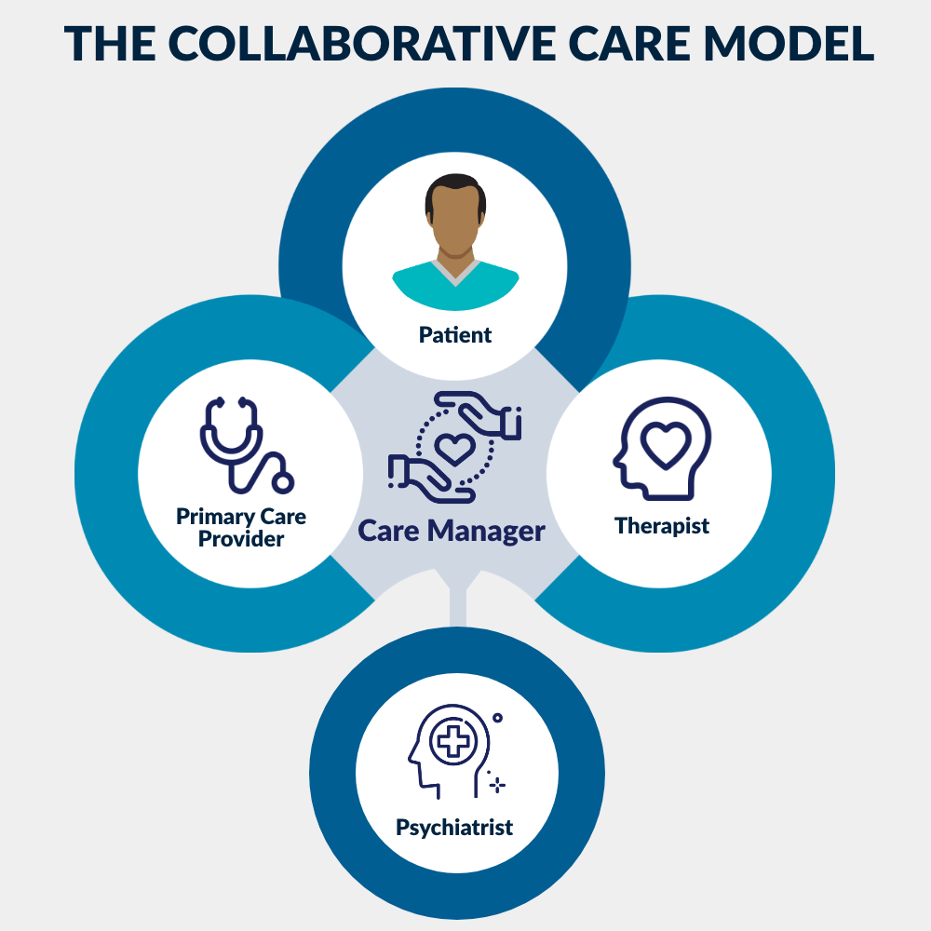
Care Management Services
General Behavioral Health Integration (BHI)
BHI is a team-based, collaborative approach to care that focuses on integrative treatment of patients with primary care and mental or behavioral health conditions
RHCs can receive payment when at least 20 minutes of qualifying BHI services are provided during a calendar month
General BHI services include:
An initial assessment and ongoing monitoring using validated clinical rating scales;
Behavioral health care planning in relation to behavioral/psychiatric health problems, including revision for patients who are not progressing or whose status changes;
Facilitating and coordinating treatment such as psychotherapy, pharmacotherapy, counseling and/or psychiatric consultation; and
Continuity of care with a designated member of the care team
Notes:
Behavioral Health Integration is an effective strategy for improving outcomes for patients dealing with mental or behavioral health outcomes.
BHI is a form of care management service for patients with a behavioral health diagnosis. BHI can be billed monthly for service elements such as systematic assessment and monitoring, care plan revision for patients whose condition isn’t improving adequately, and continuous relationship with an appointed care team member.
In my previous practice we had a psych NP and 3 counselors. The nurse spent many hours on the phone coordinating care, scheduling and reminding of appointments, following up on medication adherence etc.. BHI services cover all of those additional coordination hours that going in to caring for this patient population outside of the clinic visit.

Slide 22
Behavioral Health Integration
2. Behavioral Health Integration (BHI)
Code: G0511 (also used for BHI in RHC/FQHC)
Eligibility: Any diagnosed behavioral health condition (e.g., depression, anxiety)
Requirements: Monthly services including care planning, tracking, and psychiatric consultation
Strategic Value:
Integrates mental health into primary care
Supports whole-person care and SDOH response
Improves quality scores on behavioral health metrics

Slide 23
Community Health Integration
Medicare Part B covers community health integration services to address needs and help the provider diagnosis and treat medical conditions when it is determined by a healthcare provider through a social determinants of health risk assessment that there are social needs that are impacting the patient's health or access to care
Some community health integration services include:
An assessment to better understand the patient’s life story
Care coordination
Health education
Patient self-advocacy training
Health system navigation
Social and emotional support
Notes:
SDOH are known to influence mental health outcomes which are independent risk factors for poor health status and physical illness. With behavioral health integration it is important to reduce the silos and treat the patient as a whole
During an initiating visit the provider would assess and identify any SDOH needs that limit the providers ability to diagnosis and treat the patient’s medical condition. The provider will establish a treatment plan that would specify how addressing the SDOH unmet needs would help in the diagnosis and treatment.
The work of the CHI services would be completed by a community health worker or other ancillary personnel. These services would then be billed by the provider who initiated the service.
CHI are time-based services that can be performed monthly if medically necessary.
The initial code G0019 can be used for 60min per month in activities to address social determinants of health. G0022 can be used for an additional 30min of service per month.
Some example of services that could be provided are :
-conducting a patient centered assessment to understand the patient’s life story, strengths, needs, goals, preferences, desired outcomes, including understanding cultural and linguistic factors that affect the patients health
-providing tailored support to the patient as needed to accomplish the provider’s treatment plan
-Facilitating access to community based social services (housing, transportation, utilities, food assistance etc., to address the SDOH needs

Slide 24
Community Health Integration
10. Community Health Integration (CHI)
Codes: G0019 (30 min/month), G0022 (each additional 15 min)
Patient Criteria: Patients with unmet social needs impacting care
Requirements: Delivered by a Community Health Worker (CHW) or peer support specialist under general supervision
Services May Include:
Health education and coaching
Navigation to community resources
Follow-up and care linkage
Strategic Value:
Directly addresses SDOH
Expands team-based care with culturally responsive outreach
Improves outcomes, reduces avoidable utilization
Newly reimbursable, creating a sustainable model for CHW integration
Notes:
Community health integration (CHI) services help patients who have unmet social needs that affect the diagnosis and treatment of their medical problems identify and connect with appropriate clinical and social support resources. Practitioners may provide CHI services monthly, as medically necessary, following an initiating E/M visit (CHI initiating visit) where the practitioner identifies the presence of social determinants of health needs that significantly limit their ability to diagnose or treat the patient problems addressed in the visit. Community health workers, care navigators, peer support specialists, and other auxiliary personnel may be employed by community-based organizations if the billing practitioner provides the required supervision for these services, like other care management services

Slide 25
Next Steps
Phase 1: Assess Readiness
Phase 2: Prioritize Services to Launch
Phase 3: Build Infrastructure
Phase 4: Operationalize
Phase 5: Monitor and Optimize
Phase 6: Sustain and Scale

Slide 26
Measuring Success
Key Performance Indicators (KPIs)
Number of patients enrolled
Hospital readmissions or ED visits reduced
Reimbursement generated
Patient satisfaction
Feedback and Continuous Improvement

Slide 27
Nicole Thorell, Senior Consultant nthorell@wintergreenme.com c: (308) 325-0201
Notes:
May require more than one slide

