Slide 1


Strategies for Critical Access Hospitals to Address
Outmigration and Communities to Avoid the Worst-Case Scenario of Losing Healthcare.
Michelle Rathman, CEO
Impact! Communications, Inc.
michelle@doitwithimpact.com
Based on the framework of the guide developed for the National Rural Health Resource Center

Slide 2

Background and Review of “The Guide”
This technical assistance guide was developed in 2024 as a tool to help state Flex personnel, CAHs, and rural health clinic (RHC) leaders develop strategies to gain insight into causes for market share loss and address outmigration, defined as patients electing to receive health care services at facilities outside of their community.
Developed as a companion guide for the Small Rural Hospital and Clinic Finance 101 Guide, it provides examples of financial activities that CAHs may undertake to maintain or address market share loss, all supported through Flex funding.

Slide 3
Flex Funding May Be Fleeting
But outmigration is bound to be an ongoing factor, and that’s bad for rural hospital finances.

Slide 4

Before we dive in…
What outmigration or community engagement issues challenge you? What is are you hoping to take back with you and put into practice?

Slide 5

Acquiring Bypass Market Share Data
Understanding where your loss is coming from, where patients are going, more importantly, and why?

Slide 6
To reverse outmigration, understand what drives it.
Avoidable
Unavoidable
Ignoring the Reality of Rural Health
Not Openly Discussing Regulatory Burdens and Finances
Convenience {it’s all relative)
Customer Service and Surroundings
Privacy / Trust
Physical Plant
Services Do Not Exist / Unavailable
Out of Network (Cost)
Social Drivers (This can and must change)
Regulatory Burdens (we’ll talk)
Policy Shifts / Defunding Programs
Notes:
Example of physician leased space opening a lab – local outmigration

Slide 7
Avoiding the Avoidable
Traveling for health care that is available closer to home, Why?

Slide 8
Common Factors (Why?)
Convenience
Cost/Coverage
Customer Service and Surroundings
Privacy
Facility

Slide 9
Brand Awareness & Marketing
Is your plan strategy driven or transaction focused?

Slide 10
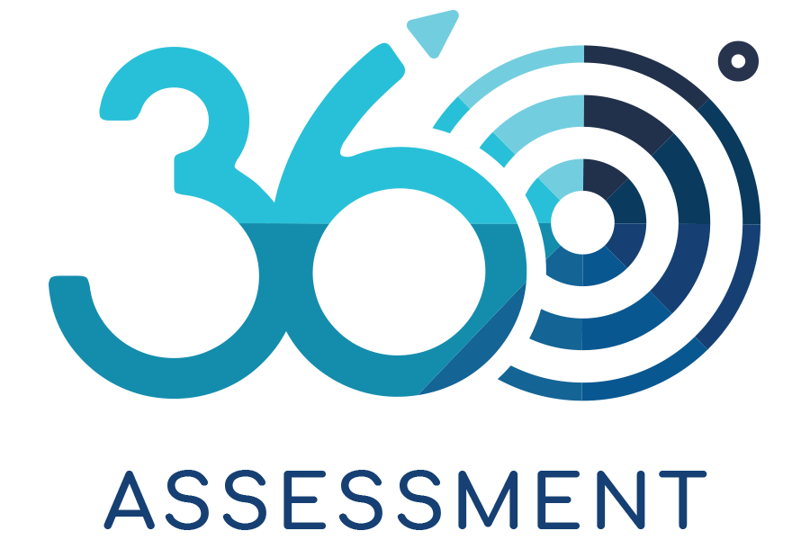
Strategy [strat-i-jee]
noun, plural strat-e-gies.
A plan, method, or series of maneuvers or stratagems for obtaining a specific goal or result
Resource: dictionary.com

Slide 11

Communication & Engagement
STRATEGIC PRIORITIES SWOT
Storytelling

Slide 12

STRENGTHS
WEAKNESSES
THREATS
OPPORTUNITIES

Slide 13
Strength | Weakness | Opportunities | Threats
Staff Position | Lack of Input | Form a Committee | Funding

Slide 14
BRAND IDENTITY
Storytelling
Notes:
Assignment: Have them tell the story of NRHD | Rely on each other to tell the story.
What do you do around a campfire? Tell stories! The best way to communicate any organizations’ message is through story telling. We tell stories through our everyday actions and interactions within the organizations we serve. Today, we will learn what story National Rural Health Day wants to share and how to share that message through a broad range of communication channels.

Slide 15
BRAND IDENTITY
What BRAND is NOT:​
Your Mission or Vision Statement ​
An Ad a Billboard or Even a Series in a Campaign​
An Event or a Participating in Parades​
A Website (nor is it your Facebook page or a periodic post on other social sites)​
What BRAND IS:​
What hearing your name, being in your presence, seeing your logo/look/people makes them:​
Think > Know > Feel​

Slide 16

Getting from the current mindset…
THE MINDSET
A process to help you evaluate your organization’s relationship building readiness.
Perception is more powerful than you may realize.
Notes:
Hospital bill showing up a year later story. Conduct a Community Health Perception Survey WITH your CHNA

Slide 17



THE CURRENT MINDSET
THINK
Hospital does not offer the quality of care that I can find in bigger city. The ER has long wait times; plus, they transfer people out to larger hospitals, and you never know what doctor you will see. It will cost you more to go there for some things.
KNOW
Hospital has a new facility and new doctors but I’m not sure what services and procedures are offered. If I have to go, there I will. I’ve read negative comments on social media about my friend’s experience there.
FEEL
In non-threatening situations, I’d be safe to stay in the county for care and go to my local Hospital. I’m angry that things cost more, that the administrator makes too much money considering how much I earn. Why worry? They’ll be here when I need them.

Slide 18
THE DESIRED MINDSET
THINK
Hospital has a new (remodeled/updated) facility, provides high quality care and is a safe choice for inpatient and outpatient services. The doctors and people who work there are invested in my health and care about the health of the community.
KNOW
Hospital has the same technology as the hospitals in the bigger city for many services and procedures. The doctors and staff have received recognition, awards and certifications. The customer service is friendly, and my bill was reasonable, easy to pay, with most of the charges covered under my insurance plan.
FEEL
I will be cared for. I will be safe. My physician is fully invested in me as a person and a patient. My personal health and wellbeing matters. I trust my Hospital and I will always turn to them to be my home for healthcare. I feel so fortunate to have them in my community and I’ll do what I can to make sure they will always be here for us! Count me in!

Slide 19
Trust in Advertising | % of global online consumers, indicating that they completely or somewhat trust sources.
Source: Nielsen
Notes:
Social and digital media is the largest platform for health care marketers. What has not changed over the years, is that health care decision makers still trust messages from people they know. The big difference is, now they can get the scoop online, with no fact checking or check on emotions and details.

Slide 20
You have information competition
Nearly 90% of all adults in the USA search for health information on Facebook, Twitter, YouTube, and other social media sites.
Social media is the most common place Americans learn about health tactics, followed by search engines, doctors, and health information sites.
Social media influencers are also a source of health advice for one-third of Americans.

Slide 21
Media’s Role in Public & Health
What Say WHO?
Media outlets, such as radio and TV, can give people information to improve their health
News stories and campaigns can also have an impact on people who make decisions
In supporting health, the media should:
  Tell true stories about the things that impact on health in an interesting way
  Give the public an opportunity to debate and talk about health issues
  Report on health and in health emergencies in a way that is responsible and honest
  Hold the government and people who make decisions to account
  Social media and digital platforms can help to expand public coverage of an issue
  Anyone can report on news as and when it happens around them (this known as civic journalism)

Slide 22
Misrepresentation of Health Risks by Mass Media
“The number of media reports inversely correlated with the actual number of deaths for the health risks evaluated.
SARS and bioterrorism killed less than a dozen people in 2003, but together generated over 100,000 media reports, far more than those covering smoking and physical inactivity, which killed nearly a million Americans.”
Notes:
(Journal of Public Health)

Slide 23
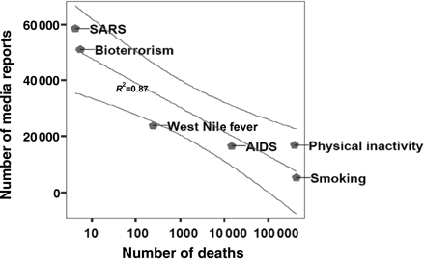

Fig. 1 Number of media reports in the United States on selected causes of death versus actual number of deaths from ...
Notes:
Fig. 1 Number of media reports in the United States on selected causes of death versus actual number of deaths from these causes (4,5) in 2003 (on log scale). Regression line is represented with 95% confidence intervals.
Unless provided in the caption above, the following copyright applies to the content of this slide: © The Author 2008, Published by Oxford University Press on behalf of Faculty of Public Health. All rights reserved

Slide 24
How “Right-Leaning” Media Coverage of COVID-19 Facilitated the Spread of Misinformation in the Early Stages of the Pandemic in the U.S.
  Right-Leaning Media Were More Likely to Discuss COVID-Related Misinformation in Early March
  More than One in Three Americans Endorse COVID-Related Misinformation
  Right-Leaning Media Viewers Are More than Twice as Likely to Endorse COVID-Related Misinformation
  Misinformed Americans Think that the CDC Exaggerated COVID's Health Risks
Notes:
(Cambridge University Press)

Slide 25
Online Misinformation Most Likely to be Believed by Ideological Extremists,
New Study Shows
NYU researchers captured 139 news articles (November 2019-February 2020)—102 of which were rated as true and 37 of which were rated as false or misleading by professional fact-checkers—and calculated the spread of those articles across Twitter from the time of their initial publication.
This sample of popular articles was drawn from five types of news streams: mainstream left-leaning publications, mainstream right-leaning publications, low-quality left-leaning publications, low-quality right-leaning publications, and low-quality publications without an apparent ideological lean.
To establish the veracity of the articles, each article was sent to a team of professional fact checkers within 48 hours of publication. The fact-checkers rated each article as “true” or “false/misleading.”
Notes:
NYU

Slide 26
Overall, the findings showed that while false news reached users across the political spectrum, those with more extreme ideologies (both conservative and liberal) were far more likely to both see and believe it.
Crucially, these users, who are receptive to misinformation, tend to encounter it early in its spread through Twitter.
The fact-checkers rated each article as “true” or “false/
misleading.”

Slide 27
Media bias exposure and the incidence of COVID-19 in the USA
The media continues to play a crucial role in the transmission of health information during public health crises
The alignment of media messages with those advocated by medical experts, without any attempt at political slant, is crucial in the battle against the spread of COVID-19 and future pandemics.
Notes:
(BMJ Global Health)

Slide 28

Echo Chambers, Filter Bubbles, and Polarization

Slide 29

Latest Real Headlines…
“CDC Contradicts RFK Jr. On Immunization For Kids Amid COVID Vaccine Changes, Confusion And Misinformation.”
“Robert F. Kennedy Jr.'s announcement that the Centers for Disease Control and Prevention will no longer recommend COVID vaccines for "healthy children and healthy pregnant women.”
“Vaccine sceptic RFK Jr is now a powerful force in US science: what will he do?”

Slide 30
“Because...extreme users also tend to see misinformation early on, current social media interventions often struggle to curb its impact—they are typically too slow to prevent exposure among those most receptive to it."
--Zeve Sanderson, executive director of NYU's Center for Social Media and Politics

Slide 31

How has health care misinformation impacted community engagement?
What impact has it had on patients’ participation in prevention, screening, recommended routine things, like vaccines?

Slide 32
What’s in a name?
Opportunities to retell your story and reshape perception

Slide 33
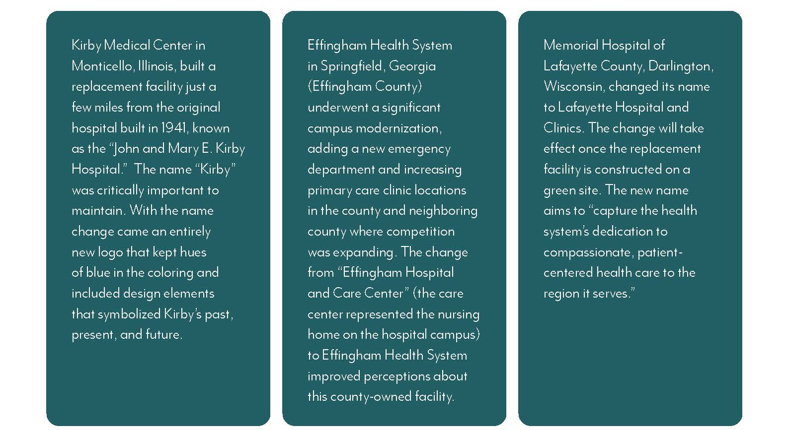
New Name = New Opportunity

Slide 34

Clinging to the Past
If you are going to change your name, change it everywhere.
Signage
Team Apparel and Swag, Don’t forget the linens
Printed materials (including recruitment promotional pieces)
Websites and other digital assets

Slide 35
KEY MESSAGES
Storytelling

Slide 36

KEY MESSAGES
Notes:
Board, Senior and Dept Leadership, Staff Volunteers??? Mexico, Morning Rowers

Slide 37
STORYTELLING
Storytelling
Notes:
Assignment: Have them tell the story of NRHD | Rely on each other to tell the story.
The best way to communicate any organizations’ message is through story telling. We tell stories through our everyday actions and interactions within the organizations we serve. Today, we will learn what story National Rural Health Day wants to share and how to share that message through a broad range of communication channels.

Slide 38
STORYTELLING
Based on the Storybrand® Framework
A Character
Has a Problem
And Meets a Guide
Who Gives Them a Plan
And Calls Them to Action
That Helps Them Avoid Failure
And Ends in Success

Slide 39
STORYTELLING: A Character
The customer is the hero, not your brand.

Slide 40
STORYTELLING: Has a Problem
Companies tend to sell solutions to external problems, but customers buy solutions to internal problems.
Health care represents the most complex of all consumer industries.

Slide 41
STORYTELLING: And Meets a Guide
Customers aren’t looking for another hero; they’re looking for a guide.

Slide 42
STORYTELLING: Who Gives Them a Plan
Customers trust a guide who has a plan.

Slide 43
STORYTELLING: And Calls Them to Action
Customers do not act unless they are challenged to take action.

Slide 44
STORYTELLING: And Calls Them to Action
Customers do not act unless they are challenged to take action.

Slide 45
STORYTELLING: And Ends in Success
Never assume people understand how your brand can change their lives.

Slide 46
ELEVATOR PITCH
Storytelling

Slide 47

ELEVATOR PITCH
Notes:
You only have a few seconds.
Is everyone within your organization saying the same thing?
Are you loosing a captive audience through confusion?

Slide 48
ELEVATOR PITCH
You only have a few seconds.
Is everyone within your organization saying the same thing?
Are you loosing a captive audience by including too many details?

Slide 49
ELEVATOR PITCH
Who is your customer?
What is their problem?
What is your plan to help them?
What will their life look like after you do?

Slide 50
Shifting from Outbound to Inbound Engagement Strategies
(“joe public doesn’t care about your ct scanner”)

Slide 54
How Persona Development Works
(and Why)
Demographic Information:
Age, gender, location, income, education, and other basic characteristics are gathered through surveys, analytics, and existing customer data.
Psychographic Information:
Understanding attitudes, values, interests, lifestyles, political and religious leanings, and motivations through surveys, interviews, and social media listening.
Behavioral Data:
Analyzing online behavior, including social media engagement, website interactions, purchase history, and other relevant actions.
Social Media Analysis:
Examining follower demographics, content engagement, and the hashtags they use to understand their interests and online habits.

Slide 55
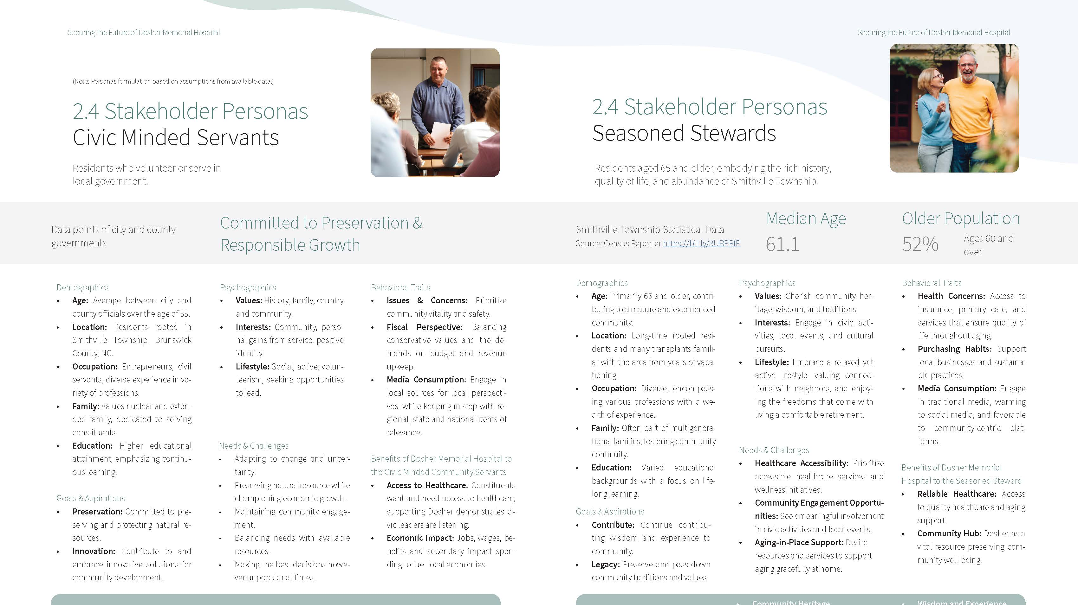

Slide 56
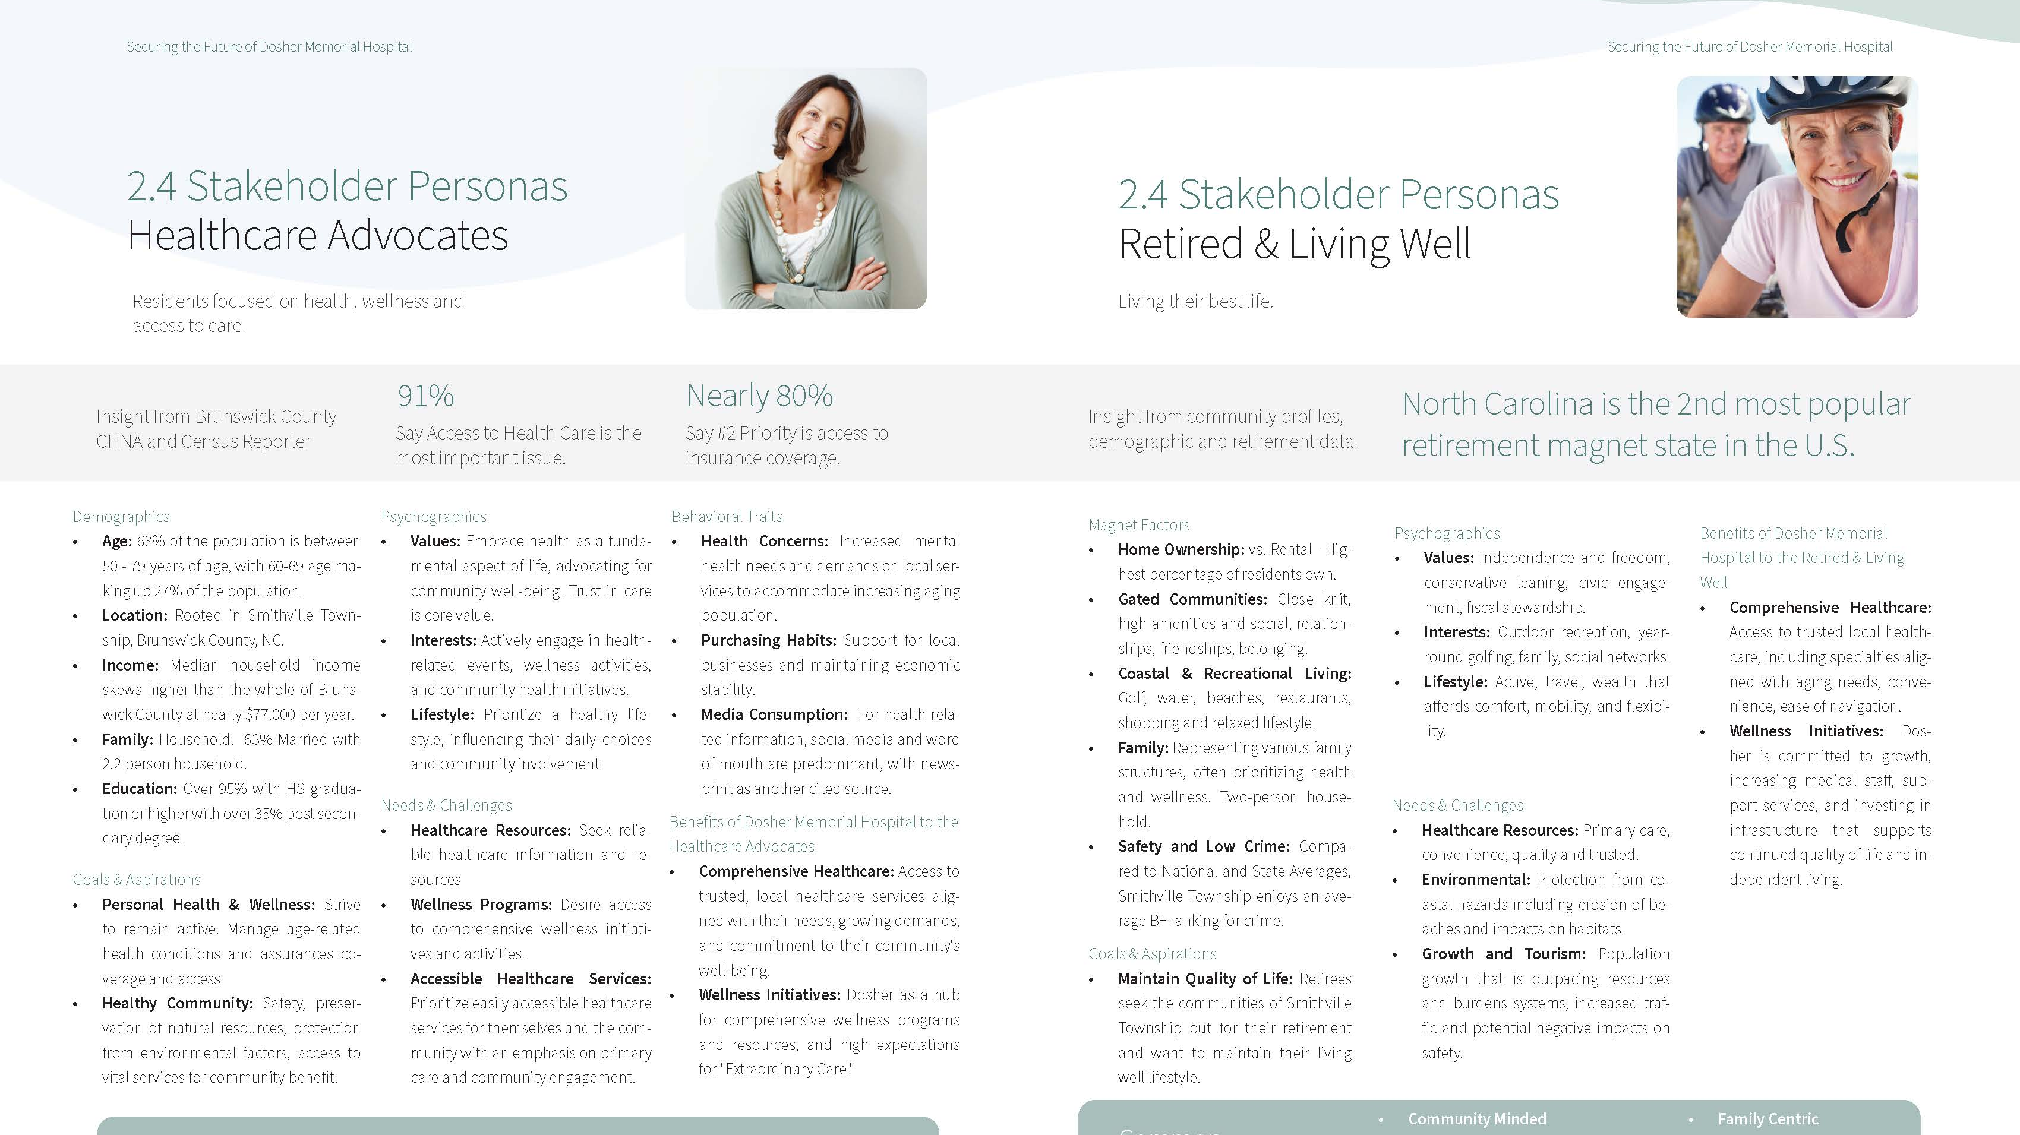

Slide 57
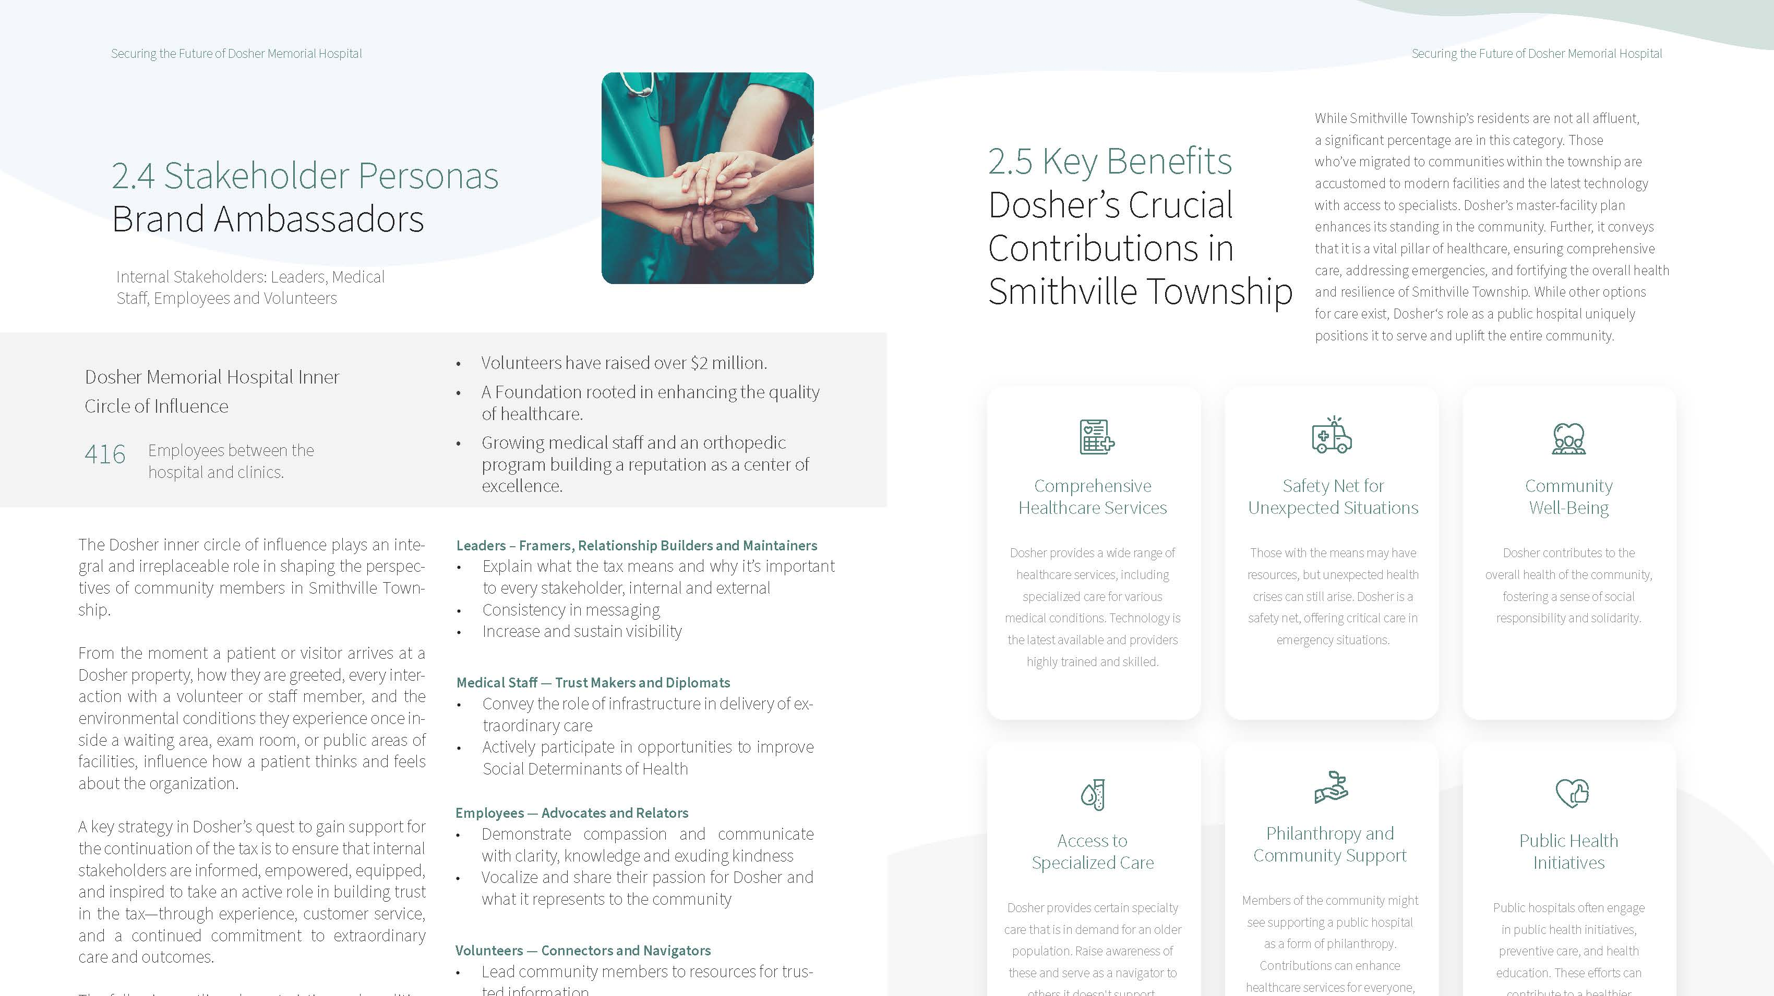

Slide 58
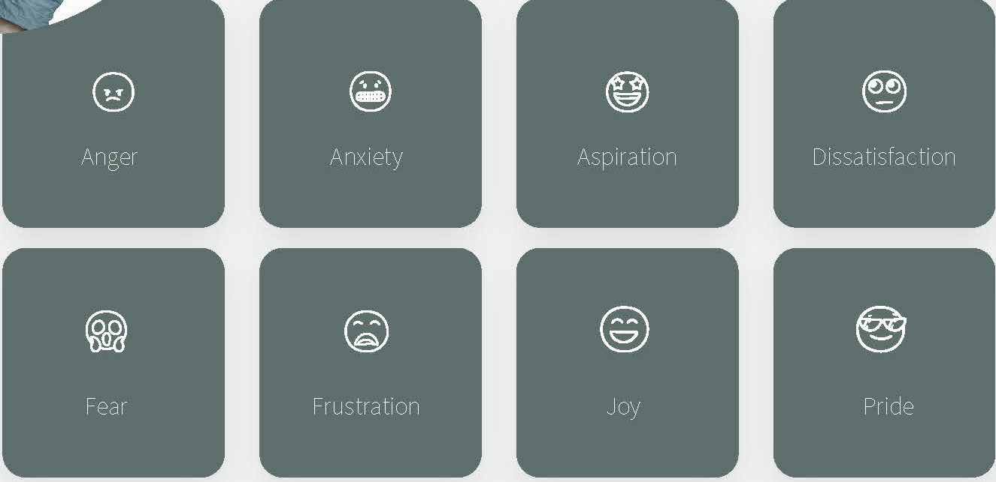
THE RANGE OF FEELINGS THAT INSPIRE CONSUMERS OF NEWS TO ACT

Slide 59

Communication and Engagement Strategies to:
Address Outmigration Factors,
Pursue Culture Improvement, and Build Trust that Fosters a Healthier Rural Community
Strategy is a powerful Remedy

Slide 60
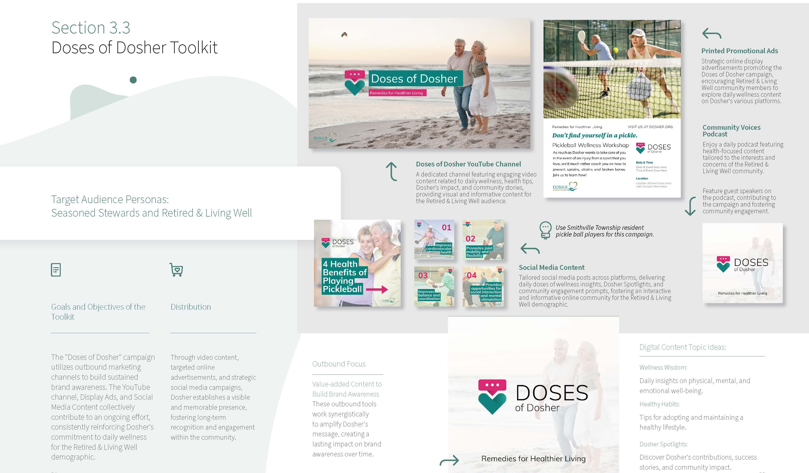

Slide 61
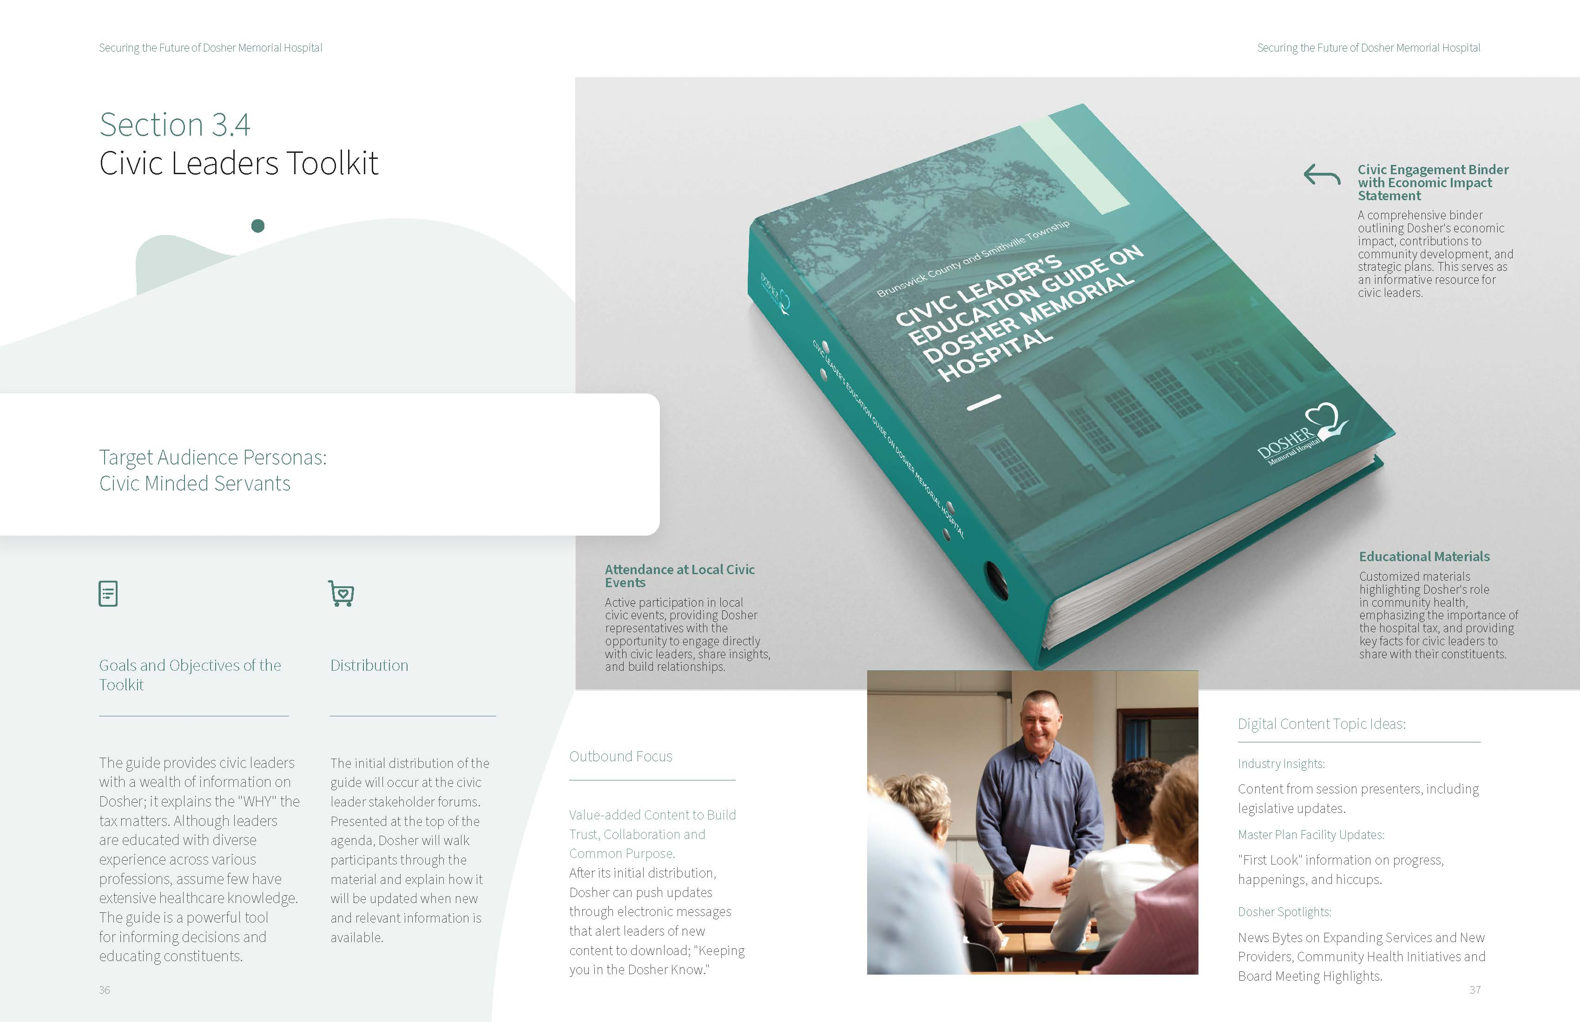

Slide 62
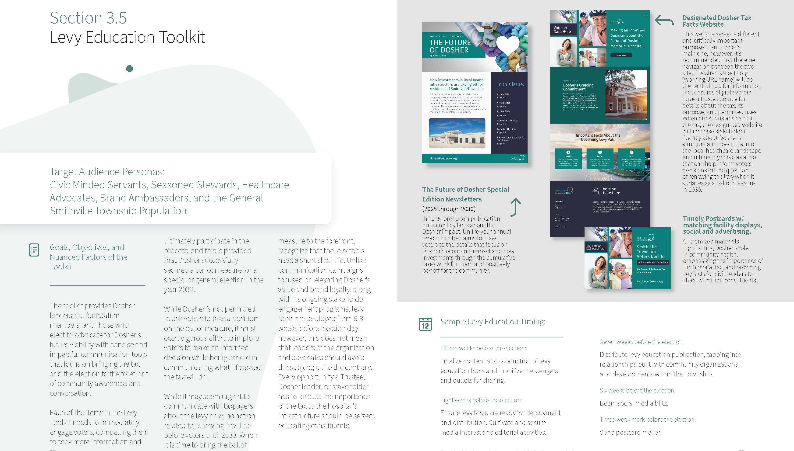

Slide 63
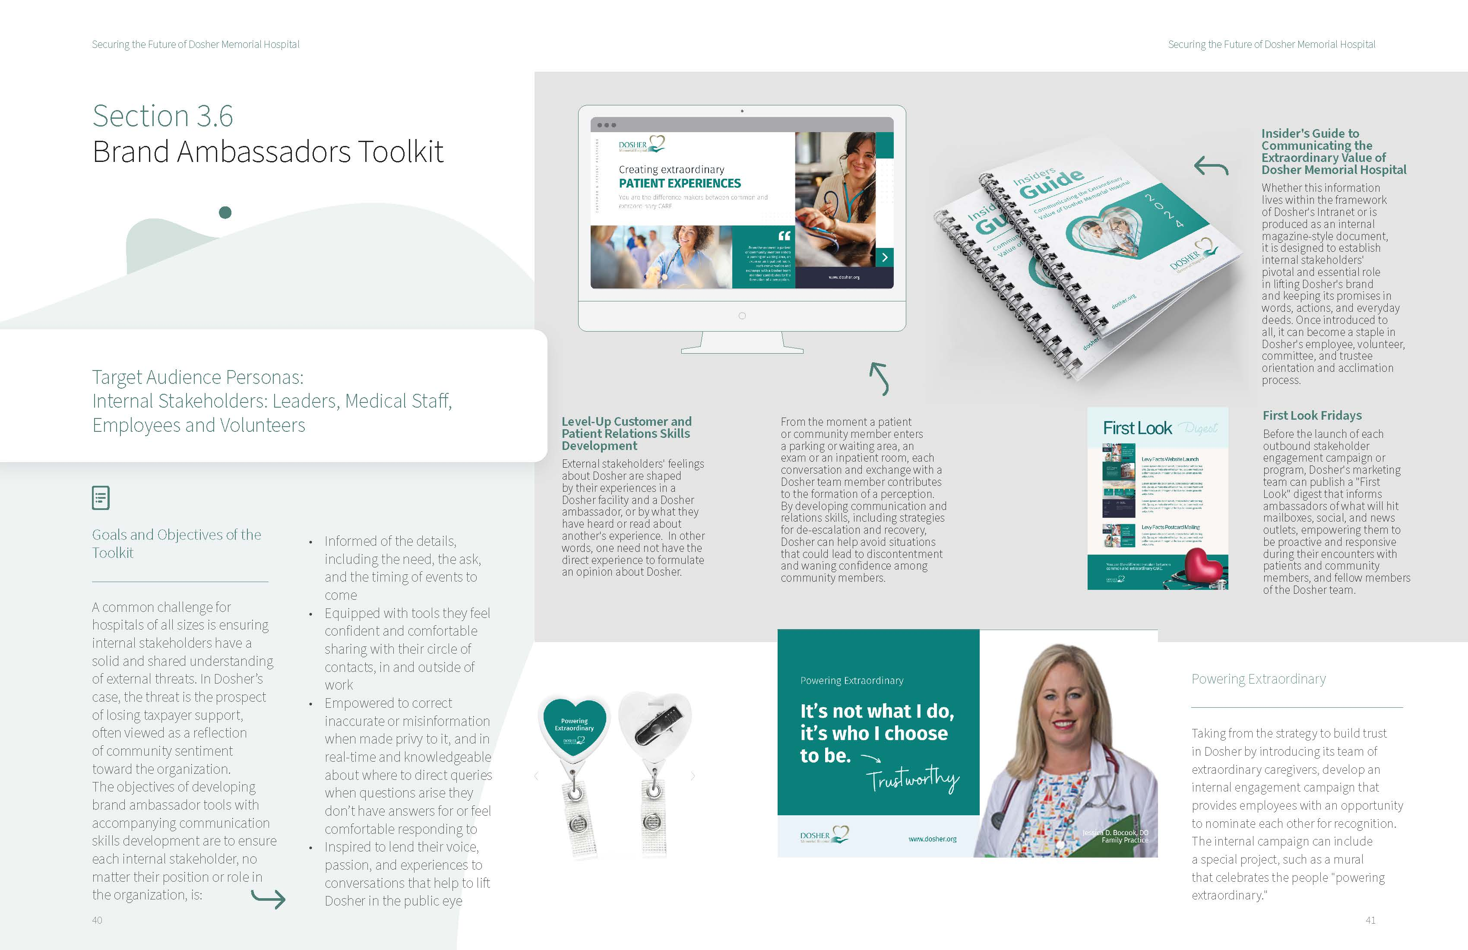

Slide 64
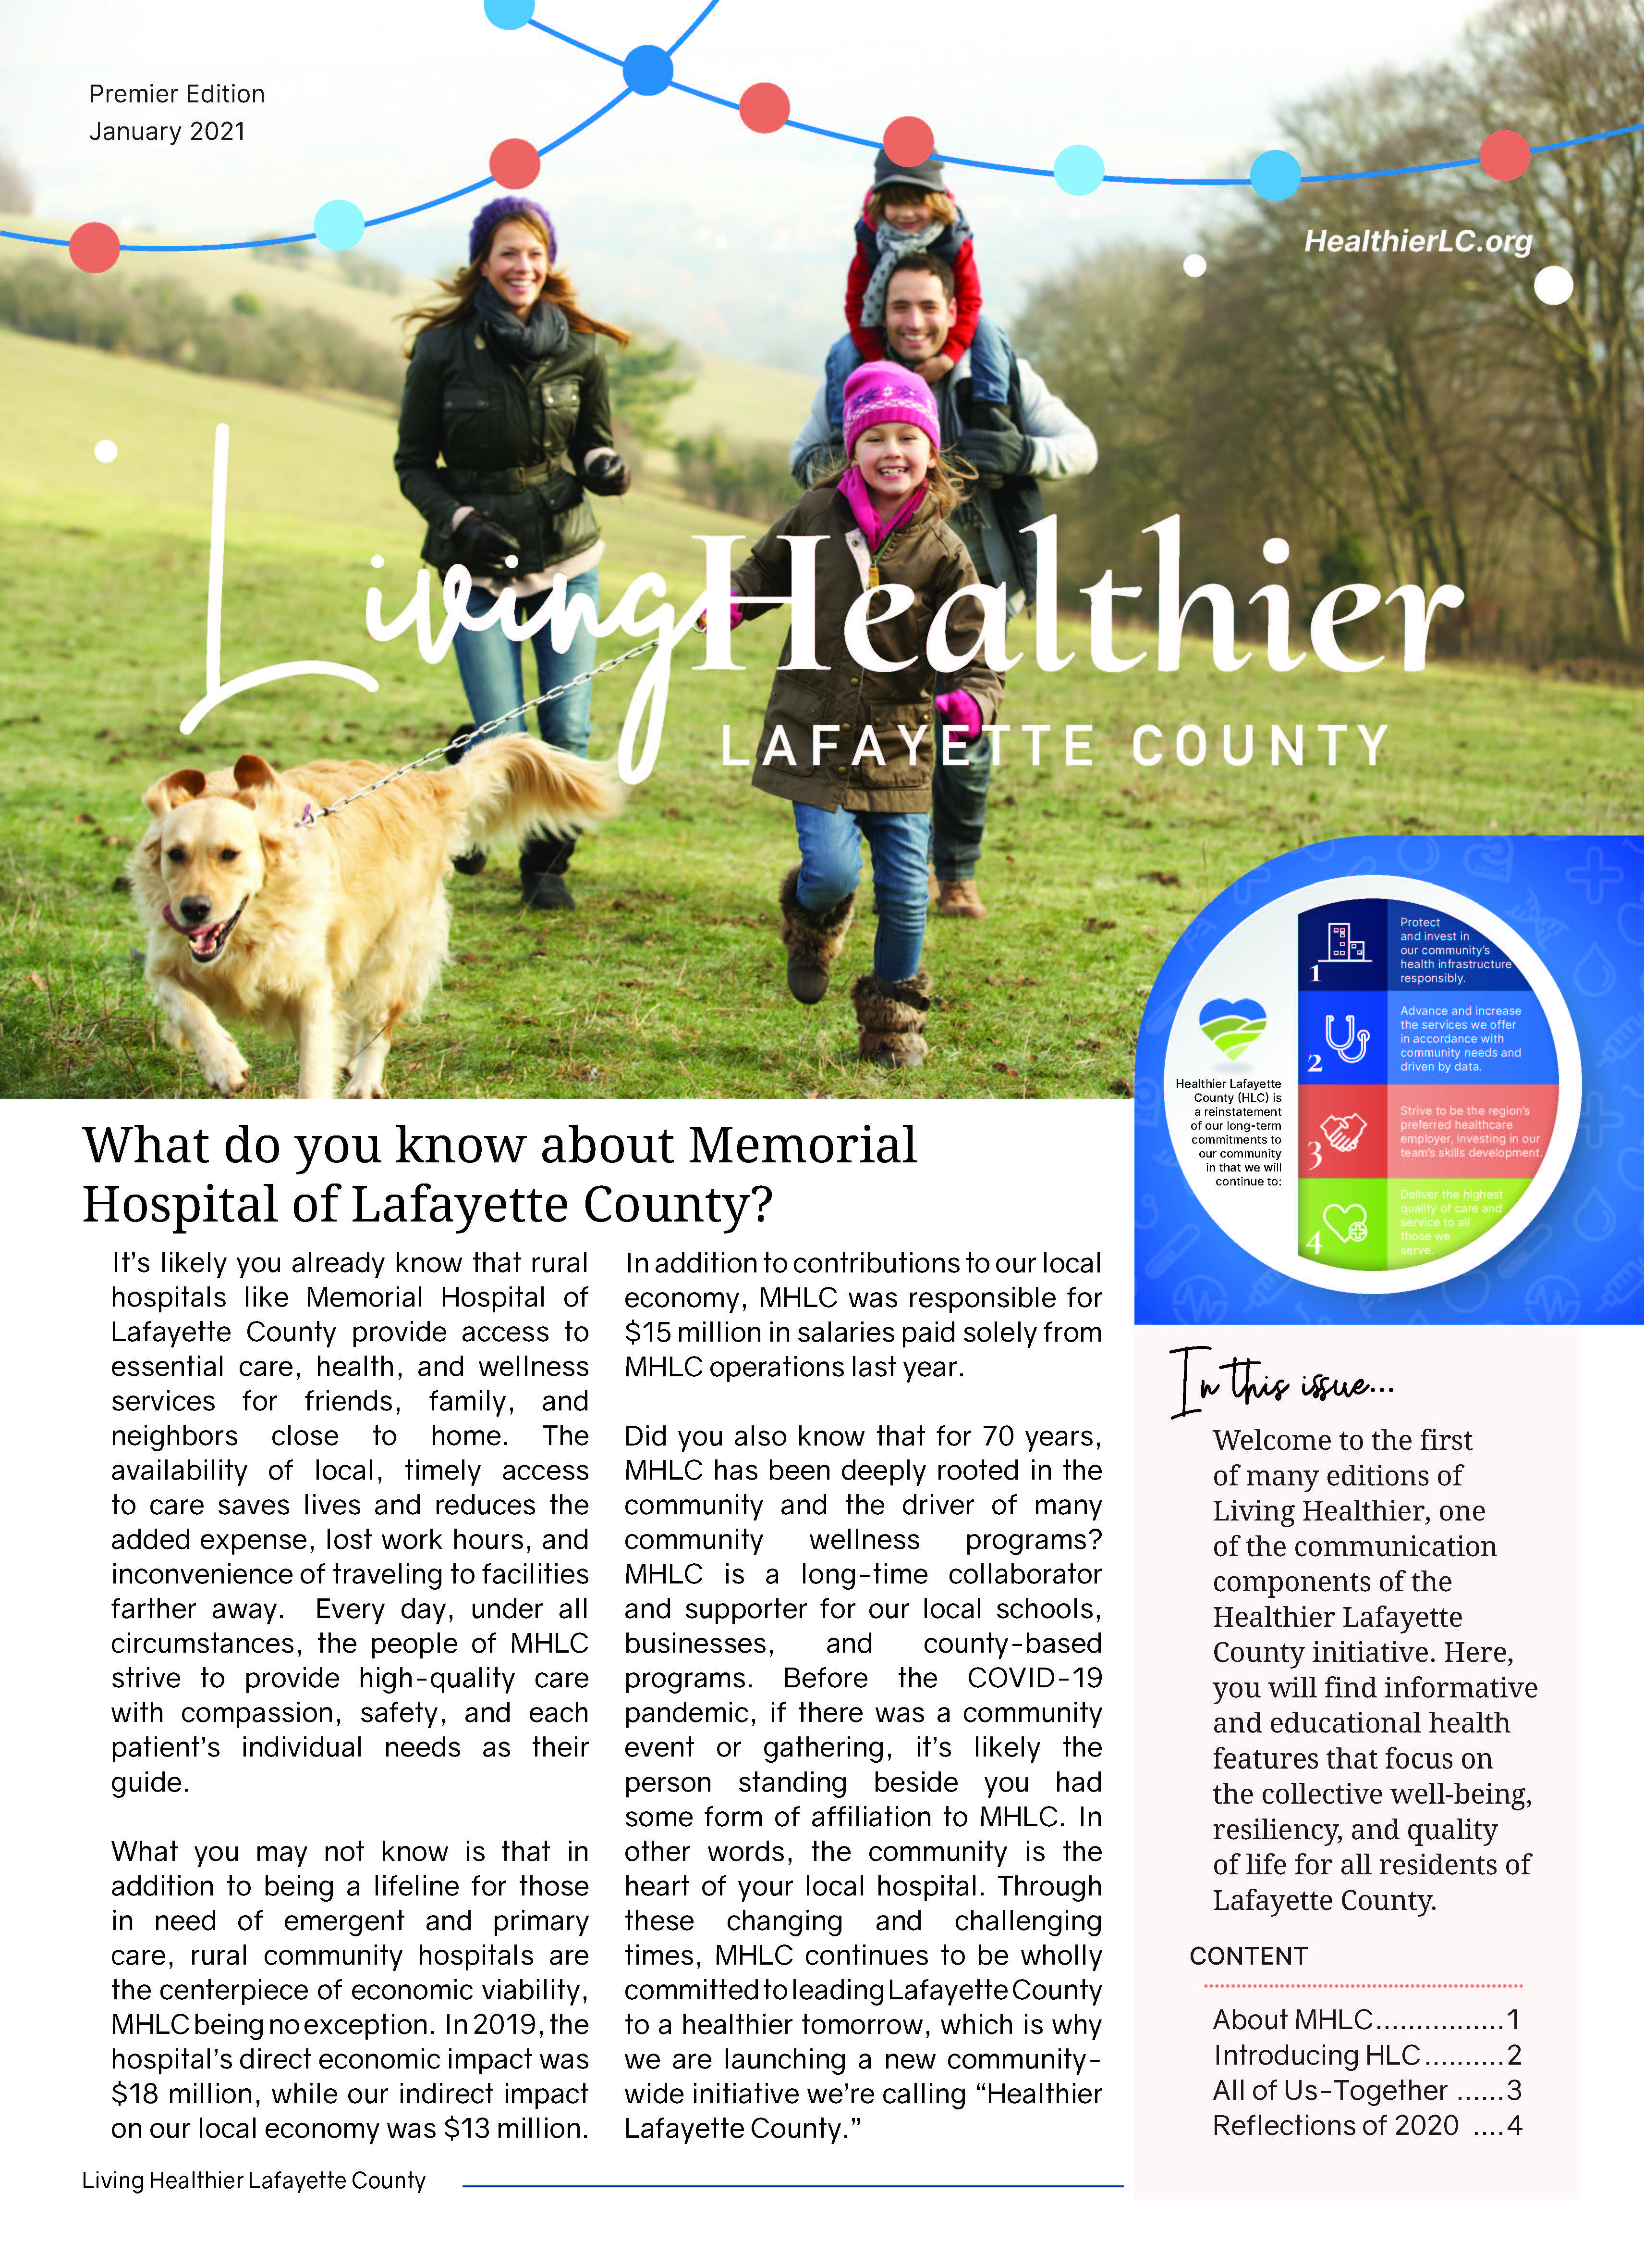
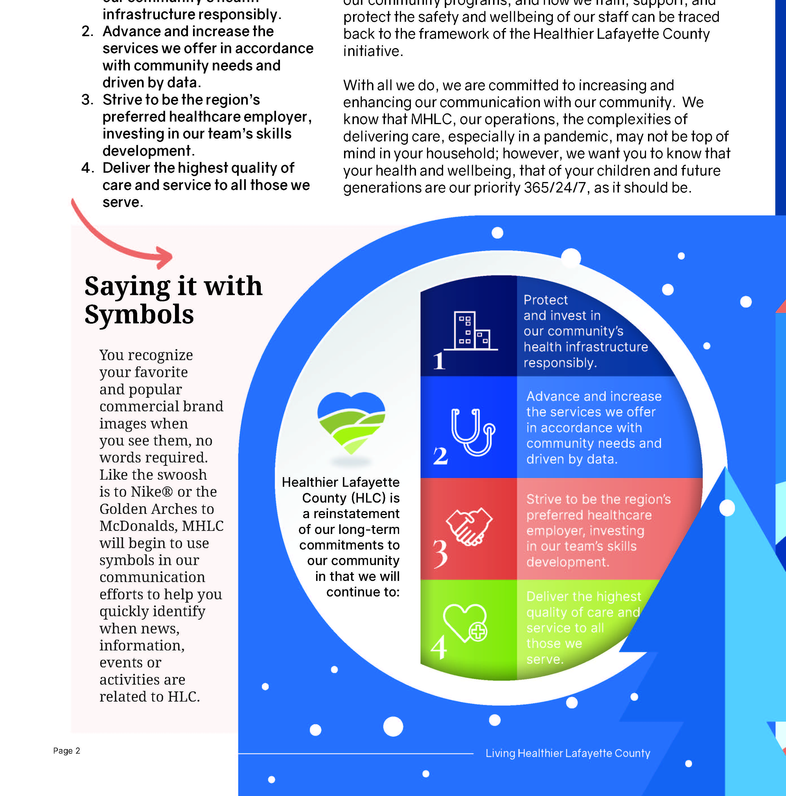

Slide 65
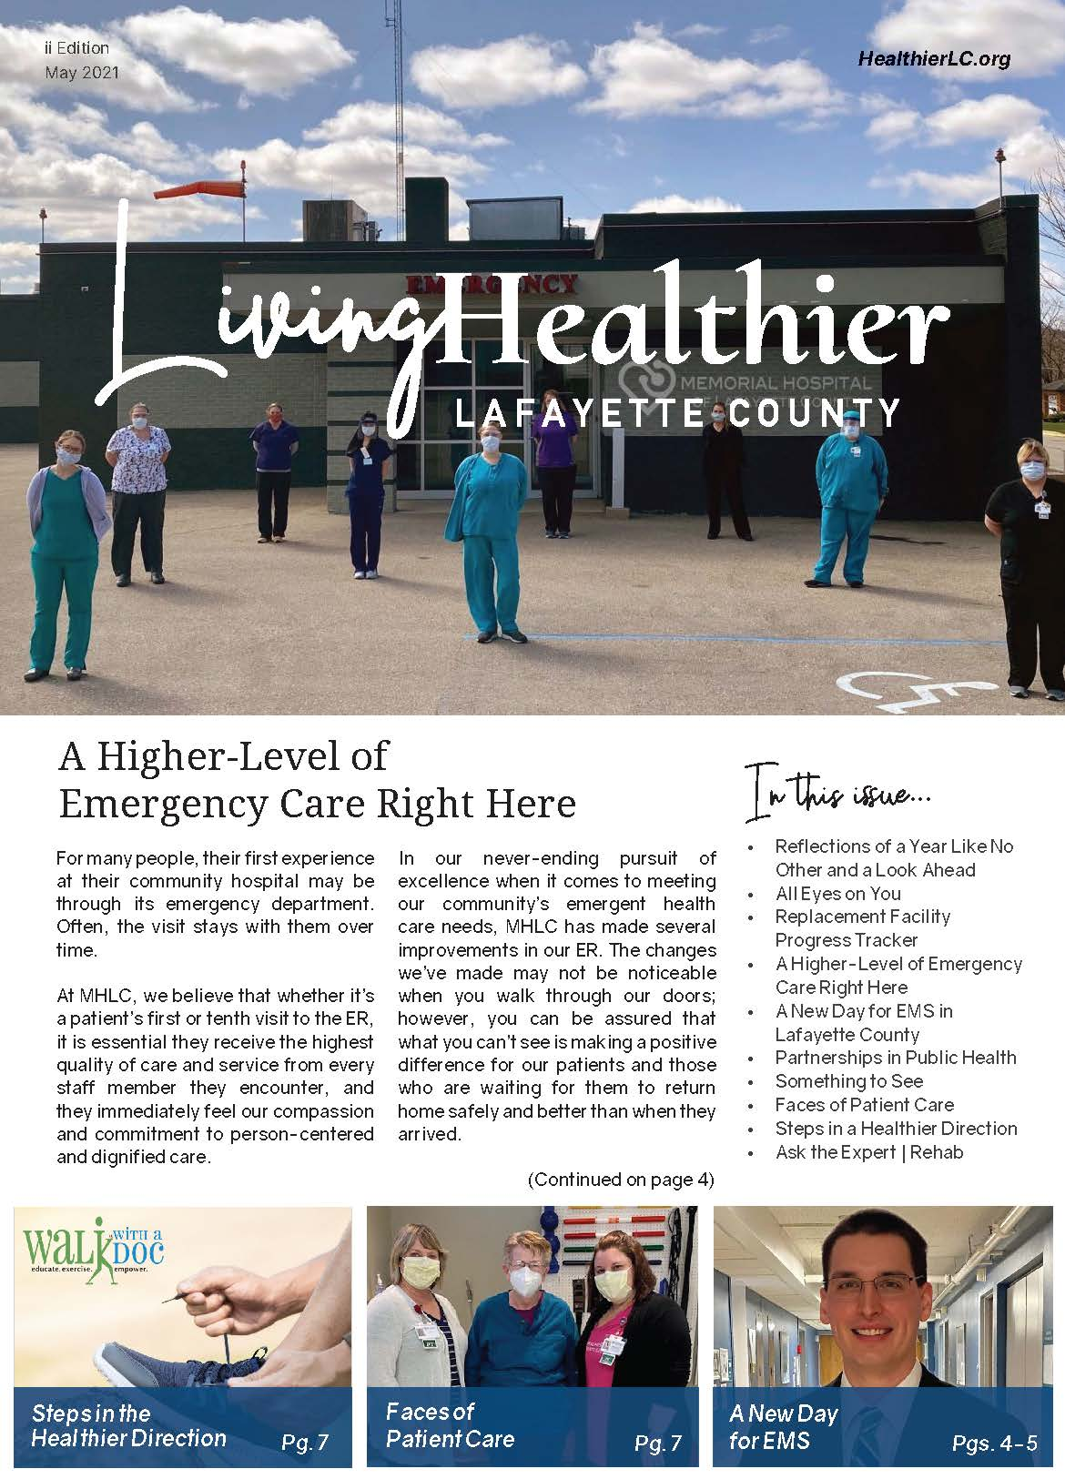
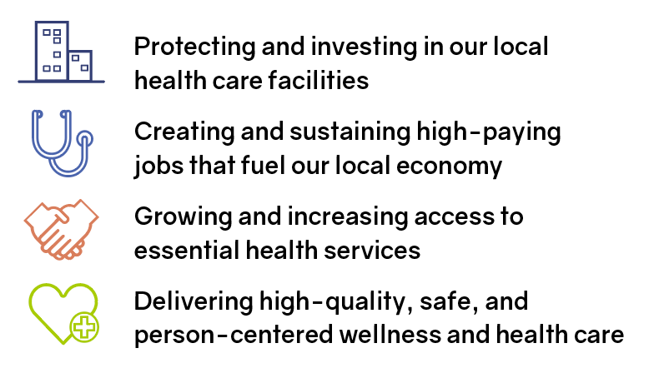

MHLC sponsors / contributes to…
H
Healthier Lafayette County Initiative

Slide 66
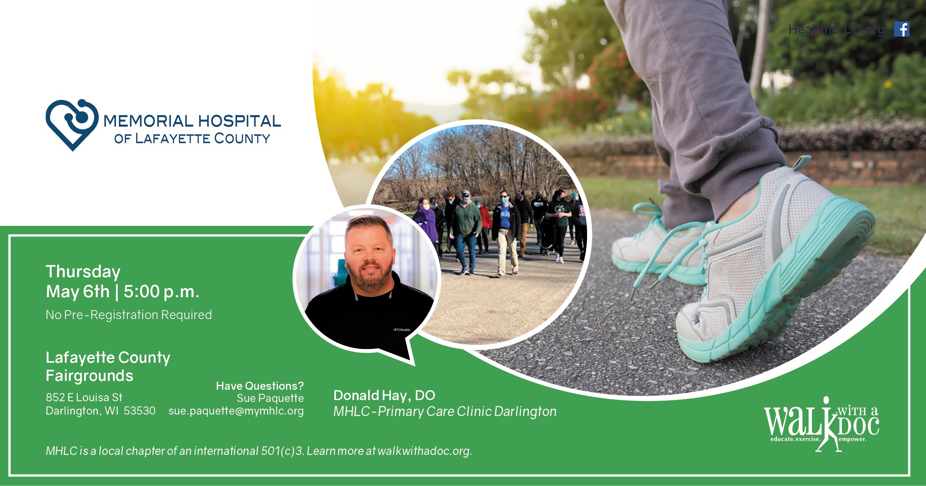
MHLC sponsors / contributes to…

Slide 67
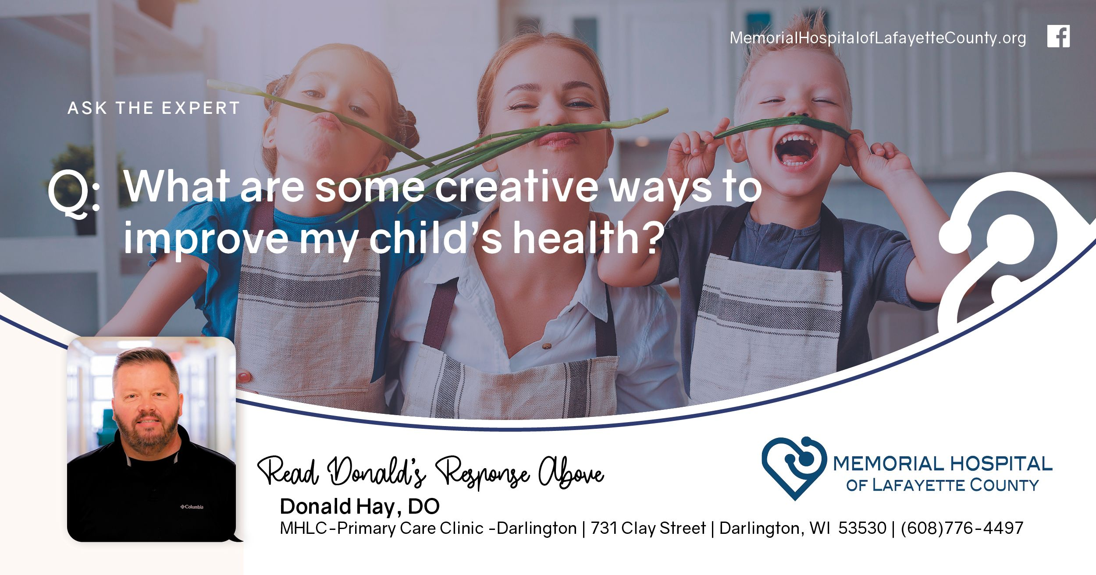

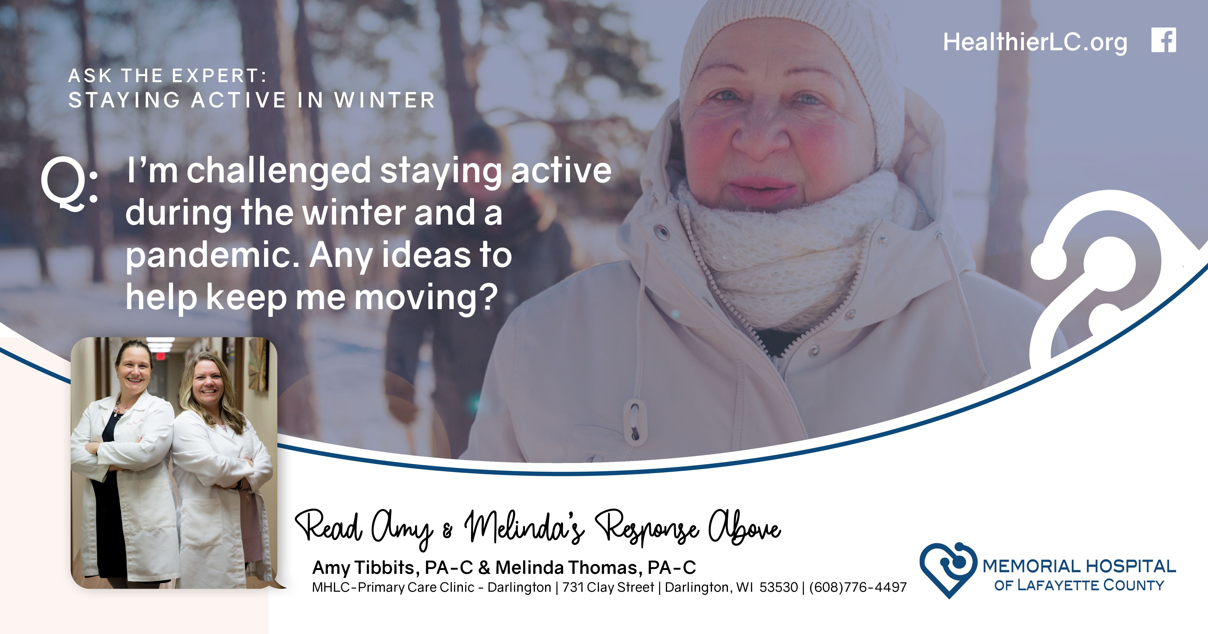
MHLC sponsors / contributes to…
We’re
We’re not just advertising. We’re educating. Raising the bar on health literacy. It’s what we should be doing.

Slide 68
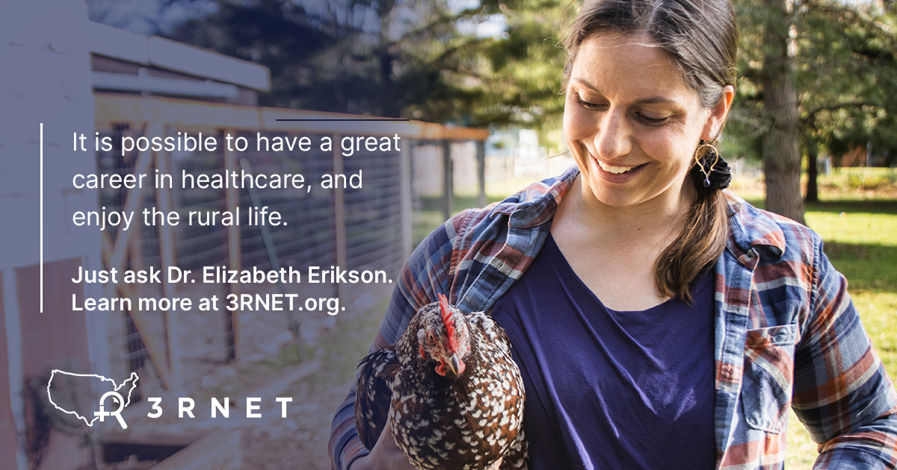
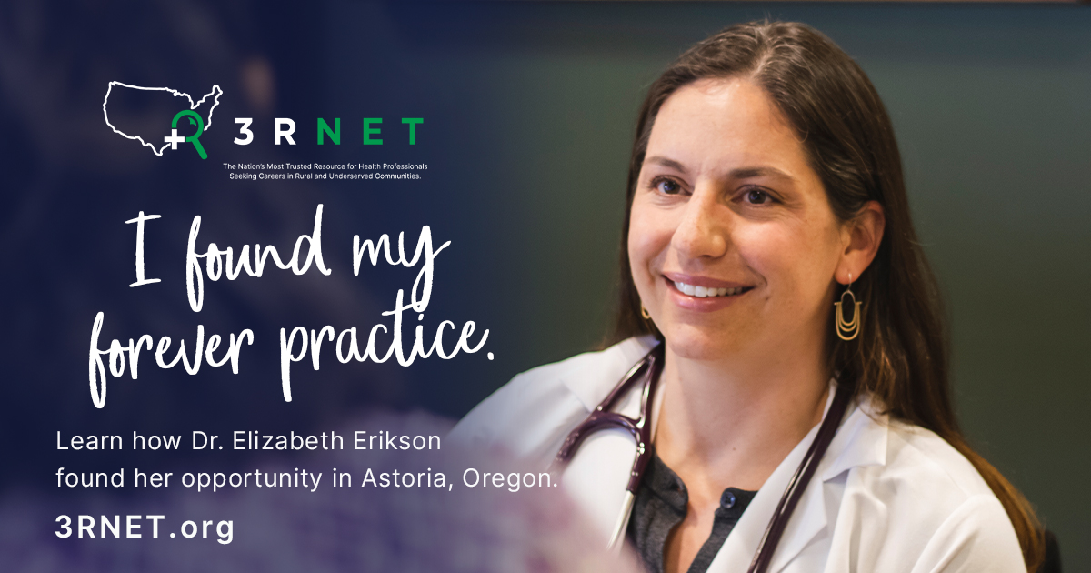

Celebrate and share your success stories.
Make yours a Destination, a Choice, a Location that is Welcoming and Ideal for Place Making.
Impact! Communications, Inc. - Michelle Rathman - michelle@doitwithimpact.com

Slide 69
Sample Inbound Engagement Strategies

Slide 70
Let’s Get to Work
Pick a topic, issue, area, or service you want to work toward a reverse.
Who are your targets?
What’s your strategy?
Framing
Tools
Implementation
Success Metrics

Slide 71
Guide Summary
Successfully addressing outmigration requires a shift in mindset, acknowledging that community members will travel long distances for care if they believe there are better options in the next county. Patient loyalty is established not because a CAH is closer, but because it has earned their trust.

Slide 72

Before you can lift others,
you must rise to the occasion.
Michelle Rathman - michelle@doitwithimpact.com
Notes:
Communication Style, Emotional Intelligence, Strengths, Generational Perspective

Slide 73
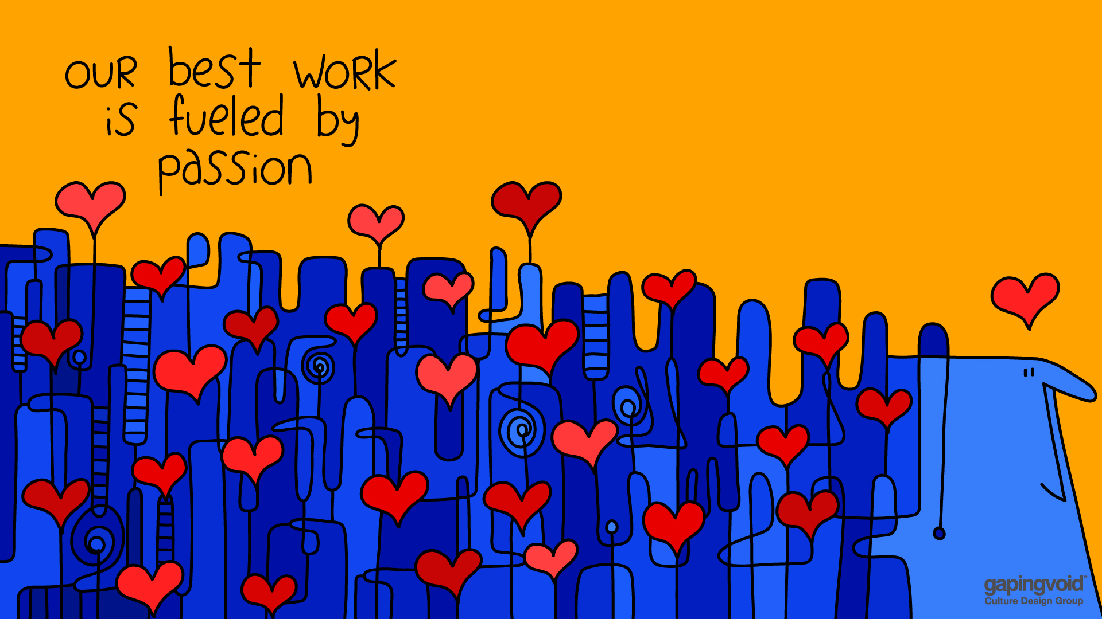
gapingvoid.com

Slide 74







Helping Rural Health Organizations Develop Communications and Community Engagement Strategies that are Right for Rural and Responsive to Each Communities Uniqueness.
Because no place is the same, one size plan does not fit all.
--michelle@doitwithimpact.com
michellerathman.com

