Slide 1
High Performing Quality Improvement Teams
Victoria Kennel, PhD
University of Nebraska Medical Center

Slide 2
Learning Objectives
Compose a high performing quality improvement team
Discuss strategies to lead effective teams
Define desired team performance outcomes

Slide 3
Small Group Discussion
What do quality improvement teams look like at your organization?
What works well?
What challenges do you encounter?

Slide 4
Why Improvement Teams?
Quality improvement is complex and the path to improvement isn’t always clear
Processes don’t exist in a vacuum
Interprofessional approach allows us to use the knowledge, skills, experiences of many professionals
Efficient use of resources
https://www.hrsa.gov/sites/default/files/quality/toolbox/508pdfs/improvementteams.pdf

Slide 5
Your Capstone Project

Slide 6
Quick Team Self-Assessment
Does our team have the right people on it with the right mix of individual and team knowledge, skills, and attributes?
Do team members possess the right beliefs and attitudes about our team?
Is our team consistently demonstrating effective teamwork behaviors?
Are team members sharing information effectively with each other and with those outside of the team?
Do team members have a shared understanding about priorities, roles, vision, etc.?
Are the necessary conditions in place to enable our team to work together and succeed?
Are our team leader and/or other members demonstrating leadership behaviors that help the team?
5 = Very Strong
4 = Fairly Strong
3 = Neither
2 = Fairly Weak
1 = Very Weak
Tannenbaum, S., & Salas, E. (2021). Teams that work. Oxford University Press. Tool D – Quick Diagnostic, pp. 223-226.

Slide 7
7 C’s – Teams that Work
Capability
Cooperation
Coordination
Communication
Cognition
Conditions
Coaching
Tannenbaum, S., & Salas, E. (2021). Teams that work. Oxford University Press.

Slide 8
Capability
Knowledge, skills, abilities, and other attributes among members of your team
Task-related
(to do the work)
Team-related
(to work together)
Tannenbaum, S., & Salas, E. (2021). Teams that work. Oxford University Press.

Slide 9
Ideal Qualities for Improvement Team Members
Well respected by others
Strong communication skills
Proven problem solvers
Frustrated with the current situation
Creative and willing to offer solutions
Team player
Strong, active listening skills
Flexible, adaptable
Expertise in improvement area
Willing to learn
Assume responsibility for tasks
Committed to success of the project/team
https://www.hrsa.gov/sites/default/files/quality/toolbox/508pdfs/improvementteams.pdf

Slide 10
Cooperation
Attitudes and beliefs team members have about their team that emerge as a result of interactions over time
Trust
Psychological Safety
Collective Efficacy
Cohesion
Expectation that team members will do what they say and do the right thing
Belief team members have positive intentions and others best interests in mind
Team members can speak up with questions, concerns, mistakes, requests for help, etc. and do so without feeling like they are taking an interpersonal risk
Belief the team can be successful to achieve its specific goals/tasks
Team members demonstrate a shared attachment and commitment to the team
Tannenbaum, S., & Salas, E. (2021). Teams that work. Oxford University Press.

Slide 11
Coordination
What we usually think of when we say “teamwork”
Monitoring what is going on within/outside the team
Providing support when needed
Adapting and making adjustments when needed
Managing conflict
Tannenbaum, S., & Salas, E. (2021). Teams that work. Oxford University Press.

Slide 12
Communication
Clearly and accurately sharing information that is useful, on time, to the right people
"more is not better; better is better"
Sharing common and unique information
Closed-loop communication
Conveying intellect and emotion
Boundary spanning
Tannenbaum, S., & Salas, E. (2021). Teams that work. Oxford University Press. Quote from p. 102

Slide 13
Cognition
We are all ‘on the same page’
“Where to?”
Vision, purpose, goals
“What’s important?”
Priorities
“Who should?”
Role clarity
“How to?”
Tasks, SOPs, norms
“Why to?”
Rationale for how to
“What if?”
Contingencies
“What’s up?”
Situation awareness
“Who knows?”
Expertise among team
Tannenbaum, S., & Salas, E. (2021). Teams that work. Oxford University Press. Table 8.1 p. 124

Slide 14
Team Goals
An aim or objective (an ‘end’) toward which effort is directed
Provide initial direction about what needs to be done and how much effort is required
Specific, challenging goals related to better performance for individuals and teams
https://www.dictionary.com/browse/goal ; https://www.merriam-webster.com/dictionary/goal
Locke, E. A., & Latham, G. P. (2002). Building a practically useful theory of goal setting and task motivation: A 35-year odyssey. American Psychologist, 57(9), 705–717. https://doi.org/10.1037/0003-066X.57.9.705
Kleingeld, A., van Mierlo, H., & Arends, L. (2011). The effect of goal setting on group performance: a meta-analysis. The Journal of applied psychology, 96(6), 1289–1304. https://doi.org/10.1037/a0024315

Slide 15
Team Members: Roles
Clinical and technical expert(s)
Knowledge and experience with the process
Team leader
Project sponsor
Improvement expert(s)
Customer, patient perspective
Ogrinc, G. S., Headrick, L. A., Moore, S. M., Barton, A. J., Dolansky, M. A., & Madigosky, W. S. (2012). Fundamentals of health care improvement: A guide to improving your patient’s care. (2nd ed). Institute for Healthcare Improvement.

Slide 16
Team Members: Responsibilities
Tasks and duties assigned to each team member or team role
Leverage team member knowledge, skill, ability, etc. when assigning responsibilities
Consider opportunities for team members to develop new skills
Creates a foundation for accountability

Slide 17
Resource: IHI QI Team Member Matrix Worksheet
https://www.ihi.org/resources/Pages/Tools/Quality-Improvement-Team-Member-Matrix-Worksheet.aspx

Slide 18
Resource: Creating an Improvement Team Worksheet
Resource created by Dr. Kennel

Slide 19
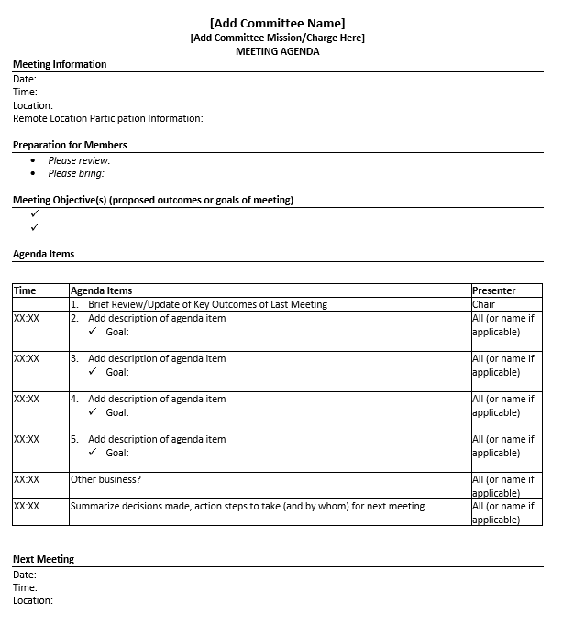
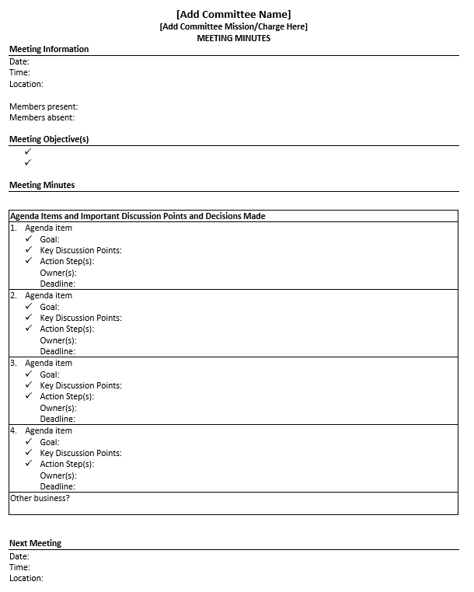
Resources: Team Meeting Agenda and Minutes Templates
Resources created by Dr. Kennel

Slide 20
Conditions
Context/environment that the team operates within
Policies and practices
Resources
Senior leadership support
Organizational and team culture
conditions x capabilities is a powerful force
Tannenbaum, S., & Salas, E. (2021). Teams that work. Oxford University Press.

Slide 21
Coaching
Leadership
Align QI projects with priorities and strategic goals
Foster psychological safety, encourage participation, empower team members
Track progress, outcomes to encourage accountability and allow for replicability
Remove obstacles and advocate for programs and resources
Develop relationships with leadership and make the team’s work visible
Ensure fidelity to QI methodologies and be willing to rigorously test and evaluate improvements
Establish clear standards and expectations for how the team will work together
Tannenbaum, S., & Salas, E. (2021). Teams that work. Oxford University Press.

Slide 22
Monitoring Team Performance
Did we achieve our goal(s)/aim(s)?
Are we satisfied with the team? Our work? Our performance?
Did we work together successfully? Are we a viable team moving forward?

Slide 23
Your Capstone Project

Slide 24
Sticky Team Issues
Not enough personnel to support QI efforts/always the same people
Multiple hats are a blessing and a curse
Be incredibly intentional when crafting roles, responsibilities, and your ask for their expertise and time
Physician engagement
IHI Engaging Physicians in a Shared Quality Agenda
Be incredibly intentional when crafting roles, responsibilities, and your ask for their expertise and time
Relationships among QI and senior leadership
Project sponsor role is key
Advocate for resources and support
Establish accountability structures to support forward progress
Reinertsen JL, Gosfield AG, Rupp W, Whittington JW. Engaging Physicians in a Shared Quality Agenda. IHI Innovation Series white paper. Cambridge, MA: Institute for Healthcare Improvement; 2007

Slide 25
Wrap Up

