Slide 1
What’s an ACO? Where does a quality team fit?
Heidi Lauenstein MSN, MBA, RN
Bryan Health Connect

Slide 2
Objectives
Participants will gain an initial or enhanced understanding of the purpose of an ACO
Participants will gain an initial or enhanced understanding of the operations of an ACO related to quality improvement efforts and performance management

Slide 3
About Bryan Health Connect
Bryan Health Connect is a physician-led Physician Hospital Organization (PHO) and Accountable Care Organization (ACO), organizations created to represent physician practices, facilities, hospitals and other providers to offer a broad, clinically and financially-integrated, high-quality, cost-effective network of providers. Bryan Health Connect represents more than 1,400 providers.
We work closely with our members, assisting them to maintain independence in an ever-changing healthcare environment, and supporting them by offering services that add value to their membership.
Mission
We connect a network of resources, innovative leadership and data to drive cost-effective population health improvement.
Vision
Leading exceptional healthcare transformation.

Slide 4
Bryan Health Connect ACO Members
Current Members
Beatrice Community Hospital & Health Center
Bryan Medical Center
Bryan Physician Network
Crete Area Medical Center
Merrick Medical Center
Saunders Medical Center
Boone County Health Center
Pender Community Hospital
Howard County Medical Center
Kearney Regional Medical Center
Antelope Memorial Hospital
Great Plains
Mary Lanning
Inpatient Physicians Associates
Supporting the process toward clinical integration

Slide 5
Bryan Health Connect ACO Members
Members starting 2025
Hart & Arndt Family Health PC
Jefferson Community Health & Life
Memorial Community Health
Midwest Independent Physician Practice Association
York Medical Clinic PC
Supporting the process toward clinical integration

Slide 6
What is an Accountable Care Organization (ACO)?
An ACO is a group of hospitals, physicians and other health care providers working together to provide improved coordinated care for their patients.
ACOs are leading the change from a volume-based care model to a
value-based one
VALUE-BASED
VOLUME-BASED
Notes:
Providers get paid based on the number of patients they see and the services they provide, rather than meaningful patient outcomes
This model can lead to repetitive tests, miscommunication or even conflicting medications and treatments
Can drive up the cost of health care
Not in the patients’ best interest

Slide 7
The Healthcare Landscape in Nebraska is Shifting
We Are Here
Notes:
JF

Slide 8
Value-Based Care
Value = Quality/Cost
A value-based care model shifts the focus to the PATIENT
Access to high quality care
A positive health-care experience
Improved outcomes and quality of life
Decrease in cost of care
Value-based healthcare is a healthcare delivery model in which providers, including hospitals and providers, are reimbursed based on patient health outcomes

Slide 9
Components of Value-Based Care (V = Q/C)
Patients
Quality Components
Access
Convenience
Satisfaction
Individual outcome
Positive interactions
Cost Components
Co-pays
Deductibles
Rx out-of-pocket
Travel time
Payers
Quality Components
HEDIS quality measures
CAHPS
Consumer Assessment of Healthcare Providers and Systems
Evidence-Based Medicine and Best Practices
Cost Components
$$$ Rx
Overutilization (lab, rad, post-acute)
ED visits
Readmissions
Out-of-network spend

Slide 10
How an ACO works…in a Nutshell
ACOs enter into value-based agreements with payers (insurance providers)
The value-based agreements include specific performance measures centered around quality and cost
There may be contracted Clinical Coordination Fees (CCF) paid quarterly to the ACO participants to offset costs incurred to operationalize improvements
If the ACO reaches the performance measures – quality scores and lowering the total cost of care – they are financially rewarded with Shared Savings
If the ACO does not meet the measures or they do not realize enough shared savings, they miss out on the savings…and possibly have to pay losses back to the payer

Slide 11
Value-Based Care: Why an ACO?
Value-based Care fosters comprehensive, coordinated care using payment models that hold organizations accountable for cost-control and quality gains
ACOs are a recognized and viable pathway to improve the health of a population utilizing value-based care arrangements with payers
ACOs support the process toward clinical integration across providers
This helps health care providers “shift” from a reactive environment to a proactive approach

Slide 12
How Does an ACO Succeed?
The Quadruple Aim
Improve the work life of all health care providers
Improve the patient experience
Improve the health of a population
Reduce the cost of care

Slide 13
Improve the Work Life of ALL Healthcare Providers Value-Based Care is NOT a Task of One

Slide 14
Improve the work life of all members of the health care team
As we focus on the goal:
Improve processes and create efficiencies in our daily delivery of care for our patients
We have the potential to:
Improve our daily work life by maximizing efficiencies that come through collaboration and teamwork
Lessen the risk of burn-out
Why we all are uniquely prepared to take on the change
Sense of Purpose
We are here because we want to make a difference in the lives of those we serve
We Value Autonomy
We want opportunities to affect the changes toward improvement
Mastery
We are driven to get better

Slide 15
Improve the Patient Experience
Highly coordinated care through:
Efficiency of electronic medical record (EMR)
Efficiency of team
Access to outside clinical data
Sharing of clinical data
Service recovery
Continuous process improvement
CAHPS for MIPS
Consumer Assessment of Healthcare Providers and Systems Survey

Slide 16
Improve the Health of the Population
Data analysis drives quality and helps improve patients’ overall care
BHC collects and analyzes data from a number of sources
Medical records
Insurance claims
Pharmacy records
Data identifies population health needs
Quality Measures
Focus on services that patients need the most, such as:
Preventive screenings
Immunizations
Disease management
Medication management
Cost Measures
The cost performance is measured against benchmarks on projected spending based on demographics and the documented risk of the patient population within the agreement

Slide 17
Value Based Care is Continuous Process Improvement
Analytics
Actions
Accountability
Assignment
Population Insights
Data Ingestion and Analytics
Attribution Management (Covered Lives)
Risk Adjustment
Top 5-10% Patient Cohort Identification
Practice and System Transformation
Clinical Workflows
Care Gap Closure Processes
Transitional & Chronic Care Management
High Risk Management
Locally Implemented
Performance Management
Dashboards, reporting

Slide 18
Reduce the Cost of Care The end goal of all we do… Making Healthcare Sustainable

Slide 19
Hospitalists and Specialists
Improved Inpatient Care Efficiency
All Providers
Improved Management of Complex Patients
Use of Lower Cost Treatments
Reduction in Adverse Events
Reduction in Preventable Readmissions
Use of Lower Cost Settings and Providers
Lower Total Cost of Health Care
Primary Care Providers
Improved Prevention and Early Diagnosis
Improved Practice Efficiency
Reduction in Unnecessary Testing and Referrals
Reduction in Preventable ED Visits and Admissions
All Providers

Slide 20
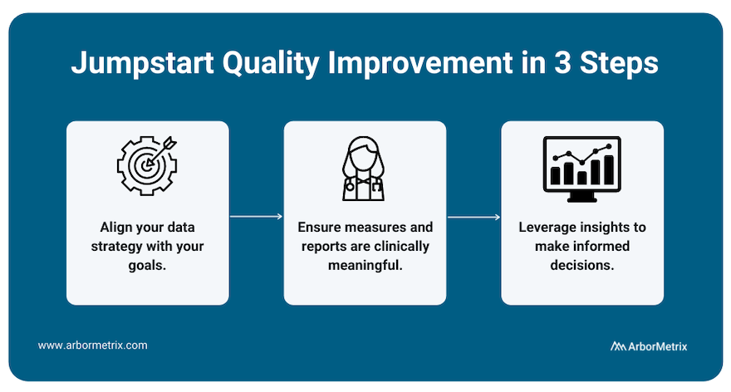
Where does quality fit in?
Notes:
So where does quality fit in? I would say all of it!
Many of our members have their quality team as their lead for ACO initiatives.
Work on practice transformation, process improvement projects, organizational goals and projects are related to ACO initiatives
Some projects; CRCS project-HM, AWV plans, eye exams with retinavue

Slide 22
We would be more than happy to visit with you!

Slide 23
Heidi Lauenstein
Value Based Care Operations Manager
Bryan Health Connect – Bryan Firethorn Campus
Mailing Adress: Office Location:
1600 South 48th St 2920 South 84th St
Lincoln, NE 68506-1299 Lincoln, NE 68506-4142
402-483-8894
Heidi.Lauenstein@bryanhealth.org

