Slide 1

The Future of Aging in Nebraska:
Challenges, Opportunities, & Innovations
nebraskahospitals.org
Dana Steiner, MSN, MBA, CPHQ
Amber Kavan, BSN, RN, CPHQ

Slide 2
Objectives
Describe the key principles of Age-Friendly Health Systems and their application across Nebraska healthcare settings.
Recognize the signs, risks, and consequences of delirium in older adults and explore evidence-based approaches to prevention and management.
Explore innovative models and collaborative efforts addressing the evolving needs of Nebraska’s aging population.

Slide 3
Age-Friendly CMS Measures Approved
Structural Measures: CMS expects that by attesting to these measures, hospitals will develop evidence-based programs and processes to support improvements in high impact areas.
Hospitals must attest to activities within the 5 domains deemed essential to providing clinical care to patients over 65 years old.
Each domain is worth one point, for a total of five (5) points. The hospital must meet each element within a domain to receive a point. No partial credit is given within the domain.

Slide 4
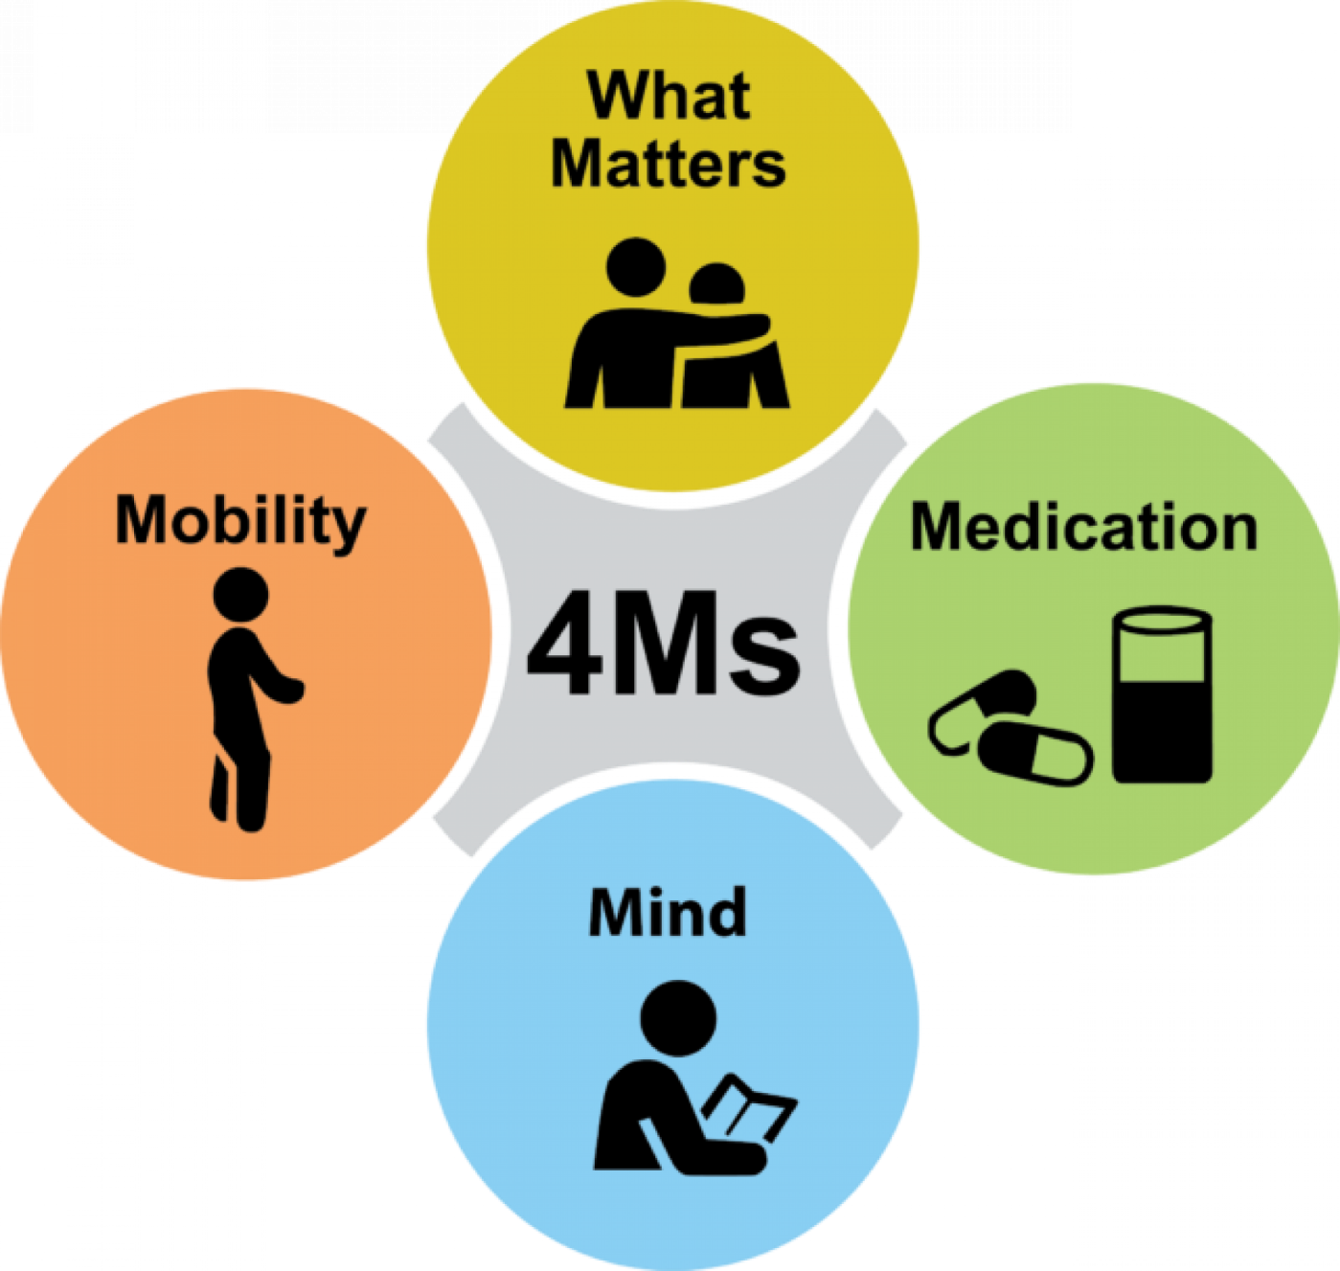
Age-Friendly CMS Measures Approved
Beginning in 2025, as part of the IQR program, hospitals will be required to report on protocols in place to:
Elicit patient health care goals, (What Matters?)
Responsibly manage medications, (Medication)
Implement frailty screening and intervention (including cognition and mobility), (Mobility and Mentation)
Assess social vulnerability (e.g. social isolation, caregiver stress, elder abuse),
Designate Age-Friendly leadership
Notes:
434 July 1, 2024

Slide 5
Diving into the 4Ms…
What Matters?
Elicit patient health care goals.
Established protocols are in place to ensure patient goals related to healthcare (health goals, treatment goals, living wills, identification of healthcare proxies, advance care planning) are obtained/reviewed and documented in the medical record. These goals are updated before major procedures and upon significant changes in clinical status.

Slide 6
Diving into the 4Ms…
Medication
Responsibly manage medications.
Medications are reviewed for the purpose of identifying potentially inappropriate medications (PIMs) for older adults as defined by standard evidence-based guidelines, criteria, or protocols. Review should be undertaken upon admission, before major procedures, and/or upon significant changes in clinical status. Once identified, PIMS should be considered for discontinuation, and/ or dose adjustment as indicated.

Slide 7
Diving into the 4Ms…
Mobility and Mentation
Implement frailty screening and intervention – including cognition and mobility
Patients are screened for risks regarding mentation, mobility, and malnutrition (ideally upon admission, before major procedures, and/or upon significant changes in clinical status).
Positive screens result in management plans including minimizing delirium risks, encouraging early mobility, and implementing nutrition plans where appropriate. The plans should be included in discharge instructions and communicated to post-discharge facilities.
Data is collected on the rate of falls, decubitus ulcers, and 30-day readmissions for patients >65. Data is stratified by demographic and/or social factors.
Protocols exist to reduce the risk of emergency department delirium by reducing length of emergency department stay with a goal moving older patients out of the ED within 8 hours of arrival and/or within 3 hours of the decision to admit.

Slide 8
Diving into the 4Ms…
Assess social vulnerability (e.g. social isolation, caregiver stress, elder abuse)
Older adults are screened for geriatric specific social vulnerability including social isolation, economic insecurity, limited access to healthcare, caregiver stress, and elder abuse.
The assessments are performed on admission and again prior to discharge.
Positive screens for social vulnerability are addressed through intervention strategies: appropriate referrals and resources for patients upon discharge.

Slide 9
Diving into the 4Ms…
Designate Age-Friendly Leadership:
Our hospital designates a point person and/or interprofessional committee to specifically ensure age friendly care issues are prioritized to oversee quality related to older patients, identify opportunities to provide education to staff, and update hospital leadership on needs related to providing age friendly care.
Our hospital compiles quality data related to the Age-Friendly Hospital measures. Data is stratified by demographic and/or social factors and should be used to drive improvement cycles.

Slide 10
Why Age-Friendly Metrics are Important…
nebraskahospitals.org

Slide 11
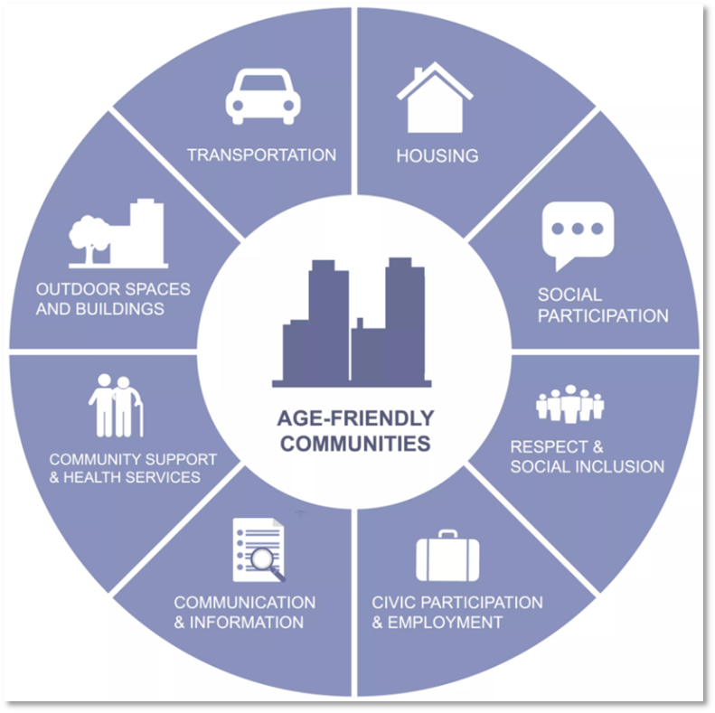
It’s All Connected…
Guide improvements in care and services
Promote health equity
Enhance quality of life
Support policy and funding decisions
Enable benchmarking and accountability
Facilitate person-centered care
It takes a Village!

Slide 12
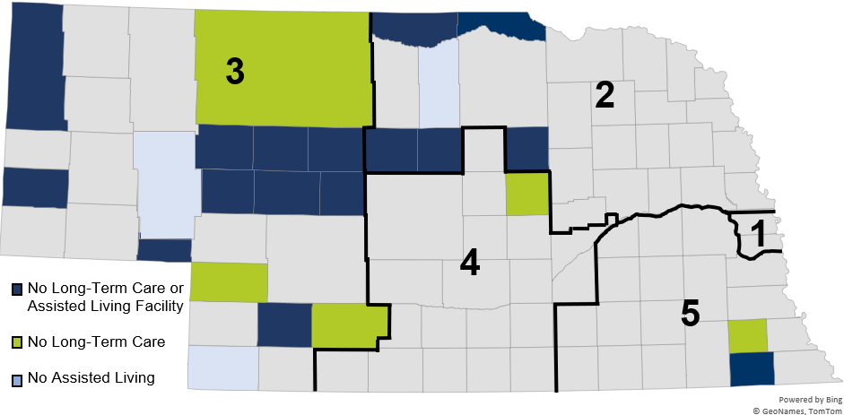
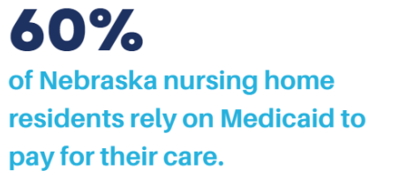
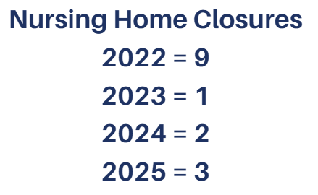
We are in Trouble…

Slide 13
We are in Trouble…
According to the 2023 Status of the Nebraska Healthcare Workforce Report…
47.8%
Physicians
50 +
22.4%
PAs
50 +
26.8%
APRNs
50 +
36.5%
RNs
50 +
11.6%
Physicians
65 +
2.4%
PAs
65 +
5.2%
APRNs
65 +
10.1%
RNs
65 +
https://www.unmc.edu/publichealth/_documents/healthcare-workforce-2024.pdf

Slide 14
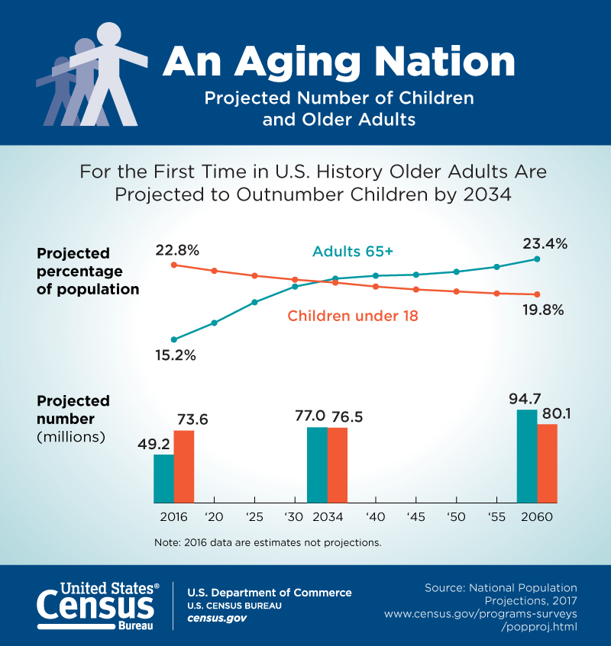
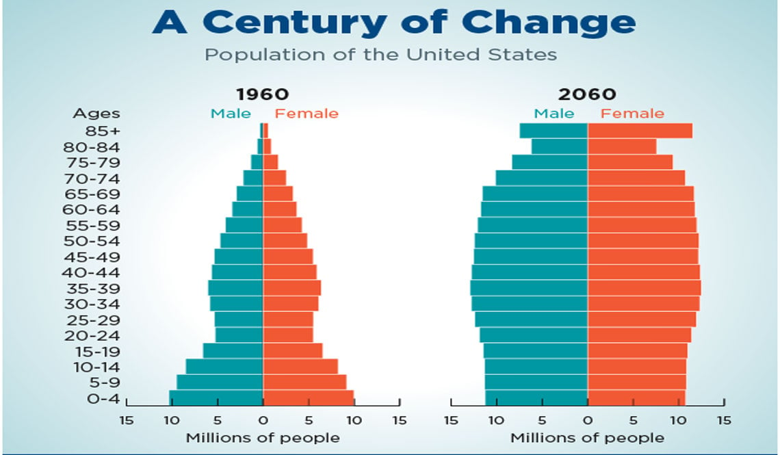
Our Country is Aging

Slide 15
Nebraska is Aging
Percent of Nebraska’s total population age 50 and older
5.6%
age
50 - 54
6.0%
age
55 - 59
6.2%
age
60 - 64
5.5%
age
65 - 69
4.4%
age
70 - 74
2.7%
age
75 - 79
1.8%
age
80 - 84
1.9%
age
85+
Making up 34.1% of the total population
43% live in non-metro counties
33% live in metro counties
https://dhhs.ne.gov/Reports/UNO%20State%20Aging%20Plan%20Report%20-%202022.pdf

Slide 16










Top 5 Concerns of Aging Nebraskans
85.2%
Health Care
72.1%
Financial Security
64.2%
Having enough
food to eat
59.7%
Affordable and accessible housing
56.4%
Programs to help persons with dementia and their families
https://dhhs.ne.gov/Reports/UNO%20State%20Aging%20Plan%20Report%20-%202022.pdf

Slide 17
Aging in Place
Most Nebraskans age 65 and older live in the same home as they did the year prior (93%), suggesting many in Nebraska choose to age in place.
nebraskahospitals.org
Source: U.S. Census Bureau, American Community Survey 2020

Slide 18
What is Aging in Place
‘Aging in place’ is the ability to remain in one's own home and community as one ages, with access to the necessary support and services to maintain quality of life.
According to AARP (2018) – 86% of adults age 65+ reported wanting to stay in their own homes as long as possible.
Aging in place is a necessary option, as the population continues to age – and post-acute availability continues to create barriers to placement.

Slide 19
Why Age in Place?
Safe alternative to placement in a post-acute setting.
Links to several health benefits:
Improved quality of life
Reduced health care costs
Decrease stress of moving
People with functional limitations and chronic conditions are 4x more likely than the general population to be among the 5% costliest users of health services.
Yet function is rarely addressed at medical visits

Slide 20
Barriers to Aging in Place
Lack of formal programming to support safety and well-being
Homes are not prepared for declines in mobility and other health needs
Loneliness
Financial constraints

Slide 21
Ideas to Promote Aging in Place
Formal programming – CAPABLE
Home visits – nursing, occupational therapy, physical therapy
Assistance with ADLs
Help create a safe living space
Assess changes in needs before crisis

Slide 22
CAPABLE
Person-direct, home-based program that addresses function, safety, and healthcare
4-5 month program that integrates services from PT/OT, RN and ADL support.
Set goals
Direct action plans
Change behaviors to improve health, independence, safety
Participants learn new skills, exercises, and new tools / equipment to improve function and safety
Focuses on prevention and problem-solving, building skills to drive long-term independence.
Community Aging in Place—Advancing Better Living for Elders (CAPABLE) - Johns Hopkins School of Nursing
CAPABLE National Center
CAPABLEinfo@capablenationalcenter.org

Slide 23
Hospital-at-Home Model
H@H
nebraskahospitals.org

Slide 24
What is Hospital-at-Home Model?
Patients receive acute level care in their homes, rather than in a hospital
Innovative and promising approach to provide high quality care to patients in the comfort of their homes
Well suited for medium acuity patients who need hospital-level care but are considered stable enough to be safely monitored from home.
Rather than staying in the hospital, these patients can be treated safely by their doctor and a team of medical professionals along with the patient’s support system at home.

Slide 25
History of Hospital-at-Home Model
Started in the US in 2020 – CMS passed Acute Hospital Care at Home Individual Waiver (AHCaH) – part of COVID 19 Public Health Emergency.
Since the start of the program, Congress has extended it three times:
#1: 2022 (Consolidated Appropriations Act of 2023) for 2 years;
#2: 2024 (H.R. 10545, the American Relief Act) for 90 days;
#3: 2025 (H.R. 1968, the Full-Year Continuing Appropriations and Extensions Act) for 6-months.
Expired Sept. 30, 2025

Slide 26
What is Next for Hospital-at-Home Model?
The AHA supports the Hospital Inpatient Services Modernization Act (H.R. 4313 / S.2237) introduced in the House.
The bill extends the H@H waiver for five years through the end of 2030 and directs the CMS to conduct a new study of the program.
To receive approval to participate in the H@H program, hospitals must submit an individual waiver request to CMS.
Asks CMS to waive §422.23(b) and (b)(1) of the Medicare CoPs, which require nursing services to be provided on premises 24 hours/day, 7 days/week, as well as the immediate availability of a registered nurse for the care of any patient.
As of July 2025, 400 hospitals across 142 systems and 39 states had been approved to provide H@H services to patients.

Slide 27
H@H Outcomes:
October 2024, CMS released a report showing H@H is a safe, effective program.
Lower mortality rates,
Lower readmission rates,
Lower spending in the 30 days post-discharge.
Patients and caregivers expressed positive experiences with the program.
H@H patients are more likely to be white and live in an urban location and less likely to receive Medicaid or low-income subsidies:
Attributed to the variability in state Medicaid coverage of H@H programs.
As of June 2024, only 12 states provide Medicaid coverage for H@H.

Slide 28
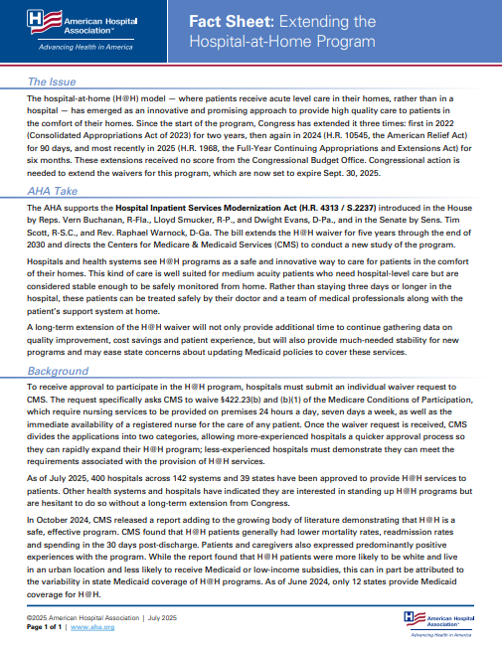
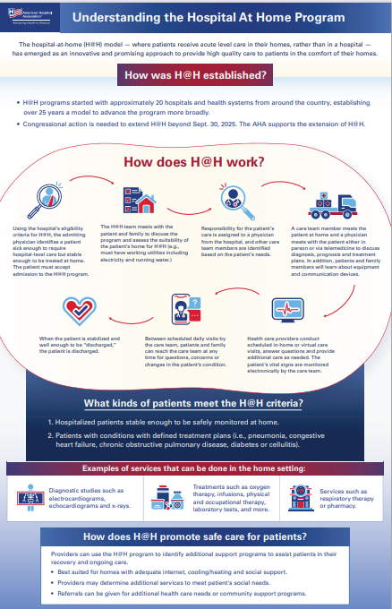
Fact Sheet: Extending the Hospital-at-Home Program | AHA

Slide 29
The Importance of Socialization in the Aging Population
nebraskahospitals.org
29% of Nebraskans 65+ reported being lonely in the past 4 weeks.
https://news.unl.edu/article/survey-younger-unemployed-nebraskans-more-likely-to-report-loneliness

Slide 30
Hospital Elder Life Program (HELP)
Delirium = Loss of independence, strength and new confusion are frequent outcomes of hospital stays for elderly patients.
Research shows that functional and cognitive decline occur in up to 50% of hospitalized older people → these declines can be prevented.
The Hospital Elder Life Program (HELP) has been successful in returning older adults to their homes or previous living situations with maintained or improved ability to function.

Slide 31
Hospital Elder Life Program (HELP)
HELP utilizes specific interventions and specially trained volunteers to keep older people oriented to surroundings, mobile within their limitations while meeting their needs of nutrition, hydration and sleep.
Through a screening process a specific “care plan” is created, listing specific interventions for volunteers to carry-out to keep the mind and body as active as possible during hospitalization.
Interventions include:
Regular orientation, socialization and mental stimulation
Therapeutic activities — friendly visiting, newspaper, cards, word puzzles
Promotion of regular exercise / mobility
Encouragement and set-up for meals and fluids
Promotion of healthy sleep

Slide 32
Wisdo Health
A clinically-proven and AI-powered social health and peer support platform.
Social health and the presence of supportive human connections are critical components of health.
The platform addresses loneliness and isolation which affect nearly 1/2 of U.S. adults, drive significant costs, and were declared a public health crisis by the U.S. Surgeon General.
Loneliness is linked to higher rates of:
Heart disease
Stroke
Dementia
Depression
Anxiety
Suicidal ideation
Addressing social health is vital for improving outcomes and ensuring individuals seek and sustain care.
Backed by peer-reviewed research, Wisdo showed improvements in health outcomes, including reductions in loneliness and depression of up to 28%, alongside measurable gains in quality of life.
https://www.businesswire.com/news/home/20251006563968/en/

Slide 33




Connecting Through Service
Who is lonely in Nebraska?
1 in 6 Nebraskans
40% of unemployed
30% of unmarried individuals
52% earning less than $50,000 annually
Finding purpose
Volunteering
Increases social interactions
Helps relationship building
Makes a positive impact
Strengthens community
https://preec.unl.edu/news/connecting-through-service-how-volunteering-can-combat-loneliness-nebraska/
Notes:
A recent survey conducted by the University of Nebraska–Lincoln's Bureau of Sociological Research highlights the prevalence of loneliness among Nebraskans

Slide 34
Keys to Supportive Care for Elderly Patients
nebraskahospitals.org

Slide 35
Incidence of Delirium in Health Care Settings
Setting | Incidence (%)
ICU | 19% - 82%
Medical Service | 11% - 29%
Nursing Home | 20% - 22%
Palliative Care (Inpatient) | 3% - 45%
Post-Operative | 11% -51%
Delirium in the Hospital
Predisposing Factors
Age 65+
Participating Factors
Burns
Delirium-Inducing Medications
Analgesics
Hospitalized
Multiple co-morbidities
Polypharmacy
Poor functional status
Sensory deprivation
Terminally ill
Chronic heart, kidney, liver, or lung disease
Dementias/degenerative disorders
Dialysis-dependent
Malnutrition
Psychiatric conditions
Substance use disorder
Dehydration
Hypoxia
Infection
Ischemia
Medication Adverse Effects
Metabolic disturbances
Seizures
Sever Illness
Shock
Sleep deprivation
Surgery/anesthesia
Tethers (catheters, restraints)
Trauma (fractures, head injury)
Uncontrolled pain
Urinary or stool retention
Withdrawal from alcohol, illicit drugs, or benzodiazepines
Antiarrhythmics
Antibiotics
Anticholinergics
Anticonvulsants
Antidepressants
Antihistamines
Antihypertensives
Antipsychotics
Antivirals
Corticosteroids
Dopamine agonists
Gastrointestinal agents
Herbal supplements
Hypnotics and sedatives
Hypoglycemic agents
Muscle relaxants

Slide 36
Delirium in the Hospital – Clinical Recommendations
The Confusion Assessment Method (CAM) is the most accurate tool for diagnosing delirium in adults.
The Hospital Elder Life Program (HELP) is a multidisciplinary strategy that addresses sleep hygiene, cognitive impairment, immobility, visual and hearing impairment, and dehydration and should be used to prevent delirium.
Medications should not be used for the prevention of delirium in hospitalized patients.

Slide 37
Delirium Reduction Strategy
The ESCAPE Bundle: evidence-based program designed to reduce delirium in hospitalized patients:
Early Mobilization: Encouraging patients to move around to prevent falls and improve mobility.
Sunlight and Sleep: Ensuring adequate light exposure and rest to support cognitive function.
Constant Reorientation: Regularly reminding patients of their surroundings and time to maintain awareness.
Avoiding Stimulants: Reducing exposure to stimulants that can exacerbate delirium.
Pain Control: Addressing pain effectively to minimize agitation and confusion.
Effective Communication: Ensuring clear and respectful communication to enhance patient understanding and safety.

Slide 38
Keep Moving… Safe Mobility Programs
Integrates strategies to promote movement while preventing harm from immobility and falls.
Key goals include:
Maintaining function
Preventing complications like pressure injuries and blood clots
Improving the overall patient experience by supporting independence and reducing hospital stays

Slide 39
Components of a Safe Mobility Program
Early and Progressive Mobility: Implementing protocols that encourage early out-of-bed activity and gradually increasing intensity.
Patient-Centered Assessment: Evaluating an individual's functional status, "What Matters?" to them, and developing an individualized care plan to promote safe mobility.
Assistive Devices: Using equipment to reduce manual stress on caregivers and ensure safe patient transfers.
Team-Based Approach: Involving interprofessional teams to implement mobility protocols, train staff, and identify patient needs.
Environmental Safety: Modifying the hospital environment to minimize fall risks.
Monitoring and Evaluation: Regularly assessing patient mobility, tracking outcomes like functional decline and length of stay.

Slide 40
Benefits of a Safe Mobility Program
Prevention of Functional Decline: Counteracts the rapid muscle loss and weakness that occurs from immobility, which can begin within 48 hours of admission.
Reduced Complications: Decreases the risk of hospital-acquired conditions like pressure injuries, blood clots, and cognitive decline / delirium.
Improved Patient Experience: Fosters mental health, confidence, and independence, leading to a better quality of life during and after hospitalization.
Reduced Hospitalization Costs: Shorter hospital stays and fewer readmissions contribute to lower healthcare costs.
Improved Staff Safety: Reduces the musculoskeletal injuries common among healthcare workers who perform manual patient handling.

Slide 41
What’s Next?
The U.S. and the Nebraska population is getting older –patients and providers
There are fewer resources available to support the older adults
Call to Action – think outside of the box, implement new programming, ensure that patients 65+ years old get the care that they deserve.

Slide 42
THANK YOU!
Questions???
nebraskahospitals.org

