Slide 1

Surviving the Epidemic of Administrative Harm
There are no solutions, only tradeoffs. ~Tomas Sowell
Nathan Kaufman, Managing Director
Kaufman Strategic Advisors, LLC &
Matterhorn Strategic Advisors Investment Banking
Kaufman Strategic Advisors, LLC
11440 West Bernardo Ct., Suite 155
San Diego, CA 92127
(858) 487-9771
N8@KaufmanSA.com www.KaufmanSA.com

Slide 2

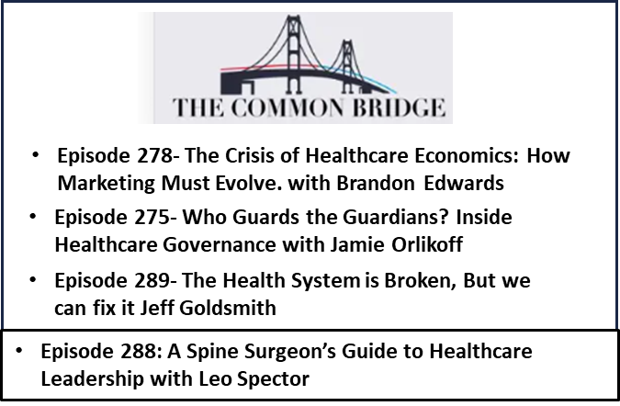
N8
Executive in Residence @ Health System:
Ortho/spine & Imaging Service Lines
HBP Contracts
JVs: Imaging ASCs
Co-Management
Managed Care Strategy
Expert Witness: Managed Care & Physician Compensation Disputes
Physician-Hospital Transactions
Traditional Consulting, aka Carpet Bombing
Partner Matterhorn Investment Advisors
Large Transactions
JV Home Health
JV Behavioral
JV Oncology groups
Aetna: $5 per month
Anthem: $330 per month
M. Cuban: $20 per month
LinkedIn’s ‘Kranky Kontrarian’
https://www.linkedin.com/in/nathan-n8-kaufman-07b8a03/

Slide 3

The Epidemic of “Administrative Harm”
Administrative Harm
The harm caused by administrative decisions that negatively impact patient care, outcomes, professional practice, and organizational efficiencies (and physician longevity).
Identifying and Measuring Administrative Harms Experienced by Hospitalists and Administrative Leaders | Hypertension | JAMA Internal Medicine | JAMA Network
Administrative
Harm
Insurance Cartels:
Delays, Denials * You are gambling with her Life
Health Plans have turned Hospitals and Physicians into Sub-Prime Lenders (forced to provide loans w/no collateral)
Health System Bureaucracy & EMR
Government
Venture-Funded
Academics
*https://www.propublica.org/article/mental-health-insurance-denials-unitedhealthcare-cigna-doctors?utm_source=sailthru&utm_medium=email&utm_campaign=majorinvestigations&utm_content=feature

Slide 4

How Decisions are Made in Many Health Systems
‘DRIs’: Antidote for Matrix Organizations
(Directly Responsible Individual)
The DRI is explicitly named as the sole owner of results, authority, and conflict resolution for their assigned area, ensuring zero ambiguity about responsibility
~Steve Jobs

Slide 5


Is Your Health “System” Driven by
Performance or Process? – Facts or Opinions?
When you optimize individual parts of a system in isolation, you can unintentionally make the overall system perform worse.
Supply Chain vs. Operations
“A bee that is watched will work harder…”
https://badbeekeepingblog.com/2016/03/02/dr-seuss-b-day/

Slide 6
Leadership:
"Management is doing things right. Leadership is doing the right things.“ Peter Drucker
Allocation of finite resources to get the greatest return.
Attract and retain the best human capital
Promote a culture focused on achieving results
Obtain and use the best information
Trade-offs
Cost
Access
Quality
From Prof. G “Raging Moderates” Podcast

Slide 7
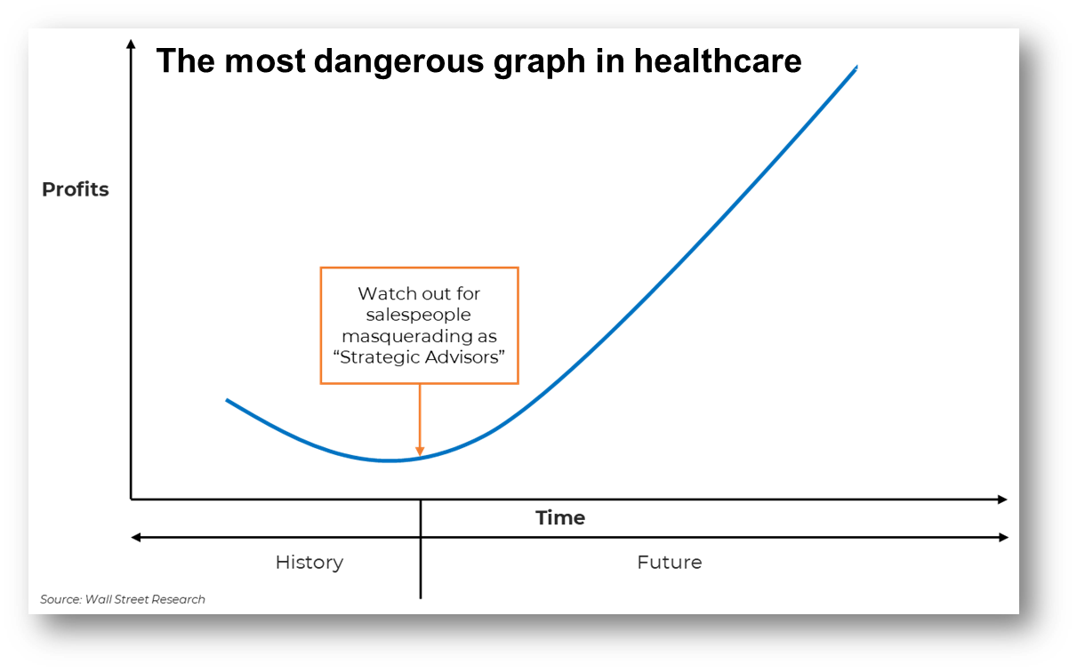
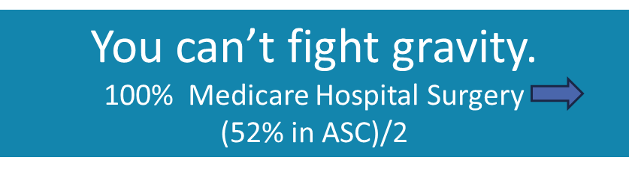
More fiction has been created in Excel than in literature.
Theme: Hope is Not a Strategy
Value
At times of great change and uncertainty, people look for simple solutions to complex problems and thus are incurably susceptible to panacea peddlers., ~Russell L. Ackoff
Volume

Slide 8
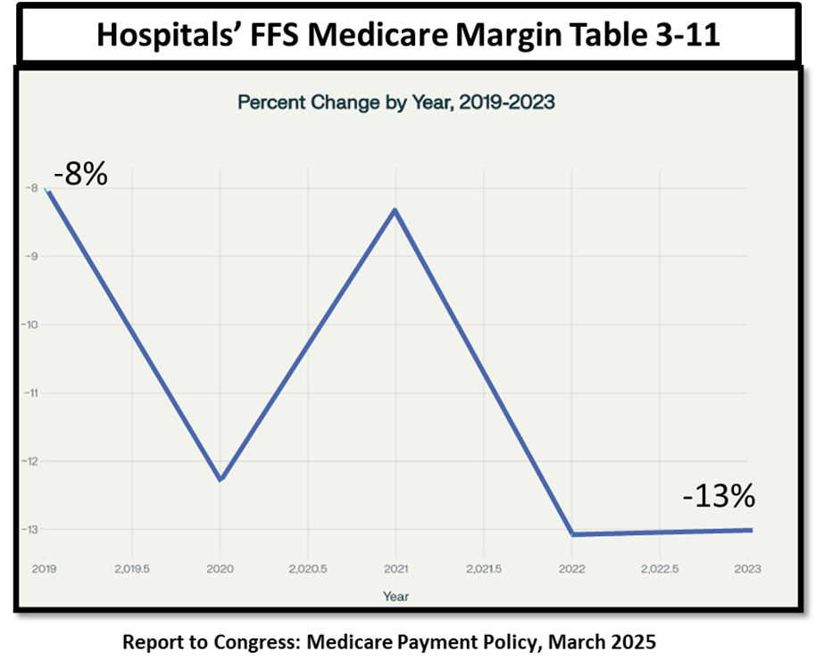
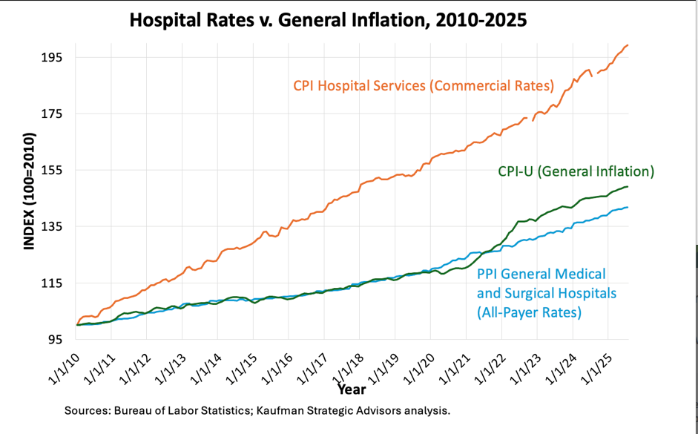
Government Underfunding is a Key Driver of the Healthcare Crisis
Traditional Medicare

Slide 9
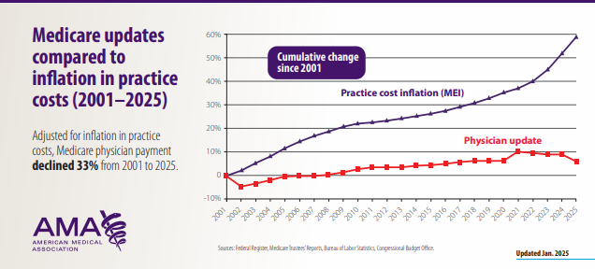
Government Underfunding is a Key Driver of the Healthcare Crisis

Slide 10
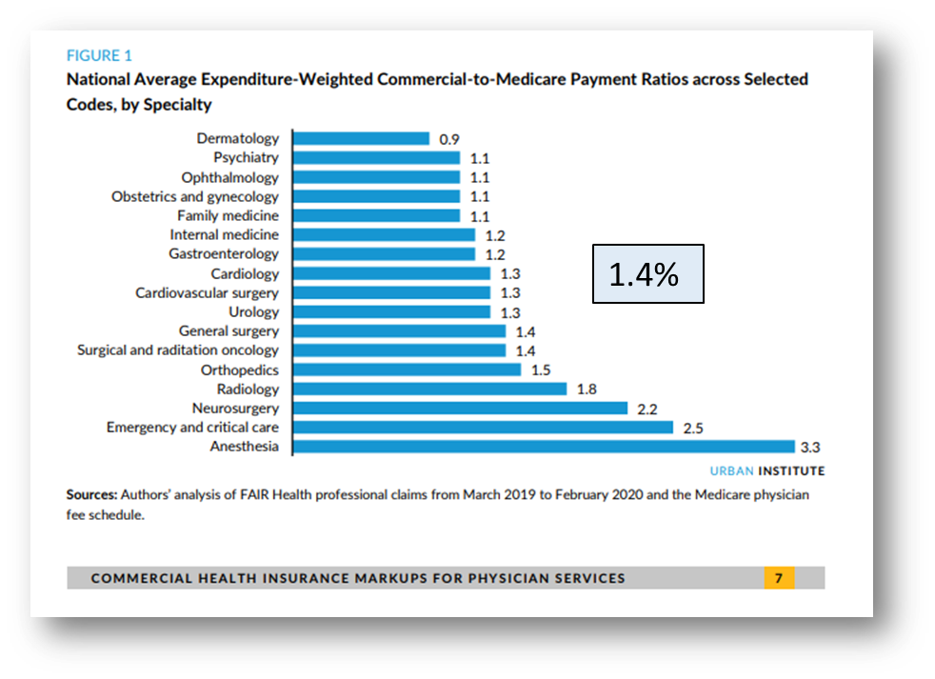

Commercial Insurance Shadow-Prices Medicare
On average, physician practices complete 39 prior authorizations per physician per week, requiring 14 hours of physician and staff time combined.

Slide 11
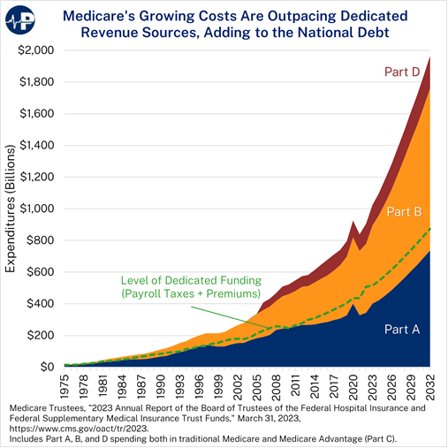
“There are No Solutions, Only Trade-offs.” ~Tomas Sowell
Premiums
Payroll Taxes

Slide 12
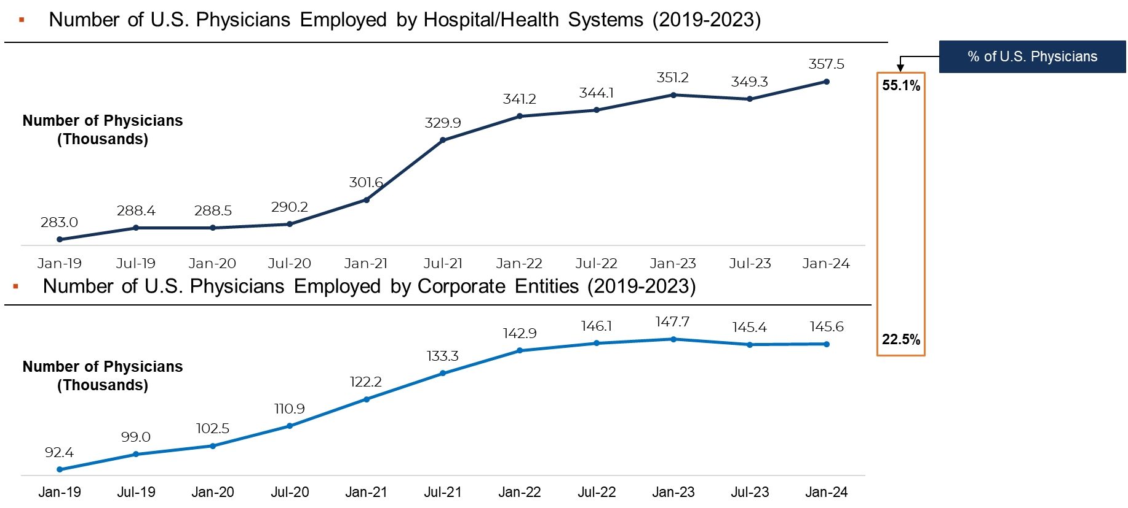
Is Physician Employment a Disruptive Strategy or a Flight to Safety?
Primary Drivers for Physicians Seeking Hospital Employment*
Higher payment rates with payers
Payers’ regulatory and administrative processes
Ability to recruit
Cyber
*Source: Policy Research Perspectives, Recent Changes in Physician Practice Arrangement: Shifts Away from Private Practice and Towards Larger Practice Size Continue Through 2022 AMA (ama-assn.org), Wall Street Research
PAI Updated Report: Hospital and Corporate Acquisition of Physician Practices and Physician Employment 2019-23 April 2024 by Avalere

Slide 13
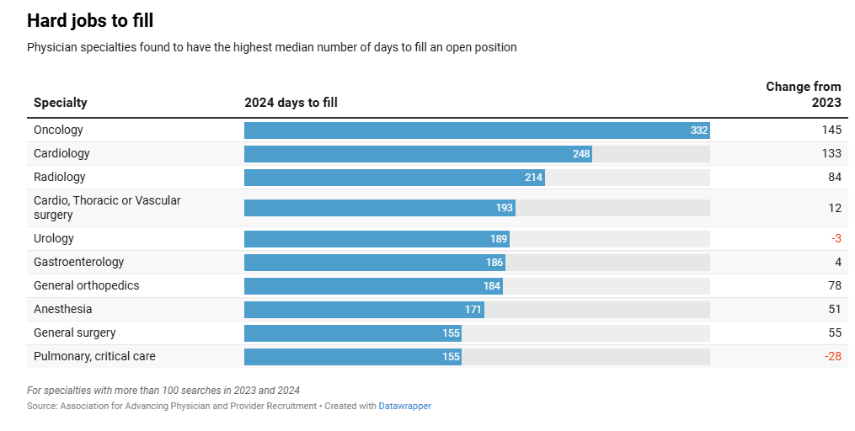
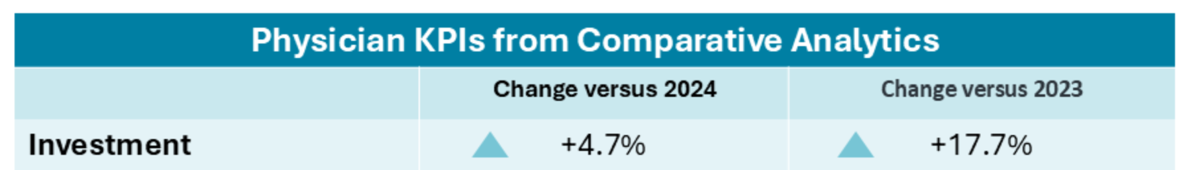
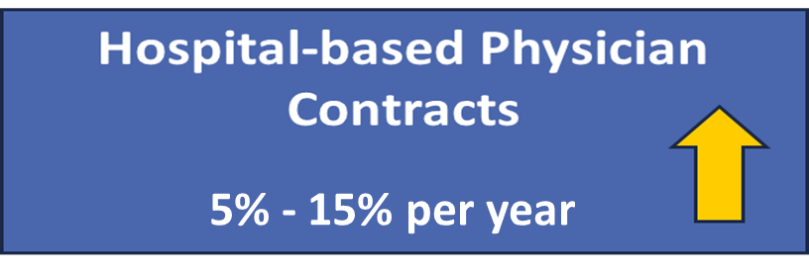
Is Physician Employment a Disruptive Strategy or a Flight to Safety?
Investment per physician full-time equivalent (FTE) reached $326,199
https://www.stratadecision.com/monthly-healthcare-industry-financial-benchmarks
If my practice were paid at Medicaid rates, I would qualify for Medicaid!

Slide 14
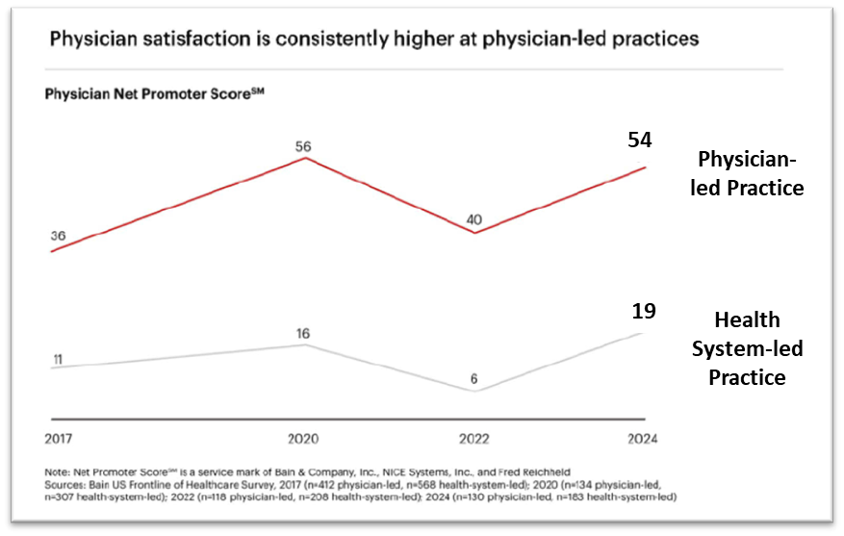
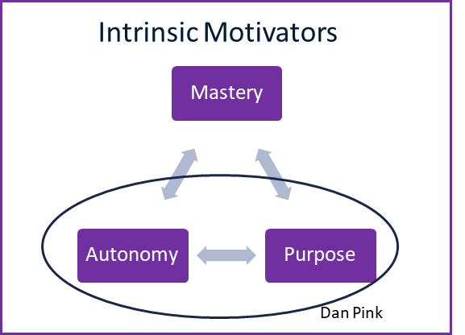
The Critical Balance of Physician Satisfaction
Boosting Physician Satisfaction: Lessons from Physician-Owned Practices | Bain & Company

Slide 15

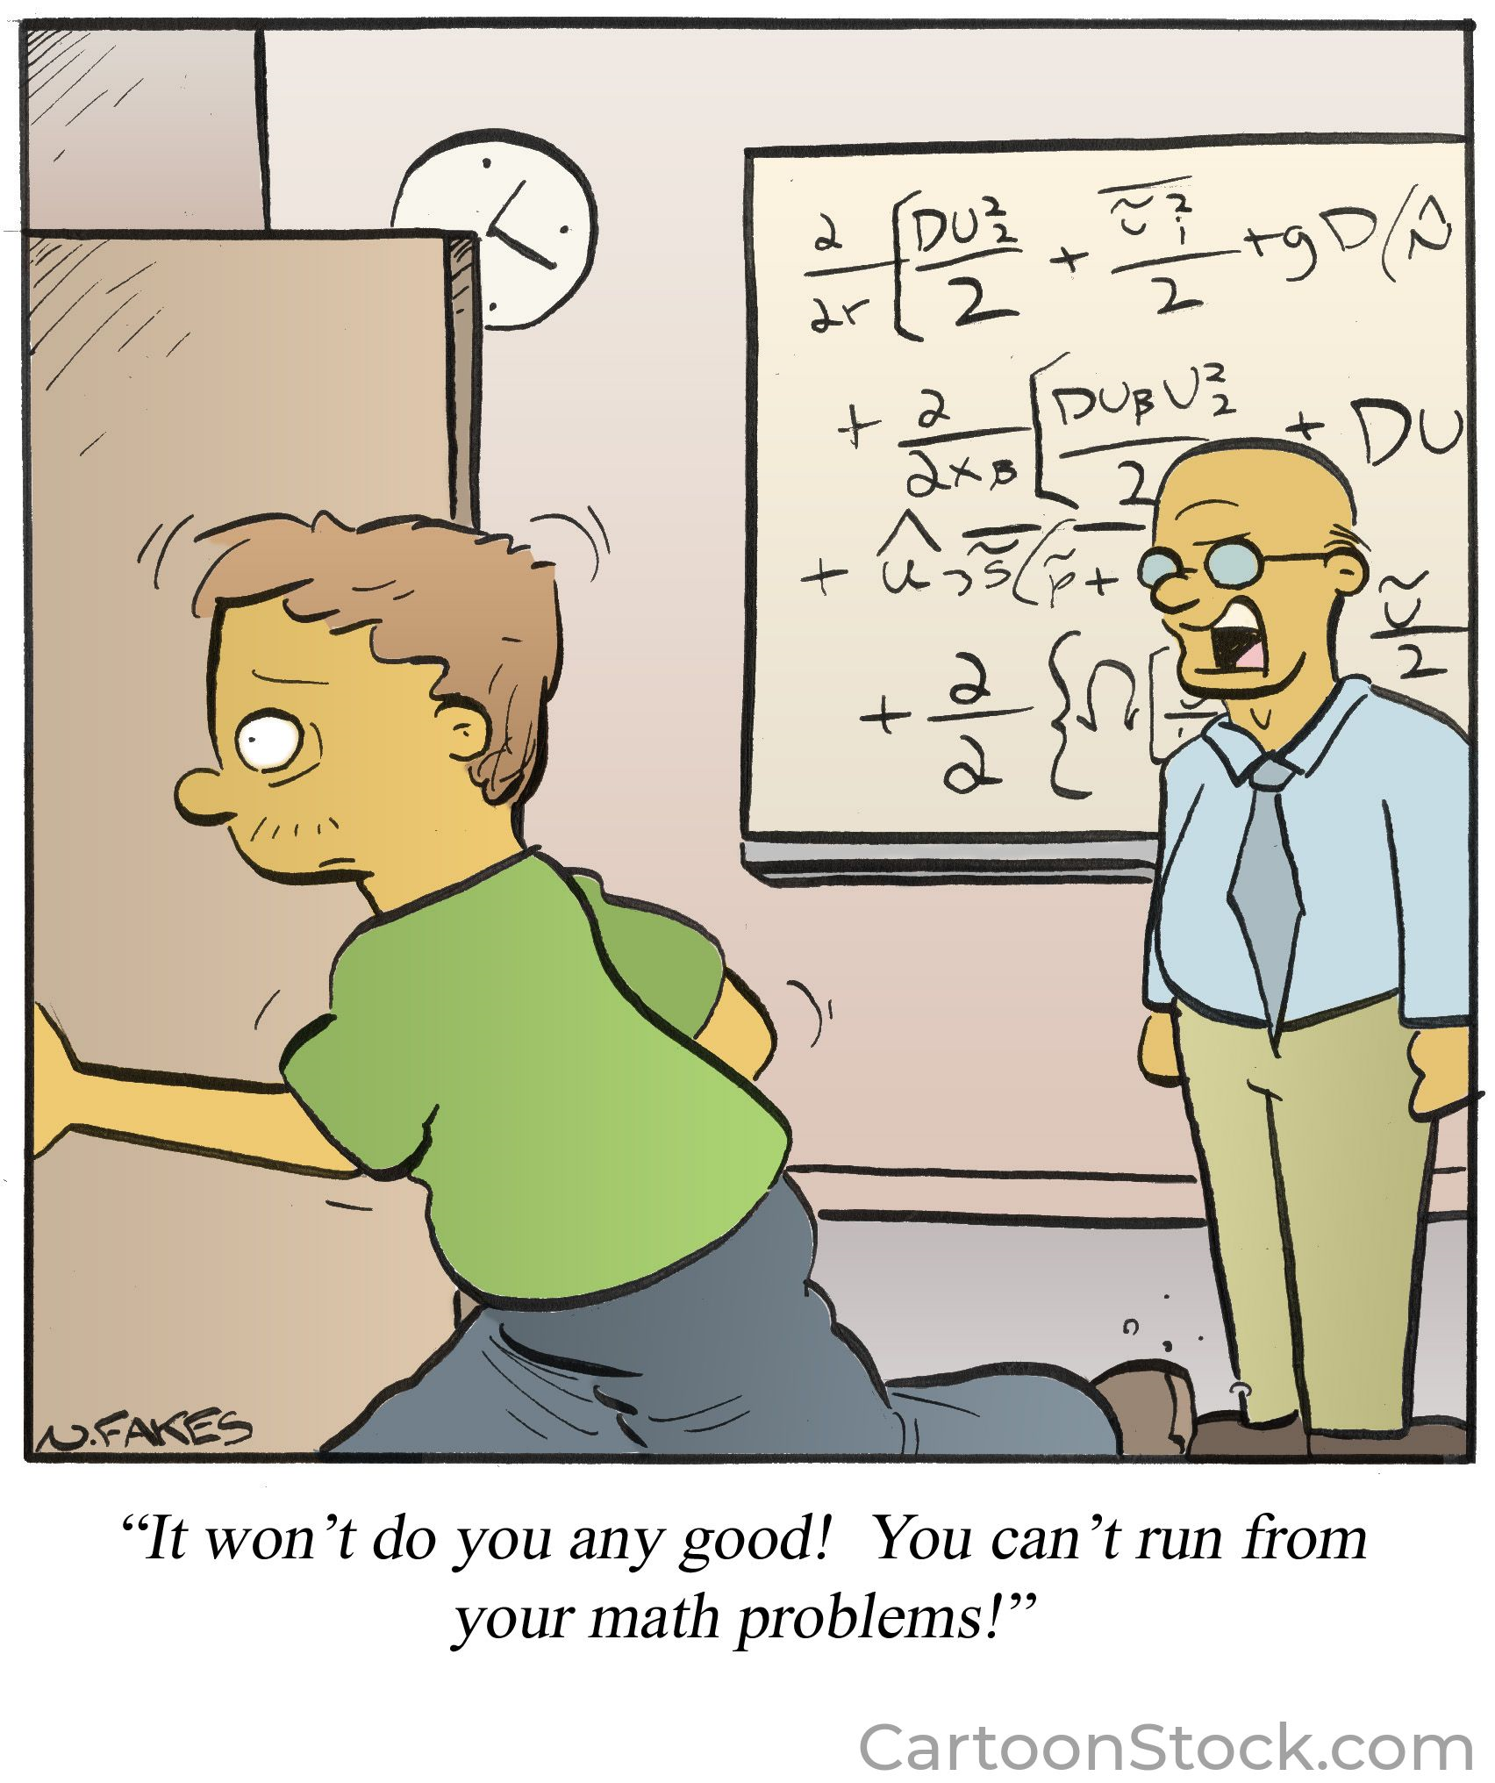
The Industry-Wide Universal Equation Requires a Local Solution
Physician Compensation
Revenue – Expenses = Survival (or Better)
((Volume x Price) + Philanthropy)
(Personnel + Supplies + Capital)
(Producing superior outcomes, access and
maintaining the dignity of patients)

Slide 16
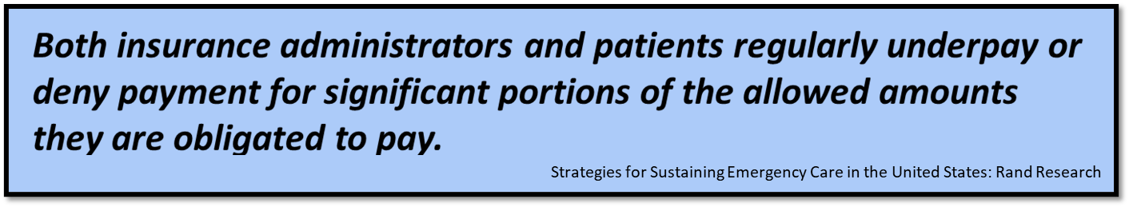
Commercial Insurance Negotiations
?
?
?

Slide 17
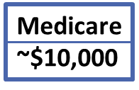
Dare to Compare
170%
210%
280%
345%

Slide 18
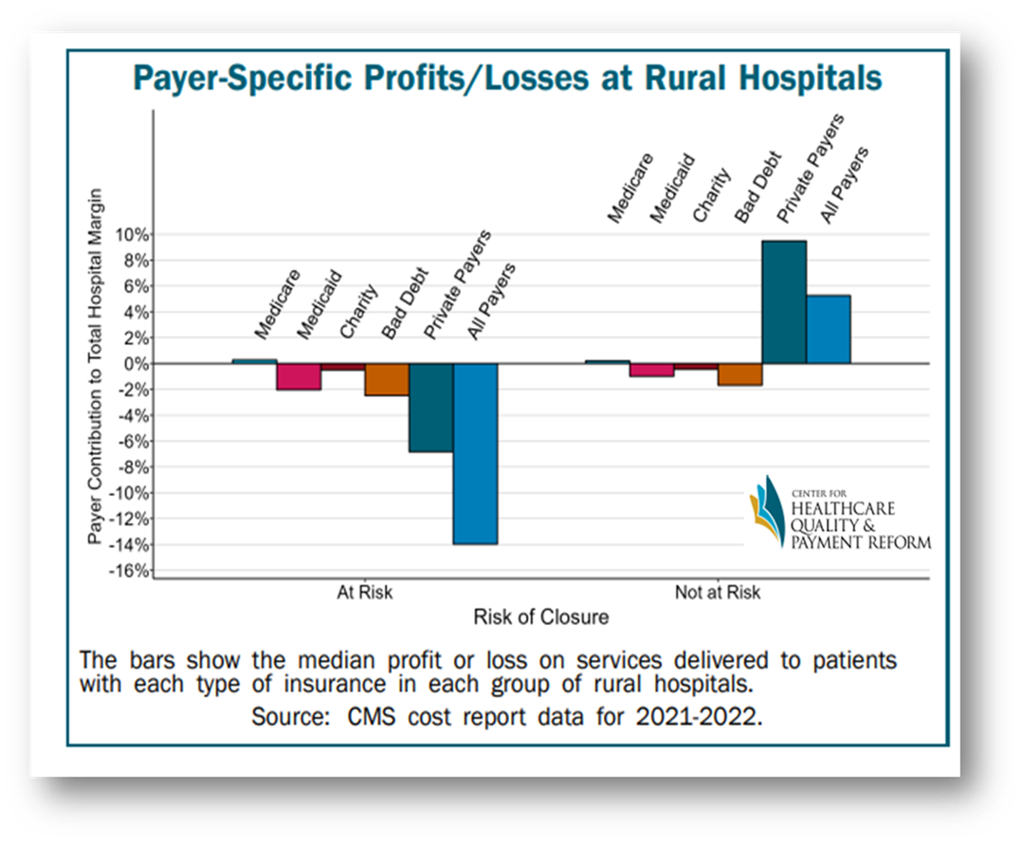
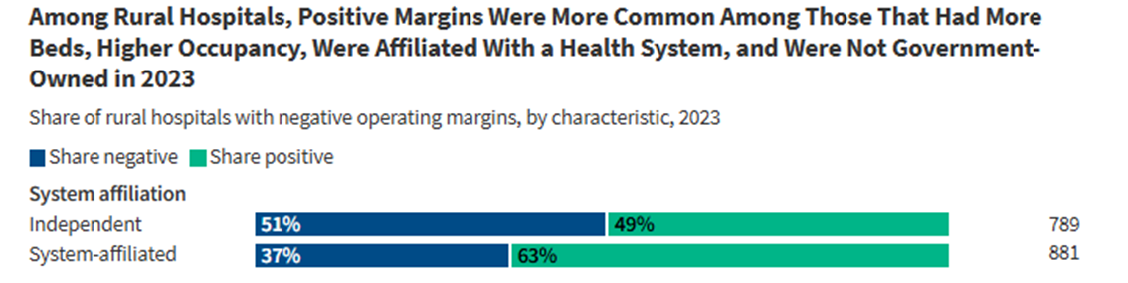
Private Insurance Plans are Paying Rural Hospitals Less
10 Things to Know About Rural Hospitals | KFF

Slide 19
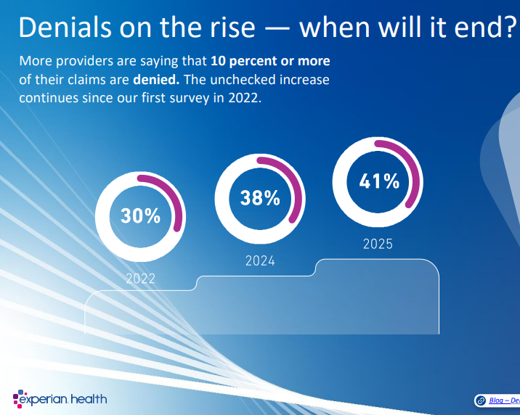
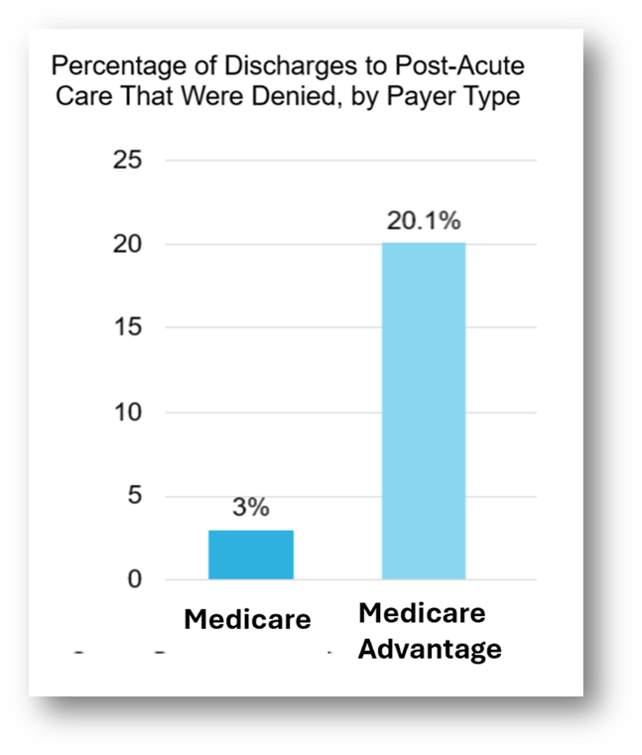
Has the Journey to Value Taken a Wrong Turn?
Medicare Advantage payments are yielding
critical-access hospitals 20% to 35% less than traditional Medicare for the same service.”¹
(1)Scott Taylor, administrator of Ozarks Community Hospital in Gravette, Arkansas MHC 1228/2023
https://premierinc.com/newsroom/blog/trend-alert-private-payers-retain-profits-by-refusing-or-delaying-legitimate-medical-claims
file:///C:/Users/n8/Documents/Dropbox/6.5%20DB%20Research/Denials%20-%20Premier/state-of-claims-2025.pdf

Slide 20
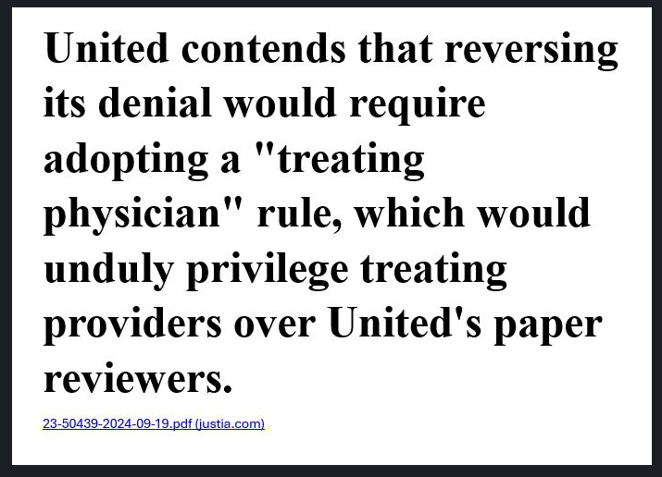
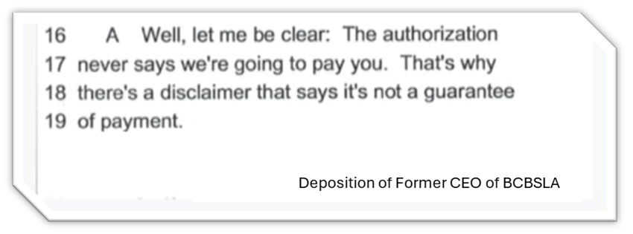
The Value-Scam Exposed
At Duke, we employ 236 people full-time to appeal all denials from payors…
Duke Health CEO's 'significant concerns' about UnitedHealthcare contract (beckershospitalreview.com)
Blue Cross Defrauded Breast Cancer Center, Must Pay $421M, Jury Finds — ProPublica

Slide 21
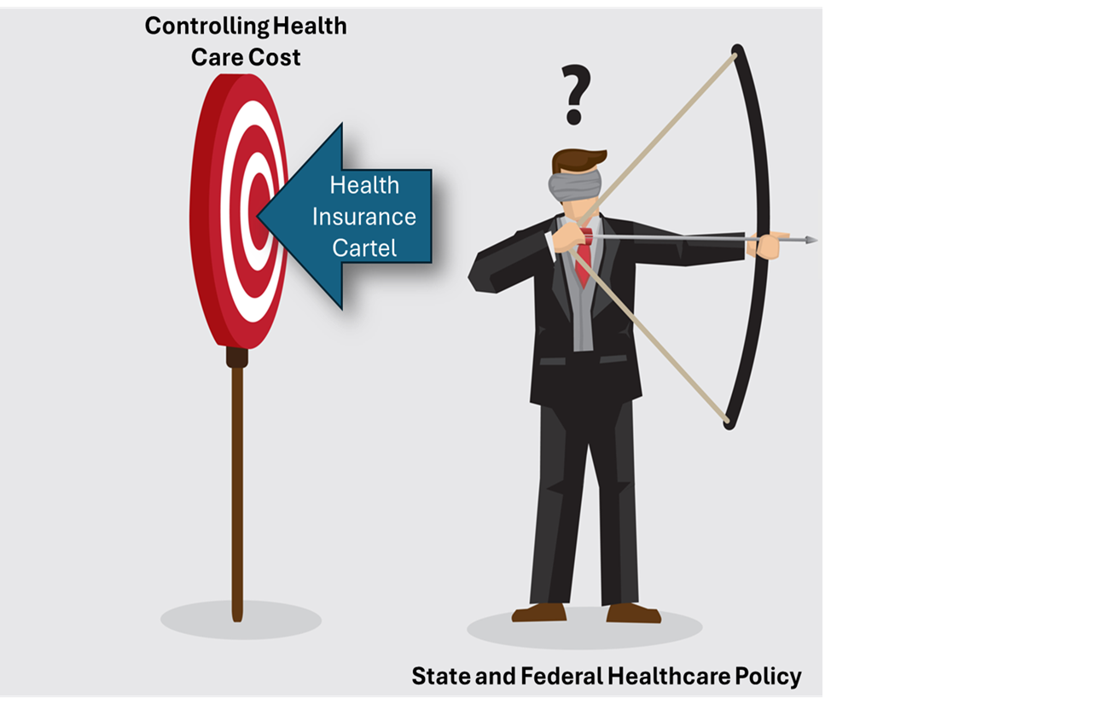
Beginning in 2029, hospitals that exceed the Indiana state average aggregate inpatient and outpatient charges will lose their nonprofit designation but can regain it by returning to compliance.

Slide 22
Value and Cheap are Not the Same Value = (Results + Service)/Cost
How much does a cheap misdiagnosis or the wrong treatment plan cost in the long run?
Is anyone measuring diagnostic accuracy and the appropriateness of treatment per $ of Cost.
Not CMS, the insurance cartels, or
most academic researchers.
¹https://www.clinicbyclevelandclinic.com/blog/how-often-are-second-opinions-different/#:~:text=The%20Clinic%20by%20Cleveland%20Clinic's,modified%20after%20a%20second%20opinion.

Slide 23
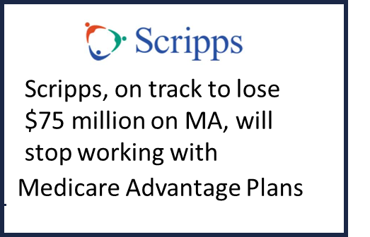
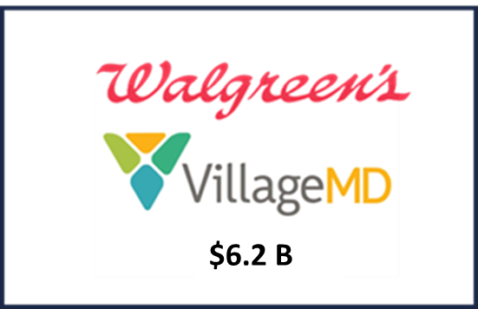
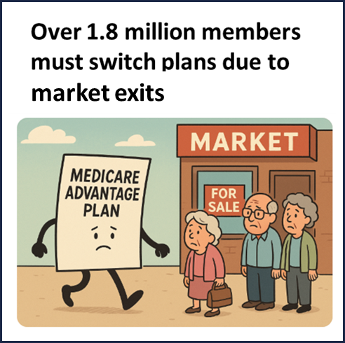

The “Disruptors” Are Becoming the Disrupted
Geisinger Health Plan lost approximately $231 million in ‘24
Adjacency Strategies have a 75% Failure Rate.

Slide 24
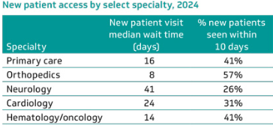
Follow the Money: Why Price Transparency and Primary Care Will Not Materially Impact Our Nation’s Healthcare Problems
U.S. Healthcare Expenditures and Expenditure per Person
System of CARE scorecard: Q2 2024 to Q1 2025
Source: Agency for Healthcare Research and Quality, Medical Expenditure Panel Survey, Household Component, 2019, Wall Street Research
https://www.ecgmc.com/insights/whitepaper/the-waiting-game-new-patient-appointment-access-for-us-physicians

Slide 25
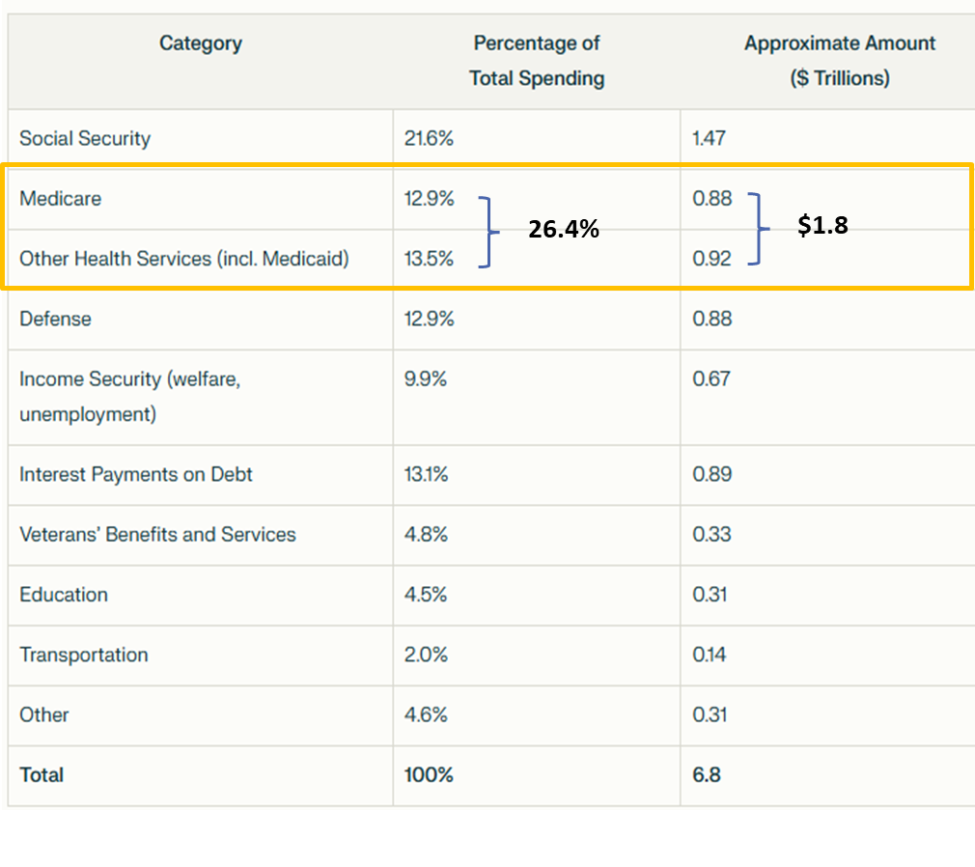
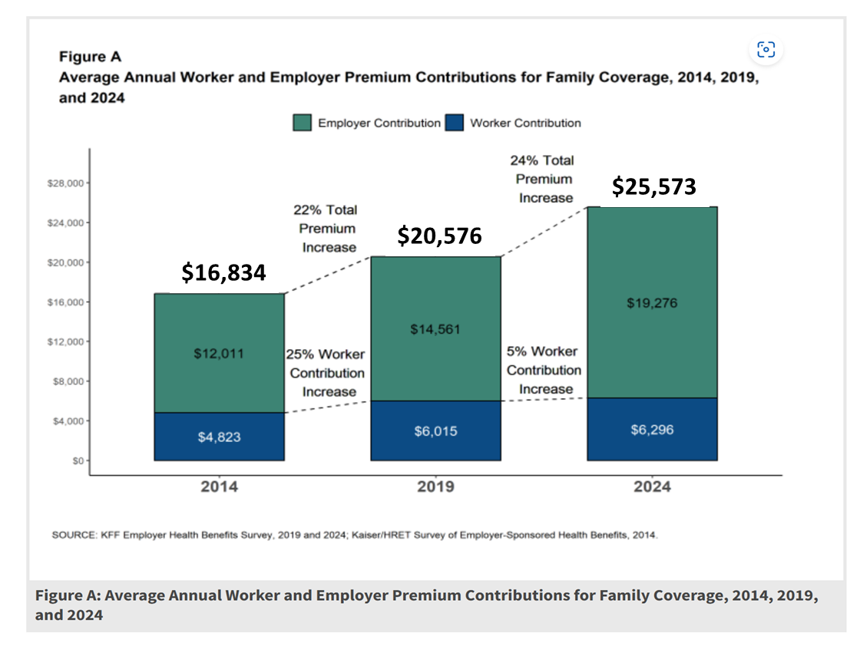
Certain Disruption: If Something Cannot Go On Forever,
It Will Eventually Stop

Slide 26
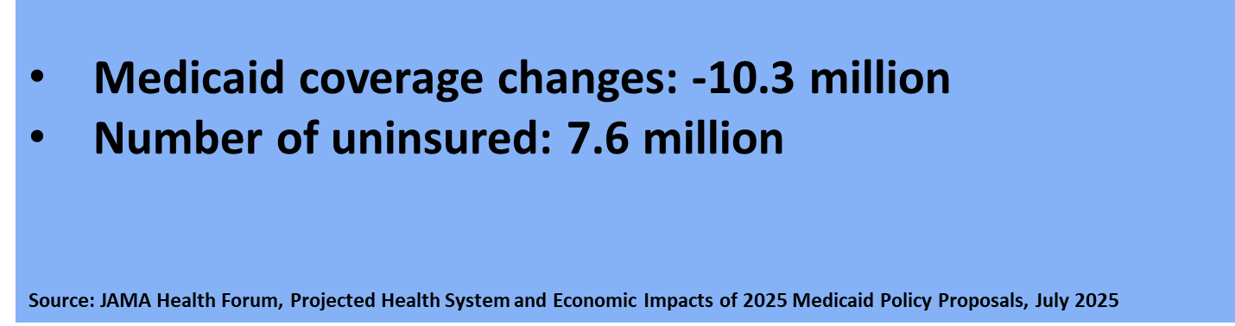
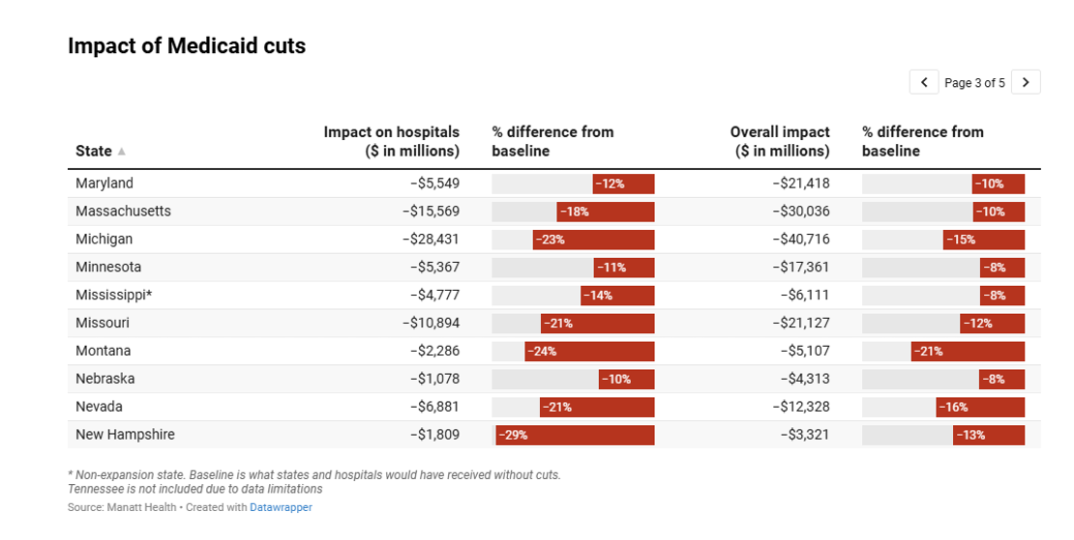
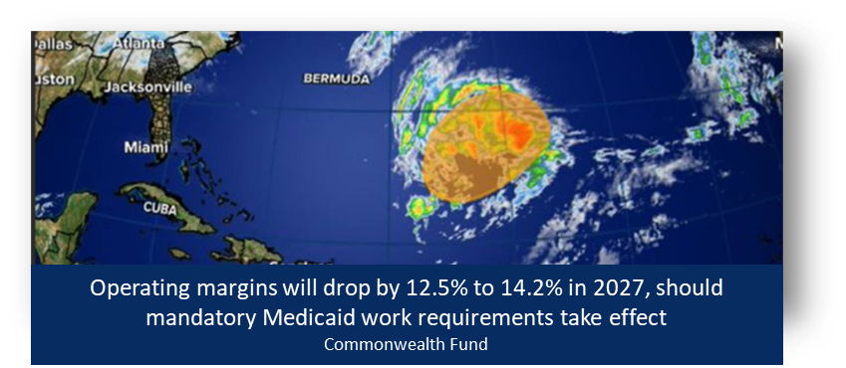
Projected Ten-Year Impact on Medicaid and Uninsured, and Hospitals Due to the New Legislation
State Employee Health Plan (reduction in provider tax)?

Slide 27
So, What Should We Do?
WE SHOULD PRAY (WHAT ELSE?)

Slide 28
Grant me the serenity to accept the things I cannot change, the courage to change the things I can, and the wisdom to know the difference.

Slide 29


Strategy is a Commodity. Execution is an Art. ~ Peter Drucker
What is your “brand promise?”
Amazon
“to be Earth’s most customer-centric company.”
You will receive optimal service and clinical care
based on the best science
in medicine every time.
Results Culture
Dashboards
DRIs
Your service and clinical care will be highly variable and no worse than that provided by our least competent department.
OR

Slide 30
The Industry-Wide Universal Equation Requires a Local Solution
Physician Compensation
Revenue – Expenses = Survival (or Better)
((Volume x Price) + Philanthropy)
(Personnel + Supplies + Capital)
(Producing Superior Outcomes, Access, and
Maintaining the Dignity of Patients)
“The Strategic Seven” Areas
for Execution Excellence
Ownership is not a strategy

Slide 31
“The Strategic Seven” Areas for Execution Excellence
Demand optimal commercial and MA rates and TERMS
Back to basics (more renovation vs. innovation) – Measure and optimize access, service, true quality, and efficiency
Contingency plan for more uninsured and Medicaid cuts
Organize clinical service lines as differently better clinical & service brands
Build trust with your clinical workforce (dyad leaders provide the leverage)
Aggressively explore partnerships and other affiliations where you lack core competencies
Evaluate all programs and services for sunsetting -Eliminate ‘chunks’ of expense
(AI Rev Cycle)
Spend time on the front lines actively listening to physicians, nurses, patients, and others, and less time in meetings listening to each other
Intensify advocacy and philanthropy

Slide 32
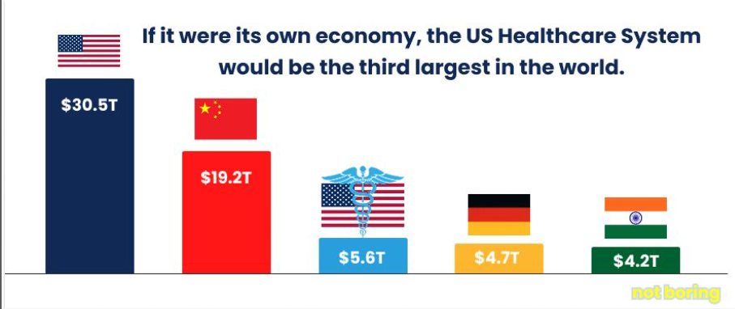

Slide 33
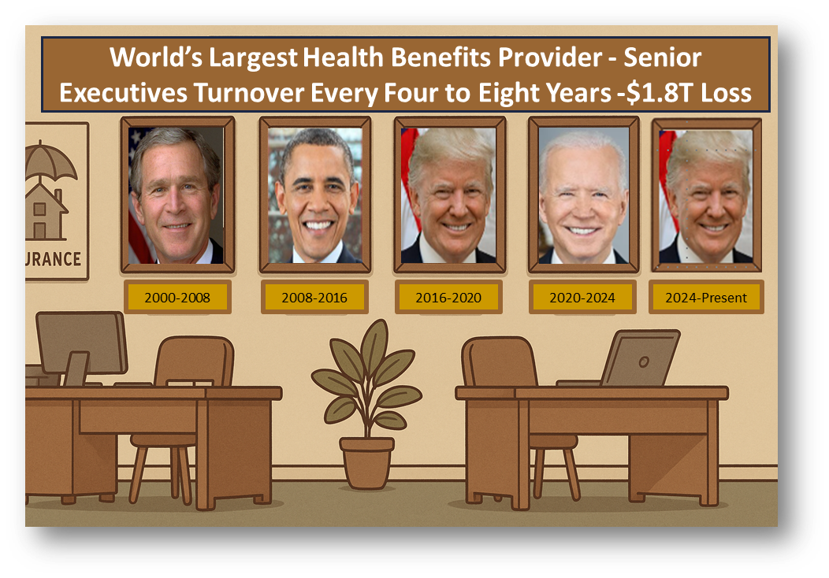


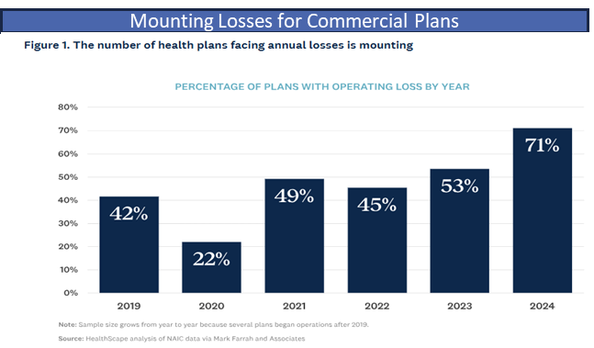
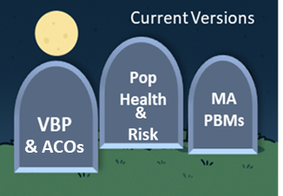
U.S. Health System – Politics and Profits What is the Health System’s Role?
?
Graveyard of Misfit Strategies
https://www.healthscape.com/insights/unsustainable-regional-not-profit-health-plans-face-tough-choices-over-next-2-years

Slide 34
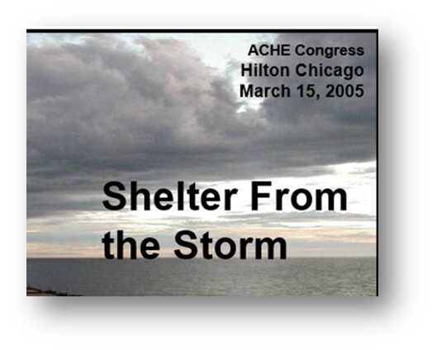
The measure of organizational intelligence is not your ability to acquire knowledge but how you handle uncertainty, navigate through it, and behave when you don't know what to do.
~ Prof. Feynman
Value
WKW
Volume
Volume
Theory
Reality

