Slide 1
Quality Residency
Capstone Project
nebraskahospitals.org
Danielle Morgan, October 4th, Kearney County Health Services

Slide 2
Introduction to the Organization, Project, Team
Kearney County Health Services is a 10-bed critical access hospital located in South Central Nebraska. Recently updated in 2013, our services include a 3-bay Emergency Department, Acute/Inpatient care, Observation, Swing Bed, Outpatient Surgery, Outpatient Infusion, Wound care, Lab and Radiology services, Cardiac Rehab, and host a wide variety of Outpatient Specialty Clinics.
Timely administration of antibiotics in patients who present to the Emergency Department with sepsis decreases the risk of hospital mortality and improves patient outcomes. My Capstone project tracked our door to antibiotic time intervals in the Emergency Department.
My team members include Chief Nursing Operator, Quality Director, ED Providers, Acute Care RN and LPNs who work in the ED and Laboratory. These members are our front line staff who take care of and manage the care of patients who present to the ED. C-Suite support is essential in facilitating change and policy.

Slide 3
AIM Statement
The aim of this project is to improve antibiotic administration in the Emergency Department at Kearney County Health Services for patients with a diagnosis of Sepsis by 30 minutes within 1 year from July 2024-June 2025. Current recommendations include early administration of an intravenous broad-spectrum antimicrobial agent within 1 hour or sooner in patients who present to the ED with sepsis and septic shock.

Slide 4
Measuring Success
Sepsis DA2 monthly report from Cerner will be utilized to provide list of patients who present to the ED with a qualifying diagnosis of Sepsis. Time interval studies will be done to track patients, these include; door to lab order, lab order to lab result, lab result to ABX order, and ABX order to administration time. Time interval also done from flagged EHR alert to ABX administration time. All patients will be placed in a spreadsheet and tracked.
810 total ED admissions from Jan 1 2024-August 31st 2024
20 patients had a final diagnosis of sepsis or severe sepsis.
15 of those patients flagged the EHR for Sepsis ED Alert or SIRS ED Alert
**EXCLUSIONS to Project: Patients that presented to ED with Sepsis criteria and discharged to hospice care will not be included in results.

Slide 5
Selecting Changes
A multidisciplinary team approach was done to organize and drive improvement in this project, included nursing, provider, leadership, quality, and lab services. The aim was to include leadership and front-line staff to ensure change and feasibility of interventions.
Staff education provided and re-enforcing importance of early antibiotic administration.
Lab specimens collected at the earliest time.
Antibiotic order time to administration time goal of 15 mins.
Working with lab to call back ED providers when labs are resulted in EHR.

Slide 6
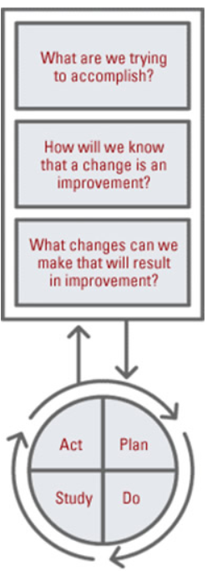
Plan ~ Do ~ Study ~ Act
Plan
ER Charts reviewed and time intervals collected for all patients identified (diagnosed) with sepsis.
Time interval studies from door to lab results, lab result to antibiotic order, antibiotic order to administration, and door to antibiotic
Monitor timely administration of antibiotic order once it is placed
Time interval and monitoring UA collection time to lab order placed
Create Sepsis flowsheet for nursing staff
This will help identify time gaps that result in a delay to antibiotic administration
CNO, Quality Director, ED providers, and staff to facilitate improvement
Do
Project is a work in progress. It will need additional observation time to track changes. Additional data from DA2 reports needed to trend time intervals after implanting interventions in order to see if there was or will be an improvement in time of antibiotic administration
Study
Collect DA2 reports and place data into a spreadsheet. There are multiple variables found in determining the door to antibiotic administration times. Plan revised to try and improve shorter time intervals for nursing, laboratory, and providers. Overall more observation time is needed.
Act
Track and monitor progress. Interventions may need modified or changed depending on time intervals.

Slide 7
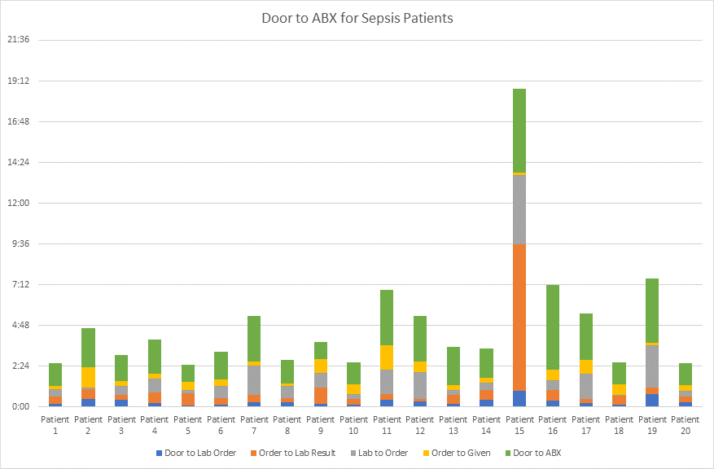
Data and Trends
Average time of ED EHR Sepsis Alert/Sirs Alert to ABX Administration time is 0:45
Average time of UA order to collection time is 1:41
Average time of Door to antibiotic administration from Jan1 2024-Aug 31 2024 is 2:15

Slide 8
Return on Investment (ROI)
Explore the financial implications of the project:
Will costs/expenses be incurred to make noted changes?
Patient improvement outcome vs cost/expense incurred
Earlier antibiotic administration time leads to improved patient mortality and improved patient outcomes which leads to a decrease in length of stay in the hospital and resources used.
What savings/revenue will be noted?
Decrease use of hospital resources

Slide 9
Spreading / Sustaining / Maintaining / Replicating
Ensure successful changes is spread to all units, staff, appropriate areas
Staff education in all patient care areas to facilitate change of process—Nursing, Providers, Lab, Pharmacy. New changes addressed in nursing unit meeting
Audits and spot checks to assess sustainability and maintenance
Continue monitoring ED Sepsis metrics and DA2 report
Can the program be replicated in other areas or organizations?
Simple PDSA cycle used, yes program could be replicated for other areas.

Slide 10
THANK YOU/Questions
Danielle Morgan RN, BSN, Kearney County Health Services, Minden NE. 308-832-3400 ext 2674
nebraskahospitals.org

