Slide 1
CMS Final Rule – CoPs Changes: Emergency and Obstetrical Services
nebraskahospitals.org
May 12, 2025 at 11:00 AM CST

Slide 2
Why Behind the What?
US has one of the highest maternal mortality rates among high-income countries with disproportionate impact on racial and ethnic minorities.
New requirements for OB services are necessary to protect the health and safety of pregnant, birthing and postpartum patients.
Conditions of Participation changes for PPS and CAHs for OB services:
Maternal quality assessment and performance improvement (QAPI),
Baseline standards for the organization, staffing and delivery of care within OB units, and
Staff training on evidence-based best practices every two years.
CY 2025 Medicare Hospital Outpatient Prospective Payment System and Ambulatory Surgical Center Payment System Final Rule (CMS 1809-FC) | CMS

Slide 3
New Standard within Emergency Services CoP – Effective July 1, 2025
To improve care for all patients, including pregnant, birthing and postpartum women receiving emergency services, CMS proposed a new standard, "Emergency Services Readiness," within the Emergency Services CoPs.
Maintain protocols consistent with Complexity and Scope of services offered and aligned with Nationally recognized evidence-based guidelines for care of patients with emergency conditions.
Including, but not limited to, OB emergencies, complications, and immediate post-delivery care.
Facility must “be able to articulate their standards and sources and to demonstrate that their standards are based on evidence and nationally recognized sources”.
nebraskahospitals.org

Slide 4
Emergency Services’ Readiness – Effective July 1, 2025
New requirements apply to all hospitals offering emergency services – regardless if they offer OB services.
All hospitals must have adequate provisions and protocols to meet the emergency needs of patients, consistent with nationally recognized and evidence-based guidelines for the care of patients with emergency conditions – to include obstetric emergencies.
Applicable staff must be trained on protocols and provisions annually, and documentation to prove staff have successfully completed training and can demonstrate knowledge.
Hospitals must have emergency provisions to include equipment, supplies, and medication used in treating emergency cases. Does not require specific items but must include:
Drugs, blood and blood products, and biologicals commonly used in lifesaving procedures.
Equipment and supplies commonly used in lifesaving procedures.
Call-in system for each patient in each emergency services’ treatment area.
Emergency supply requirements are not required for CAHs and REHs - already have emergency supply requirements included in their CoPs.

Slide 5
Emergency Services’ Readiness – Effective July 1, 2025
Best Practices and Notes from Survey:
40% do not have RRT | 60% of teams have access to needed medications and equipment | 33% do not have massive transfusion protocol, policy, or procedure | 40% do not have OB hemorrhage order set | 50% do not have team-based drills and simulations to maintain preparedness | 74% do not have routine trainings such as BSLO and ALSO
Multidisciplinary Team Communicate how to call RRT Patients and families can call RRT | Supplies kept in ER Pyxis OB hemorrhage kit One dedicated location | Infant transfusion policy Older infant and children transfusion policy CAH-specific MTP *one hospital reported not having an MTP due to lack of blood products in the facility | PPP Hemorrhage and Shock Policy PP order set with major bleeding considerations | Annual training for precipitous deliveries, OB hemorrhage, shoulder dystocia, neonatal resuscitation, preeclampsia management, and magnesium administration | Hospitals do not currently require these classes

Slide 6
Emergency Services’ Readiness – Effective July 1, 2025
Best Practices and Notes from Survey:
Key Policies, Protocols, and Treatment Algorithms
Hypertension | 50% do not have
Preeclampsia and Eclampsia | 30% do not have
Magnesium Sulfate Administration | 30% do not have
Cardiovascular Disease Assessment | 40% do not have
Telemetry Monitoring | 30% do not have
Care for Cardiac Patient | 50% do not have
Sepsis Assessment | 40% do not have
Universal Verbal Screening for SUD | 30% do not have
Pain Protocol for Patients with SUD | 40% do not have
Risk Assessment for Suicidal Ideation | 20% do not have
Perinatal Mental Health Response | 60% do not have
Perimortem Cesarean Delivery | 73% do not have

Slide 7
Hospital Discharge Planning - Transfer Protocols – Effective July 1, 2025
Maintain written Polices & Procedures for transferring patients (not just OB patients) to appropriate level of care promptly and without delay to meet specific patient’s needs:
Including transfers from ED to inpatient admission, transfers between inpatient units within hospital, and inpatient transfers to different hospital
Must provide training to the relevant staff regarding the hospital policies and procedures for transferring patients - training must be done annually.
Only PPS hospitals (not CAHs) are required to meet the revised discharge planning requirements in this phase.
Survey indicates the majority of hospitals have appropriate protocols in place.

Slide 8
Organization and Staffing – Effective January 1, 2026
OB services should be well organized and provided in accordance with nationally recognized acceptable standards of practice for the health care (including physical and behavioral health and substance use disorders) of pregnant, birthing, and postpartum patients.
Organization of the OB services should be appropriate to the scope of services offered by the facility and be integrated with other departments in the facility.
OB patient care units be supervised by an individual with the necessary education and training, such as an experienced registered nurse (RN), certified midwife, nurse practitioner, physician assistant, or Doctor of Medicine or osteopathy.
OB privileges be granted subject to written criteria for all practitioners providing OB care in accordance with the current requirements for hospitals and CAHs.

Slide 9
Delivery of Service – Effective January 1, 2026
It will be required that facilities have basic equipment for treating OB cases (including a call-in-system, cardiac monitor, and fetal doppler/monitor) be readily available in accordance with the scope, volume, and complexity of services offered by the facility.
*** Volume of equipment and location it is stored can be determined by the facility based on needs***
*** Facilities maintain obstetrical emergency supplies in crash carts; obstetrical emergency bags/boxes/kits; OB hemorrhage carts; or other readily accessible method for use when and where needed***
The facility must ensure that it has adequate, readily available provisions / protocols consistent with nationally recognized and evidence-based guidelines for OB emergencies, complications, immediate post-delivery care, and other patient health and safety events.
***Regs are not requiring specific items, examples of provisions would include equipment, supplies, and blood used in treating emergency cases***

Slide 10
Staff Training – Effective January 1, 2027
It will be required to develop policies and procedures that ensure relevant staff are trained on certain topics aimed at improving the delivery of maternal care.
*** Training topics should reflect scope and complexity of services offered ***
*** Facility-identified, evidence-based, best practices and protocols to improve the delivery of maternal care within the facility *** Have a standard process for identifying training topics.
Facility must use findings from their QAPI programs to inform staff training needs and any additions, revisions, or updates to training topics on an ongoing basis.
New staff will receive initial training and the hospital will identify which staff must complete training at least every two years.
Facility must document in staff personnel records that training was successfully completed and be able to demonstrate staff knowledge on the training topics identified.

Slide 11
Quality Assessment and Performance Improvement Program
(QAPI) – Effective January 1, 2027
Hospitals providing OB services must use their QAPI programs to assess and improve health outcomes and disparities among OB patients on an ongoing basis. At a minimum:
Analyze data and quality indicators collected for the QAPI program by diverse subpopulations as identified by the facility among OB patients.
Measure, analyze, and track data, measures, and quality indicators on patient outcomes and disparities in processes of care, services and operations, and outcomes among obstetrical patients.
Analyze and prioritize patient health outcomes and disparities, develop and implement actions to improve patient health outcomes and disparities, measure results, and track performance to ensure improvements are sustained when disparities exist among obstetrical patients.
Conduct at least one performance improvement project focused on improving health outcomes and disparities among the hospital’s population(s) of obstetrical patients annually.
It will be required that obstetrical services’ leadership engage in OB QAPI activities.
CMS is finalizing a requirement that if a Maternal Mortality Review Committee (MMRC) is available at the state, Tribal, or local jurisdiction in which the facility is located, hospitals that offer OB services must have a process for incorporating publicly available information and data from the MMRC into the QAPI program.

Slide 12
Implementation Phase-In
CMS plans to implement provisions in 3 phases over 2 years:
Phase 1: To be implemented 6-months following the effective date of the final rule:
Emergency services’ readiness for hospitals and CAHs.
Transfer protocols for hospitals only.
Phase 2: To be implemented 1-year following the effective date of the final rule:
Organization, staffing, and delivery of services for hospitals and CAHs.
Phase 3: To be implemented 2-years following the effective date of the final rule:
OB staff training in hospitals and CAHs.
QAPI program for OB services in hospitals and CAHs.

Slide 13
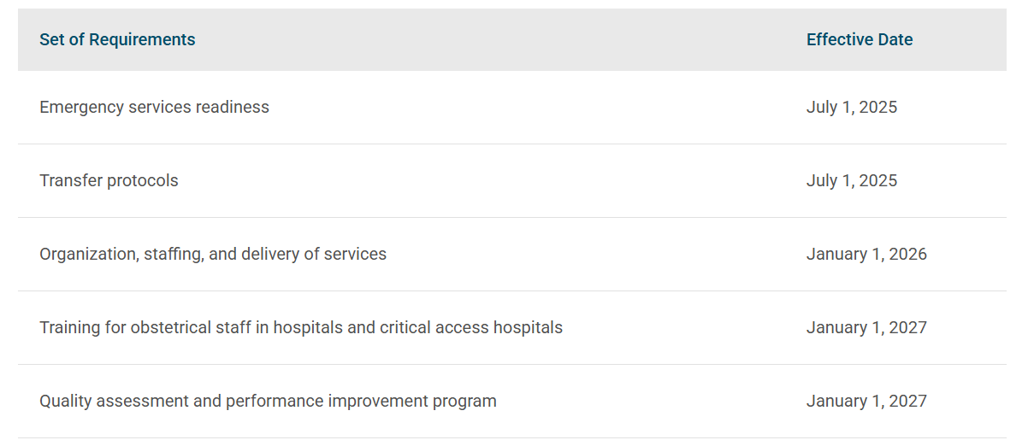
Effective Dates:

Slide 14
Severe Hypertension in Pregnancy AIM Patient Safety Bundle
nebraskahospitals.org

Slide 15
Alliance for Innovation on Maternal Health (AIM) Bundles
Primary bundles, supported by specific quality metrics and measures through the AIM Data Center, are the core building blocks of the AIM program’s efforts to address the leading known causes of preventable severe maternal morbidity and mortality in the United States.
Readiness
Recognition
Response
Reporting
Respectful

Slide 16
Readiness
Readiness — Every Care Setting
Develop processes for management of pregnant and postpartum patients with severe hypertension, including:
A standard protocol for maternal early warning signs, diagnostic criteria, monitoring and treatment of severe preeclampsia/eclampsia (including order sets and algorithms)
A process for the timely triage and evaluation of pregnant and postpartum patients with severe hypertension or related symptoms
A system plan for escalation, obtaining appropriate consultation, and maternal transfer as needed
Key Elements:
Rapid access to medications for severe hypertension/eclampsia; brief guide for administration / dosage in all areas where patients may be treated.
Interprofessional and interdepartmental team-based drills with timely debriefs.
Develop and maintain a set of referral resources and communication pathways.
Develop trauma-informed protocols to address needs of all patients.

Slide 17
Recognition & Prevention
Recognition & Prevention — Every Patient
Key Elements:
Assess and document if a patient presenting is pregnant or has been pregnant within the past year in all care settings.
Accurate measurement and assessment of blood pressure for every pregnant and postpartum patient.
Screen for structural and social drivers of health - provide linkage to resources that align with the pregnant or postpartum person’s health literacy, cultural needs, and language proficiency.
Education to all patients on the signs and symptoms of hypertension and preeclampsia - empower them to seek care.
Education to all health care team members on the recognition of signs, symptoms, and treatment of hypertension.

Slide 18
Response
Response — Every Event
Key Elements:
Standardized protocol with checklists and escalation policies
Maternal early warning signs;
Listening and investigating patient-reported and observed symptoms;
Standard labs for the management of patients with severe hypertension or related symptoms.
Postpartum follow-up visit to occur within 3 days of birth hospitalization discharge date for individuals whose pregnancy was complicated by hypertensive disorders.
Trauma-informed support for patients, identified support network, and staff for serious complications of severe hypertension:
Birth events;
Follow-up care;
Resources;
Appointments

Slide 19
Reporting and Systems Learning
Reporting and Systems Learning — Every Unit
Key Elements:
Multidisciplinary planning, huddles, and post-event debriefs for every case of severe hypertension:
Successes;
Opportunities for improvement;
Action planning for future events.
Multidisciplinary reviews of all severe hypertension/eclampsia cases to identify systems issues.
Monitor outcomes and process data related to severe hypertension.

Slide 20
Respectful Care
Respectful and Supportive Care — Every Unit/Provider/Team Member
Key Elements:
Open, transparent, and empathetic communication with pregnant and postpartum people and their identified support network:
Diagnoses;
Options;
Treatment plans.
Include pregnant and postpartum persons as part of the multidisciplinary care team - establish trust and ensure informed, shared decision-making that incorporates the pregnant and postpartum person’s values and goals.

Slide 21
Thank you!
nebraskahospitals.org
For additional questions:
Dana Steiner – dsteiner@nebraskahospitals.org
Amber Kavan – akavan@nebraskahospitals.org
Sydnie Carraher -- scarraher@unmc.edu

