Slide 1
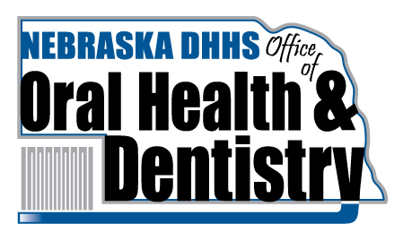
NEBRASKA CURRENT ORAL HEALTH STATUS
Presented To
NE Rural Health Conference
11 June 2025
Dr. Charles F. Craft
Dental Health Director
State of Nebraska
Notes:
Add the title of your presentation, your division, name, etc.

Slide 2
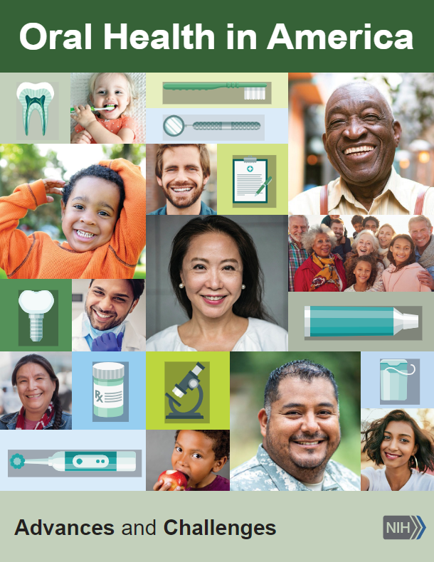
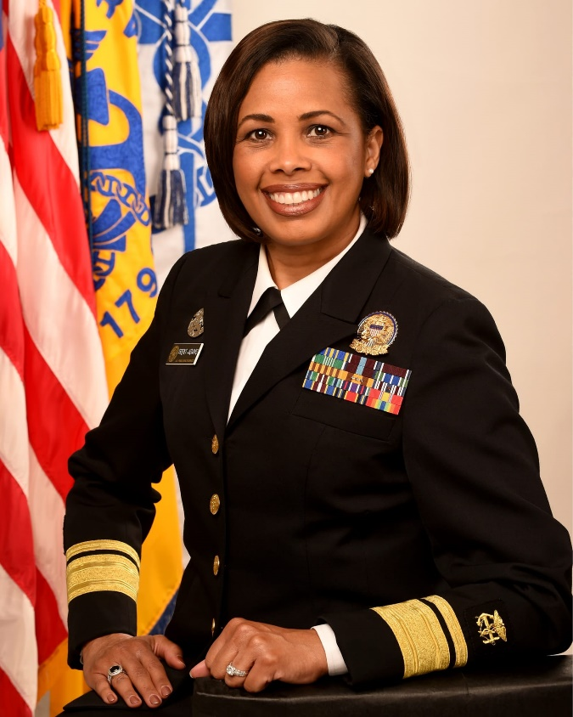
Sylvia Trent-Adams.
Acting U.S. Surgeon General
New: Dr. Casey Means
Call to Action: Improve the Oral Health of the Nation
Released December 2021

Slide 3
NE Oral Health Surveillance System Report 2024
The DHHS Office of Oral Health monitors dental disease data within
Nebraska by analyzing 58 oral health indictors. These measures
are prioritized into Tier Groups of Priority, Recommended and Optional.
This report is released every 3-4 years.
NE Priority indicators follow the 15 CDC Health People 2030 Oral Health Objectives that track access to care, caries rates, missing
teeth, dental sealants and fluoridated community water systems.
Nebraska can gather data on 9 of the 15 HP2030 Objectives.

Slide 4
Nebraska Significant OH Trends compared to US Average
OH-1 NE Dental Caries Experience rate for 3rd Graders is 58.1%, compared to National Avg of 60%
OH-2 NE Untreated Decay Rate for 3rd Graders is 24.3%, compared to National Avg of 18%
OH-3 NE Untreated Decay Rate for Older Adults is 46.6%, National Avg approx. 20%
OH-5 NE Adults who have all Teeth Extracted is 9.5%, National Avg approx. 20%
OH-7 NE Incidence of Invasive Oral Cancer cases s #285, new cases in US about 50,000
OH-8 NE Adult use of the Oral Health Care System is 66.2%, compared to National Avg of 65.9%
OH-9 NE Low Income Children with Preventive Visit is 47%, National Avg is over 30-40%
OH-10 NE 3rd Grade Children with Dental Sealants is 50.8%, compared to 42% Natl.
OH-11 NE Percent of Pop. with CWF is 74.2%, compared to 72.7% National Avg

Slide 5
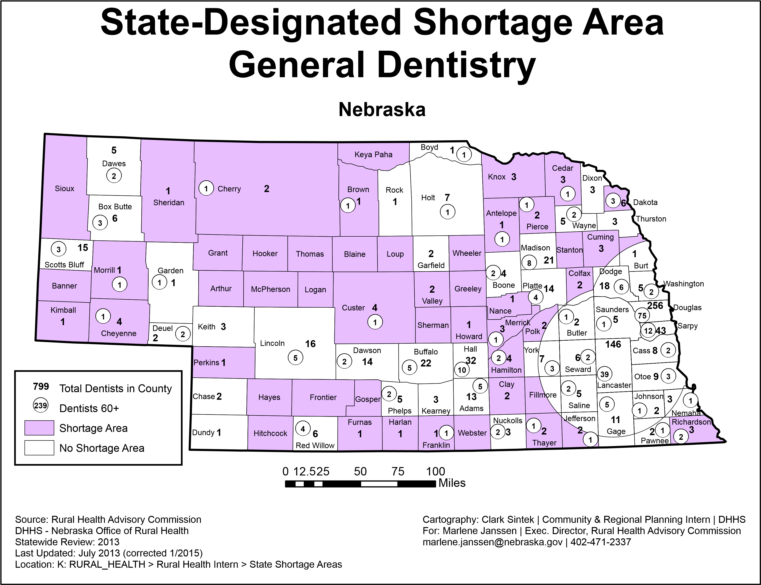
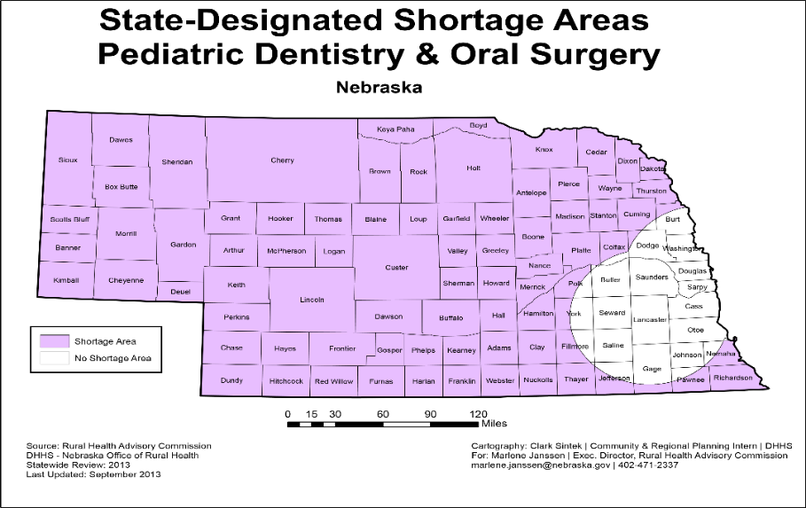

Slide 6
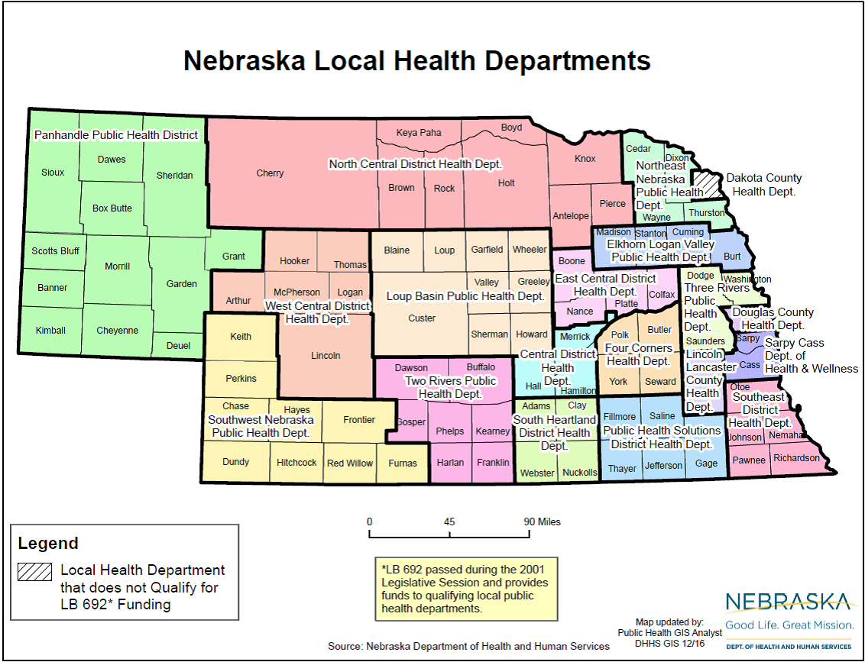

Slide 7
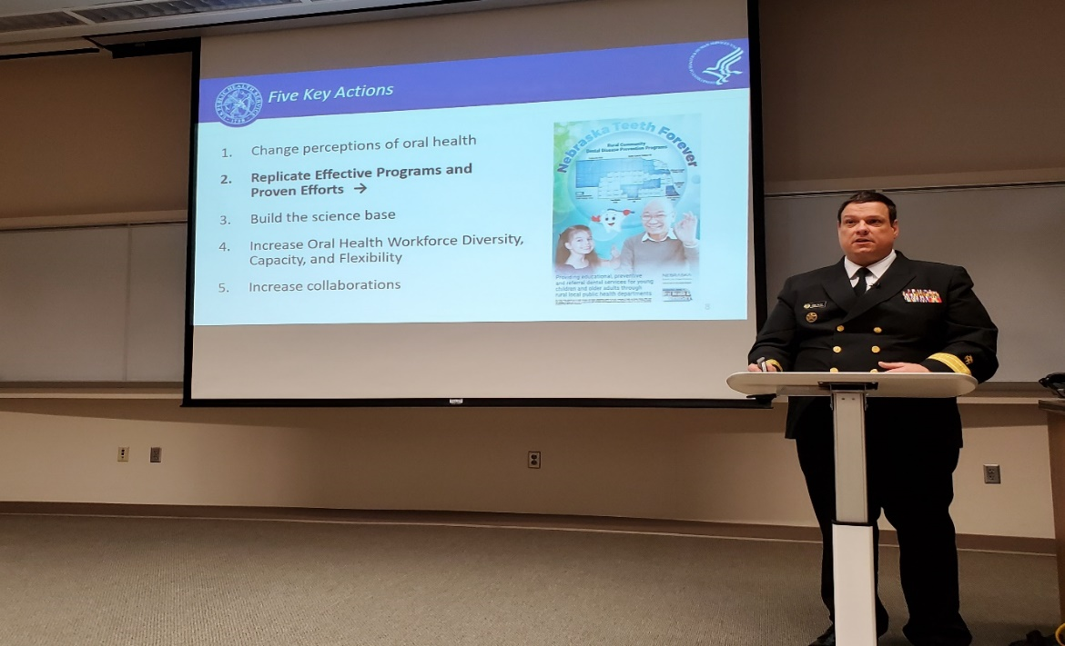
OOHD STARTED 2017
NEBRASKA TEETH FOREVER PR
Community Dental Disease Prevention Teams
Portable Dental Hygiene Units/Screenings & Education
Children’s Centers: Fluoride Varnish
Elementary Schools: Dental Sealants
Elder Facilities: Cleaning/SDF/Refer

Slide 8
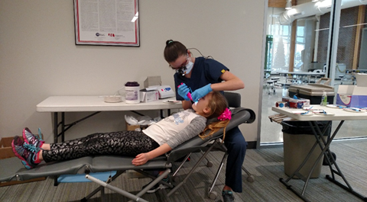
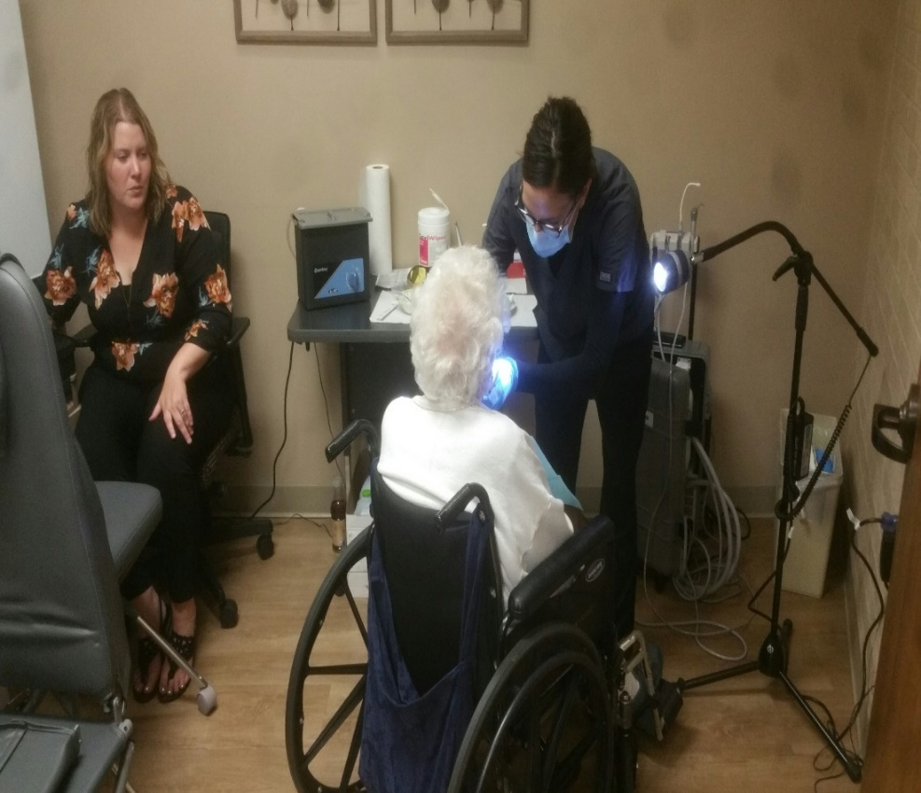
UNIQUE NE WORKFORCE
PUBLIC HEALTH HYGIENSITS
COMMUNITY HEALTH WORKERS
SCREENING, PREVENTION & REFERRAL SERVICES ACROSS THE LIFESPAN OFTEN WORK SIDE BY SIDE WITH SCHOOL NURSES

Slide 9
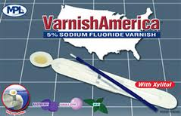
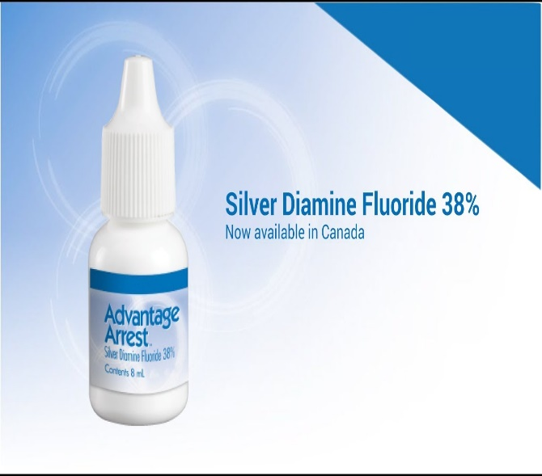
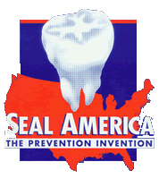
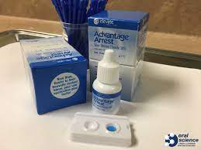
Dental Disease Prevention Services

Slide 10
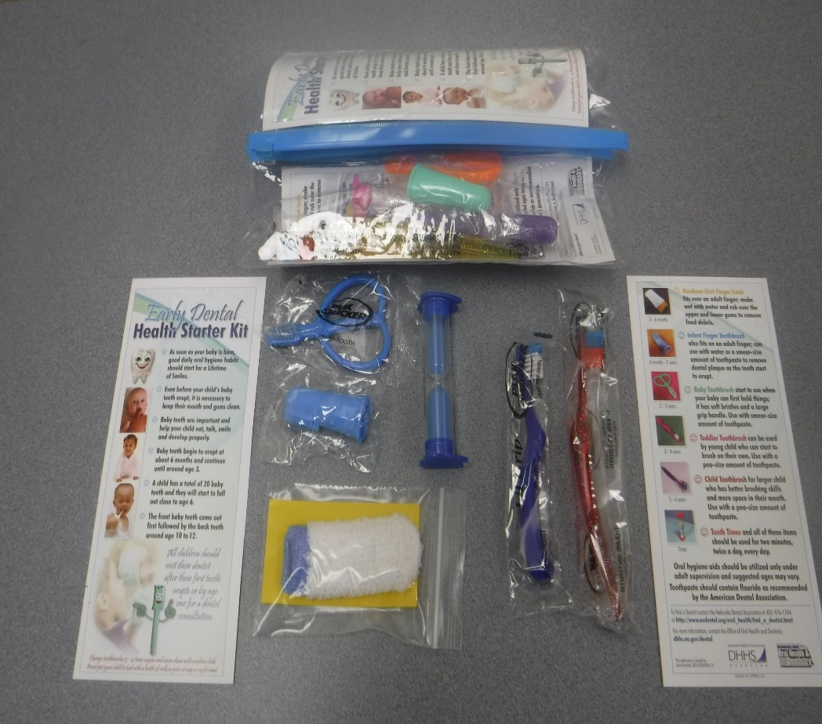
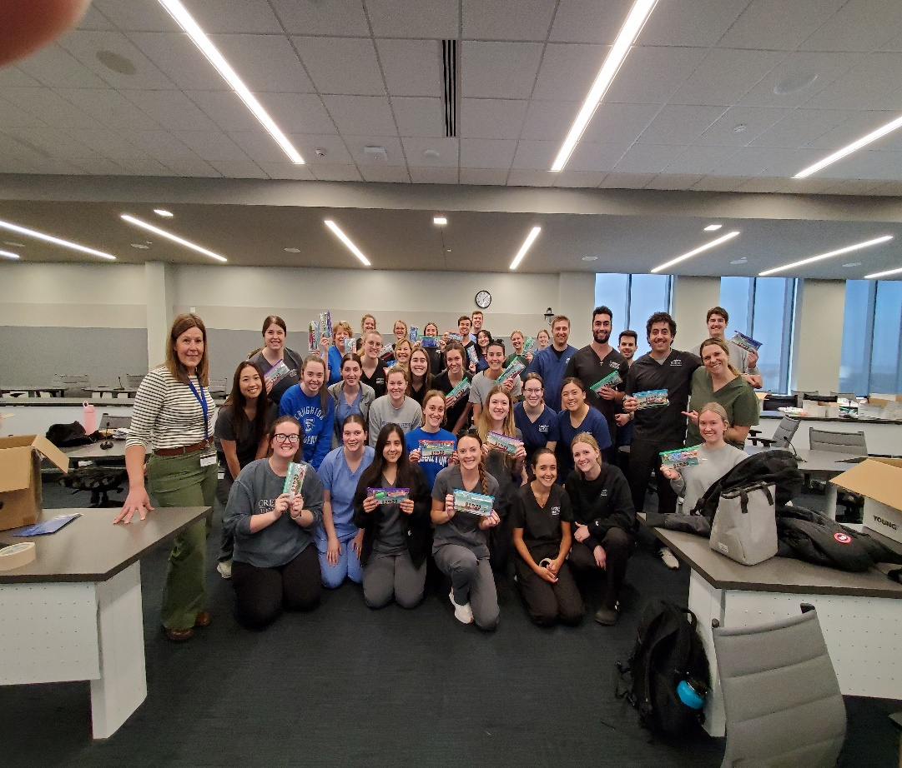
EARLY DENTAL HEALTH STARTER KIT EDUCATIONAL PROGAM
#25,000 Kits per Year

Slide 11
NE Public Health Authorization SERVICE TOTALS 2024
Annual Survey by COPH Health
Professional Tracking Service
2013 2024
63 PHAs 201 PHAs
16 Active 57 Active
6839 Screenings 47,272 Screenings
2340 Topical Fl 31,860 Topical Fl
4362 Sealants 19,312 Sealants
16,425 TOTAL 166,812 Total
Public Health Authorized Dental Hygienists provided educational and dental
disease prevention services in 124 sites and 79 counties, representing 85% of the
state. These services are offered at 15 of the 19 health departments. Annual PHA
service report is submitted to the Clerk of the Legislature.

Slide 12
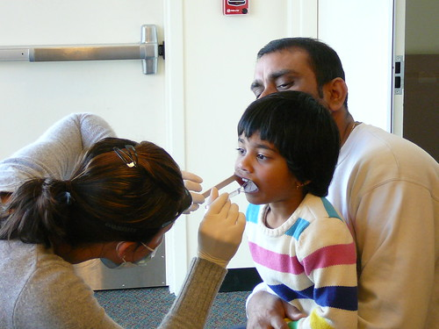
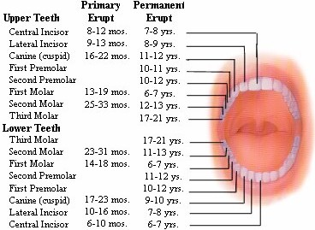
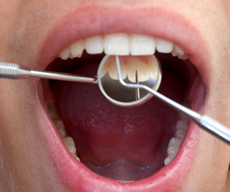
Basic Screening Surveys for HS and 3rd Grade Children - decay experience -untreated decay -dental sealants -urgency of care

Slide 13
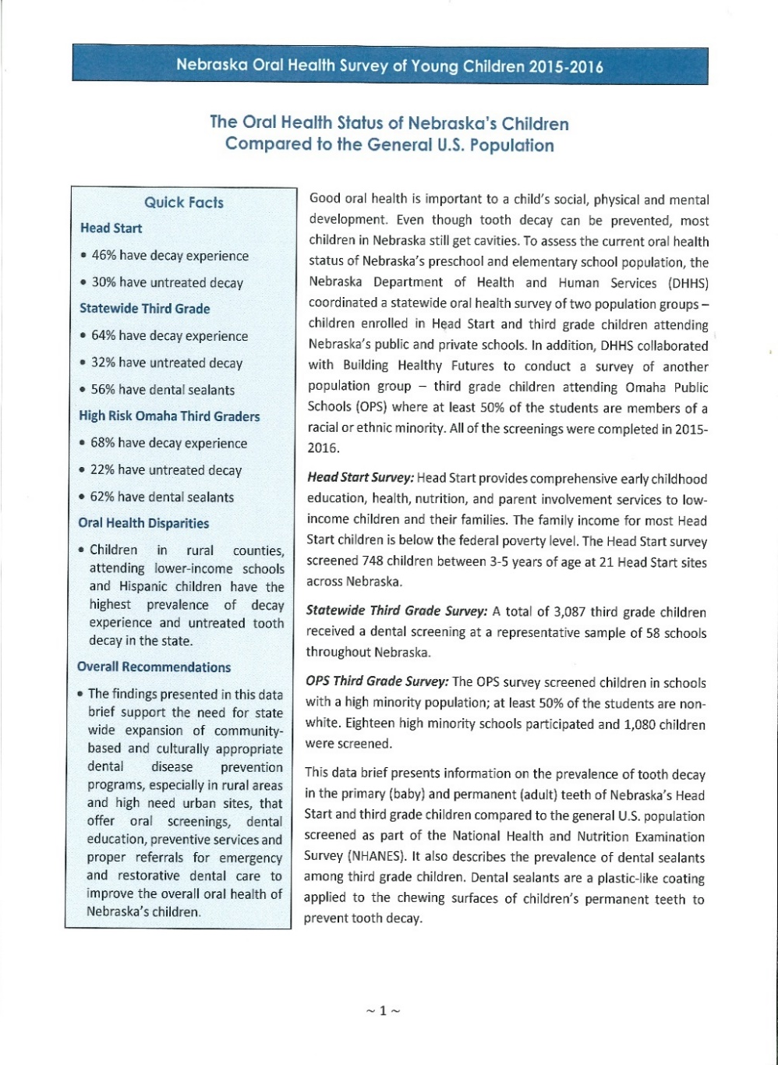
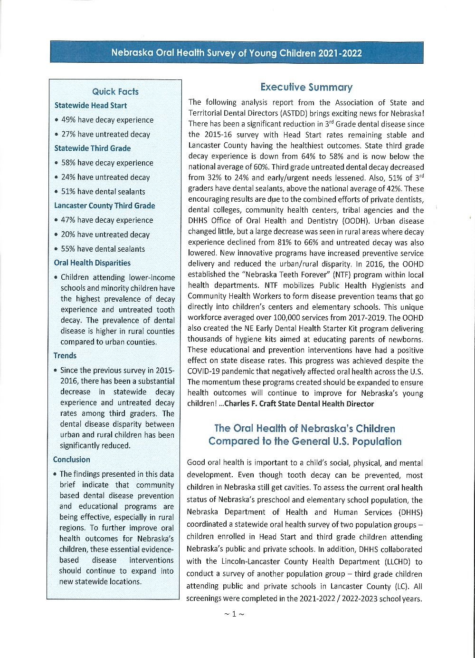
2021-2022
2015-2016
IMPACT

Slide 14
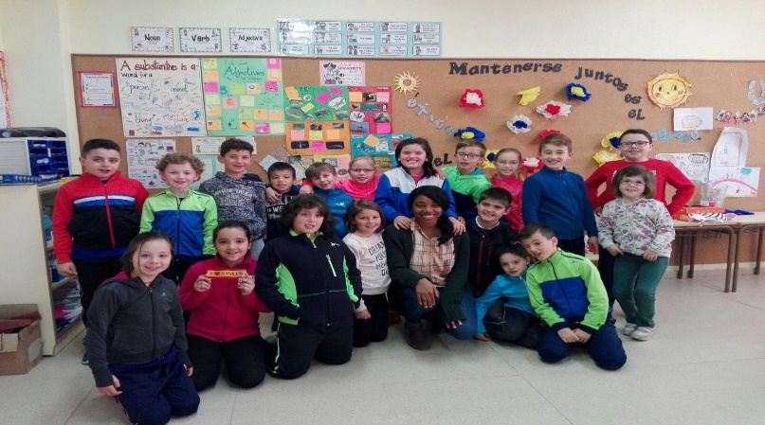
STATEWIDE THIRD GRADE CHILDREN
NE 2016 NE2022 US 2022
2016 2022 US
Decay Experience 64% 58% 60%
Untreated Decay 32% 24% 20%
Dental Sealants 56% 51% 42%
Early / Urgent Care 19% 17% ----
This Photo by Unknown Author is licensed under CC BY-NC

Slide 15

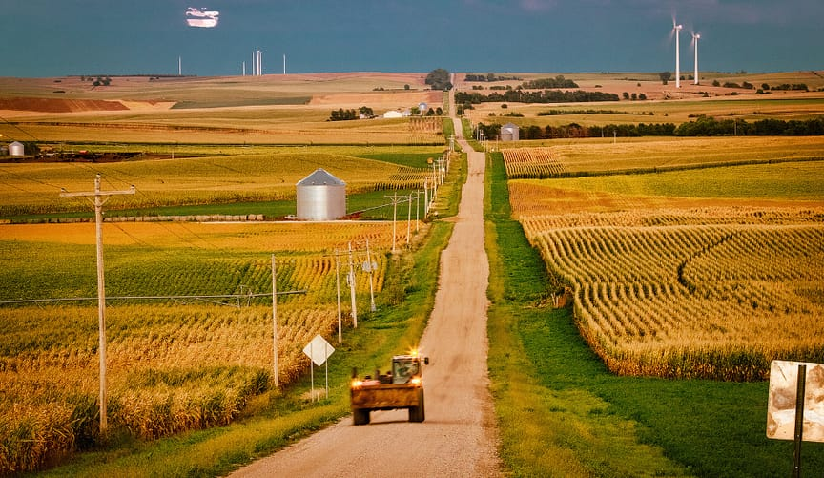
URBAN / RURAL DISPARITY
THIRD GRADE 2016 2022EGRADE 2016 2022
Decay Experience 81% R 66% R
55% U 54% U
Untreated Decay 53% R 25% R
21% U 24% U
Dental Sealants 49% R 55% R
60% U 49% U
Early / Urgent Care 28% R 22% R
14% U 15% U
The Pandemic seemed to affect urban area
numbers more than rural
This Photo by Unknown Author is licensed under CC BY-NC

Slide 16
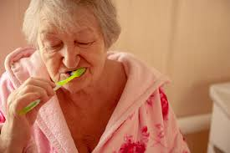
56% of LTCF residents have less than 20 teeth 28% Of LTCF residents have no natural teeth 47% of LTCF residents have untreaded decay 31% LTCF residents have severe gum disease 52% of rural residents need restorative 37% urban 40% of rural residents need Perio care 15% urban
2019 NEBRASKA OLDER ADULT SURVEY
The OOHD will conduct new survey in 2025-26

Slide 17
2019 NEBRASKA DENTAL PATIENT USE OF HOSPITAL ERs
- Average 7,982 dental patient visits per year
- Average cost per ER visit was $1,375
- Average yearly cost was approx. $10 Million USD
- 45% of visits by patients 26-45 years old
- Dental ER visits in the US cost hospitals, taxpayers
and the government approx. $2 Billion per year
- New 2025-26 report is being conducted by the OOHD
and Creighton that shows fewer ER dental patients
but much higher costs
- Free and Urgent Clinics are helping ease
burden on ERs: CU Diversion, COD Sharing,
PCM, CWAH, Heart Ministry, Dental Home Innitative

Slide 18
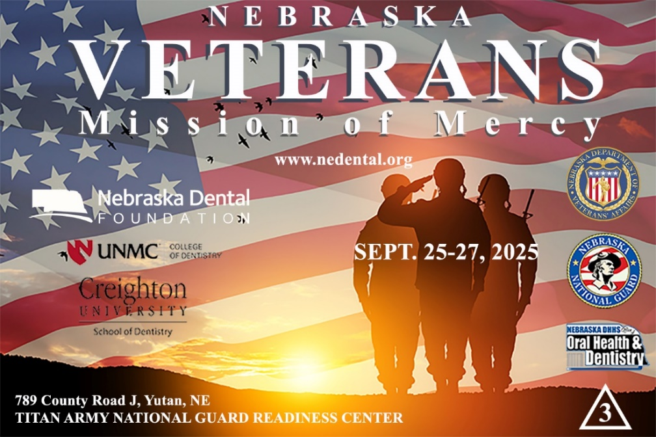
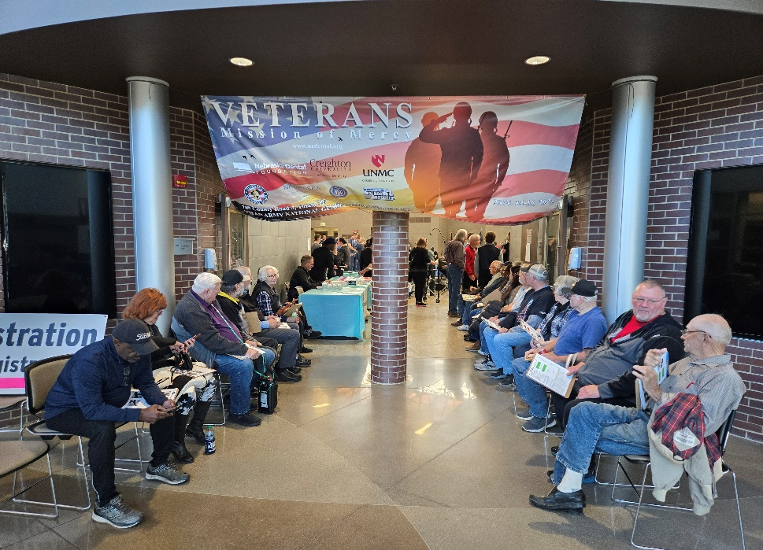
NEBRASKA VETERAN SERVICES 2023 VETMOM 2024 VETSmile

Slide 19
NEBRASKA ORAL HEALTH CHALLENGES
- Need to increase Dentist workforce in rural shortage areas
- Need to increase Medicaid providers for low-income patients
Need to support and increase PHA workforce and preventive care services
Need to expand urgent care programs to lessen burden on Hospital ERs
Need to expand access to dental services for older adults

Slide 20
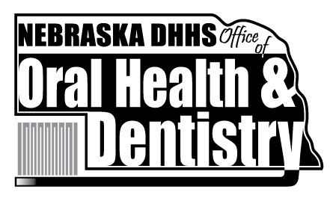
Oral Health Reports, Resources and Educational
Resources can be found on the OOHD Website:
Questions: Dr. Charles F. Craft
charles.craft@Nebraska.gov
#402-890-7400

