Slide 1



ADVANCING PERINATAL CARE FOR A THRIVING RURAL NEBRASKA: COLLABORATIVE SOLUTIONS FOR BETTER OUTCOMES
Sydnie Carraher, DNP, APRN-NP, NNP-BC, C-ONQS
Executive Director
Lindsey Steele, MPH
Project Coordinator

Slide 2



OBJECTIVES
DISCUSS THE CURRENT STATE OF PERINATAL HEALTH IN NEBRASKA
DESCRIBE THE NEBRASKA PERINATAL QUALITY IMPROVEMENT COLLABORATIVE'S MATERNAL SAFETY INITIATIVES
IDENTIFY STRATEGIES AND RESOURCES TO IMPROVE MATERNAL AND INFANT HEALTH IN RURAL HEALTHCARE SETTINGS

Slide 3

WHY SHOULD WE PRIORITIZE PERINATAL HEALTH?

Slide 4
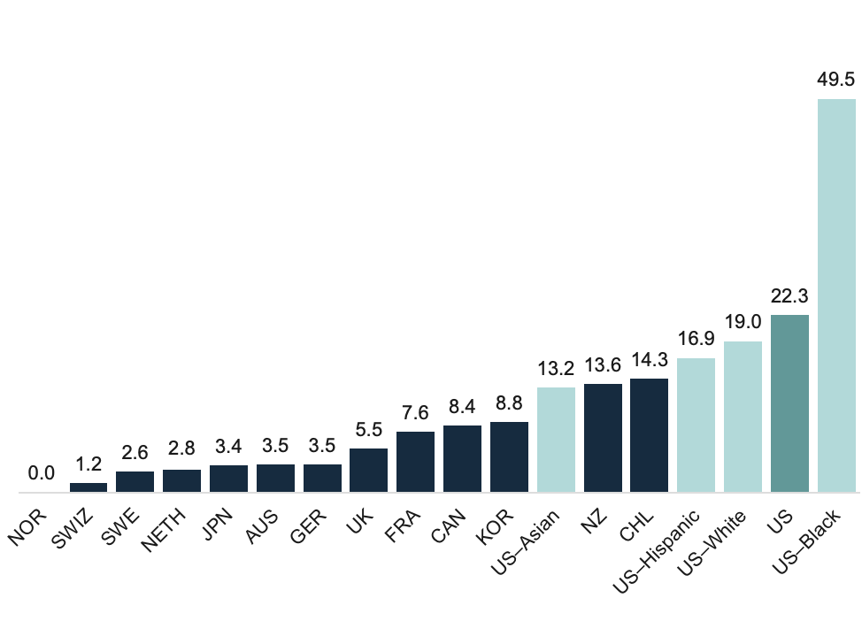
MATERNAL MORTALITY IN THE U.S.
Maternal deaths per 100,000 live births
Notes: The maternal mortality ratio is defined as the death of a woman while pregnant or within 42 days of termination of pregnancy, irrespective of the duration and site of the pregnancy, from any cause related to or aggravated by the pregnancy or its management but not from accidental or incidental causes. Due to sample size limitations, data for US–AIAN cannot be displayed.
Data: All country data from OECD Health Statistics 2023 extracted on February 29, 2024, except data for US are 2022 data from the Centers for Disease Control and Prevention, National Center for Health Statistics, National Vital Statistics System, mortality and natality data files, “Maternal Mortality Rates in the United States, 2022.”
SOURCE: Munira Z. Gunja et al., Insights into the U.S. Maternal Mortality Crisis: An International Comparison (Commonwealth Fund, June 2024). https://doi.org/10.26099/cthn-st75
Notes:
This graph shows us just how far behind we are. Among wealthy nations, the U.S. is one of the most dangerous places to give birth. Despite a decline since the end of the COVID-19 pandemic, the US maternal mortality rate continues to far exceed those of other high-income nations.
In 2022, there were 22 maternal deaths for every 100,000 live births in the U.S. — more than double, sometimes triple, the rate for most other high-income countries in a recent analysis by the Commonwealth Fund. In half of the countries, there were less than five maternal deaths per 100,000 live births. For Black women, maternal mortality is exceptionally high.

Slide 5
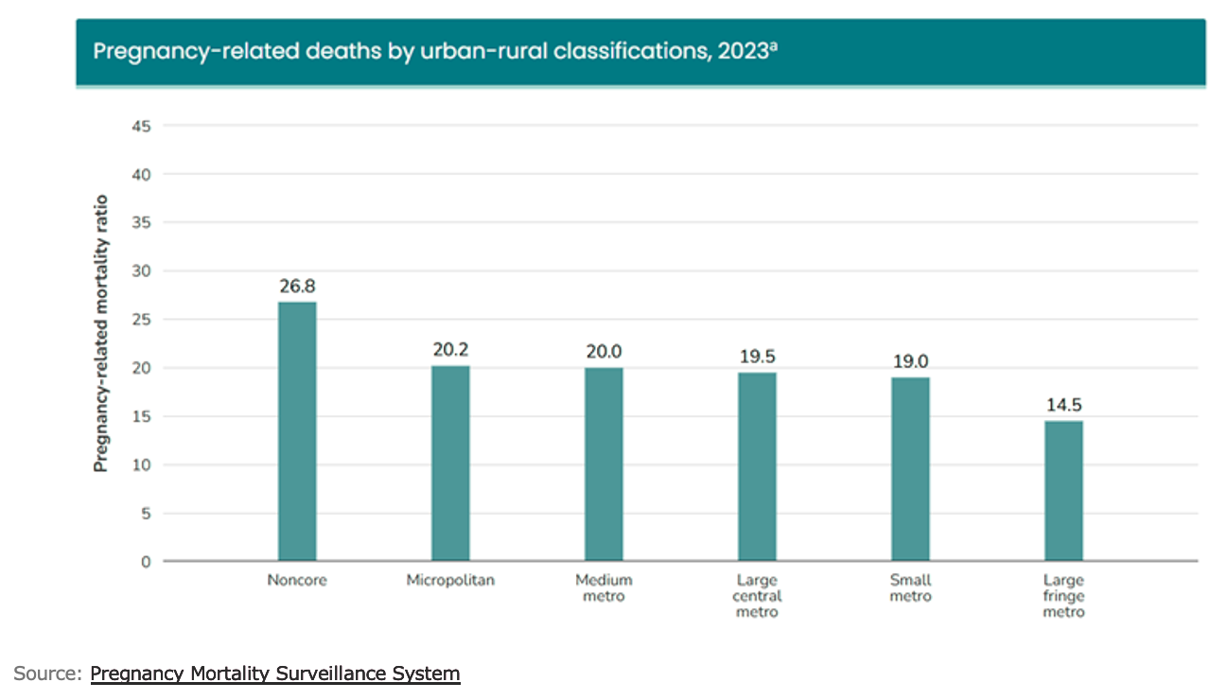
Notes:
According to the Pregnancy Mortality Surveillance System from the Centers for Disease Control and Prevention, risks of pregnancy-related mortality are highest for rural populations, with 26.8 pregnancy-related deaths per 100,000 occurring in noncore areas in 2023 and 20.2 deaths per 100,000 in micropolitan areas.
Micro 10-50k, Med metro 250-999k, Large Central and Large Fringe > 1 million. Small Metro 50-250k

Slide 6
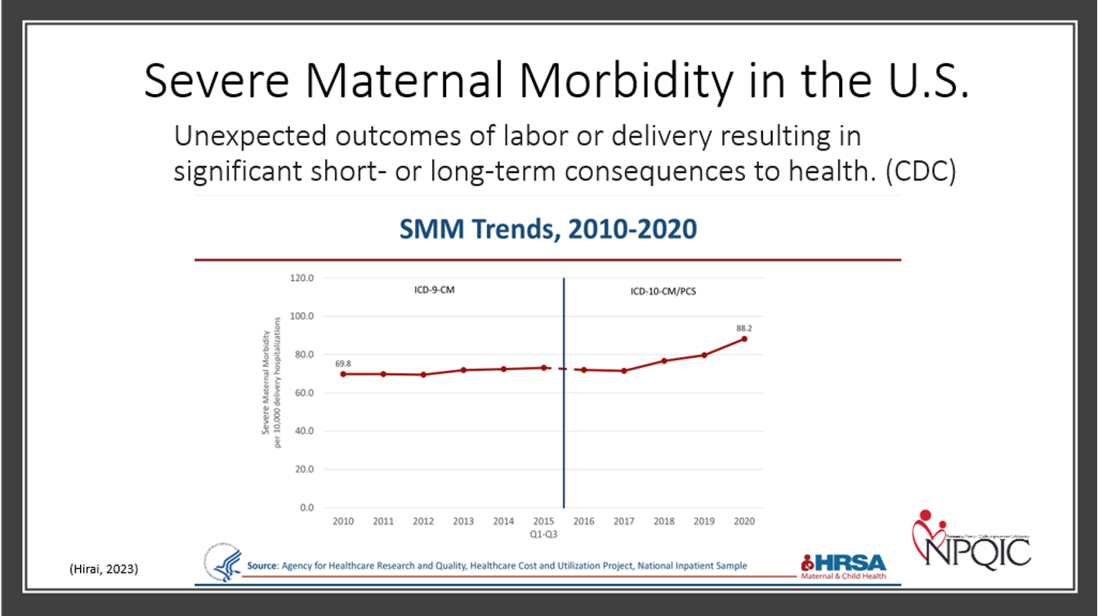
Notes:
Defn: Unexpected outcomes of labor or delivery resulting in significant short- or long-term consequences to health. Based on 21 ICD-10 Indicators- excludes, tx alone.​
U.S rates of SMM have been increasing over time​
2010: 69.8 per 10,000 delivery hospitalizations​
2020: 88.2 per 10,000 delivery hospitalizations​
This represents a 26.4% increase in SMM rates nationally over a decade. ​

Slide 7
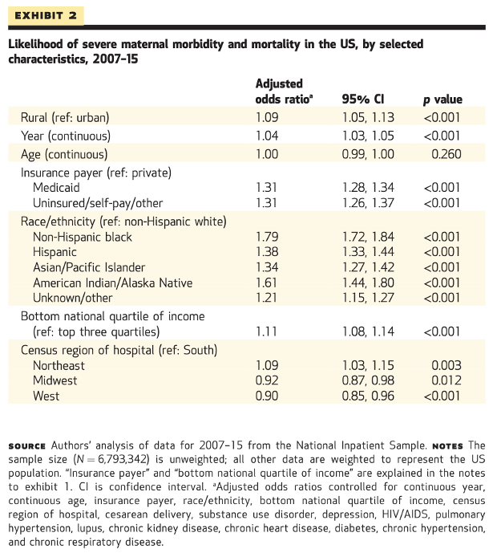
RURAL MOTHERS
9%
HIGHER LIKELIHOOD OF MORBIDITY OR MORALITY
Source: https://www.healthaffairs.org/doi/10.1377/hlthaff.2019.00805
Notes:
According to Rural-Urban Differences In Severe Maternal Morbidity And Mortality In The US, 2007–15, rural women have had a consistently higher predicted probability of severe maternal morbidity, such as sepsis, pulmonary edema, and acute renal failure, as well as mortality, even after accounting for sociodemographic factors and clinical conditions. Rural and urban health disparities have continued to widen over time.
Data from National Inpatient Sample. When controlling for sociodemographic factors and clinical conditions, we found that rural residents had a 9 percent greater probability of severe maternal morbidity and mortality, compared with urban residents.

Slide 8
CURRENT LANDSCAPE OF PERINATAL HEALTH IN NEBRASKA

Slide 9
NEBRASKA NUMBERS
25.1 per 100,000 live births
60.9 per 10,000 deliveries
60%
43 of 84
Maternal deaths occur during the postpartum period (up to 1 year).
Nebraska Hospitals provide delivery services.
Maternal Mortality Rate (2018-2022) higher than national rate of 23.2.
Severe Maternal Morbidity in 2021. Increasing from previous years.
11.1%
29.8%
D
5.8 per 1,000 live births
Preterm birth rate in 2023.
An increase from 8.7% in 2013. National rate 10.4%
2024 CAH NTSV C/S rate compared to non-CAH NTSV C/S rate of 23.9%
Grade on the Policy Center Maternal Mental Health Report Card.
Infant Mortality Rate (2022) higher than national rate of 5.6.

Slide 10
PREVENTABILITY
Nebraska’s Maternal Mortality Review Committee found that 93% of pregnancy-related deaths between 2017 and 2021 were preventable.
The most frequent contributing factors include:
Lack of continuity of care
Limited access
Financial resources
Clinical skill issues
These factors disproportionately affect rural communities.
93%
PREVENTABLE
State Maternal Death Review Team Annual Report, 2024

Slide 11
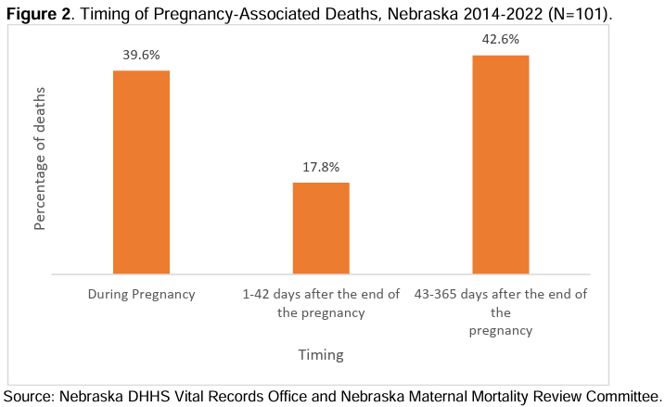
18%
MENTAL HEALTH CONDITIONS
CONTRIBUTING FACTORS
17%
SUBSTANCE USE DISORDER
15%
OBESITY

Slide 12
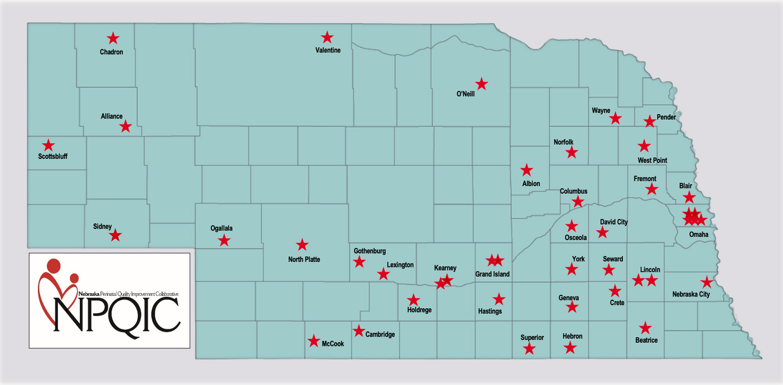
NEBRASKA BIRTHING HOSPITALS
Total of 43 Birthing Hospitals
26 CAH
17 Non-CAH
~24,000 births annually
Facility range from 10-5,000 births/year
55% < 100
28% < 55

Slide 13
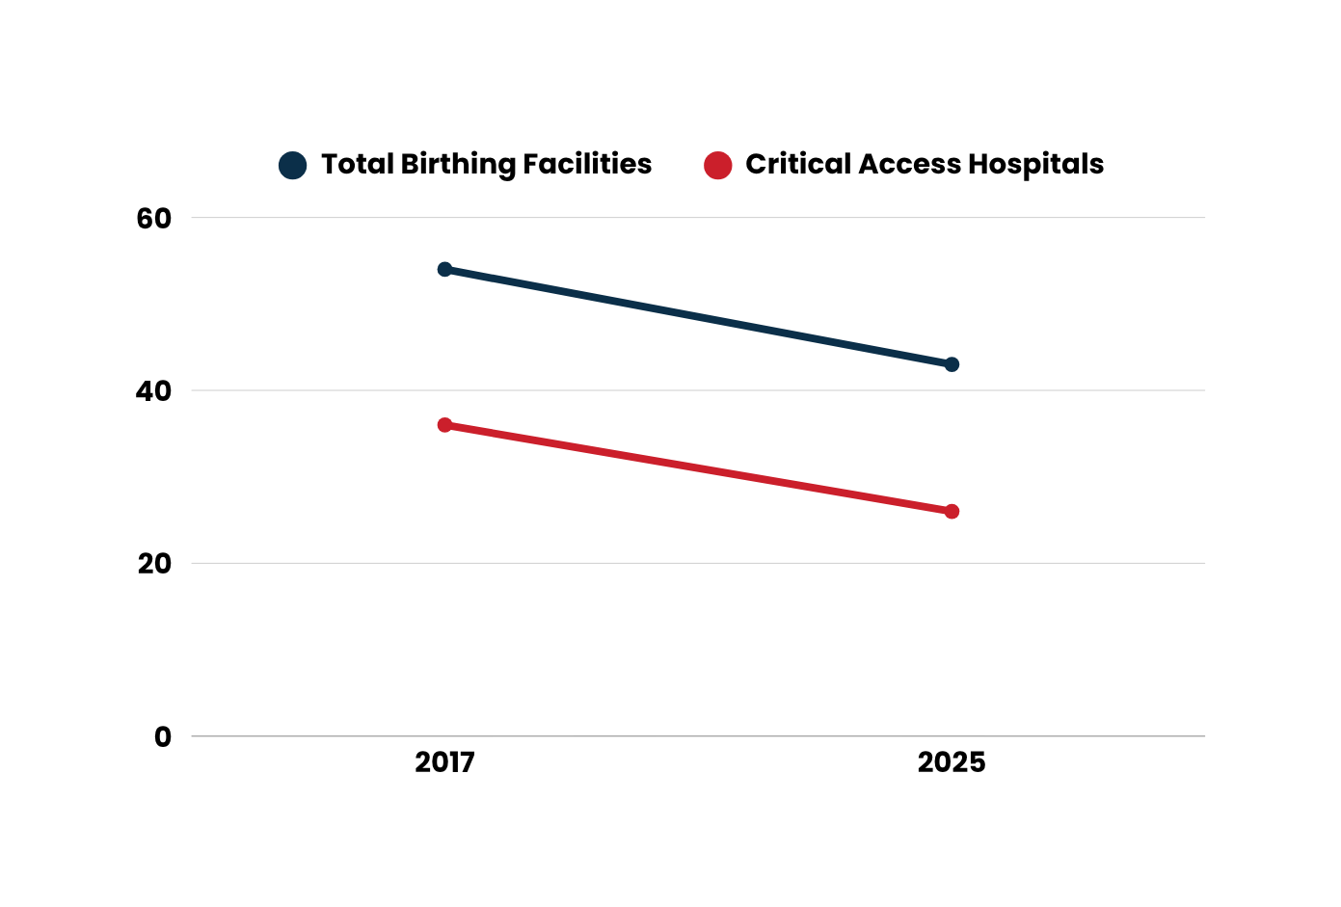


NEBRASKA BIRTHING HOSPITALS
62.2%
54
57 of 93 NE counties do not have a birthing facility
43
36
26
Regional Perinatal Health Care Centers (Level IV) only located in Omaha or neighboring states.

Slide 14


FACTORS IMPACTING RURAL HEALTH OUTCOMES
Higher poverty rates: Rural median incomes 20% below urban areas; 16% of rural Nebraska children live in poverty
Housing issues: 6% of rural homes are inadequate quality
Food insecurity: 15% of rural households lack access to healthy food
Childcare deserts: 36% of rural Nebraskans live in areas lacking childcare
Transportation barriers: Rural residents travel twice the distance for healthcare
Closure of facilities and/or loss of services
Lack of providers: Only 7.7% of maternity care providers practice in rural NE counties
Nebraska Hospital Association, 2024

Slide 15
NEBRASKA PERINATAL QUALITY IMPROVEMENT COLLABORATIVE (NPQIC) MATERNAL SAFETY INITIATIVES

Slide 16
WHAT IS NPQIC?
State Perinatal Quality Improvement Collaborative (PQC), founded in 2015.
Mission: NPQIC seeks to improve the delivery of and access to evidence-based health care for all Nebraska mothers and newborns.
Current Initiatives:
Postpartum Alert
Perinatal Substance Use Disorder
Obstetric Hemorrhage
Respectful Care
Previous Initiatives:
Breastfeeding
Doula Support
Severe Hypertension
Prematurity Prevention
Hyperbilirubinemia
Perinatal Mental Health
Prevention of Primary Cesarean
Count the Kicks

Slide 17
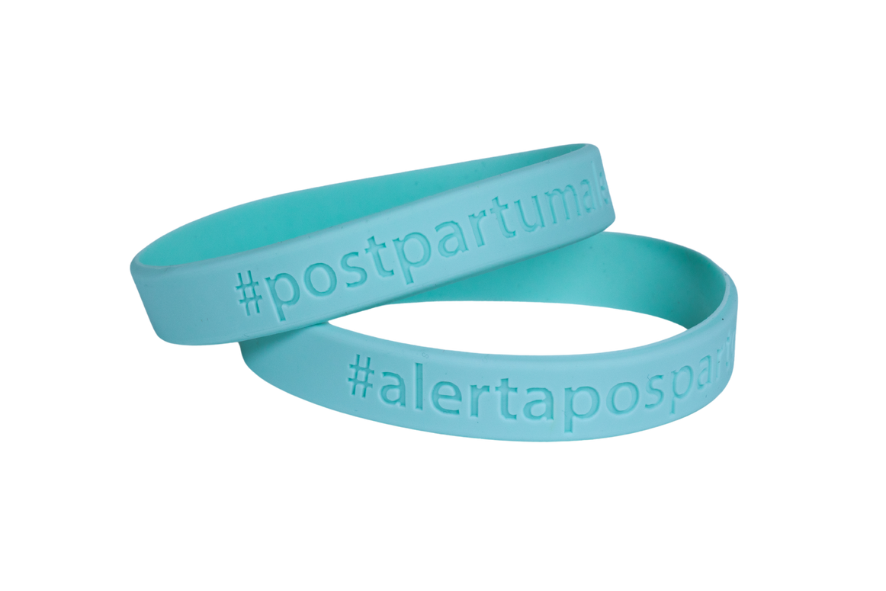
POSTPARTUM ALERT INITIATIVE
A statewide maternal safety program that launched May 15th, 2025
Aims to reduce maternal mortality and improve postpartum care.​
A visual alert system using teal wristbands.​
Worn by postpartum patients for six weeks after delivery.​
Goal is to improve recognition and response to postpartum complications.
Notes:
Educates patients about warning signs requiring immediate medical attention​
Ensures healthcare providers recognize postpartum status and respond quickly to complications.​

Slide 18
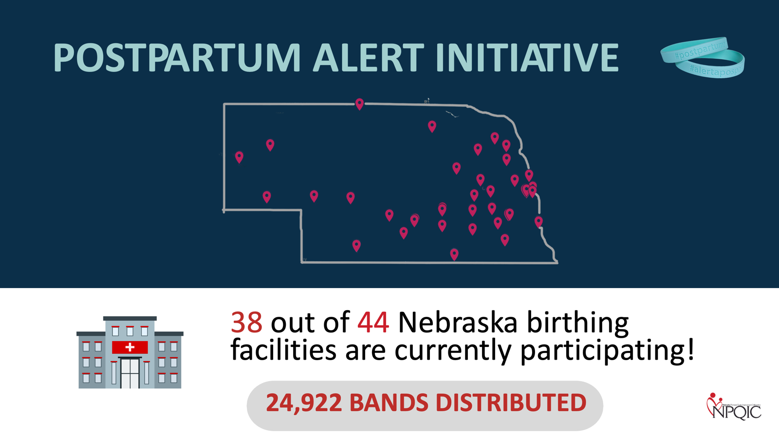

Slide 19
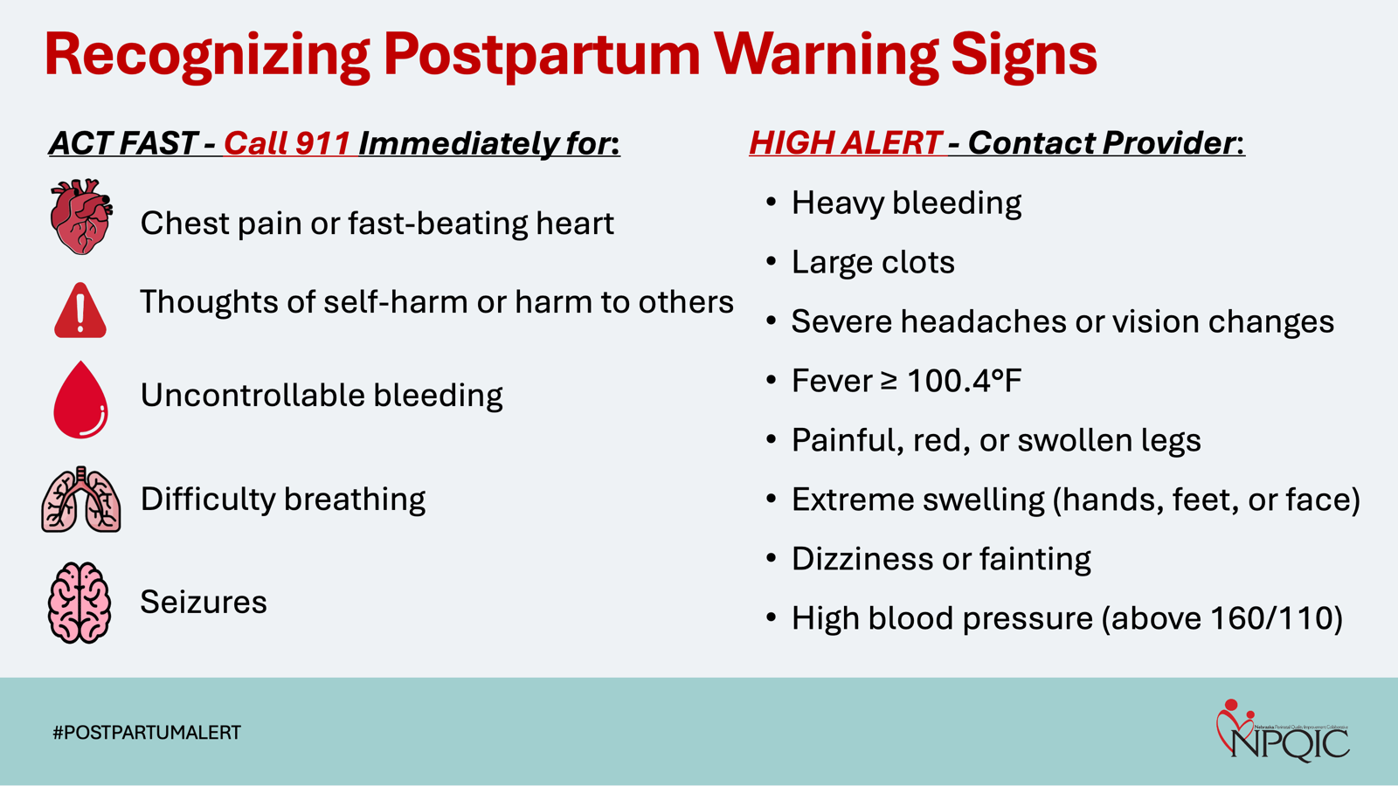

Slide 20
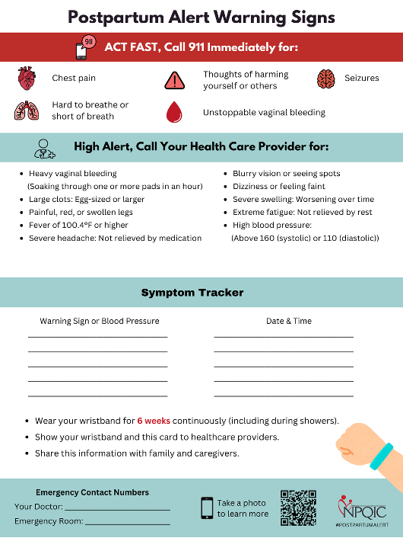

PATIENT EDUCATION RESOURCES
Patient Education
Multiple Languages:
Wristband
Wallet card
Postcard
One-pager
English
Spanish
Karen
Arabic

Slide 21
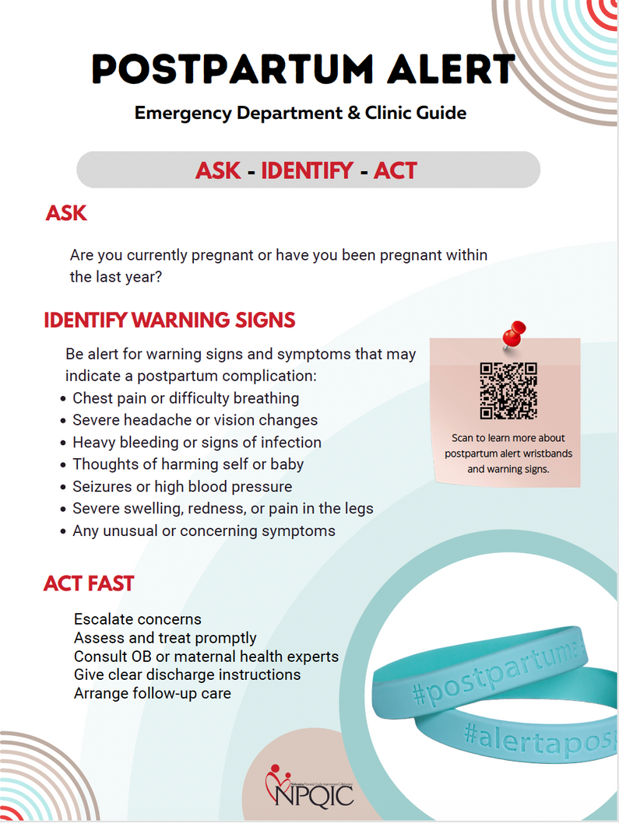

PROVIDER & STAFF EDUCATION RESOURCES
Webinar Recordings:​
Launch Webinar Recording​
Clinical Education: Urgent Maternal Warning Signs by Dr. Todd Lovgren ​
Clinical Resources:​
Quick Reference Guide
Emergency Department and Clinic Poster​
EMS Provider Poster
EMS & ED Engagement
38
ED Contacts
45
EMS Teams

Slide 22

Evaluation and Follow-Up
Hospital Teams
Follow up with patients 6-7 weeks postpartum
Goal: Up to 10 patients per quarter
Data entry in RED Cap started in Q3 2025
ED Provider and EMS Survey
Will be sent in January 2026 to assess awareness and impact
Notes:
Educates patients about warning signs requiring immediate medical attention​
Ensures healthcare providers recognize postpartum status and respond quickly to complications.​

Slide 23

Evaluation Metrics
Wristband Receipt & Usage
Symptom Experience & Care-Seeking Behavior
Provider Recognition of Wristband
Patient Confidence in Recognizing Warning Signs
Patient Demographics (collected from the chart)
Notes:
Educates patients about warning signs requiring immediate medical attention​
Ensures healthcare providers recognize postpartum status and respond quickly to complications.​

Slide 24


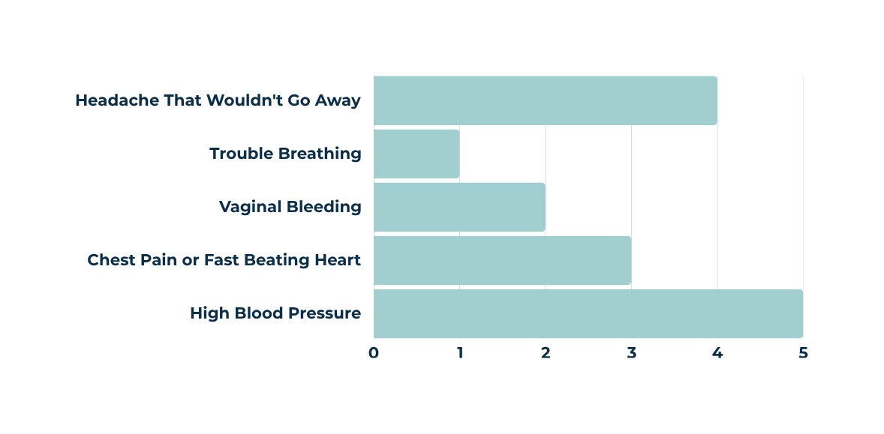
1 in 5 Mothers Reporting Experiencing a UMWS
90%
Of mothers indicated that they were confident or very confident in their ability to recognize urgent maternal warning signs and when to seek medical care

Slide 25

ALLAINCE FOR INNOVATION ON MATERNAL HEALTH INITIATIVES
Patient Safety Bundles
5 R’s
Readiness
Recognition & Prevention
Response
Reporting
Respectful Care
Structured way of improving the processes of care and patient outcomes using evidence-informed best practices which address clinically specific conditions in pregnant and postpartum people.
Nebraska Initiatives
Severe Hypertension in Pregnancy
Obstetric Hemorrhage
APROACH
Implementation
Educational Webinars
Individual and grouped coaching calls
Quarterly data monitoring

Slide 26



OBSTETRIC HEMORRHAGE
June 2025 - December 2026
5
3
Key Elements
Obstetric hemorrhage management processes including:
Rapid response team, Stage-based obstetric hemorrhage emergency management plan, Massive transfusion protocols
Hemorrhage cart with supplies, checklists, and hemorrhage medications
Interprofessional and interdepartmental education and team-based drills
Quantitative blood loss for all deliveries
Monthly
Educational Webinars
Cohorts of Hospital teams
Collection of structure, process, and outcome measures started in Q3 2025
41
Birthing Hospitals

Slide 27


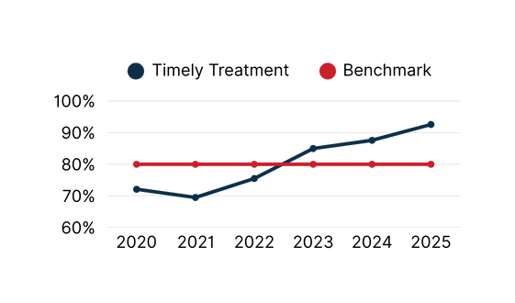
SEVERE HYPERTENSION IN PREGNANCY
2019 - June 2025
30,000
Key Elements
Process for management of pregnant and postpartum patients with severe hypertension including:
Maternal early warnings signs criteria, treatment algorithms, and escalation plans
Accurate measurement of blood pressure and timely treatment for hypertensive disorders
Interprofessional and interdepartmental education and team-based drills
Postpartum follow-up visits for patients who experienced a hypertensive disorder
105
Urgent Maternal Warning Sign Magnets
Available in 4 languages
Preeclampsia Foundation Blood Pressure Cuff Kits
Timely Treatment of Severe Hypertension
29
Birthing Hospitals

Slide 28
STRATEGIES AND RESOURCES FOR RURAL HEALTHCARE SETTINGS

Slide 29

GOAL:
ENSURE RURAL WOMEN CAN ACCESS QUALITY MATERNITY CARE CLOSE TO HOME
Nebraska Maternal Mortality Review Committee (MMRC) Priority Recommendations:
Closed-loop social support
Non-discriminatory practices
Behavioral health access
Healthcare best practice adoption
Domestic violence safety plan development
Care continuity
Medical care access
Strategies:
Statewide coordination to improve maternal health
Expand effective programs
Increase education and training opportunities
Share best practices, policies, and protocols

Slide 30
CMS Final Rule – CoP Changes:
OBSTETRICAL SERVICES
Conditions of Participation changes for PPS and CAHs for OB services:
Maternal quality assessment and performance improvement (QAPI)
Baseline standards for the organization, staffing and delivery of care within OB units
Staff training on evidence-based best practices every two years.
Set of Requirements | Effective Date
Applies to all acute care and CAHs regardless of whether they offer OB services: Emergency services readiness Equipment, supplies, protocols (OB emergencies, complications, and immediate post-delivery needs) Staff training annually on protocols and provisions Transfer protocols Within the same hopsital or to a different facility | July 1, 2025
Applies to all acute care and CAHS with OB services: Organization and supervision of services Delivery of care Staff Training Quality Assessment and Performance Improvement Program | January 1, 2026
Notes:
COPS: Conditions of Participation
PPS: Prospective Payment System

Slide 31
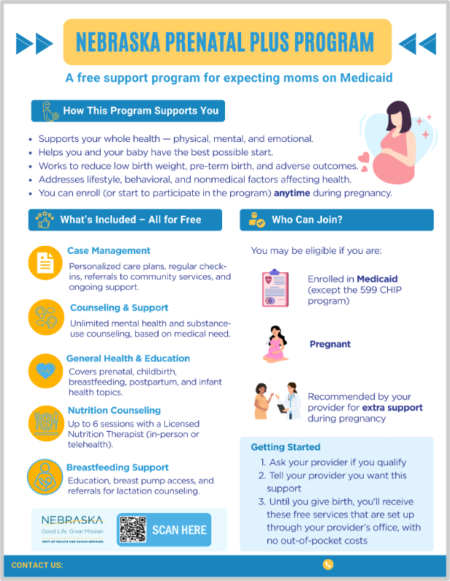
PRENATAL PLUS PROGRAM
Launched January 1, 2025
Provides essential support to pregnant women who:
Eligible for Medicaid
Identified by their healthcare provider as being at risk for adverse maternal or infant health outcomes.
NE DHHS Prenatal Plus Program
Notes:
The Legislative Bill 857 (LB857, 2024) requires NE Medicaid MCO’s to …
This program is designed to help improve health outcomes by offering services throughout the prenatal period, from enrollment until delivery.
The purpose of the Prenatal Plus Program (PPP) is to reduce the incidence of low birth weight, preterm birth, and adverse birth outcomes while also addressing other lifestyle, behavioral, and nonmedical aspects of an at-risk mother's life that may affect the health and well-being of the mother or the child.​

Slide 32

ALLAINCE FOR INNOVATION ON MATERNAL HEALTH
Patient Safety Bundles
Structured way of improving the processes of care and patient outcomes using evidence-informed best practices which address clinically specific conditions in pregnant and postpartum people.
NPQIC implemented Severe Hypertension in Pregnancy and Obstetric Hemorrhage
Maternal Early Warning System Implementation Resource Kit
Collection of best practices to aid in readiness efforts to appropriately care for people experiencing obstetric emergencies in non-obstetric or lower-resources settings
Obstetric Emergency Readiness Resource Kit
Collection of best practices to aid in the early recognition of changes in pregnant and postpartum patient’s vital signs and clinical conditions.
AIM Resource Kits
Notes:
The Legislative Bill 857 (LB857, 2024) requires NE Medicaid MCO’s to …
This program is designed to help improve health outcomes by offering services throughout the prenatal period, from enrollment until delivery.
The purpose of the Prenatal Plus Program (PPP) is to reduce the incidence of low birth weight, preterm birth, and adverse birth outcomes while also addressing other lifestyle, behavioral, and nonmedical aspects of an at-risk mother's life that may affect the health and well-being of the mother or the child.​

Slide 33
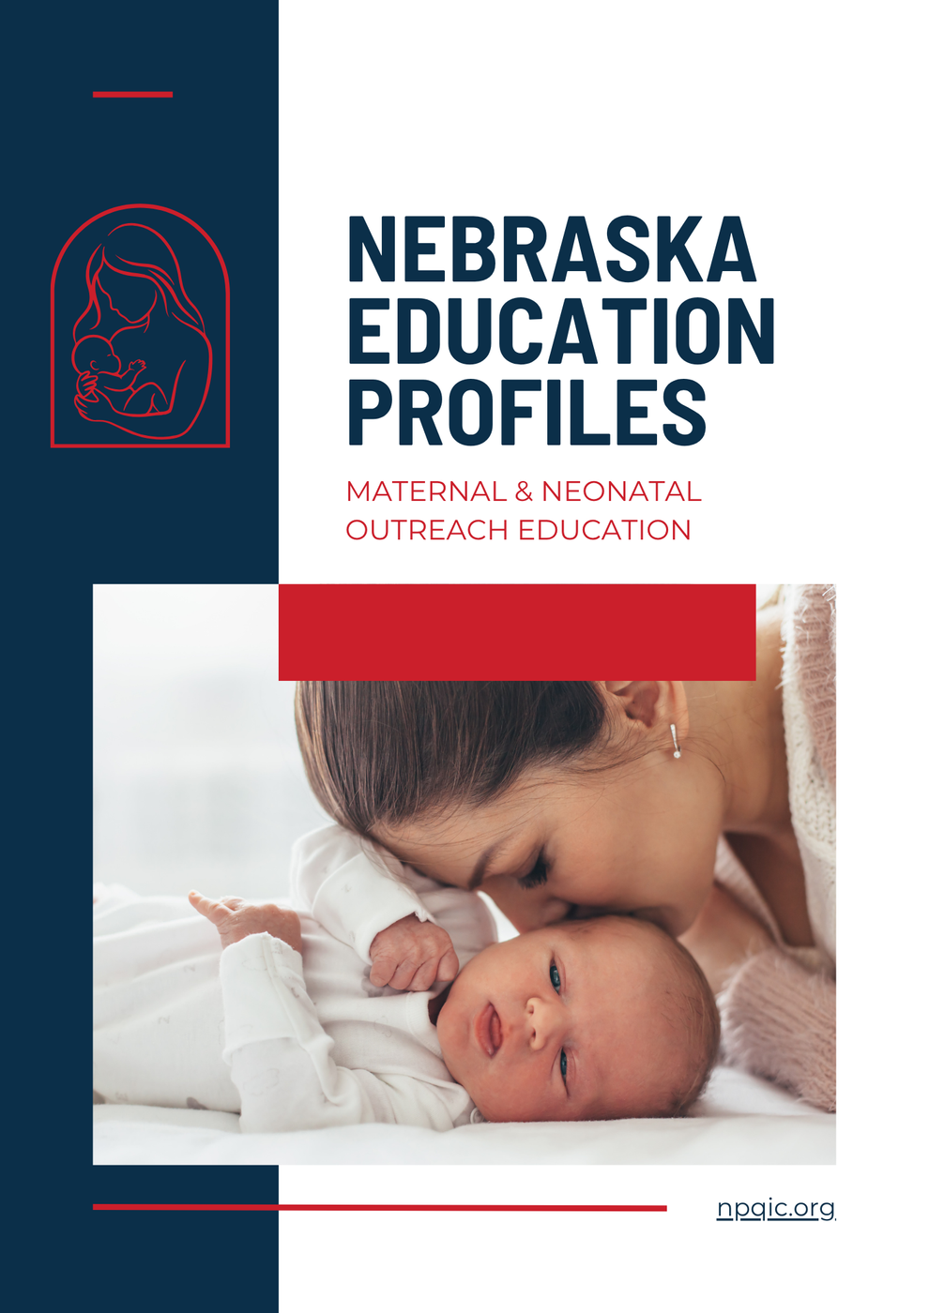
MATERNAL & NEONATAL EDUCATION RESOURCES
Profiles for organizations providing education across Nebraska.
Training offerings
Cost
Training locations
Etc.
Nebraska Education Profiles: Maternal and Neonatal Outreach Education
Notes:
The Legislative Bill 857 (LB857, 2024) requires NE Medicaid MCO’s to …
This program is designed to help improve health outcomes by offering services throughout the prenatal period, from enrollment until delivery.
The purpose of the Prenatal Plus Program (PPP) is to reduce the incidence of low birth weight, preterm birth, and adverse birth outcomes while also addressing other lifestyle, behavioral, and nonmedical aspects of an at-risk mother's life that may affect the health and well-being of the mother or the child.​

Slide 34
QUESTIONS OR COMMENTS

Slide 35






THANK YOU
CONNECT WITH US
npqic.org
LinkedIn
Facebook
Instagram

