Slide 1
Quality Residency
Capstone Project
nebraskahospitals.org
Kayleigh Allen
Beatrice Community Hospital and Health Center

Slide 2
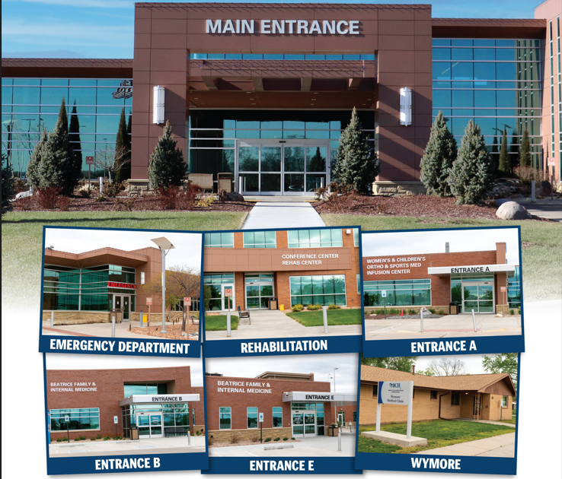
Beatrice Community Hospital and Health Center
25-bed Critical Access Hospital in Southeast Nebraska.
8,243 Emergency Department Visits
1,051 Acute Care Admissions
49,444 Clinic Visits
The organizational strategic plan and goals to increase annual adjusted outpatient visits for 2023 and decrease unnecessary Emergency Department utilization aligned with the performance improvement project to reduce the number of patients with no established primary care provider seen in the ED.
Notes:
Beatrice Community Hospital (BCH) is a 25-bed Critical Access Hospital (CAH) in southeast Nebraska covering Gage County as well as several surrounding counties for care close to home. In 2023, we had 8,243 Emergency Department visits, 1,051 Acute Care admission, and 49,444 clinic visits. We have 545 employees and 58 employed providers
We offer:
Rehabilitation Services
Express Care
BFIM
Women’s & Children’s Clinic
General Surgery
Infusion Center
Immunization Clinic
Orthopedics and Sports Medicine
Pain Services
Wound & Ostomy Services
Wymore Medical Clinic
Specialty Provider Clinics-
Cardiology
ENT
Pulmonary
Team Members: Quality, Executive Sponsor-CNO, Clinic Supervisor, Physician Clinic Receptionist Supervisor, Director of Patient Accounts, Director of Emergency Services and Clinic Case Managers

Slide 3
AIM Statement
The aim of this project is to establish a consistent workflow for patients identified in the Emergency Department as not having a PCP to have a follow-up appointment, with a Primary care provider, and establish care. Currently the average is 14% of the Emergency patients do not have a PCP. When broken down to Beatrice, Wymore/Blue Springs makes up 59% of those visits on average.
Notes:
The aim of this project is to establish a consistent workflow for patients identified in the Emergency Department as not having a PCP to have a follow-up appointment, with a Primary care provider, and establish care. Currently the average is 14% of the Emergency patients do not have a PCP. When broken down to Beatrice, Wymore/Blue Springs makes up 59% of those visits on average. When looking at lives versus visits (due to repeat visits) 53% are from Beatrice or Wymore/Blue Springs area.
An increasing number of patients coming into the Emergency Department have been identified as not having a Primary Care Provider.
The Emergency Room is the highest cost area for patients to receive care.
This can also tie up rooms in the Emergency Room that could be utilized for higher level of care patients.
This does not meet with the standards of serving our community.
The patients are without a consistent follow-up for care, unless they make it themselves.
This can impact Readmissions as well as the 72 hour return visit quality metric.
Inconsistent work flow for which primary care provider will do the follow-up and how it is set up for the patient.

Slide 4
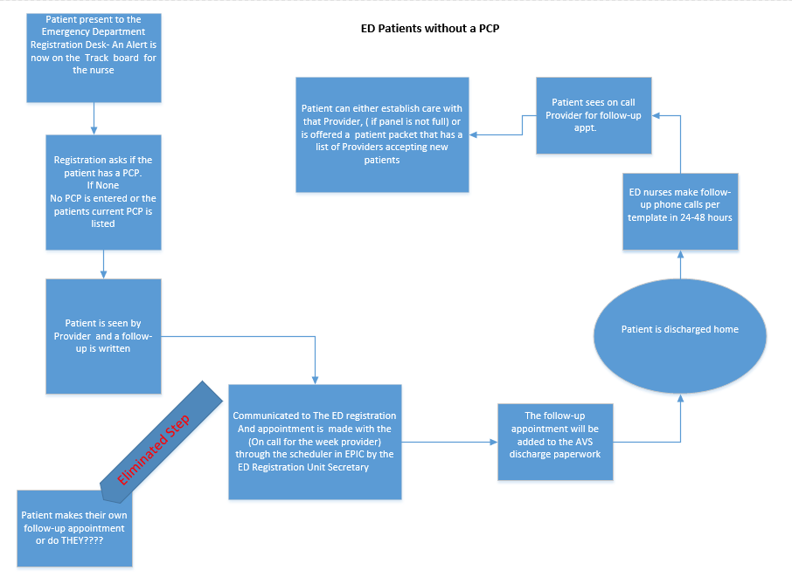
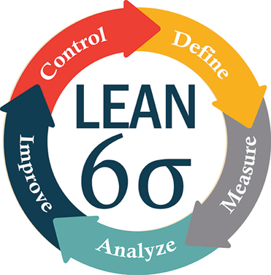
Selecting Changes
Notes:
The process improvement method utilized was the lean six sigma DMAIC cycle. The DMAIC cycle consists of define, measure, analyze, improve, and control phases
Define: Through this process it was noted that there was an increasing number of ED patients as well as 72 hour returns to the ED that had no Primary Care Provider allocated to them. Prior to the project we had a month with as high as 8 people with a 72 hour return to the ED.
Measure: The team studied the current ED throughput report and added addresses and towns of the patients to identify the scope of patients that would be focused on for this project. The team evaluated the current process of asking the patients who their PCP is for those that did not have one listed in the EHR.
Analyze: Continued to see the inconsistent way of asking who the patient’s PCP is as well as inconsistent methods for changing the PCP in the electronic health record. It was also found that the process for follow-up with a clinic provider was inconsistent. Some patients had an order to follow up and some did not. It was agreed that not all patients needed a follow-up visit, but it was a good time to get the patient established with a PCP if they did not have one.
Improve: a process map was developed to give workflows to front desk staff, nurses, case managers and providers.
case managers in the clinics would make follow-up phone calls to all patients that were seen in the emergency department. At this time, the case manager would make follow-up appointments to be seen by the newly assigned PCP for the ED follow-up or to get them their first appointment with the newly assigned PCP to establish themselves officially as their patient.
ED providers were trained to be more consistent with which patient really needs a follow-up appointment for their ED visit and which patients could wait for a later appointment to become established.
It was decided that patients without a PCP will be assigned to the on-call provider. Patients may also be offered an appointment with a provider that has more flexibility to see new patients if the on-call provider’s schedule was full.
Pediatric patients from Beatrice were referred to the Beatrice Children’s Clinic. Pediatric patients from Wymore and Blue Spring were given the option of Beatrice Children’s Clinic or Wymore Clinic for their PCP.
Control: All responsibilities were assigned to individuals to keep the process active with appropriate accountability. Quality will own the report and share the results with the ED director, registration director and clinic director

Slide 5
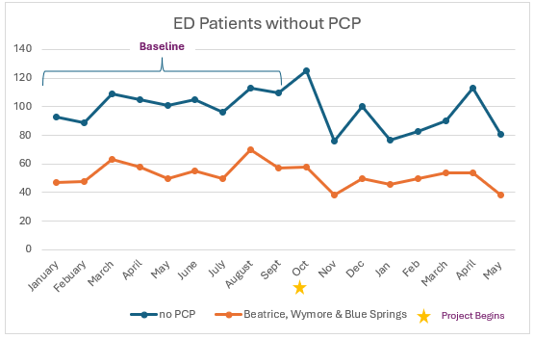
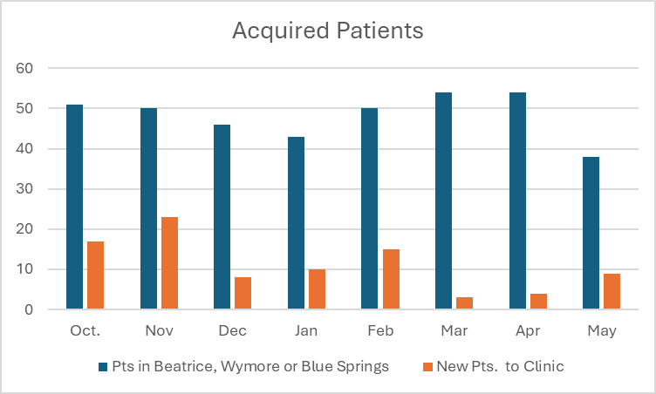
Measuring Success
Notes:
The process of patients that present themselves to the emergency department was modified with this project
Even though we did not meet our goal of 95% of all patients seen without a PCP would have a follow-up visit, the positive number of patients that have established with a provider since the start of this project was an accomplishment on its own.
A total of 139 patients to date have been established with a primary care provider with ED patients with no PCP were down to 11%

Slide 6
Return on Investment (ROI)
Patient Satisfaction
Staff Satisfaction
Notes:
Patient Satisfaction:
Clinic Case Managers are present CCM services
Cheaper than ED
Closer follow up
Staff Satisfaction
Unnecessary soft admissions
Not taking up necessary ED beds to focus on more complex patients
Proper utilization for appropriate level of care

Slide 7
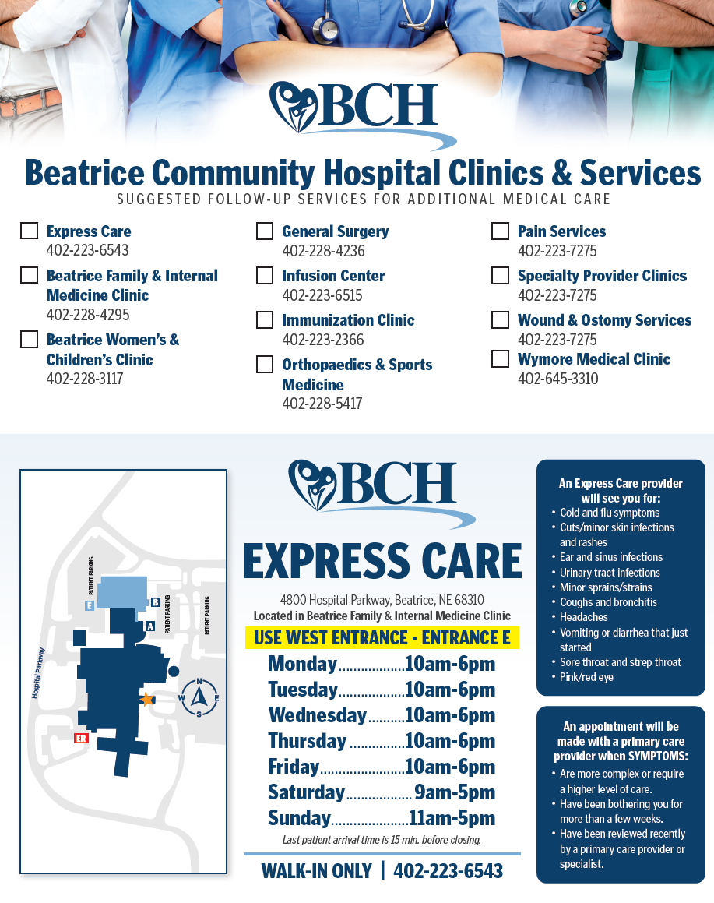
Spreading / Sustaining / Maintaining / Replicating
Express Care Clinic
Other Community Connect Sites
Notes:
The senior leader for our Express Care Clinic is working to implement the same process for patients that come through the Express Care Clinic without a PCP.
We have also heard that other community connect sites that share our EHR are planning to implement this process and structure in their facilities. Even though we utilize Epic as our EHR, this workflow could easily be implemented with any other EHR.

Slide 8
THANK YOU/Questions
Kayleigh Allen, CSW
Quality Population Health Manager/Social Worker
Office: 402-223-7279
E-Mail: kdallen@bchhc.org
nebraskahospitals.org

