Slide 1
Mock Trial
Carrie O’Brien, BSN, RN, VA-BC
Chastity Orr, MSN, BSN, RN, CPAHA
Rebecca Harling, Lincoln County Attorney
Katie Silva, BSN, RN
Notes:
Intro, state who we are, that Rebecca (point) will be up with us shortly. Katie Silva is unable to be here with us today but she was an incremental part of this projects and this presentation

Slide 2
No Disclosures

Slide 3
Objectives:
Discover out of the box method to bolster nursing engagement in education
Use quality indicators to guide the direction of a Mock Trial
Define outcomes of educational engagement supported by data
Discuss engagement with Lincoln County Attorney
Notes:
Explain Tandem back and forth presentation.
CARRIE -As we present Chastity and I will be doing a tandem presentation explaining each level of the 2 Mock Trials Great Plains Health created in 2024.

Slide 4
Educational Engagement
Notes:
We are going to talk about educational engagement…
Educational engagement in a nutshell is the degree to which people are actively involved, interested, and motivated in their learning process, encompassing their attention, effort, and emotional connection to the learning environment and content.
So… how do you grab interest… how do you increase attendance… how do you get your staff involved

Slide 5
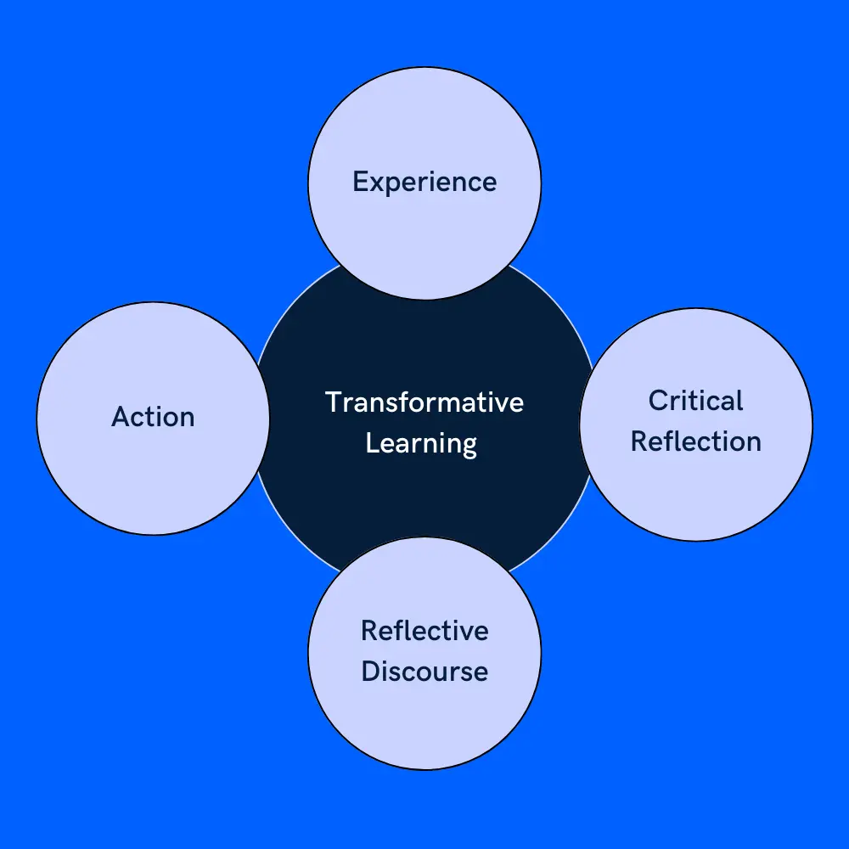
Adult Learning Principles
Behaviorists
Humanists
Cognitivists
Social Learning Theorists
Notes:
When planning any educational event, you should focus on the adult learning principles and attempt to include as many as possible….
Behaviorist theory believes that adult learning occurs as a result of the surrounding environment, not as a result of anything the learner does. behaviorist learning theory is used extensively in healthcare Code Blue.
Behaviorist learning theory has provided many of the planning basics we use today, including developing learning outcomes, providing feedback to learners, and evaluating learning activities to improve them.
In humanism, learning is student‐centered and personalized, and the educator’s role is that of a facilitator of learning. Humanists believe that we all have a drive to learn
Cognitive learning puts an emphasis on the importance of experience, meaning, problem‐solving and development of insights.
Social learning theory is a bridge from behavioral to cognitive models and looks at learning from the standpoint of observation.
Now, we want to attempt to encompass as many of these theories as possible to engage our staff

Slide 6

Mock Trial
Simulated court case
Role-play
Which adult learning theory?
Where did we start?
Notes:
I had the idea of using a Mock Trial to help guide education, I was in Mock Trial in high school and it left an impression
When your looking at the benefits of a mock trial it is created based on facts of cases, patients, experience. You have staff and colleagues in roles as witnesses, jury, legal team.
Which adult learning theory does a mock trial include?
All 4
Behavioral putting them In a court room setting, creating the environment
Humanist have the staff testify based on their roles and specialties
Cognitive showing the importance of their role by having staff be questioned as though in a true court case by lawyers in a prosecutor and defense role.
Social learning, observational stand point.. Teaching them as members of the jury, awaiting as a witness, and as spectators.
Once you have what your educational goal is then where do you start to choose a topic, well I oversee the Sexual Assault Program at GPH

Slide 7
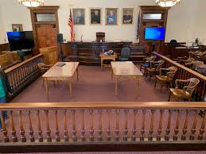
Sexual Assault Nurse Examiner Mock Trial
Anne Boatright MSN, RN SANE-A FAAN
Rebecca Harling, Lincoln County Attorney
Mariah Nickel, Assistant Attorney General
Lincoln County Court House
Notes:
I reached out to Anne Boatright Nebraska’s Sexual Assault Coordinator in September of 2023 to see if this was a project she would be up for helping me with.
Anne thought this was a great opportunity for the sexual assault nurses at Great Plains Health and she was thrilled to help.
As I spoke with her, we thought it would be great to encompass lawyers from Lincoln County and the NE Attorney Generals Office.
Next, I contacted Rebecca Harling, Lincoln County Attorney, she was very excited about the opportunity and was ready to help in anyway possible.
Rebecca brought up using the court room at the Lincoln County Court house and was willing to facilitate obtaining the court room for the event.
I coordinated with Rebecca and Anne on a date for the Mock trial, with including all our calendars and the court room schedules we decided the best time would be March 2024.
Anne spoke with one of her colleagues Mariah Nickel an Assistant Attorney at the Nebraska Attorney Generals Office, who was eager to help with the Mock Trial.
Now that you have everyone involved you need to build the trial.

Slide 8

Sexual Assault Nurse Examiner Mock Trial
Notes:
Rebecca offered to be the prosecutor and Mariah was gracious enough to be the defense attorney, she typically is not a defense attorney
Anne then pulled a variety of sexual assault cases from throughout the state to compile together to create our Sexual Assault Mock Trial case. This included photos and paperwork that is specific to the state of Nebraska.
Then who is going to be the witnesses reviewing the documentation? Well at that time GPH had 9 sexual assault nurses and we decided we would break the documentation up and each nurse would then testify for each section.
The invitation was sent to all our SANE nurses in September when the date was set. This allowed these nurses to make sure they were available to attend.
As they were witnesses, we paid them for the time they attended the event and provided them with continuing nurse education hours.
We also created a fake Curriculum Vita or CV as this often gets referenced during a witness's testimony to prove they are qualified to testify and have a background to care for these types of patients.
Which also gave the nurses an example of how to create their own CV.
At GPH we have a great available program that can award continuing nurse education. As we went through that process and our created documents for the witnesses we needed to determine what was the time frame we were going to need.
Working with Anne we determined a 4 hour court case would give the impact we were looking for.
Now Carrie is going to speak about how Katie and her continued to expand on this type of educational engagement

Slide 9

“Death by Documentation” Mock Trial
Notes:
Carrie
Katie and I were invited to be guests for the sexual assault mock trial as an educational opportunity in our Quality Department. Being able to watch the sexual assault mock trial was impactful to us as Quality Nurse Abstractors.
We see gaps in charting during our abstractions and we became excited on how we could use a mock trial to bring forward those gaps in documentation in a way that empowered our nurses, not make them feel as though we were just pointing out what they are missing.
After the sexual assault mock trial, our Manager saw our excitement, as we bounced around ideas on how it could help our nurses, and she suggested that we develop something similar.
As she is our Director of Patient Safety and Risk Management reached out to our County Attorney, Rebecca to see if she would be willing to help facilitate a similar trial for us. Rebecca said yes ☺
Next, We asked ourselves…”How we can we use a mock trial to bring forward the gaps in documentation that we see from our charts?”
What data points are we missing from our abstractions?
How can we touch as many of our nurses as possible? We wanted all our Nurses to attend this event.
During this pre-planning phase, you can be overwhelmed on how to move forward…We were. Having a planning committee with your key stakeholders is imperative.
We had planning meetings with Quality and Nursing Leaders and our Primary Nurse Planner for continuing education.
We identified that we would not be able to build a chart that encompassed all Nursing modalities.
So, we needed to get our Nurse educators involved… to help create an educational presentation, that include other modalities such as OB MOM/Babe.
How do we get their attention and get all modalities to sign up? Named it “Death by Documentation” to grab attention.
We had all the key players needed to move forward.

Slide 10

“Death by Documentation” Mock Trial Planning
Notes:
We met with our CNO and got her buy-in to help us recruit staff for witnesses. Our CNO reached out to our nursing managers to have a minimum of 4 nurses per floor, volunteer to be witnesses.
We only needed a couple nurses as witnesses from each floor, but we wanted extra available for backup
We were able utilize our charge nurses and preceptors in these roles . These nurses were given just a section of the chart to review a couple days before the trial, via email.
We asked our nurse educators to help by building our educational presentation. We asked them to show examples and give the why behind certain documentation that is required in their areas.
We wanted to make sure that examples of good charting and opportunities for improvement were available for every specialty, since our chart was not able to encompass all of our nursing specialties.

Slide 11
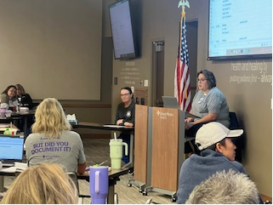
“Death by Documentation” Mock Trial Timeline
Notes:
We wanted to create a timeline, that way everyone was on the same page during our planning.
From the beginning, we knew we wanted to offer continuing education hours to our nurses. We decided our education event would be from 8-1pm with the last hour being education. The first 4 hours was the mock trial.
Katie and I wanted to be respectful of Rebecca’s time and we also worried about losing an audience if it went too long. When Rebecca confirmed that she was willing to participate in another mock trial, we asked for dates that she would be available in the fall. We knew we would need plenty of time to plan everything.
We chose November 7th, 2024. We liked this date for a couple of reasons.
#1 It was March/April while we were planning on how we wanted our Mock Trial to look. This would allow for the building of the chart and education pieces to not be rushed.
#2 Nursing license renewal was Oct 31st, so perhaps we could pull in a good crowd with it being a new cycle to gain our educational hours.
When meeting with your Planning Committee, you need to have a few key points to discuss. Here’s a few of ours:
Nursing participation. By offering 4.5 continuing nursing education hours to help pull interest. We offered our volunteer witnesses to be paid as well as earning continuing education. We developed a flyer to put into our weekly announcements, CEO newsletter and on our great plain's televisions.
How do we have staff sign up? We used our online educational hub for our staff to sign up. This allowed us monitor how many people since we had a seat capacity of 100.
Swag-we developed a T-Shirt for all members of our Planning Committee and our Education Team to wear at the event. “But did you document it?”
We decided to offer a breakfast bar during registration and offered snacks during our break. Everyone know nurses love food.
We also had cute little books and pens for notes for our “gallery” or audience
We put together gift baskets for our County Attorney office for being such huge role in our Mock Trial.
During the pre-planning phase we determined monthly planning meetings would help facilitate working through each step of the mock trial.
Our first monthly planning meeting started in March. April and May we came up with “due dates” It was decided Katie and I will have the mock trial patient chart to education department by end of July.
Education will have there power point presentation ready by end of August for Katie and I to have time to review and make or add any changes.
We also had our shirts made in September. We really tried to allow plenty of time in case there were any hiccups along the way.
Next Chastity and I will review how we picked the content of our Mock Chart

Slide 12
Quality Indicators
Notes:
Chastity, A part of determining your education for staff is what is the content, what do they need?
This is where Quality indicators play a role. Quality indicators are standardized, evidence-based measures that can be used to measure and track clinical performance and outcomes.
If we can help identify areas for Improvement in clinical practice, we can help improve patient safety and outcomes in our hospital.
We can use our data to create a culture of continuous improvement with our Nurses.
Quality Indicators can be derived from chart audits, assessment needs, department requests, and high risk situations.
Honestly the sky is the limit as long as you have indicators to guide you.
These are indicators that we used for our Mock Trials.

Slide 13

Sexual Assault Nurse Examiner Mock Trial
High risk
First experience
Patients story
Notes:
Testifying in a sexual assault case is high risk low volume, I have been a sexual assault nurse for 10 years and have only been deposed once. A sexual assault case may take 3 to 5 years after the assualt to reach the court room.
It may be that sexual assault nurses first time testifying, on everything they do in a sexual assault exam from paperwork, to pictures, to collection of evidence.
This can be extremely intimidating and by using a mock trial we are able to rip off the band aide of the first experience of being in a witness box.
Part of the sexual assault documentation is having that patient walk through the assault and this verbatim charted. What a patient says to a healthcare provider is considered truthful.
That way if a patient is unable to testify this documentation can be used. This is why documentation can be the heaviest burden for a sexual assault nurse.
It can be scary for a nurse in court to know… How to talk about their charting, how to talk to an attorney, reviewing paperwork, reviewing pictures. For many of them this mock trial was their very first experience.

Slide 14
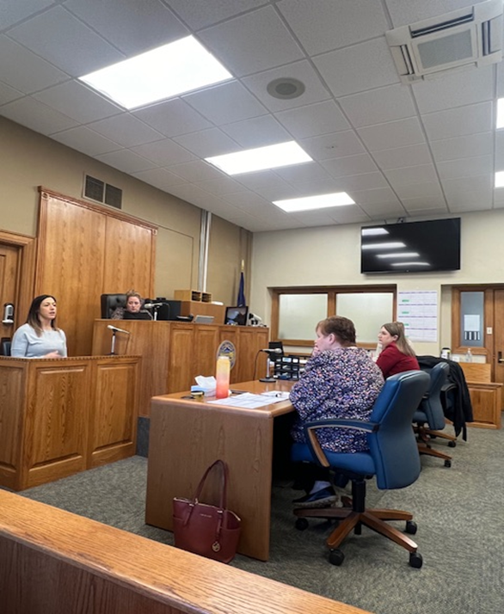
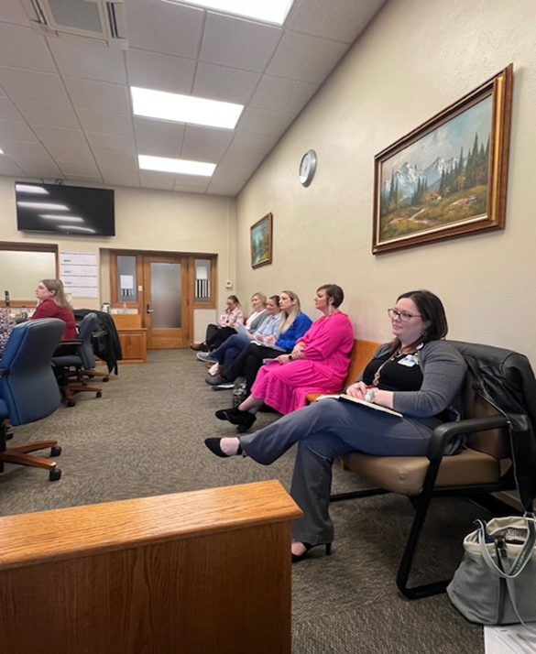
Sexual Assault Examiners Mock Trial
Notes:
These are pictures from our Mock Trial
Carrie will now share with you the quality indicators for “death By Documentation”

Slide 15

“Death by Documentation”
Trauma
Sepsis
Code Blue Event
Blood transfusion
Notes:
Carrie
As Inpatient abstractors, Katie and I look at trauma, stroke, sepsis, mom/babes, and psych patients. We also review multiple different charts for non abstraction purposes.
“We know that we are giving great care. Why aren’t we documenting it?
Some examples of areas that we noticed were missing data included : vital signs NOT being done frequently enough based on patient condition, provider documentation, pain assessments and reassessments, staff not charting in real time and/or not changing the documentation time to reflect the actual time that care occurred. Our goal was to pull in real charting into our Mock Trial Chart. How did we do that?
We collected multiple charts with some really excellent documentation and some charts with some really bad documentation in an attempt to bring forward the two ends of the spectrum
We had a trauma chart, sepsis chart, a patient that had a code blue event, blood transfusions, etc. We really attempted to encompass as many nursing specialties as possible. Our patient visited ER, Med/Surg, ICU. So we had to meshed multiple charts into one chart.
Katie and I had marked a few charts during our planning phase. We then worked them together to have our Mock Trial Patient, Cruella Deville, to “travel” through our hospital.
She started in the ER as a trauma patient that had fallen with a dresser on top of her and had been down for a few hours. She then went to the ICU, became stable, stayed on our Med Surg floor, then ended her stay in the ICU, where her “Death by Documentation” occurred.
We tried to have fun while building our chart, by using Disney Characters for staff names. Prince Aladdin and Meriada from Brave were just a few we used.
We used the names to remind our audience that this was not a “real chart” in its entirety. We did copy and paste documentation, to highlight those excerpts of poor quality documentation.
The goal of our education was to teach the importance of Nursing Documentation.
Katie and I wanted our nurses to get the WHY of documentation.
Why should I chart vitals more frequently than ordered…why should I chart that I called a provider… Why is my verbiage so important?
We chose to highlight documentation that we notice most frequently in our abstractions. Remember, what we noticed was a weak area in our documentation, might not be yours. You may notice other data points in your facility than we don’t, or vice versus .

Slide 16
Inappropriate Documentation…
Received patient from ICU tonight. States she fell, a few days ago at home, not sure when. ICU nurse was rushed and had to hurry back to her new patients. Patient has done alright during shift, only complaint of pain on hip when walking to bathroom with a walker. Voiding normal. Patient says she normally has low blood pressure "don't worry about it, my doctor knows." Vitals and Assessment done as ordered. Chart check completed.
Notes:
Here is an example of inappropriate end of shift report from our Mock Chart. This was to highlight how important our handoff’s are and what you put in the chart is part of the permanent record. Trust me, Rebecca had fun with this one! Let me read it to you….

Slide 17
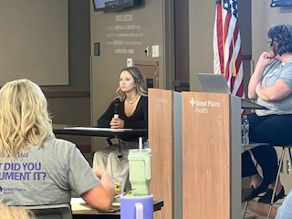
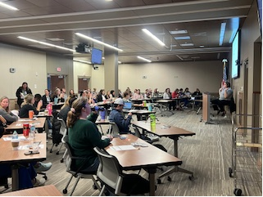
“Death By Documentation” Mock Trial
Notes:
Photos from Death from Documentation trial.
Both Chastity and I utilized our evaluation tools to obtain feedback.

Slide 18
Feedback
Notes:
Feedback from any educational event, helps guide future education and determines if your education was effective.
We will start with feedback from the SANE mock trial.

Slide 19
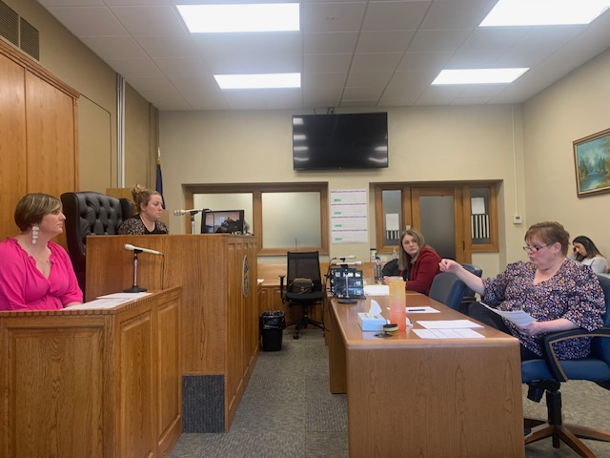
SANE Mock Trial Impact
Courtroom
Chart review
Bridge of Hope
Law Enforcement
Notes:
The impact for the sexual assault nurses was positive the feel of a real courtroom and sitting in the witness box was powerful. They stated they felt empowered and more comfortable in the room.
One of the first things that Rebecca told the sexual assault nurses was that the pace is up to the witnesses as the trial progressed, so that meant that the faster they answered the faster the defense asked questions trying to trip them up.
This helped several of the nurses when they started to feel overwhelmed by cross examination, they took breathes and slowed down. One of the newer nurses stated that they will feel more comfortable when the time comes for them to testify.
Some of the feedback help guide changes in future mock trial, the chart was given to the witnesses when they arrived that day in court and the sections were broken up then. The nurses did not get the opportunity to review it ahead of time which left them feeling under prepared.
When I spoke about this event to the sexual assault response team in Lincoln county the Bridge of Hope and Law Enforcement expressed their desire to have another mock trial where the case would start with the police all the way through the sexual assault assessment at the hospital and/or the BOH through the court preceding's.
The feedback was already setting up new opportunities for sexual assault education for our community response.
Next we will look at the feedback from “Death by Documentation”

Slide 20
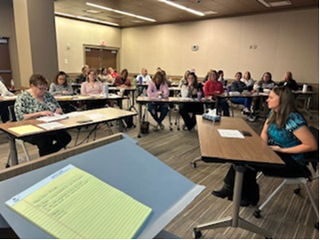
“Death by Documentation” Impact
Notes:
Carrie Feedback from the sexual assault mock trial was used to help guide how we ran our mock trial.
We saw and felt the impact of being in an actual courtroom while attending the sexual assault mock trial. We tried to set up our conference room to mimic a court room.
We had our Educational team sitting in the jury box with their T-shirts of “But did you document it?”; Katie and I sat to the side like a court scribe, while we ran the overhead monitors. We had our mock chart on display so the audience or gallery could follow along.
Our Director of Patient Safey and Risk Management played our Judge. Rebecca had the fun of playing both the prosecutor and defense attorney as her other attorney was unable to attend last minute.
We gave the witnesses their portion of the chart a couple days before the trial through email. We only gave our witnesses their piece they were role-playing for.
We were able to see that this was still not an adequate prep for the nurses. The feedback we received from our witnesses, is that it would have been beneficial to have a face to face.
We realized it would have decreased their anxiety to explain thoroughly that this was documentation FROM a chart but NOT their personal documentation. Even though the email they received explained they were role playing, some felt as though they were going to be viewed as it was their charting.
With over 80 attendees at our Mock Trial, it was very intimidating for our Witnesses to sit in front of their peers and Role-Play to bad charting. Had we done a better prep and role-playing prior to our trial, our witnesses would of felt more comfortable. I will say our Nurses did mention that it” felt very real and still felt as though they were at court. “
Unfortunately, we had to ask Rebecca to speed up her questioning and even skip some areas as we were running out of time. Our chart was simply too big to do in 4 hours.
We decided that other mock trials in the future would have to just be a snip-it of a hospital stay, in order to stay in our time frame, or schedule an entire day just for the trial piece.

Slide 21
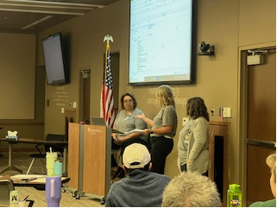
“Death by Documentation” Impact
Critical thinking
Improving documentation
Proper procedure
Notes:
Carrie
By utilizing our Charge Nurses and Preceptors our audience (and witnesses) were able to see the “grand picture”
Our witnesses were excellent at stating what should have been charted, what they would do from Evidence bases practices. When asked why something was missing, they were able to say “I don’t know why this is missing, I should of charted this…”
It really drove home the WHY that Katie and I were going for.
Another point that we were able drive home, was to increase critical thinking skills(i.e. taking VS after an abnormal reading, even if order says every 4 hours.).
Nurses on the stand were unable to testify to why or why not a provider was notified or not notified. Why a pain medication was given. A lot of this data was missing from the mock chart which showed those in attendance the importance of having that documentation.
Rebecca was great at stopping her line of questioning to explain why she was going down a certain line of questions. She explained her tactic of “taking the wind out of the sails of the defense attorney” by asking something before the defense attorney could.
She would pause and tell the audience what she would of taught you before the trial even began. She helped take the anxiety away from our witnesses.
While Feedback is a great way to see the impact and look for future opportunities, data is a great way to see the difference….

Slide 22
Data Outcomes
Notes:
Data drives our care throughout clinical and nonclinical areas, it allows us to see growth and opportunities for growth, as well as drives further educational options.
When looking at the sexual assault mock trial there is not tangible data to collect this was more of a subjective comfort level and high risk for sexual assault nurse. On the other hand “Death by Documentation” was able to do a before and after assessment utilizing objective data …..

Slide 23
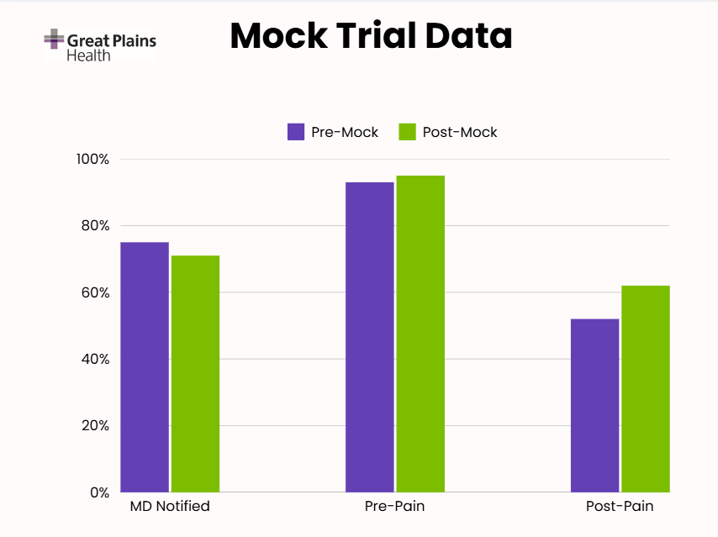
Notes:
CARRIE-In our feedback, The most common responses for how nurses would change their practice was documentation of providers and pain medication assessments/reassessments.
We chose to audit charts from ICU and Med Surg, the 3 months prior and the 3 months after our educational event . We did 30 charts per month looking at provider notification, pain medication pre and post assessments. Katie compiled all of the data we collected to view the effectiveness and outcomes of “death by documentation”
On the left you can see our physician notification pre-mock trial was 75% compliance, unfortunately there was a 4% decrease in notifications post mock trial.
In the middle is our Pre pain medication assessment before the Mock trial was a 93% compliance, there was a 2% increase in pre pain medication assessment after mock trial.
Finally, on the right is our Post Pain medication re-assessment prior to the mock trial was a 52% compliance, after the Mock trial there was a 10% increase in post assessments!!
Overall we felt our data showed a positive impact from our Mock Trial event.
Chastity: This is a great example of why an educational event should be looking at more then one data point, when staff start focusing on something that popped out to them at an education, they may miss other opportunities in their charting that they weren’t before. We need to continue to have education including these newly missed opportunities…

Slide 24
Lincoln County Attorney
Notes:
Now, Before I introduce our County Attorney, I have a little housekeeping…Please kindly remember, she is here to talk about her role in our Mock Trials. She is not here to answer legal questions. And ABOVE ALL, don’t try to steal her! She is awesome and she’s ours ☺
Honestly, Rebecca made our Mock Trial the hit that it was.
Ladies and Gentlemen, Rebecca Harling…

Slide 25
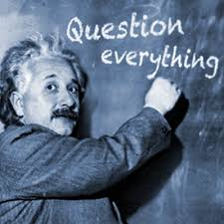

Slide 26
Contact Information
Chastity Orr orrc@gphealth.org
Carrie O’Brien obrienc@gphealth.org

