Slide 1


Slide 2

Children’s Nebraska – Behavioral Health
October 2025

Slide 3
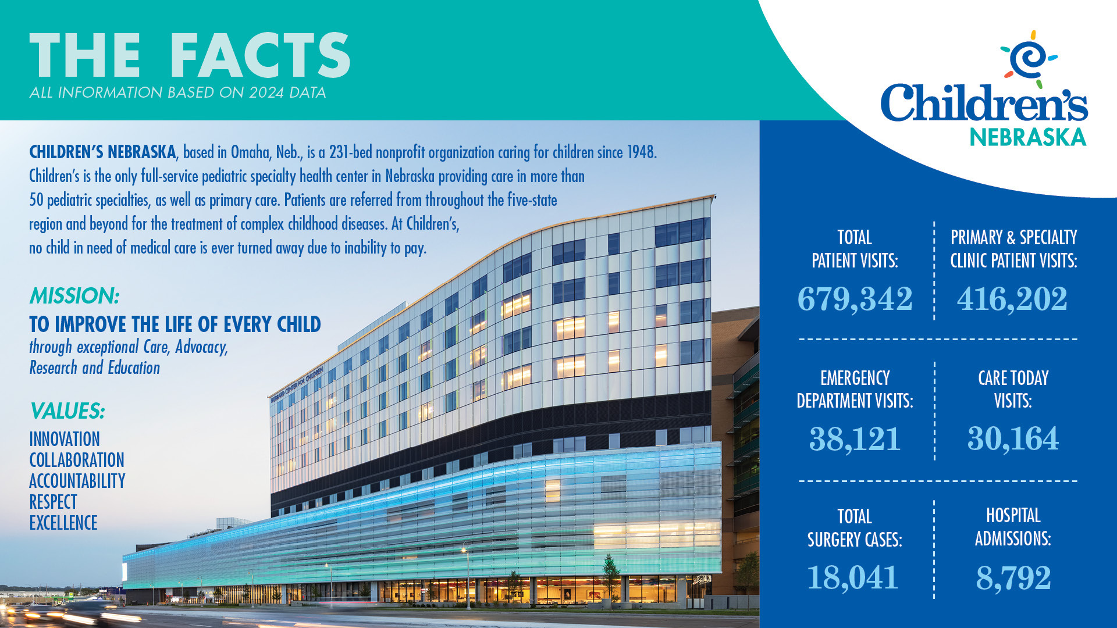
Notes:
Renee

Slide 4
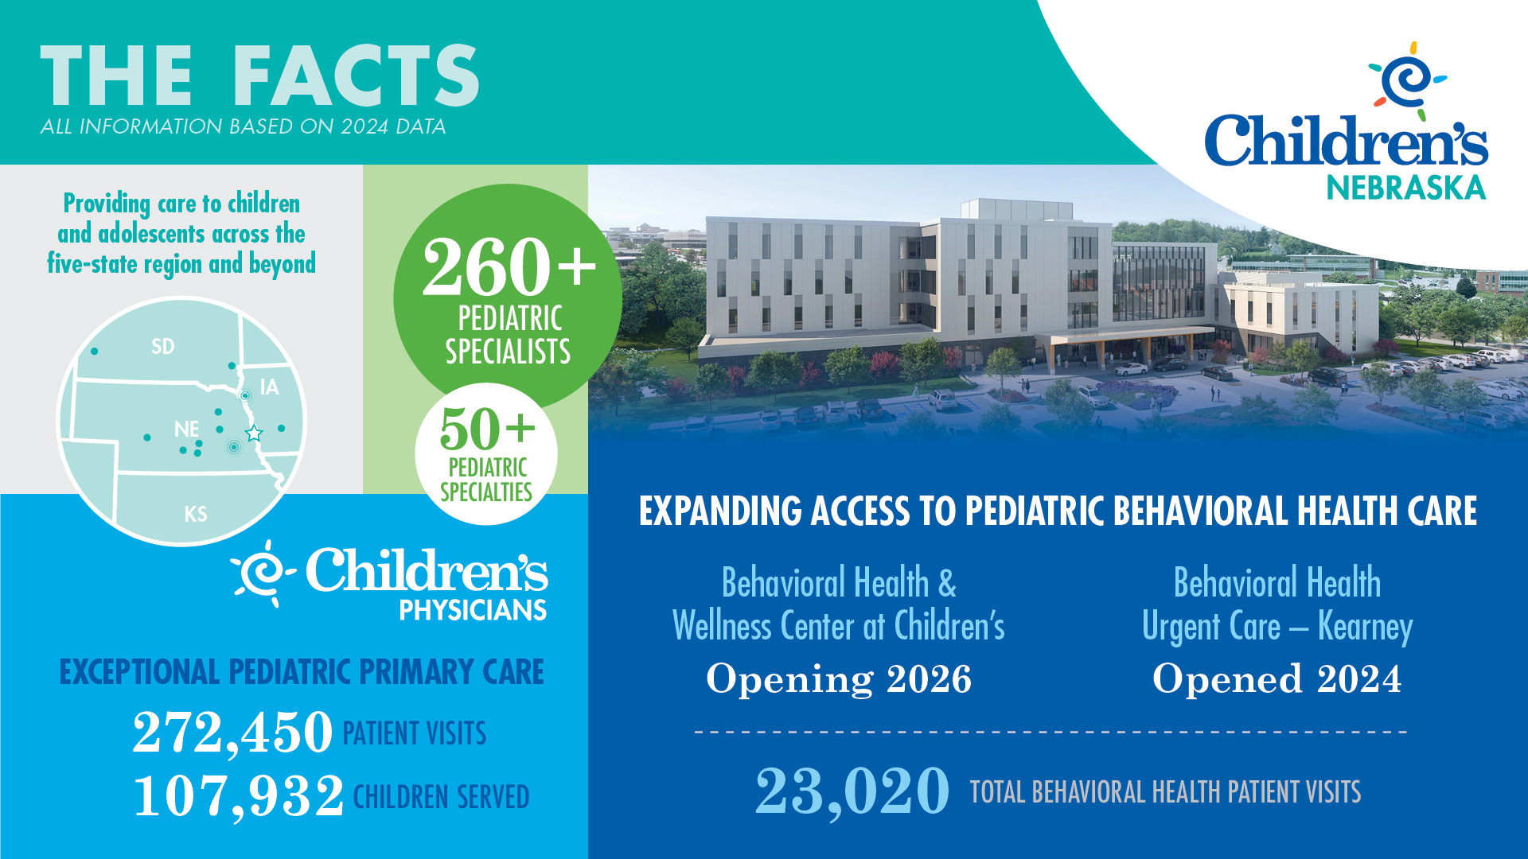
Notes:
Renee

Slide 5


WHAT IS HAPPENING TO CHILDREN & YOUTH…
Of youth seen in an ED for mental health concerns
From 2006-2016
Pediatric mental health ED visits increased by
Each year,
1 in 5
25%
NATIONAL
children experience mental illness, yet half never get treatment
60%
will return within 6 months due to unmet needs
27%
1 in 7
10%
Bommersbach, T., et al. (2023). National Trends in Mental Health-Related Emergency Department Visits Among Youth, 2011-2020. JAMA.
Hoge, M., et al., (2021). Emergency Department Use by Children and Youth with Mental Health Conditions: A Health Equity Agenda. Community Mental Health Journal.
Hoffmann, J., et al., (2023). Follow-up After Pediatric Mental Health Emergency Visits. Pediatrics.
Centers for Disease Control & Prevention, “High School YRBS: Nebraska 2024 and United States 2024 Results.”
of high school youth
felt sad or hopeless
almost every day for two weeks
of high schoolers seriously
considered attempting suicide
in the previous year
of high school youth
made a plan to attempt suicide
in the previous year
NEBRASKA
Notes:
Nationwide, the mental health struggles of children and youth are growing.
Prior to the pandemic, emergency department data nationally showed a 60% increase in incidence of mental health disorders between 2006-2016, while the overall pediatric ED visits were unchanged.
In our post-COVID era, 1 in 5 children experience mental health illnesses each year, yet half never get appropriate treatment.
And of those evaluated for mental health concerns in an ED, 25% will return to the ED within 6 months for subsequent unmet mental health needs.
Children in Nebraska are not immune
Almost 40% of our high school students report feeling sad or hopeless…so much so that they stop doing their usual activities with friends and family
Can you think of 10 children you know and love in Nebraska? Statistically 4 of them are showing signs of depression.
1 in 5 seriously consider attempting suicide. When breaking down by subpopulations, females and 9th graders are experiencing significantly higher rates, each at 25% each.
And lastly…this statistic is heart-wrenching. 10% of our high schools have attempted suicide in the last year.
This data speaks for itself…our systems of care have not been working for us. We need to think differently about how we are addressing pediatric mental health, and we need to do it now.

Slide 6
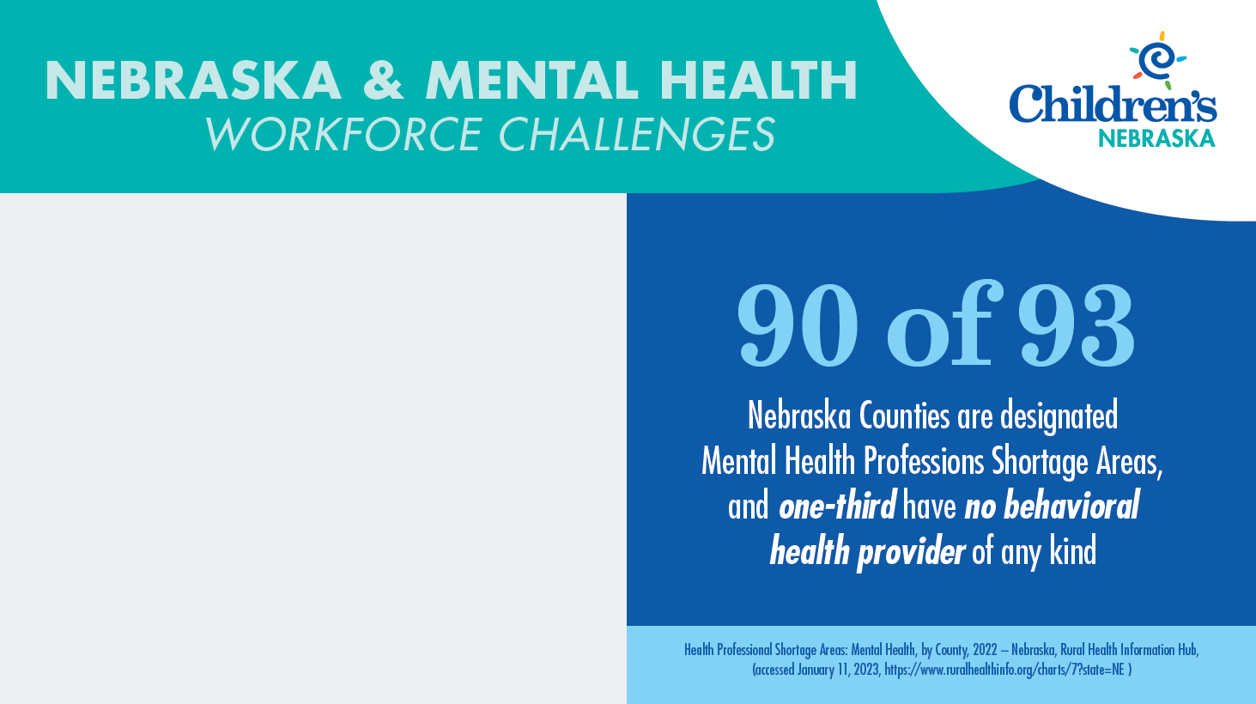
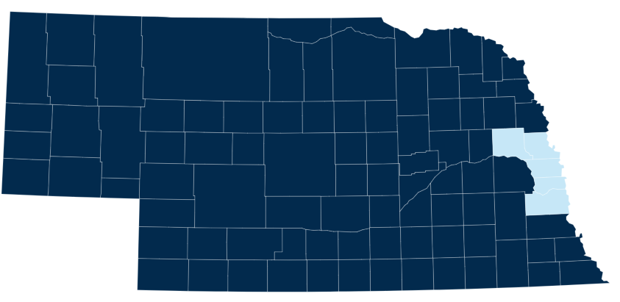
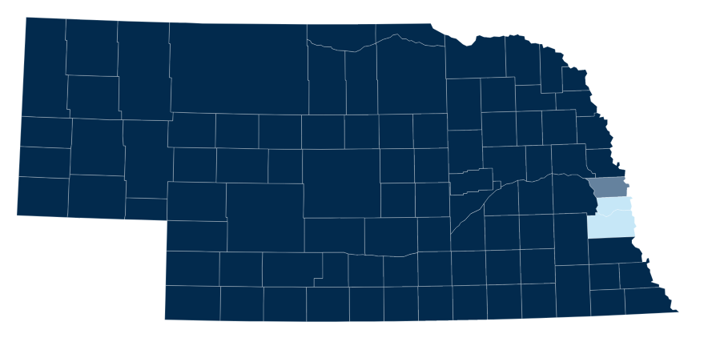

88 of 93
None of county is shortage area
Part of county is shortage area
Whole county is shortage area
Health Professional Shortage Areas: Mental Health, by County July 2025 – Nebraska, Rural Health Information Hub, (accessed September 9, 2025, https://www.ruralhealthinfo.org/charts/7?state=NE )

Slide 7

Dedicated to helping children and adolescents up to 22 years of age showing signs of behavioral or mental health crisis
Services include:
Crisis Stabilization
Short-Term Bridge Care
Psychiatric Evaluation
Notes:
The first of those projects, the Behavioral Health Urgent Care in Kearney Nebraska opened on July 1st, and we recently celebrated our ribbon cutting ceremony in September.
BHUC is co-located with Children’s Physicians and is dedicated to helping children and adolescents up to 22 years of age showing signs of a behavioral or mental health crisis.
Often families do not have access immediate care when urgent behavioral symptoms occur. This clinic fills a gap in the community and helps children to stabilize during a crisis.
The services include crisis stabilization, short-term bridge care and psychiatric evaluation.

Slide 8
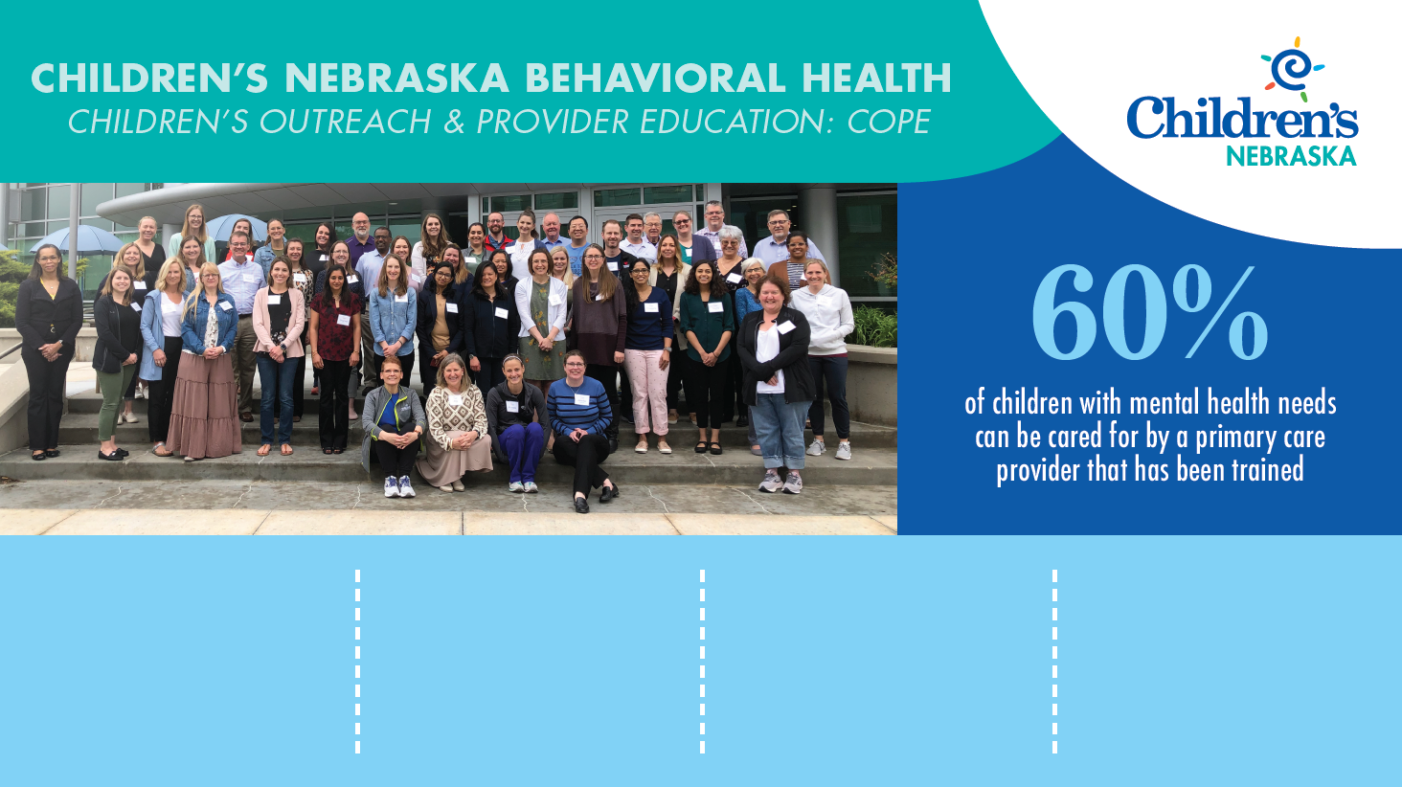
112
PROVIDERS HAVE EACH COMPLETED 20 HOURS OF INTENSIVE TRAINING
413
MENTAL HEALTH PROFESSIONALS ATTENDED COPE’S MONTHLY WEBINARS
2,747
CMEs HAVE BEEN AWARDED THROUGH COPE TRAININGS
127 PCPs & 23 CLINICS
ARE SUPPORTED BY COPE’S PSYCHIATRIC CONSULTATION SERVICES
Notes:
60% of mental health conditions can be cared for by a PCP
Children’s COPE program aims to ensure the state’s 4000 PCP has the skills and comfort in identifying, treating and managing those conditions in children.
Since May 2023,
Nebraska has 94 more medical professionals better equipped to address the state’s mental health crisis due to the work of COPE.
164 providers have attended monthly webinars over lunch
1927 CMEs were earned by providers
79 PCPs & 10 clinics are supported through COPE’s psychiatric consultation services

Slide 9
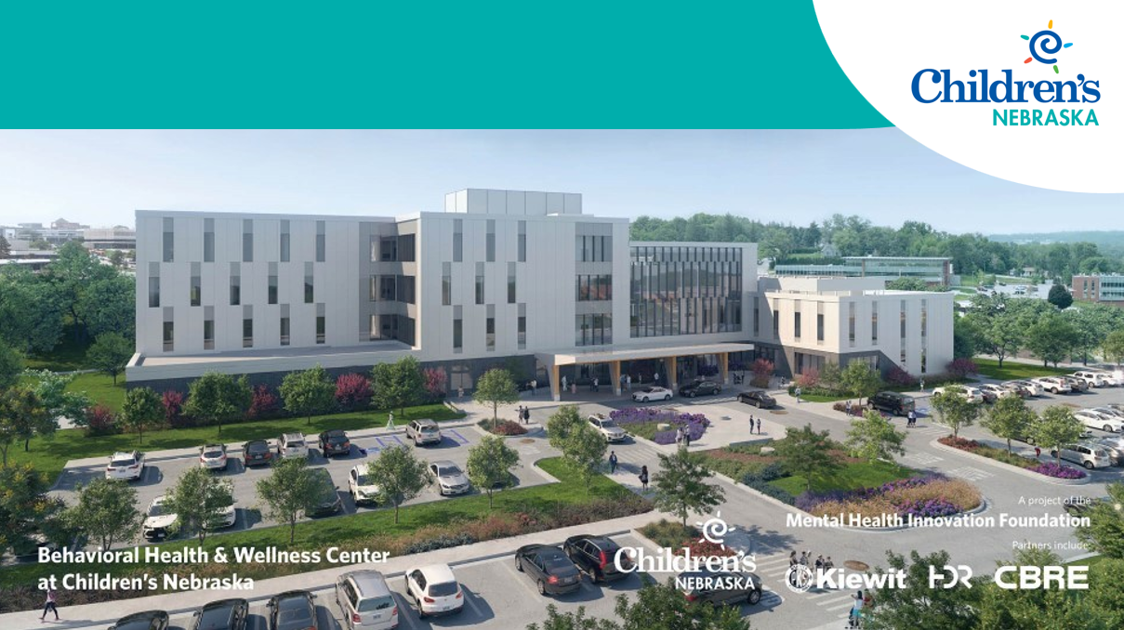
BEHAVIORAL HEALTH & WELLNESS CENTER
Notes:
Renee
In 2022, under the leadership of Chanda, our Board of Directors and key stakeholders, Children’s took the bold step to significantly expand its footprint within the mental health landscape
But, expanding that footprint and doing more will require us to be innovative about the services provided, to lean into best and emerging practices and models, and to rethink how we develop and support our mental health workforce.
And we were very fortunate…we had community organization and our leaders in state government that understand the value add Children’s could bring to the work
Those stakeholders helped us to go faster - Nebraska is unique. We live in a place that donors recognize and are not shying away from the challenging topic of pediatric mental health, and allowing grow faster than we ever previously imagined – impacting more kids and families.

Slide 10













Behavioral Health & Wellness Center
SERVICES & LEVELS OF CARE
33
33
33
Partial Hospitalization
Crisis Assessment Center
Inpatient
Mental Health
Primary Care
Outpatient
Mental Health
Eating Disorder
0-19 Years
Well-child visits
Physicals
Screening
Parent Education
Medication Mgmt
0-19 Years
Assessment
Intervention
Crisis Observation
Stabilization
Navigation Support
2-19 Years
Family Therapy
Individual Therapy
Medication Mgmt
Navigation Support
5-19 Years
Day Treatment
Group Therapy
Family Therapy
Individual Therapy
19+ hrs per week
8-19 Years
Day Treatment
Group Therapy
Family Therapy
Individual Therapy
19+ hrs per week
5-19 Years
Inpatient stay
Group Therapy
Family Therapy
Individual Therapy
Avg. Stay 7 Days
Notes:
Renee & Amy

Slide 11

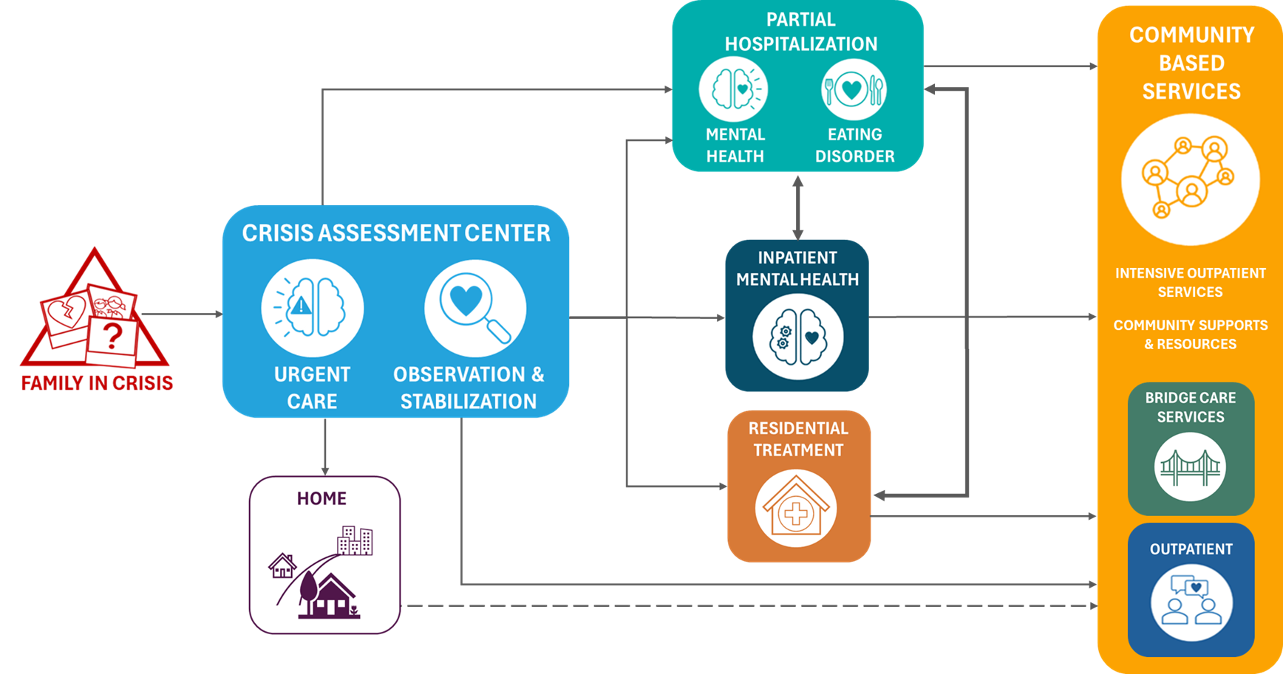
BEHAVIORAL HEALTH & WELLNESS CENTER
PATIENT FLOW
Notes:
Amy

Slide 12
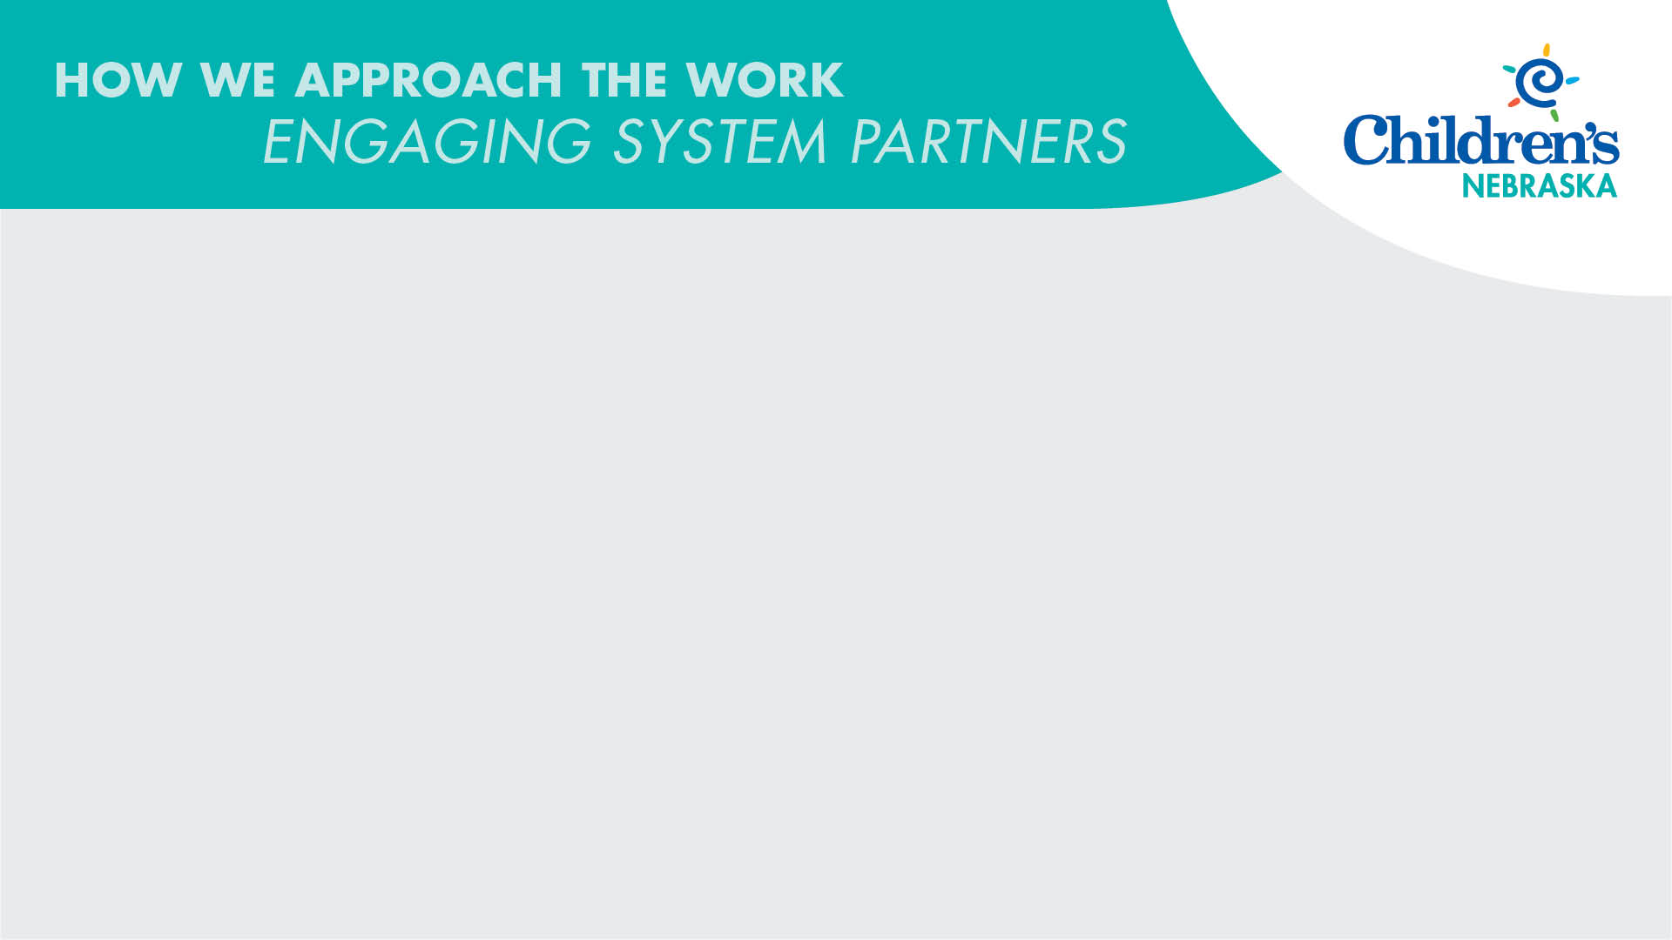


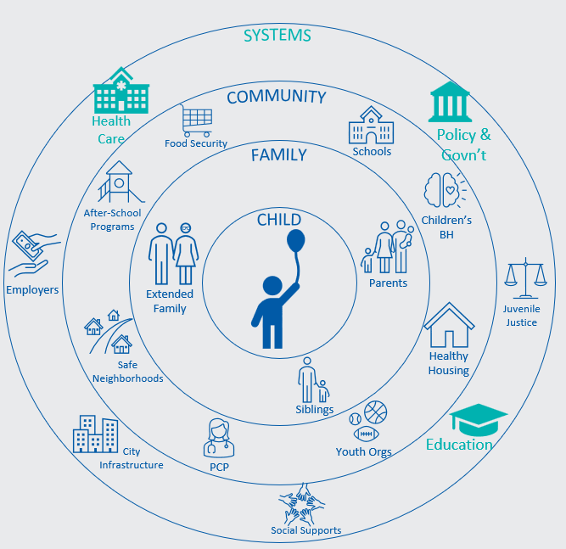






















SYSTEMS
Health Care
Policy & Govn’t
COMMUNITY
Food Security
Schools
FAMILY
After-School Programs
Children’s
BH
CHILD
Juvenile Justice
Employers
Extended Family
Parents
Policy Makers & Government
Education Systems
Safe Neighborhoods
Healthy Housing
Health Care Systems
Siblings
City Infrastructure
PCP
Youth Orgs
Education
Social Supports
Notes:
Our processes has included collaborations with policy makers to ‘rethink’ how the state can tackle the pediatric mental health crisis
Resulting in $10M in ARPA funding to develop the state’s first pediatric behavioral health urgent cares

Slide 13
Methodist Community Counseling Program
Ellen McElderry LIMHP, LADC, LPC

Slide 14

Innovative idea in 1996
Omaha closed 2 major mental health facilities, Richard Young and St. Joseph Center for Mental Health, leaving a gap in the community.
Dr. Alva Clark, Hospital Chaplin collaborated with community churches to invent accessible and affordable outpatient behavioral health services

Slide 15

Treatment Services
We accept all major insurance, Medicare and Medicaid. No one is turned away due to the inability to pay thanks to the generosity of the Methodist Foundation. Financial assistance is available for those in need. ​
​
Our team of licensed providers perform:
  Outpatient behavioral health services to clients ages 12 through adulthood ​
  Individual and family therapy
  Crisis intervention ​
  General mental health assessments​
  Mental wellness presentations/groups
  “Harper Hope”- Cancer support therapy
  “SANE”- Follow up from sexual assault
Inpatient ​Hospital services include:
  Emergency Department consults/assessment
  Brief short-term therapy & referral
  Psychoeducation groups
  Integrated care

Slide 16

Easy access & destigmatize care
Locations: ​
All Alternative Programs, Middle Schools and High Schools in Omaha Public Schools. (25)​
Metro Community College campuses (3)​
Neighborhood churches (5)​
Health Center/Clinics (4): ​
  Center Pointe​
  Benson Community Health Center​
  Estabrook Cancer Center ​
  Methodist Community Health Clinic​
Methodist and Women’s Emergency Dept’s and hospitals.​

Slide 17

Last Year Data
Served 1300 individuals
Performed 9600 sessions
No show rate 8%
Frequent diagnosis:
  Depression
  Anxiety
  Trauma
  Behavioral issues

Slide 18

Care, Compassion, Community
Affordable and accessible behavioral healthcare where you live, work & learn
WWW.Bestcare.org/CCP
402-354-6891

