Slide 1


Rural Research for Impactful Programming
Greater Nebraska Rural Research Network (GNRRN)
Opening Remarks: Jed Hansen
Panelists:
Ryan Larsen, Brian Schelmadine, Carol Geary
Moderator: Jeff Ordway

Slide 2
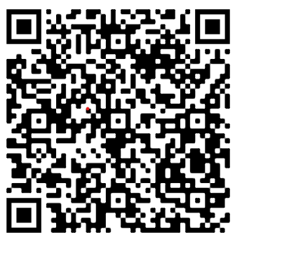
Please complete a survey to help focus the work:

Slide 3
Interested?
Annette.Wolfe@neruralhealth.org or
CarolR.Geary@unmc.edu

