Slide 1
No Primary Care Provider in the Emergency Department
Jan Rains, RN, CPHQ
Kayleigh Allen, CSW

Slide 2
Objectives
To provide structure to improve No Primary Care Provider in the ER utilizing Lean Six Sigma DMAIC process
Improve workflow process between the Emergency Department and the Clinic
Improve communication between inter-departmental disciplines
Refine Clinic Provider schedule to block appointment times for new patients without a Primary Care Provider
Standardize process for other entities to utilize
Notes:
Kayleigh

Slide 3
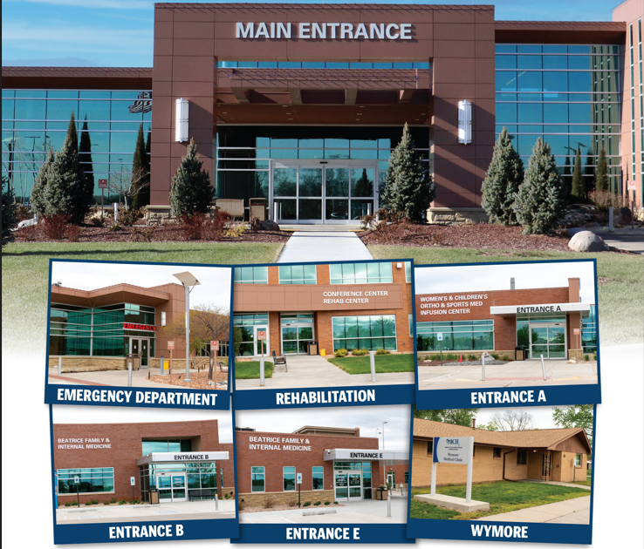
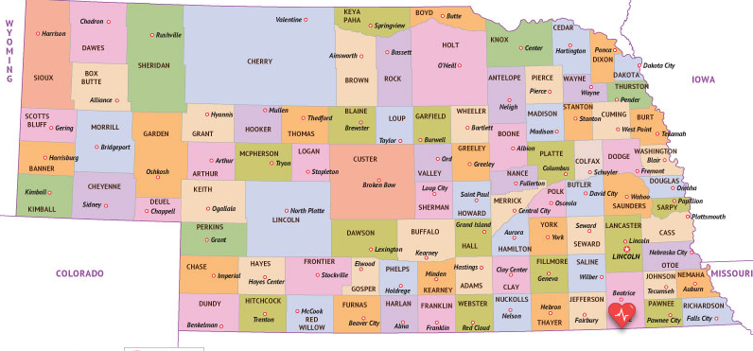
Beatrice Community Hospital and Health Center
25-bed Critical Access Hospital in Southeast Nebraska.
8,243 Emergency Department Visits
1,051 Acute Care Admissions
49,444 Clinic Visits
The organizational strategic plan and goals to increase annual adjusted outpatient visits for 2023 and decrease unnecessary Emergency Department utilization aligned with the performance improvement project to reduce the number of patients with no established primary care provider seen in the ED.
Notes:
Kayleigh
Beatrice Community Hospital (BCH) is a 25-bed Critical Access Hospital (CAH) in southeast Nebraska covering Gage County as well as several surrounding counties for care close to home. In 2023, we had 8,243 Emergency Department visits, 1,051 Acute Care admission, and 49,444 clinic visits. We have 545 employees and 58 employed providers
We offer:
Rehabilitation Services
Express Care
BFIM
Women’s & Children’s Clinic
General Surgery
Infusion Center
Immunization Clinic
Orthopedics and Sports Medicine
Pain Services
Wound & Ostomy Services
Wymore Medical Clinic
Specialty Provider Clinics-
Cardiology
ENT
Pulmonary

Slide 4
Our Mission
We are dedicated to be the healthcare resource for the communities we serve by providing quality services and compassionate care.
Our Vision
Caring People, Committed to Caring for People
Our Values Excellence * Compassion * Ethics
Notes:
Kayleigh

Slide 5
Project AIM Statement
The aim of this project is to establish a consistent workflow for patients identified in the Emergency Department as not having a PCP to have a follow-up appointment, with a Primary care provider, and establish care. Currently the average is 14% of the Emergency patients do not have a PCP. When broken down to Beatrice, Wymore/Blue Springs makes up 59% of those visits on average.
Notes:
The aim of this project is to establish a consistent workflow for patients identified in the Emergency Department as not having a PCP to have a follow-up appointment, with a Primary care provider, and establish care. Currently the average is 14% of the Emergency patients do not have a PCP. When broken down to Beatrice, Wymore/Blue Springs makes up 59% of those visits on average. When looking at lives versus visits (due to repeat visits) 53% are from Beatrice or Wymore/Blue Springs area.
An increasing number of patients coming into the Emergency Department have been identified as not having a Primary Care Provider.
The Emergency Room is the highest cost area for patients to receive care.
This can also tie up rooms in the Emergency Room that could be utilized for higher level of care patients.
This does not meet with the standards of serving our community.
The patients are without a consistent follow-up for care, unless they make it themselves.
This can impact Readmissions as well as the 72 hour return visit quality metric.
Inconsistent work flow for which primary care provider will do the follow-up and how it is set up for the patient.

Slide 6
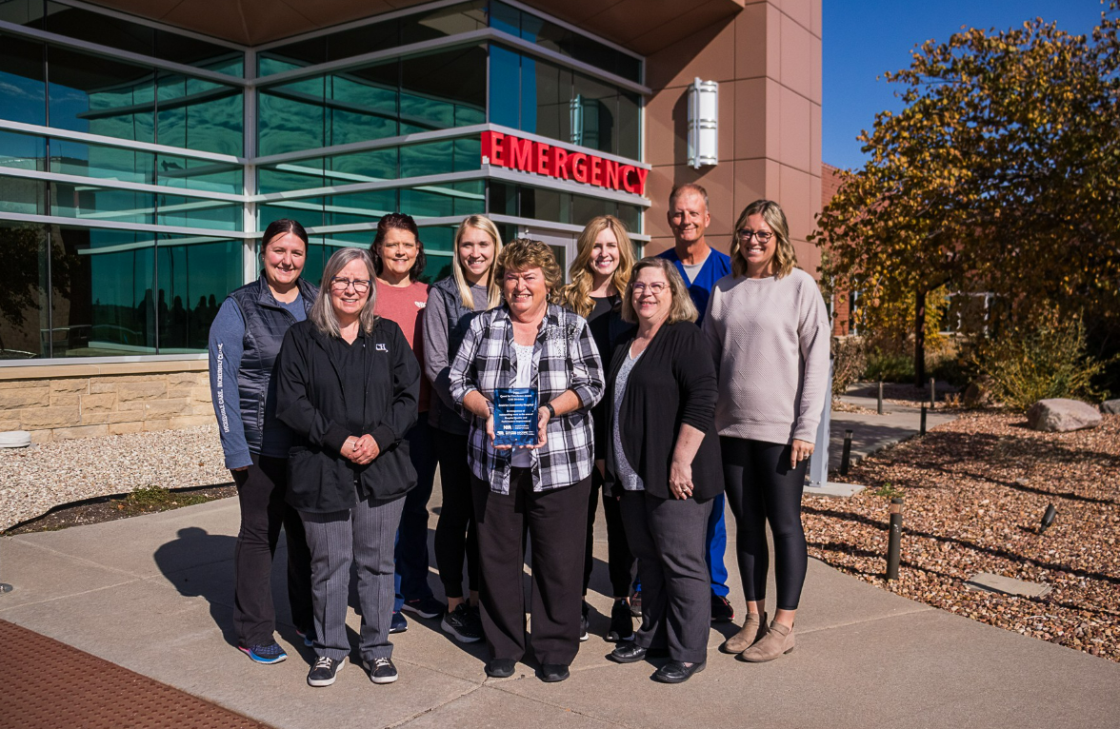
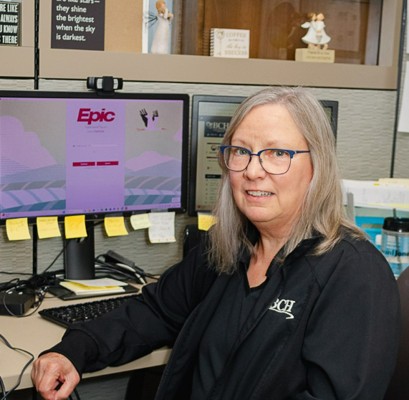
Project Team
Notes:
Team Members: Quality, Executive Sponsor-CNO, Clinic Supervisor, Physician Clinic Receptionist Supervisor, Director of Patient Accounts, Director of Emergency Services and Clinic Case Managers

Slide 7
Project Opportunity Statement
An increasing number of patients coming into the Emergency Department have been identified as not having a Primary Care Provider.
The Emergency Room is the highest cost area for patients to receive care.
This can also tie up rooms in the Emergency Room that could be utilized for higher level of care patients.
This does not meet with the standards of serving our community.
The patients are without a consistent follow-up for care, unless they make it themselves.
This can impact Readmissions as well as the 72 hour return visit quality metric.
Inconsistent work flow for which primary care provider will do the follow-up and how it is set up for the patient.
Notes:
The process improvement project for Patients without Primary Care Provider in the Emergency Room was identified through ED throughput reports and follow-up telephone calls. It was suspected that BCH had an increasing number of patients being seen in the ED that did not have a PCP. Upon development of a specific report, it was identified that 14% of emergency visits do not have a PCP. When drilled down to Beatrice, Wymore, and Blue Springs zip codes, it was 53% of those unique patients. A group was then brought together for this process improvement project. Additional problems and opportunities were discovered through a brainstorming session. The top six identified were:

Slide 8
Scope
In Scope:
ED patients with an address of Beatrice or Wymore/Blue Springs
Workflow establishing a new patient at the clinic
Out of Scope:
Specialty clinic appointments
Patients working in our service area from out of state for longer periods of time
Students at Southeast Community College
OB patients
Patients living outside of targeted service area
Express Care Visits

Slide 9
Assumptions
Every patient is asked in the Emergency Department who their Primary Care Physician is
All patients are offered a follow-up appointment with the on-call provider listed
Re-assigned patients from providers who left our entity
More male patients than female patients don’t utilize follow up appointments
The Emergency Department has a solid process when follow-ups are made and with the appropriate on call provider
All follow up appointments occur within 2 weeks after Emergency Department visit
Most patients that do not have a Primary Care Physician is because of their lack of insurance

Slide 10
Selecting Changes
Notes:
The process improvement method utilized was the lean six sigma DMAIC cycle. The DMAIC cycle consists of define, measure, analyze, improve, and control phases

Slide 11
Define
Through this process it was noted that there was an increasing number of ED patients as well as 72 hour returns to the ED that had no Primary Care Provider allocated to them. Prior to the project we had a month with as high as 8 people with a 72 hour return to the ED.
Notes:
Define is the first phase where we clarify the problem and the process. Through this process it was noted that there was an increasing number of ED patients as well as 72 hour returns to the ED that had no Primary Care Provider allocated to them. Prior to the project we had a month with as high as 8 people with a 72 hour return to the ED. Many of these patients returned to the ED as their follow-up visit instead of an actual ED visit because they did not have a PCP.
Timing is everything- Our clinics merged into one building with the exception of our clinic in Wymore

Slide 12
Emergency Department Patients without PCP

Slide 13
Measure
The team studied the current ED throughput report and added addresses and towns of the patients to identify the scope of patients that would be focused on for this project. The team evaluated the current process of asking the patients who their PCP is for those that did not have one listed in the EHR.
Notes:
The Measure phase is the second phase of the DMAIC process in which the team quantifies the problem and maps the current process. The team studied the current ED throughput report and added addresses and towns of the patients to identify the scope of patients that would be focused on for this project. The team evaluated the current process of asking the patients who their PCP is for those that did not have one listed in the EHR. The conclusion was that this process had many inconsistencies

Slide 14
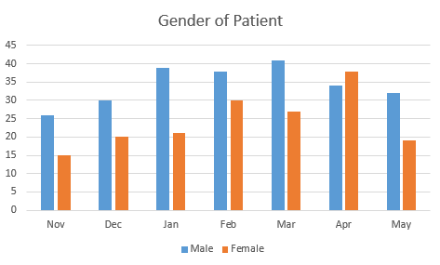
Breakdown of Data
Notes:
Some additional information that was identified for potential vulnerable populations was seen with stratification of data early in the project. The areas that were prominent in the data were age, sex, and payer sources. Males were found to have a higher rate of ED utilization than females.

Slide 15
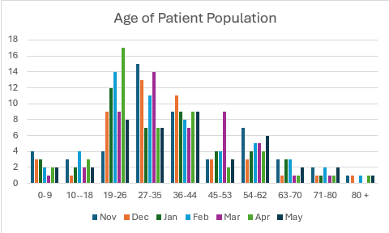
Breakdown of Data
Notes:
The age group with the highest number of ED visits was seen with 19-26 years of age and a close second was 27-35 years of age. Those people just don’t get sick right????

Slide 16
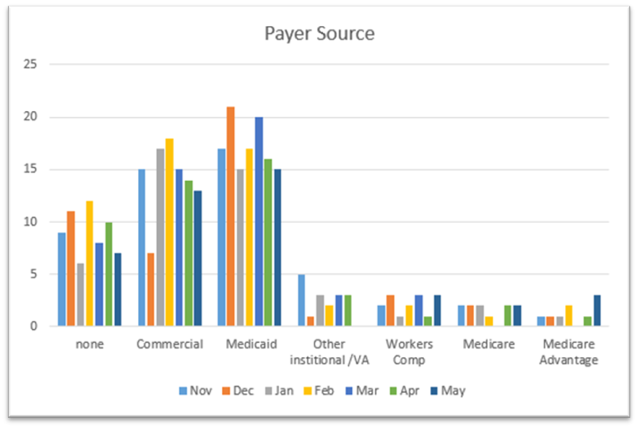
Breakdown of Data
Notes:
The most notable payer source seen was Medicaid with a close second of commercial.

Slide 17
Analyze
Continued to see the inconsistent way of asking who the patient’s PCP is as well as inconsistent methods for changing the PCP in the electronic health record. It was also found that the process for follow-up with a clinic provider was inconsistent. Some patients had an order to follow up and some did not. It was agreed that not all patients needed a follow-up visit, but it was a good time to get the patient established with a PCP if they did not have one.
Notes:
Kayleigh
The third phase of the DMAIC process is the Analyze phase. This is the phase where the root cause or causes are determined. Continued to see the inconsistent way of asking who the patient’s PCP is as well as inconsistent methods for changing the PCP in the electronic health record. It was also found that the process for follow-up with a clinic provider was inconsistent. Some patients had an order to follow up and some did not. It was agreed that not all patients needed a follow-up visit, but it was a good time to get the patient established with a PCP if they did not have one.
How to deal with VA patients

Slide 18
Improve
A process map was developed to give workflows to front desk staff, nurses, case managers and providers.
case managers in the clinics would make follow-up phone calls to all patients that were seen in the emergency department. At this time, the case manager would make follow-up appointments to be seen by the newly assigned PCP for the ED follow-up or to get them their first appointment with the newly assigned PCP to establish themselves officially as their patient.
ED providers were trained to be more consistent with which patient really needs a follow-up appointment for their ED visit and which patients could wait for a later appointment to become established.
It was decided that patients without a PCP will be assigned to the on-call provider. Patients may also be offered an appointment with a provider that has more flexibility to see new patients if the on-call provider’s schedule was full.
Pediatric patients from Beatrice were referred to the Beatrice Children’s Clinic. Pediatric patients from Wymore and Blue Spring were given the option of Beatrice Children’s Clinic or Wymore Clinic for their PCP.
Notes:
Kayleigh
The fourth phase of the DMAIC cycle is the Improve phase. At the beginning of this phase, a process map was developed to give workflows to front desk staff, nurses, case managers and providers. It was determined that case managers in the clinics would make follow-up phone calls to all patients that were seen in the emergency department. At this time, the case manager would make follow-up appointments to be seen by the newly assigned PCP for the ED follow-up or to get them their first appointment with the newly assigned PCP to establish themselves officially as their patient. ED providers were trained to be more consistent with which patient really needs a follow-up appointment for their ED visit and which patients could wait for a later appointment to become established. It was decided that patients without a PCP will be assigned to the on-call provider. Patients may also be offered an appointment with a provider that has more flexibility to see new patients if the on-call provider’s schedule was full. Pediatric patients from Beatrice were referred to the Beatrice Children’s Clinic. Pediatric patients from Wymore and Blue Spring were given the option of Beatrice Children’s Clinic or Wymore Clinic for their PCP.

Slide 19
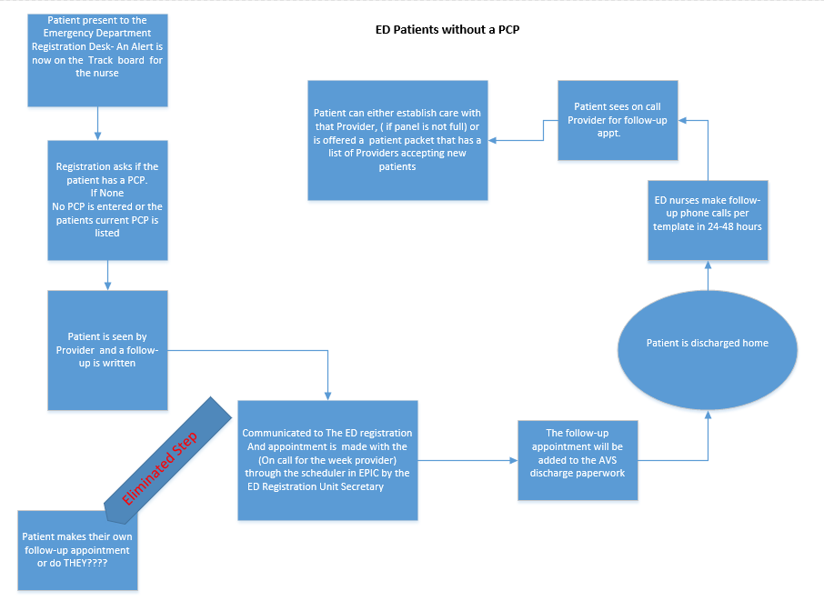
Process Map
Notes:
Kayleigh

Slide 20
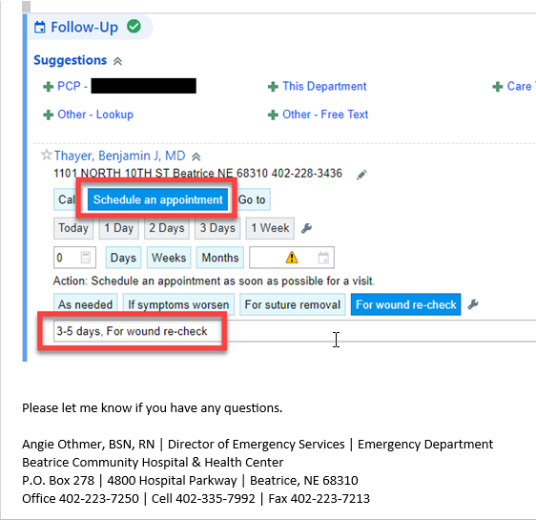
Memo to the Providers
Beginning tomorrow, 11/1/23, patients that do not have PCP’s will be followed up on by the clinic case managers. They will be calling those patients that REQUIRE a follow up from their ED visit. Because of this, they are asking us to be very specific with those that need a follow up appointment scheduled.
They will look at the AVS to see what you have entered in the follow up section when you discharged the patient. If the follow up says “as needed” they will NOT schedule an appointment. If you do want them to schedule an appointment for the patient, please do the following:
Enter the on-call provider as you have been doing
Select the “Schedule an appointment” quick button
In the comment box enter what timeframe you want the patient to follow up and the reason for the follow up
Notes:
Kayleigh

Slide 21
Memo to Registration Staff
Notes:
Kayleigh

Slide 22
Control
All responsibilities were assigned to individuals to keep the process active with appropriate accountability. Quality will own the report and share the results with the ED director, registration director and clinic director
Notes:
Kayleigh
The final phase of the DMAIC process is the Control phase. This phase is crucial for continued success of a process improvement project. All responsibilities were assigned to individuals to keep the process active with appropriate accountability. Quality will own the report and share the results with the ED director, registration director and clinic director. If there is an increase in consecutive months of patients with no PCP in the ED being seen, each one will be evaluated for a break in the process and reeducation to those individuals will occur. The goal will continue for the Beatrice, Wymore, and Blue Springs area until the group decides to expand the population.

Slide 23
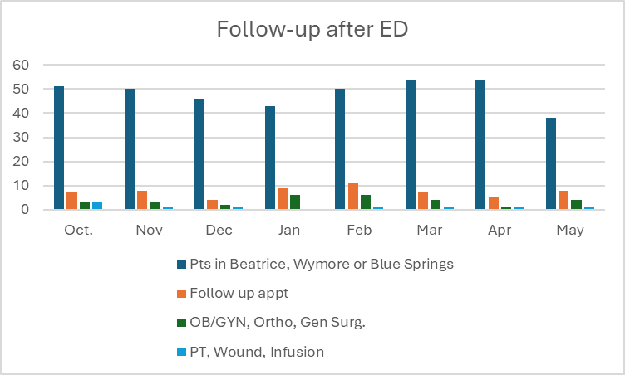
Measuring Success
Notes:
Kayleigh

Slide 24
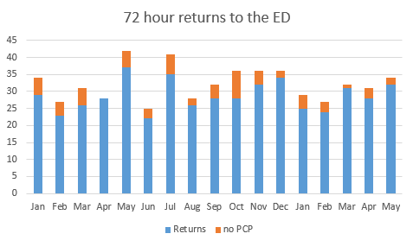
Measuring Success
Notes:
Kayleigh

Slide 25
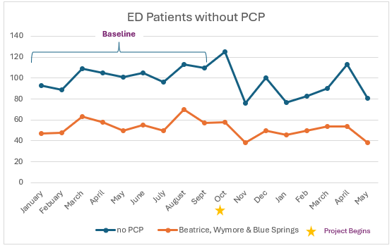
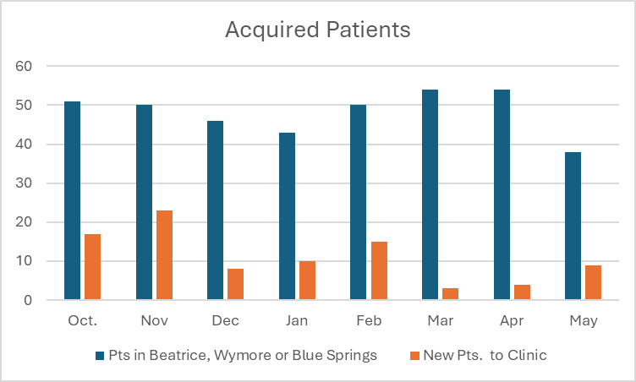
Measuring Success
Notes:
Kayleigh
The process of patients that present themselves to the emergency department was modified with this project
Even though we did not meet our goal of 95% of all patients seen without a PCP would have a follow-up visit, the positive number of patients that have established with a provider since the start of this project was an accomplishment on its own.
A total of 245 patients to date have been established with a primary care provider with ED patients with no PCP were down to 11%

Slide 26
Return on Investment (ROI)
Patient Satisfaction
Staff Satisfaction
Notes:
Kayleigh
Patient Satisfaction:
Clinic Case Managers are present CCM services
Cheaper than ED
Closer follow up
Saved patients $206,760 as of the end of October Est savings of 844 per patient
Staff Satisfaction
Unnecessary soft admissions
Not taking up necessary ED beds to focus on more complex patients
Proper utilization for appropriate level of care

Slide 27
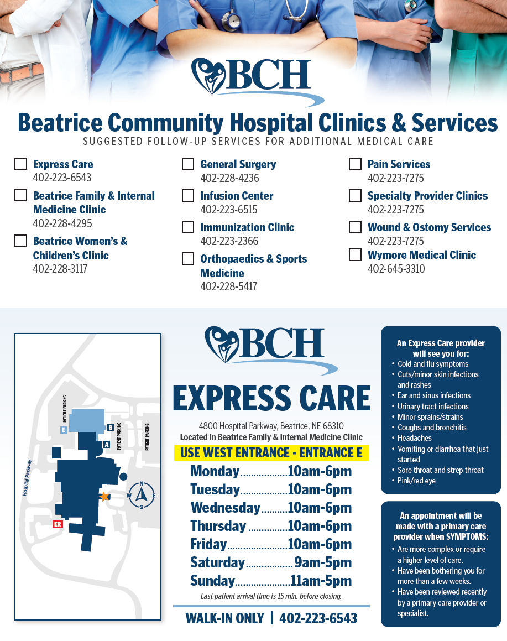
Lessons Learned / Spreading / Sustaining / Maintaining / Replicating
Express Care Clinic
Other Community Connect Sites
Notes:
Kayleigh
The senior leader for our Express Care Clinic is working to implement the same process for patients that come through the Express Care Clinic without a PCP.
We have also heard that other community connect sites that share our EHR are planning to implement this process and structure in their facilities. Even though we utilize Epic as our EHR, this workflow could easily be implemented with any other EHR. Other Community connect sites are using our report now
One of the lessons learned from this project was that not all patients want to connect with a PCP. While we can encourage this and offer appointments, we cannot force anyone to select and establish with a PCP. Even though we did not meet our goal of 95% of all patients seen without a PCP would have a follow-up visit, the positive number of patients that have established with a provider since the start of this project was an accomplishment on its own. Overall, the project was successful as it has allowed the case management team to build a trusting relationship with the patients. Often the patients without primary care seem to be skeptical about healthcare and this approach shows empathy and gains rapport with the patients.
BCH continues to provide a high level of care to the community we serve. As a Critical Access hospital and rural health clinic, we strive to be the top resource for our local population. These efforts were evident in the most recent interdepartmental quality improvement project to decrease the number of patients seen in the organization’s Emergency Department with no PCP. A total of 245 patients to date have been established with a primary care provider, which speaks volumes about the organization’s dedication to providing excellent care in the right place, at the right time.

Slide 28
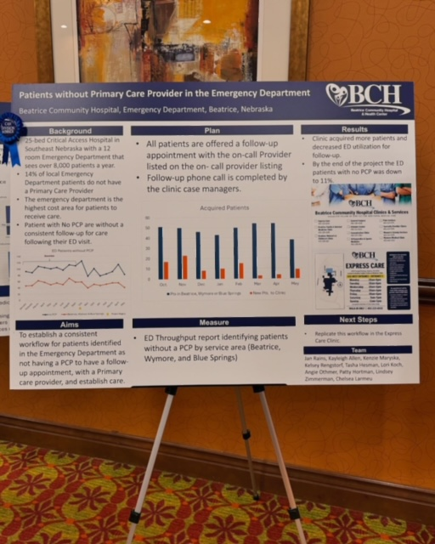
Awards
Quality
Notes:
Kayleigh

Slide 29
Questions

Slide 30
Contact Information
Jan Rains, RN, CPHQ
jrains@bchhc.org
402-223-7268
Kayleigh Allen, CSW
kdallen@bchhc.org
402-223-7279

