Slide 1

State of the State: The Stability of the Rural Health Safety Net in Nebraska
November 2025
Nebraska Critical Access Hospitals and Rural Health Clinics Conference on Quality

Slide 2

The State of America’s Rural Health Safety Net
Financial Instability Nearly 50% of rural hospitals are operating in the red and 432 are vulnerable to closure.
Declining Access
195 hospitals have closed and hundreds more have dropped vital services like OB and chemo.
Vulnerable Populations
Rural Americans are less healthy and more likely to die prematurely than their urban peers.

Slide 3
Nearly Half of all Rural Hospitals in the Red
ME
WA
VT
MT
ND
NH
MA
OR
MN
NY
ID
WI
RI
Overall, 46% of America’s rural hospitals are operating in the red.**
SD
MI
PA
NJ
CT
WY
NE
IA
OH
DE
IL
IN
WV
MD
NV
VA
CA
UT
CO
KY
KS
MO
NC
TN
SC
In non-expansion states, 53% of rural hospitals are in the red.
AZ
NM
OK
AR
AL
GA
MS
TX
LA
AK
FL
HI
Source: The Chartis Center for Rural Health, December 2024.
State-level percentage of rural hospitals with negative operating margin.
**CMS Healthcare Cost Report Information System (HCRIS) Q3 2024. Operating margin is computed in accordance with Flex Monitoring Team guidance. Outliers are excluded. Hospitals for which data are unavailable are excluded. Reported Covid-19 PHE Funds (Worksheet G-3 line 24,50) excluded from operating margin. Adjustments made to operating margin to reflect full 2% sequester.
NA
0-20
21-40
41-60
61-80
81-100
© 2025, The Chartis Group, LLC. All rights reserved.

Slide 4
Vanishing Access to Rural Inpatient Care
ME
WA
VT
MT
ND
NH
MA
OR
MN
NY
ID
WI
RI
SD
MI
PA
NJ
CT
Access to care continues to deteriorate significantly in rural communities.
WY
NE
IA
OH
DE
IL
IN
WV
MD
NV
VA
CA
UT
CO
KY
KS
MO
NC
TN
SC
OK
AR
195 rural hospitals have either closed or converted to a model that excludes inpatient care (e.g., REH).
AZ
NM
GA
MS
AL
AK
TX
LA
FL
HI
Number of rural hospitals closed or ceasing inpatient care since 2010.
0
1-2
3
4
5-9
10 or more
Source: Cecil G. Sheps Center for Health Services Research, August 27, 2025.
© 2025, The Chartis Group, LLC. All rights reserved.

Slide 5
432 Rural Hospitals Vulnerable to Closure
ME
WA
VT
432 rural hospitals across America are vulnerable to closure.
MT
ND
NH
MA
OR
MN
NY
ID
WI
RI
SD
MI
PA
NJ
CT
WY
NE
IA
OH
DE
IL
IN
WV
MD
NV
VA
Across 15 states, the percentage of rural hospitals vulnerable to closure is 25% or higher.
CA
UT
CO
KY
KS
MO
NC
TN
SC
AZ
NM
OK
AR
AL
GA
MS
AK
TX
LA
FL
Non-expansion states are home to 205 vulnerable rural hospitals.
HI
Percentage of State Rural Hospitals Determined to be Vulnerable
0
1%—9%
10%—15%
16%—20%
21%—25%
26%—30%
31%—40%
41%+
Source: The Chartis Center for Rural Health, December 2024
© 2025, The Chartis Group, LLC. All rights reserved.

Slide 6
Rural Safety Net Snapshot: Nebraska
70
38%
Rural Hospitals
in the Red
3
Closures/Conversions
21%
Nebraska
2.1%
Vulnerable to Closure
Median Operating Margin

Slide 7
Diminishing Access to Specific Services
WA
ME
ME
VT
MA
WA
VT
MT
ND
MN
NY
NH
MT
ND
NH
MA
OR
WI
RI
OR
MN
NY
RI
ID
WY
SD
MI
PA
NJ
CT
ID
SD
WI
MI
CT
IA
OH
DE
WY
PA
NJ
NE
IL
IN
WV
MD
NE
IA
OH
DE
NV
UT
VA
NV
IL
IN
WV
VA
MD
CA
CO
KS
MO
KY
NC
CA
UT
CO
KY
TN
KS
MO
NC
AZ
NM
OK
AR
SC
TN
SC
MS
AL
GA
AZ
NM
OK
AR
GA
AK
TX
LA
MS
AL
FL
AK
TX
LA
FL
HI
HI
Obstetrics
Chemotherapy
Between 2011 and 2023, 293 rural hospitals ceased to provide OB services.
Between 2014 and 2023, 424 rural hospitals stopped providing chemotherapy.
Percentage of rural hospitals that stopped offering OB between 2011 and 2023.
Percentage of rural hospitals that stopped offering Chemo between 2014 and 2023.
0
1%-10%
11%-20%
21%-30%
31%-40%
41%-50%
51% or more
0
1%-10%
11%-20%
21%-30%
31%-40%
41%-50%
51% or more
Source: The Chartis Center for Rural Health,

Slide 8


Deteriorating Population Status Across Rural America
“Older, less healthy and less affluent” no longer captures rural America’s population health challenges
With lower median household income and higher rates of child poverty, rural areas are struggling to gain the financial stability necessary to meet their health needs.
Rural Americans carry a greater share of the chronic disease burden and are more likely to die prematurely than their urban counterparts.
Veterans are a particularly vulnerable population within rural areas.

Slide 9
Where is Behavioral Health Care the Scarcest in Rural America?
ME
WA
VT
MT
ND
NH
MA
OR
MN
NY
ID
WI
RI
SD
MI
PA
NJ
CT
WY
Access to behavioral health providers in rural hospital service areas is at its lowest in North Dakota, followed by Georgia, Tennessee, and Texas.
NE
IA
OH
DE
IL
IN
WV
MD
NV
VA
CA
UT
CO
KY
KS
MO
NC
TN
SC
AZ
NM
OK
AR
AL
GA
MS
AK
TX
LA
FL
HI
Rural percentile ranking for Mental Health Providers.
0
1%-19%
20%-39%
40%-59%
60%-79%
80%-100%
Source: The Chartis Center for Rural Health, October 2024

Slide 10
Where is Diabetes Prevalence Highest in Rural America?
ME
WA
VT
MT
ND
NH
MA
OR
MN
NY
ID
WI
RI
SD
MI
PA
NJ
CT
WY
The prevalence of diabetes within rural communities is highest in Mississippi, South Carolina, Louisiana, and Georgia.
NE
IA
OH
DE
IL
IN
WV
MD
NV
VA
CA
UT
CO
KY
KS
MO
NC
TN
SC
AZ
NM
OK
AR
AL
GA
MS
AK
TX
LA
FL
HI
Rural percentile ranking for Diabetes Prevalence.
0
1%-19%
20%-39%
40%-59%
60%-79%
80%-100%
Source: The Chartis Center for Rural Health, October 2024

Slide 11
Rural Healthcare and the One Big Beautiful Bill Act (OB3A/H.R. 1)

Slide 12
How Will OB3A/H.R. 1 Impact Rural Healthcare?
Decrease in Medicaid enrollment within rural communities
Higher levels of uninsured = more uncompensated/charity care
Provider Tax adjustments will negatively impact balance sheets
Revenue loses may push hospitals to close or reduce service lines
Worsening outcomes among an already vulnerable population

Slide 13
Importance of Medicaid in Rural Hospital Communities
ME
WA
VT
MT
ND
NH
MA
OR
MN
NY
ID
WI
RI
An estimated 10.2 million people living in rural hospital communities are enrolled in Medicaid.*
SD
MI
PA
NJ
CT
WY
NE
IA
OH
DE
IL
IN
WV
MD
NV
VA
CA
UT
CO
KY
KS
MO
NC
TN
SC
In 33 states, the estimated number of rural hospital community Medicaid enrollees exceeds 100,000.
AZ
NM
OK
AR
AL
GA
MS
TX
LA
AK
FL
HI
Source: The Chartis Center for Rural Health, May 2025
Estimated total Medicaid enrollees withing rural hospital communities.
*Rural hospital community defined as a county in which 1 or more rural hospitals is located.
<100,000
100,001-200,000
200,001-300,000
300,001-400,000
400,001-500,000
© 2025, The Chartis Group, LLC. All rights reserved.

Slide 14
At Median, Medicaid Adds $3.9 million to the Bottom Line
ME
WA
VT
MT
ND
NH
MA
OR
MN
NY
Nationally, rural hospitals generate nearly $4 million in net Medicaid revenue at the median.
ID
WI
RI
SD
MI
PA
NJ
CT
WY
NE
IA
OH
DE
IL
IN
WV
MD
NV
VA
CA
UT
CO
KY
KS
MO
NC
TN
SC
In 12 states, the median net Medicaid revenue for rural hospitals exceeds $8 million.
AZ
NM
OK
AR
AL
GA
MS
AK
TX
LA
FL
HI
State Rural Hospital Median Medicaid Net Revenue
Source: The Chartis Center for Rural Health, May 2025
<$1M
$1M-$5M
$5M-$10M
$10M-$15M
>$15M
© 2025, The Chartis Group, LLC. All rights reserved.

Slide 15

How the Rural Health Transformation Program Breaks Down
$25 Billion
$25 Billion
First half of fund distributed by CMS equally among states with an approved Rural Health Transformation Plan.
Second half of fund distributed at discretion of CMS.
Possible that not all states will receive allocation from this portion of the fun.
One time plan that covers all 5 years of fund allocation.
Plans must address at least 3 (of 10) allowable uses outlined in OB3A.
$100M/year
If all 50 states have an approved plan, each state would receive $100M annually for 5 years ($500M total). States allowed 10% for administration services.

Slide 16
Nebraska Rural Hospital Performance
Chartis Rural Hospital Performance INDEX

Slide 17

What Makes INDEX Unique?
The INDEX was built for rural hospitals.
Objective Rural-Relevant Actionable
1
Based Entirely on Public Data
no surveys, no opt-ins, no questionnaires
Comparative Metrics
from ~2,100 rural hospitals
2
2
Today, more than 200 rural hospitals rely on INDEX benchmarks to help improve the delivery of care.
3
Identify Opportunities
for performance improvement

Slide 18
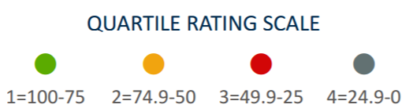
Chartis Rural Hospital Performance INDEX
 | Overall INDEX Score | IP Market Share | OP Market Share | Quality | Outcomes | Patient Sat. | Cost | Charges | Capital Efficiency
NE CAH Median | 76.6 | 73 | 82 | 76 | 39 | 75 | 19 | 73 | 42
All U.S. CAH Median | 59.7 | 42 | 51 | 65 | 49 | 66 | 37 | 61 | 53
NE RPPS Median | 52.4 | 93 | 88 | 36 | 50 | 22 | 35 | 29 | 77
All U.S. RPPS Median | 34.5 | 61 | 48 | 26 | 52 | 31 | 67 | 29 | 45

Slide 19
Chartis Rural Hospital Performance INDEX Market Share Indicator Deep-Dive
 | IP Market Share | OP Lab Share | OP Infusion Share | OP ED Share | OP Procedures Share | OP Imaging Share | OP Visits & Consults Share
NE CAH Median | 45% | 56% | 44% | 66% | 13% | 49% | 51%
U.S. CAH Median | 29% | 43% | 9% | 50% | 5% | 23% | 33%
NE RPPS Median | 62% | 38% | 64% | 71% | 29% | 43% | 40%
U.S. RPPS Median | 38% | 25% | 12% | 49% | 11% | 24% | 18%
Nebraska’s rural hospitals are outperforming their peers across each of the 6 service lines that comprise the outpatient market share pillar. That said, opportunity for improvement exists within each service line, particularly OP Procedures.

Slide 20
Chartis Rural Hospital Performance INDEX Quality Indicator Deep-Dive
 | IMM3 Staff Flu Vax | OP18b Med Time ED Arr to Depart | OP22 Patients Left w/o Seen | PSI6 Iatrogenic Pneum | PSI9 Periop Hemor/Hema | PSI11 Postop Resp Fail | PSI12 Periop Pulm Emb or DVT | PSI13 Postop Sepsis
NE CAH Median | 79% | 110 mins | 0% | 0.0 | 0.0 | 0.0 | 0.0 | 0.0
U.S. CAH Median | 82% | 114 mins | 1% | 0.0 | 0.0 | 0.0 | 0.0 | 0.0
NE RPPS Median | 87% | 126 mins | 0% | 0.0 | 0.0 | 1.1 | 0.0 | 0.0
U.S. RPPS Median | 81% | 142 mins | 0% | 0.0 | 0.0 | 1.7 | 0.0 | 0.0
Within the Quality pillar, the state’s Critical Access Hospitals are matching the performance of their national CAH peers except for Staff Flu Vaccination rates. The state median is slightly lower than the national median.

Slide 21
Chartis Rural Hospital Performance INDEX Outcomes Indicator Deep-Dive
 | 30-Day HF Readmit | 30-Day PN Readmit | 30-Day HF Mortality | 30-Day PN Mortality | Hosp-Wide 30-Day Readmit | Hosp All-Cause Mort Score*
NE CAH Median | 19.8% | 15.7% | 12.8% | 18.1% | 14.9% | -1.4
U.S. CAH Median | 19.6% | 15.8% | 12.6% | 17.3% | 14.9% | -1.0
NE RPPS Median | 19.1% | 16.3% | 12.9% | 16.0% | 14.7% | -0.9
U.S. RPPS Median | 19.7% | 15.9% | 12.4% | 17.0% | 14.9% | 0.3
For Outcomes, the state’s rural hospitals show lower all-cause hospital mortality scores than the respective national medians, indicating higher mortality rates.

Slide 22
Chartis Rural Hospital Performance INDEX Patient Perspectives Indicator Deep-Dive (CAH)
 | Definitely Recommend | Rating 9 or 10 | Cleanliness | Nurse Comm | Doctor Comm
NE CAH Median | 78% | 83% | 82% | 85% | 87%
U.S. CAH Median | 77% | 79% | 81% | 84% | 85%
Overall, the state’s CAHs are either outperforming or matching their national peers across the 10 domains of HCAHPS.
 | Staff Responsiveness | Medications Well Explained | Discharge Instructions | Care Transitions | Quietness
NE CAH Median | 78% | 70% | 88% | 57% | 75%
U.S. CAH Median | 76% | 67% | 89% | 57% | 68%
That said, percentages in individual domains like ‘medications well explained’ and ‘care transitions’ indicate opportunity for improvement.

Slide 23
Chartis Rural Hospital Performance INDEX Patient Perspectives Indicator Deep-Dive (RPPS)
 | Definitely Recommend | Rating 9 or 10 | Cleanliness | Nurse Comm | Doctor Comm
NE RPPS Median | 65% | 72% | 75% | 79% | 77%
U.S. RPPS Median | 66% | 71% | 74% | 81% | 80%
Overall, the state’s Rural & Community Hospitals are matching the performance of their national peers across the 10 domains of HCAHPS.
 | Staff Responsiveness | Medications Well Explained | Discharge Instructions | Care Transitions | Quietness
NE RPPS Median | 61% | 60% | 88% | 50% | 64%
U.S. RPPS Median | 68% | 62% | 87% | 51% | 63%
The area of greatest opportunity for improvement is ‘staff responsiveness.’ In this domain the state’s Rural & Community Hospitals are under performing by 7 percentage points.

Slide 24
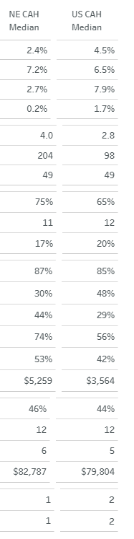
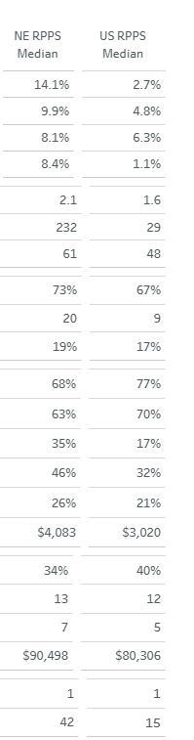
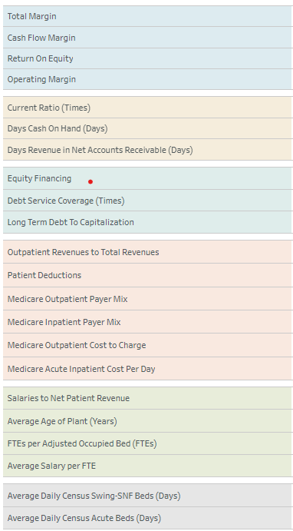
Flex Financials – State and National Medians

Slide 25

Celebrating the Power of Rural
Top Quartile Performance in Quality
ANTELOPE MEMORIAL HOSPITAL | NELIGH
AVERA CREIGHTON HOSPITAL | CREIGHTON
AVERA ST ANTHONY'S HOSPITAL | O' NEILL
BEATRICE COMMUNITY HOSPITAL | BEATRICE
BOONE COUNTY HEALTH CENTER | ALBION
BRODSTONE MEMORIAL | SUPERIOR
BUTLER COUNTY HEALTH CARE CENTER | DAVID CITY
CHADRON COMMUNITY HOSPITAL | CHADRON
CHI HEALTH PLAINVIEW | PLAINVIEW
COMMUNITY MEDICAL CENTER | FALLS CITY
CRETE AREA MEDICAL CENTER | CRETE
FRANKLIN COUNTY MEMORIAL HOSPITAL | FRANKLIN
GENOA MEDICAL FACILITIES | GENOA
HARLAN COUNTY HEALTH SYSTEM | ALMA
HENDERSON HEALTH CARE SERVICES | HENDERSON
HOWARD COUNTY MEDICAL CENTER | ST PAUL
JEFFERSON COMMUNITY HEALTH CENTER | FAIRBURY
JOHNSON COUNTY HOSPITAL | TECUMSEH
LEXINGTON REGIONAL HEALTH CENTER | LEXINGTON
MEMORIAL HEALTH CARE SYSTEMS | SEWARD
PENDER COMMUNITY HOSPITAL | PENDER
PERKINS COUNTY HEALTH SERVICES | GRANT
PHELPS MEMORIAL HEALTH CENTER | HOLDREGE
REGIONAL WEST GARDEN COUNTY HOSPITAL | OSHKOSH
SAUNDERS MEDICAL CENTER | WAHOO
ST FRANCIS MEMORIAL HOSPITAL | WEST POINT
THAYER COUNTY HEALTH SERVICES | HEBRON
THE MELHAM MEDICAL CENTER | BROKEN BOW

Slide 26
Celebrating the Power of Rural
Top Quartile Performance in Outcomes
BEATRICE COMMUNITY HOSPITAL | BEATRICE
BOONE COUNTY HEALTH CENTER | ALBION
BRYAN HEALTH KEARNEY REGIONAL MEDICAL CENTER | KEARNEY
COLUMBUS COMMUNITY HOSPITAL | COLUMBUS
COZAD COMMUNITY HOSPITAL | COZAD
FAITH REGIONAL HEALTH SERVICES | NORFOLK
MARY LANNING MEMORIAL HOSPITAL | HASTINGS
PHELPS MEMORIAL HEALTH CENTER | HOLDREGE
SYRACUSE AREA HEALTH | SYRACUSE
VALLEY COUNTY HOSPITAL | ORD

Slide 27
Celebrating the Power of Rural
Top Quartile Performance in Patient Perspective
ANTELOPE MEMORIAL HOSPITAL | NELIGH
BOONE COUNTY HEALTH CENTER | ALBION
BRODSTONE MEMORIAL HOSP | SUPERIOR
CALLAWAY DISTRICT HOSPITAL | CALLAWAY
CHI HEALTH SAINT MARYS | NEBRASKA CITY
COMMUNITY MEDICAL CENTER INC | FALLS CITY
CRETE AREA MEDICAL CENTER | CRETE
GORDON MEMORIAL HOSPITAL DISTRICT | GORDON
HENDERSON HEALTH CARE SERVICES | HENDERSON
JOHNSON COUNTY HOSPITAL | TECUMSEH
KEARNEY COUNTY HOSPITAL | MINDEN
MEMORIAL COMMUNITY HOSPITAL | BLAIR
MORRILL COUNTY COMMUNITY HOSPITAL | BRIDGEPORT
PERKINS COUNTY HEALTH SERVICES | GRANT
PHELPS MEMORIAL HEALTH CENTER | HOLDREGE
PROVIDENCE MEDICAL CENTER | WAYNE
ROCK COUNTY HOSPITAL | BASSETT
ST FRANCIS MEMORIAL HOSPITAL | WEST POINT
SYRACUSE AREA HEALTH | SYRACUSE
WEST HOLT MEMORIAL HOSPITAL | ATKINSON

Slide 28



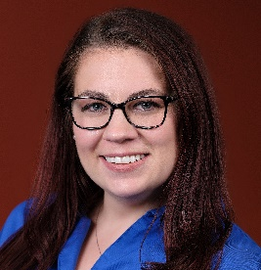




Chartis Center for Rural Health Our Team
Michael Topchik
Executive Director
Troy Brown
Network Consultant
Melanie Pinette
Data Innovation
Billy Balfour
Communications
Ana Wiesse
Data Analyst
Renee Burnham
Senior Research Associate

Slide 29

Thank you

