Slide 1
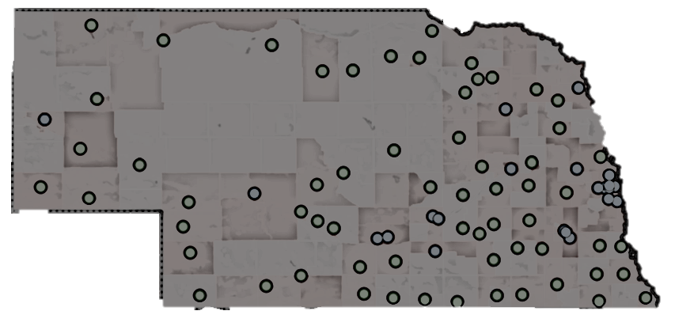

15 Minutes With Quality Data
Using Dimensions to Gain Insight and Improve Patient Care
Ryan Anderson
Director of Data & Analytics, Nebraska Hospital Association
NHA Quality Conference | November 2025

Slide 2
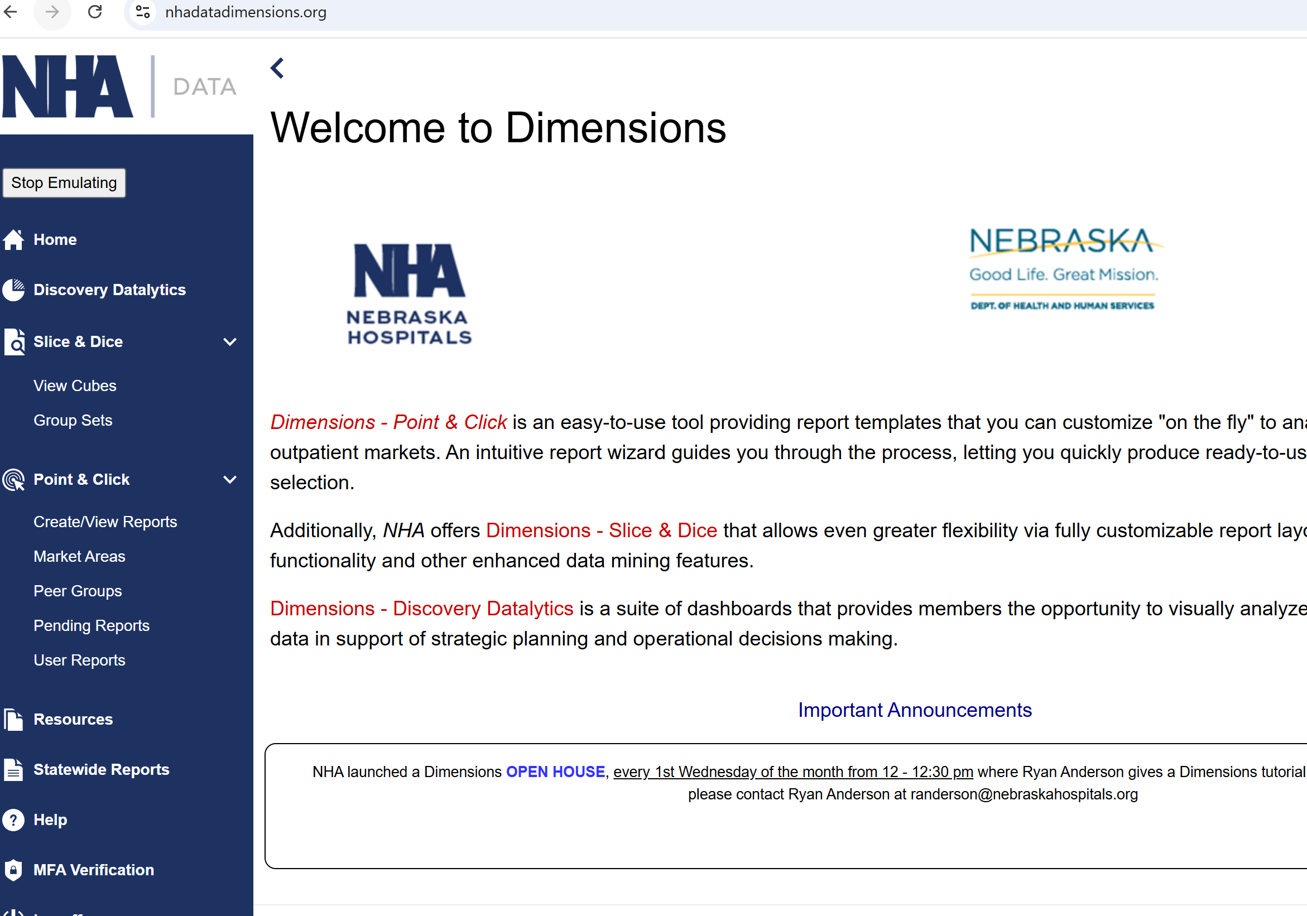
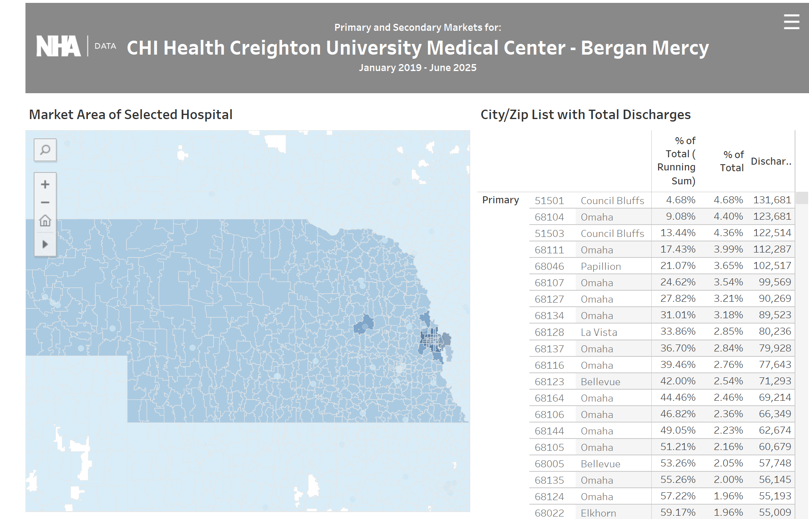
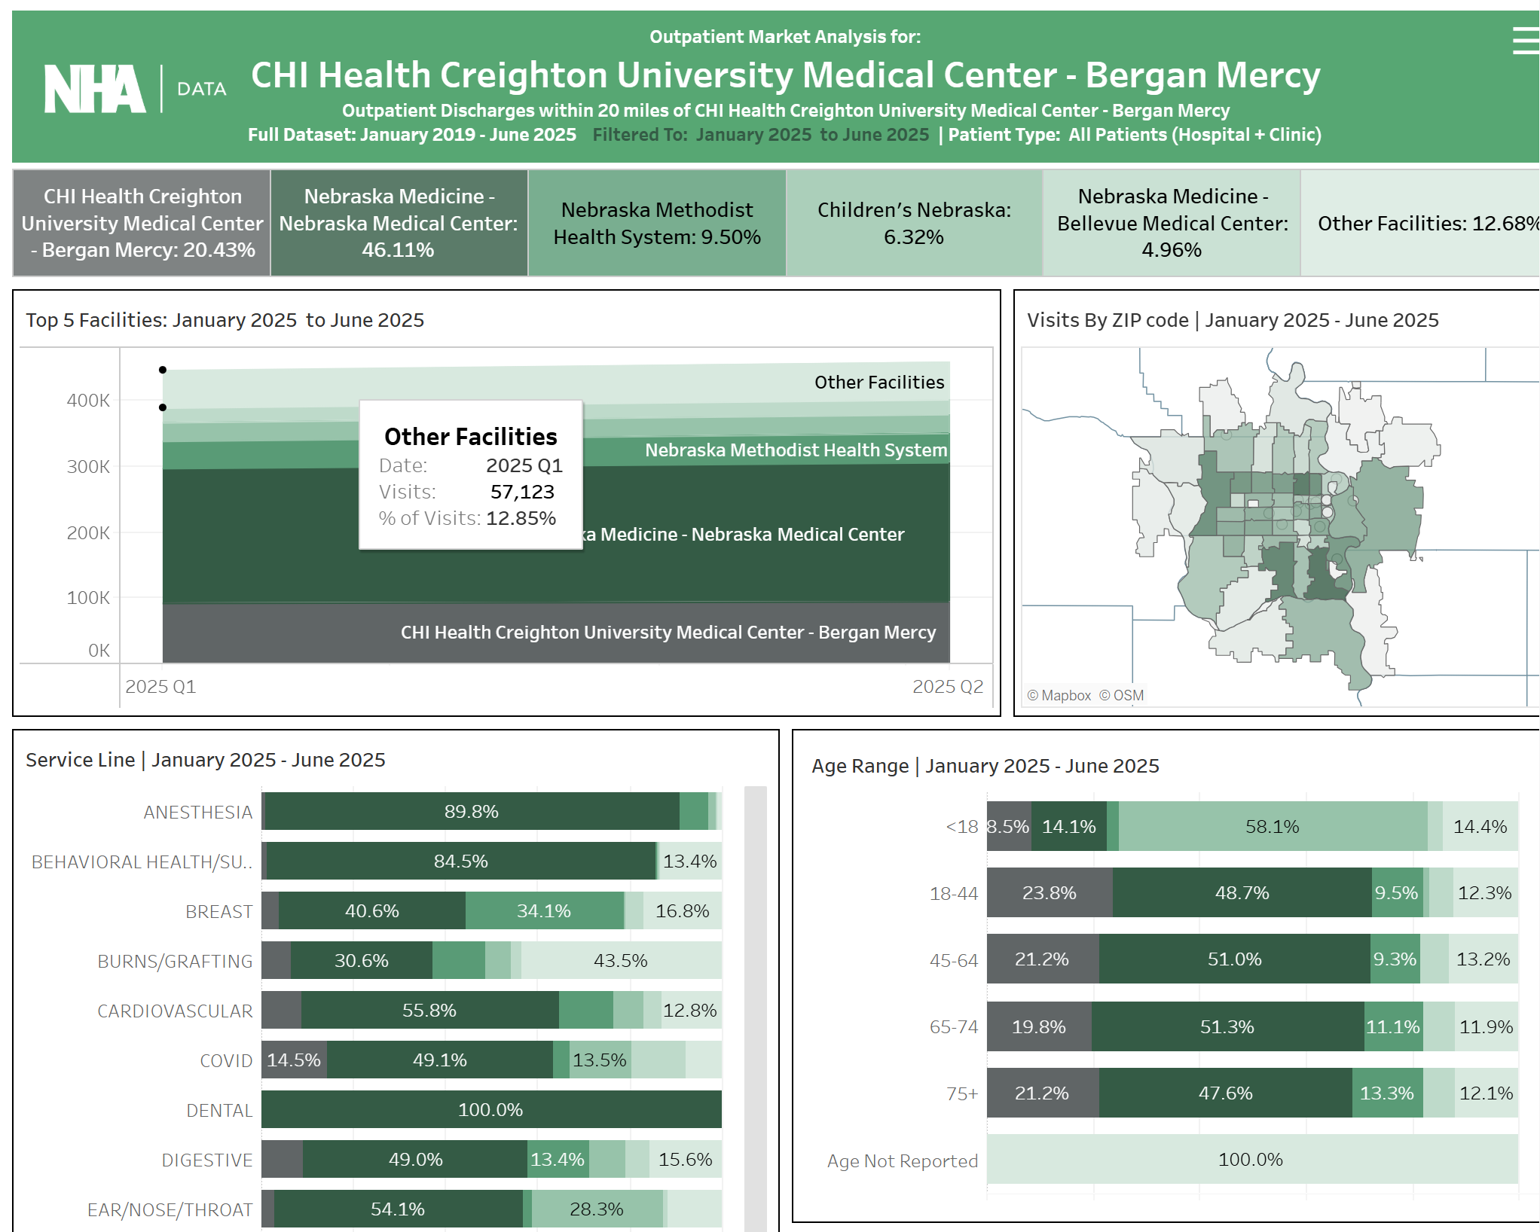
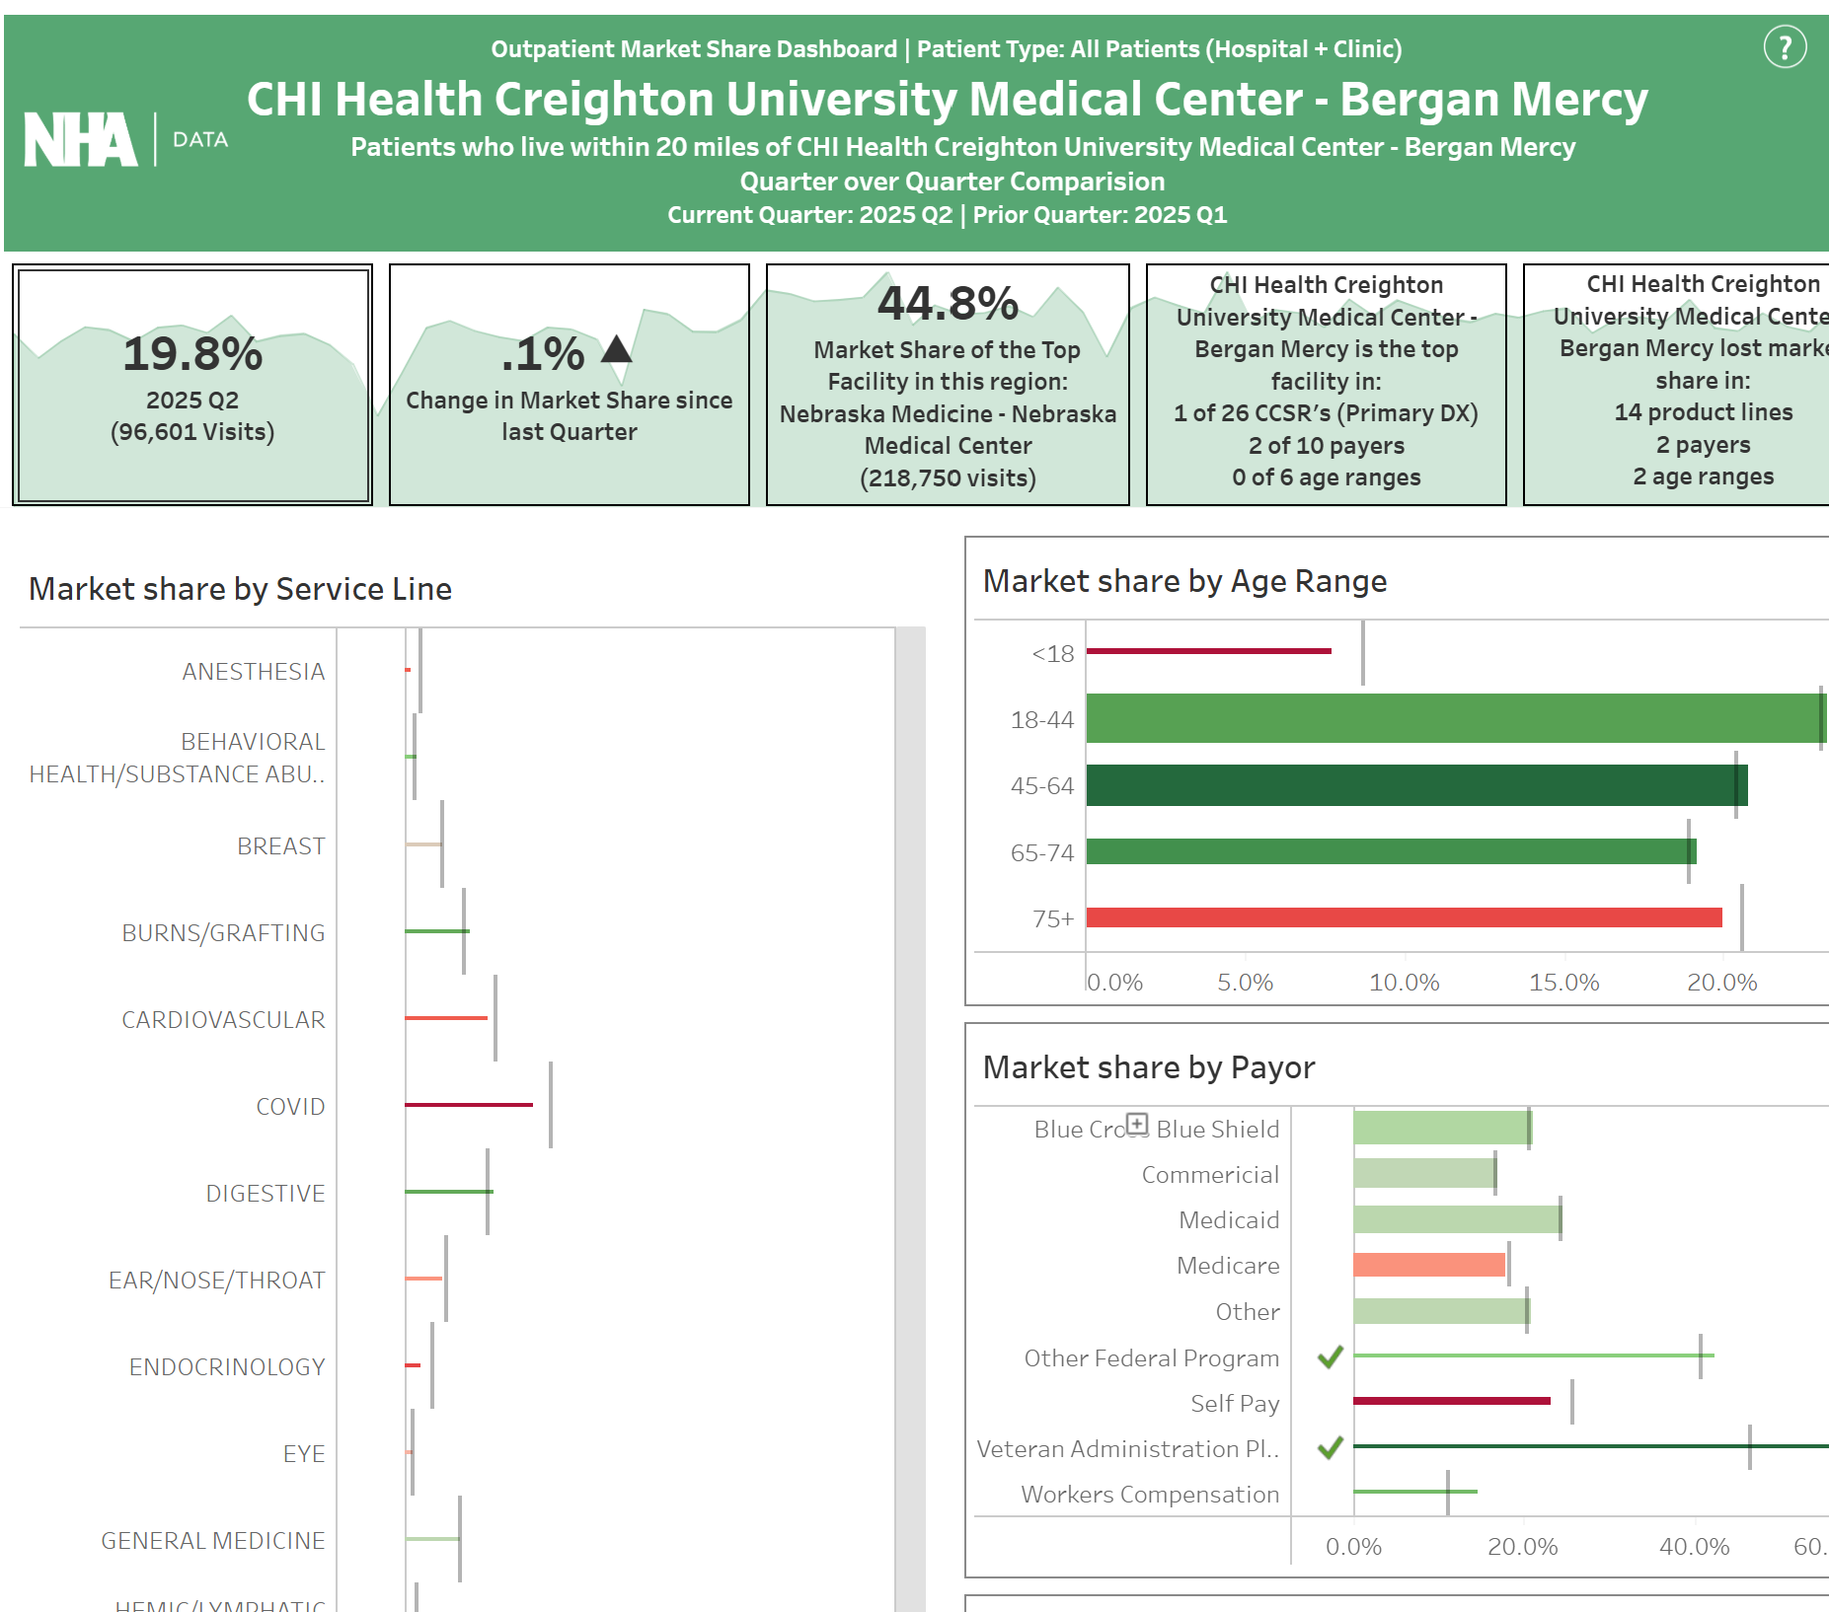
The Tool We’re Covering Today

Slide 3
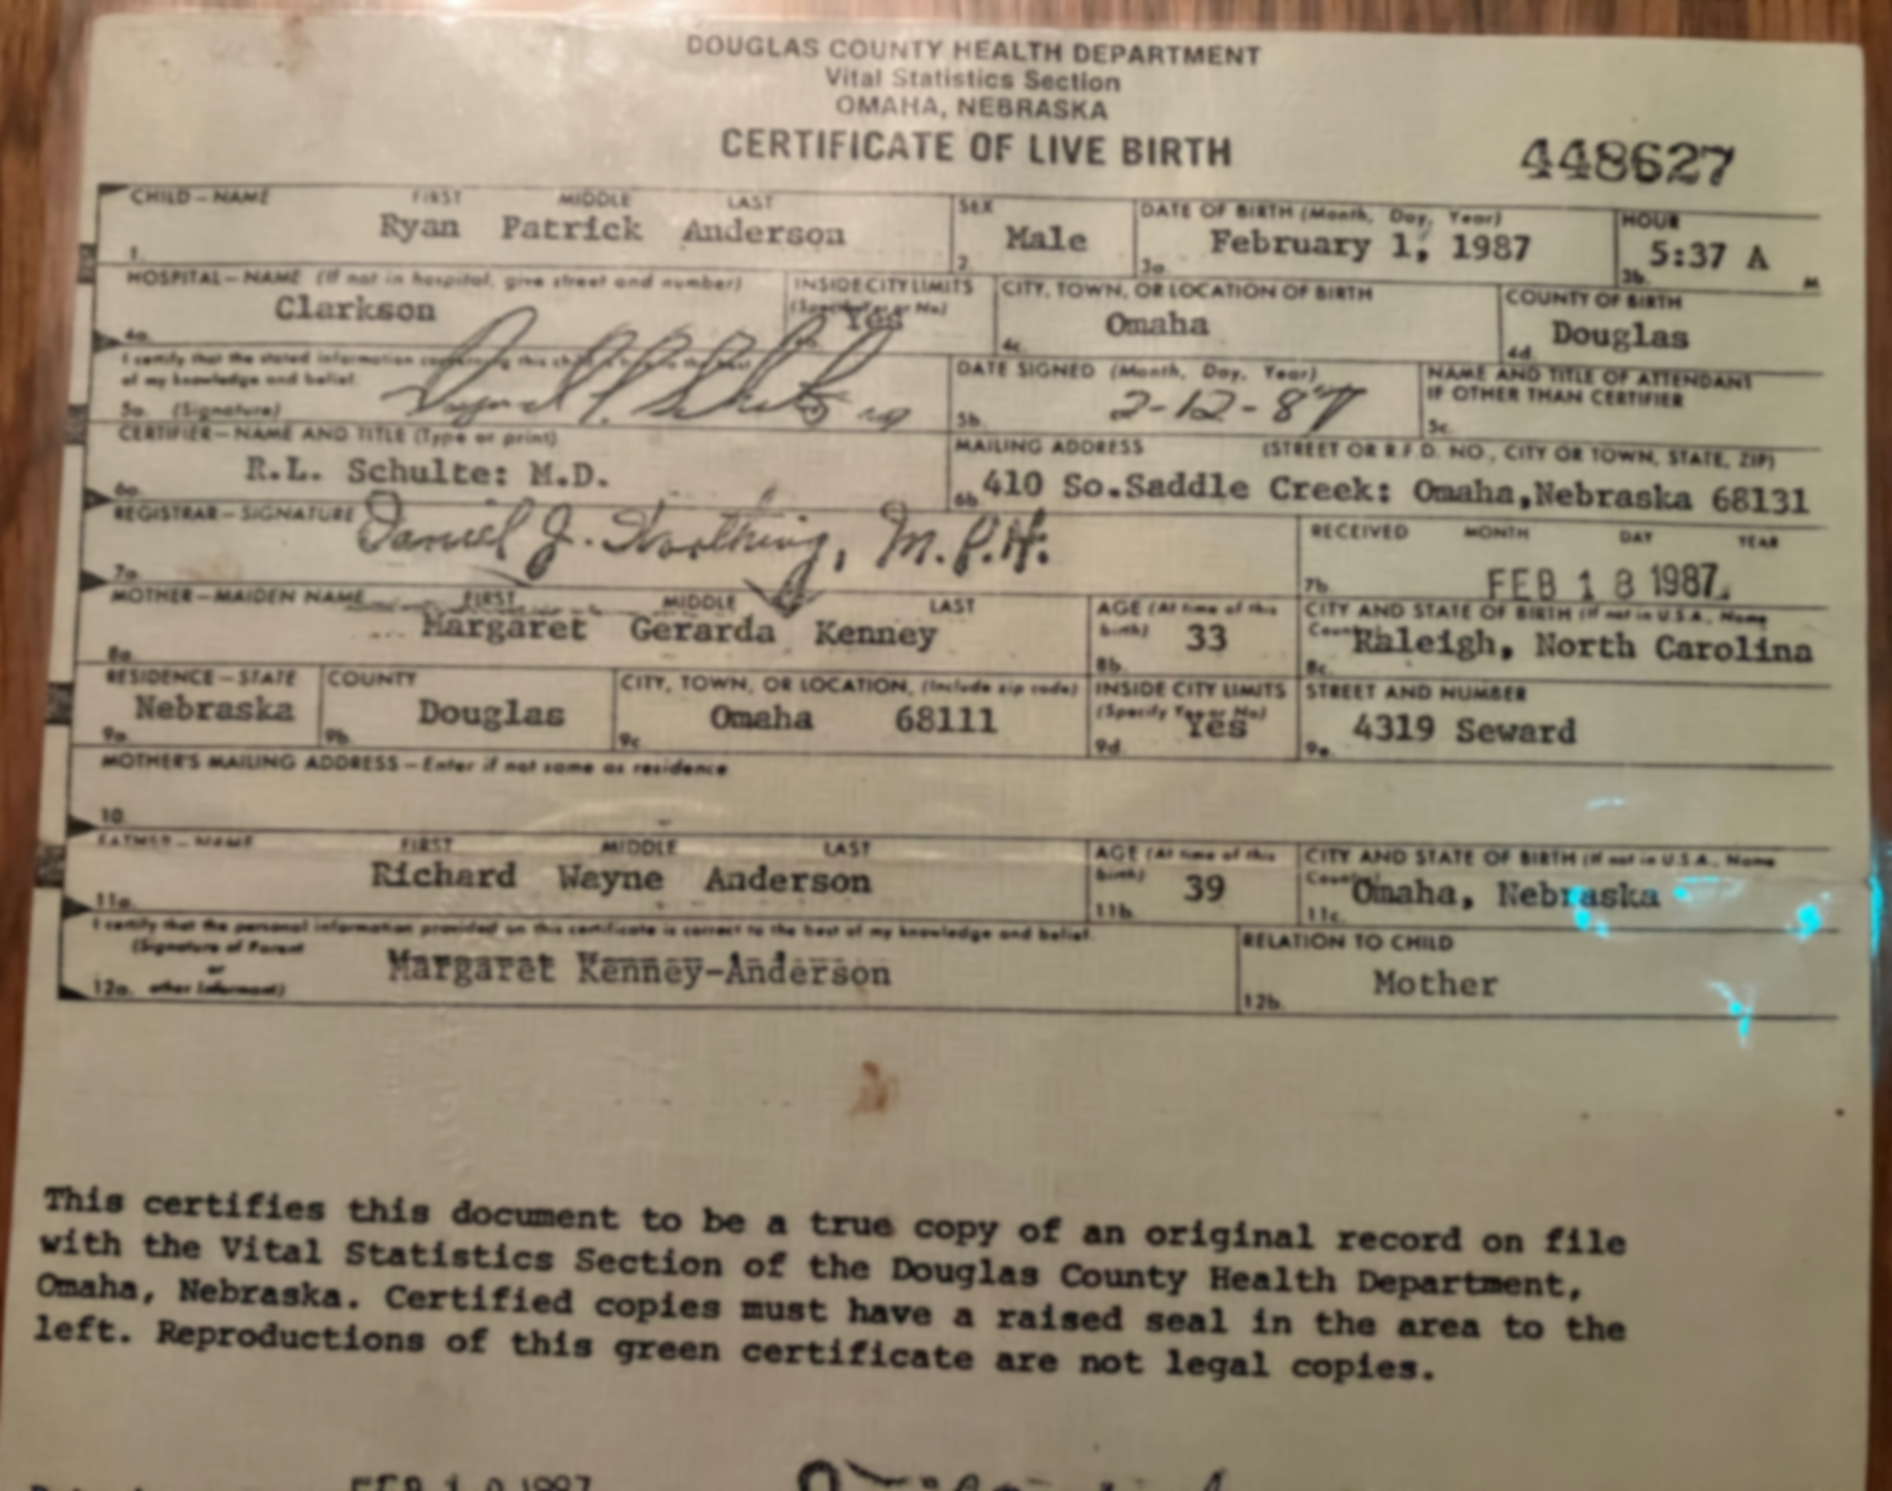

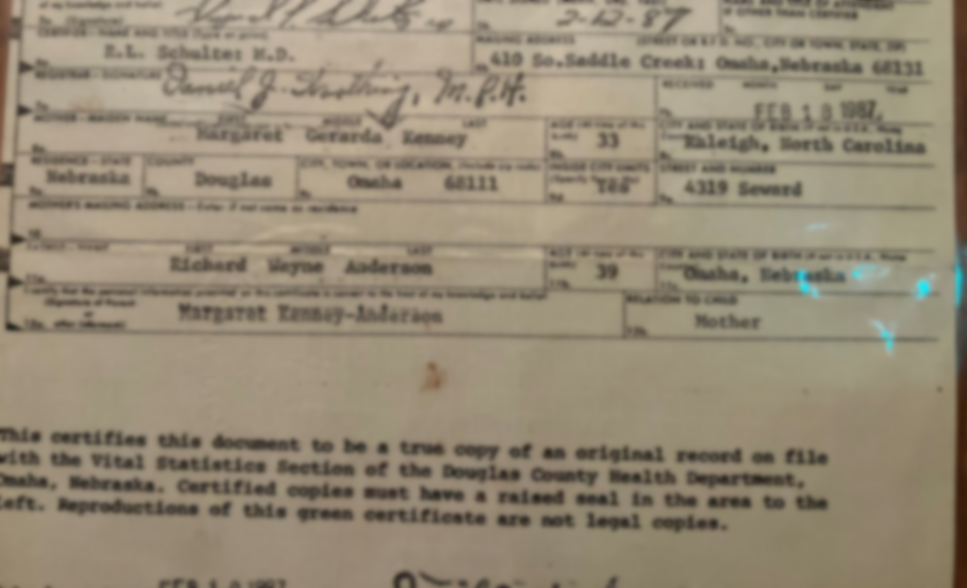
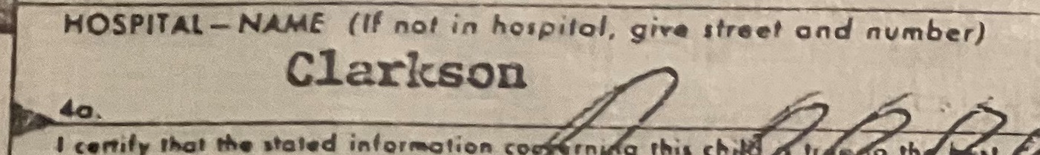

Slide 4
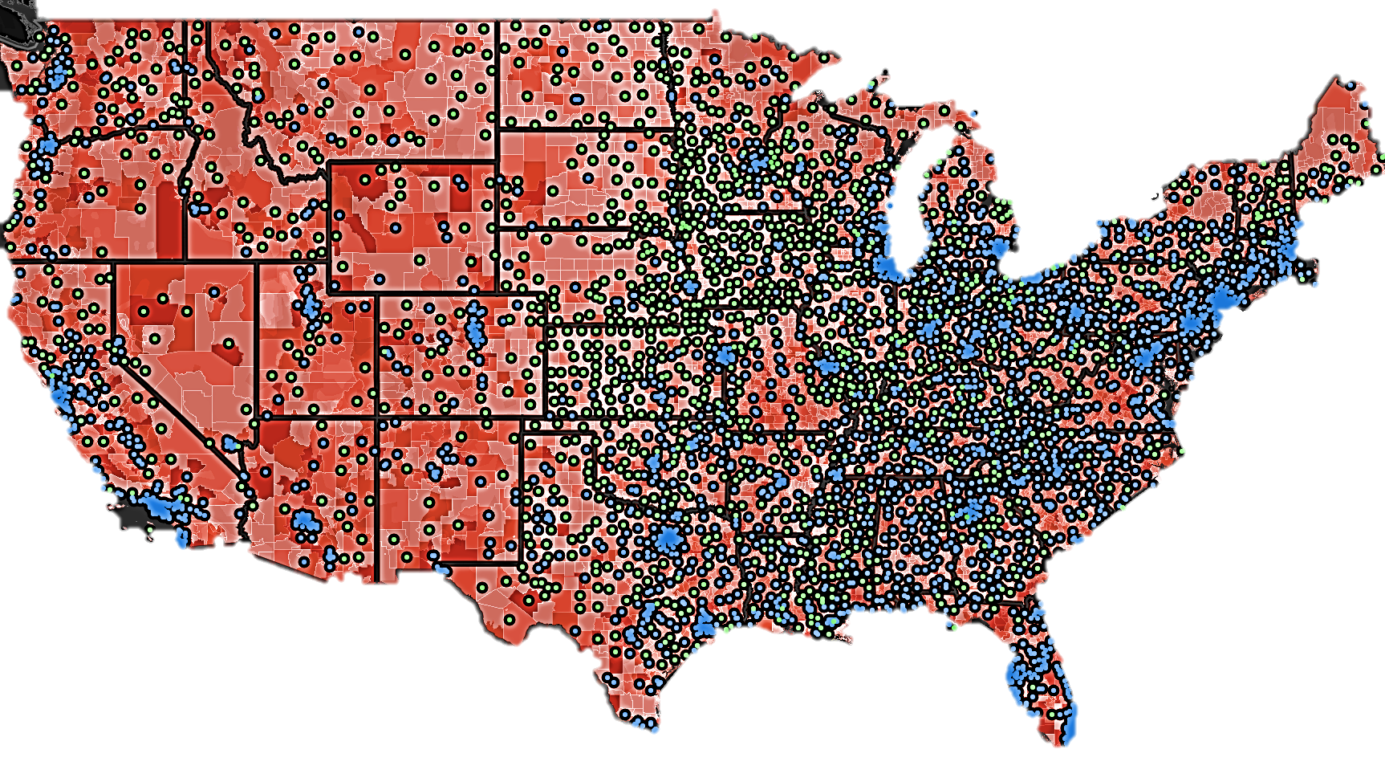
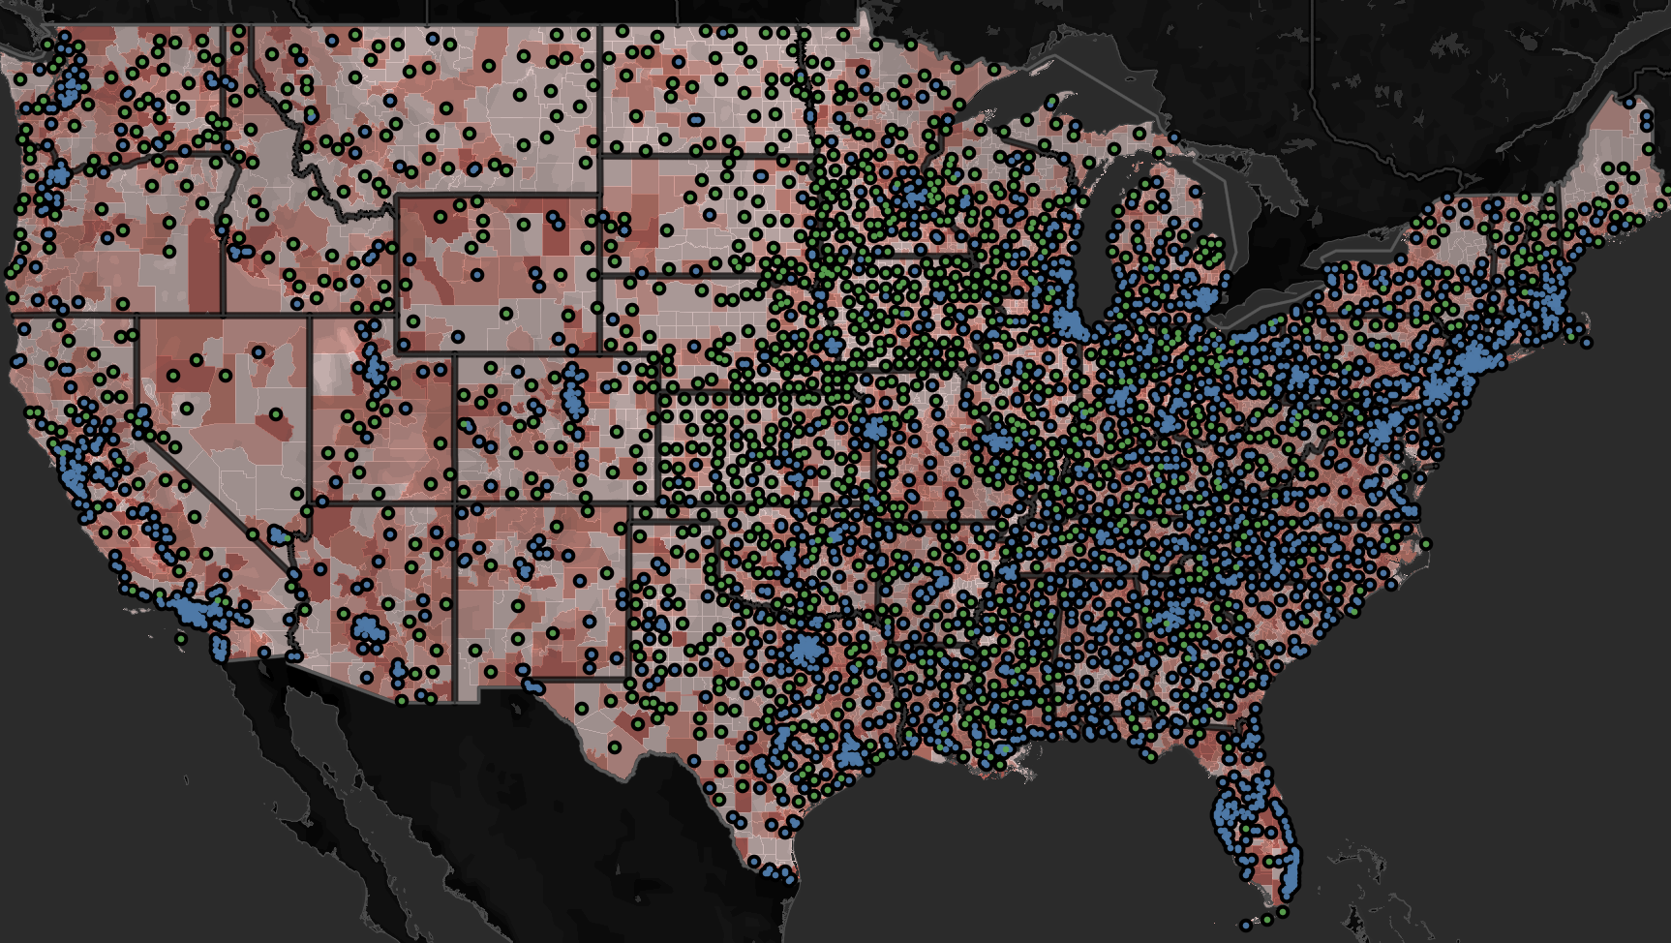
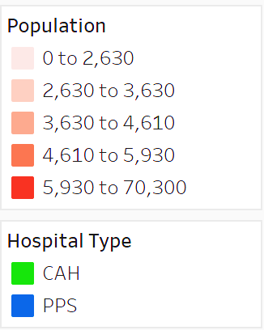
Distribution of American Hospitals

Slide 5
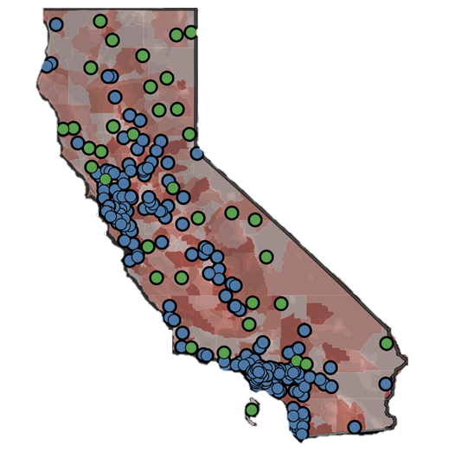
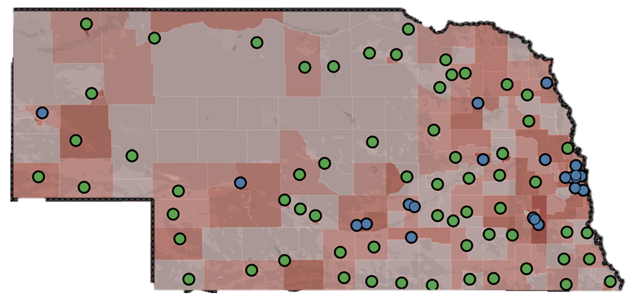


Hospitals in Nebraska and California

Slide 6
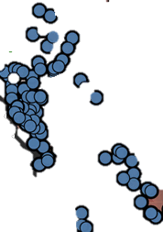

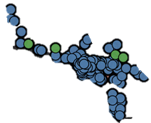
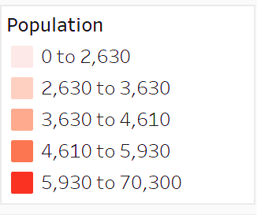
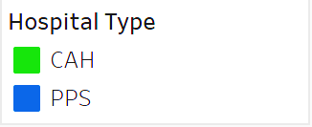
Hospitals in Nebraska and California

Slide 7
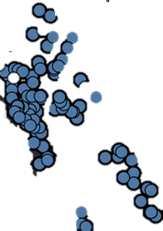
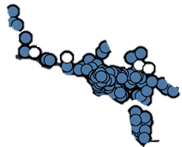
Hospitals in Nebraska and California

Slide 8
Hospitals in Nebraska and California
59%
41%

Slide 9
Hospitals in Nebraska and California
61%
80%
39%
20%

Slide 11
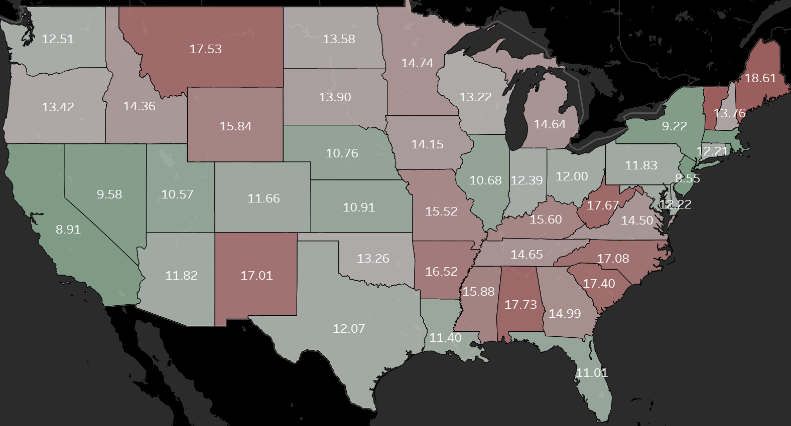
Nebraska’s Rank in Average Drive Time
HOSPITAL
10th

Slide 12
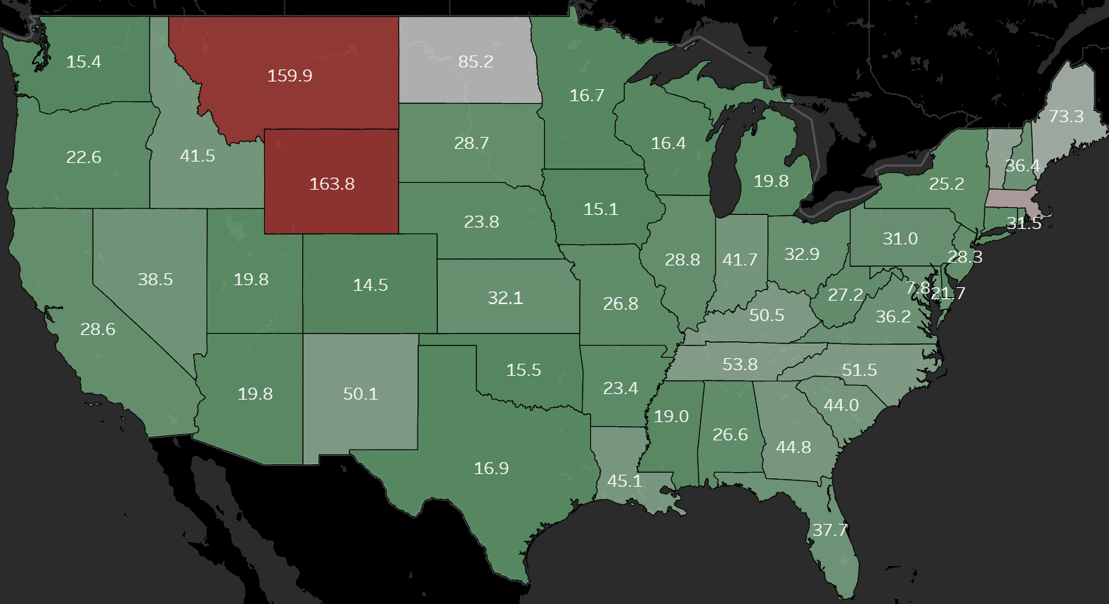
Nebraska’s Rank in Average Drive Time
HOSPITAL
TRAUMA CENTER
10th
16th

Slide 13
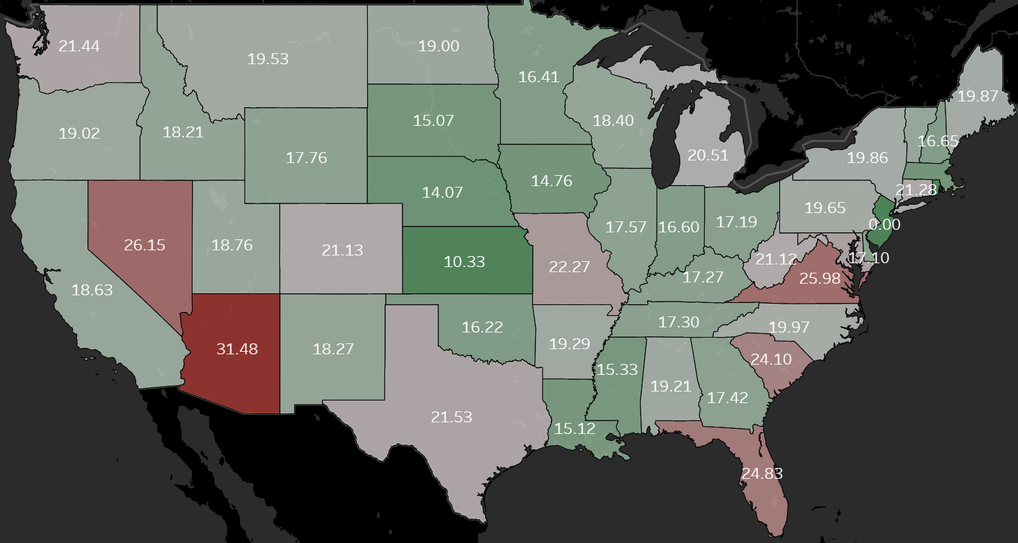
Nebraska’s Rank in Average Drive Time
ALL COUNTIES
HOSPITAL
TRAUMA CENTER
10th
16th
RURAL COUNTIES ONLY
HOSPITAL
5th

Slide 14
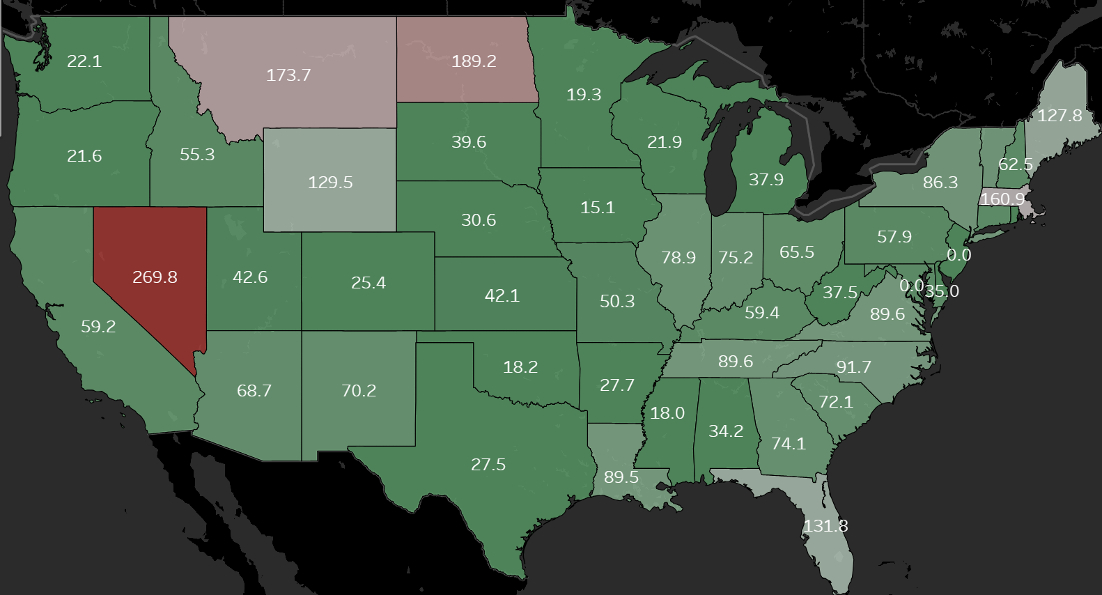
Nebraska’s Rank in Average Drive Time
ALL COUNTIES
HOSPITAL
TRAUMA CENTER
10th
16th
RURAL COUNTIES ONLY
HOSPITAL
TRAUMA CENTER
5th
11th

Slide 15
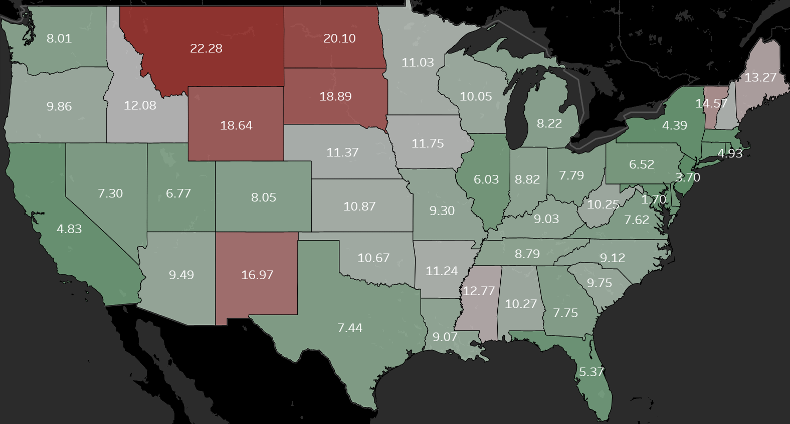
Nebraska’s Rank in Average Drive Time
PHARMACY
39th

Slide 16
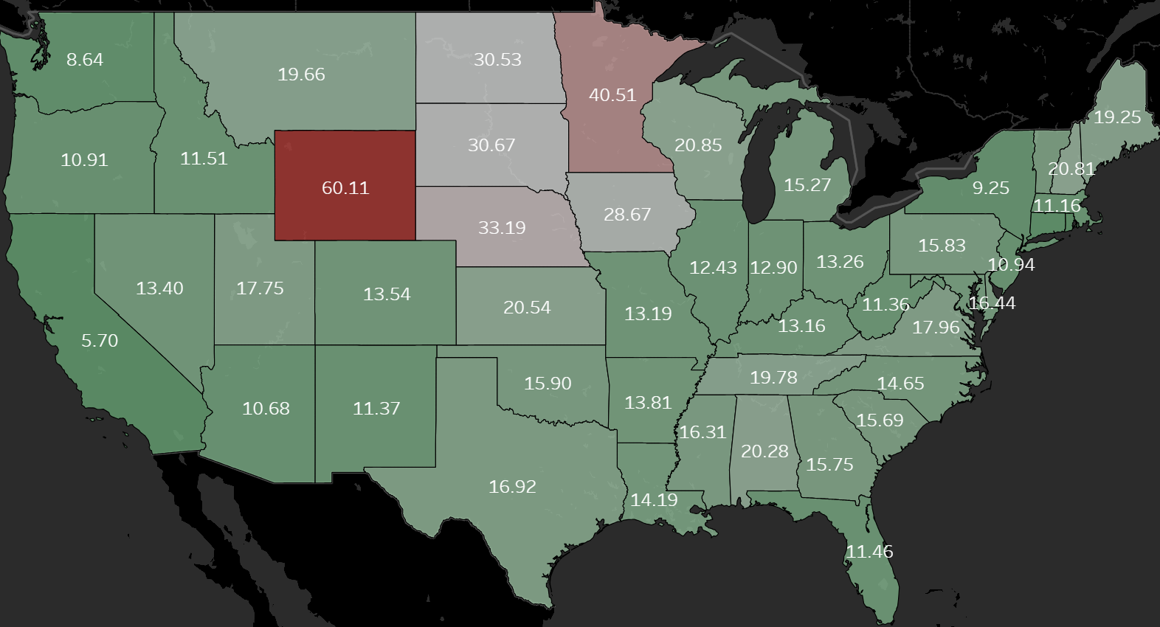
Nebraska’s Rank in Average Drive Time
PHARMACY
HSRA
39th
49th

Slide 17
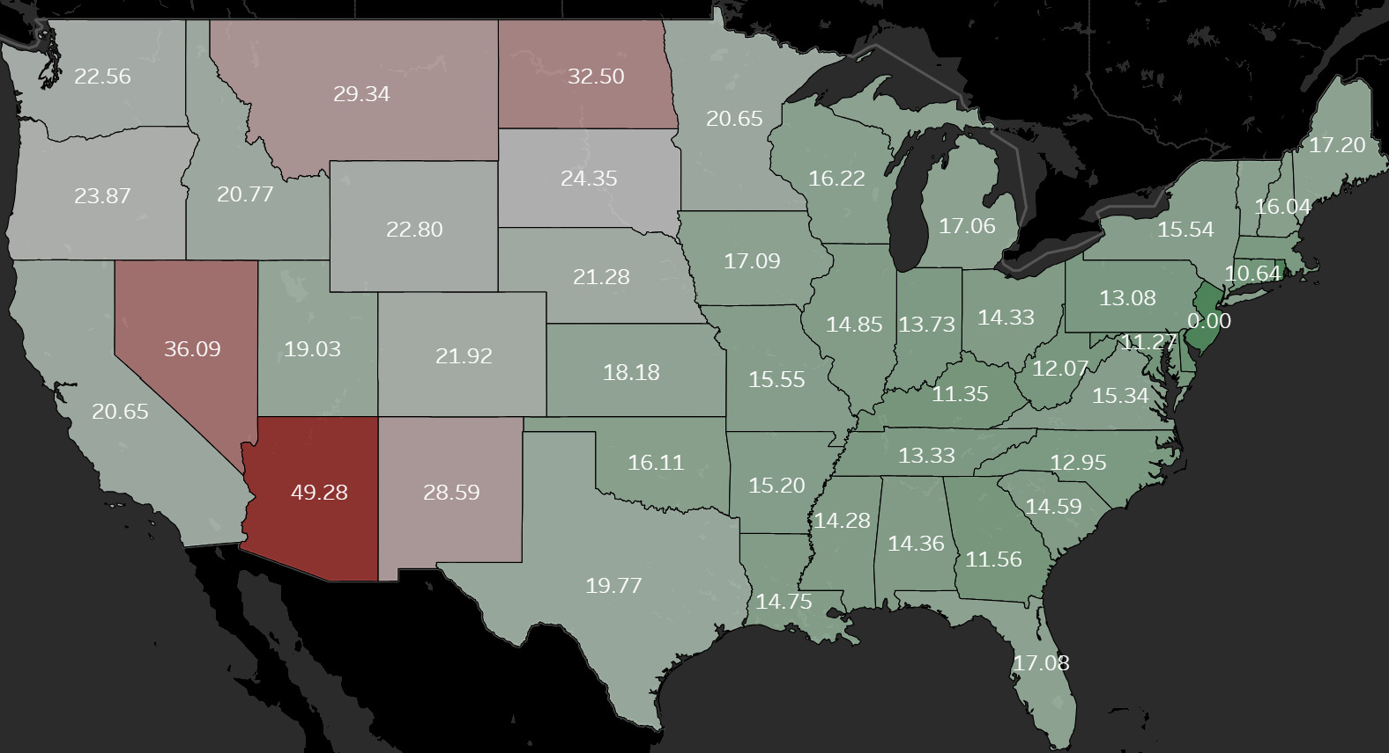
Nebraska’s Rank in Average Drive Time
ALL COUNTIES
PHARMACY
HSRA
39th
49th
RURAL COUNTIES ONLY
PHARMACY
40th

Slide 18
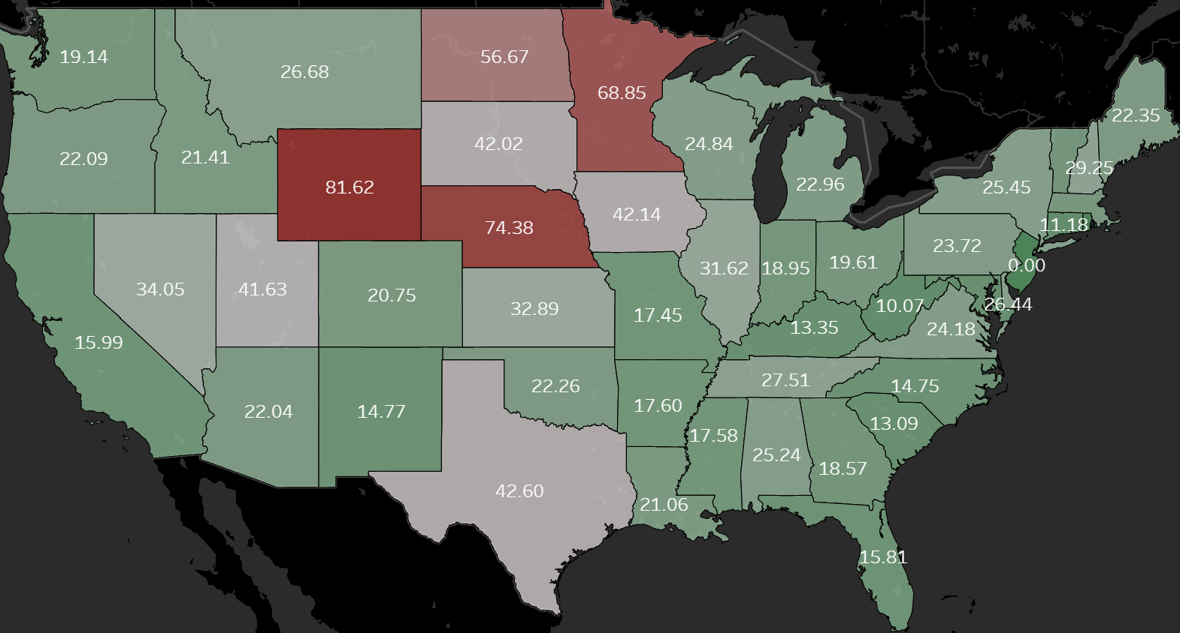
Nebraska’s Rank in Average Drive Time
ALL COUNTIES
PHARMACY
HSRA
39th
49th
RURAL COUNTIES ONLY
PHARMACY
HSRA
40th
50th

Slide 19
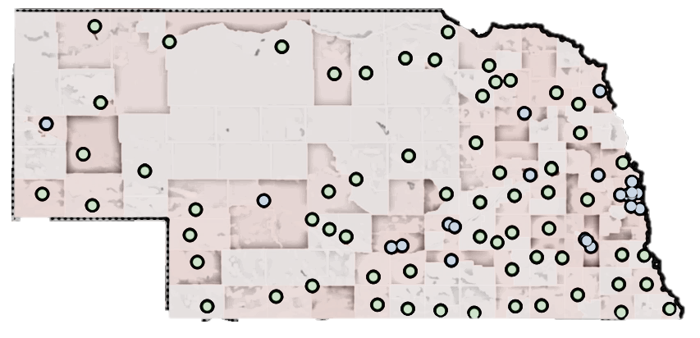
Nebraska’s Rank in Average Drive Time
ALL COUNTIES
ALL COUNTIES
HOSPITAL
TRAUMA CENTER
PHARMACY
HSRA
10th
16th
39th
49th
RURAL COUNTIES ONLY
RURAL COUNTIES ONLY
HOSPITAL
TRAUMA CENTER
PHARMACY
HSRA
5th
11th
40th
50th

Slide 20
Rural Nebraskans Are Exceptional
Rank HIGHEST Among Rural Populations in All States For:
    Labor force participation (65%)
    Employment rate (97%)
    Commercial health coverage (34%)
Rank BELOW National Average For:
    Arthritis among adults (30%)
    High-blood pressure among adults (35%)
    Diagnosed diabetes among adults (12%)

Slide 21
But the Headwinds Are Here
    Rising Labor Costs, Workforce Shortages
    Flat or Falling Reimbursement Rates
    Declining Inpatient Volume and Case Mix Shift
    Payer and System Consolidation

Slide 22
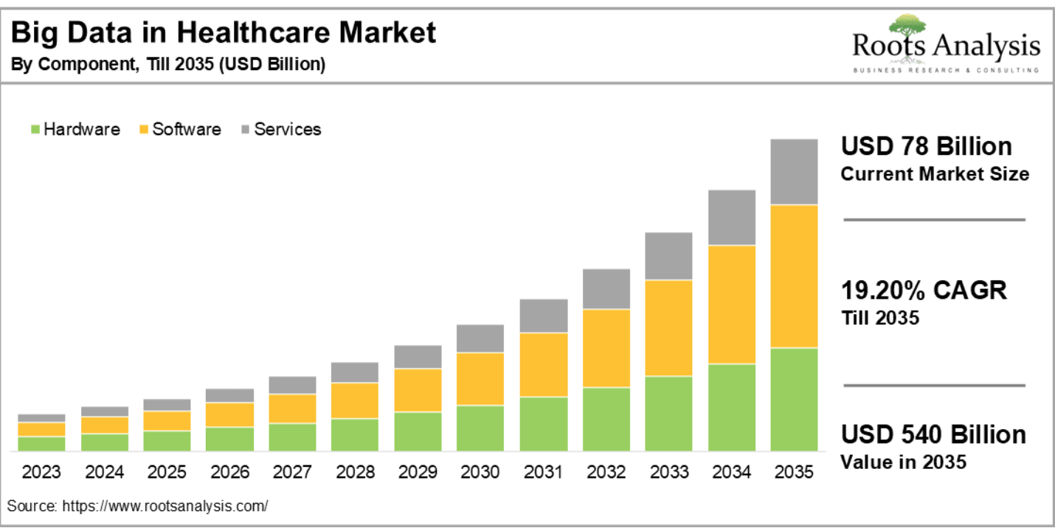
Data: Challenge and Opportunity

Slide 23
The Tool We’re Covering Today

Slide 24

You Forgot Your Board Presentation!

Slide 25
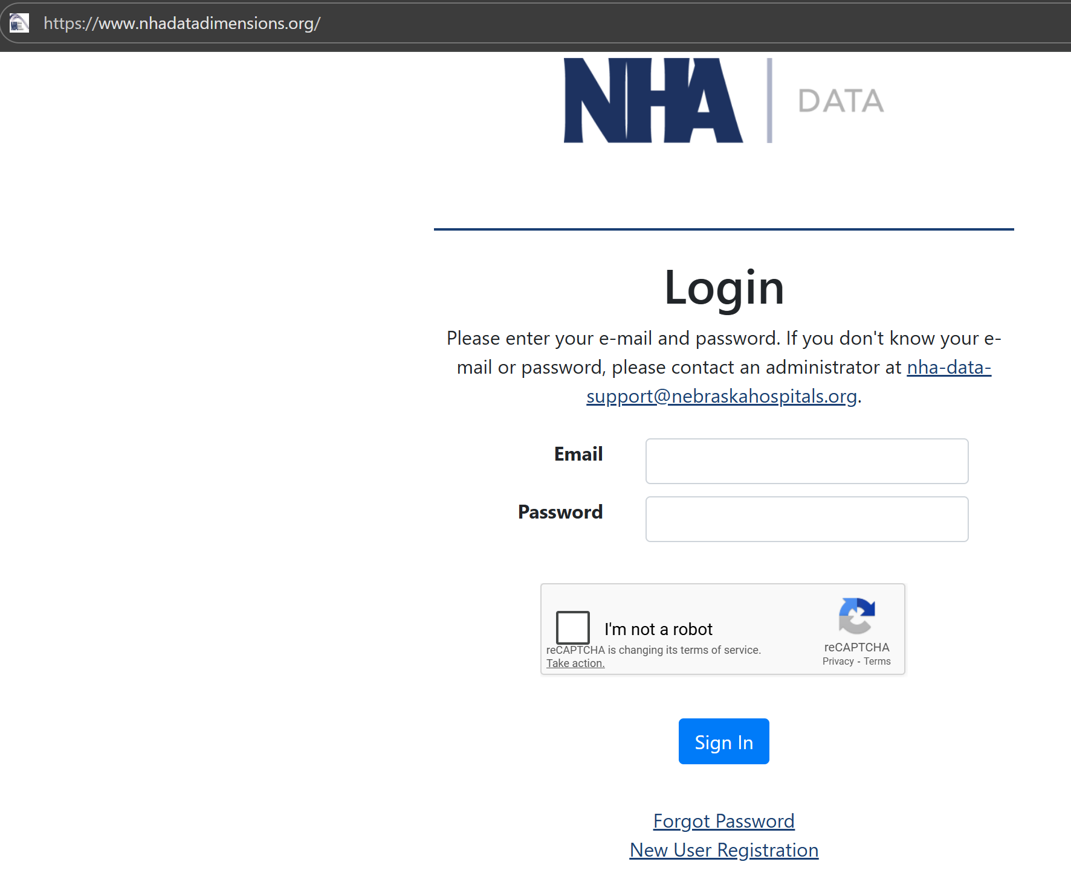
NHADataDimensions.org

Slide 26
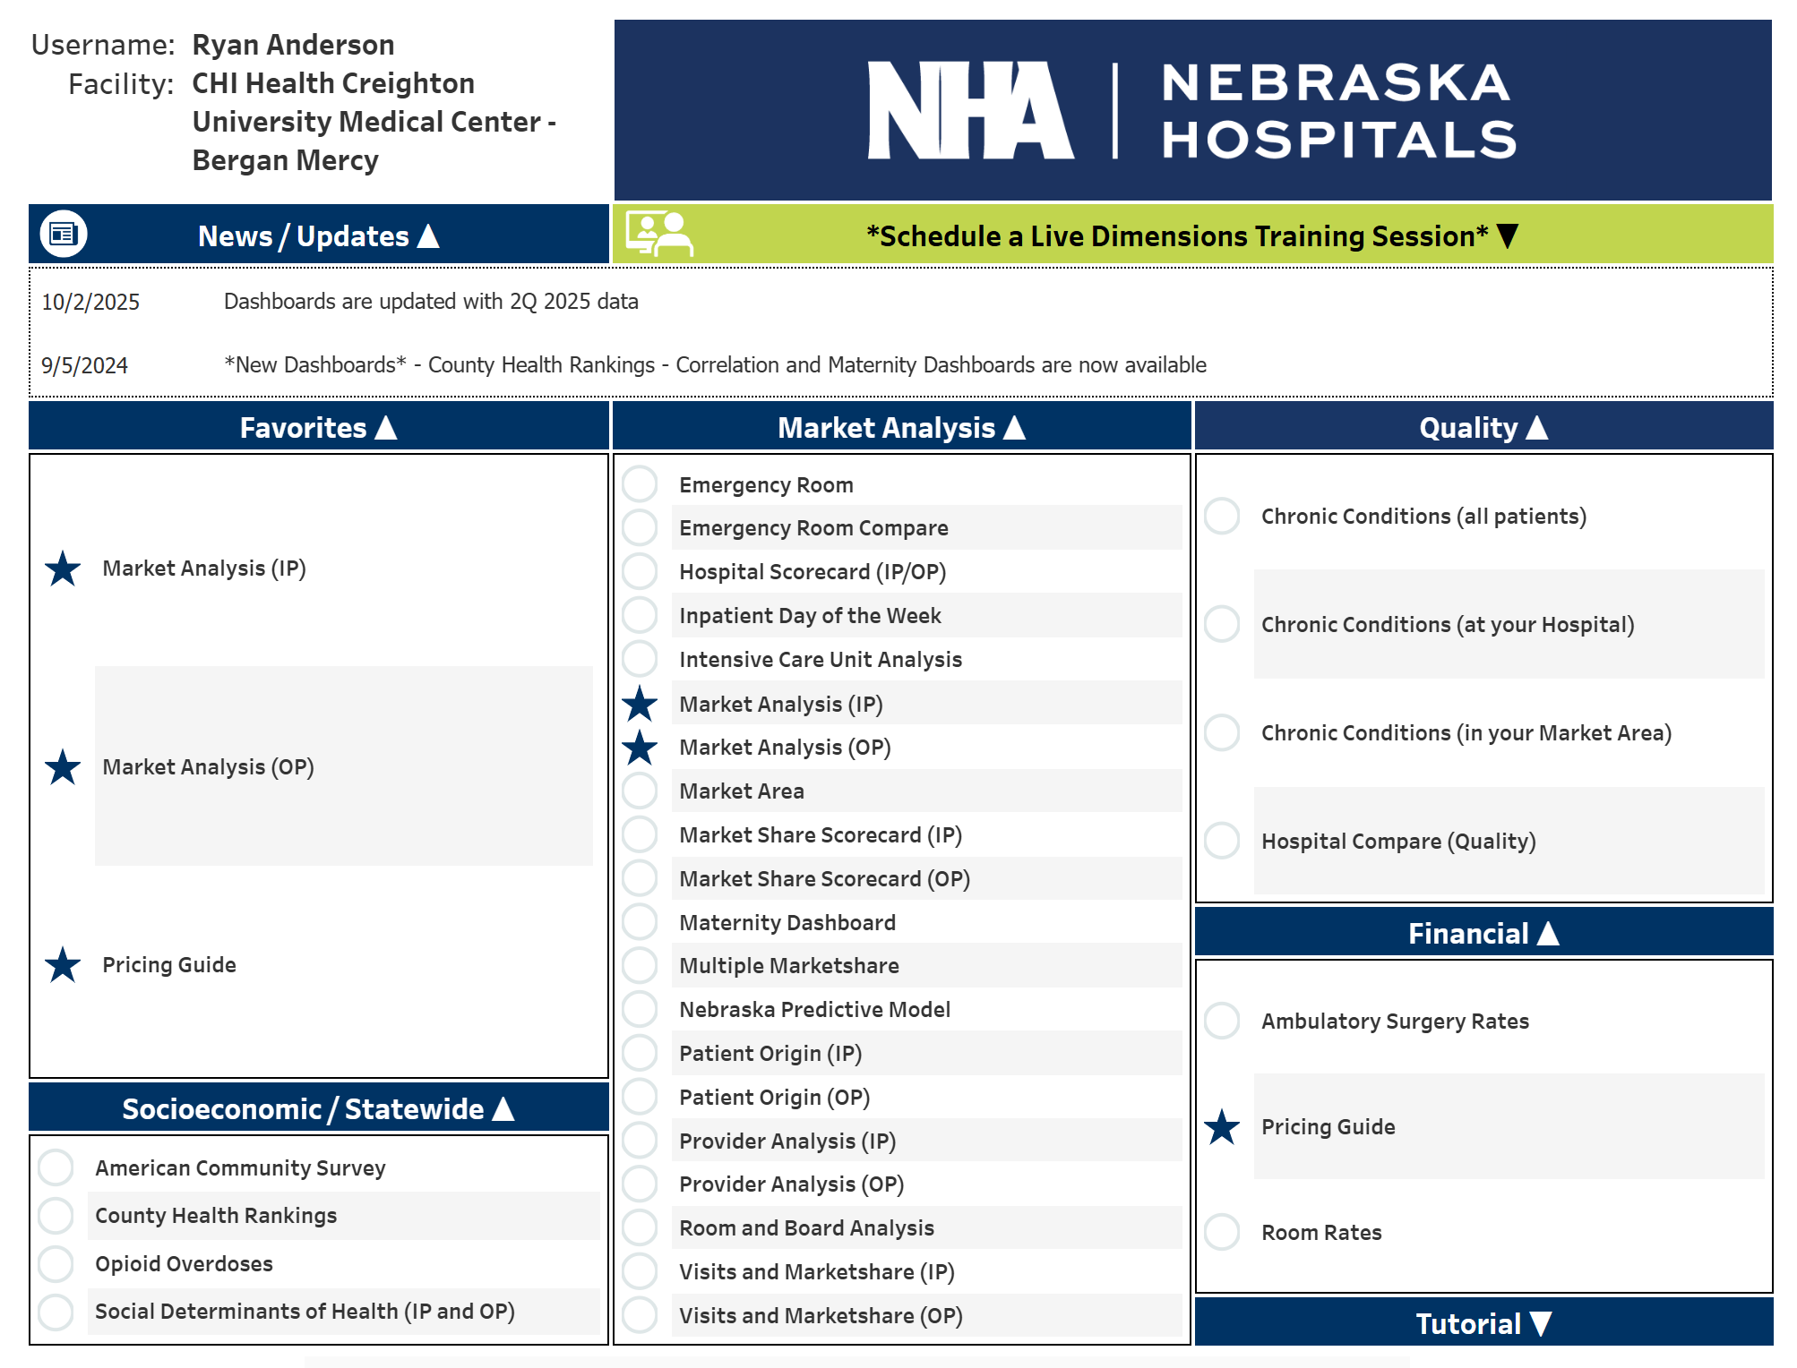
Discovery Datalytics

Slide 27
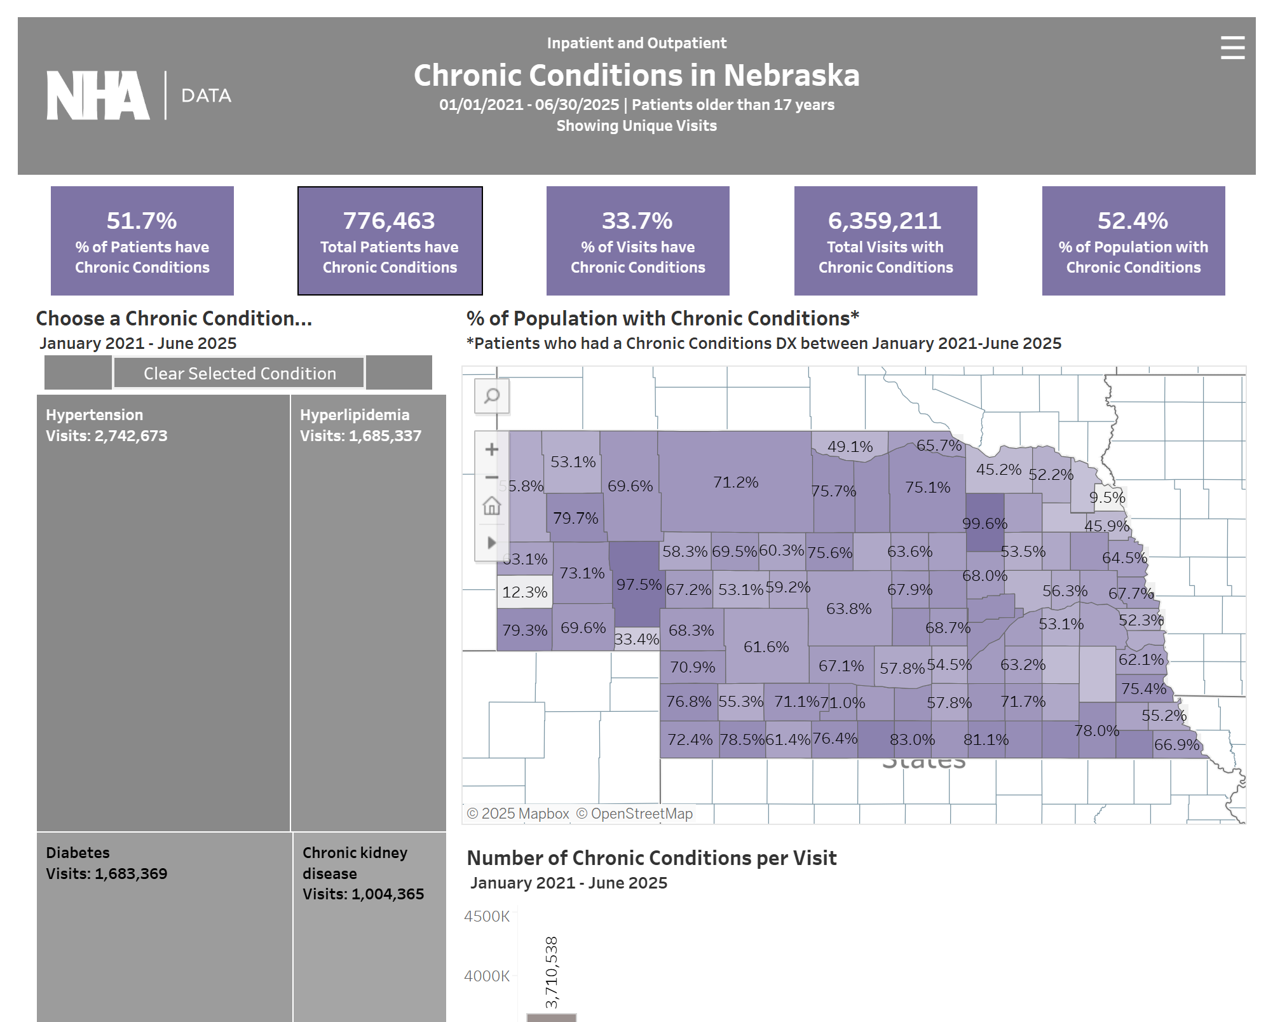
Chronic Conditions in Nebraska

Slide 28
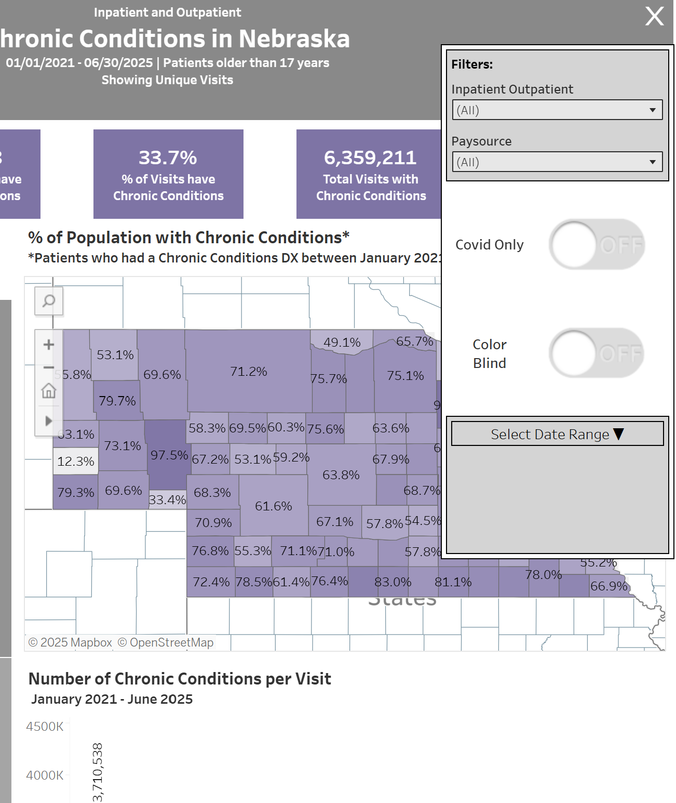
Chronic Conditions in Nebraska

Slide 29
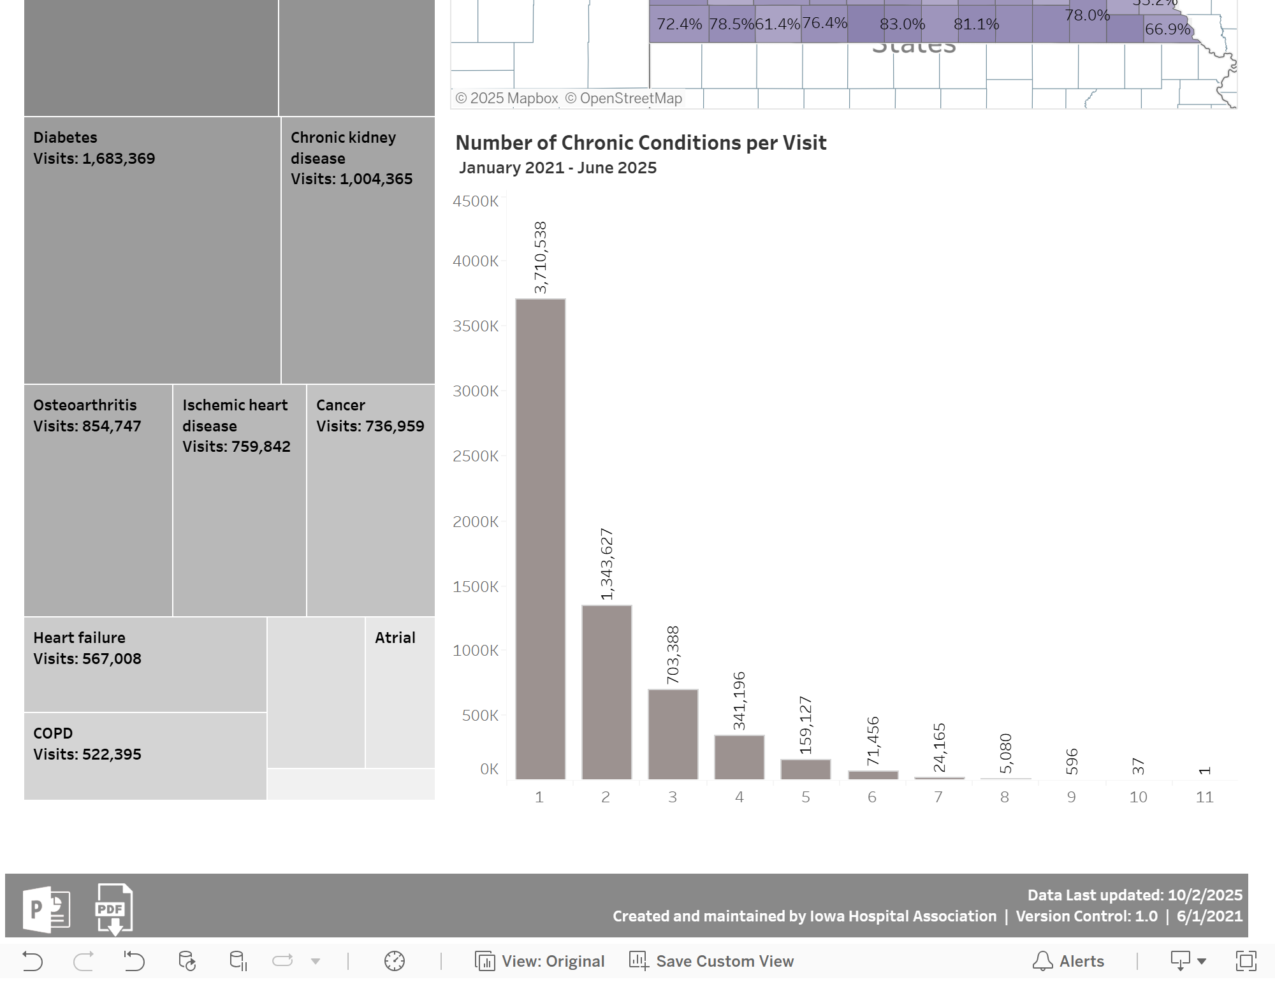
Chronic Conditions in Nebraska

Slide 30
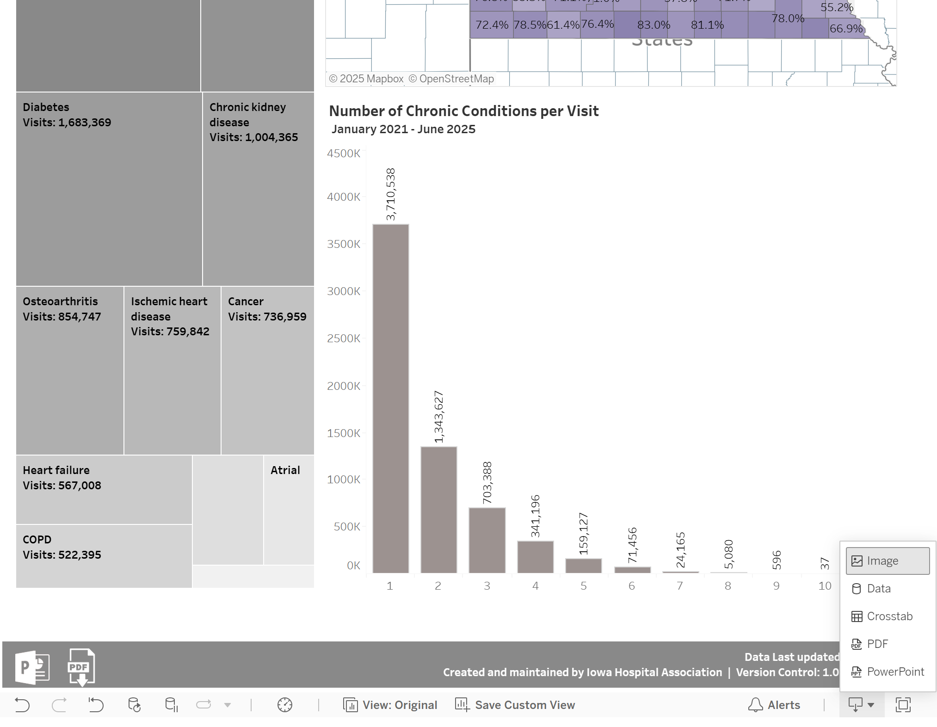
Chronic Conditions in Nebraska

Slide 31
Discovery Datalytics

Slide 32
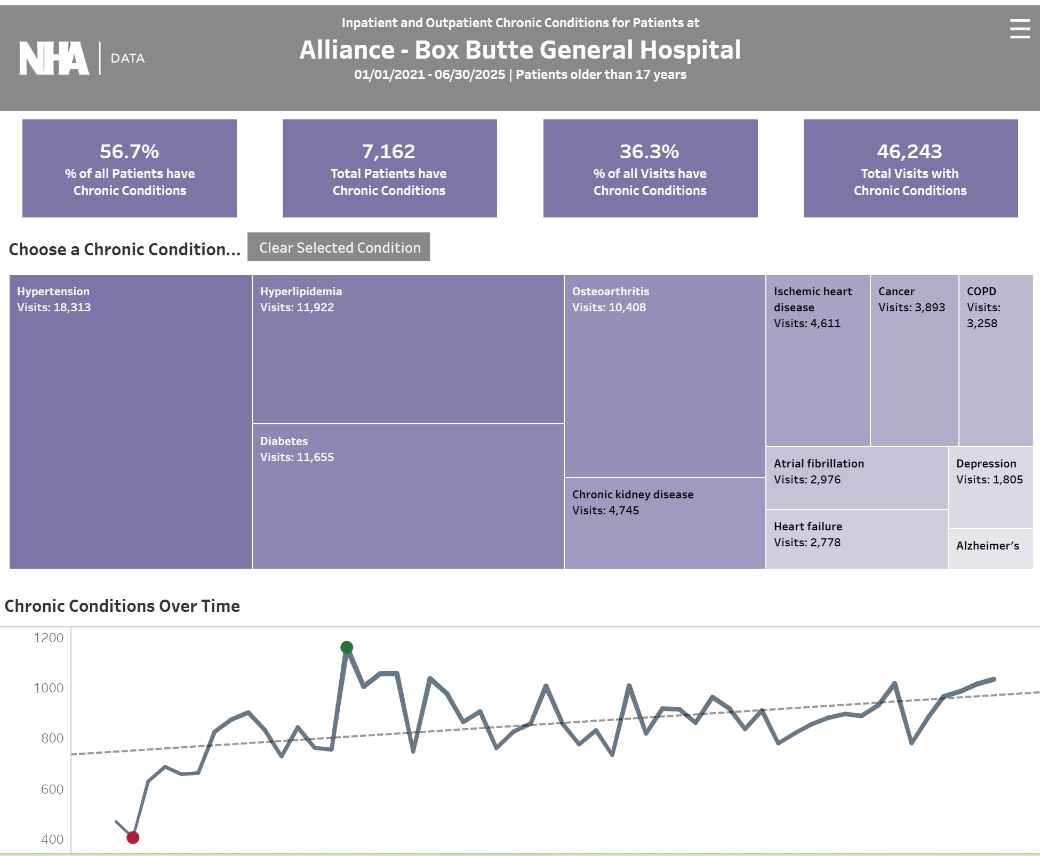
Chronic Conditions at Your Hospital

Slide 33
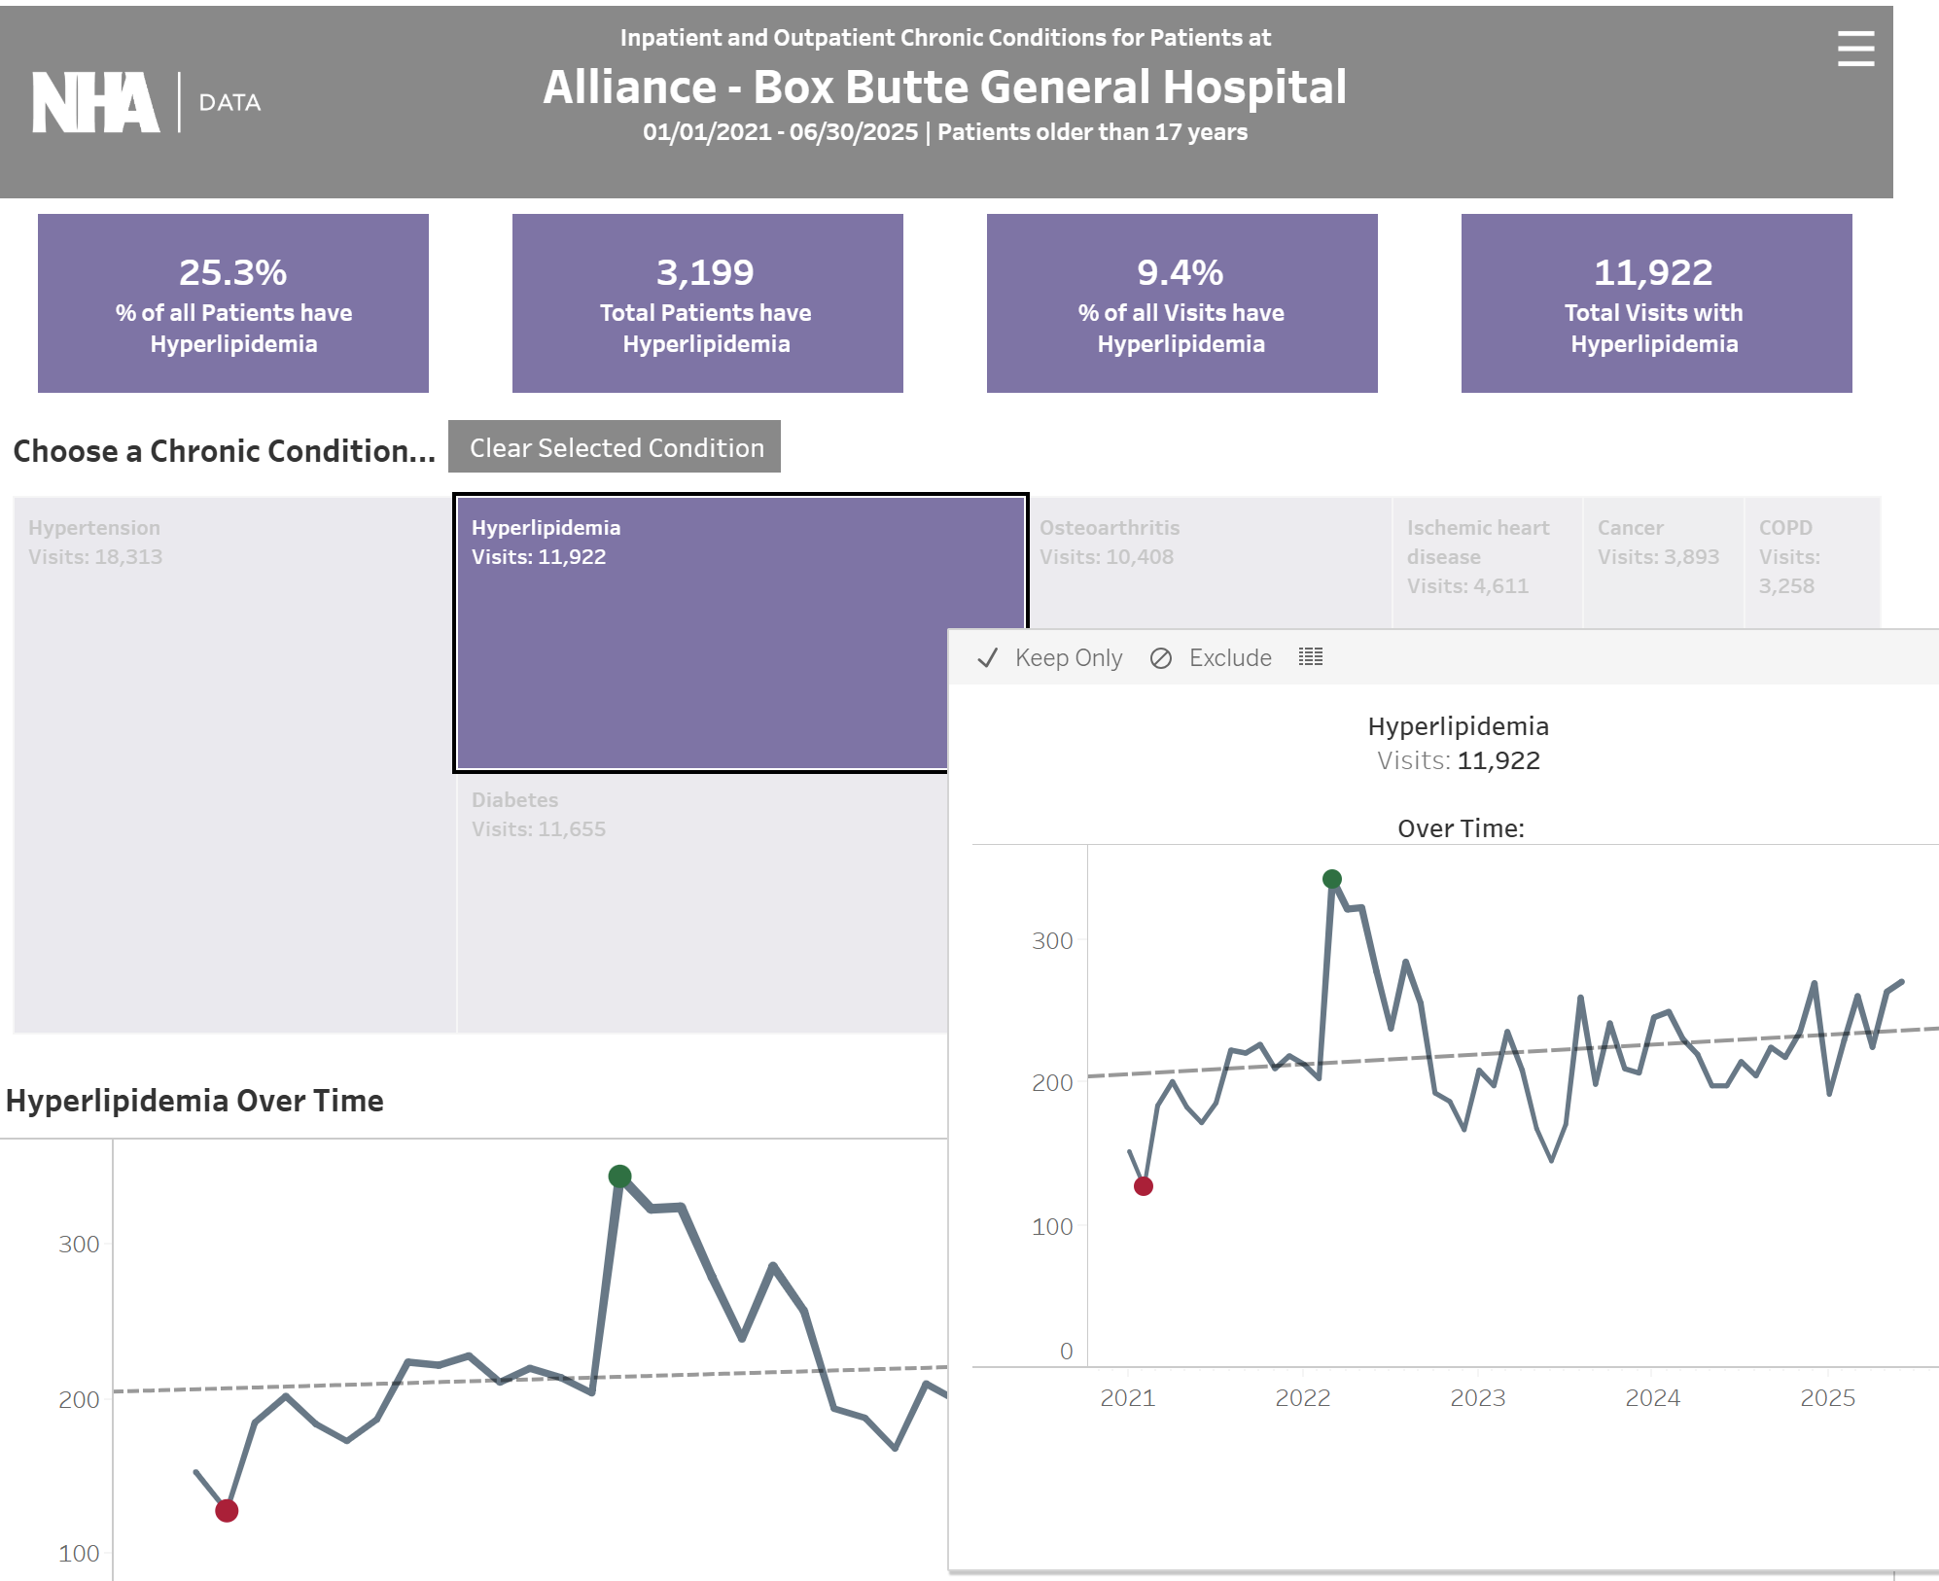
Chronic Conditions at Your Hospital

Slide 34
Discovery Datalytics

Slide 35
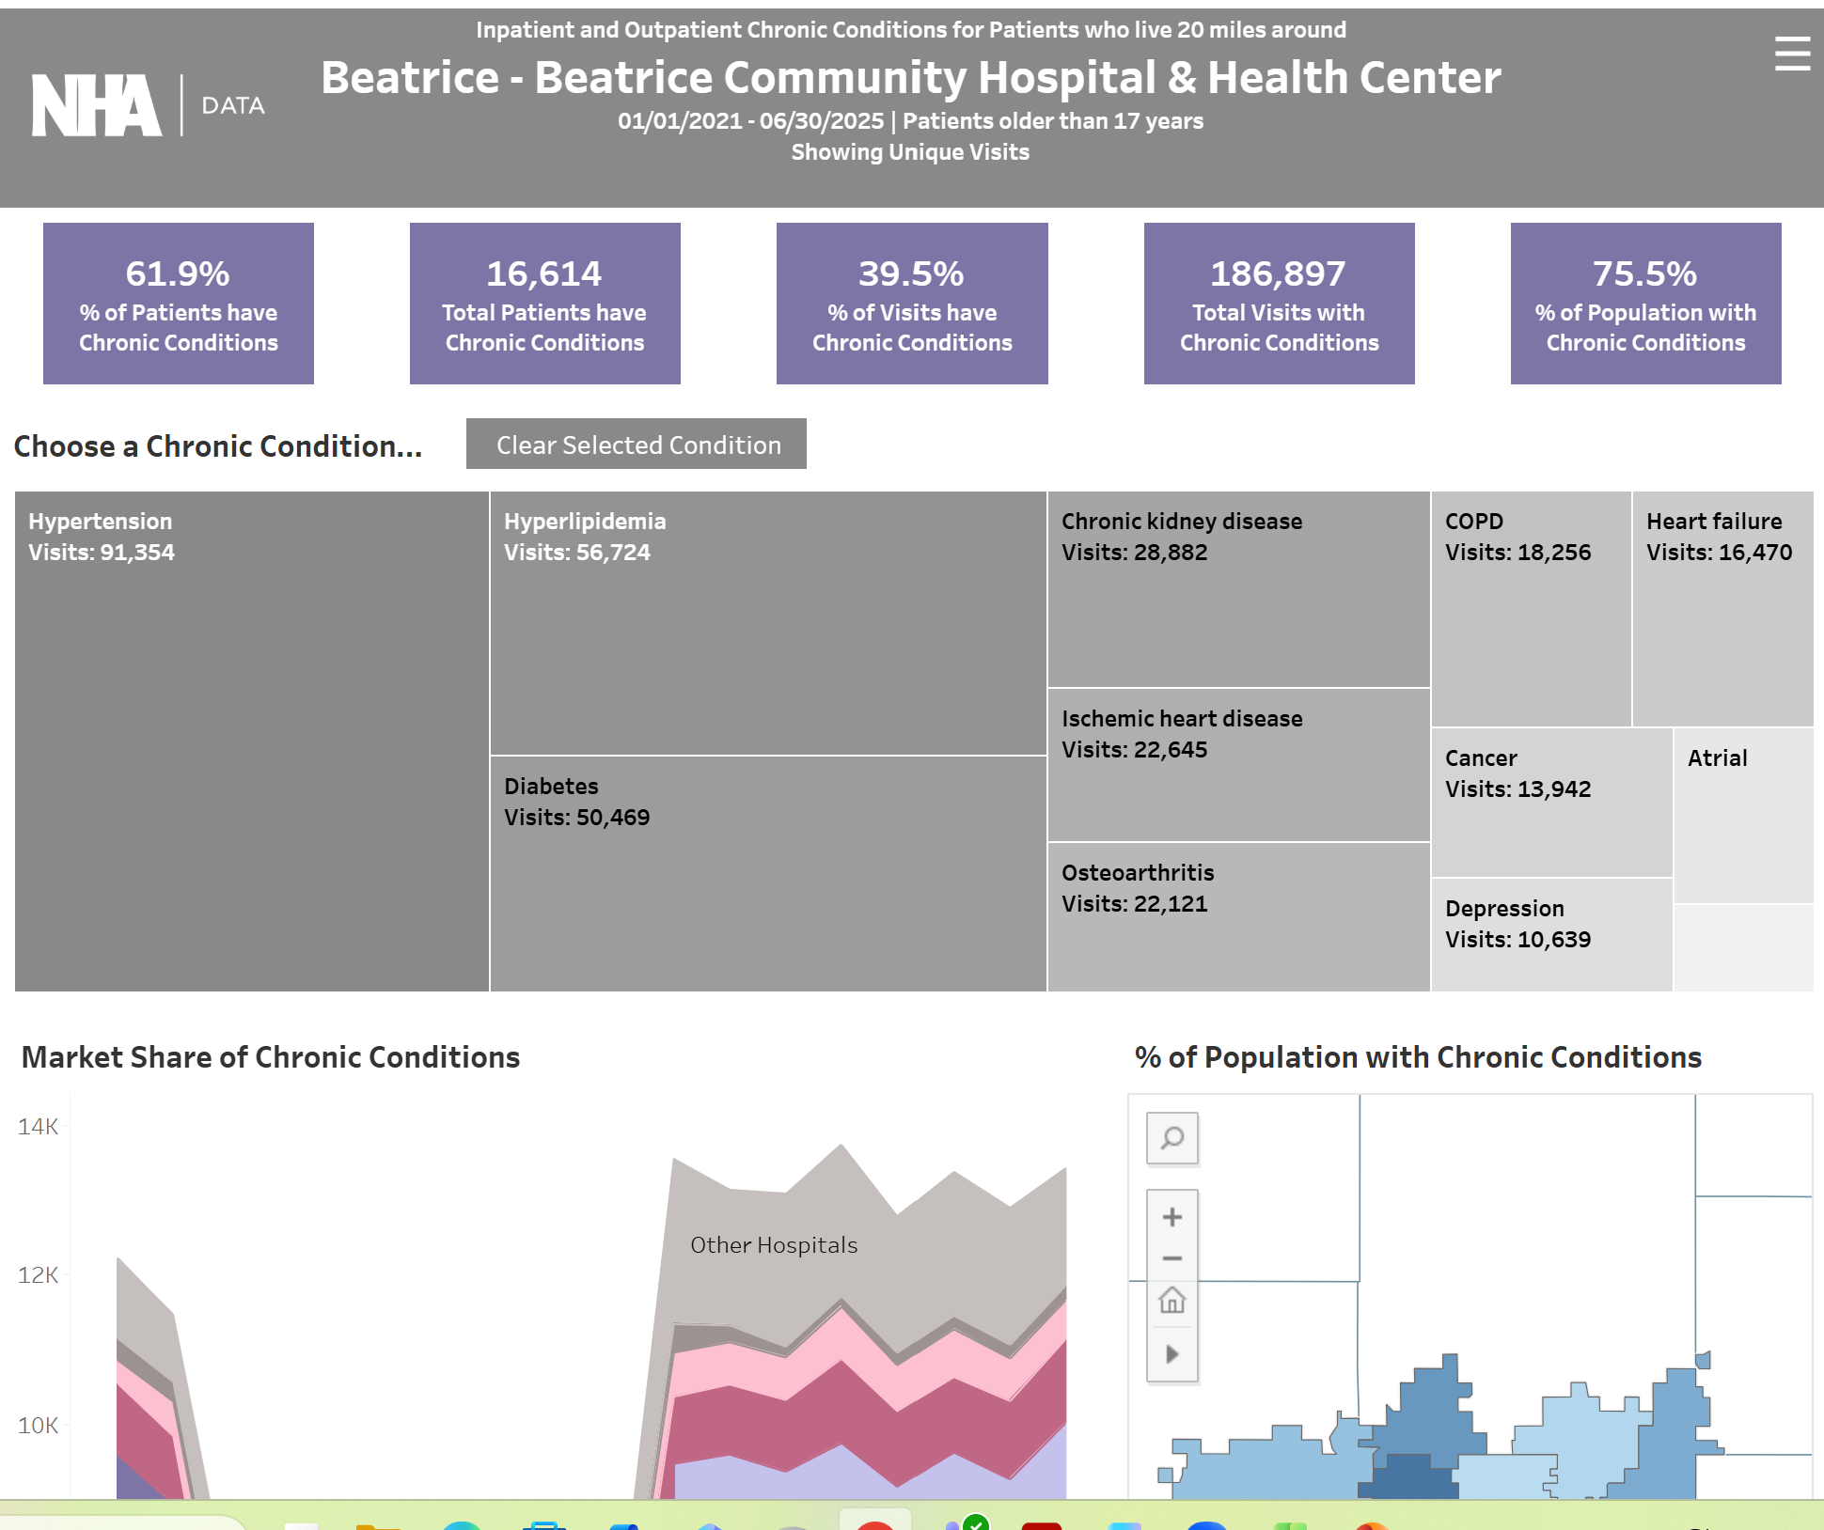
Chronic Conditions in Your Market Area

Slide 36
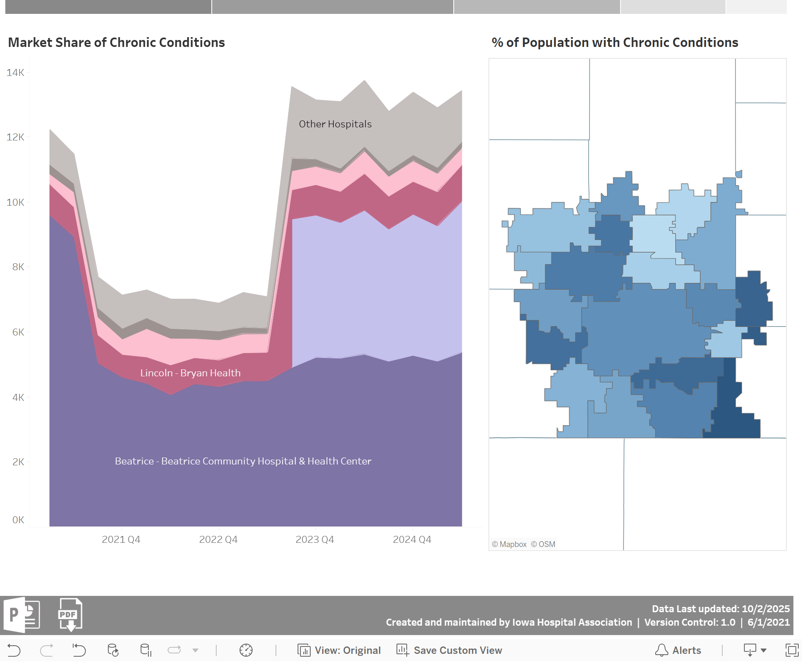
Chronic Conditions in Your Market Area

Slide 37
Discovery Datalytics

Slide 38
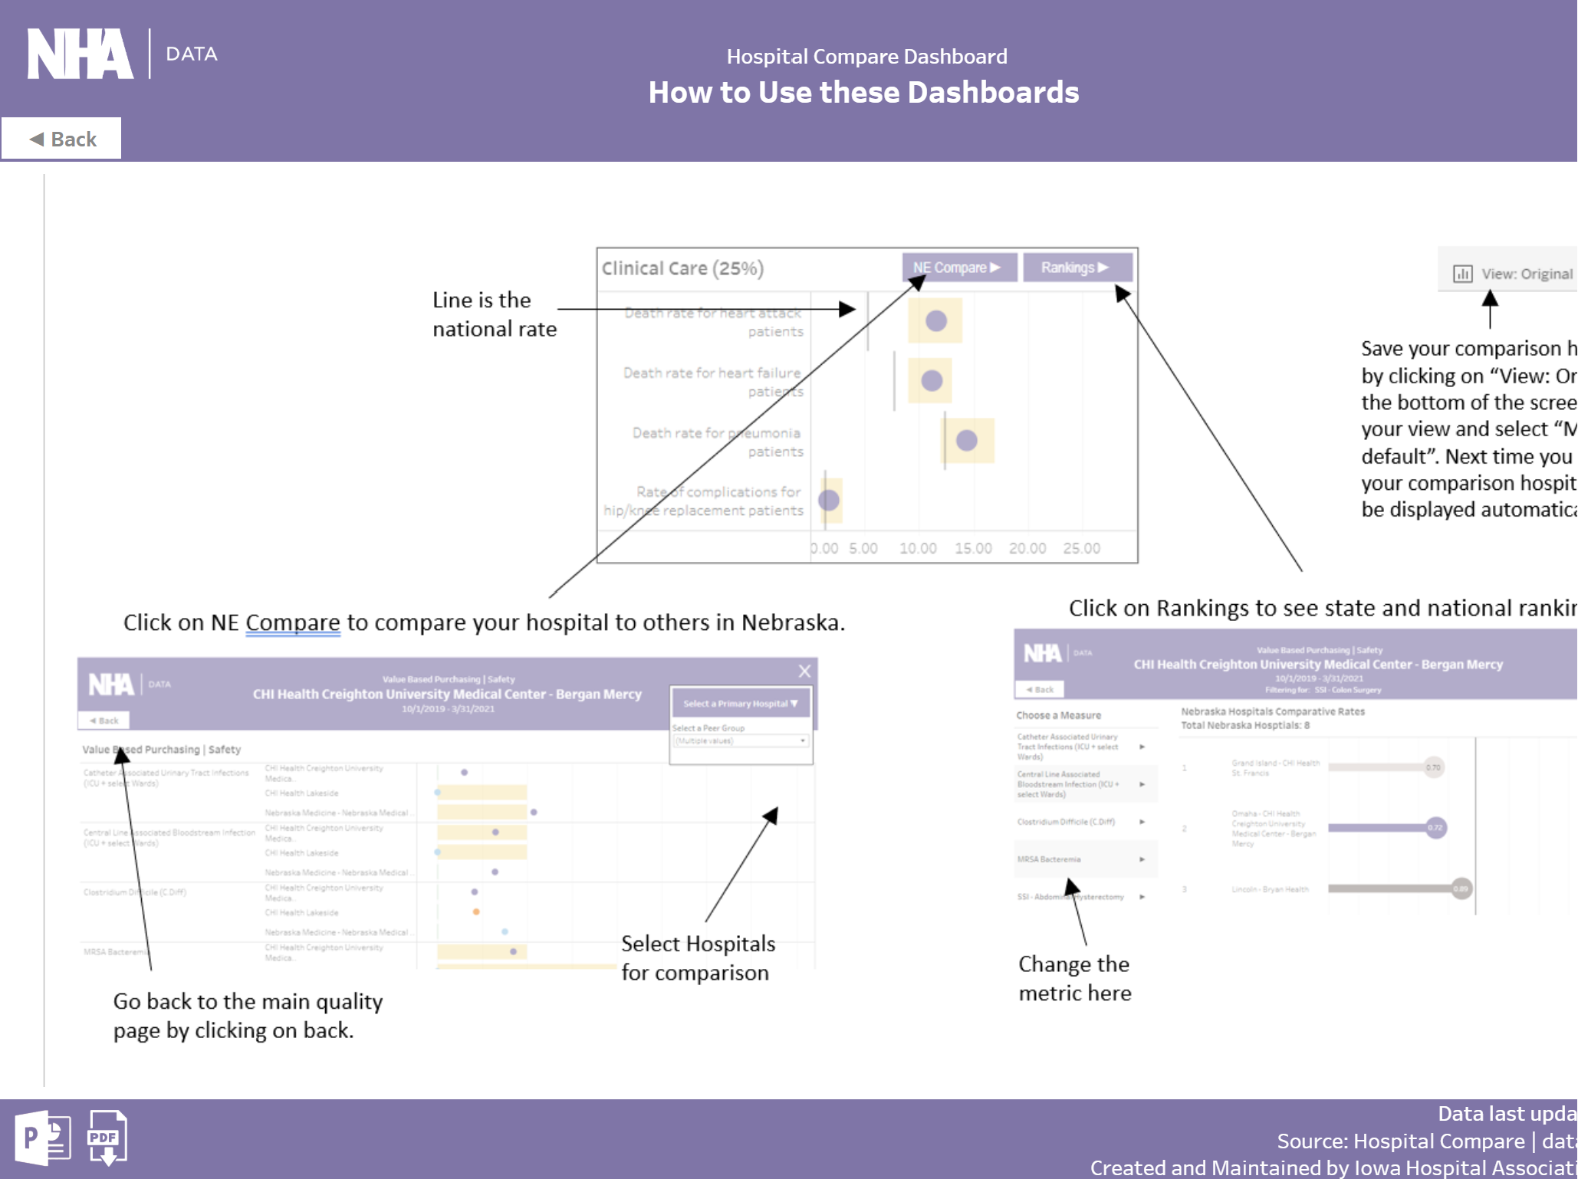
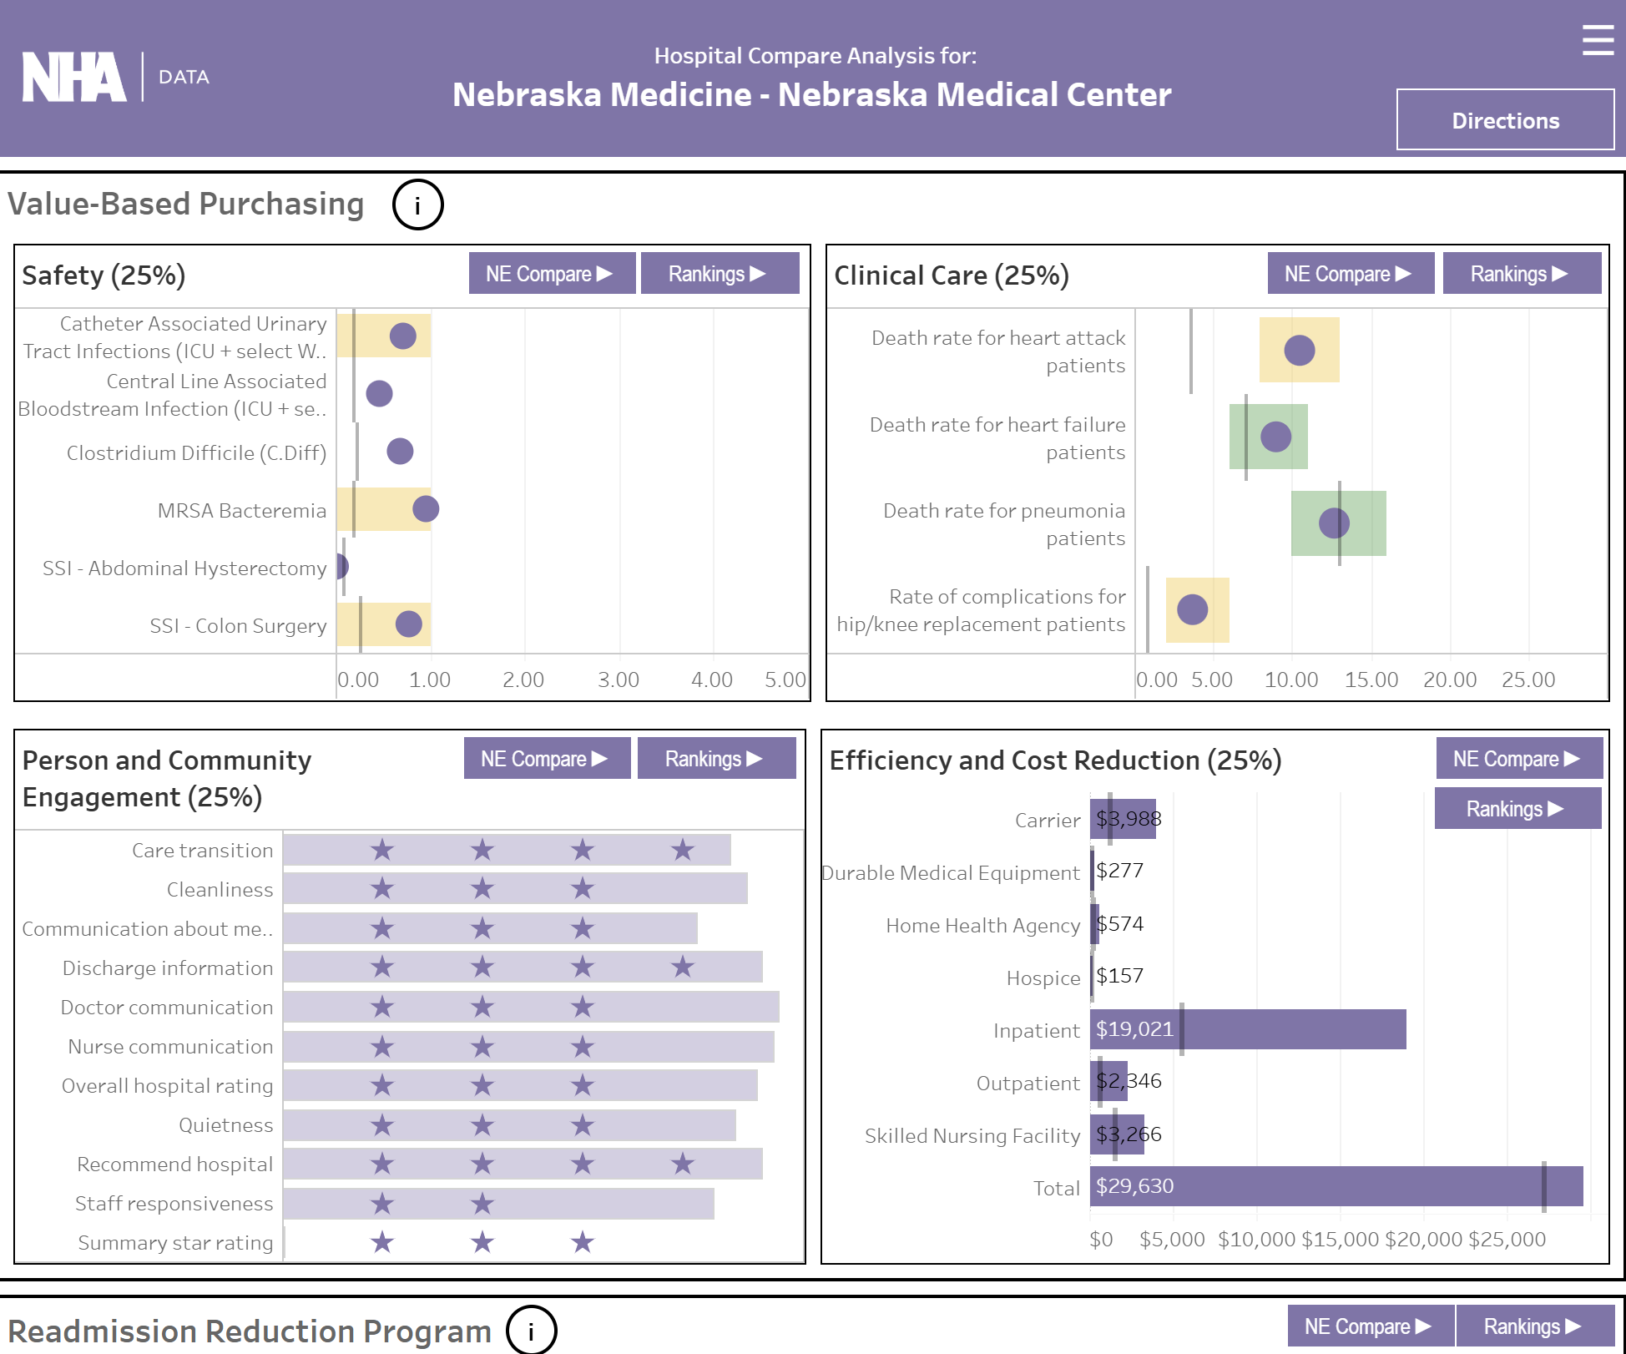
Hospital Compare

Slide 39
Hospital Compare

Slide 40
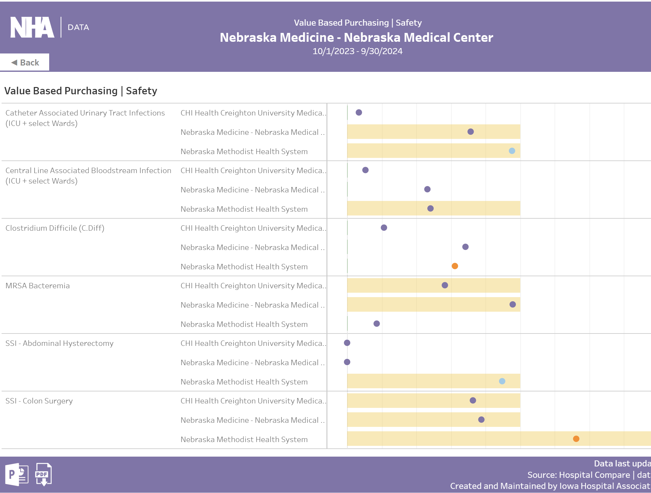
Hospital Compare

Slide 41
Hospital Compare

Slide 42
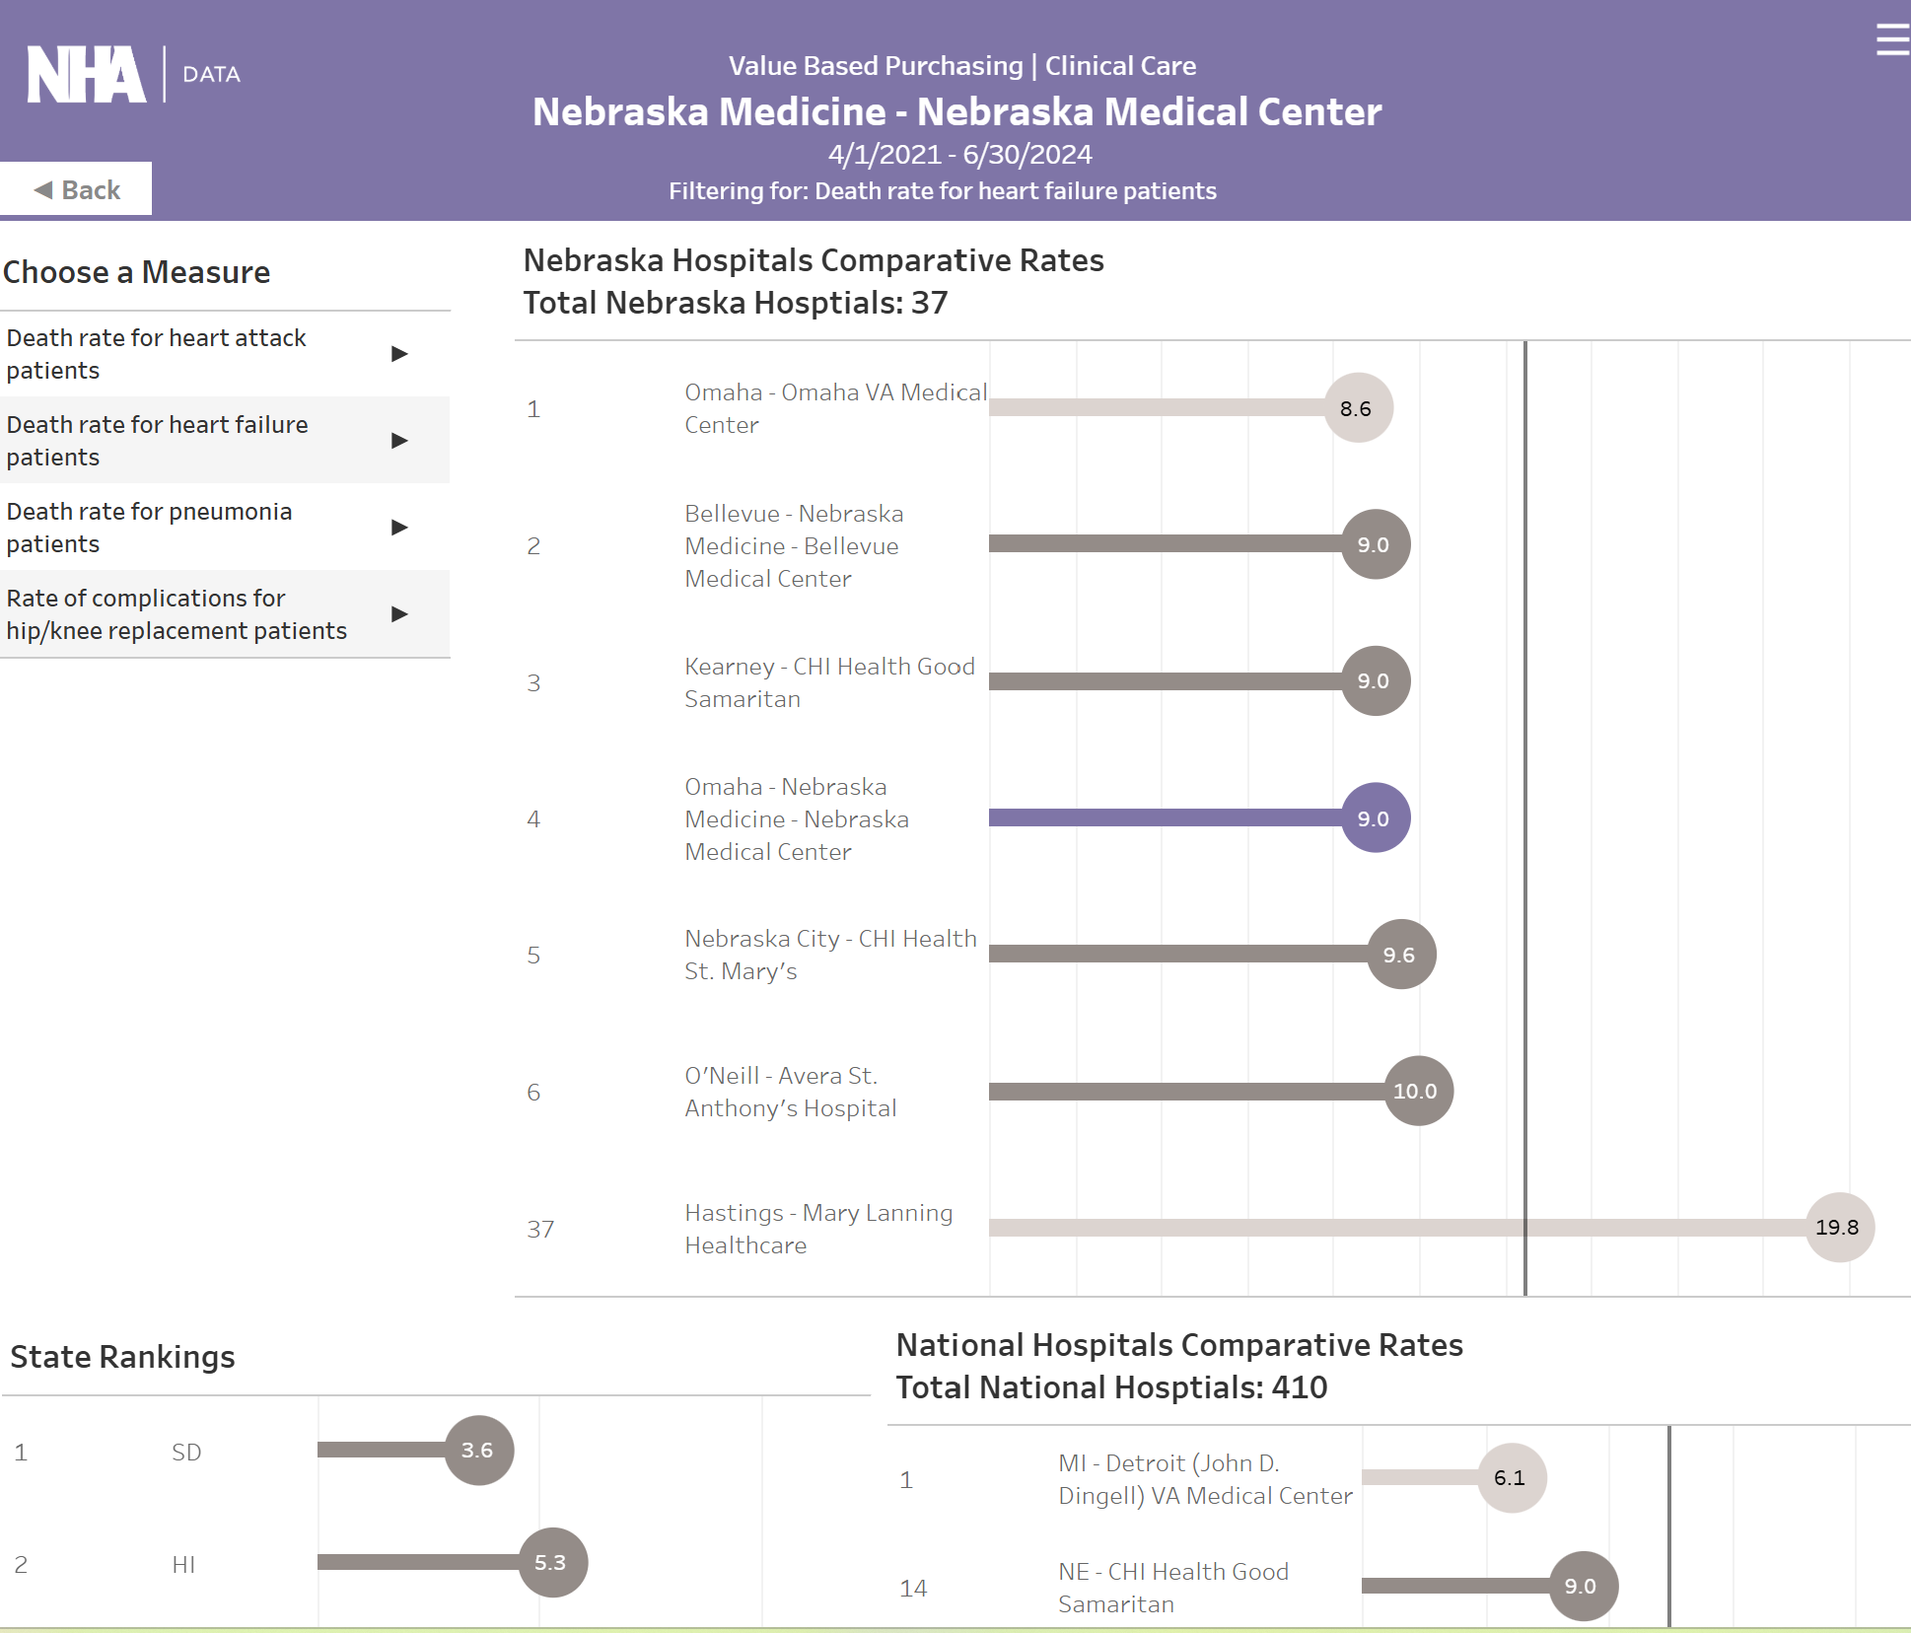
Hospital Compare

Slide 43
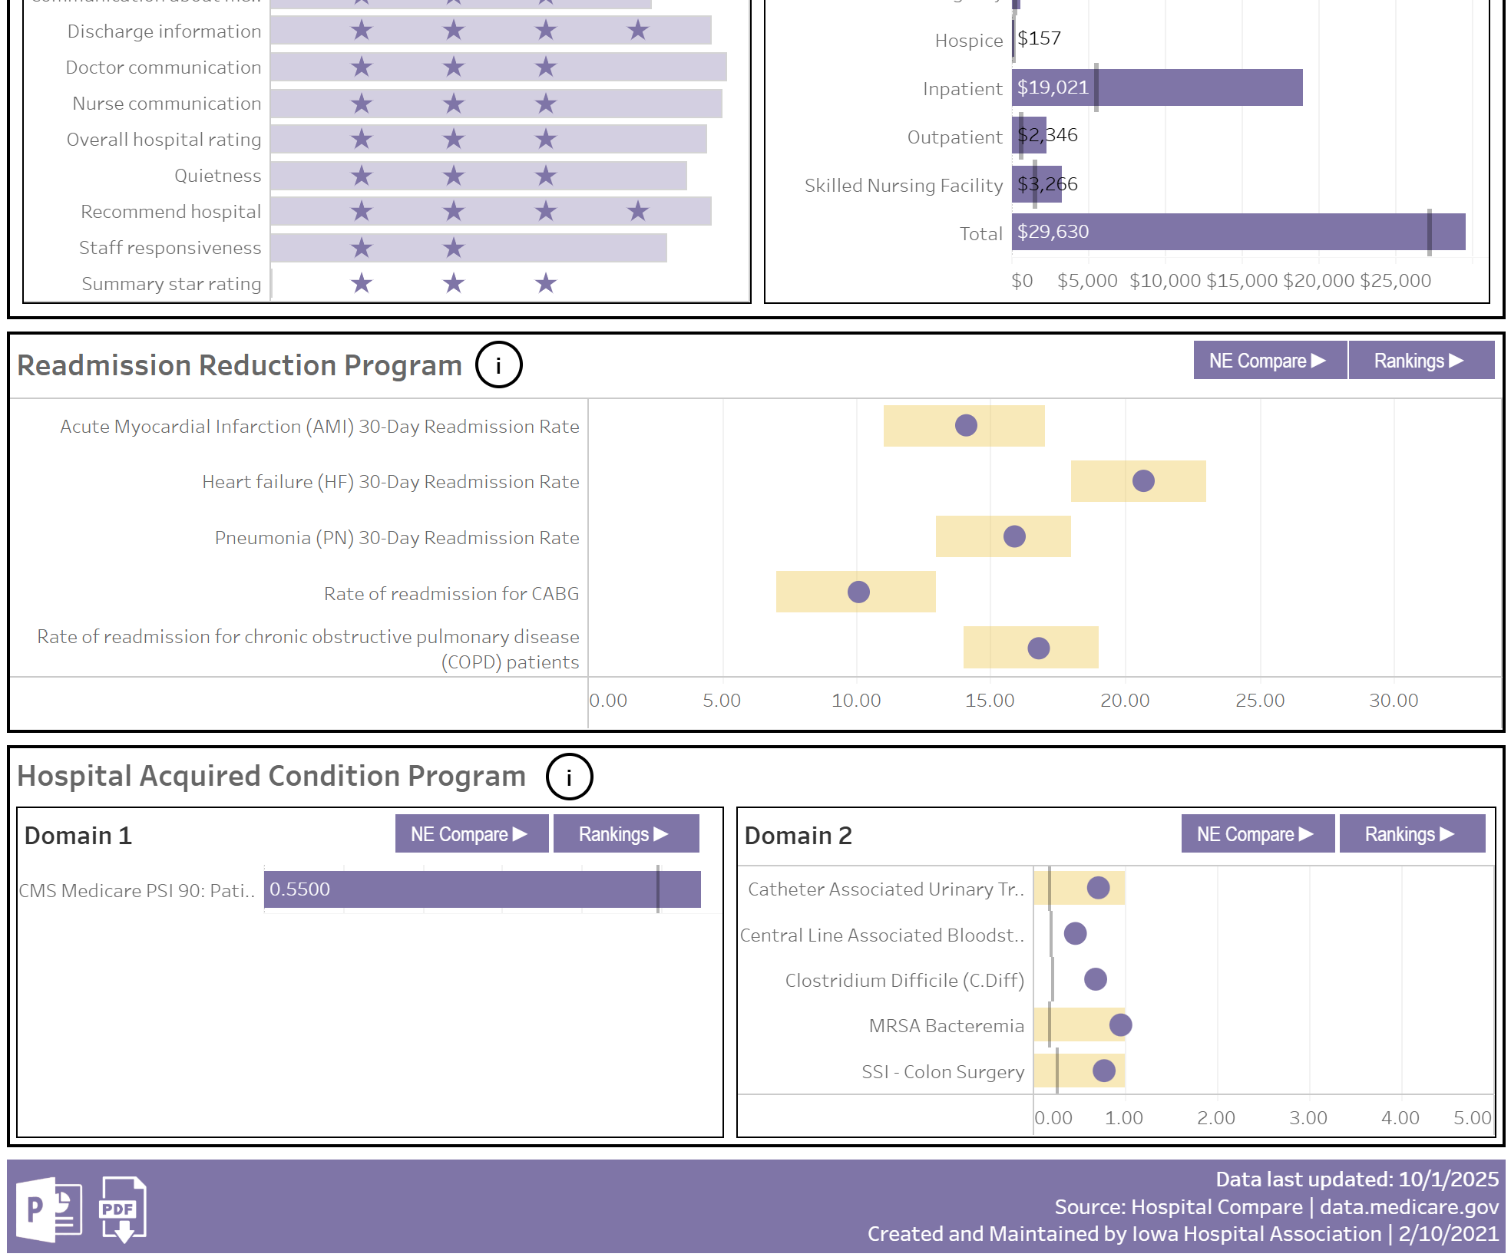
Hospital Compare

Slide 44
Discovery Datalytics

Slide 45
Questions?
randerson@nebraskahospitals.org

