Slide 1
BEST PRACTICES CHECKLIST – FINANCIAL PERFORMANCE (PART 1)
June 10, 2025

Slide 2
OVERVIEW
Notes:
May require more than one slide

Slide 3
The Current Landscape
Rural providers continue to experience cost increases, while having to address staffing shortages, outmigration, and significant policy/legislative changes
The past few years have fundamentally changed how many patients receive healthcare services
Organizations must take a proactive approach to address these changes
Population-based initiatives and telehealth continue to gain traction across the industry
Rural Providers
Staffing / Provider Shortages
Service Disruption
Cost Increases
Policy and Legislative Changes
Outmigration
Revenue Cycle Issues

Slide 4








Interdependence of Major Drivers
Reimbursement
Recruitment
Capital
Health Benefits
Value vs. Volume
Technology
Modernization
Retirement Benefits

Slide 5
Performance Improvement
Notes:
May require more than one slide

Slide 6
Performance Model
Value to Community
Strategy
Operations
CAHs/RHCs serve an essential and unique role in the rural healthcare safety net. Organizations that have direct control or contractual alignment with its service area’s primary care provider network can shape and guide how prevention, education and patient care processes are implemented across the service area.
Financial
Quality
Revenue
Expense
The monitoring and target-setting process for rural relevant quality measures represents a new priority and challenge. Quality measures will also increasingly influence reimbursement via Value Based Payment programs.
Productivity
Compensation
Staffing
In rural America, we’ve learned to do more with less. This principle should apply to all service areas, when appropriate, by working with staff to work at the top of their license.
Compensation scale and design are key drivers of performance and satisfaction. How staff are paid can vary widely but compensation models should be tailored to your market realities.
Staff are the single most important asset and should be the primary focus for leaders. Having the right mix of motivated professionals is the key to performance.

Slide 7
Evolution of Improvement Model
Quality
Revenue Cycle
Finance
1980-1990
Quality
Assurance (QA)
Revenue Cycle Committee
Budgets & Statements
Quality
Improvement (QI)
1990-2000
2000-2015
Performance
Improvement (PI)
Revenue Cycle / Finance Committee
KPIs, OKRs, etc.
Quality/Finance
Today
Strategy-Focused
Integrated Quality & Finance Performance Improvement

Slide 8
Performance Improvement Opportunities
Organizations must focus and establish plans for each of the four identified areas to improve the organizational position
Operating
Financial
Value
Market
Demand-Based Staffing tools
Departmental performance improvement
Revenue cycle and coding
Cost report optimization
Practice / clinic designations
Process improvement
Supply chain & purchasing
Define performance gaps
Integrate department leaders into budgeting process
Determine cash position and run rates
Establish actionable metrics
Pricing transparency and patient engagement
New market entry and increased competition
Explore clinically integrated model
Ambulatory network establishment
Increase access to care
Direct contracting
Improve patient engagement and satisfaction
Payor contract reviews
Value-based initiatives
Population-based strategy
Self-insured insurance plan offering
Medicare Advantage negotiations
Establish payor and provider partners
Manage overall cost of care

Slide 9
Core Financial Improvement Concepts
Notes:
May require more than one slide

Slide 10
Alignment and Designation Strategies
Due to the changing healthcare landscape, healthcare entities must leverage additional revenue opportunities, including reimbursement methodologies, to drive improved financial performance
Healthcare entities can leverage the following to improve reimbursements when those practices can meet certain eligibility requirements:
Periodically evaluate and convert practices to a designation that will improve the net financial position of that practice
Establish system strategy and realign practices, when possible, to leverage alternative designation types
Consolidate practices by integrating specialty practices and providers, when possible, within a PBC or RHC to realize operational efficiencies and leverage alternative reimbursement methodologies
Pursue acquisition of independent practices to leverage reimbursement and revenue opportunities afforded to rural hospital providers
Note: An RHC owned and operated by a hospital that qualifies for 340B does not have to meet the provider-based rules at 42 CFR 413.65 to be registered as a child site for 340B purposes

Slide 11
Practice Alignment and Designation
The following table shows the net financial impact of different designations on a hospital:
Outcomes:
Prior to the change in the RHC reimbursement methodology, the PB-RHC would have been the most advantageous designation; however, under the new reimbursement methodology, the practices would be better served to remain as a PBC until the RHC UPL surpasses the average PBC rate
Since the practices were already PBCs, there was no additional 340B benefit by converting the practices to RHCs

Slide 12
Practice Management
Practice Management To Do List
Work with your practice managers and physicians as a team to understand what is happening with:
Physician contracts
Physician compensation
Scheduling
Set up management dashboard that monitors the following:
Gross collection rate
Net collection rate
Overhead ratio
Individual category expense ratio
Days in accounts receivable
wRVUs per provider
Accounts receivable per FTE physician
Staff ratio
Average cost and revenue per patient
Aging of accounts receivable by payor
Payor mix ratio

Slide 13
RHC Cost Structure
Variable Costs: Those costs that increase as visit volumes increase. Examples include supplies and medications.
~10 percent
Variable
Fixed costs are especially important for provider-based RHCs because they represent one of the key reimbursement opportunities for the hospital. Various organization-wide costs are allocated from what is typically considered traditional hospital operations to the clinic (e.g., hospital administration salaries). This is why we often see provider-based RHCs with larger expense structures and lower profit margins.
Fixed
Fixed Costs: Those costs that do not increase as visit volumes increase. Examples include salaries, benefits and overhead expenses such as utilities and administration.
~90 percent

Slide 14
RHC Rate Establishment
Lesser of their AIR
or
Each facility is paid the lesser of their AIR or the established per visit limit*
Independent RHC
AIR capped at national limit
Provider-based RHC
RHC is part of hospital with 50+ beds
RHC is part of hospital with < 50 beds
AIR capped at national limit
(Not Grandfathered)
RHC enrolled in Medicare after 12.31.20
(Grandfathered)
RHC enrolled in Medicare or submitted application for enrollment as of 12.31.20
AIR capped at national limit
AIR capped at the greater of the facility’s 2020 AIR (+ MEI) or national payment limit
https://www.medpac.gov/wp-content/uploads/2021/11/medpac_payment_basics_21_fqhc_final_sec.pdf

Slide 15
Medicare Economic Index (MEI)
The Medicare Economic Index (MEI) was developed in 1975 and is the baseline for each year’s payment update calculation
The following table presents the MEI from 2014 through 2023
Physician payments were updated annually based on the MEI starting in 1992
The Medicare Economic Index has always included a productivity adjustment
The Medicare Access and CHIP Reauthorization Act of 2015,ended use of the SGR and replaced with defined annual update factors from 2015 through 2025. https://www.congress.gov/bill/114th-congress/house-bill/2/text
The MEI market basket was used to update FQHC PPS payments in CY 2016

Slide 16
RHC Charge Structure
Coinsurance Burden
$200
$300
$20
$40
$60
30%
RHC Cost
RHC Charge
Commercial
20% Cost
20% Charge
of the cost of care is passed to the Medicare beneficiary via coinsurance ($60/$200)
The fully-allocated cost for a single visit according to the hospital Medicare cost report
A typical co-payment for a primary care visit under a commercial policy
Medicare beneficiary out-of-pocket obligation based on a “percent of charges” methodology for provider-based RHCs
The “retail price” of the visit according to the RHC’s Chargemaster
High prices disproportionately impact Medicare Beneficiaries

Slide 17
Provider Complement
Evaluate the integration of additional primary and specialty care providers into the RHC to leverage reimbursement advantages
Due to the increase in the UPL for independent RHCs, those practices now have additional opportunities to bring in specialty providers which before was often unsustainable
Catalog all providers within the primary and secondary service area to better understand patient demand and provider availability
In today’s market, organizations must also include telehealth providers when cataloging providers
Implement team-based initiatives to increase efficiencies and create an environment where staff operate at the top of their license
RHCs must leverage a complement of CMAs, RNs, APPs, and Physicians, based on patient need, to optimize care delivery models
Leverage available data sources, such as the Medical Group Management Association (MGMA), to benchmark provider productivity and drive performance improvement initiatives

Slide 18
Provider Productivity and Engagement
Wait, does this still matter?
CMS defines a minimum expected number of patient visits for physicians and advanced practice providers (Nurse Practitioners and Physician Assistants)
4,200
2,100
Physicians
APPs
Note: Providers with regular scheduled time are subject to the Minimum Productivity standards
Note: Providers with non-regular scheduled time are not subject to the Minimum Productivity standards
Note: Contracted physician volumes are not included in the calculation
Note: If clinics do not meet productivity standards, the clinic will not get full cost-based reimbursement, subject to CAA provisions
RHCs must engage providers about their performance

Slide 19
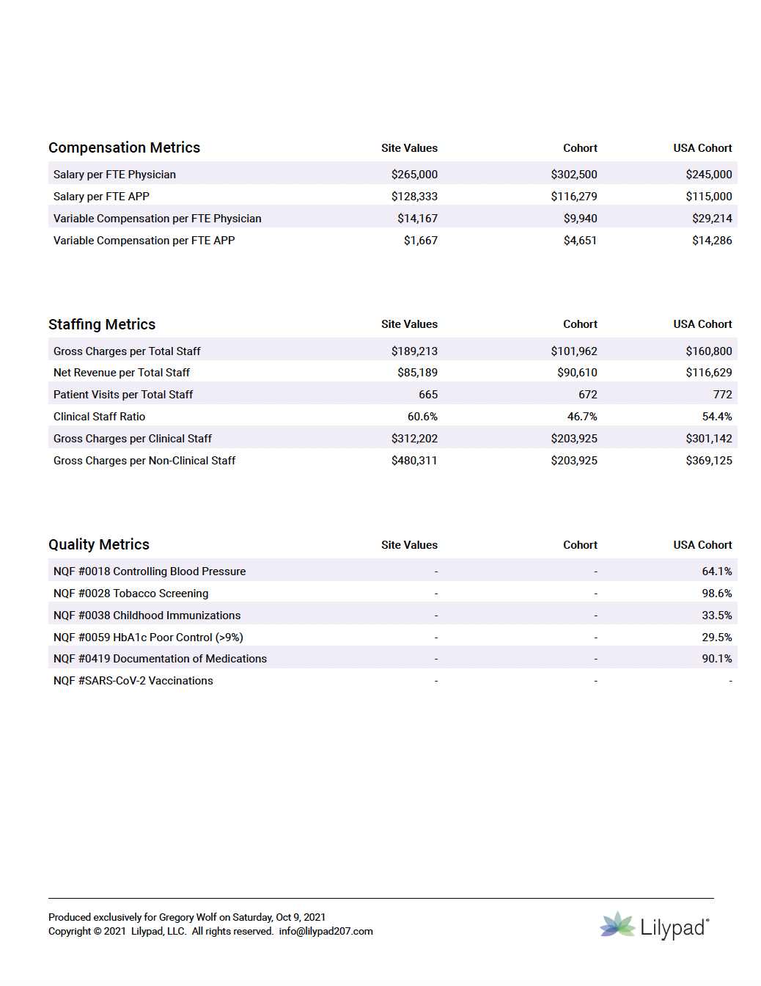
Provider Contracts
Notwithstanding fair market valuation regulations, in most instances the market and basic supply and demand dynamics drive provider compensation
Increasingly, RHC physicians and APPs are migrating away from straight salary arrangements toward productivity-based arrangements and in some cases, value-based compensation models
The challenge for RHC operators is how to balance and accelerate these different types of compensation plans in a delicate rural healthcare market
Provider contracts now often include the following components:
Base Salary
wRVUs
Panel Size
Compensation Metrics
Salary and bonus metrics to assess and compare provider costs
Quality Scores
Patient Satisfaction Scores
Page 2 of 2

Slide 20
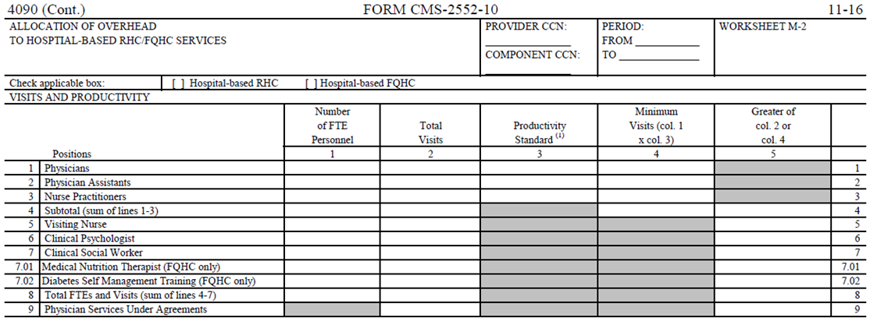
Cost Report Opportunities
RHCs must get away from viewing the Cost Report as an administrative function and realize the Cost Report has a direct impact on reimbursements received
Due to the new reimbursement methodology and UPLs, RHCs can quickly see their cost structure surpass reimbursements received from Medicare

Slide 21
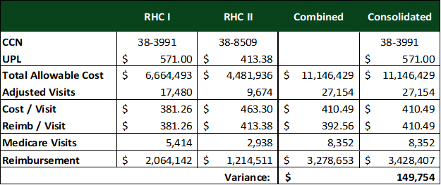
RHC Consolidation
RHC Cost Report Consolidation
Entities that operate more than one RHC have the opportunity to consolidate cost reports
Must receive prior approval from MAC
Can improve reimbursements for organization
Reduces administrative burden
Establishes single reimbursement rate across practices
Note: Due to the Consolidated Appropriations Act of 2021, limitations exist regarding which RHCs can consolidate

Slide 22
Additional Cost Report Opportunities
RHC Rate Establishment (Worksheet M-3)
RHCs must evaluate the rate letter received from the MAC to determine if the UPL established for the RHC is appropriate based on the new RHC reimbursement methodology
The 2020 cost report was used to establish the grandfathered rate for future years with the 2020 rate trended forward based on the Medicare Economic Index (MEI); the UPLs for the practice going forward is set as follows:
In FY20, the cost per visit was used as the base rate for future MEI increases
In FY21, the UPL would have increased by 1.4% (MEI);
In FY22, the UPL would have increased by 2.1% (MEI);
In FY23, the UPL would have increased by 3.8% (MEI);
In FY24, the UPL would have increased by 4.6% (MEI);
Determine if the UPL reported on the cost report is reported lower than calculated based on the guidance issued under the new RHC reimbursement methodology
RHCs across the country have experienced issues with the establishment of their starting UPL

Slide 23
Additional Cost Report Opportunities
RHC Cost per Visit (Worksheet M-3)
Evaluate and pursue rural opportunities to ensure the RHC is not negatively impacted or miss out on reimbursement opportunities if its cost per visit is greater than its Medicare reimbursement rate
Prioritize clinic volume growth of current providers and leverage lower cost RHC provider types such as licensed clinical social workers (LCSW) that can help to dilute the clinic’s cost per visit to reduce direct losses in the RHC while further integrating behavioral health services within the RHC
The Consolidated Appropriations Act of 2023 included provisions allowing RHCs to bill for Marriage and Family Therapists (MFTs) and Mental Health Counselors (MHCs) beginning January 1, 2024
Evaluate opportunities to reduce the amount of overhead allocated to the RHC through the B-1 stepdown on the cost report which will reallocate overhead to cost-based departments in the hospital increasing reimbursement and reducing losses in the RHC
RHC Vaccine Reporting (Worksheet M-4)
Ensure the RHC is accurately tracking vaccines provided to patients and tracking costs for inclusion on the cost report
Vaccines given to Medicare patients are to be reported on line 13 where they will be reimbursed at cost

Slide 24
CAH Financial and Operational Best Practices
Revenue Cycle
Reorient the overall managerial focus on the revenue cycle process to the “front end” of the value chain (e.g. pre-authorizations, scheduling, registration, etc.) and a measurement culture
Organization should have the appropriate workflows to pre-register patients, accept copayments, review contracts, etc.
Ensure all outpatient services are scheduled and prior authorizations received before the patient presents for services
Implement and maintain a performance measurement system that evaluates key areas throughout revenue cycle
Metrics selected should evaluate both the macro and micro processes
Establish a price list (charge description master) and review at least annually to ensure the price list is accurate and defensible
Organizations must also address the public reporting requirements regarding their price list
Prioritize point of service (POS) collections to improve cash flow and reduce the patient responsibility portion
Staff must be held accountable for achieving POS goals

Slide 25
Embrace Change (And Make It)
Notes:
May require more than one slide

Slide 26






People
Recruitment Challenges
Hospitals are facing personnel shortages across nearly all positions, not just clinical. This represents an increase in effort and complexity.
New Competitors
Competition is multi dimensional: regional, national, disruptors, and new industries all compete for rural resources.
Changing Workforce
Social evolution and communication platforms are changing the expectations of the existing and potential workforce.
Cost Constraints
Reimbursement pressures and unfunded mandates mean that the issue can’t be solved by throwing money at the problem.
Checking the Box
Historically, most hospitals have a very similar menu of benefit options with little in the way of ingenuity.

Slide 27
Stop Complaining Recruitment and Retention
Hospital
Environment
Physician Shortages
Bidding War
All position competition
Regulation
New Competitors
Access Challenges
The largest expense on the income statement of rural hospitals is labor related.
Less than 10% of US physicians practice in rural communities despite rural composing 20% of the US population.
Labor costs continue to challenge economic viability and remains the biggest driver of margin pressure.
Vacant positions generally mean something isn’t getting accomplished under optimal conditions; from care to administrative tasks.
Benchmarking to other healthcare providers doesn’t truly represent market position.
Notes:
Rob/Brett

Slide 28
Strategic Reality
Money doesn’t care how it’s spent.
Ultimately, dollars spent on benefits, reduce the amount of dollars available for salary.
Value to the employee must be the focus.
Carrying costs of benefit packages reduce employee value; they represent payments to other organizations.
Reductions in carrying costs create an opportunity to take savings or pass on savings as pay increases.
Value creation
Double value opportunity:
Develop new competencies
Reduction in total costs
Notes:
Rob tee up Brett

Slide 29
Large Employer Contracting
Hospital serves as the domestic network
Direct contract
TPA
Insurance Adjudication: Through contracting with large employers at rates decided on between the hospital and employer hospitals can increase utilization and revenue while lowering costs for community employers.
Drive Value: Over the past 10 years, health insurance costs have increased 47%. These increases are directly related to an increase in healthcare expenditure of 67.9% over that same span. Utilizing the same skills gained from operating the hospital’s own plan, community employers improve overall employee health and reduce expenses both for the employer and the employee.
Simple plan: There are only three parties, no different than in traditional settings.
Employer
Third Party Administrator
Hospital
Notes:
Rob tee up Brett

Slide 30
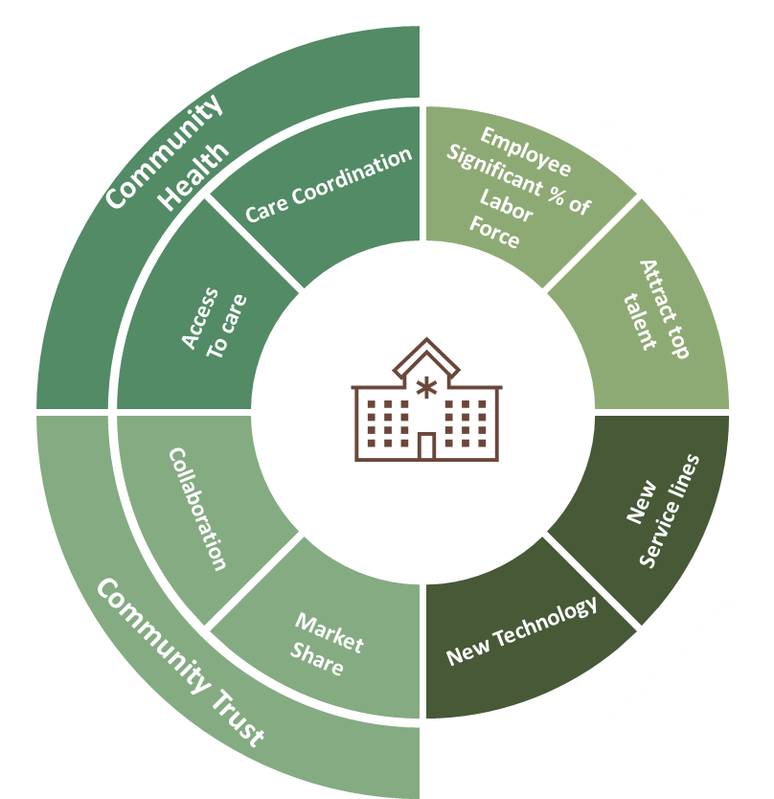

Community Center for Population Health
Community Health Assessments: Rural hospitals utilizing the domestic network model for their employees can build advanced population health competencies to better support the community.
Domestic Network Coordination: Leveraging competencies developed through the domestic network, rural hospitals place themselves in a position to drive care coordination network development involving local healthcare providers, social service agencies, and other community.
Health Promotion Initiatives: Utilizing population health competencies, rural hospitals can develop and implement health promotion initiatives focused on preventive care, chronic disease management, and health education, aimed at improving overall community health outcomes and reducing healthcare utilization through proactive interventions.
Domestic Extension: What works for the Hospital, works for large employers because incentives have been aligned, payment for defined value, not just volume.
Notes:
Brett tee up rob

Slide 31
Get Into Behavioral Health
BH integration into the care continuum represents an opportunity for increased value.
Physical healthcare costs can be favorably impacted by appropriate BH intervention
Ensure payers know the intent to bring efficiency to the table as part of a holistic approach to care.

Slide 32
BH Fits with Rural
Behavioral health is an ancillary feeder service similar to other service lines
Labs
340b
GI
Primary Care
Value based contracts- up to 50% of ER high utilizers have BH issues
BH has an expected growth rate of 9% according to SG2, profitable if people practice at the top of their license
According to SG2, there has been a 25% increase in addiction
BH is health, it affects everything else related: decision making, medication compliance, home life, employment, etc. Organizations cannot do value based/pop health contracts without it.
Behavioral Health
Community Value
Organizational Value
Employee Value
Payor Value

Slide 33
Deal With Your Third-Party Contracts
Base Contract
Policies &Manuals
Rate Sheets
Provider Enrollment
Amendments
Contracts are seldom a single document
Increases the level of complexity and confusion
Necessitates a comprehensive evaluation process
Seldom a one-person process
Not everything is negotiable
Commercial
Managed Governmental

Slide 34
Create A Matrix
A contract matrix is a useful tool
to track complex agreements and
facilitate negotiation and analysis.
This should include minimally the
following information:
Payer Agreements
Term
Agreement Documents
Web based Links
Enrollment Link
Payer | Term | Agreement | Policy | Manual | Enrollment
BCBS | Date-Date | Contact XXXX Amendment 1 Rate Sheet 1 | https://XXXXXXXXX | https://XXXXXXXXX | https://XXXXXXXXX
MA | Date-Date | Contact XXXX Amendment 1 Rate Sheet 1 | https://XXXXXXXXX | https://XXXXXXXXX | https://XXXXXXXXX
MCO | Date-Date | Contact XXXX Amendment 1 Rate Sheet 1 | https://XXXXXXXXX | https://XXXXXXXXX | https://XXXXXXXXX
Tricare | Date-Date | Contact XXXX Amendment 1 Rate Sheet 1 | https://XXXXXXXXX | https://XXXXXXXXX | https://XXXXXXXXX

Slide 35

Perform A Contract Analysis
Locate the entire agreement
Understand Terms & Structure
Senior Leadership must be engaged in negotiations
Identify a renegotiation priority matrix
Perform a thorough contract analysis.
Common Revenue Cycle Assessment Key Discoveries
Failure to identify afforded benefits based upon designation.
Failure to amend contract with language that is nonspecific.
Failure to monitor and maintain provider services and demographics with payors.
Failure to appropriately identify pharmacy and supply reimbursement.
Failure to recognize provider-based departments/technical components.

Slide 36


Develop Reimbursement Strategy
Link to Strategic Plan
Multidisciplinary approach
Align incentives
Evaluate competency gaps
Perform an analysis to identify a reimbursement strategy that focuses on a past, present and future state.
Common Revenue Cycle Assessment Key Discoveries
Failure to identify preventative services and market no patient out of pocket.
Failure to evaluate payment variances.
Lack of participation, implementation, monitoring and expertise with incentive and quality programs.
Lack of coordination across organization silos
CTA

Slide 37





Negotiate the Contract
Read the Entire Agreement
As oversimplified as this sounds, third party agreements are written to be difficult to read. This causes many professionals to rely on skimming
Study with Deliberation
Due to the complex legalese employed, contracts are deliberately difficult to comprehend and take time, effort, and deliberation to fully understand.
Read Referenced Materials
Most modern third-party agreements contain language which references online policies and procedures. These are subject to unilateral change and part of the agreement.
Write out payment terms
Payment terms can have multiple variables that ultimately impact total payment to the provider. Lack of understanding can lead to disappointment.
Understand Negotiation
Everything within the contract is a negotiation. Too often, organizations accept a false argument to the contrary.

Slide 38
Conflicts and Confusion
Both sides of the negotiation have similar goals– but our goals often appear misaligned
Conflicts
Confusion
Both parties to the negotiation have a profit incentive, however, the sides often view each other as adversaries in that goal. This ultimately leads to conflict and misaligned terms in the agreement as each side seeks to achieve their end.
Confusion occurs when neither party recognizes that there are shared goals, some of the conflicts can be aligned; for instance, patient outcomes and profit via cost control. This leads to standoff positions that result in the weaker party’s yielding of position.
The net result has been rural providers that don’t know where to start, how to expand nor link behavioral health delivery to growth and profitability

Slide 39
The Relationship Matters
Patient
Payer
Provider
Prior to engaging in contract negotiations, it is useful to establish a relationship with local payer leadership
Goals
Challenges
Opportunities
Making the negotiation more personal almost always helps, bring the payer representatives on site for a meeting
Provide education to the payers on cost-based structure, particularly MA payers.

Slide 40
Questions
Notes:
May require more than one slide

Slide 41

Rob Bloom, CPA, Principal rbloom@wintergreenme.com o: (207) 280-6497 c: (315) 405-1535
Notes:
May require more than one slide

