Slide 1
From Data to Detection: Personalizing Cancer Screening in Nebraska with Risk Tools and EHR Workflows
Rachael Schmidt, DNP, APRN, AOCNP
Program Director, Cancer Risk & Prevention / Cancer Survivorship, Nebraska Medicine
Assistant Director, Health Promotion & Screening, Fred & Pamela Buffett Cancer Center

Slide 2
Objectives
Describe current cancer incidence and cancer screening rates across Nebraska.
Explain how risk-assessment tools (e.g., CancerIQ) can personalize cancer screening and prevention-based recommendations.
Analyze the lung cancer screening program case study to outline integration steps, review metrics, and lessons learned.

Slide 3
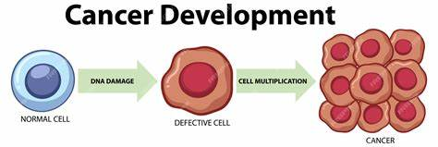
What is Cancer?
Cancer is a group of diseases where abnormal cells grow out of control and crowd out normal cells.
It affects 1 in 3 people in the United States.
Chances are that you or someone you know has been affected by cancer

Slide 4

What Causes Cancer?
Cancer starts when something goes wrong in the normal process of cells growing and dividing to make new cells.
Gene changes that lead to cancer can have many possible causes, including:
Lifestyle habits (obesity, alcohol, tobacco use, diet, physical activity, stress, etc)
Genes you get from your parents
Exposure to certain chemicals or radiation can all play a role.
Many times, there is no one clear cause.
Notes:
Imagine your body is a giant cookbook filled with recipes (your DNA) that tell your cells how to grow, function, and repair themselves. Normally, your body has editors (repair systems) that catch and fix typos when recipes are copied.
But sometimes, a small typo slips through – maybe from smoking, too much sun, certain chemicals, or even just wear and tear over time. One typo might not be a big deal. But if enough typos build up in the wrong spots, especially the parts that control how fast a cell grows or when it dies, the cell can go rogue.
That’s cancer — a cell with too many typos in its recipe, growing out of control and not following the rules.

Slide 5
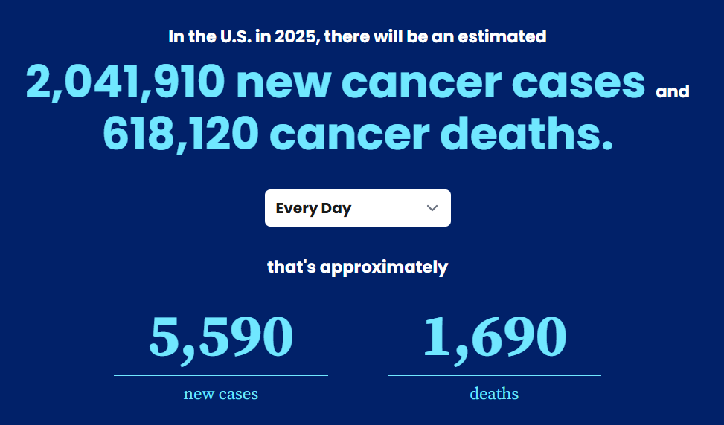

Slide 6
Cancer Incidence in Nebraska
Age-Adjusted Incidence Rates Per 100,000 (2017-2021): NE vs. US
Sites for which NE has significantly* higher rate (per 100,000) than the US
Cancer | NE | US
Overall | 456.2 | 444.4
Breast | 130.7 | 129.8
Prostate | 122.6 | 113.2
Colorectal | 39.2 | 36.4
Melanoma | 28.7 | 22.7
Thyroid | 15.7 | 12.9
Oral | 13.0 | 12.0
Brain | 7.1 | 6.3
*Significant at .05 level
Source: NCI State Cancer Profile

Slide 7
Age-Adjusted Mortality Rates Per 100,000 (2018-2022): NE vs. US
Cancer Mortality in Nebraska
Sites for which NE has significantly* higher rate (per 100,000) than the US
Cancer | NE | US
Colorectal | 14.7 | 12.9
Pancreas | 11.9 | 11.2
Leukemia | 6.2 | 5.9
Brain & CNS | 5.1 | 4.4
Esophagus | 4.5 | 3.7
Kidney | 3.9 | 3.4
*Significant at .05 level
Source: NCI State Cancer Profile
Notes:
This slide shows mortality data.
Colorectal, pancreatic, leukemia, CNS, esophagus, and kidney age-adjusted mortality rates are higher in Nebraska.

Slide 8
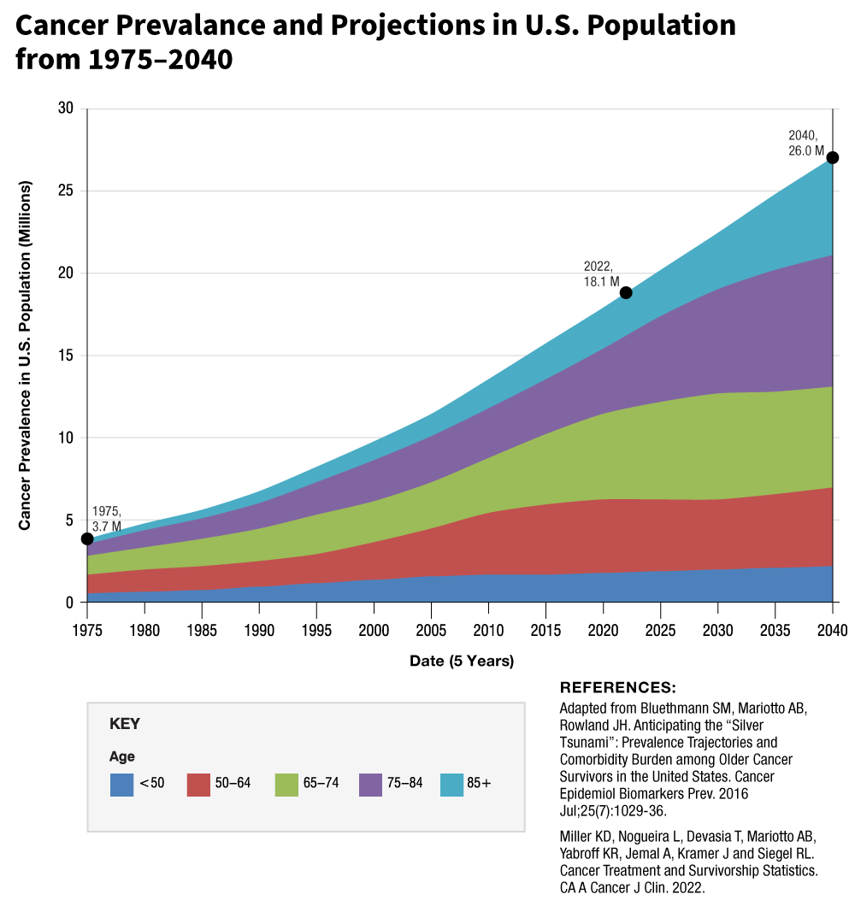
Impact of Cancer Screenings

Slide 9
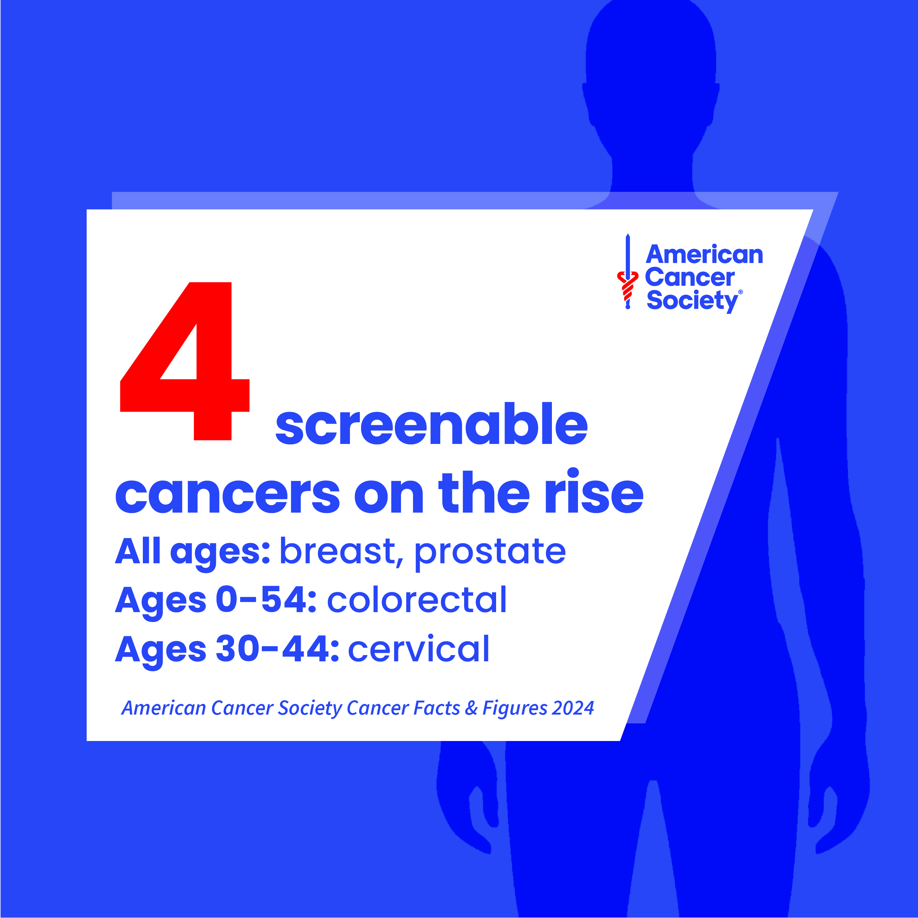
Misconceptions About Cancer Screenings
I feel fine, so I don’t need a screening
I don’t have cancer in my family so I’m not at risk
Screenings are painful or dangerous (radiation exposure)
I do not want to know if I have cancer
Only older people need to worry

Slide 10
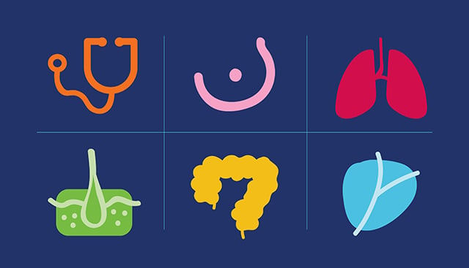
General Population Cancer Screenings
Breast
Lung
Colon
Prostate

Slide 11
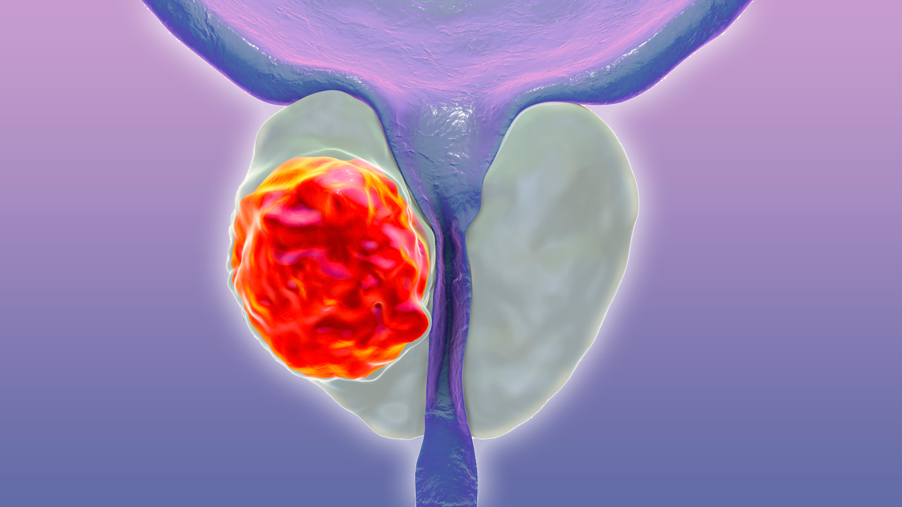
Prostate Cancer Screening
Prostate cancer is the most common cancer in men (after skin cancer).
Often has no symptoms in early stages.
PSA blood test typically recommended starting at age 50—or earlier (age 45) for Black men or those with family history.
Black men are more than twice as likely to die from prostate cancer.

Slide 12
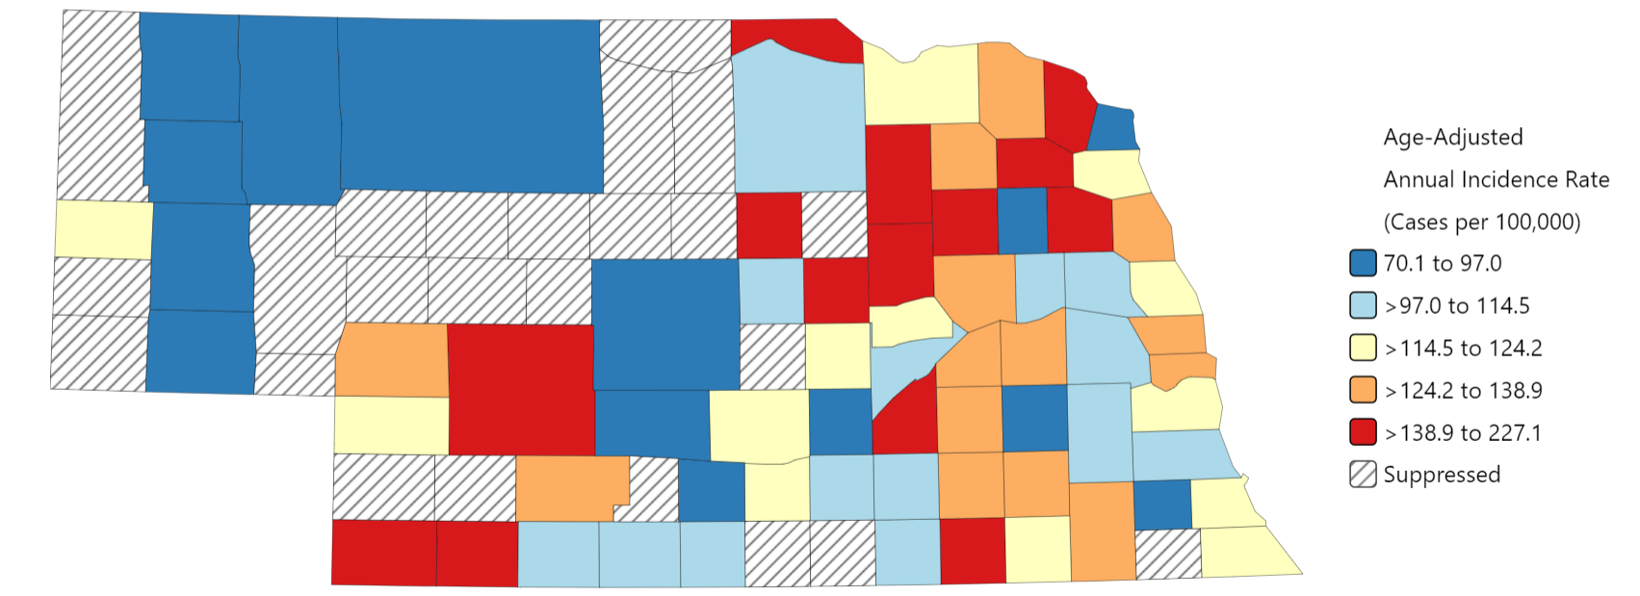
Prostate Cancer Incidence Rates Per 100,000: 2017-2021
Greeley County
216.9 (127.5-355.6)*
Boone County
227.1 (169.3-302.7)*
Antelope County
215.6 (159.1-288.4)*
Madison County
165.1 (141.5-191.7)*
Cuming County
157.6 (118.6-207.4)*
NE average rate is higher than US average
8 rural and 2 urban NE counties have significantly higher rates than US average
Lincoln County
144.7 (123.7-168.5)*
Douglas County
136.6 (130.5-142.9)*
U.S. Average: 113.2 (113-113.4)
NE Average: 122.6 (119.8-125.6)*
Hamilton County
156.4 (117.0-206.5)*
Thayer County
182.8 (128.2-257.7)*
Sarpy County
128.9 (118.4-140.4)*
*Statistically significantly different from US at .05 level​​
Source: NCI State Cancer Profile
Rural counties according to RUCC

Slide 13
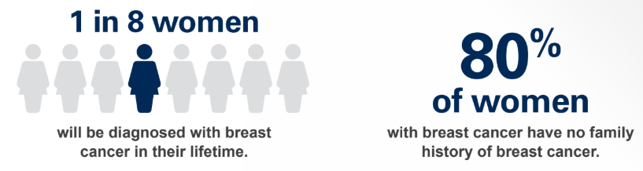
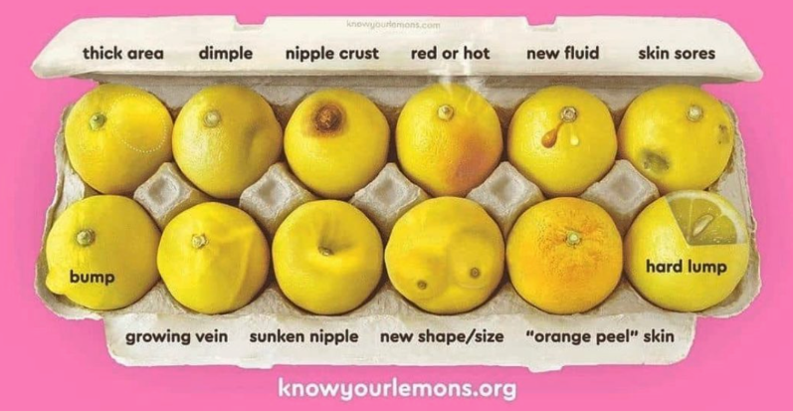
Breast Cancer Screening
Most common cancer diagnosed among women.
Black women are more likely to be diagnosed at younger ages and with more aggressive types.
Men can get breast cancer too—especially with family history.

Slide 14

Nebraska’s
Breast Cancer Screening Rate
Nebraska: below average
~ 64-67% based on different data sources
US average (70-79.8%)
1 in 3 women in Nebraska are overdue for a mammogram

Slide 15
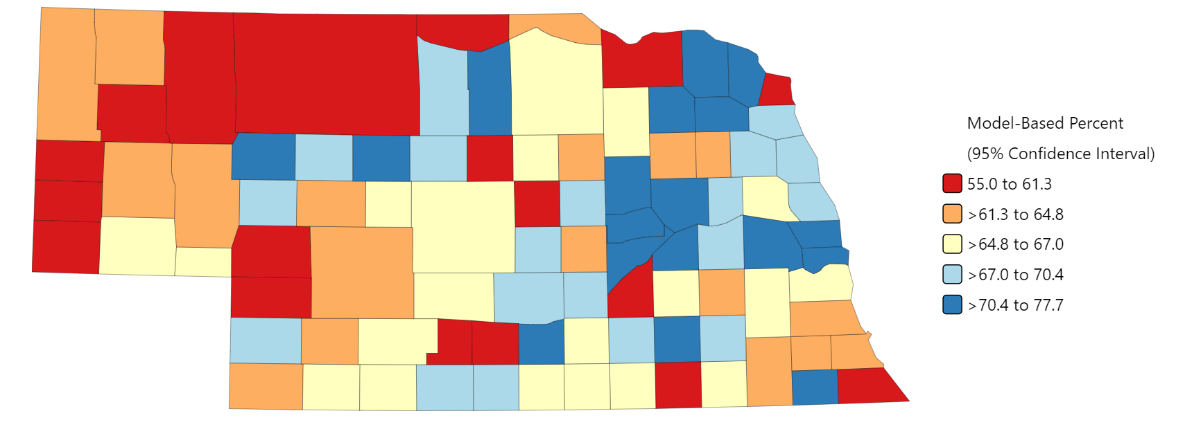
Mammogram in Past 2 Years (Women Ages 40-75): 2017-2019
81 rural and 8 urban NE counties have significantly lower rates than US average
U.S. Average: 70.2%
NE Average: 67.6% (65.3-69.9)
(There is no statistical significance difference at .05 level)
US Data for 2023: 79.8%
Source: NCI State Cancer Profile

Slide 16
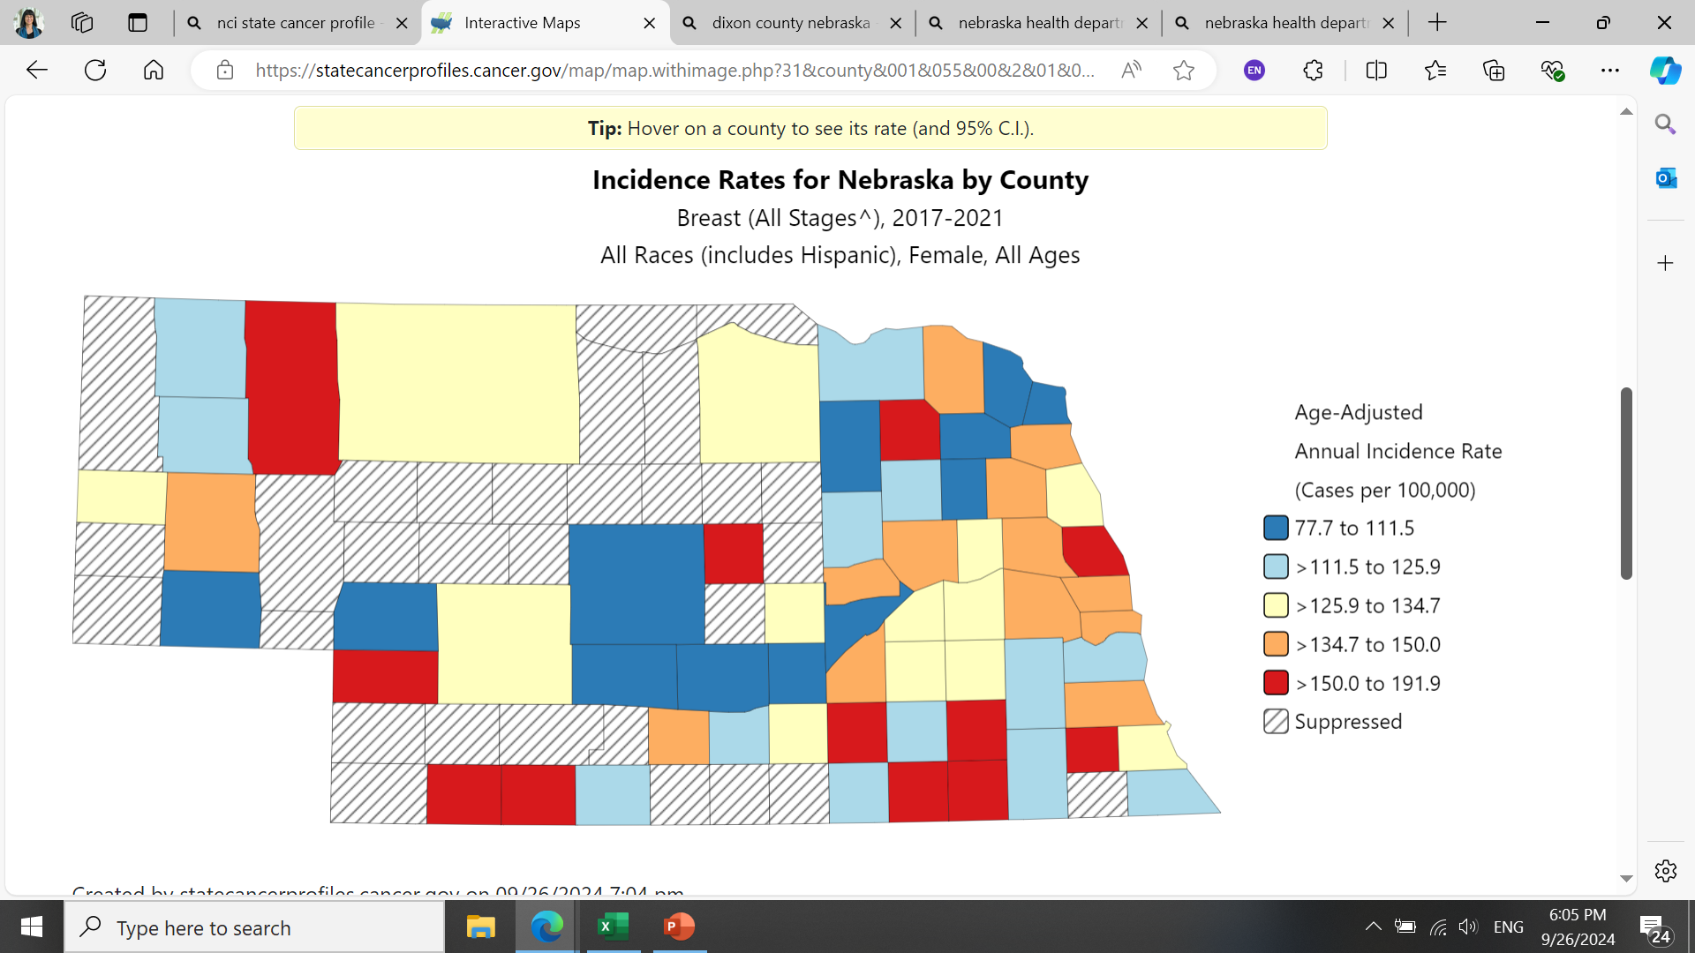
Female Breast Cancer Incidence
Rate per 100,000: 2017-2021
NE average rate is higher than US average
U.S. Average: 129.8 (129.5-130.0)
NE Average: 130.7 (127.6-133.8)*
* Significantly higher than U.S. average at .05 level
Source: NCI State Cancer Profile

Slide 17
Breast Cancer Incidence & Mortality Rates
by Race/Ethnicity
* NH: Non-Hispanic; AI/AN: American Indian/Alaska Native
Source: NCI State Cancer Profile

Slide 18
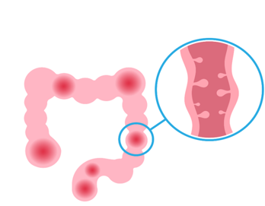
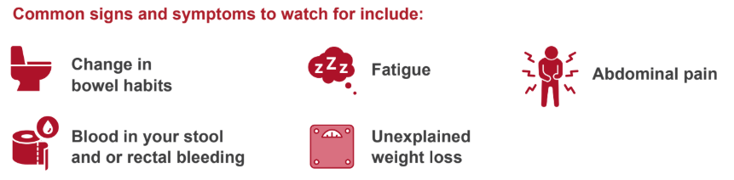
Colorectal Cancer Screening
Colorectal cancer is one of the most preventable cancers with regular screening.
1 in 24 people will be diagnosed with colorectal cancer.
Recommended for adults ages 45 to 75.
Black Americans have the highest incidence and death rates.

Slide 19
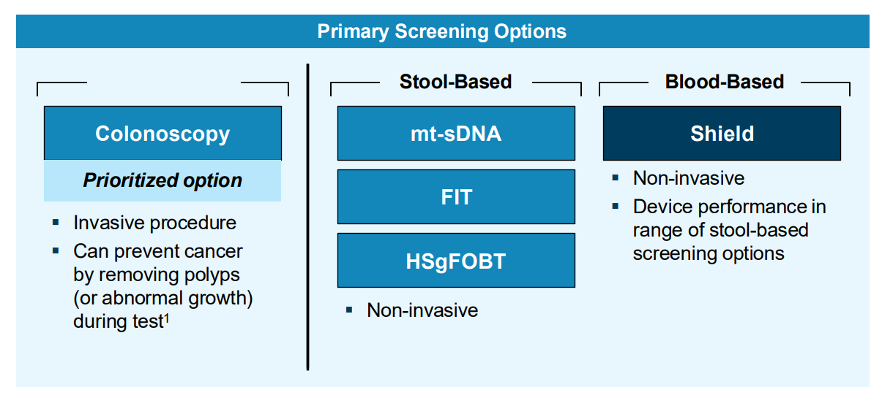
Colorectal Cancer Screening
Screening flexibility with more options: Multiple validated options increase access and compliance and better outcomes
CRC test use was lower among those aged 45 to 49 years than those aged 50 to 75 years (37.1% vs 73.4%

Slide 20

Nebraska’s
Colon Cancer Screening Rate
Nebraska: below average
~ 61-64% based on different data sources
US average (66.9-72.6%)
2 out of 5 Nebraskans are overdue for colon cancer screening

Slide 21
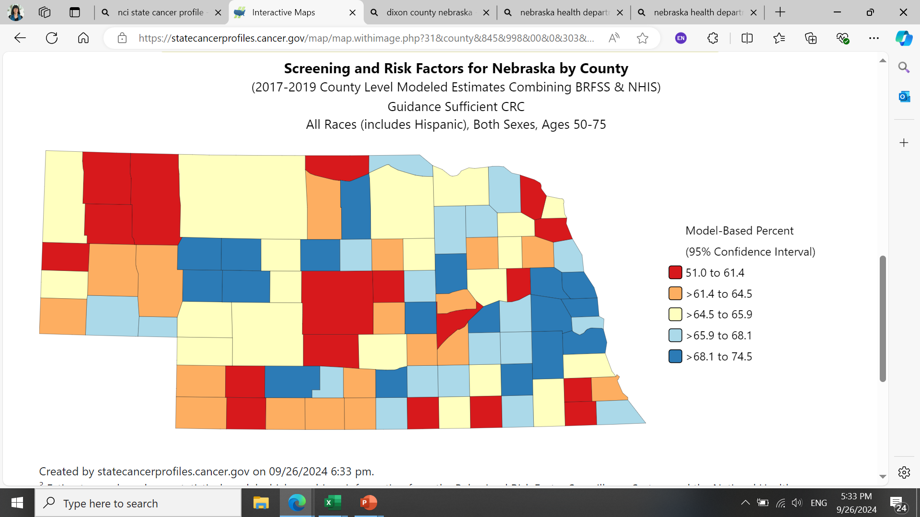
Colorectal Cancer Screening Up-To-Date
(Ages 50-75): 2017-2019
76 rural and 4 urban NE counties have significantly lower rates than US average
U.S. Average: 66.9%
NE Average: 64.1% (62.1-66.1)
(There is no statistical significance difference at .05 level)
US Data for 2023: 72.6%
Source: NCI State Cancer Profile

Slide 22
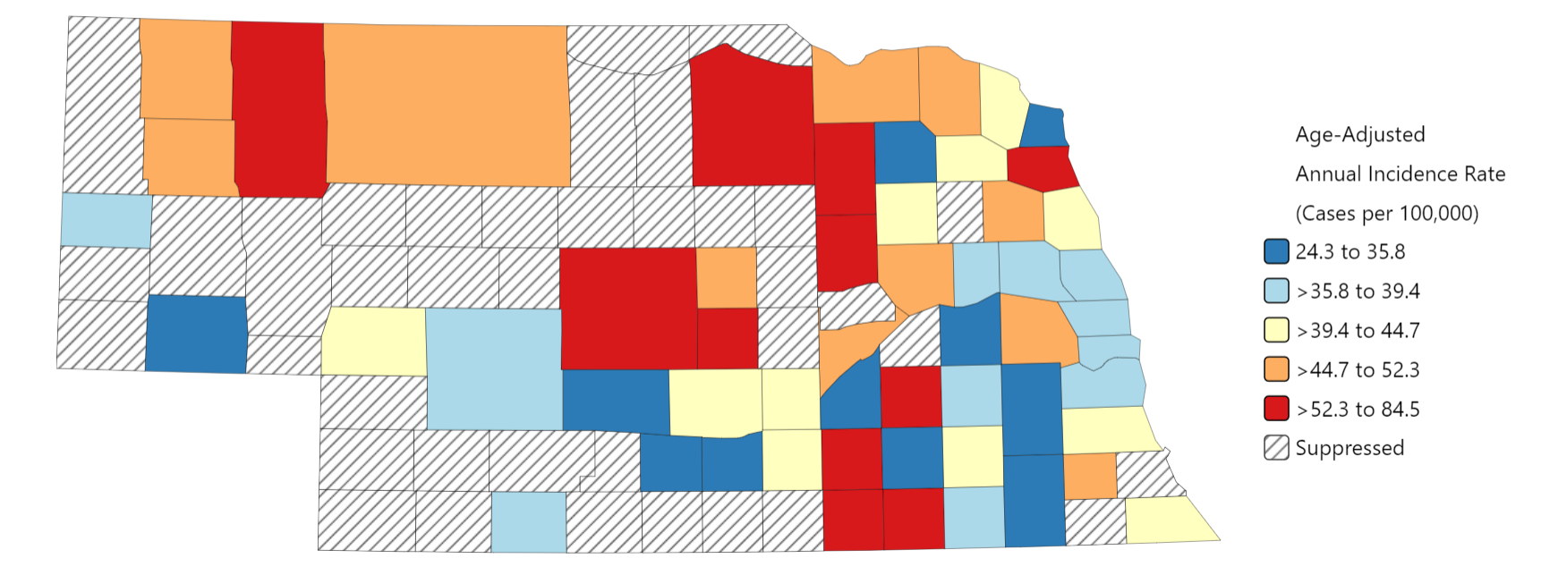
Colorectal Cancer Incidence
Rates Per 100,000: 2017-2021
Boone County
84.5 (57.2-121.9)*
Antelope County 63.9 (42.8-93.3)*
NE average rate is higher than US average
4 rural NE counties have significantly higher rates than US average
Thurston County 68.0 (41.3-105.0)*
U.S. Average: 36.4 (36.3-36.4)
NE Average: 39.2 (38.0-40.4)*
Platte County
50.6 (40.9-62.0)*
*Statistically significantly different from US at .05 level​​
Source: NCI State Cancer Profile
Rural counties according to RUCC

Slide 23
Colorectal Cancer Incidence & Mortality Rates
By Race/Ethnicity
NE AI/AN Population has significantly higher incidence rate compared to all the races across US and NE**
* NH: Non-Hispanic; AI/AN: American Indian/Alaska Native
** Statistically significant differences at .05 level
Source: NCI State Cancer Profile

Slide 24
Colon Cancer Screening
by Race/Ethnicity
Screening: Colorectal Cancer
Colorectal Cancer Screening Rates are much lower in NE American Indian/ Alaskan Natives and Hispanics when compared to any other race and the US average**
Source: NCI State Cancer Profile
* NH: Non-Hispanic; AI/AN: American Indian/Alaska Native
** Statistically significant differences at .05 level

Slide 25
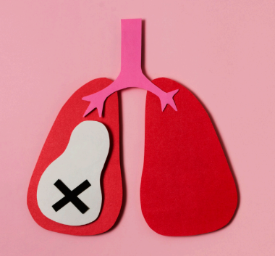
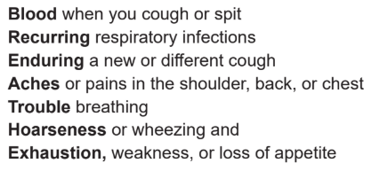
Lung Cancer Screening
More people in the United States die from lung cancer than any other type of cancer.
Low-dose CT scan (LDCT) for adults 50–80 with a 20-pack year or 20-year history of smoking.
Often no symptoms until it’s very advanced.
Black men have the highest death rate from lung cancer.

Slide 26

Nebraska’s
Lung Cancer Screening Rate
Nebraska: slightly above average
~ 20-23.6% based on different data sources
US average (14-18%)
4 out of 5 eligible Nebraskans are overdue for lung cancer screening

Slide 27
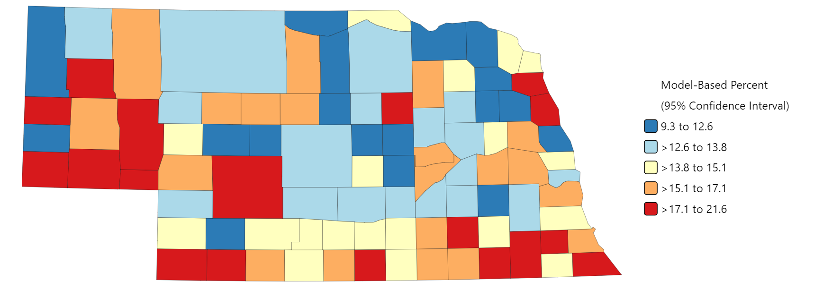
Current Smoker (Ages 18+): 2017-2019
28 rural and 2 urban NE counties have significantly higher rates than US average
U.S. Average: 14.0%
NE Average: 13.0% (11.8-14.1)
Source: NCI State Cancer Profile

Slide 28
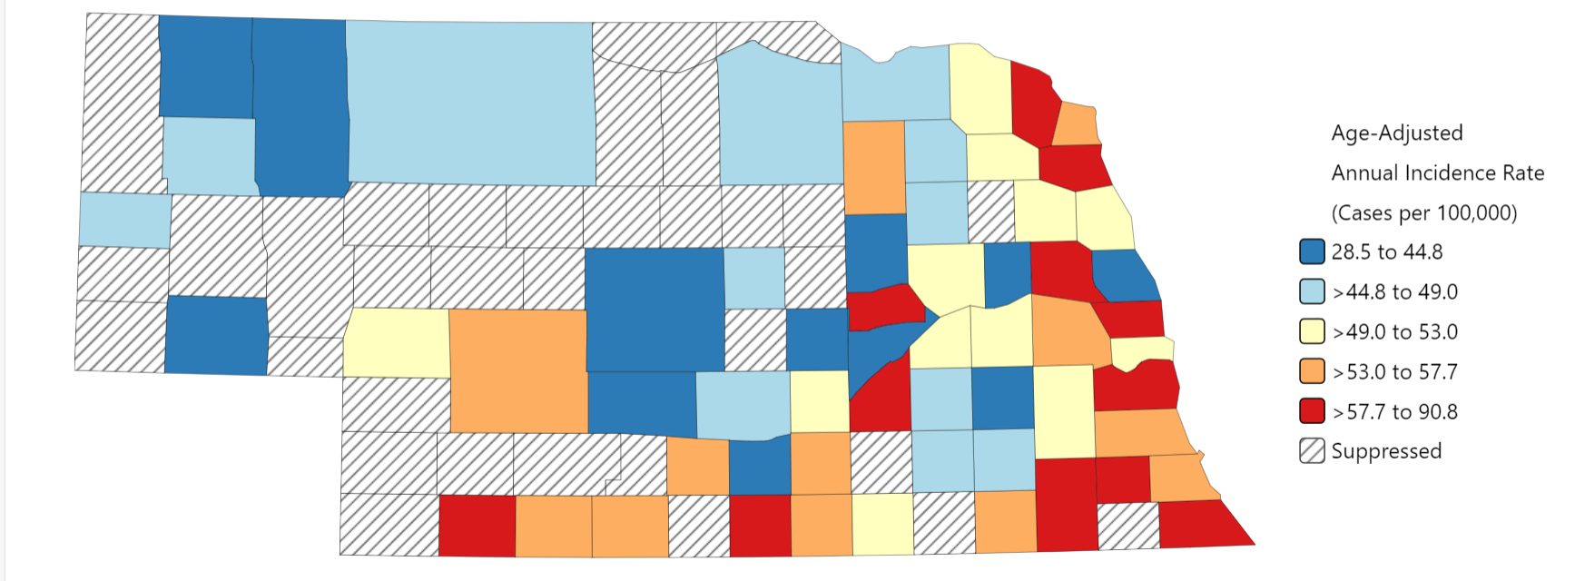
Lung Cancer Incidence Rates Per 100,000: 2017-2021
NE average rate is higher than US average
2 rural and 1 urban NE counties have significantly higher rates than US average
Thurston County 90.8 (59.6-132.1)*
U.S. Average: 53.1 (53.0-53.2)
NE Average: 52.2 (50.9-53.5)*
Cass County
65.2 (53.8-78.5)*
Franklin County 87.6 (53.8-140.0)*
* Significantly higher than U.S. average at .05 level
Source: NCI State Cancer Profile
Rural counties according to RUCC

Slide 29
Cancer Risk
Risk For Cancer
Lifestyle
Environmental Exposures
Hereditary Risk
Age
Notes:
It is usually not possible to know exactly why one person develops cancer and another doesn’t. But research has shown that certain risk factors may increase a person’s chances of developing cancer.
Cancer risk factors include exposure to chemicals or other substances, as well as certain behaviors. They also include things people cannot control, like age and family history.
Exposure to harmful substances in the environment or workplace can cause cancer. Substances that cause cancer are called carcinogens. Some of these carcinogens can cause cancer years after you have been exposed to them. Examples include asbestos, radon, and certain chemicals.
Lifestyle risk factors include smoking, weight, diet, physical activity, sun exposure, and tobacco and alcohol use.
When we look at age, for most people, increasing age is the biggest risk factor for developing cancer. In general, people over 65 have the greatest risk of developing cancer. People under 50 have a much lower risk.

Slide 30
Cancer Risk
Hereditary 5-10%
Familial 5-15%
Sporadic 70-80%
Hereditary – caused by inherited mutation, typical to see recurring pattern across 2-3 generations
Familial – Occurs more frequently in families than chance alone, no mutation identified
Sporadic – Refers to cancer that occurs due to spontaneous mutations, cannot be explained by a single cause

Slide 31
Cancer Risk Stratification
Family History
Average
Standard general population recommendations
Assessment
Risk Classification
Intervention
Moderate (Familial)
Personalized prevention recommendations
High / Genetic
Genetic evaluation with personalized prevention recommendations

Slide 32







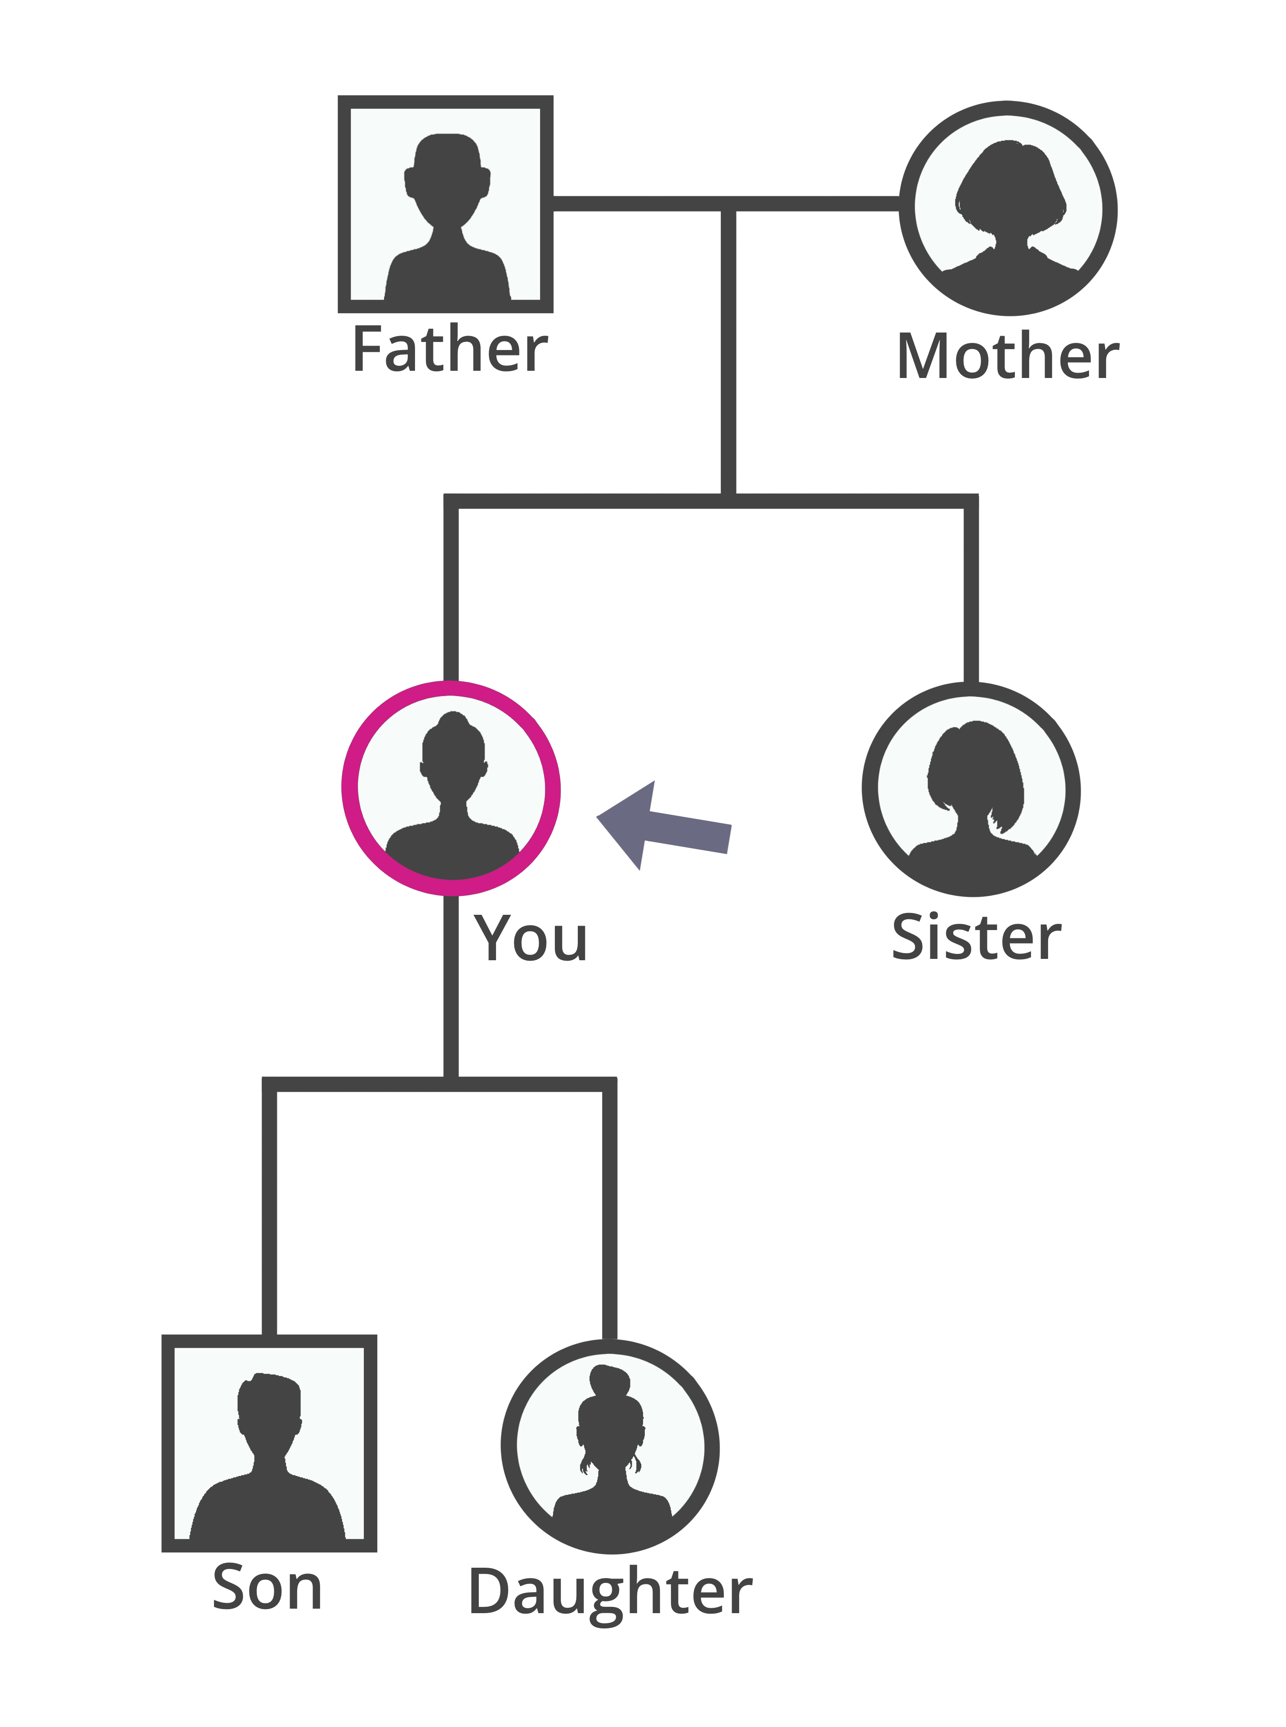



Cancer Risk Stratification is COMPLEX
Notes:
. [NOTE TO RACHAEL: GOOD THING TO START WITH WOULD BE TO SAY “Lung cancer is just one piece of the puzzle – multiple this complexity but all the other things a primary care provider needs to manage] Lung cancer ranks high in cancer-related mortality. Nebraska's low screening rates, at 3.7%, demand urgent action. NM's recent adoption of lung cancer screening tools lacks mandatory smoking history documentation, hindering eligibility assessment
Leveraging external resources can help alleviate the workload on primary care providers and internal IT departments with long list of other priority projects, provide patients with specialized care, and improve early detection rates.
The CancerIQ platform offers advanced tools for cancer risk assessment, streamlined workflows, and enhanced patient care. Integrating it within our EPIC system could provide seamless access to vital information and improve clinical decision-making.
While the benefits are clear, our IT department faces significant resource constraints that prevent internal IT resources from replicating CancerIQ at this time. Here are the primary challenges:
1. Limited IT Resources: Our IT team is currently operating at full capacity, managing multiple critical projects and maintaining existing systems.
2. Complexity of Development: Creating a home version of CancerIQ is a complex and resource-intensive task that requires specialized knowledge and significant time investment.
By leveraging CancerIQ, it can enhance our ability to identify and monitor high risk patients.

Slide 33

We decided to tackle this larger problem by starting with an urgent cancer disparity in Nebraska
Lung cancer is the leading cancer killer in Nebraska, but the screening rate is only 3.7%.
Notes:
Note to rachael: Looking back on your talk track maybe you should start with this slide – introduce the “why” of the lung cancer problem first Lung cancer ranks high in cancer-related mortality. Nebraska's low screening rates, at 3.7%, demand urgent action. NM's recent adoption of lung cancer screening tools lacks mandatory smoking history documentation, hindering eligibility assessment
New Report Reveals Nebraska Lags Behind Country in Lung Cancer Screening
American Lung Association examined toll of lung cancer in Nebraska, underscores urgent need for more high-risk people to be screened
The 2023 “State of Lung Cancer” report reveals Nebraska ranks 33rd in the nation for lung cancer screening with just 3.7 percent of those at high risk of lung cancer getting screened.

Slide 34



Nebraska Medicine’s Community Needs
630 lung cancer deaths were estimated in 2023 in Nebraska
EVERY
2.2 minutes
1,340 cases
20% reduction
Someone is diagnosed with lung cancer in Nebraska
estimated number of new lung cancer cases diagnosed in Nebraska in 2023
in the death rate is possible by detecting tumors at earlier stages when curable
Notes:
On the lung cancer screening problem in her community:
Screening for lung cancer with annual low-dose CT scans among those at high risk can reduce the lung cancer death rate by up to 20% by detecting tumors at early stages when they are more likely to be curable.

Slide 35

We needed better tools to serve our patients – so we had to look to outside resources
NEEDED
ACCESS TO SPECIALIZED EXPERTISE
PATIENT INITIATED TOOLS
ENHANCED PATIENT CARE
“Junk data in is junk data out”
It was clear that our existing EHR systems were not adequately capturing or flagging those who needed to be assessed for risk, so our cancer risk and prevention program needed to look further.
Notes:
Delayed Access to Information: Manual data entry and separate system usage can slow down our workflow.
Utilizing outside resources for cancer screenings can offer several benefits:
1. Access to Specialized Expertise:
- Example: External screening centers often have specialized equipment and trained personnel dedicated to cancer detection.
- "Specialized resources can provide more accurate and comprehensive screenings to bridge the gap in our resources"
2. Patient initiated screeners:
- Alleviating Workload from clinic staff by referring patients to external resources
- Voiceover: "Free up your time to provide holistic care by utilizing specialized screening services."
3. Enhanced Patient Care:
- Example: Patients benefit from a multidisciplinary approach, receiving care from specialists who can provide targeted screening and follow-up.
- Voiceover: "Collaborative care improves patient outcomes and satisfaction."
4. Improved Screening Rates:
- Example: Access to external resources can increase the overall screening rates, ensuring more patients are screened in a timely manner.
- Voiceover: "Higher screening rates lead to early detection and better patient prognosis."

Slide 36


Guidelines for lung cancer risk assessment are complex
Lung cancer screening guidelines are more complicated than other cancer screening guidelines which usually are solely based off age. Lung cancer screening takes into account age, number of years smoking, number of packs per day, quit date, and total pack year history.
Notes:
Most people use the USPTF
It can be challenging for providers to stay up to date with NCCN guidelines and keep track of patient adherence to recommendations.
Based on new research, in March of 2021, the United States Preventive Services Task Force expanded its recommendation for screening to include a larger age range and more current and former smokers. This dramatically increased the number of women and Black Americans considered at high risk for lung cancer.
Lung cancer screening guidelines are more complicated than other cancer screening guidelines which usually are solely based off age. Lung cancer screening takes into account age, number of years smoking, number of packs per day, quit date, and total pack year history.

Slide 37


We needed a precise approach to identify patients
YOUR PATIENT POPULATION
87% LIFETIME
CANCER RISK
KNOWN GENETIC MUTATIONS
FAMILY HISTORY
24% LIFETIME
CANCER RISK
+
ELEVATED RISK
LIFESTYLE
22% LIFETIME
CANCER RISK
ADHERENCE
ELEVATED RISK OF
LATE-STAGE DETECTION
AVERAGE
12% LIFETIME
CANCER RISK
Streamlined Patient Identification:
"CancerIQ has been instrumental in helping us identify high-risk patients efficiently. Its tools allow us to segment our patient population based on specific risk factors, which is essential for launching targeted screening campaigns."
Enhanced Patient Engagement:
"With CancerIQ, we've been able to develop personalized communication strategies that resonate with our patients. This platform enables us to educate them about their risk factors and the importance of early screening, which has significantly improved patient engagement in our campaigns."
Data-Driven Decision Making:
"CancerIQ provides us with actionable data that guides our screening strategies. By analyzing this data, we've been able to make informed decisions about where to focus our efforts, ensuring that our resources are used effectively to reach the most vulnerable groups."
Increased Screening Uptake:
"Since we started using CancerIQ, we've seen a noticeable increase in the uptake of screenings. The platform's ability to automate reminders and follow-ups has been a game changer, reducing the burden on our clinical staff and encouraging more patients to participate in preventative screenings."
Scalability of Screening Programs:
"CancerIQ has not only helped us start our campaign-based screening effectively but also scale it. As we've expanded our screening initiatives to cover more types of cancer and broader patient demographics, CancerIQ's scalable solutions have made it possible to grow without overwhelming our existing resources."
These points highlight the specific ways CancerIQ has supported Rachael Schmidt in her efforts to initiate and manage effective, campaign-based cancer screening programs.
Notes:
The missing piece for our lung cancer screening program was an effective way of identifying patients who meet eligibility. With the fragmented data in the EHR,, we needed a way to query patients on their smoking history.
CancerIQ's software and service gave us a more precise approach to screening and risk-reduction. With most healthcare systems, it is a one-size-fits-all approach to cancer prevention and early detection and screening. But utilizing a patient’s family history, genetic profile, lifestyle and a host of other health factors, precision health enables us to create more effective prevention pathways for each patient. The EHR, while a powerful tool in its own right, is not enough. It can give us this information in bits and pieces, but CancerIQ enhances the clinical guidance tools, takes out the guess work of meeting eligibility for the most up to date evidence based guidelines and helps risk stratify patients for cancer.

Slide 38
Getting off the ground: Campaign Planning
SCREEN
MANAGE
MEASURE
NAVIGATE
DIAGNOSE
1
Identified Target Population & Data Source:
Current or former smokers (50-80) sourced from EHR data pull; removed anyone who was already compliant
2
Worked with CancerIQ team to craft message:
CancerIQ provided ready-to-go language to engage patients with a known adherence risk
3
Planned distribution channel & cadence:
Patient portal messages to 3,500 patients in 500 patient batches

Slide 39
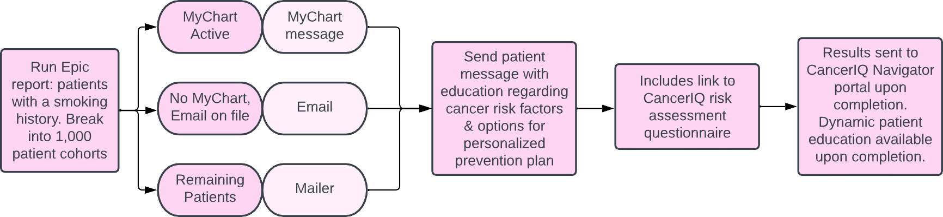
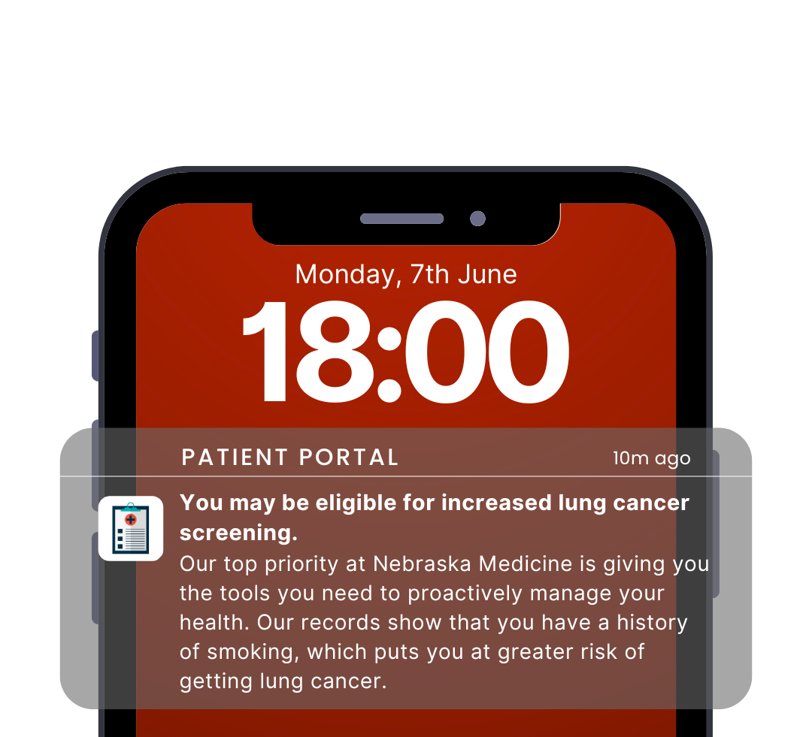
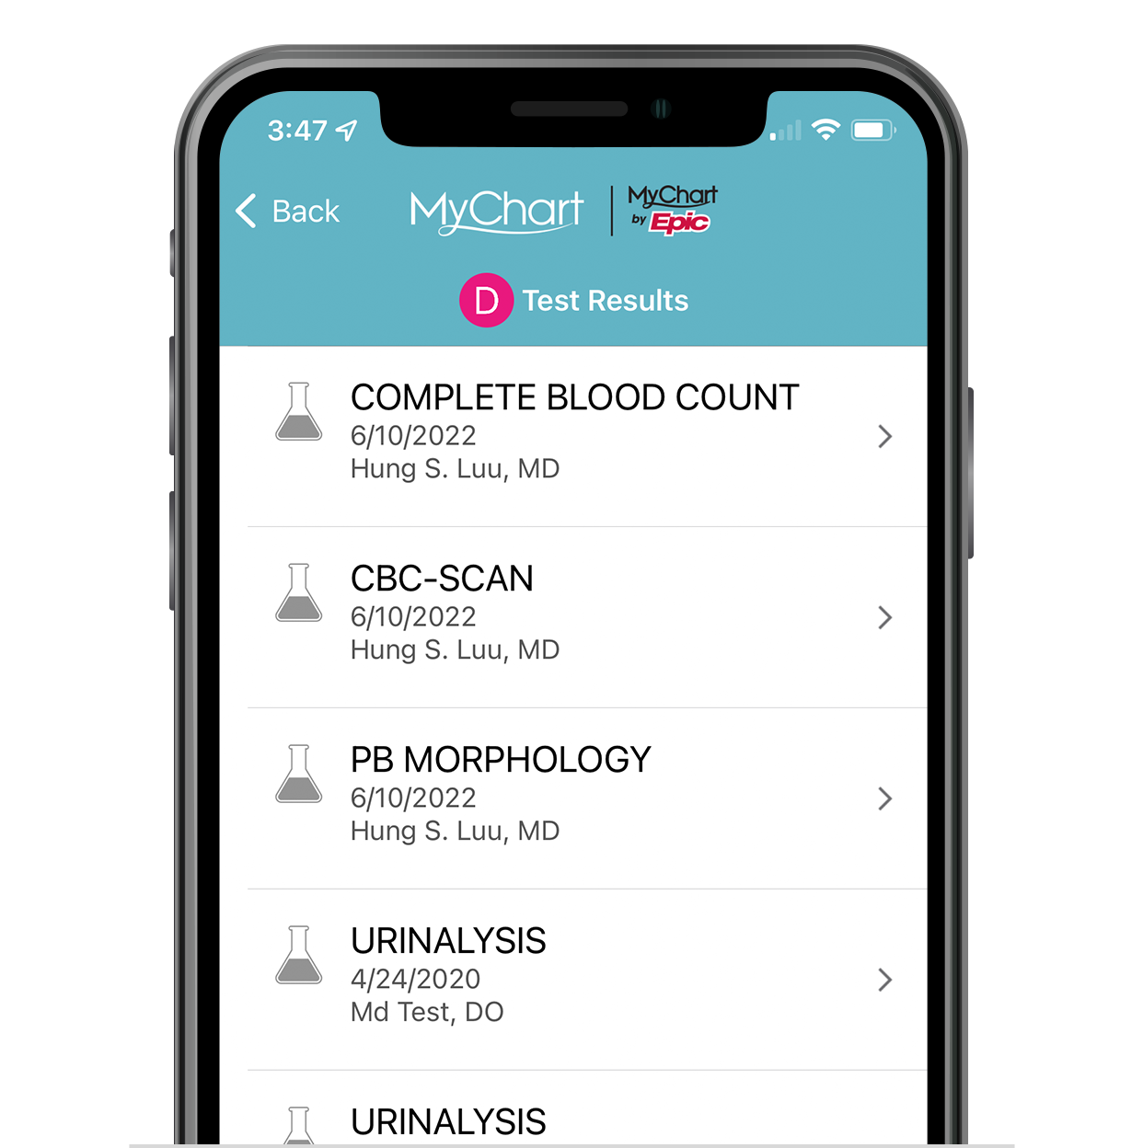
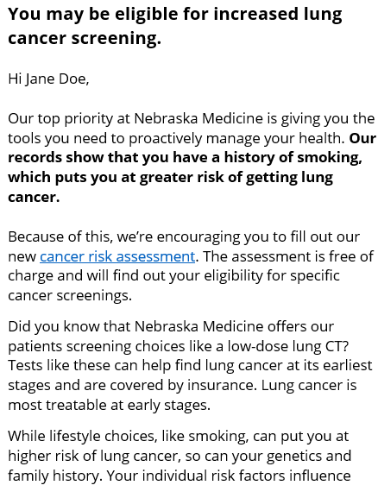

Campaign to Smokers
SCREEN
MANAGE
MEASURE
NAVIGATE
DIAGNOSE
Wanted to meet patients where they are
Delivered and seamless on mobile, tablet, or web
Reduces the need for staff to conduct lengthy, on-site questionnaires
Lesson learned: We had to go through a lot of steps, committees to get it approved, translate that back into the EHR for compliance reasons
Notes:
We wanted to send targeted messages through patient portals about the importance of lung cancer screening.
Use data from electronic health records (EHRs) to identify eligible patients and tailor messages to their specific risk factors

Slide 40


Campaign to Smokers
SCREEN
MANAGE
MEASURE
NAVIGATE
DIAGNOSE
Notes:
I believe that using multiple channels to disseminate information, including talking about lung cancer screening or any other cancer screening during regular, routine visits is great, but when you add in brochures, posters, and digital media, and targeted portal messages, it brings more awareness and increases adherence to screenings.
The questionnaire that they were asked to fill out takes approximately 3-5 minutes. We will run through this quick demo to show how easy it is.

Slide 41
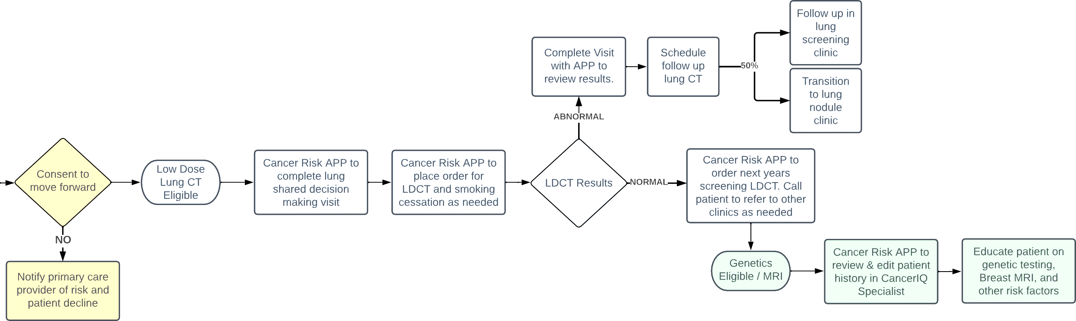
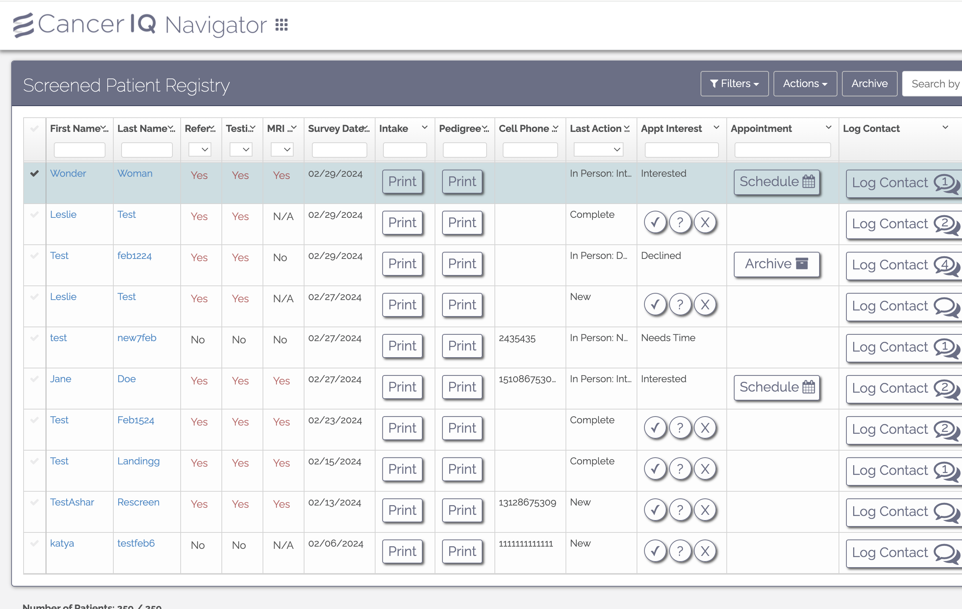
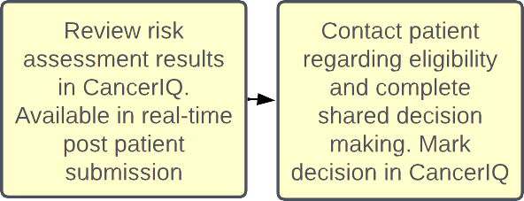
Campaign to Smokers
SCREEN
MANAGE
MEASURE
NAVIGATE
DIAGNOSE
Review a qualified list of interested leads that have proactively indicated interest
Intake and outreach coordinators can leverage CancerIQ to connect with patients directly, without the need for referrals
Notes:
Despite being proactive, many engaged patients were not be aware that lung cancer screening is an option. Lack of awareness about eligibility criteria and the benefits of early detection were the barrier and we changed that with this targeted messaging.

Slide 42
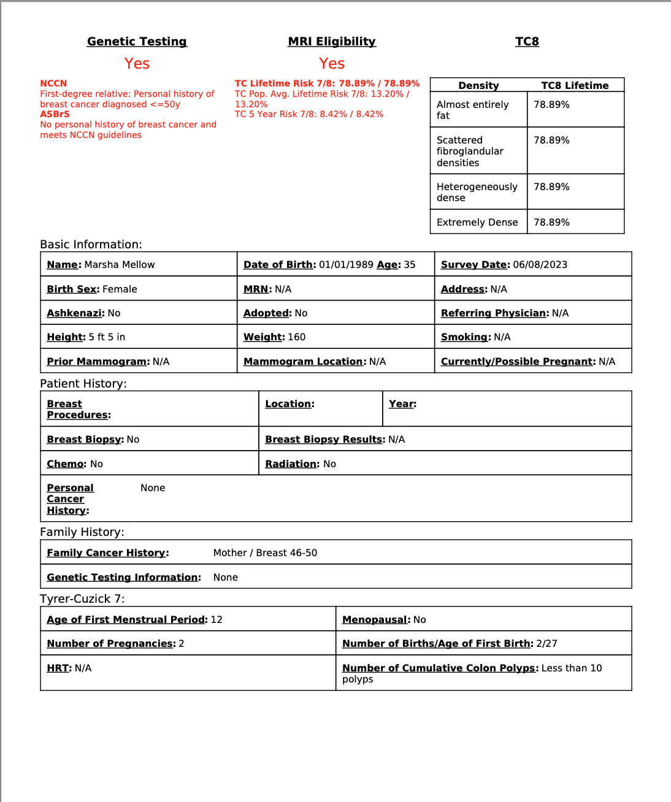

Campaign to Smokers
SCREEN
MANAGE
MEASURE
NAVIGATE
DIAGNOSE
Print Intake
Print intake form
Put into the EHR
Lesson learned: the number of patients we thought were eligible vs those that actually were was vastly different because of missing data in the EHR – CancerIQ helped close these gaps
Notes:
Because we didn’t do an EHR integration right away with CancerIQ, we had to meet legal/compliance standards and make sure all patient information got back into EPIC. Any time one of our patients filled out the screener, we copied it straight into a note in their chart and updated all the smoking and family history questions within EPIC as well. This seemed like double work but we wanted all the information condensed into one system for anyone working with the patient to utilize.

Slide 43
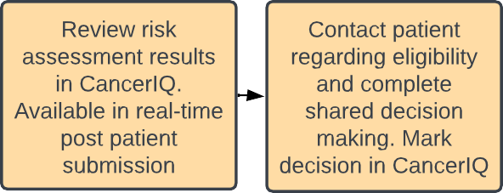
Campaign to Smokers
SCREEN
MANAGE
MEASURE
NAVIGATE
DIAGNOSE

Slide 44
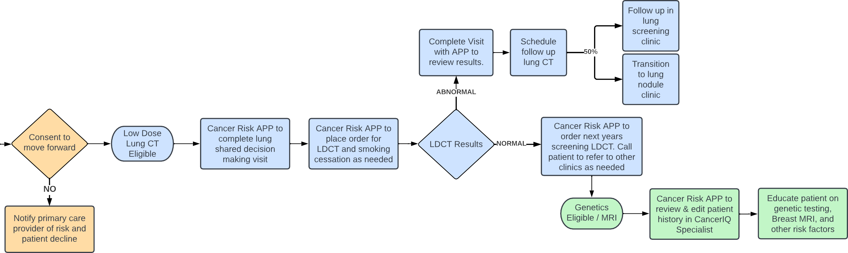
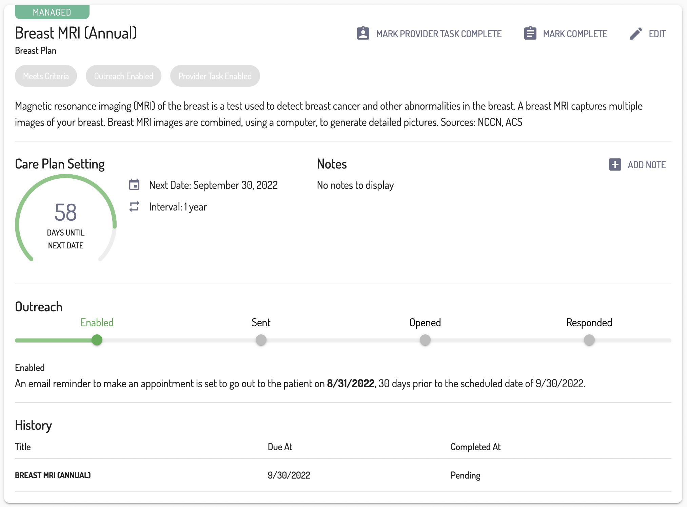
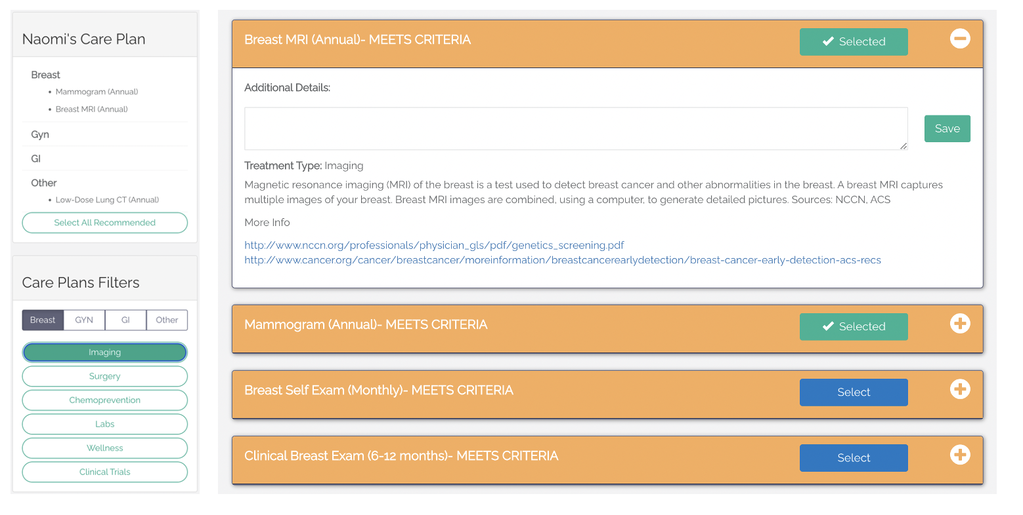
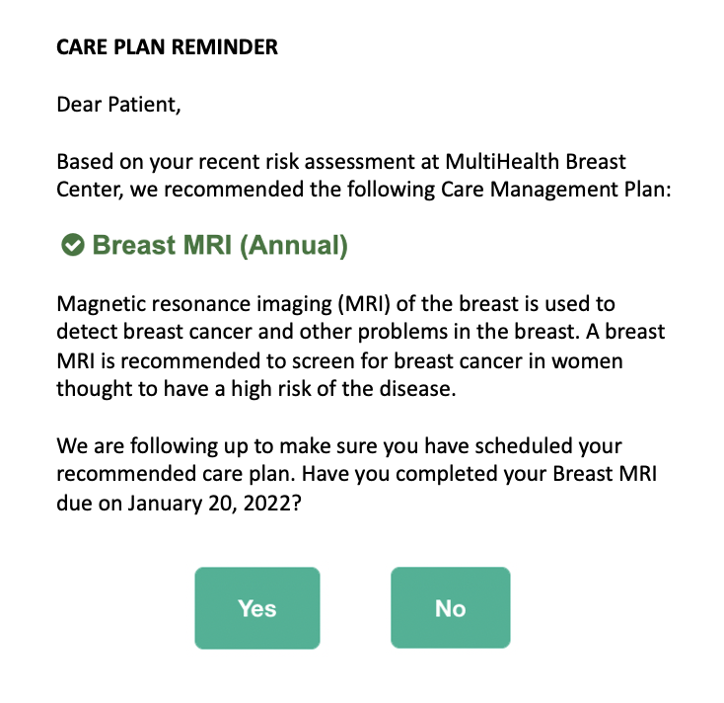
Campaign to Smokers
SCREEN
MANAGE
MEASURE
NAVIGATE
DIAGNOSE

Slide 45
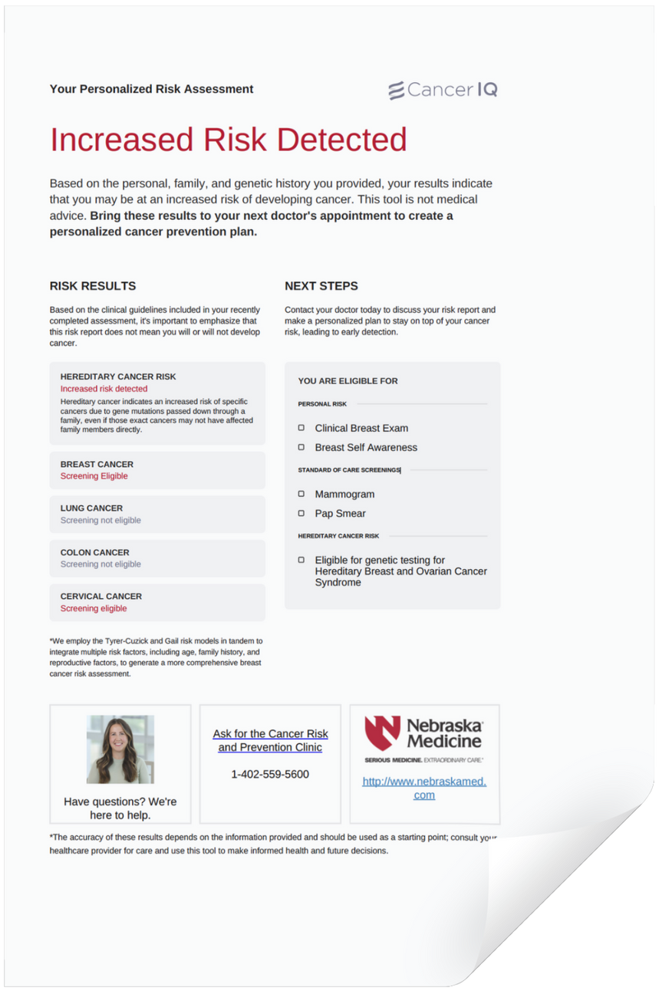
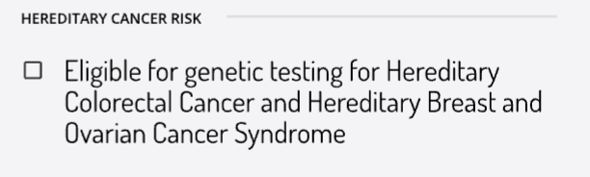
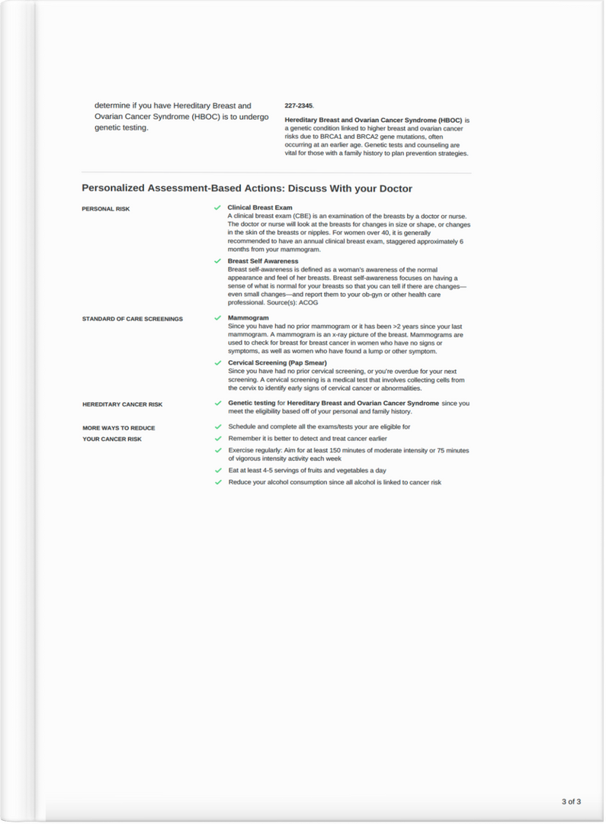
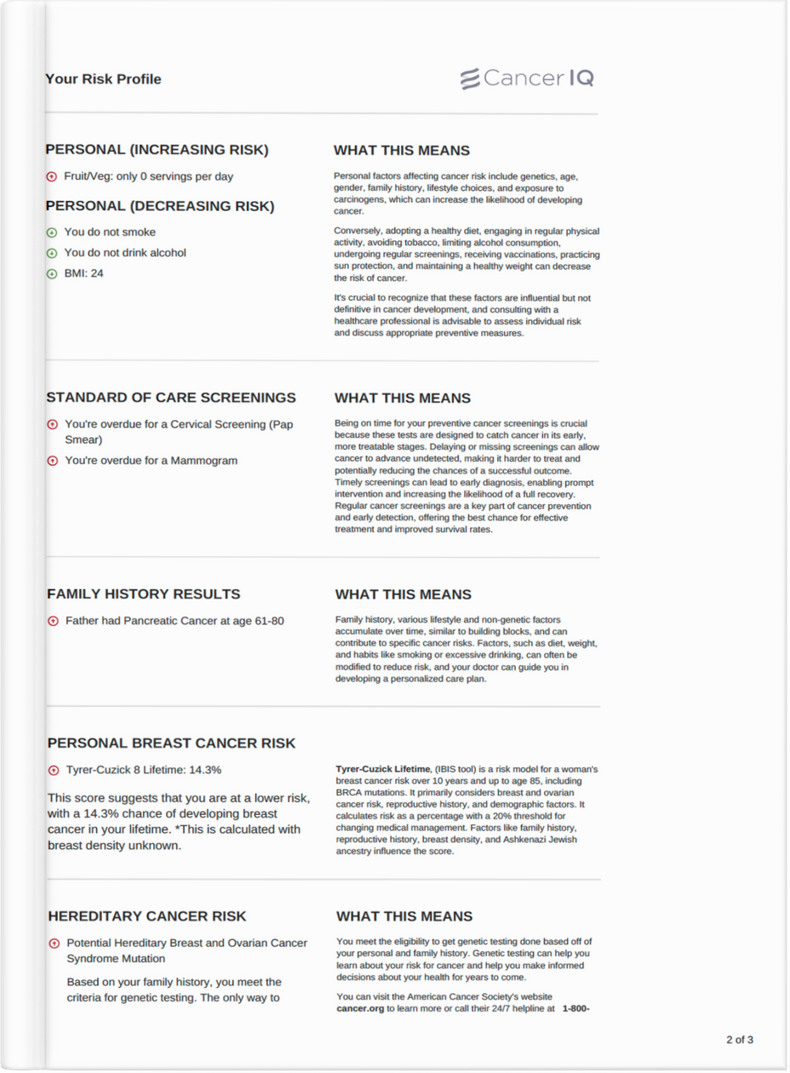
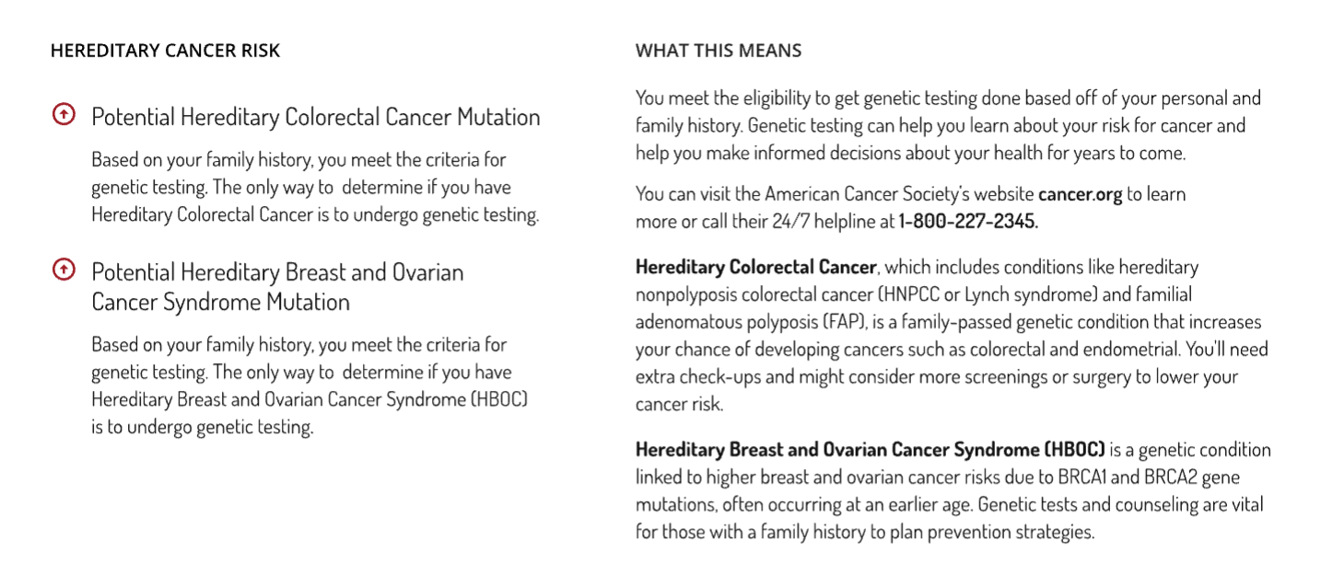
Patient-Facing Education
SCREEN
MANAGE
MEASURE
NAVIGATE
DIAGNOSE
1
AWARENESS
2
EDUCATION
3
NEXT STEPS

Slide 46


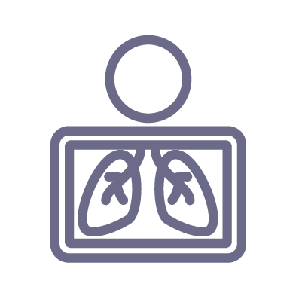



Analyzing & Planning Ahead
SCREEN
MANAGE
MEASURE
NAVIGATE
DIAGNOSE
PROJECTED POTENTIAL TO SCALE:
3500
patients enrolled in the campaign
TARGET POPULATION | 15,000
Patients screened | 4,200
Capture rate | 28%
GC Visits | 1,680
GC Eligibility | 40%
LDCT Visits | 470
LDCT Eligibility | 28%
29%
completed the risk assessment (1,030)
292
patients eligible for LDCT post screener; +10% increase with phone interview
298
patients interested in LDCT; 100% scheduled
409
patients eligible for genetics
62
patients eligible for breast MRI
10
patients diagnosed with lung cancer,
9 out of 10 are early stage (I or II)
Adjust 15,000

Slide 47

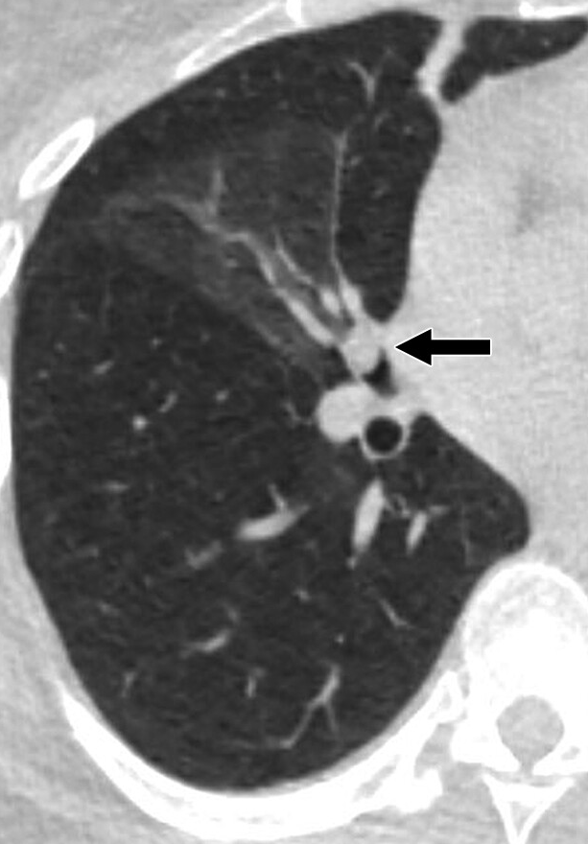
Patient Case: Early Stage Diagnosis
Patient Information: Female, Age 55
Smoking History: 40 Pack Year History (2 packs/day for 20 years)
PCP: Established
Previous Lung Cancer Screening: N/A Patient took Cancer IQ Risk Assessment Tool
REFERRED FOR LDCT September 2023
Lung RADS 4
Notes:
Clinical barriersJaimie Elizabeth
55 Y.O. Pack Year History 40 (2 packs/day for 20 years) Took CIQ Risk assessment
Underwent lung cancer screening in Sept. 2023
Came back as a Lungrads 4A
Referred to thoracic, PFTs, PET, CT ion
Surgery showed that she had stage 1A lung cancer
PCP had never screened, should have been getting lung cancer screening She’s doing great! Very thankful, spokesperson Almost a year out, 6 months from surgery (robotic assisted right VATS with middle lobectomy), surveillance

Slide 48
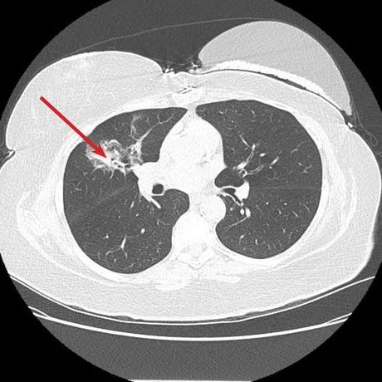
Patient Case: Early Stage Diagnosis
REFERRED TO THORACIC FOR FULL WORKUP
Patient Information: Female, Age 55
Smoking History: 40 Pack Year History (2 packs/day for 20 years)
PCP: Established
Previous Lung Cancer Screening: N/A Patient took Cancer IQ Risk Assessment Tool
PFTs
REFERRED FOR LD LUNG CT September 2023
PET Scan
CT ion
Surgery
Stage IA Lung Cancer diagnosed with surgery
(robotic assisted right VATS with middle lobectomy)
Lung RADS 4
Notes:
LuClinical barriersJaimie Elizabeth
55 Y.O. Pack Year History 40 (2 packs/day for 20 years) Took CIQ Risk assessment
Underwent lung cancer screening in Sept. 2023
Came back as a Lungrads 4A
Referred to thoracic, PFTs, PET, CT ion
Surgery showed that she had stage 1A lung cancer
PCP had never screened, should have been getting lung cancer screening She’s doing great! Very thankful, spokesperson Almost a year out, 6 months from surgery (robotic assisted right VATS with middle lobectomy), surveillance

Slide 49

Patient Case: Early Stage Diagnosis
REFERRED TO THORACIC FOR FULL WORKUP
Patient Information: Female, Age 55
Smoking History: 40 Pack Year History (2 packs/day for 20 years)
PCP: Established
Previous Lung Cancer Screening: N/A Patient took Cancer IQ Risk Assessment Tool
PFTs
REFERRED FOR LD LUNG CT September 2023
PET Scan
Celebrating 6 Months of Survivorship!
CT ion
Imaging Surveillance
Surgery
Stage IA Lung Cancer diagnosed with surgery
Yearly Risk Assessment
(robotic assisted right VATS with middle lobectomy)
BIRADS 4
Notes:
LuClinical barriersJaimie Elizabeth
55 Y.O. Pack Year History 40 (2 packs/day for 20 years) Took CIQ Risk assessment
Underwent lung cancer screening in Sept. 2023
Came back as a Lungrads 4A
Referred to thoracic, PFTs, PET, CT ion
Surgery showed that she had stage 1A lung cancer
PCP had never screened, should have been getting lung cancer screening She’s doing great! Very thankful, spokesperson Almost a year out, 6 months from surgery (robotic assisted right VATS with middle lobectomy), surveillance

Slide 50
Lung screening is a revenue opportunity our administration appreciated
LOW-DOSE LUNG CT FINDINGS
Many screened patients show nodules, necessitating additional imaging and biopsies which are high-yield for multiple follow-ups.
HIGH-RISK VISIT VOLUME
Those identified may require additional follow-up visits within 3-6 months.
SCREENING & FOLLOW-UP PROCESS
Patients eligible for lung cancer screening undergo a shared decision-making visit and low-dose CT scan.
INTERVENTIONAL PROCEDURES
IR biopsy and PET scans are part of the follow-up for those with notable findings.
SURGERY
Patients diagnosed with lung cancer may need multiple treatment options including surgery, chemotherapy, and radiation treatment depending on stage.

Slide 51
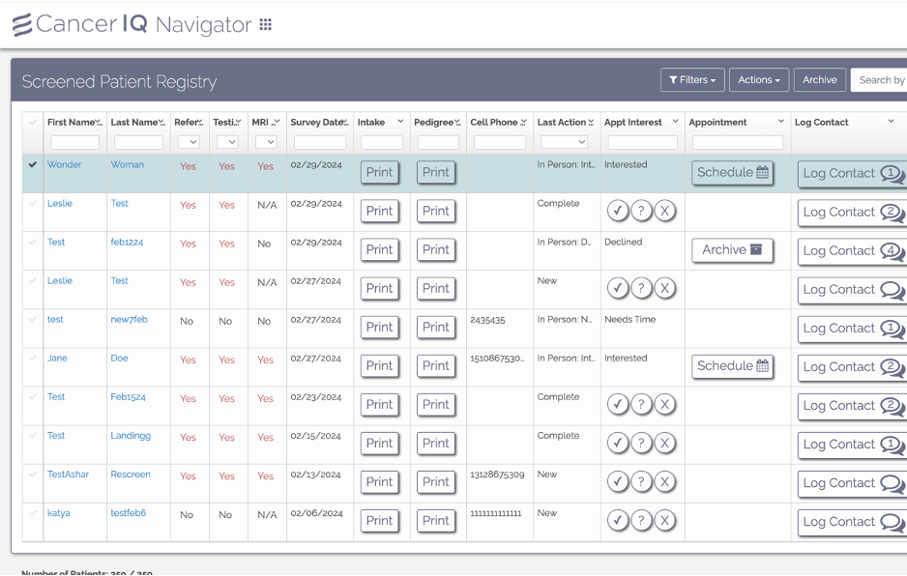
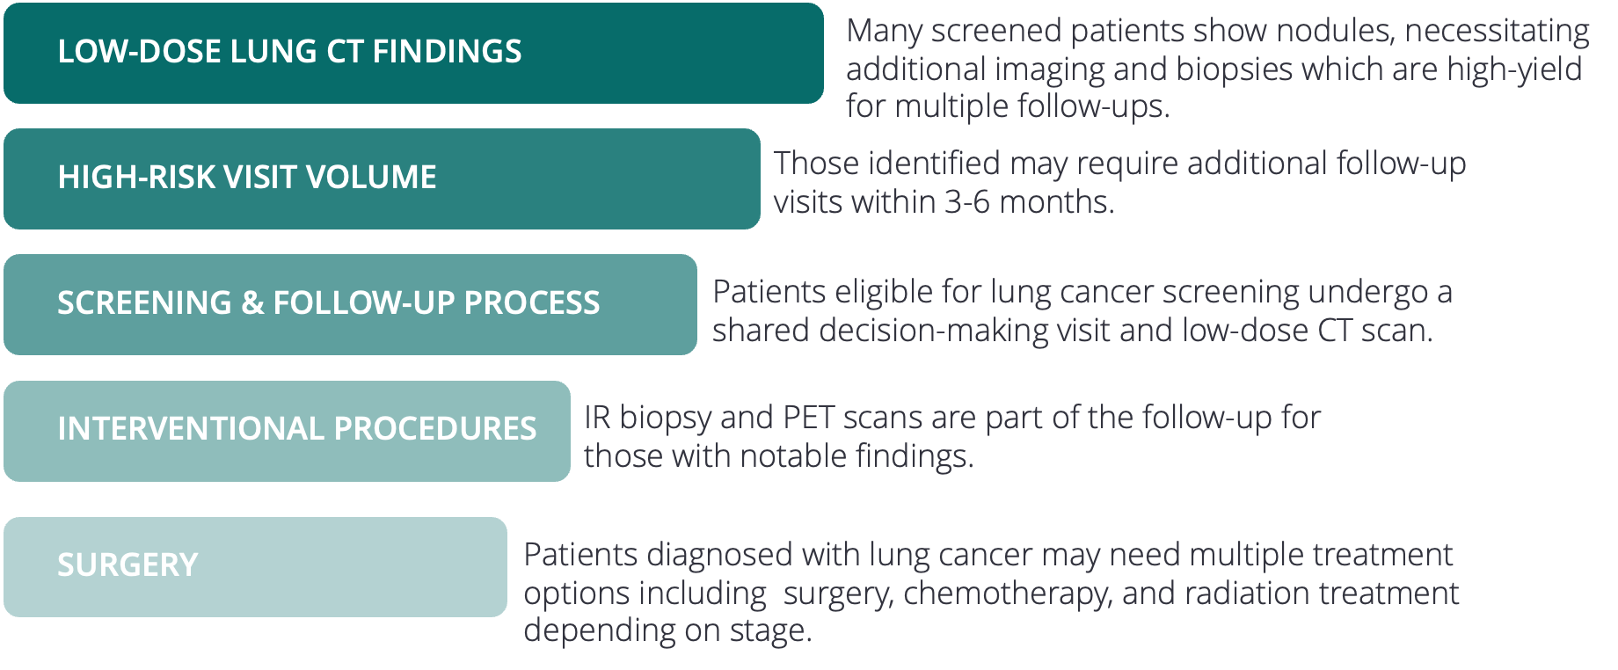
What CancerIQ helped us achieve
TARGETED, CAMPAIGN-BASED OUTREACH
AUTOMATED CLINICAL GUIDANCE
MEASURABLE SYSTEMWIDE IMPACT
CancerIQ identified our at-risk patients upstream of the lung program and offered marketing consultation to help us engage target populations in digital, patient-led cancer risk assessment.
CancerIQ automated the latest USPSTF, Tyrer-Cuzick (78), Gail, and NCCN guidelines, and populates risk results alongside education resources and clinical decision guidance, to ensure we have resources at our fingertips to engage patients.
CancerIQ expanded utilization of preventive services through the lung program, and this replicable model is now being deployed across multiple cancer types and subspecialties to increase incremental service revenue across the health system.

Slide 52

Takeaways!
Begin Again: Let’s rewrite Nebraska’s Cancer Story Understanding Nebraska’s cancer trends can help us all take targeted actions for our patients, our neighbors, and loved ones.
Speak Now: Make Screening Individualized Risk-assessment tools help the health system speak up with data, guiding the right screenings for the right populations.
Be Fearless to Take the Next Step Expanding programs and integrating new software takes courage, coordination, and commitment — because fearless systems find cancer earlier.

