Slide 1
Putting it all Together
Jenna Watson, RN, BSN

Slide 2
What is evidence Based Practice?
Providing holistic, quality care based on the most up-to-date research and knowledge rather than traditional methods, advice from colleagues, or personal beliefs
Requires review and assessment of the latest research
Used as the basis for making changes in nursing care and practice
Always evolving
Leads to better patient outcomes
Examples
  Management of angina
  Sepsis management
  Noninvasive measurement of BP in children

Slide 3
Evidence Based Practice
What are characteristics of credible evidence based practice?
  From a reputable trustworthy source
  Sources sited for research
  Not a personal opinion
  From a professional organization
    ANA, NNA, ENA ect.
How is evidence based practice implemented into polices?
  Must go through facility specific process to be implemented
  Sometimes takes longer than expected

Slide 4
Evidence Based Practice Scenario
You’re a newer nurse and have just started being independent on the med/surg unit. You are taking care of a patient who had a colon resection 8 hours earlier. You request some help from a co-worker to help you get the patient up for the first time. The seasoned nurse tells you that you don’t really need to get him up. She continues to let you know she never gets her patients out of bed this early and she always has patients with the best outcomes.

Slide 5
EBP Scenario
What are your thoughts?
How could you use EBP to help you?
What things make you uncomfortable about this situation?
How do you want to handle this?

Slide 6
Benefits of early mobility in patients
Decreased risk of complications
Increased survival rates
Improved functional recovery
Reduces hospital length of stay
Improved respiratory function
It is vital to get patients up and moving but do it SAFELY!!!

Slide 7

Clinical Admission Guidelines
When patients are admitted insurance companies use a set of guidelines to decide what status to admit them under
Several programs out there but the
  2 most used are MCG and Interqual
Providers work with utilization review staff to be sure
patients are admitted under the appropriate status
Either inpatient or observation status

Slide 8
Clinical Admission Guidelines
Inpatient
Observation
Usually stay longer that 24 hours
Medicare population – can qualify a patient for SNF if >3 midnights
Condition more serious requiring more care
Medicare population – covers all meds
Higher reimbursement rates
Usually less than 24 hours although some insurance companies allow more
Medicare population – all meds that can be self administered not covered
Does not qualify them for SNF

Slide 9
Patient Family Engagement
Research shows when patients and families are engaged in care it leads to measurable improvements in safety and quality
4 pillars of Patient/Family engagement
  Inclusiveness
  Support
  Mutual Respect
  Co-Building

Slide 10
Patient Family Engagement
What things can nursing do to promote this?
Encourage participation
Promote communication among both patients and families
Keep them informed
Bedside shift report
Enlist their help in discharge planning

Slide 11
What is Teach-Back
Evidence based health literacy intervention
Can be used in multiple settings
Involves teaching your patient a chunk of information and then asking them to teach it back to you
Start with the most important message
Limit to 2-3 key points
Use plain language
Patient education should start at admission

Slide 12
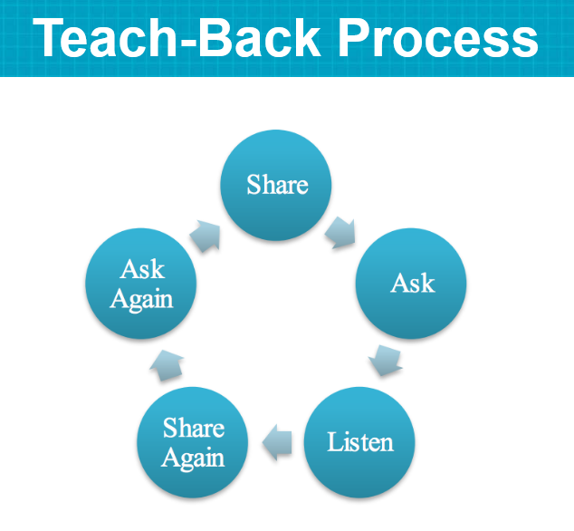
Teach-Back

Slide 13
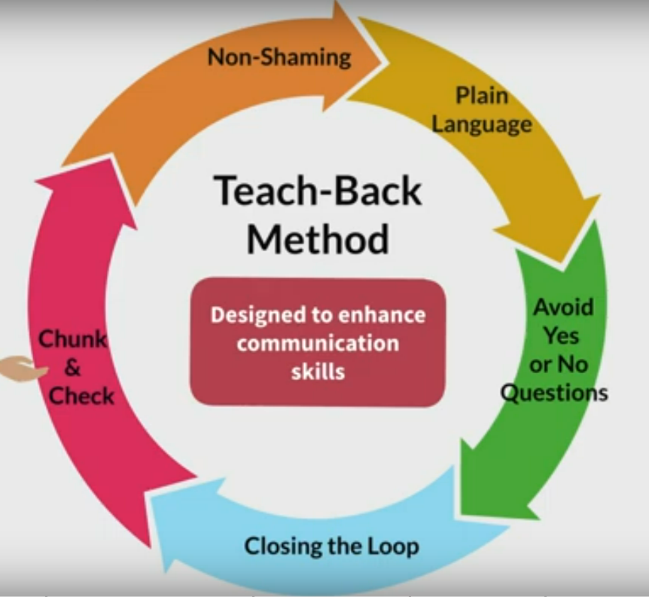
Helpful communication Techniques

Slide 14
Teach Back
Why is teach back important?
How do you think teach back affects quality measures?

Slide 15
Documentation Tips
If its not charted it didn’t happen
Make sure your documentation paints an accurate picture of what happens
Use quotation marks
Be clear and accurate
Use observations and avoid making assumptions
Be sequential

Slide 16
Documentation Examples
Patient comes into the ER with altered LOC. He is brought in by EMS and smells heavily of alcohol. He has cuts to his face and hands. Bleeding is controlled. Responds only to painful stimuli.
Nurse Charts –
Patient brought in via EMS. Is intoxicated and probably got into an altercation as evidenced by cuts to face and hands. No bleeding. Neuro assessment is likely congruent alcohol intoxication as patient is sleepy and only responds to painful stimuli.
  What RED flags do you see in this documentation?
    How would you document differently?

Slide 17
Documentation Examples
4 year old patient comes into the ER with injuries. You see bruising to legs and arms as well as abdomen. The family states she had several falls.
Nurse Documents – 4 year old female presents with parent. Several bruises noted to several areas of body. Parent is acting weird. Patient seems quiet and sad.
  What RED flags do you see in this documentation?
    How would you document differently?

Slide 18
Critical Thinking
Critical thinking in nursing involves identifying a problem, determining the best solution, and implementing an effective method to resolve the issue using clinical decision-making skills.
Helps make decisions that lead to optimal patient care
Introduced in nursing school but develops through out nursing career
Essential to provide quality and SAFE care

Slide 19
Elements of Critical Thinking
Clinical Judgement
Patient safety
Communication and collaboration
Problem solving skills

Slide 20
Clinical Judgement
Prioritization of needs and ability to adjust as changes occur
Information gathering to determine what interventions are needed
Use of critical thinking to identify and understand importance of test results and clinical presentation
  Labs
  Vitals
  Assessments
Anticipate potential complications

Slide 21
Patient Safety
Recognize abnormal and take action to prevent harm
Have a questioning attitude
Use your tools
  STAR – Stop, Think, Act, Resolve
  ARCC- Ask, request, concern, chain of command
  Validate and Verify
  CUS tool
    I am concerned that….I am uncomfortable with…….It is a safety issue….
Trust your gut!

Slide 22
Communication/Collaboration
Ask questions
Actively listen to others
Foster a collaborative environment
Interdisciplinary communication

Slide 23
Problem solving skills
Analyze the problem
Consider alternate solutions
Practice your skills
Can be applied to all situations not just patient care

Slide 24
Ways to Develop Critical thinking
Be a life long learner – gain the knowledge
  Evidence Based Practice
  Educational courses for professional development
Practice reflection
  Each day allow time to reflect on successes and areas for improvement
Open you mind to other view points
  Ask for opinions and consider view points of other nurses and interdisciplinary team members
Use critical thinking tools
Be curious – ask questions,

Slide 25

Lets Practice

