Slide 1
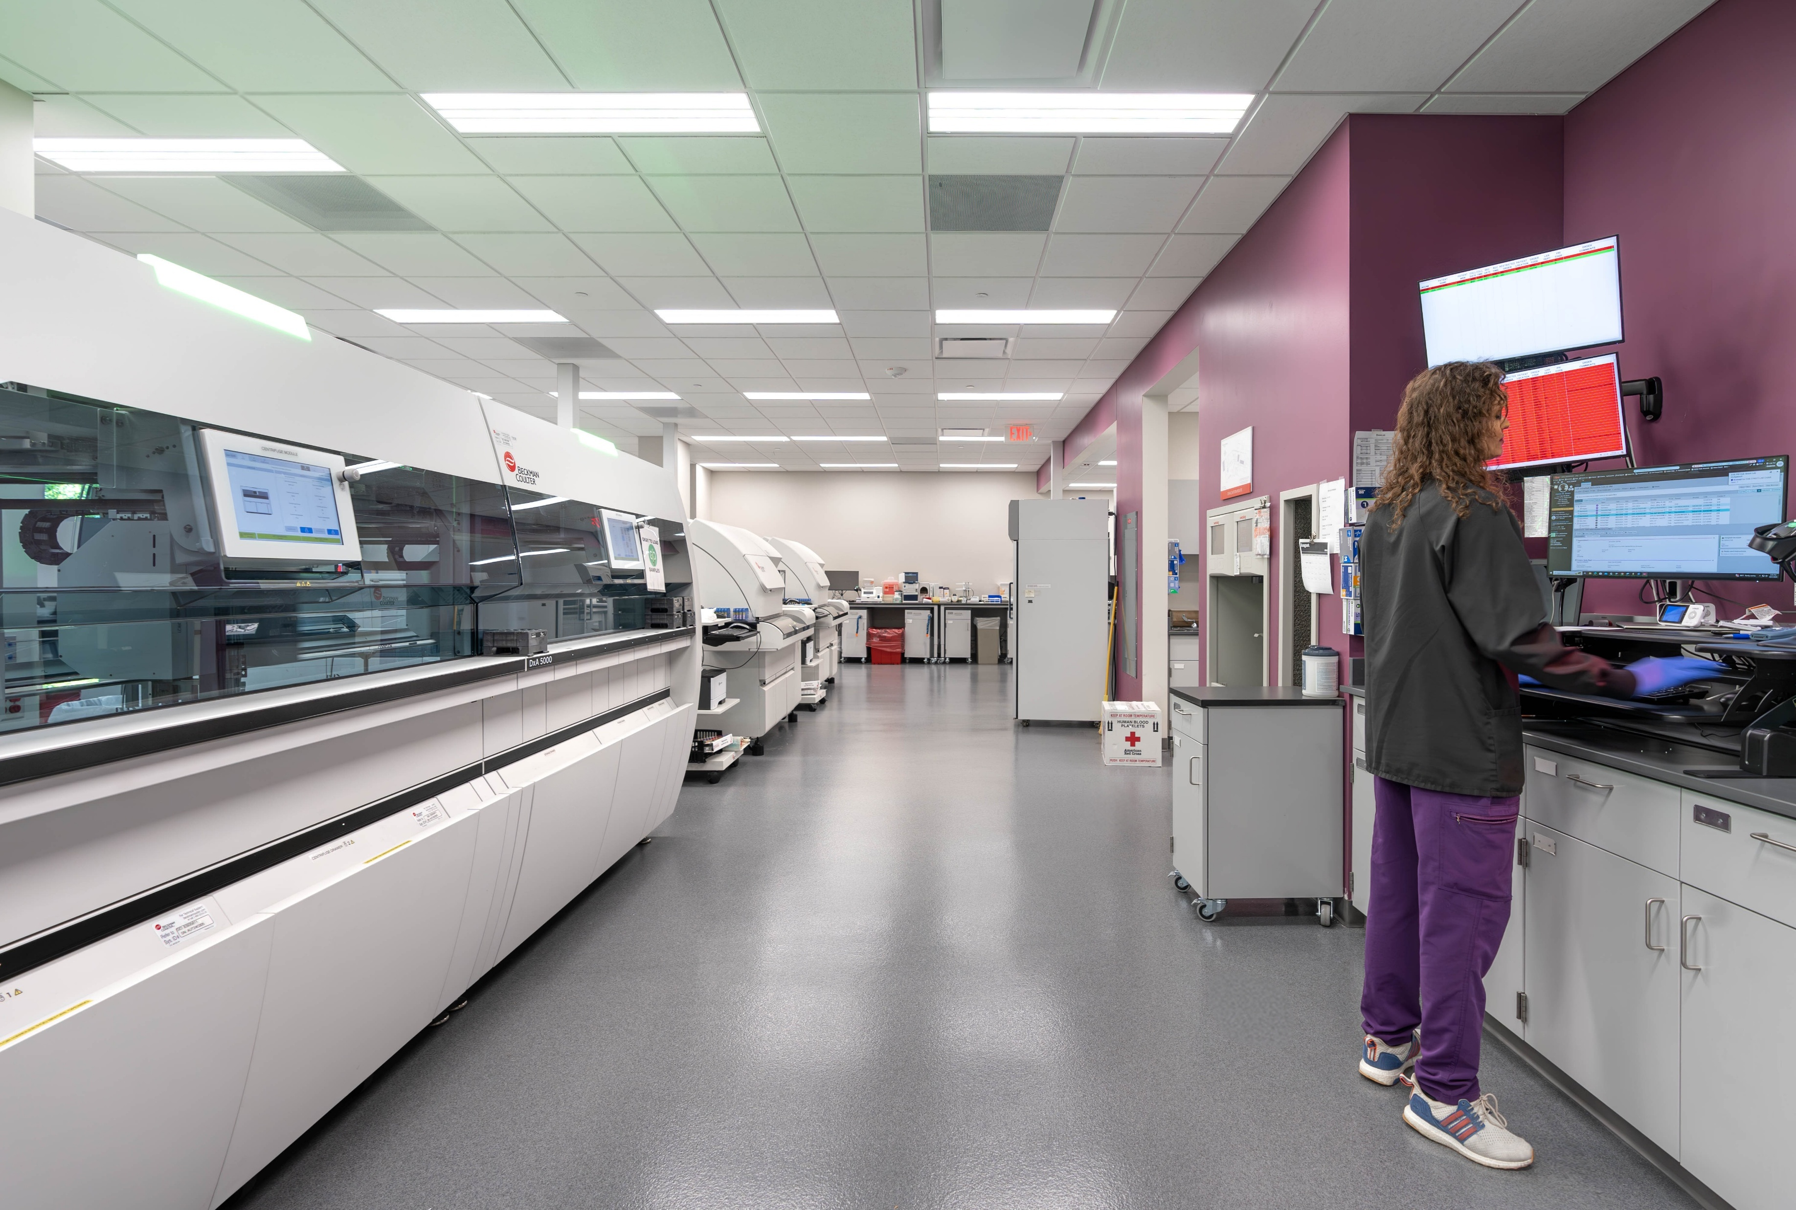



2025 NHA Convention
Panel Discussion
October 22, 2025
Notes:
30-45 min presentation, then Q&A, but can engage audience while presenting. Keep open-ended, audience engaging.
JP facilitate questions to panel.

Slide 2
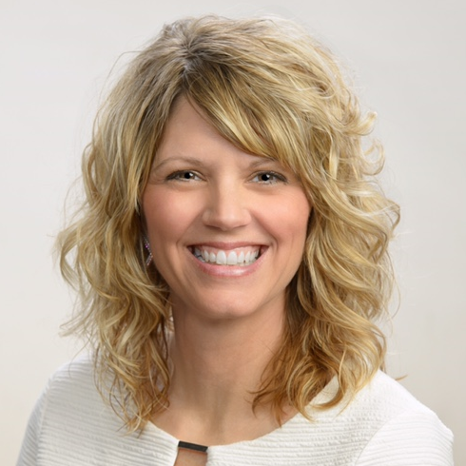
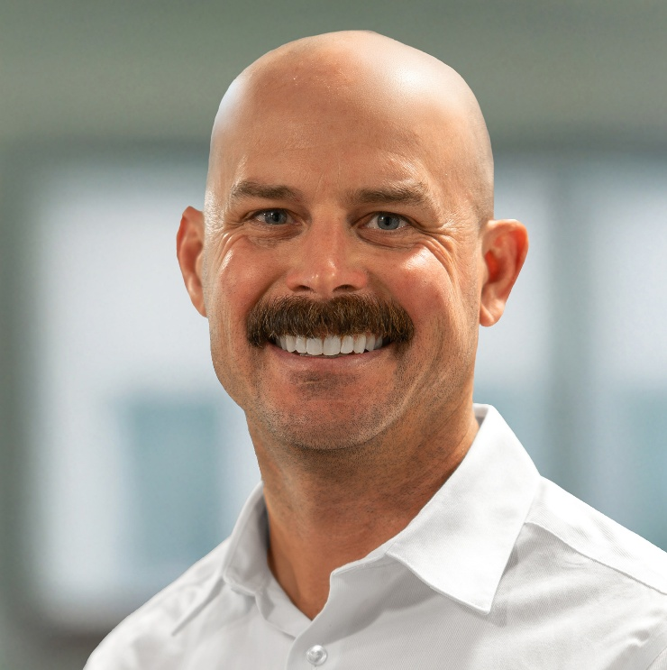
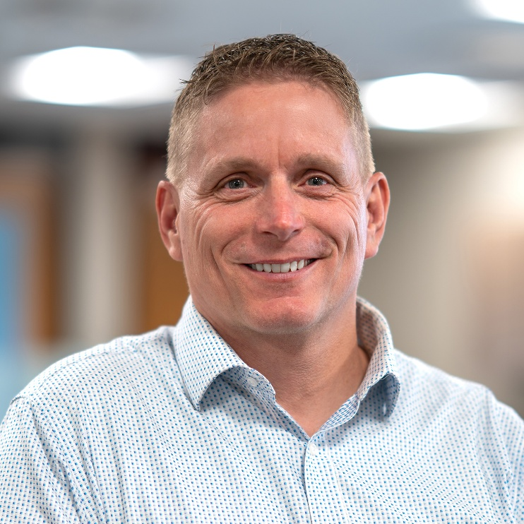
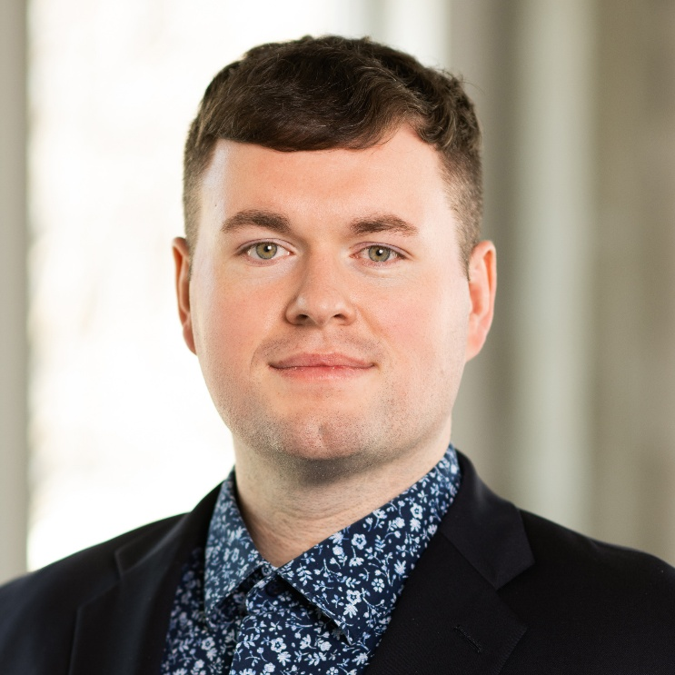
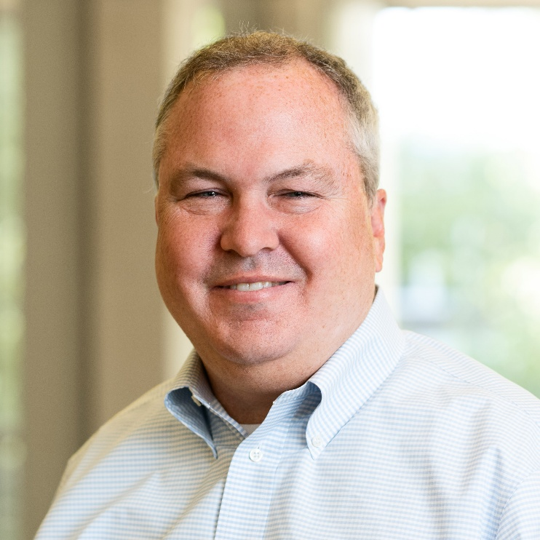
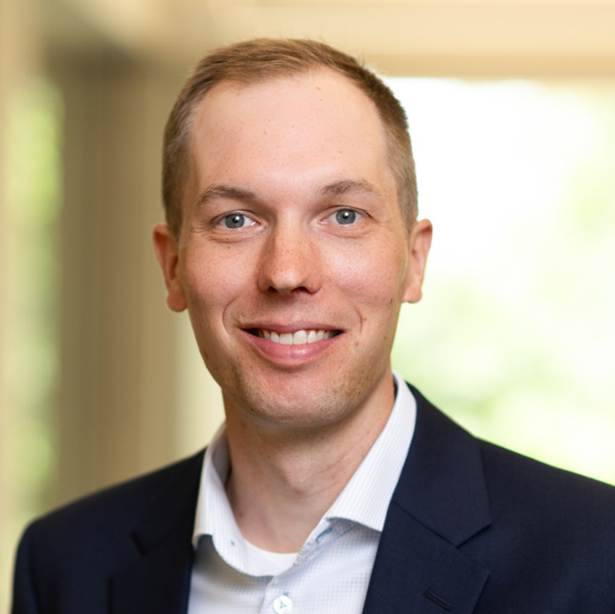
INTRODUCTIONS
DANELLE FRANZEN
Chief Operating Officer
Great Plains Health
STUART JOHNSON
Vice President
Sampson Construction
JP LAUTERBACH
Business Development
Sampson Construction
WILLIAM POKOJSKI
Architect
Clark & Enersen
T.J. SCHIRMER
Electrical Engineer
Clark & Enersen
PETE UHING
Mechanical Engineer
Clark & Enersen

Slide 3

INTRODUCTIONS
Longevity: 50 years (1975)
Size: 1,300 employees
  Multiple clinics and locations
  Main campus and 23 clinics
Services:
  Primary Care Specialist
  Family Medicine
  Internal Medicine
  Pediatricians
  Urgent Care
  23 Specialist Services including: Cardiovascular, Orthopedic, and Cancer Care
Notes:
GPH info.

Slide 4

INTRODUCTIONS
Longevity: 73 years (1952)
Size: 330 people \ 6 offices
Services:
  Construction Manager at Risk (CMAR)
  Design-Bid-Build (General Contractor)
  Design-Build
Notes:
Sampson info.

Slide 5

INTRODUCTIONS
Longevity: 79 years (1946)
Size: 200 people \ 7 offices
Services: Full-service
  Architecture
  Engineering
  Laboratory Planning
  Master Planning
  Interior Design
  Landscape Architecture
  Energy Modeling
  Digital Experience Design
  Data Analytics
  Commissioning

Slide 6
HISTORY OF RELATIONSHIP
Notes:
History of Great Plains/Sampson/C&E relationship

Slide 7
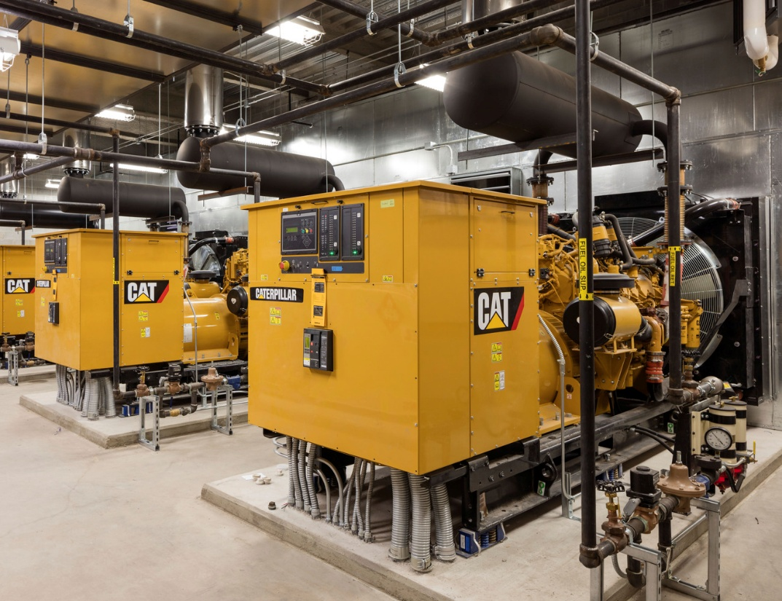
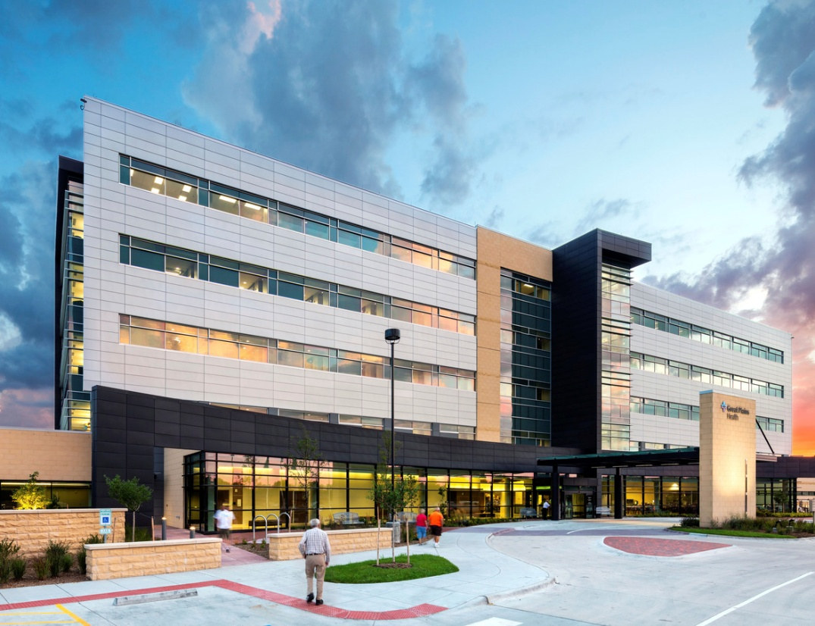
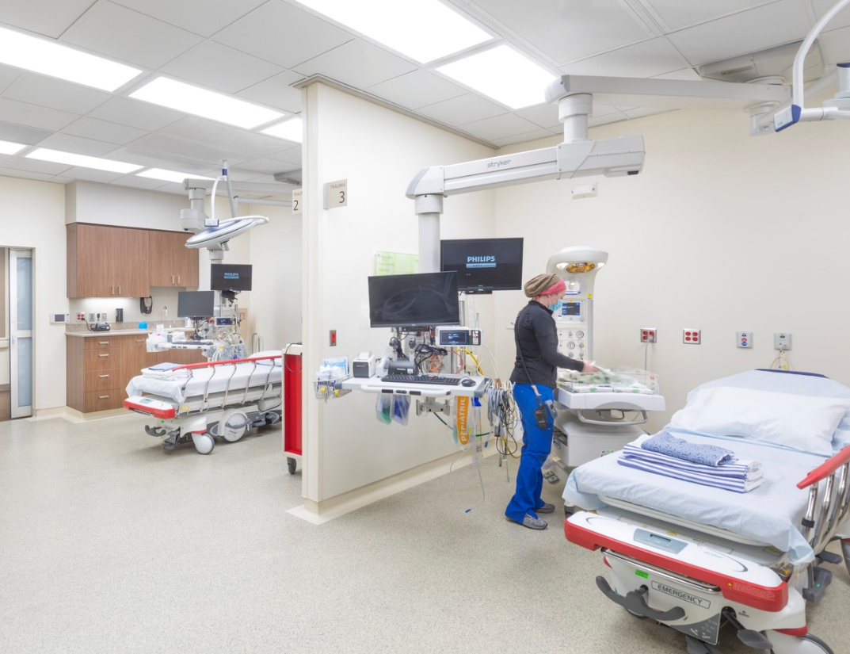
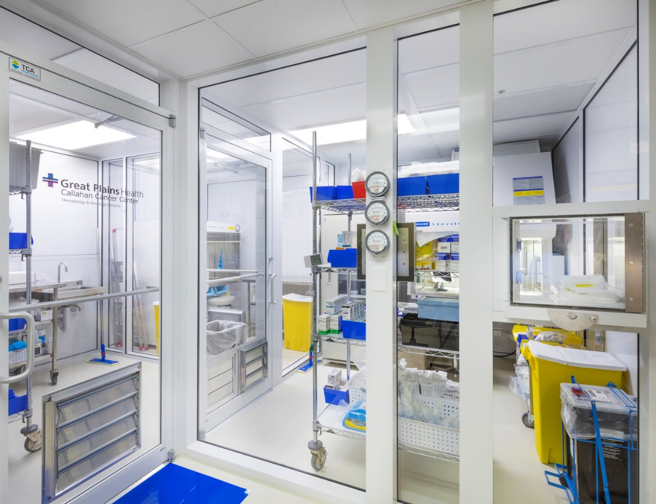
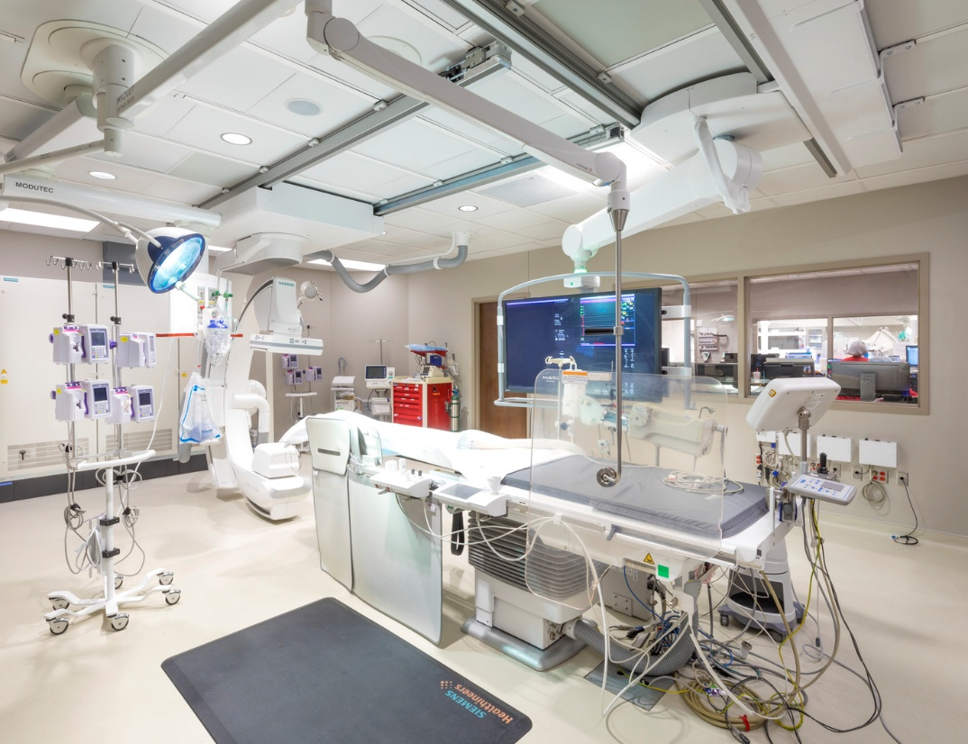
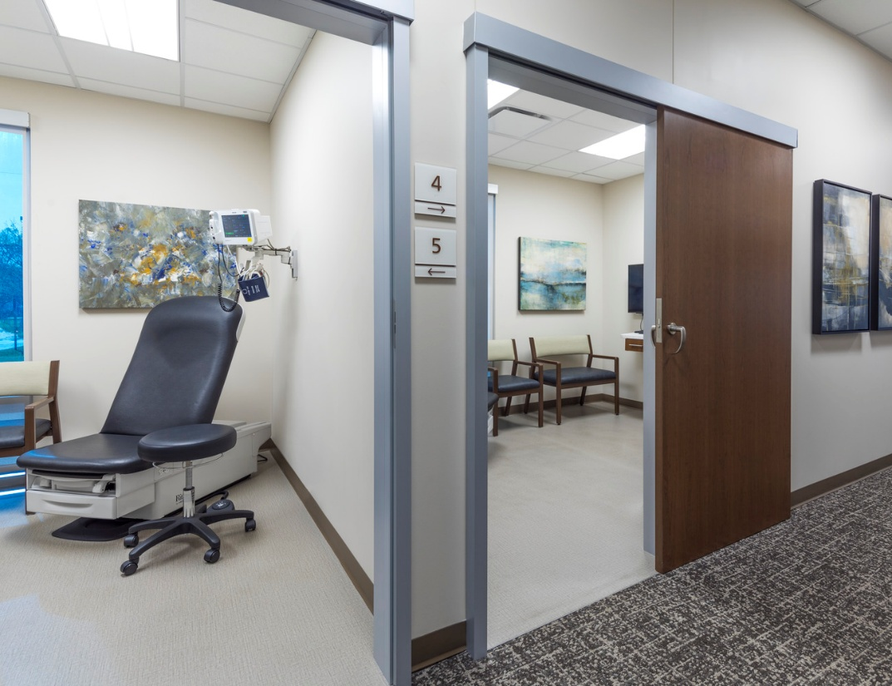
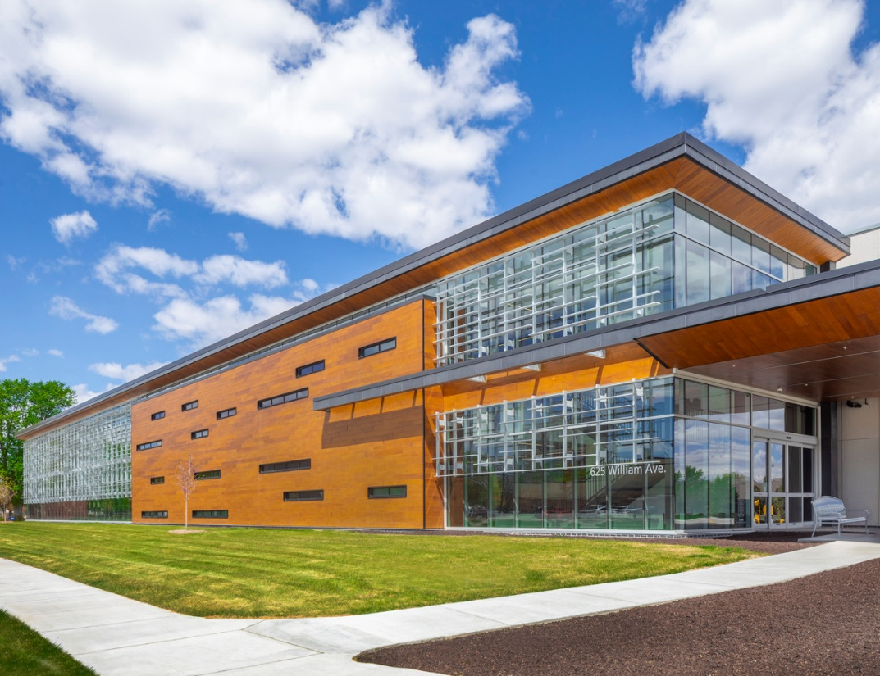
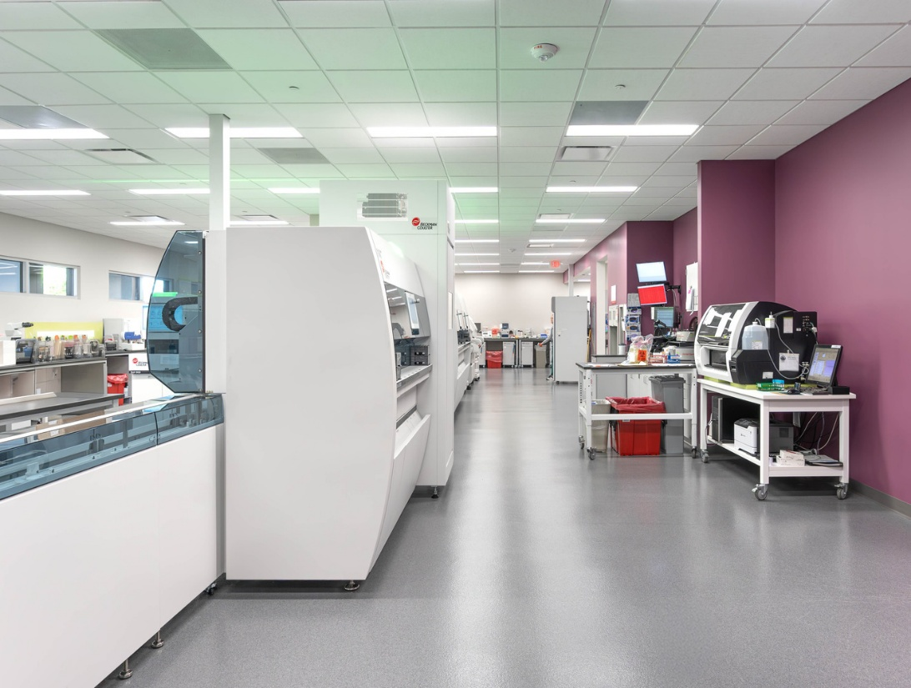
HISTORY OF RELATIONSHIP: 30 Years of Partnership
Hospital Utility Plant Upgrade
New Patient Tower, Utility, IT
Emergency Dept. Renovation
Cancer Center Clean Room
Catheterization Laboratory
Brain & Spine Clinic
Oak Street Medical Building
Laboratory Remodel
Notes:
1996 to present. (practically 30 years, especially if we’re working on projects that we know are running into future years after 2025, then we can easily say 30 years.)

Slide 8
WHY THE PROJECT WAS NEEDED

Slide 9
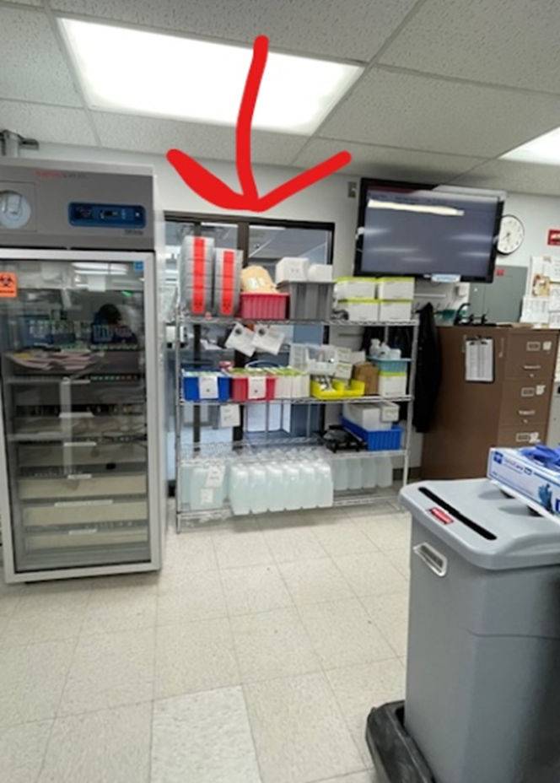
WHY THE PROJECT WAS NEEDED
Lab Remodel was necessary to meet our strategic objectives
  Ensure Access to Quality Care
    Increased access for Wound Care and Diagnostic Imaging at the east entrance
    Increased inhouse testing for the laboratory
    Adequate airflow for instrumentation and addition of instrumentation
    Decreased turnaround time for lab results for our patients.
Notes:
CAP survey last 6 years, deficiency stated for space issues
Heating and ventilation have been issues in the lab as increased instrumentation for increased testing.

Slide 10
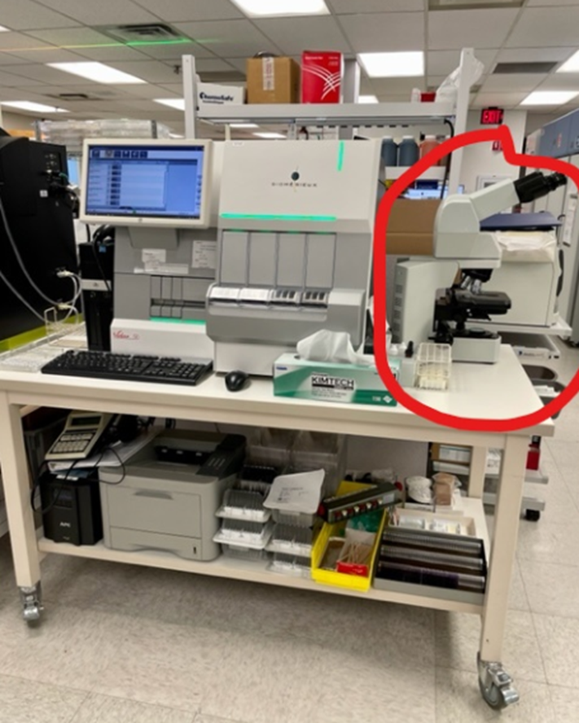
WHY THE PROJECT WAS NEEDED
Lab Remodel was necessary to meet our strategic objectives
  Grow Services to Meet our regions needs
    Become our regions premier outreach laboratory with an extensive testing menu
    With additional space GPH brought in
    30 additional inhouse testing.
Notes:
At the time of budget
Estimated shortage of 8,000 laboratorians per year
Lab workloads growing at a 66% increase in healthcare consumption per capita since 2000

Slide 11
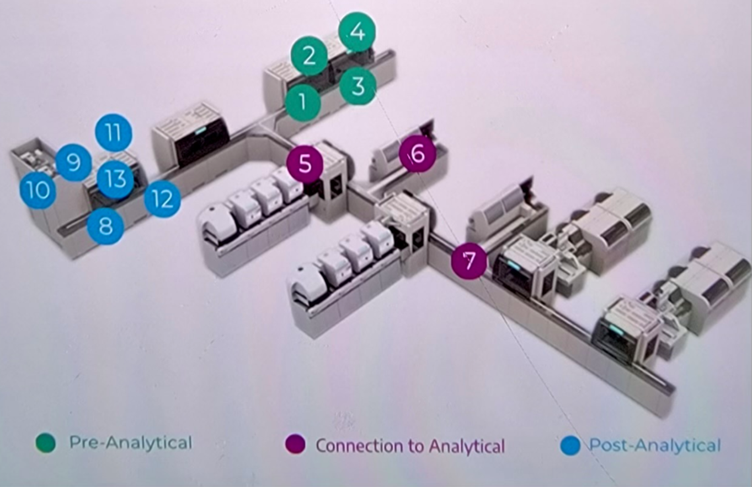
WHY THE PROJECT WAS NEEDED
Lab Remodel was necessary to meet our strategic objectives
  Deploy Innovation to Improve Organizational Outcomes
    Reduction of at least 2 entry level FTE's by using an automation line for specimen processing
Notes:
At the time of budget
Estimated shortage of 8,000 laboratorians per year
Lab workloads growing at a 66% increase in healthcare consumption per capita since 2000

Slide 12
Construction Manager at Risk
Notes:
CmaR vs Hard Bid (C&E) - Brief description of both. Compare/contrast.

Slide 13
CMAR: Basic Understanding
Definition
  CMAR is a project delivery method where the owner hires a construction manager (CM) early in the design phase to provide input and then manage the construction, guaranteeing the project will not exceed a Guaranteed Maximum Price (GMP).
Notes:
CmaR - Brief description. How if differs from other delivery methods.

Slide 14
CMAR: Basic Understanding
Comparison
Feature | CMAR | Design-Bid-Build
Contractor Involvement | The CM is hired early, during the design phase. | The contractor is hired after the design is 100% complete.
Project Process | Collaborative and often overlapping (phased construction). | Linear and sequential. Design, then bid, then build.
Risk | The CM takes on the risk of cost overruns with the Guaranteed Maximum Price (GMP). | The owner typically bears the risk of cost overruns caused by design errors or unforeseen conditions.
Cost | Cost is determined collaboratively with a GMP based on the design. | Cost is determined by the lowest competitive bid, which can be subject to change orders later on.
Notes:
CmaR - Brief description. How if differs from other delivery methods.

Slide 15

CMAR: Basic Understanding
Advantages
  Early Collaboration and Expertise
  Cost Certainty with GMP
  Accelerated Schedule
  Reduced Disputes and Change Orders
Notes:
CmaR - Brief description. How if differs from other delivery methods.

Slide 16
PHASING OPPORTUNITIES
Notes:
(Pete) Phasing opportunities and diagrams with examples - How did phasing affect the other departments/operations.

Slide 17
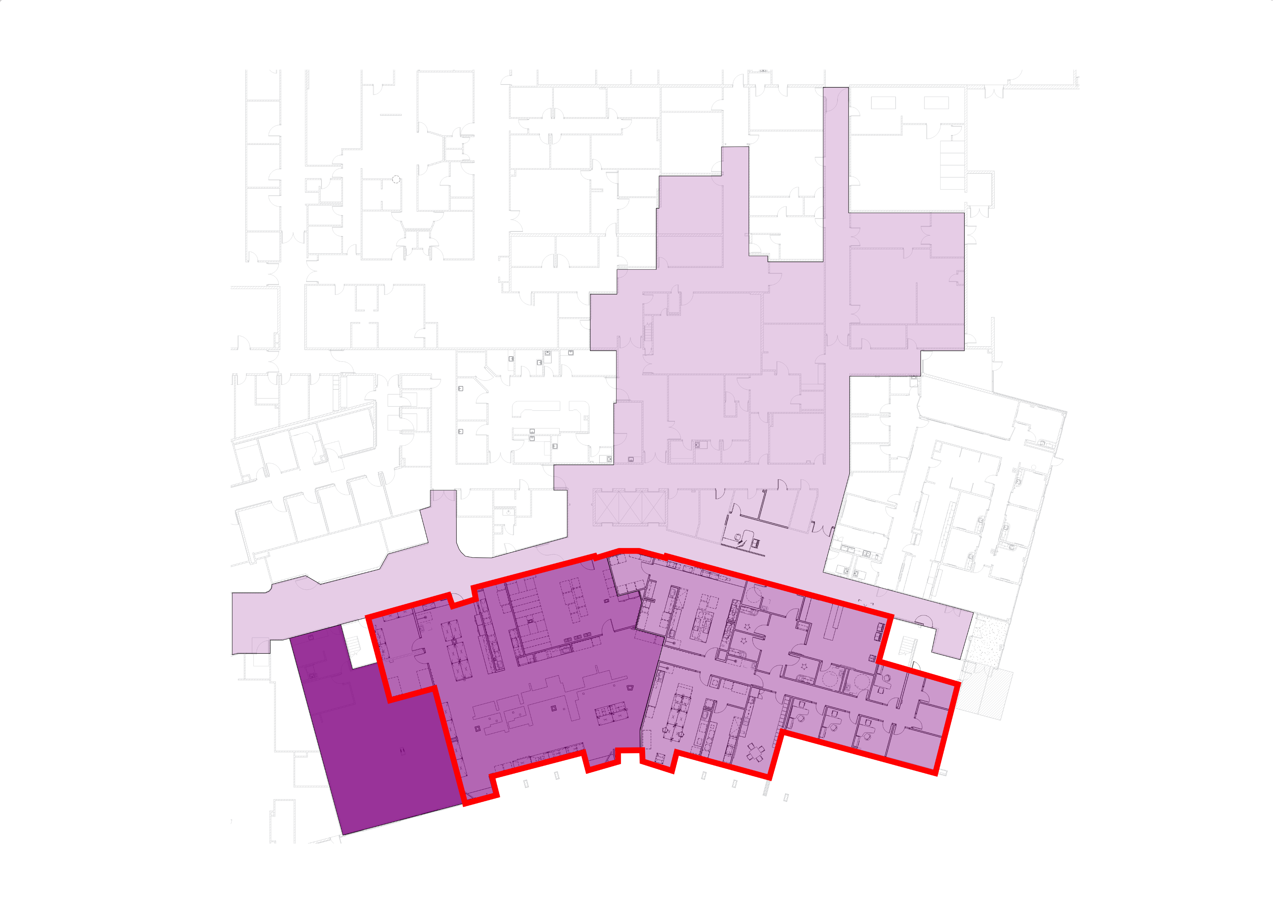
PHASING OPPORTUNITIES
P1A
P2
P1B
P3
LAB BOUNDARY
Notes:
(Pete) Phasing opportunities and diagrams with examples - How did phasing affect the other departments/operations.
P1B – underutilized space (abandoned offices)
P1A – upgraded ceilings to accommodate new mechanical systems

Slide 18
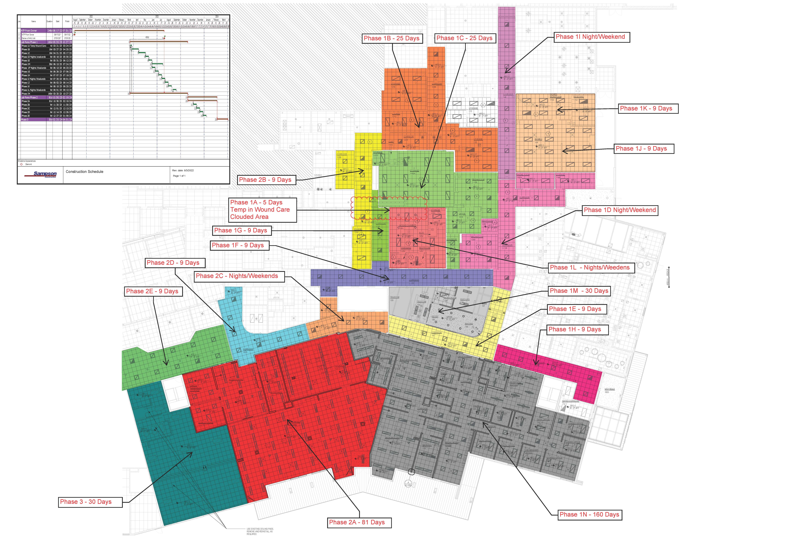




PHASING OPPORTUNITIES
P1A
P2
P1B
LAB BOUNDARY
P3
Notes:
(Pete) Phasing opportunities and diagrams with examples - How did phasing affect the other departments/operations.

Slide 19
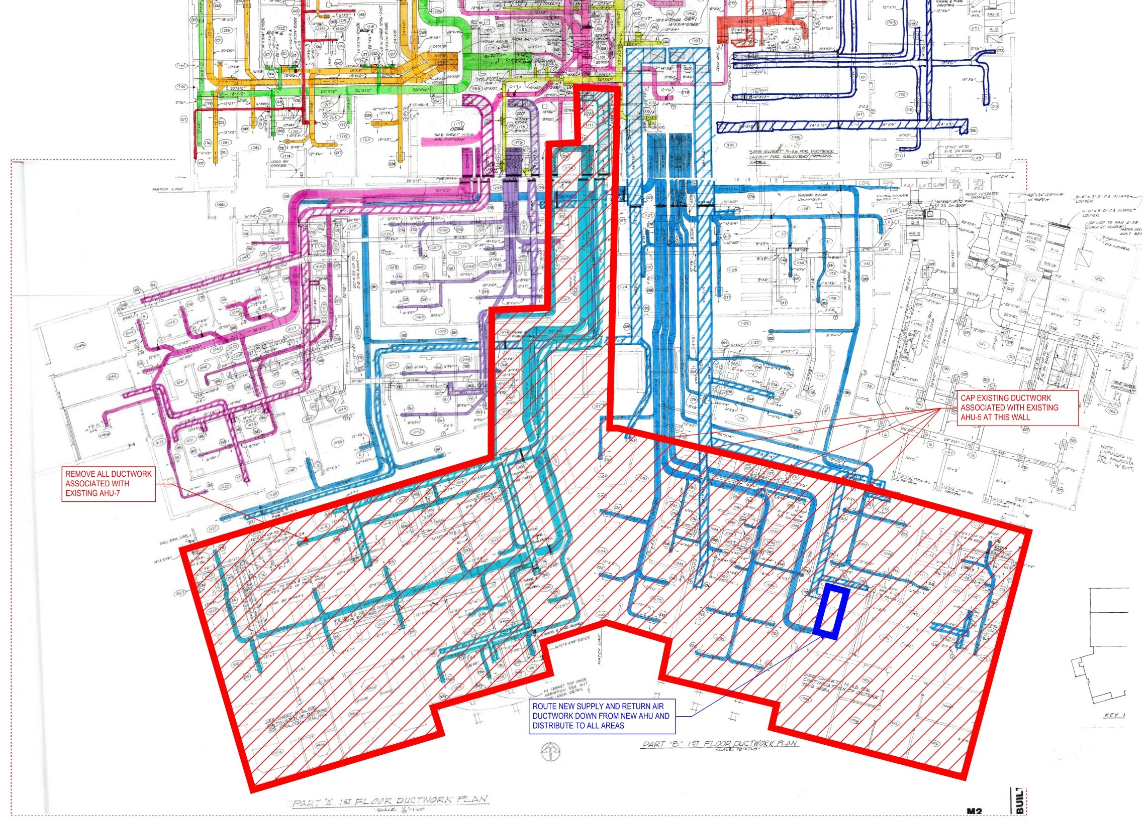
PHASING OPPORTUNITIES
Notes:
(Pete) Phasing opportunities and diagrams with examples - How did phasing affect the other departments/operations.

Slide 20
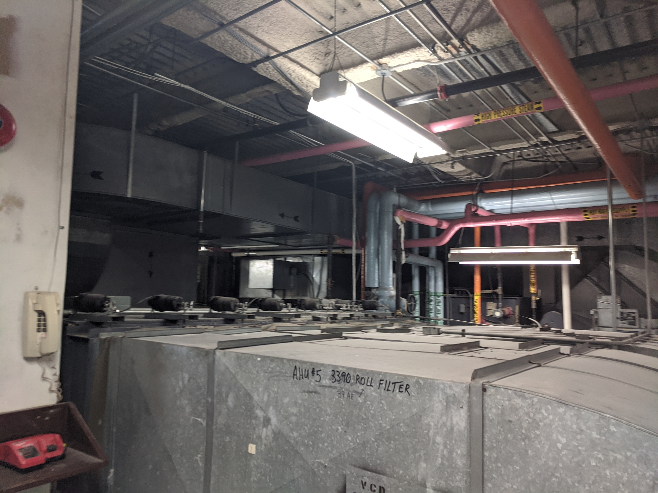
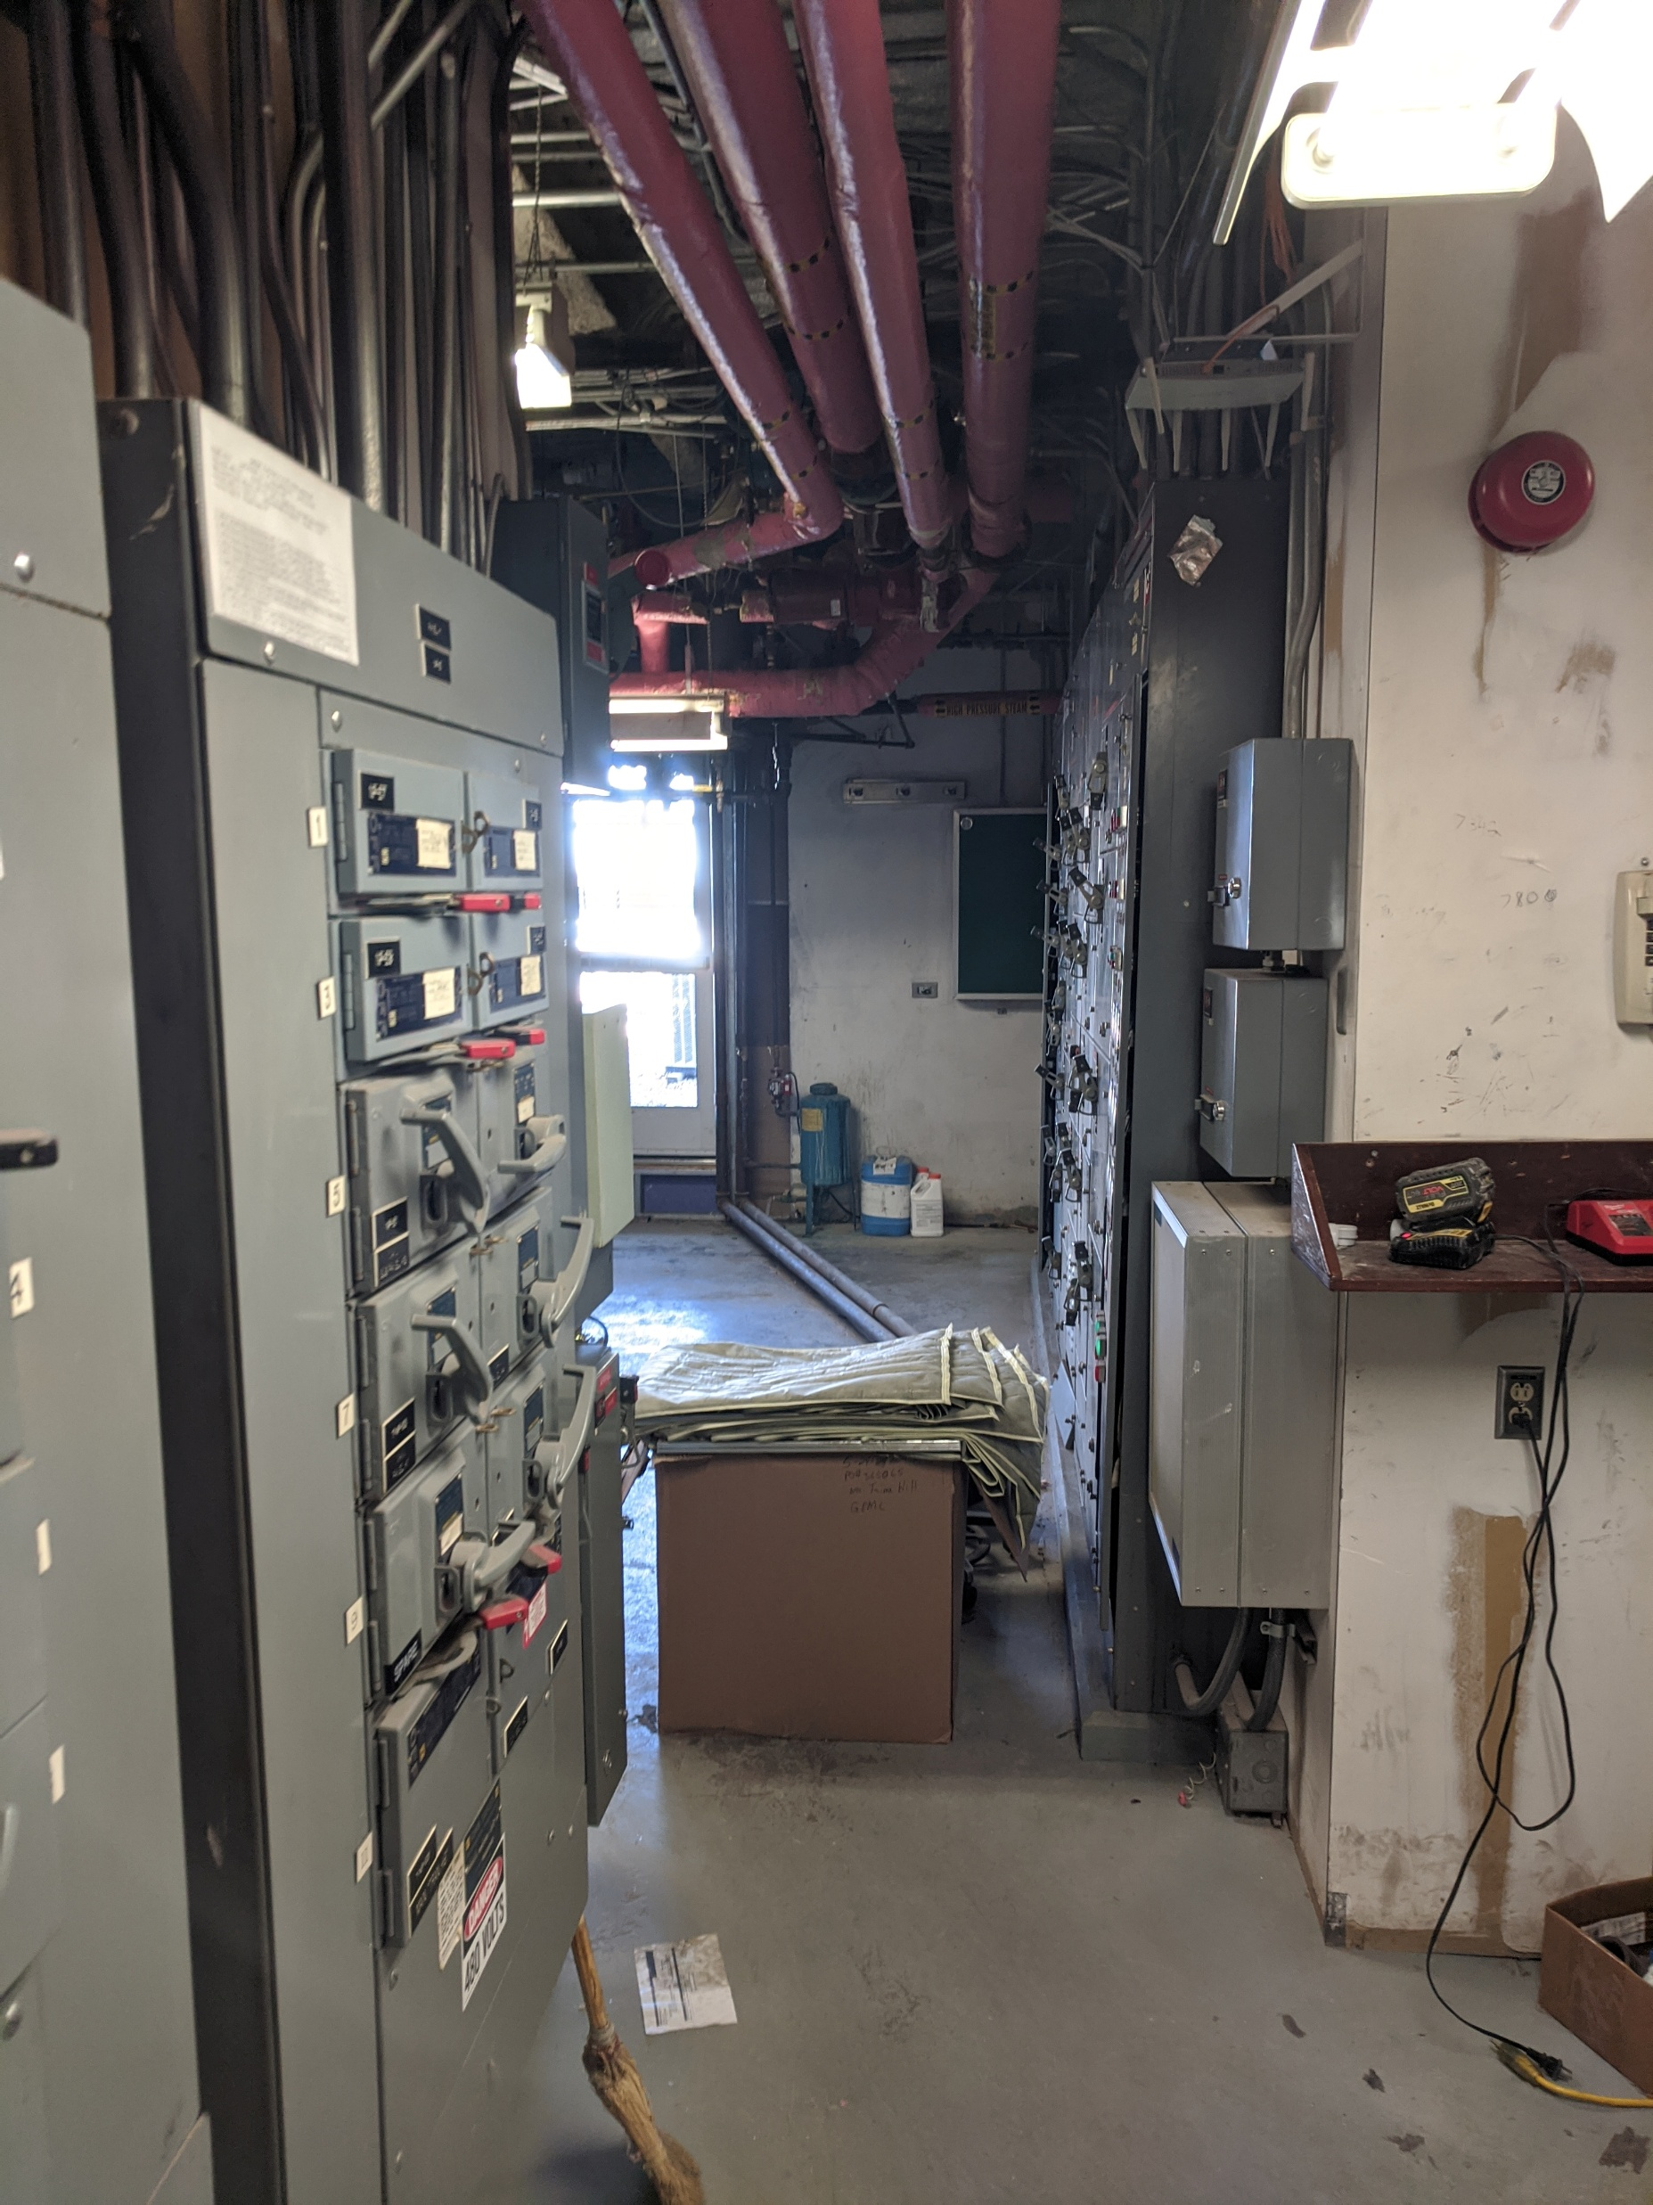
PHASING OPPORTUNITIES
Notes:
(Pete) Phasing opportunities and diagrams with examples - How did phasing affect the other departments/operations.

Slide 21
BUDGETING PROCESS
Notes:
(Stuart) Budgeting Process
- Conceptual plans lead to estimates leads to budgets
- (Dani) “Soft Costs” need to be reflected in the budget. Sometimes forgotten
- (Dani) how is the project funded — what are ways to get things paid for (Medicaid vs grants vs fundraising)
- Once the budget is approved, it is important to MEET the budget!

Slide 22
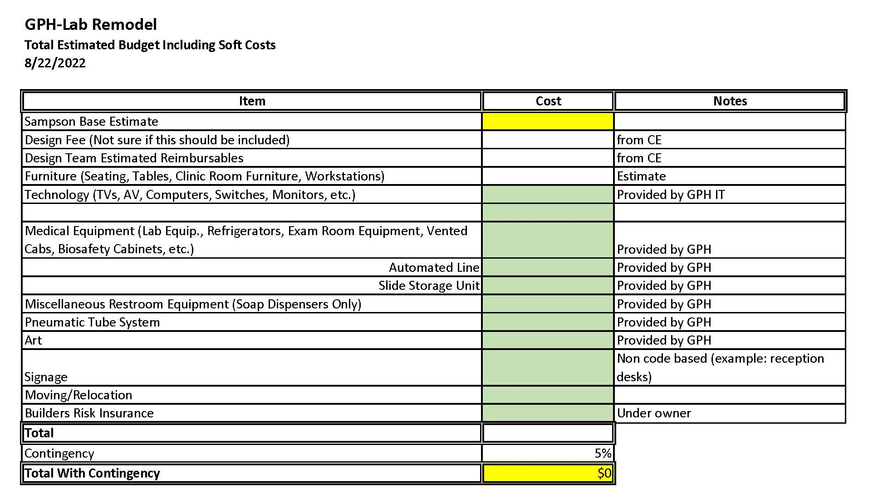
BUDGETING PROCESS: Lab Remodel
Notes:
Project funding- Fundraising- currently working on a Cancer Center Remodel.

Slide 23
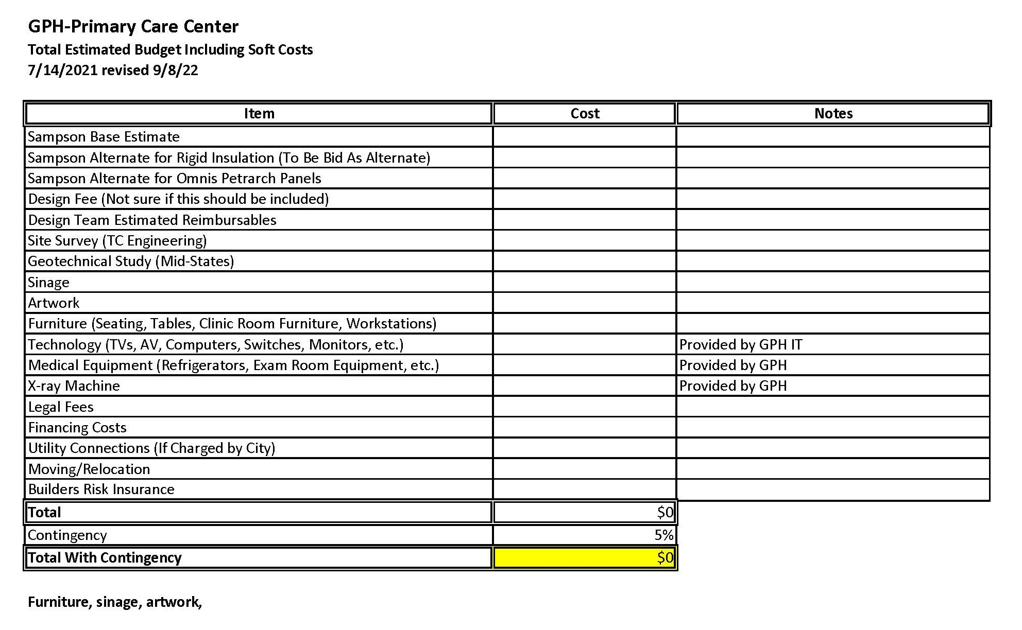
BUDGETING PROCESS: Primary Care Center
Notes:
Project funding- Fundraising- currently working on a Cancer Center Remodel.

Slide 24
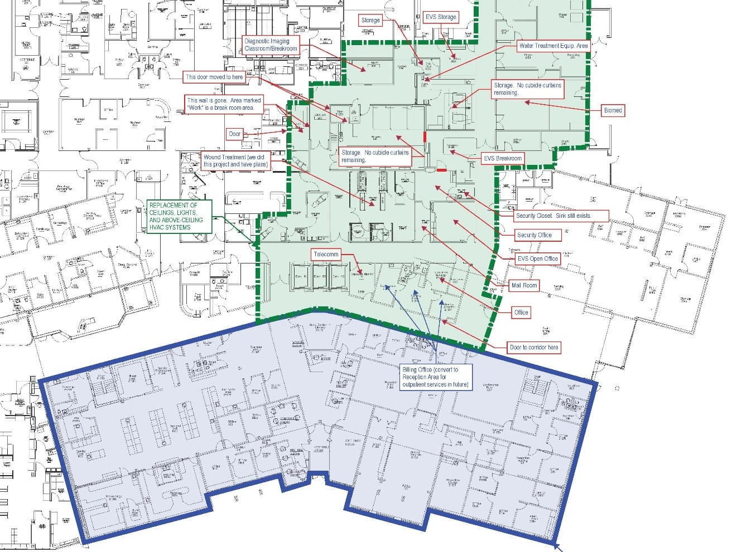
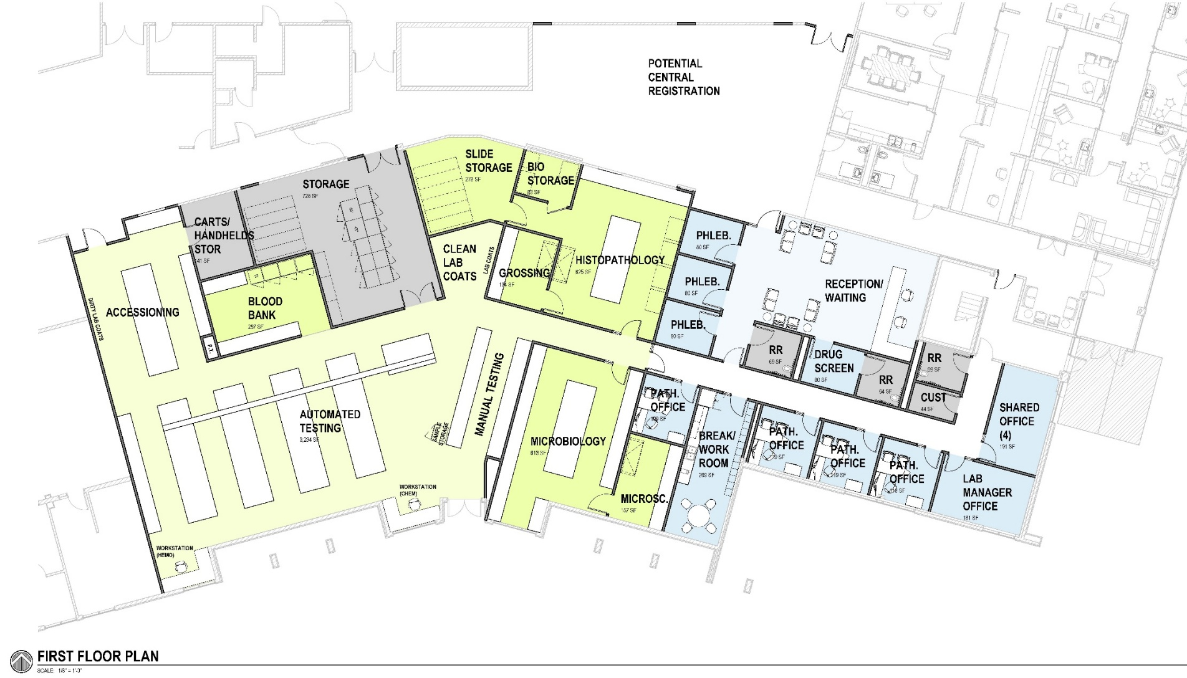
BUDGETING PROCESS
Conceptual drawings submitted to Sampson
Sampson developed budget information
GPH New Service Implementation (NSI) Team
GPH Soft Costs – Early Team Engagement
  Information Technology (IT): Provide blueprints to your IT team to address connectivity, equipment, and infrastructure needs.
  Department Managers: Involve each department manager to review operational and workflow considerations.
  Furniture Vendors: Share blueprints with your designated furniture vendors and department managers to align on space planning and design.
  Environmental Services (EVS) & Biomed:
  Include these teams early to account for equipment, utilities, and smaller items such as trash receptacles.
  Marketing: Engage the marketing team to plan for signage, branding, and communication materials.
Notes:
Establishing the budget before…engaging whole team early. Concept drawing and narrative before budget was established. Sampson estimate budget, Dani add GPH cost, then we have a budget to meet. (TJ) Images from budgeting
GPH Soft Costs- Engage your teams early as budget. GPH establishes a dedicated New Service Implementation (NSI) Team for each construction project.

Slide 25
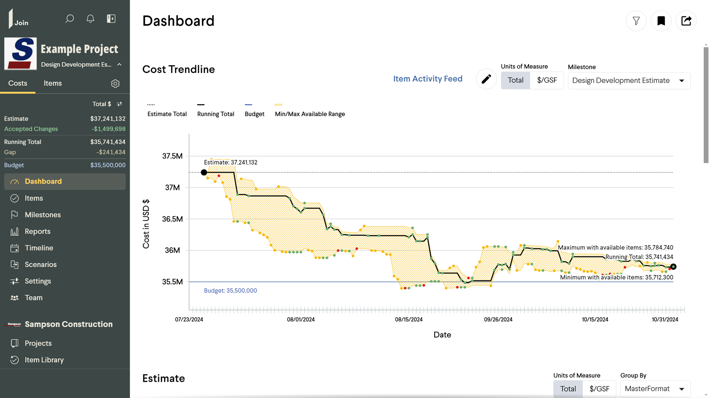
BUDGETING PROCESS: Meeting Budget
Notes:
(Stuart) Once the budget is approved, it is important to MEET the budget!

Slide 26
CONSTRUCTION
Notes:
(Stuart) Construction
- Stories
- Challenges
- Memorable moments
- Example: Existing drawings were from 1970 and not to scale. A wall was not in place. Had to be dealt with
These moments are where the relationship matters MOST

Slide 27
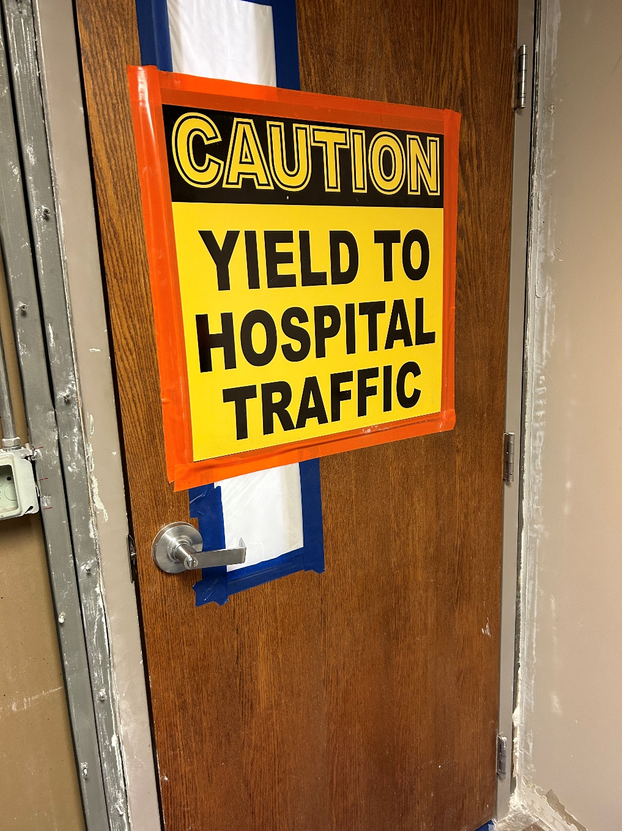
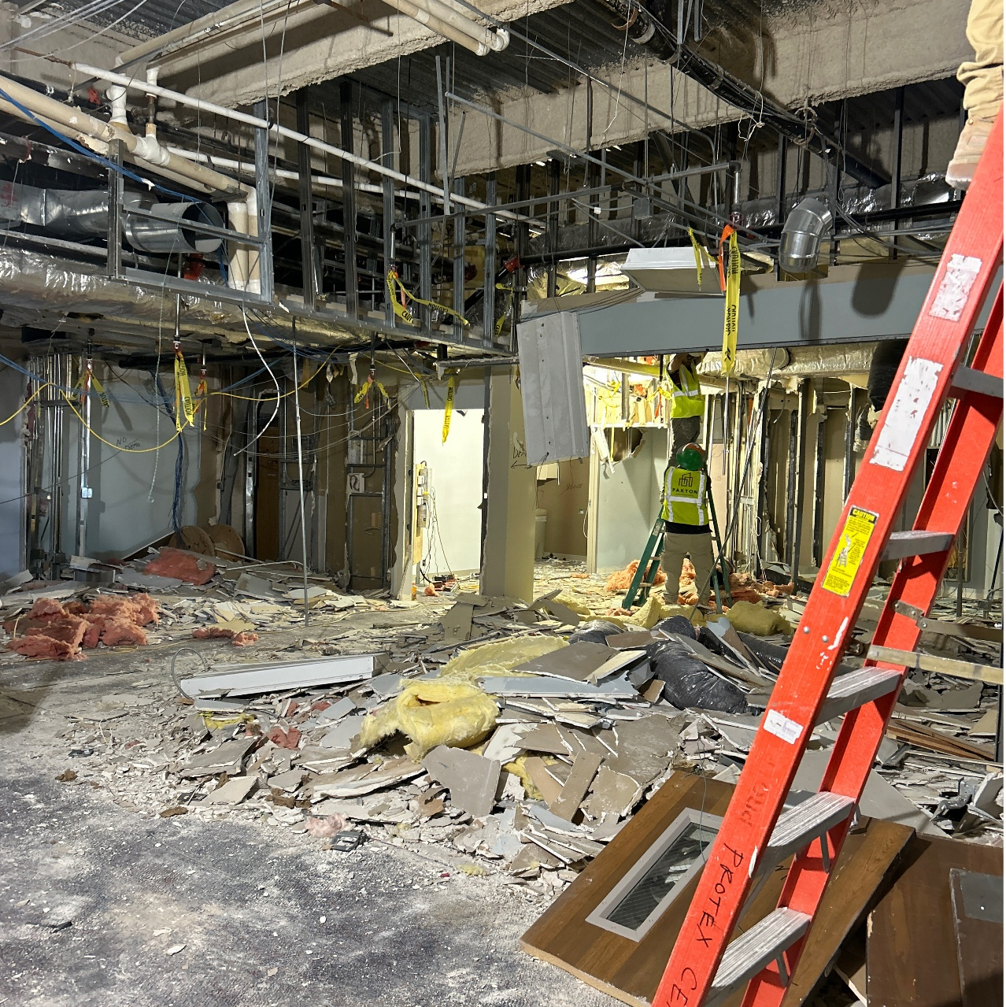
CONSTRUCTION: Timeline
AUG 2021 – Began Tracking Project
OCT 2021 – Conceptual Design Complete
NOV 2021 – Budget Established
JUN 2022 – Early Demo Package
AUG 2022 – GMP Set
MAY 2023 – Construction Start
JUN 2024 – Construction Complete
Notes:
(Stuart) Construction
- Stories
- Challenges
- Memorable moments
DHHS at Primary Care Building- VERY IMPORTANT TO ALLOW FULL 30 DAYS- tell Internal Med story
Glass at Primary Care Building- submitting change order and glass availability
Trashcans at Rehab- EVS not engaged early and assumptions on responsibility we made.
IV Clean room in Pharmacy
- Example: Existing drawings were from 1970 and not to scale. A wall was not in place. Had to be dealt with
Laboratory space, heating and ventilation with staff and instrumentation
Wound care phasing- sewer/drain pipe with crack, had to replace and phasing in another department.
These moments are where the relationship matters MOST

Slide 28
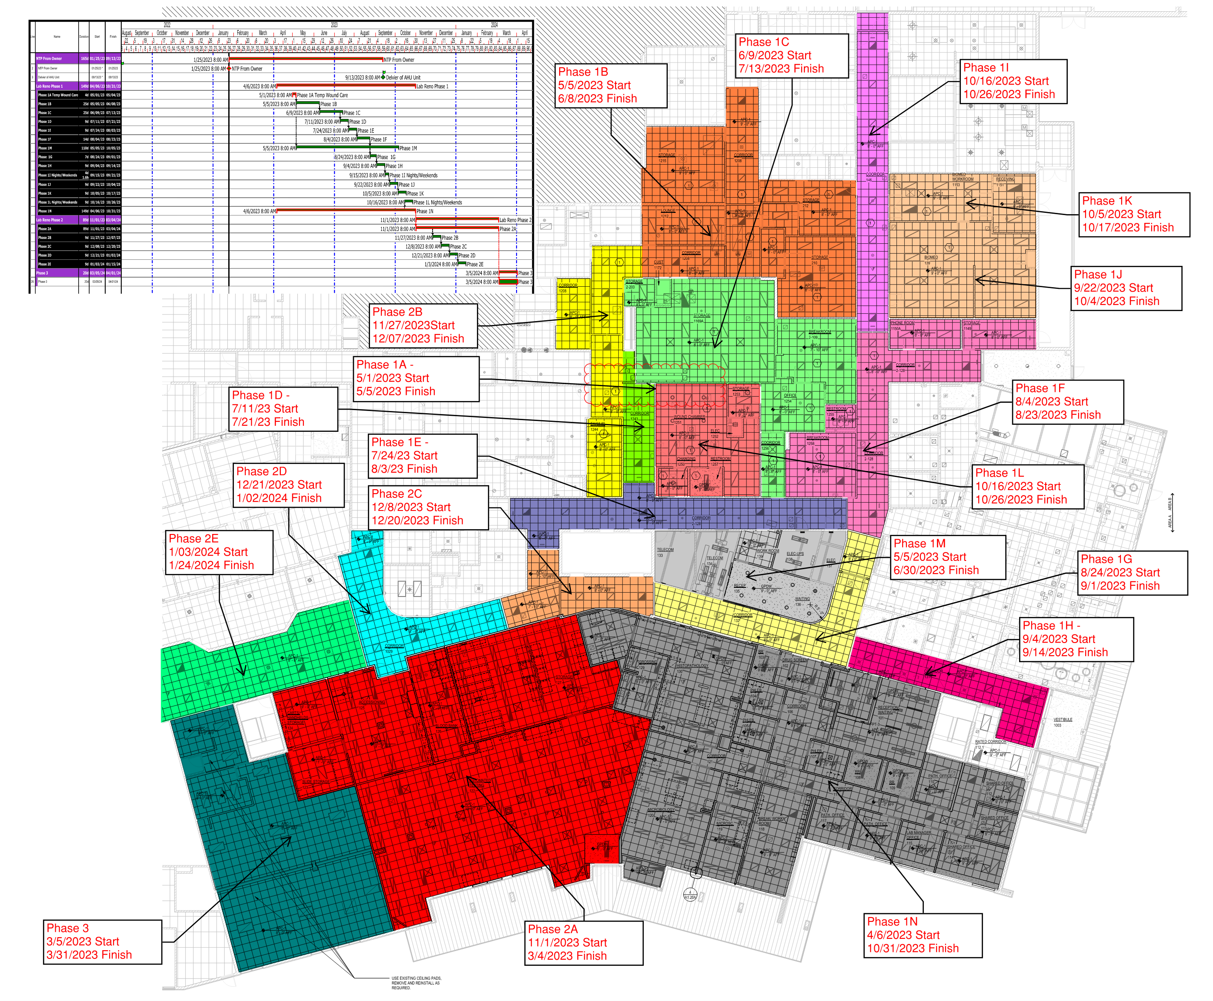
CONSTRUCTION: Phasing

Slide 29
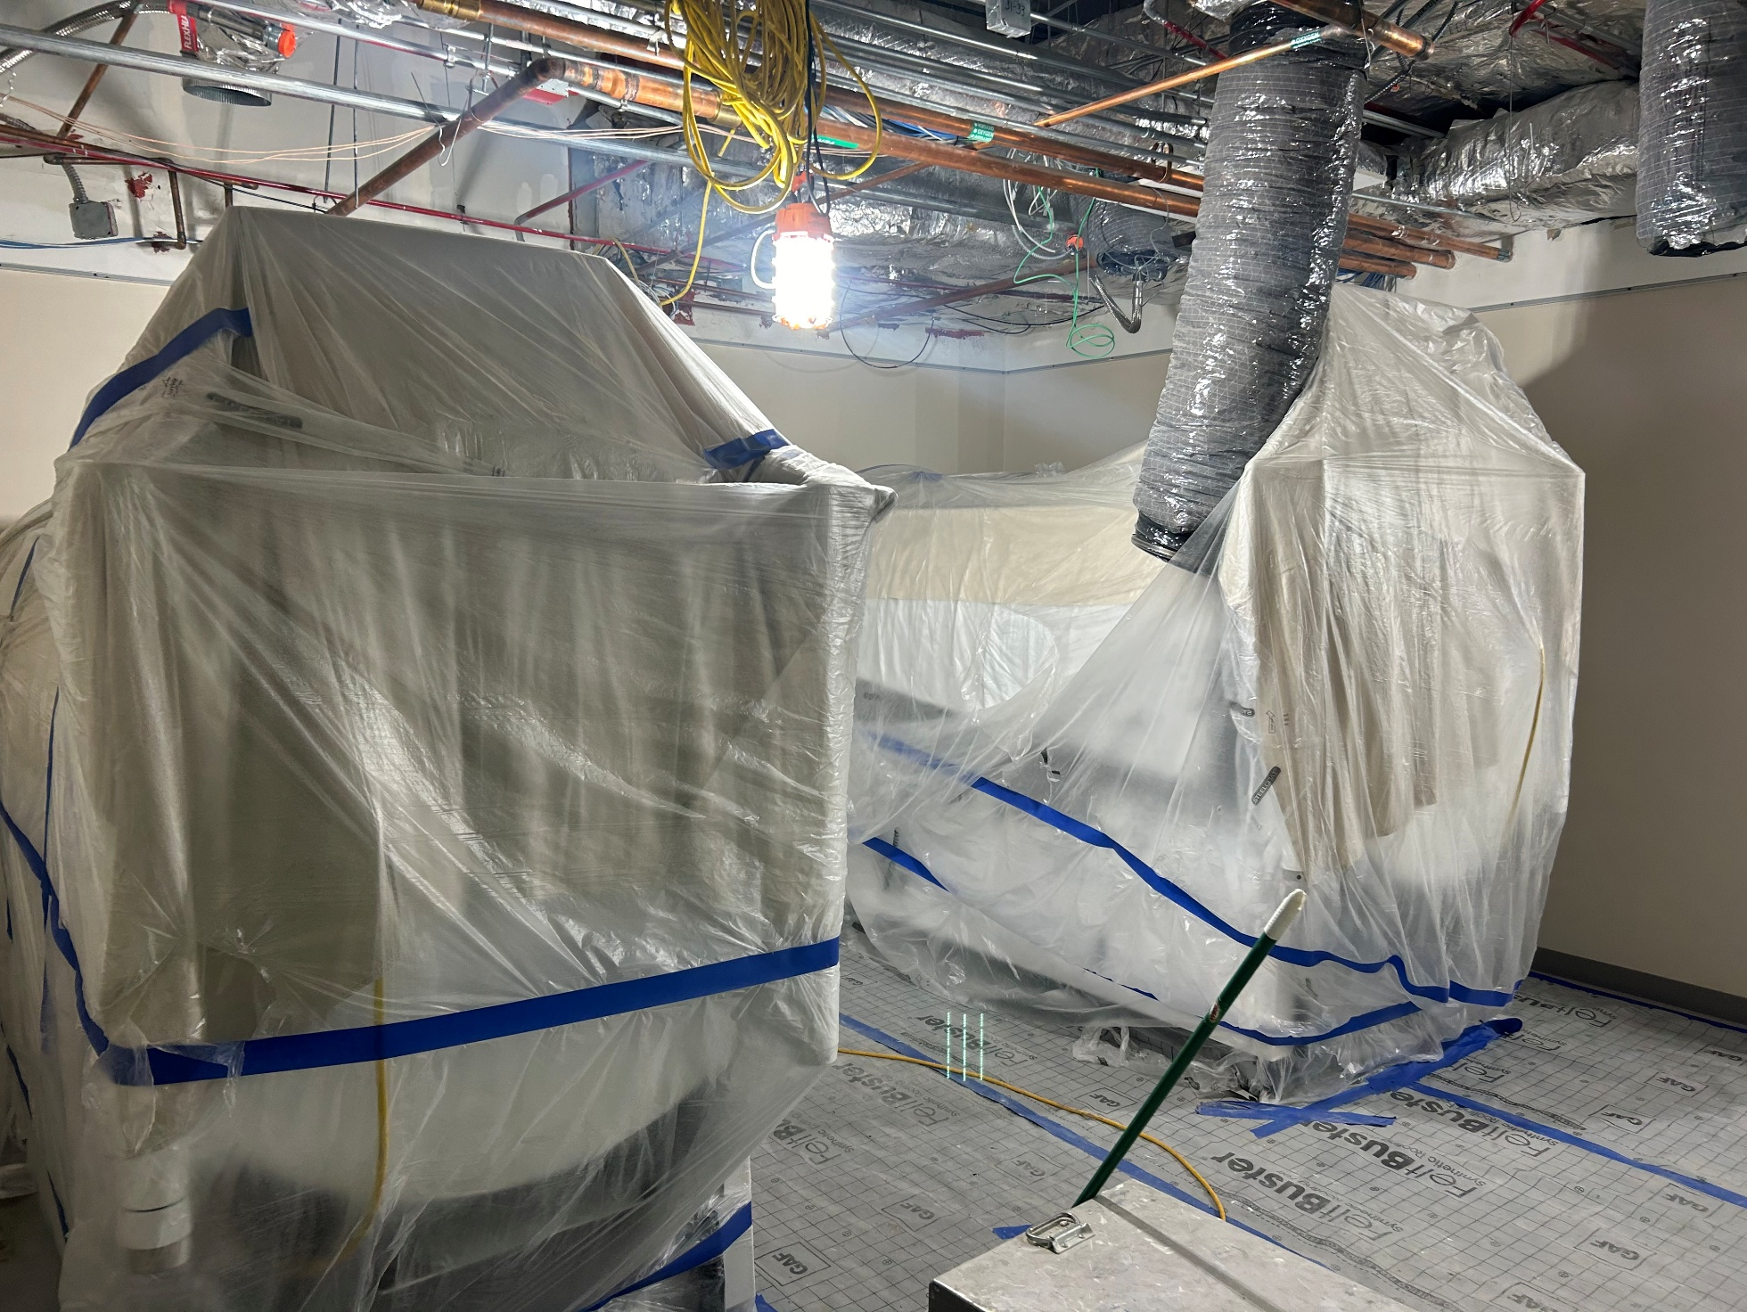
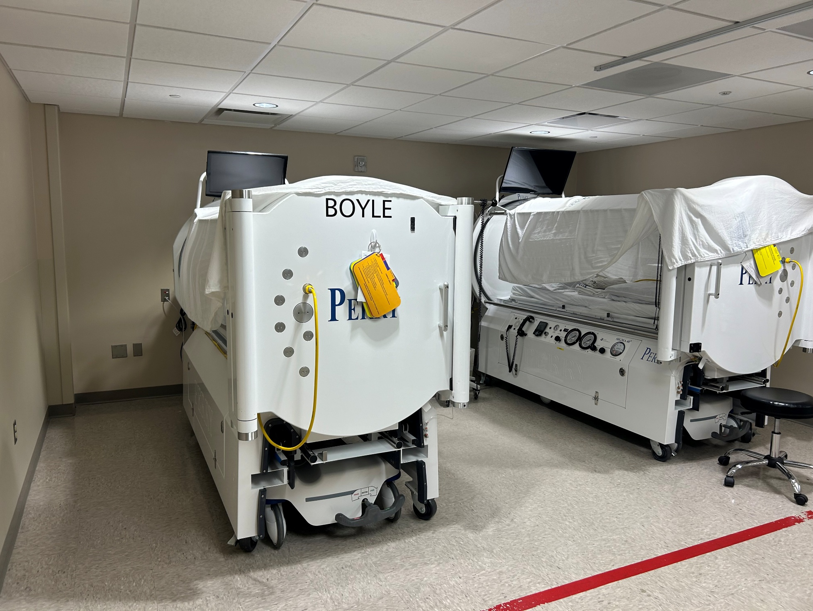
CONSTRUCTION: Wound Chamber
Notes:
(Stuart) Construction
- Stories
- Challenges
- Memorable moments
- Example: Existing drawings were from 1970 and not to scale. A wall was not in place. Had to be dealt with
These moments are where the relationship matters MOST

Slide 30

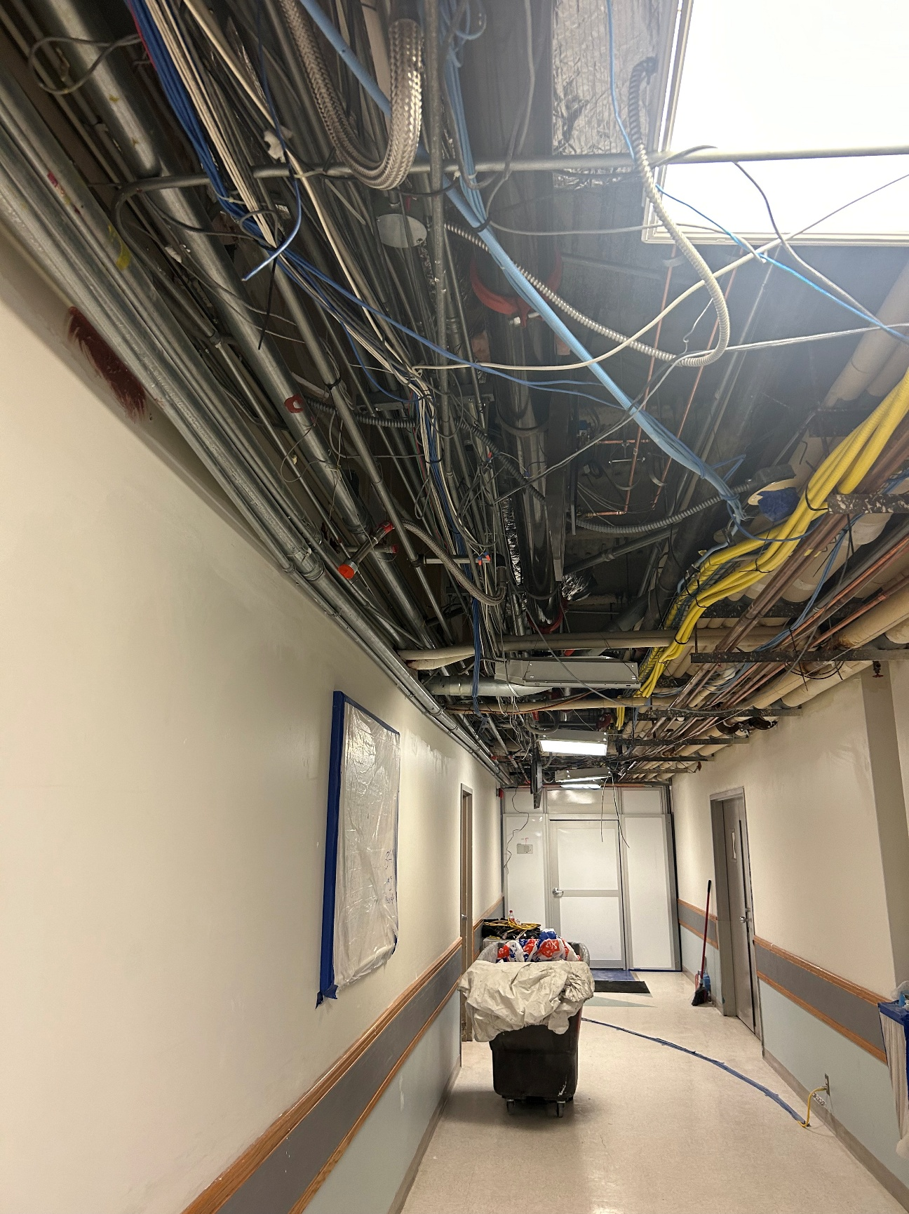
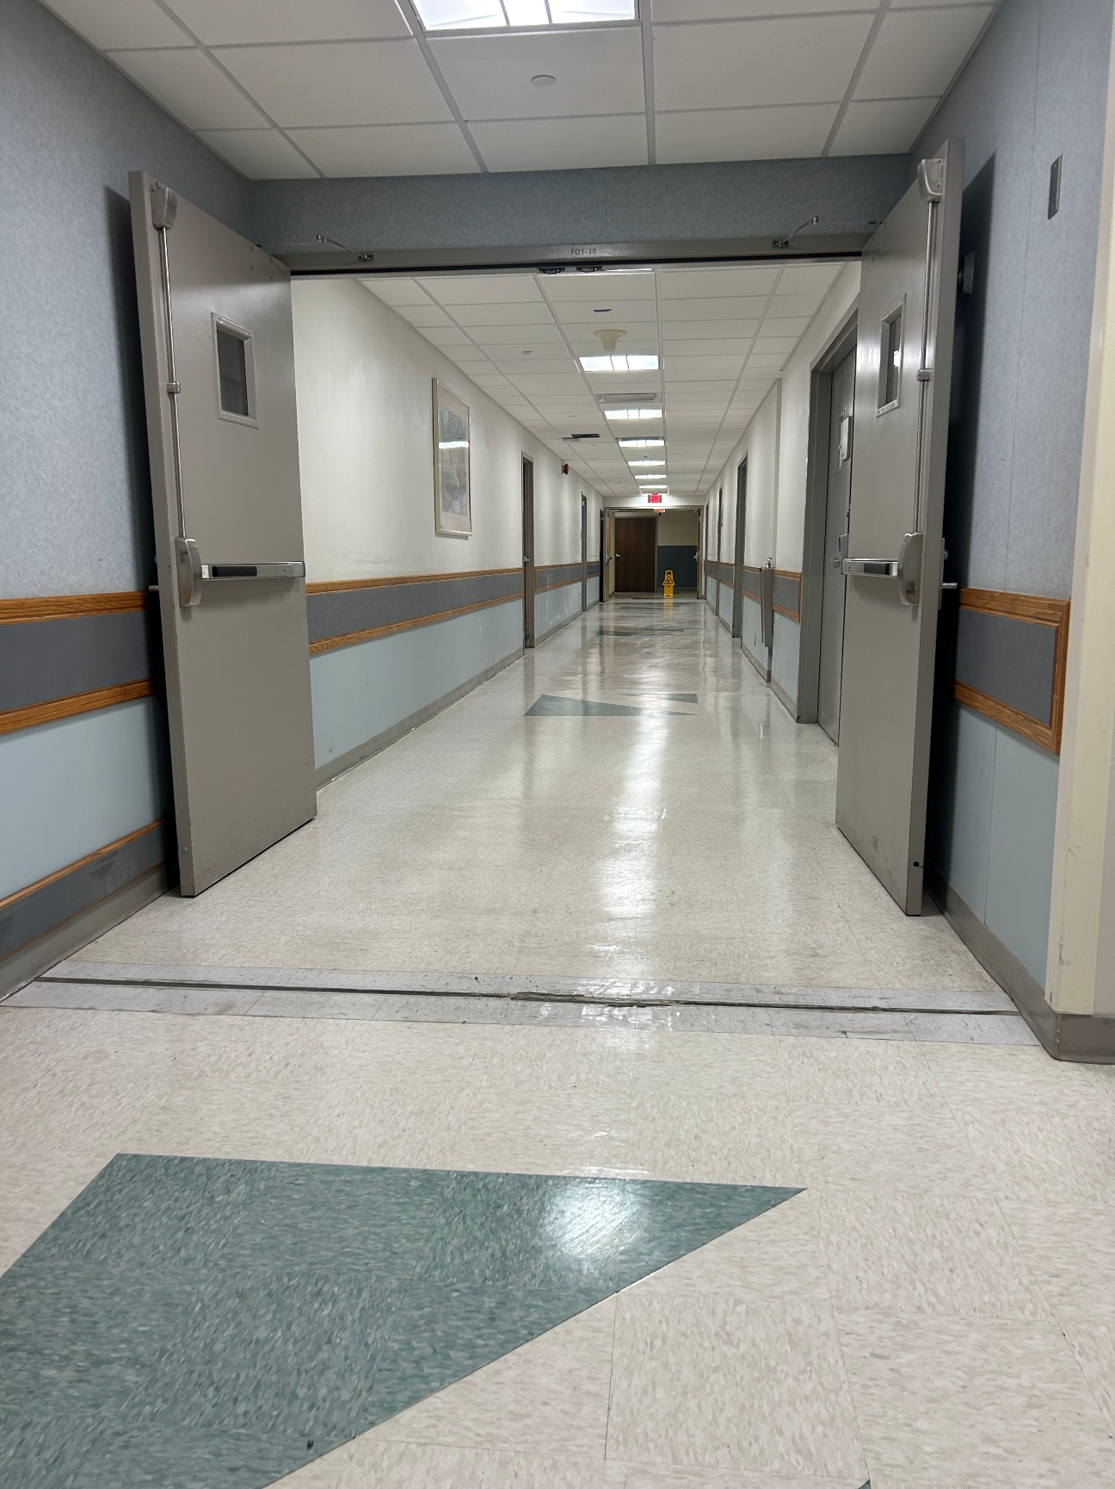
CONSTRUCTION: Corridors
Notes:
(Stuart) Construction
- Stories
- Challenges
- Memorable moments
- Example: Existing drawings were from 1970 and not to scale. A wall was not in place. Had to be dealt with
These moments are where the relationship matters MOST

Slide 31
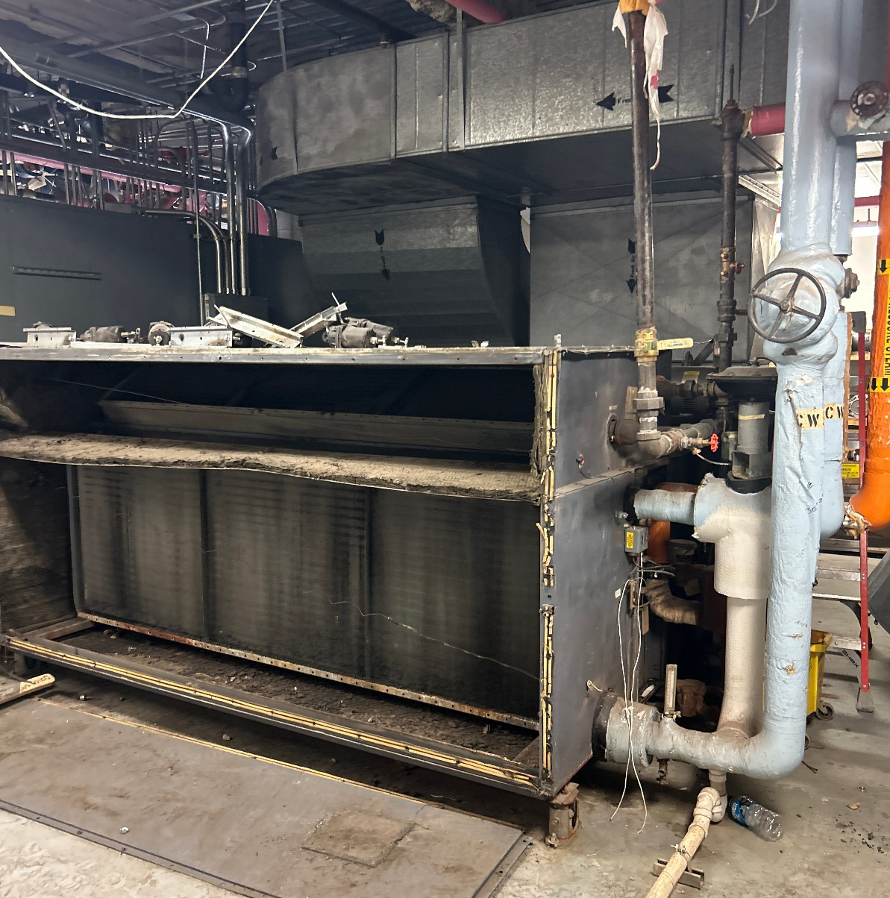
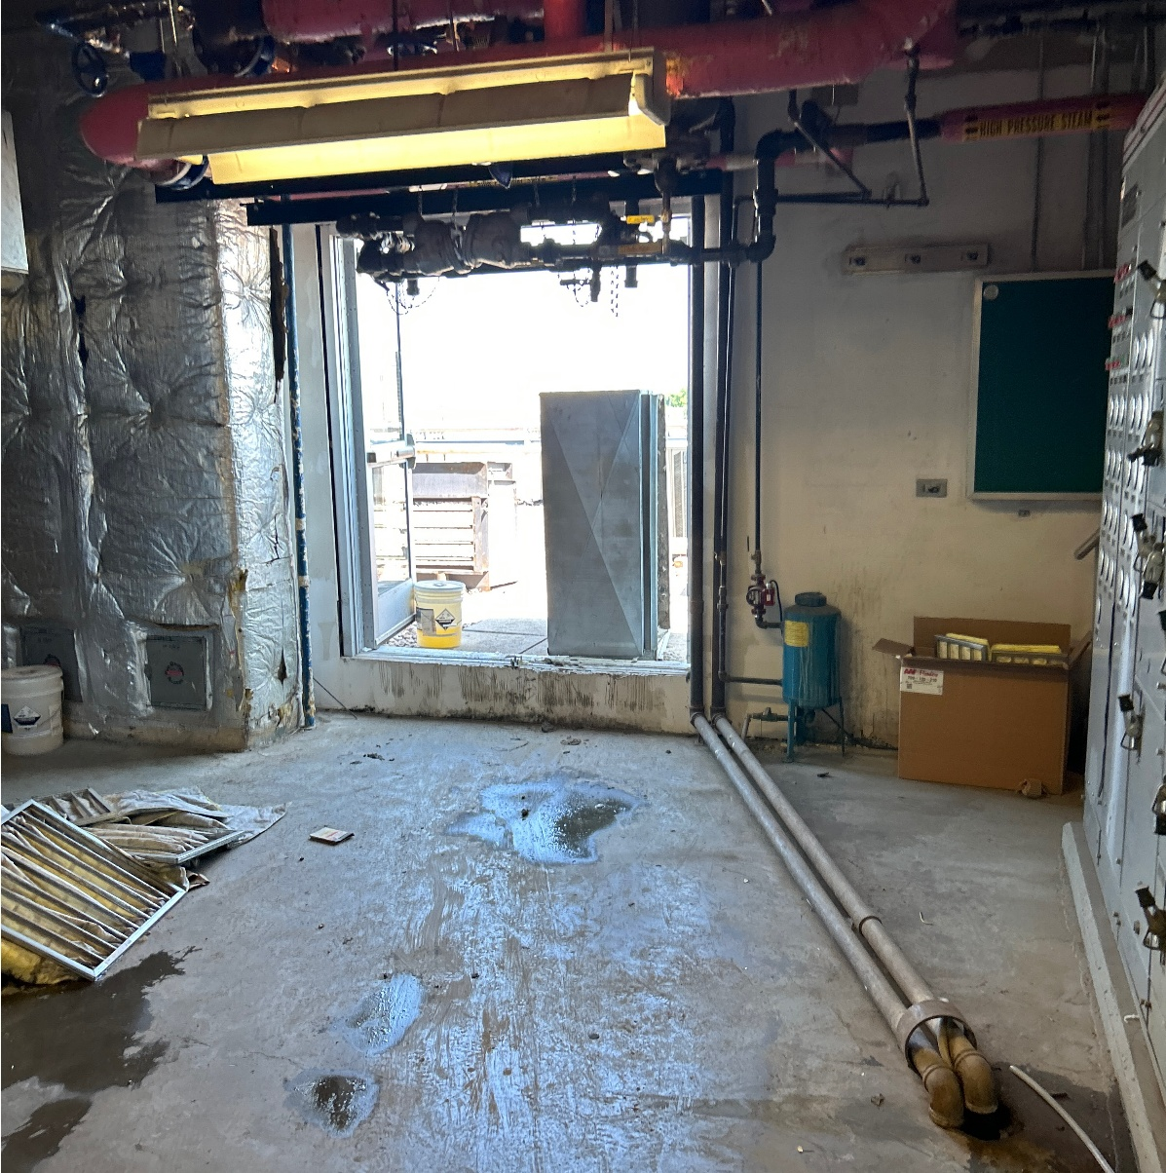
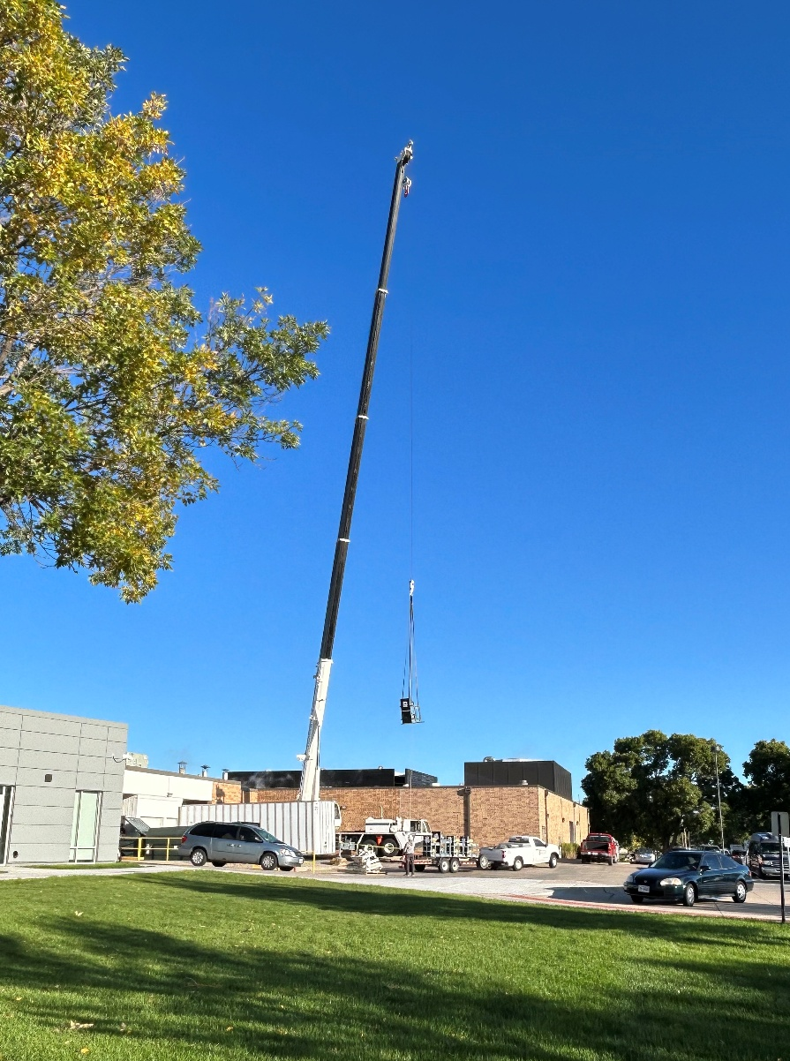
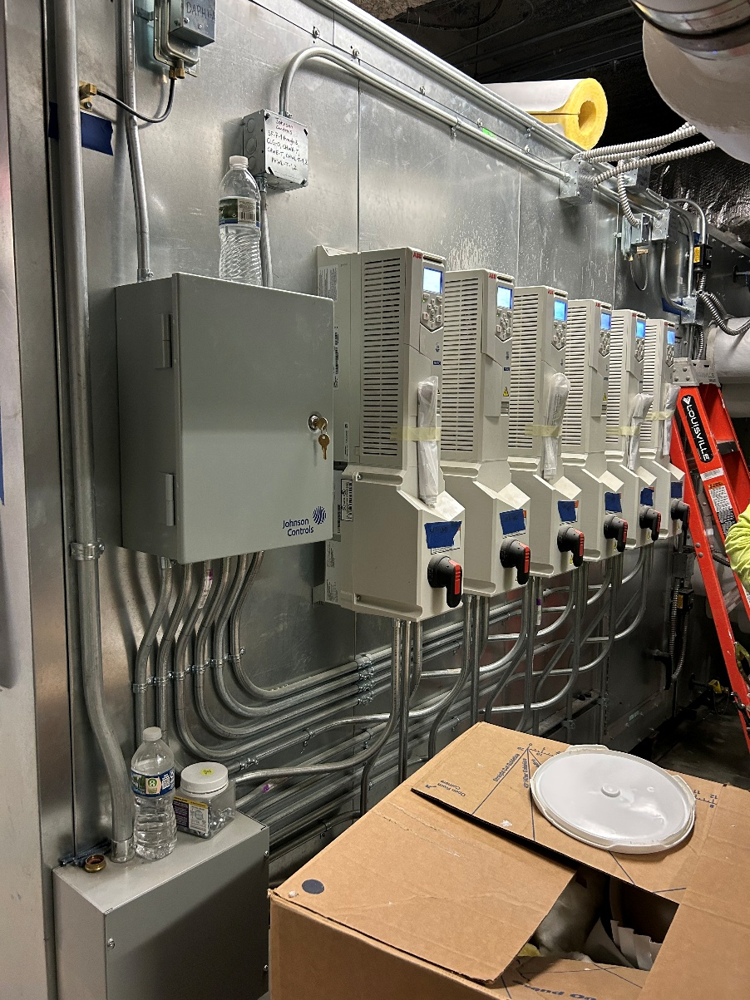
CONSTRUCTION: AHU Replacement
Notes:
(Stuart) Construction
- Stories
- Challenges
- Memorable moments
- Example: Existing drawings were from 1970 and not to scale. A wall was not in place. Had to be dealt with
These moments are where the relationship matters MOST

Slide 32
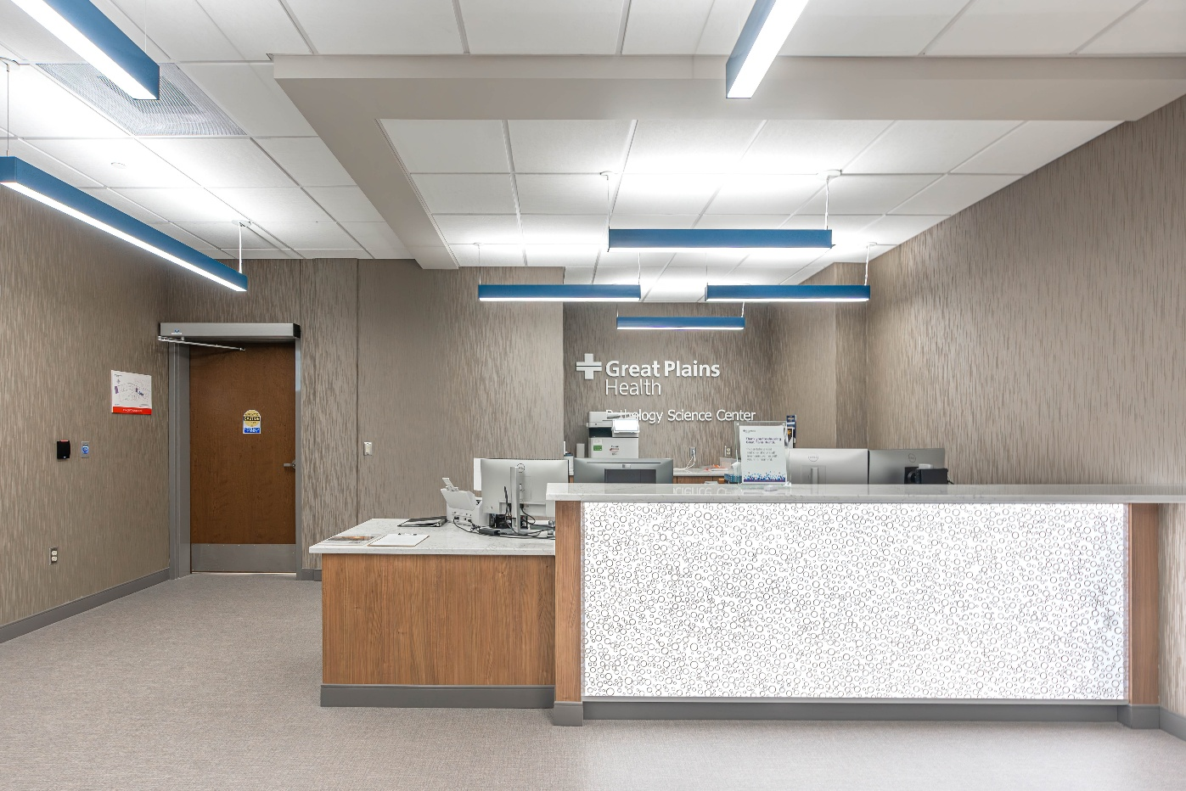
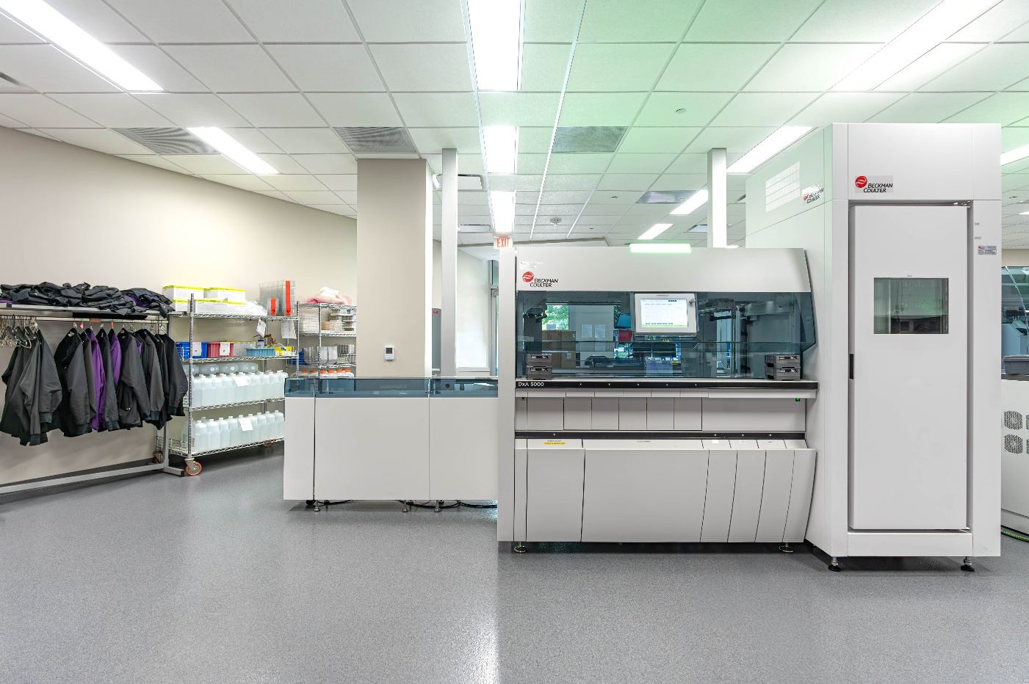
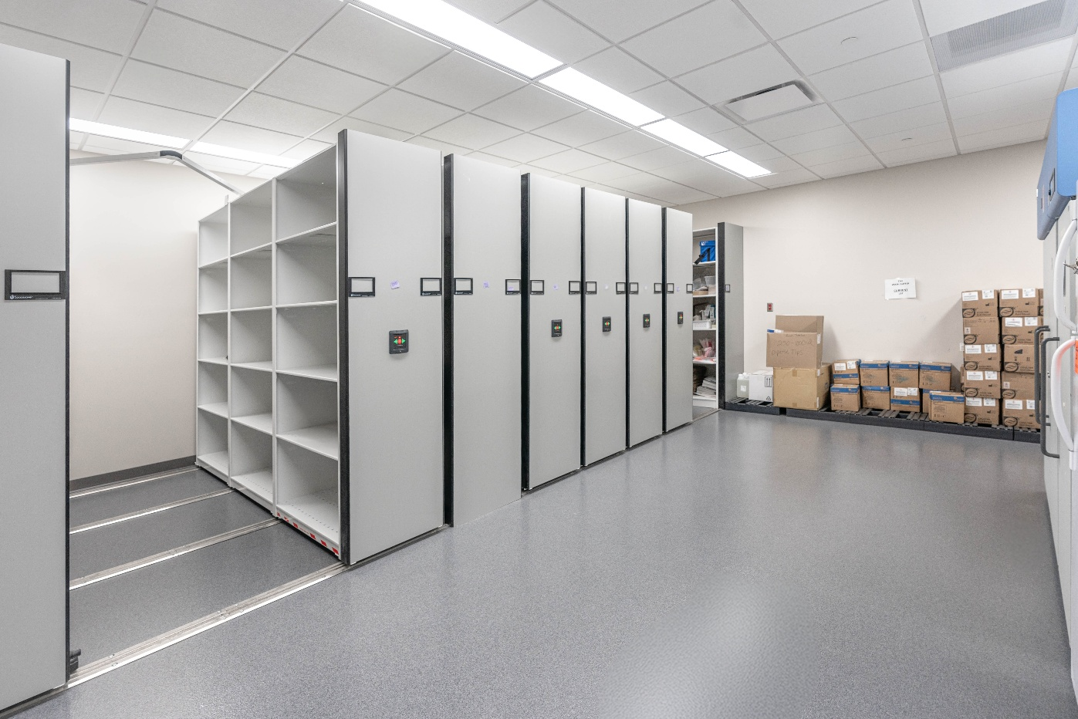
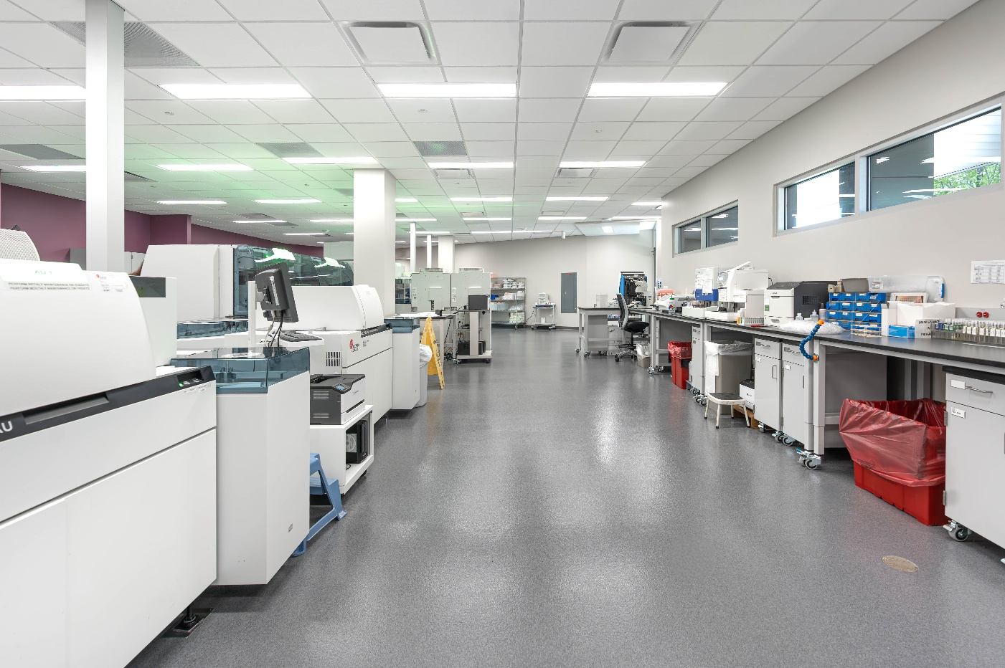

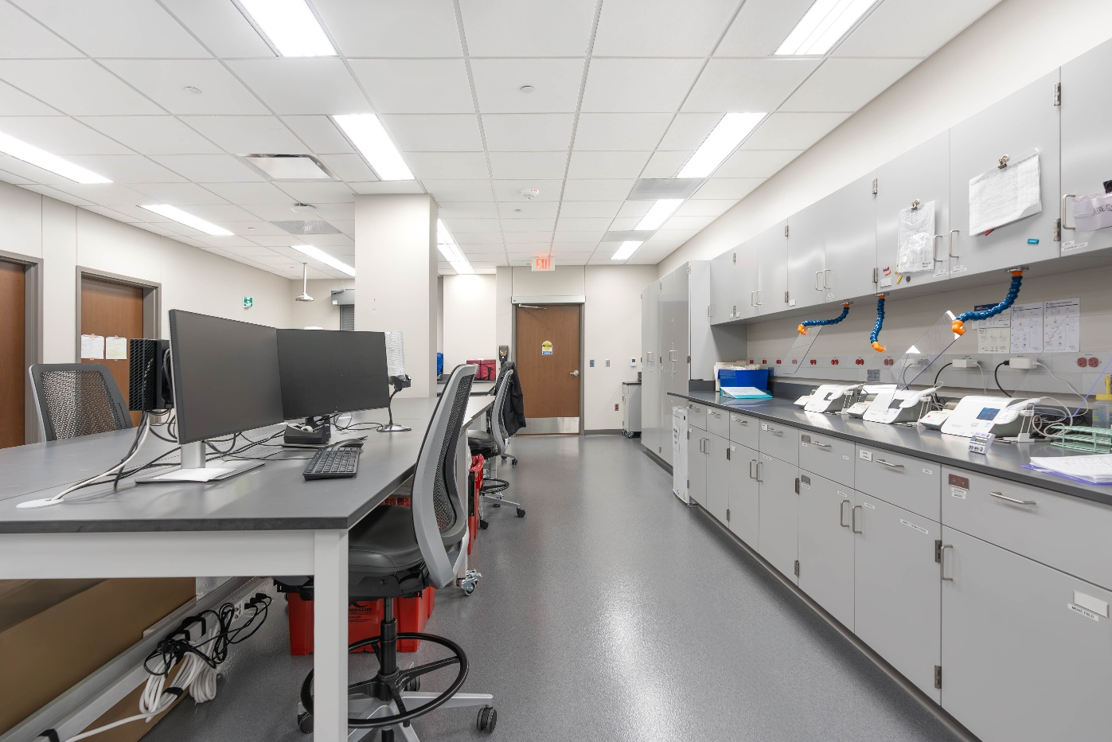
CONSTRUCTION: Complete
Notes:
(Stuart) Construction
- Stories
- Challenges
- Memorable moments
- Example: Existing drawings were from 1970 and not to scale. A wall was not in place. Had to be dealt with
These moments are where the relationship matters MOST

Slide 33
IN SUMMARY…
Notes:
Summarize-wrap up

Slide 34
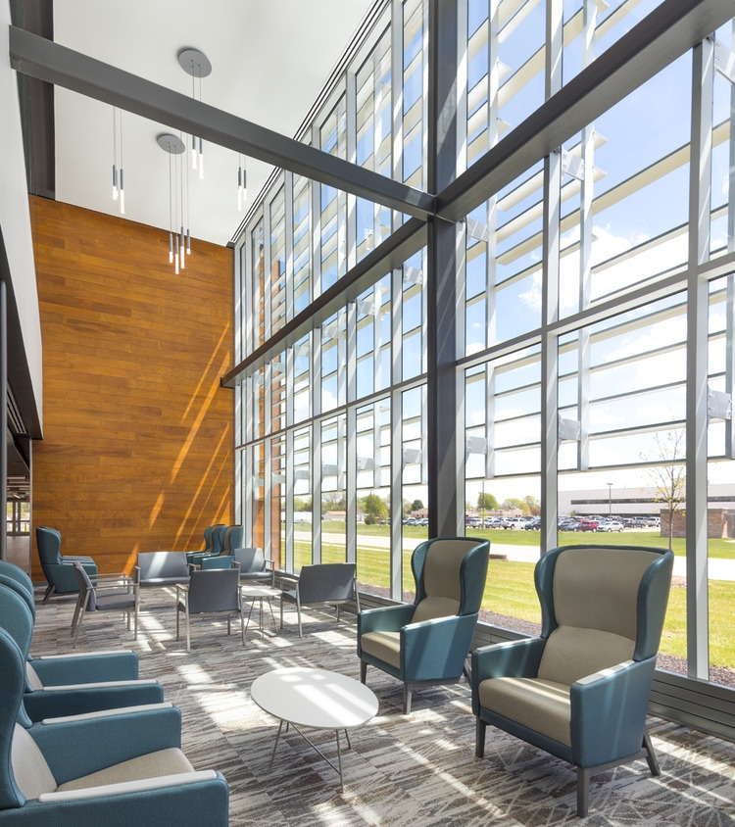
IN SUMMARY…
History of Relationship
Why Project Was Needed
CMAR
Phasing Opportunities
Budgeting Process
Construction
Successful Projects
Notes:
Summarize-wrap up: Key takeaways when doing a construction project. Don’t miss this _____.
Relationships Matter, doing what you say matters = Build Trust
Engage everyone early (CM, A/E, Client-end users)
Budget, include all soft costs (don’t forget the artwork) ;)
Parties you know and trust
Plan for opportunities (include buffer time)
Include DHHS

Slide 35
QUESTIONS?
Notes:
Q&A

