Slide 1
Quality Residency
Capstone Project
Mary WolfeRHIT/QM and Nicole Loomis R.N. and Infection Control Manager
9/18/2024
Garden County Health Services
nebraskahospitals.org

Slide 2
Introduction to the Organization, Project, Team
Garden County Health Services is a 10 bed Critical Access Hospital. We also have a Rural Health Clinic and a 40 bed Nursing Home. We are located in the panhandle with the closest tertiary hospital 80 miles away.
We chose the Antimicrobial Stewardship program because it was done as a capstone project 2 years ago.
We wanted to show the new goals, team involvement, and steps taken to grow the program. We feel this is important due to the antibiotic resistance noted on the cultures of our patient population.
Our team has grown significantly in the last 2 years. It was the CNO, a CNA and a physician assistant. It now includes those same people along with a pharmacist, an infection control nurse and the quality manager.
These people participate in direct patient care and know of the impact of the antimicrobial stewardship program. The CEO, Garden County Board Members, and the executive team fully support the program.

Slide 3
AIM Statement
.
The aim of our project is to appropriately use antibiotics, reduce resistance and increase compliance with the below benchmarks by March of 2025.
Our benchmark goals are to have 85% compliance with nursing notification to the pharmacist, 85% of form completion, and 100% provider compliance with recommendations. 100% compliance for patient education.
At this time, we are starting to incorporate the emergency room, rural health clinic, and nursing home in the antibiotic stewardship program. We are focusing on education with our new provider group on October 1, starting with the hospital process.
Our goal is to increase compliance with the above metrics to a consistent 75% by December 31, 2024.
***
***

Slide 4
Measuring Success
We will continue to track the data and identify the percentages on a monthly basis, noting an increase or decrease in the percentages. These percentages (benchmarks), increase in compliance and a decrease in the antibiotic resistance will be reported to Medical Staff, Quality Committee and Garden County Health Services Board. There is also a white board with the same data for nursing staff to review percentages for compliance.
Nursing Compliance regarding antibiotic tracking form completed and sent to pharmacy.
Provider compliance in addressing pharmacy recommendations.
Nursing compliance in educating patients receiving antibiotics.
100% of all charts in the hospital with antibiotic usage are audited by the antibiotic stewardship data analysist for form completion and pharmacist recommendations and provider response.
We are unable to utilize any reports from our current EHR. We will be implementing a new EHR in January 2025, with the ability to run the reports needed.

Slide 5
Selecting Changes
Educate the new provider group of the facility process and forms required starting October 1, 2024.
Implementation of new electronic health record.
Work with all team leaders to continue to drive the antibiotic stewardship program.
Continue to work with Nebraska ASAP and continue to work on implementing their recommendations.
Feasibility will be difficult due to the many hats worn by the committee members, but the antimicrobial committee is committed to success. Time will also be limited with the implementation of a new EHR.
To support change management, we will discuss the importance of the antibiotic stewardship program with our new medical director, once appointed. We will educate him/her on our processes and encourage buy in for a top-down approach with medical staff and nursing.

Slide 6
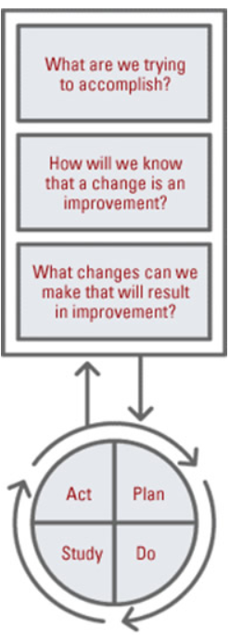
Plan ~ Do ~ Study ~ Act
Plan
I plan to: Appropriately use antibiotics and reduce antibiotic resistance
I hope this produces: improved patient outcomes with appropriate treatment and decreased resistance and side effects such as C.Diff, G.I. upset etc. that come with unnecessary antibiotic use.
Steps to execute: Implementation of forms for nursing staff to communicate with pharmacy and medical staff for appropriate antibiotic use.
Do
How long will you observe new changes? Minimum of one year.
What did you observe? Low compliance from nursing staff and medical staff.
Are the changes creating consequences ? Unintended antibiotic resistance within the patient population. Unintended, as nursing staff and medical staff are non- compliant. The turnover of medical staff and nursing staff has provided opportunities for a change in culture and expectations.
Study
What did you learn? Our first form did not meet our needs. A new form was implemented on March 1, 2024, with better tracking results.
Did you meet your measurement goal? No, we have consistently been below the benchmarks.
Do you need more observation time? Yes, more PDSA cycles are warranted to improve the current processes and meet the benchmarks.
Act
What did you conclude from this cycle? We need consistent staffing to have consistent outcomes and effective change.
Will you sustain the changes? Yes, it is a priority of Garden County Health Services executive leaders and the Antimicrobial Committee.
Does the change need adjusted or removed? It will be continually adjusted as we acquire numerous new providers and a new EHR in the upcoming months.

Slide 7
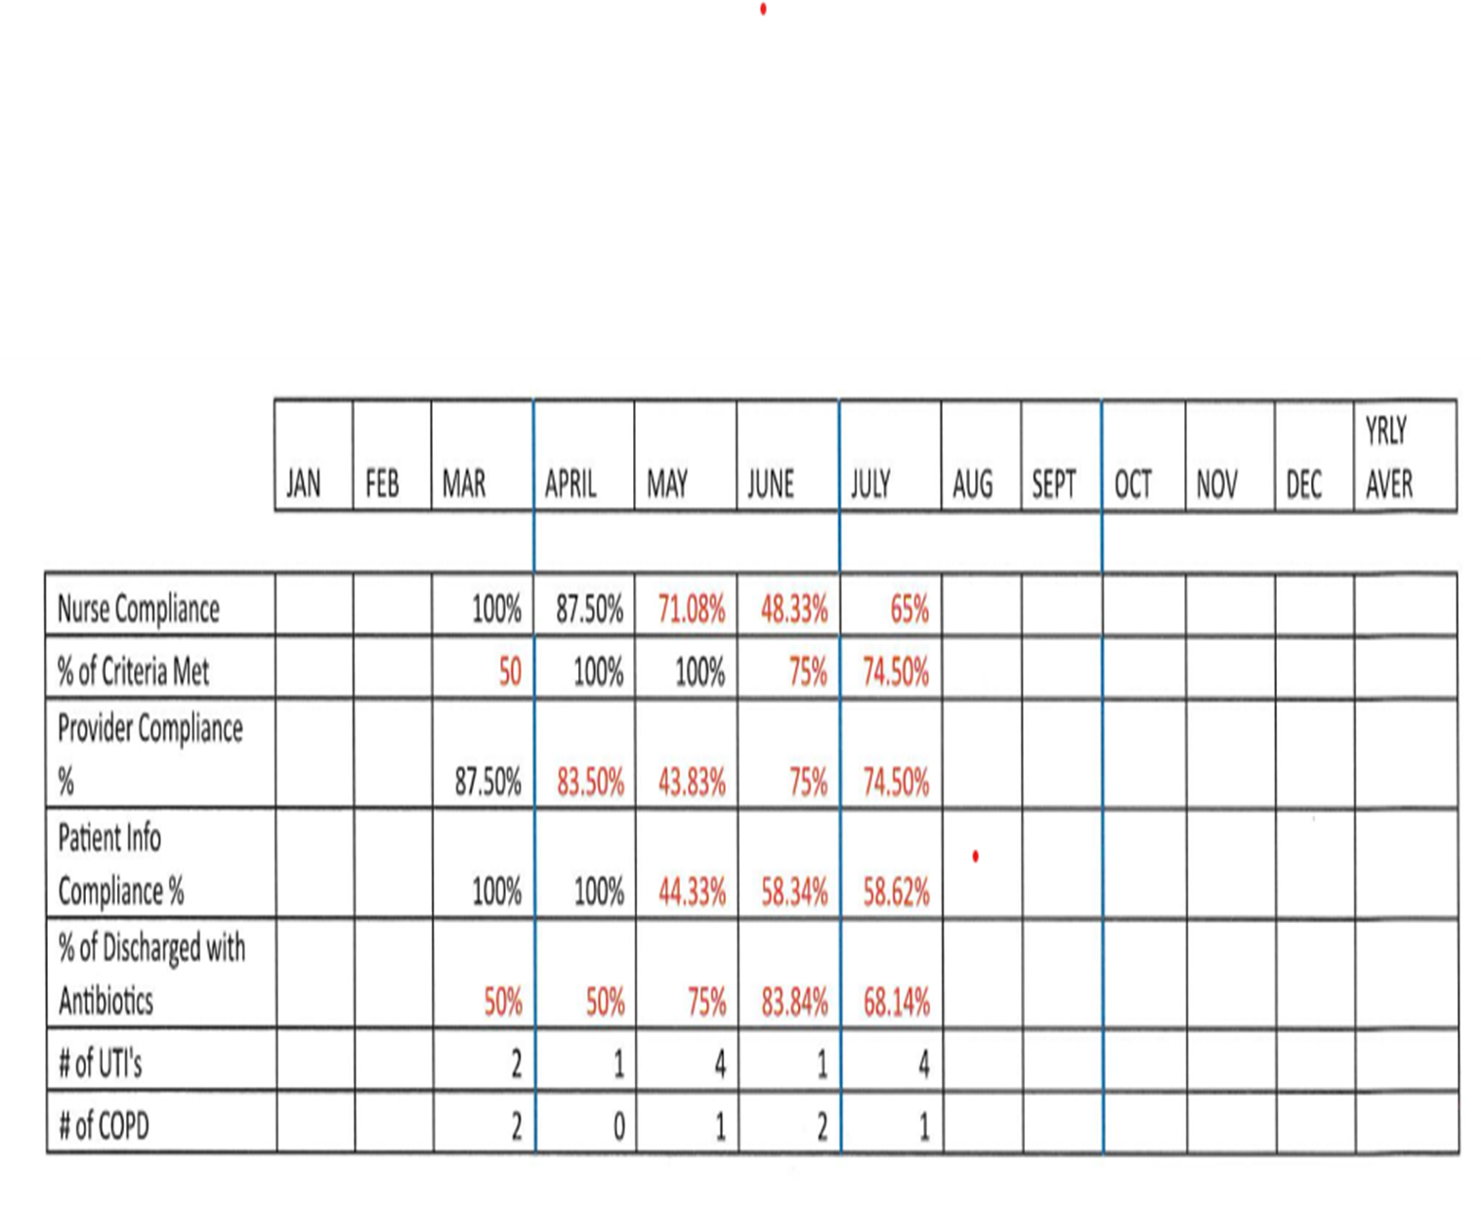
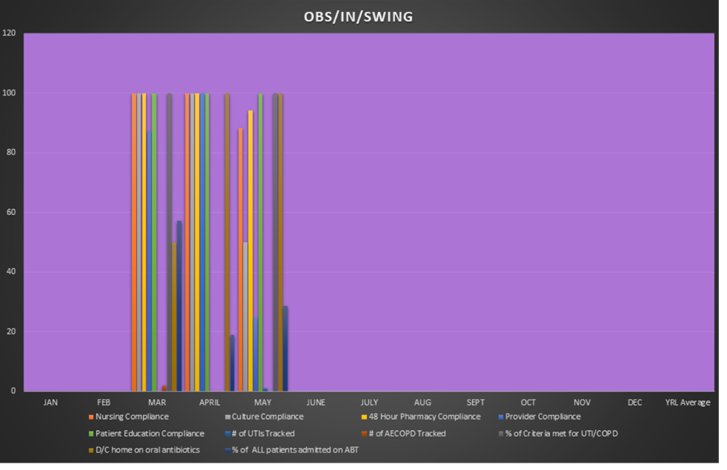
Data and Trends
Worsening due to long term provider leaving facility June of 2024.

Slide 8
Return on Investment (ROI)
Explore the financial implications of the project:
Will costs/expenses be incurred to make noted changes?
Additional staff? No, continue to utilize staffing already employed.
Additional hours? No, completed during scheduled work hours as time allows.
Equipment? No, forms and whiteboard already in use. New EHR was already in the future plan.
IT expense? No, we operate with one full time IT person.
What savings/revenue will be noted?
Decreased harms? Yes, improved patient outcomes with less antibiotic resistance and side effects.
Increased billable codes? We do not believe so as there will be a decrease in patient medication usage and effects if current benchmarks are met.
Decreased staff hours? No effect.

Slide 9
Spreading / Sustaining / Maintaining / Replicating
Maintenance-Every hospital chart is being audited currently. All cultures are being reviewed for antibiotic susceptibility. Goal is for 100% of RHC antibiotics to be reviewed.
Can the program be replicated in other areas or organizations? We are currently working on processes to include the rural health clinic and ER. The Nursing Home has an antibiotic tracking tool in place and utilizes McGeer’s criteria for correct reporting for MDS purposes.

Slide 10
THANK YOU/Questions
Nicole Loomis R.N./Infection Control Manager
Nicole.loomis@gchealth.org
Mary Wolfe RHIT/QM
Mary.wolfe@gchealth.org
nebraskahospitals.org

