Slide 1
The Acute Stay Continuum: Prevention, Treatment, and Discharge
Thomas Janousek, PsyD
Director, Nebraska Division of Behavioral Health

Slide 2
About NE Division of Behavioral Health
State agency that has a combination of state general funds, cash funds, and block grant funds to support the behavioral health system.
Separate from Medicaid
Mental Health and Substance Use under one roof.
Funds statewide behavioral health initiatives (988, Narcan), services for individuals not eligible for Medicaid, and services not reimbursed by Medicaid.
Regional system, funds any willing provider
Lincoln Regional Center and Norfolk Regional Center
  State Hospitals for Mental Health and Sex Offender Treatment.

Slide 3
Objectives
Learn about services to prevent or divert from hospitalization
Learn about methods to use while treating a person in the hospital to move them to a lower level of care
Learn about discharge options to community-based settings

Slide 4

Typical Behavioral Health Patient Scenarios
Suicidal Ideation
Psychotic Episode
Mood and Anxiety Disorder (Panic Attacks)
Personality Disorders
Unknown Mental Health Condition
Substance Intoxication or Withdrawal
For suicidal ideation, most cases are for individuals between the ages of 14 and 54
  Mostly female for ages 14-24, Mostly male for ages 25-54
Most individuals are on Medicaid

Slide 5
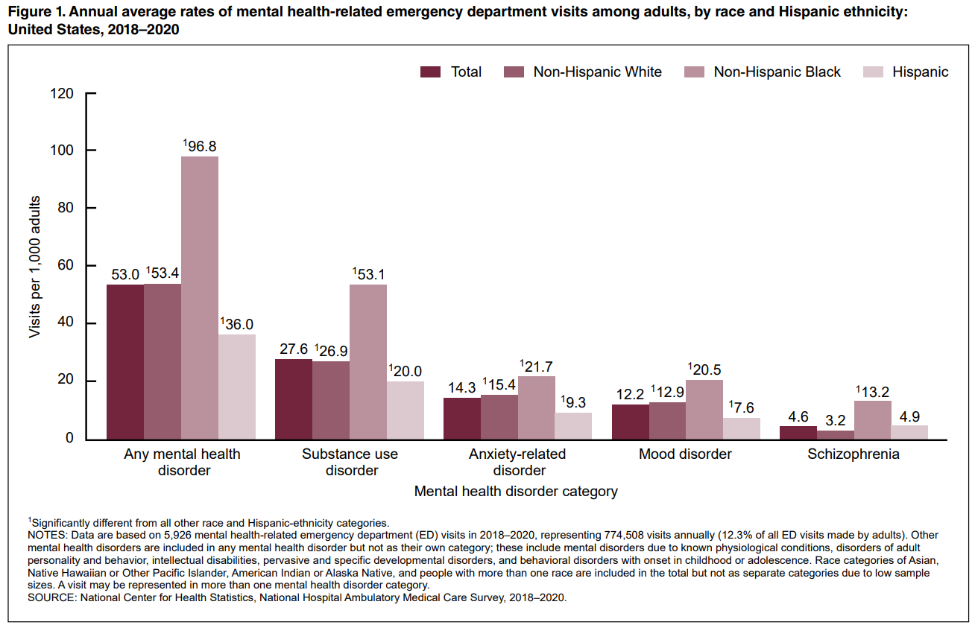

Slide 6
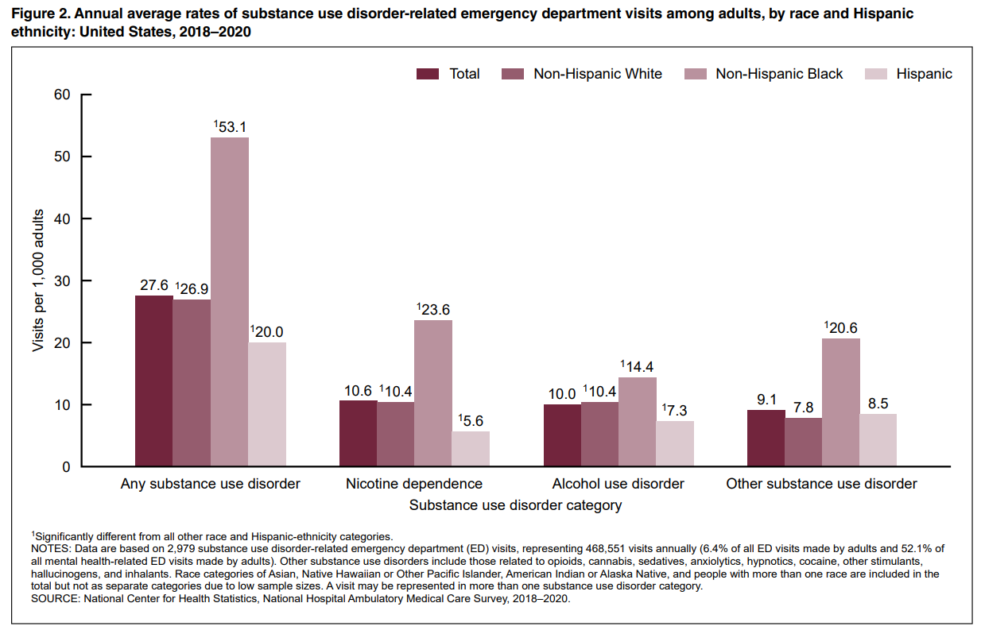

Slide 7
Problems we are up against across the spectrum
Lack of access to behavioral health professionals
Increasing reliance on jails for treatment or alternatives to treatment
Lack of health insurance coverage
Barriers to lower levels of care
Lack of knowledge of resources or lower levels of care
  Community, law enforcement, hospitals
Shifting staff

Slide 8
What do we do?
Understand the preventative options in your area and educate your staff and community partners.
  Particularly law-enforcement you work with frequently
Train staff in de-escalation techniques and monitor patient feedback about particular staff.
  Empathic treatment and bedside manner is not an inherent skill
  Difficult staff can mean difficult patients
Develop behavioral planning protocols with a BH professional
  Surprisingly universal and modular
Review your patient admission evaluations
  Are you referring cases that can be resolved quickly?
  Rural hospital example
Educate your discharge staff and doctors on community options and their criteria
  If the doctor doesn’t know about the option, it will not happen.
  When all you have is a hammer, everything is a nail
Notes:
Rural Hospital: We have instances where clients have to receive an evaluation at one hospital and then are referred to another hospital.

Slide 9
The Acute Stay Continuum
Pre-Hospitalization and Prevention
ER and Hospitalization
Discharge

Slide 10
Pre-Hospitalization and Prevention

Slide 11

Pre-Hospitalization Services
988
  Not just a suicide hotline
  For any person for any crisis
  Law enforcement can call it to deescalate a person they encounter and engage a mobile crisis team
  Staff and patients can call it if they need to engage a crisis counselor.
Receive over 28,000 calls per year and less than 5% result in a mobile crisis deployment
Integrated with the Nebraska Family Helpline to help find community resources

Slide 12
Mobile Crisis Response Teams
Mobile team that arrives on-site with Direct Care staff supervised by licensed counselors to de-escalate individuals and get them routed to alternative levels of care.
Conduct Safety Planning and Referral
Can be engaged by 988 if the patient is not able to be de-escalated.
In-person and telehealth options.

Slide 13
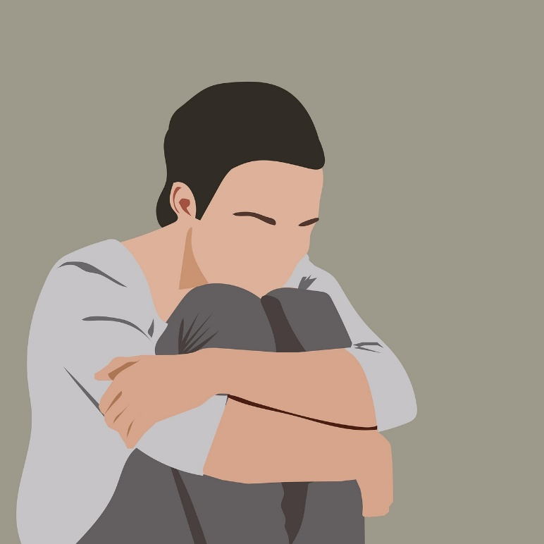
Mental Health Respite, Observation, and Diversion
Mental Health Respite:
  Provides a safe, protected, supported residential environment for people with a serious mental illnesses.
  Designed to provide shelter and assistance to address immediate needs for individuals transitioning between residential settings or need a break from their current living environment.
Emergency Psychiatric Observation (23/59):
  Less than 24 hours of care in a secure, medically supervised hospital setting for evaluation and stabilization of acute psychiatric and/or substance use disorder symptoms
Hospital Diversion:
  A peer-operated service designed to assist individuals in decreasing psychiatric distress which may lead to hospitalization

Slide 14
Emergency Community Support
Designed to assist individuals who can benefit from high levels of support due to an urgent behavioral health need. Often individuals are either at risk of loss of community residence due to behavioral health crisis, are homeless, or are transitioning from a psychiatric hospital into a community setting
Quick access to community resources and support.
Aims to tackle mental health conditions arising due to lack of resources.

Slide 15

Crisis Stabilization Centers
Provides immediate, short-term, individualized, crisis-oriented treatment to stabilize acute psychiatric symptoms, alcohol or other drug use, and/or significant emotional distress for voluntary and involuntarily admitted individuals.
Up to 7 days
Assessments, stabilization and referral.
Some offer Detox services
Supervised by a medical director.

Slide 16
Behavioral Planning in the Hospital

Slide 17

Behavioral Planning
Behavioral Management plans for staff working with the patient
Assists with reducing 1:1’s and video monitoring.
Therapist meets with the individual to conduct counseling, but also assesses their needs while they are hospitalized
  What factors will help keep the patient de-escalated?
  Are they having troubles with staff? The environment?
  To make accommodations, what procedures need to be changed?
  What does the next level of care need from the client?
  How do we assist transferring practices to the next facility?
  How do we create a follow-up plan to ensure the individual is transitioned appropriately?
  What community resources or economic assistance will they require?

Slide 18
Behavioral Planning
Therapist is a part of the treatment team and works closely with the social worker and discharge staff.
Assists receiving staff with what the patient requires.
Make sure the plan follows the patient to the next level of care
Typically allowable under hospital daily rate codes or psychotherapy since the therapist should complete an initial assessment.
A valuable service because it can identify opportunities for quality of care improvement.
  Staff training

Slide 19
Discharge Options

Slide 20
Residential Levels of Care
Secure Residential
  Secure Residential Treatment provides individualized recovery, psychiatric rehabilitation, and support for individuals with a severe and persistent mental illness and/or co-occurring substance use disorder demonstrating a moderate to high-risk for harm to self/others and in need of a secure, recovery/rehabilitative/therapeutic environment.
Psychiatric Residential Rehabilitation
  Psychiatric Residential Rehabilitation is provided by a treatment/recovery team in a 24-hour staffed residential facility.
  The intent of the service is to support the individual by improving symptom management and life skills so that he/she can be successful in a community living setting of choice.

Slide 21

Assertive Community Treatment (ACT)
Specialized treatment for the SMI population
Consists of a community-based group of transdisciplinary professionals who use a team approach to meet the needs of individuals with severe mental illness. The team provides comprehensive, high intensity services, with the capacity to provide crisis response and regular, frequent, face to face contacts as dictated by client need
“A hospital without walls”

Slide 22
Intensive Outpatient Treatment
Substance Use Focused
Group based, non-residential, intensive, structured interventions consisting primarily of counseling and psychoeducation about substance related and co-occurring mental health problems. Services are goal-oriented interactions with the individual or in group/family settings
9 hours of therapy a week

Slide 23

Community Support and Peer Support
Community Support is a rehabilitative and support service for individuals who have complex and extensive treatment needs.
  Provide service coordination and restorative interventions for development of interpersonal, community, coping and independent living skills to maintain wellbeing, community living, and stabilize mental health symptoms.
Peer Support assists individuals and families in initiating and maintaining the process of recovery and resiliency to improve quality of life, by way of working with someone with lived experience

Slide 24
Things to Come
CCBHCs
More Crisis Stabilization Centers
Pathways Home Program
SMI IMD waiver

Slide 25
Resources

Slide 26
Statewide Resources
988 Crisis Line
  Call, Text or Chat on the web at 988lifeline.org
Behavioral Health Service Definitions:
  https://dhhs.ne.gov/Pages/Medicaid-Behavioral-Health-Definitions.aspx
  Assertive Community Treatment
  Intensive Outpatient Therapy
  Social Detox, Medically Monitored Withdrawal Management
Network of Care Website
  https://portal.networkofcare.org/NebraskaBehavioralHealth
  Resources for referral
Same Day Services
  DHHS.NE.GOV/SAMEDAY
  Referrals for same-day outpatient intakes

Slide 27
24-Hour Crisis Response Teams (Can be engaged by 988)
Team of direct care staff with access to a licensed counselor who can arrive on site and de-escalate a situation.
Omaha Area
  Community Alliance
  Heartland Family Services
  Lutheran Family Services
Lincoln Area
  Centerpointe
  Lutheran Family Services
Norfolk
  The Well
South Sioux City and O’Neil
  Heartland Counseling Services
Hastings, Kearney, Grand Island
  South Central Behavioral Health Services
Scottsbluff
  Box Butte Hospital
  Western Community Health Resources

Slide 28
Crisis Stabilization Centers
Residential stabilization unit for up to seven days
Lincoln
  Lancaster Crisis Center
Grand Island
  Mid-plains Center (includes substance use withdrawal management)
Coming Soon:
  Omaha
    Heartland Family Services

Slide 29
Emergency Community Support and Respite
Emergency Community Support
  Community Alliance –Omaha
  CenterPointe – Lincoln
  Good Life Counseling – Columbus
  Heartland Counseling and Consulting – North Platte
  Western Community Health Resources - Chadron
Mental Health Respite
  The Well – Norfolk
  Integrated Behavioral Health Services- Lincoln
  Heartland Family Services - Omaha
  South Central Behavioral Health Services – Hastings
  Nebraska Youth Center – North Platte

Slide 30
Other Programming
Hospital Diversion
  Mental Health Association – Lincoln
  Community Alliance – Nebraska
Emergency Psychiatric Observation (23/59)
  UNMC - Omaha

Slide 31
Discharge Service
ACT
  Centerpointe - Lincoln
  Community Alliance – Omaha
  South Central BH Services – Hastings
IOP
  Centerpointe – Lincoln
  Community Alliance – Omaha
  South Central BH Services – Hastings
  Heartland Family Services – Omaha
  Heartland Counseling Services – South Sioux City
  Lutheran Family Services – Fremont, Lincoln, Omaha

Slide 32
Thoughts and Discussion

Slide 33

Thomas Janousek, PsyD
Director, NE DHHS Division of Behavioral Health
Thomas.Janousek@nebraska.gov
Nebraska Department of Health and Human Services
Nebraska DHHS
NEDHHS
nebraska_dhhs
NebraskaDHHS

